Slide 1
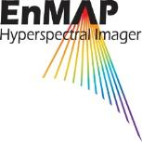
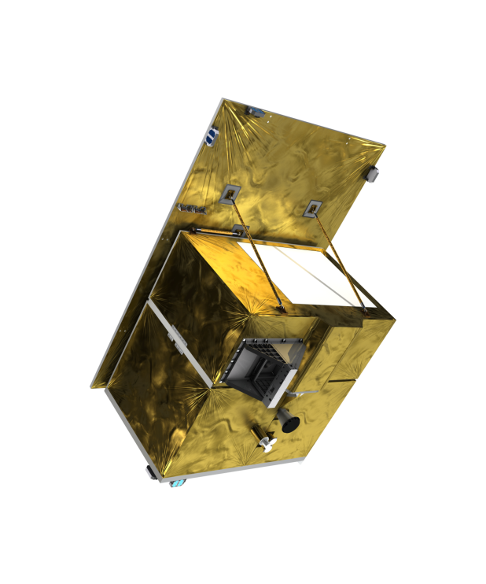
CB Support to Hyperspectral remote sensing
Michael Bock
Dr. Anke Schickling
DLR Space Administration

Slide 2
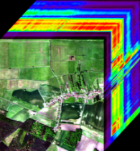
Hyperspectral remote sensing and imaging spectroscopy
Reflectance [%]
VNIR
SWIR- I
SWIR- II
0.4
0.6
0.8
1.0
1.2
1.4
1.6
1.8
2.0
2.2
2.4
Wavelength [µm]
Measurement of reflected solar radiation in many narrow contiguous spectral bands
Quantitative derivation of biogeophysical parameters of vegetation, soil, water bodies, artificial surfaces

Slide 3
Hyperspectral vs. multispectral systems
Many surface information can be derived more accurately with hyperspectral data, while they are essential for certain applications
PAN
8
1
2
3
4
5
9
6
7
Landsat 8
6
7
8
10
12
3
5
8a
9
11
70
1
2
4
Sentinel-2
60
50
Goethite
Kaolinite
Vegetation
40
Reflectance [%]
30
20
10
0
0.5
0.6
0.7
0.8
0.9
1.0
1.1
1.2
1.3
1.4
1.5
1.6
1.7
1.8
1.9
2.0
2.1
2.2
2.3
0.4
VIS
NIR
Wavelength [µm]
SWIR

Slide 4
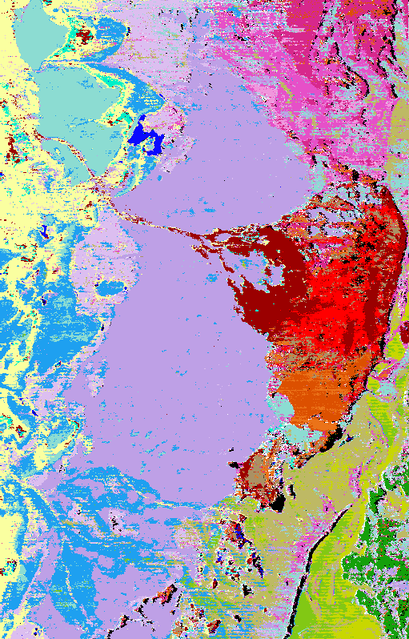
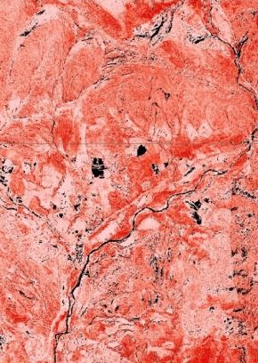
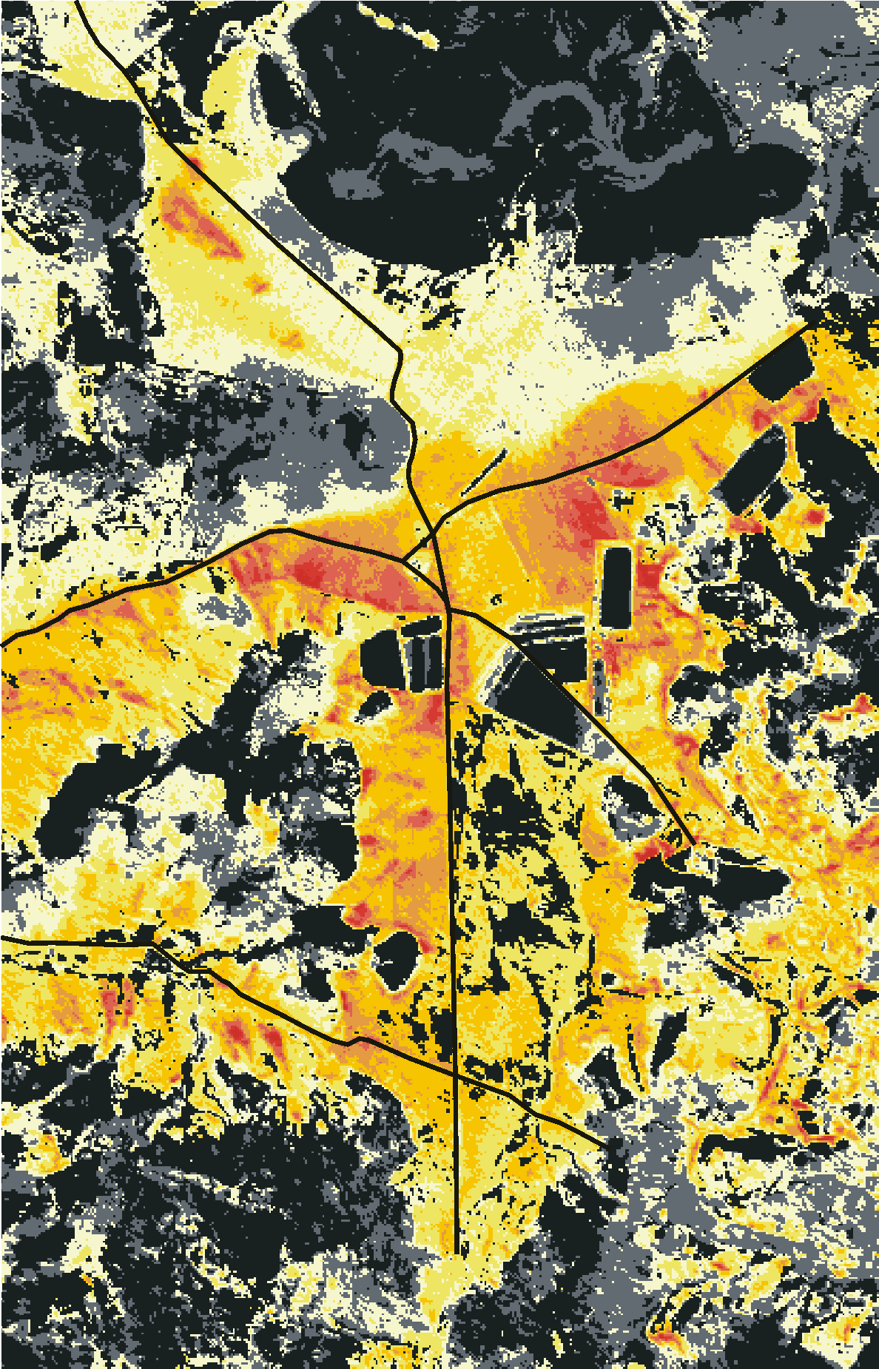
Hyperspectral application fields
Mineral mapping
chlorite
Mine exploration to restoration
Soil mineralogy, SOC and texture
Vegetation monitoring: plant stress, crop residues, plant composition
calcite
dolomite
illite
Scaled Reflectance
gypsum
Dry vegetation Mapping
kaolinite
Fraction of non-photosynthetic vegetation
0%
100%
400
800
1200
1600
2000
2400
Wavelength [nm]
cellulose
Soil mapping
lignin
Reflectance
soil
Fe_{d} content [%]
> 3.0
dry vegetation
3.0
2.5
400
800
1200
1600
2000
2400
Reflectance
Wavelength [nm]
2.0
1.5
Fe²⁺/Fe³⁺
1.0
0.5
400
800
1200
1600
2000
2400
< 0.5
Wavelength [nm]

Slide 5
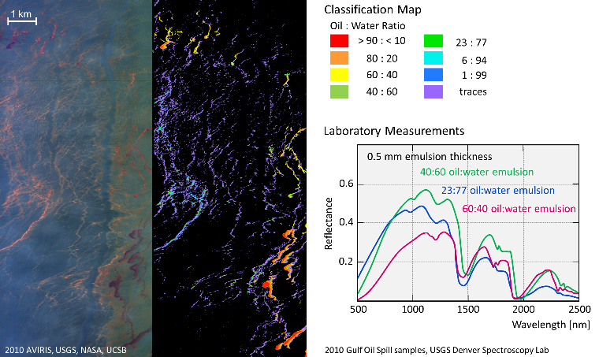
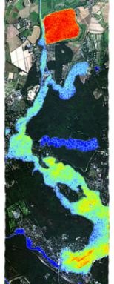
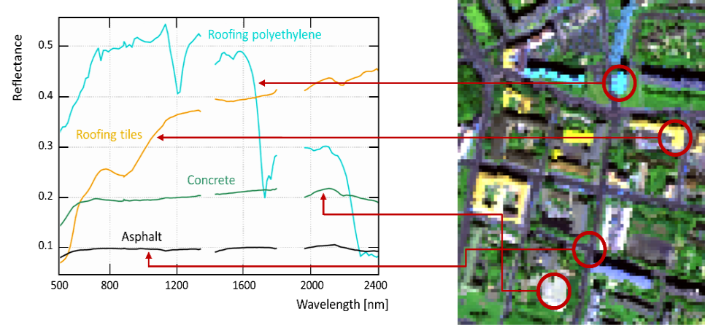
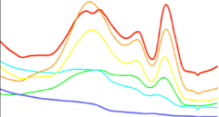
Hyperspectral application
Pollution mapping
Hazardous materials: oil, dust, mine waste, pollutants, plastics
Inland and costal waters: phytoplankton composition, (harmful) algae species
Urban surface materials
Water quality mapping
Urban surface mapping
Phycocyanin content
low
high
CHL 440 nm
CAR
485 nm
PE
570 nm
PC
624 nm
CHL 678 nm
Reflectance
400
500
600
700
800
Wavelength [nm]

Slide 6
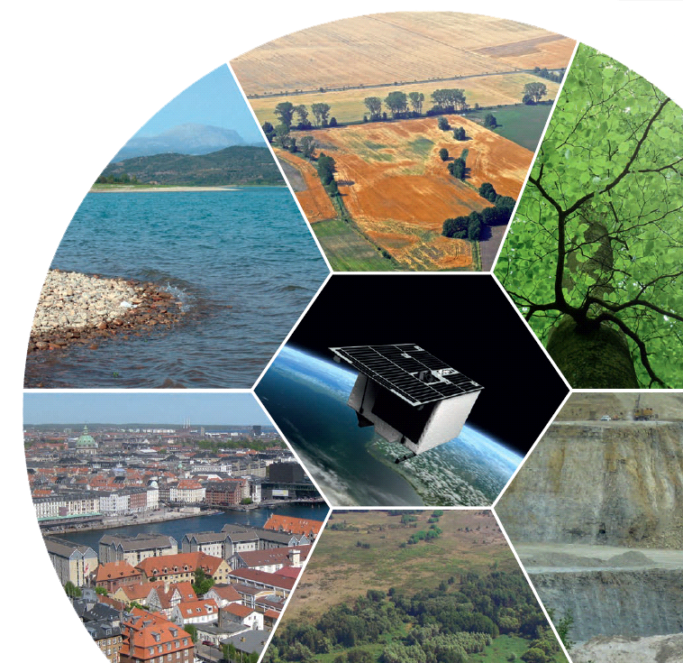
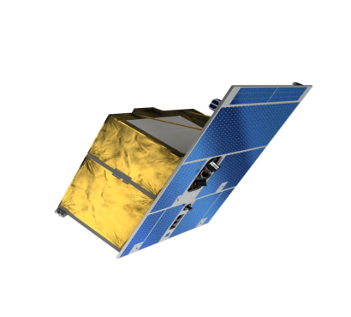
EnMAP - Environmental Mapping and Anaylsis Program
EnMAP is Germany’s first spaceborne hyperspectral mission
EnMAP aims at monitoring and characterizing the Earth’s environment on a global scale
EnMAP serves to measure and model key dynamic processes of the Earth’s ecosystem
EnMAP is a scientific path finder for later operational services

Slide 7
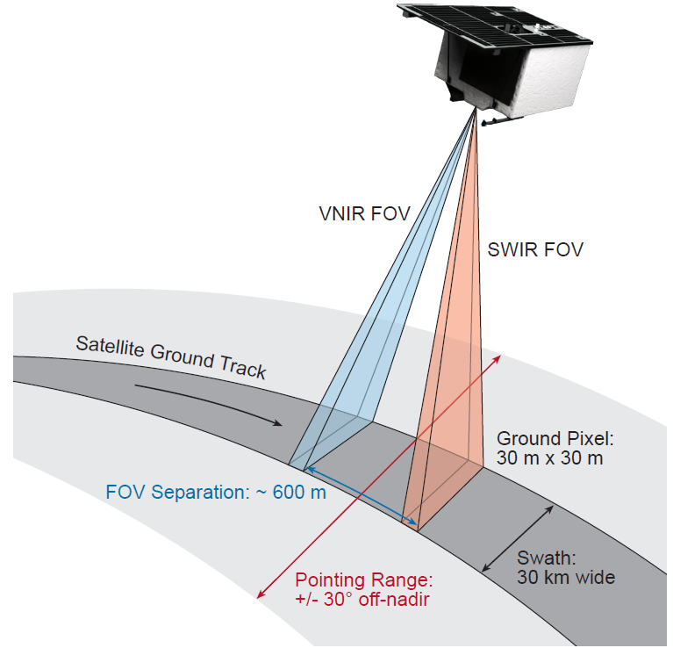
EnMAP – Mission Overview
Push-broom imaging spectrometer
Sun-synchronous orbit, 11h LTDN
Spectral Range: >240 bands from 380 nm (VIS) to 2400 nm (SWIR)
Ground sampling distance: 30 m , Swath: 30 km
Recording capacity: 1000 km/orbit and 5000 km/day
Revisit time: 27 days at nadir and up to 4 days with 30°accross-track pointing
Launch: Q4 2020, Mission lifetime: > 5 years
Open data policy
Guanter et al., Remote Sensing, 2015

Slide 8
EnMAP – Project structure
International advisory:
ESA/ CSIRO/ NASA/ University of Valencia
Project Management
DLR Space Administration
Scientific Principal Investigator
GFZ Potsdam
EnMAP Science Team
Geology/ Soils
GFZ
Space Segment
OHB-System AG
Ground Segment
DLR Oberpfaffenhofen
Forests
Trier University
Ecosystems/ Biodiversity
HU Berlin & MPI
Advisory groups:
EnSAG – EnMAP Science Advisory Group: gives general advise towards the mission. Members are DLR Space Administration, GFZ PI and national and international advisors
ECST – EnMAP Core Science Team: gives mainly advise towards scientific activities and developments. Members are DLR Space Administration, GFZ PI, universities and research centers
Agriculture
LMU
Water
HZG & AWI
Urban areas
DLR

Slide 9
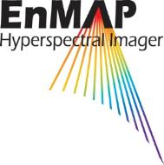
EnMAP – Mission Exploitation Program
Program goals:
Raising scientific knowledge
Supporting the science community to develop new data products, algorithms and services
Supporting the discovery of new application fields
Raising awareness of the EnMAP mission
Ensuring easy and fast access towards EnMAP data
Enable easy data processing capabilities
Supporting national and international cooperation
Explore synergies with other missions
Research
Education & Training
Mission support
Data handling
Algorithms & Applications
Community building
International activities
EnMAP
Mission Exploitation Program
Value-Adding

Slide 10
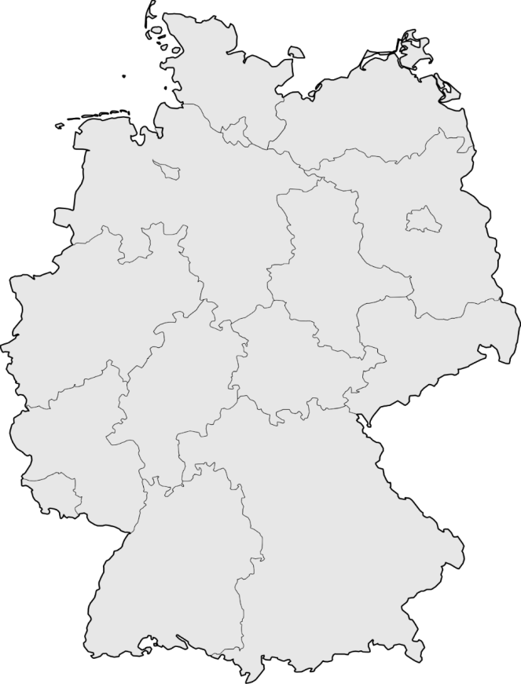
EnMAP – Science Education Program
More than 40 PhD students and Postdocs funded as part of the EnMAP science program since 2010
Application and algorithm development in various fields incl. agriculture, forestry, natural ecosystems, geology and soil, urban areas, coastal and inland waters

Slide 11
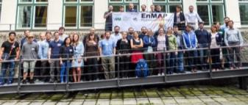
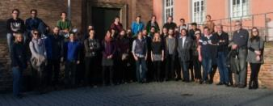
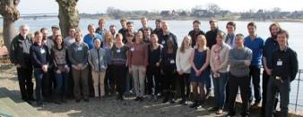
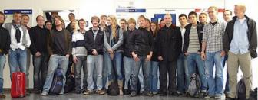
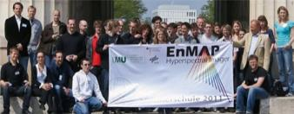
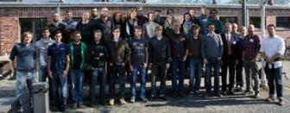
EnMAP Summer Schools
Munich (September 2017)
Trier (April 2016)
Lauenburg (March 2015)
Berlin (September 2012)
Munich (April 2011)
Trier (September 2010)
wikimedia.org
orangesmile.com

Slide 12
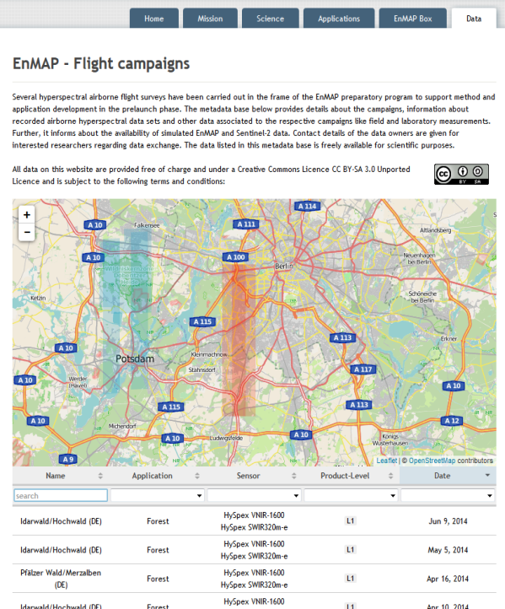
EnMAP – flight campaign datasets
Hyperspectral airborne campaign data, simulated EnMAP data and in-situ data
Datasets provided free of charge to science community
Datasets published as data publications (with DOI)
Basis to simulate future EnMAP data using EnMAP simulator software EeTeS developed at GFZ (Segl et al. 2012)
www.enmap.org/flights
Segl, K.; Guanter, L.; etal. EeteS - The EnMAP End-to-End Simulation Tool. IEEE
Journal of Selected Topics in Applied Earth Observations and Remote Sensing, 2012.
Notes:
that EnMAP is committed to open data policy and there is an effort also on make campaign data available to users
Creative Commons Licence CC BY-SA: Attribution + ShareAlike.
(BY) Licensees may copy, distribute, display and perform the work and make derivative works based on it only if they give the author or licensor the credits in the manner specified by these. (SA) Licensees may distribute derivative works only under a license identical to the license that governs the original work.
As the general licence of Wikipedia, CC BY-SA is one of the most important and widespread CC licences.
Current status:
Metadata portal ready containing details on 25 flight campaigns that have been carried out in the EnMAP preparatory programme (all campaigns funded by BMWi). More data will be included in the future.
Database can be searched in different ways. Contact person named per dataset.
In near future (to be finally decided at EnSAG Meeting in April):
Publishing datasets as data publications (each dataset has DOI, authors, standardized description including reference to own publications to be cited)
Writing technical report on each dataset.

Slide 13
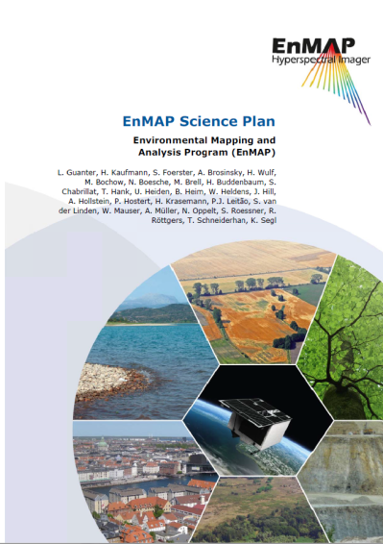
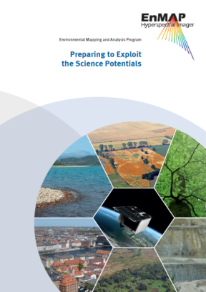
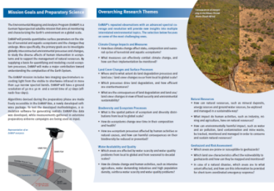
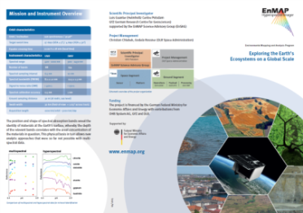
EnMAP information and Capacity building
Development of online learning platform for imaging spectroscopy started as part of the EnMAP education initiative
Reviewed and structured Presentations and tutorials on principles, methods and applications of imaging spectroscopy
Application Tutorials for EnMAP-Box
MOOC with modules and certificate planned
To be launched in 2020 at EO-College.org
EnMAP Science Plan, booklet and flyer
Central point of information: www.enmap.org

Slide 14
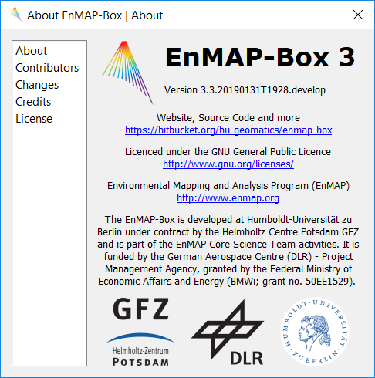
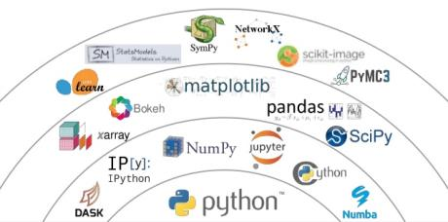
EnMAP-Box 3 Toolbox for visualization, processing & analysis of EnMAP data
Free and open-source
Multiple target groups:
Imaging spectroscopy novices
Imaging spectroscopy/EO experiences users
Experts for EO data processing, who code their own workflows and applications
QGIS Plugin
Notes:
Aussagen:
Aims and motivation
Bridging Imaging Spectroscopy with GIS and Python functionality
Free and open source nur im Wort wiederholen

Slide 15
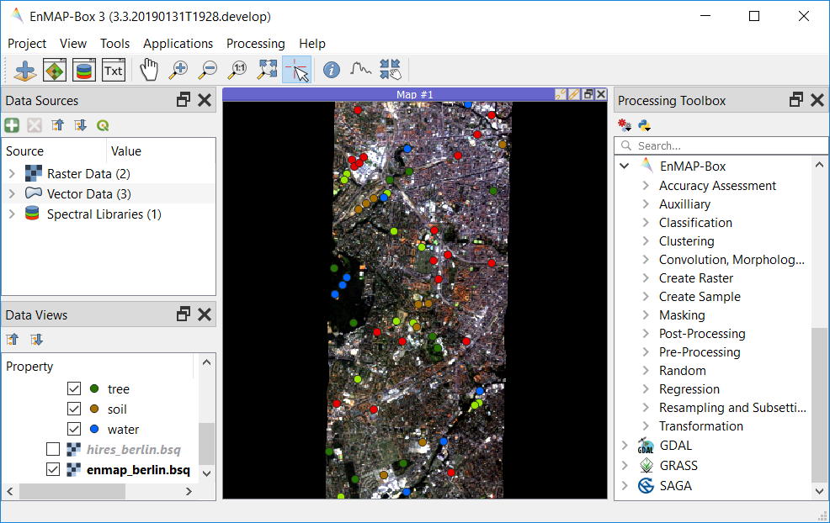
Offer new workflows, create synergies, avoid redundancies
User friendly GUI and data handling
Availability of state-of-the-art applications
Extension points for advanced users
Offer full GIS functionality
Notes:
Aussagen:
Aims and motivation
Bridging Imaging Spectroscopy with GIS and Python functionality
Free and open source nur im Wort wiederholen

Slide 16
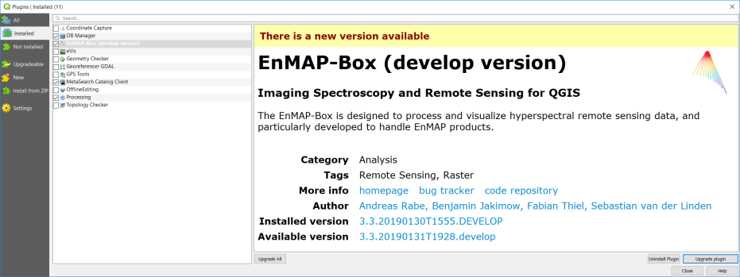
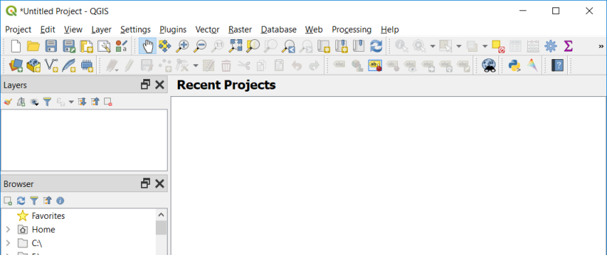
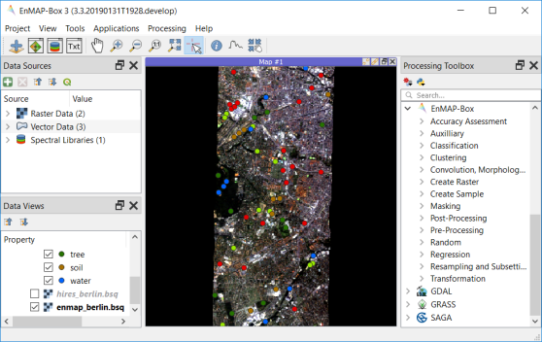
EnMAP-Box 3 as a plugin
Planned to be part the official QGIS Plugins Repository by end of March 2019

Slide 17
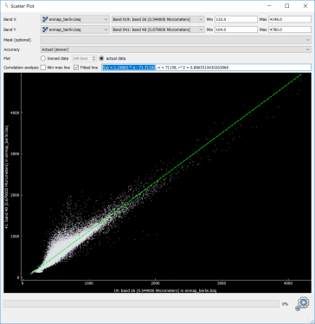
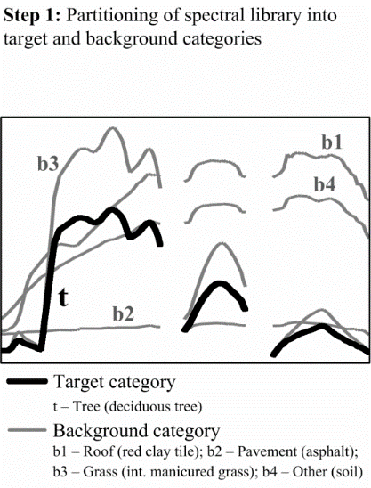
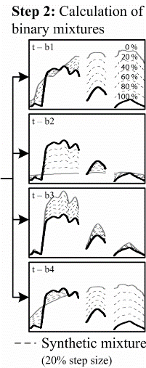
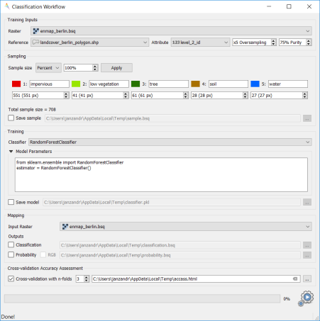
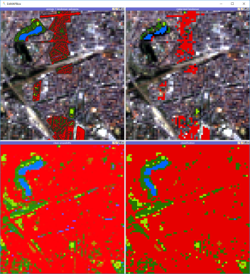
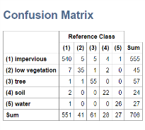
EnMAP-Box 3 - tools and applications
Scatter Plot
Classification Workflow
Regression-based unmixing
Agricultural Applications
Mineral and soil mapping application coming soon
Extension points:
imageMath interface
Scikit-Learn Estimator interface
EnMAPBoxApplication interface

Slide 18
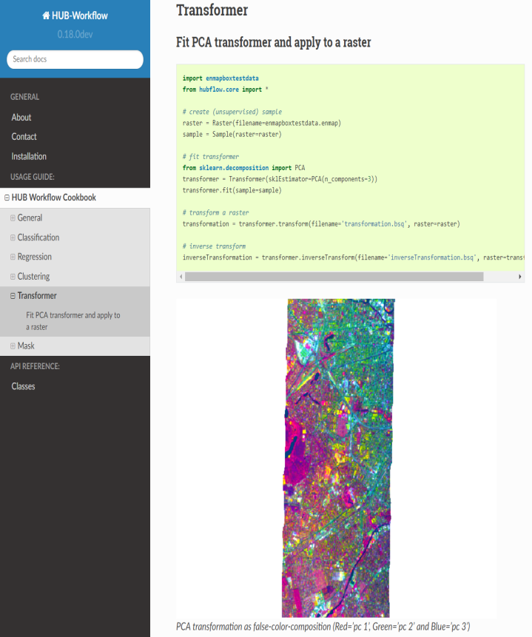
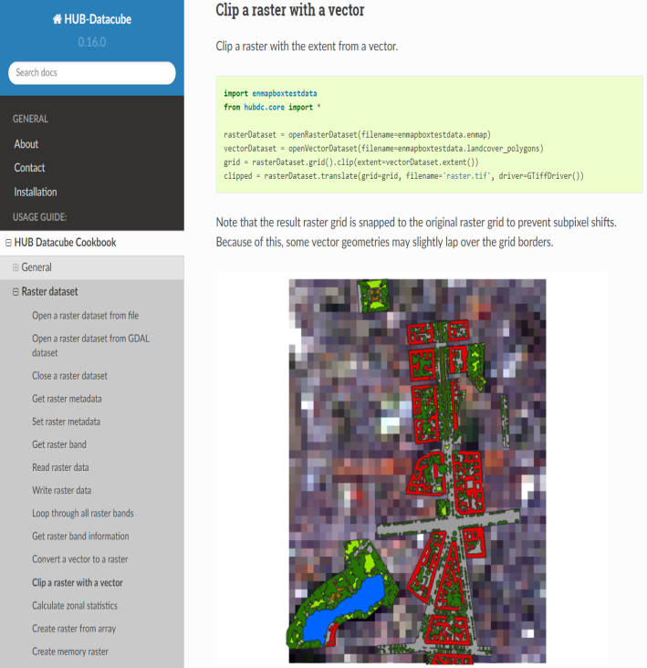
EnMAP-Box 3 - API for algorithm development and workflow scripting
HUB Datacube: http://hub-datacube.readthedocs.io
HUB Workflow: http://hub-workflow.readthedocs.io
Notes:
To optimize the use of the scientific python stack we deliver an API to link e.g. GDAL with sci-kit learn, and to… …
This way we address two target groups: pure users (beginners and advanced) and developers, who want to integrate and share their own algorithms.

Slide 19
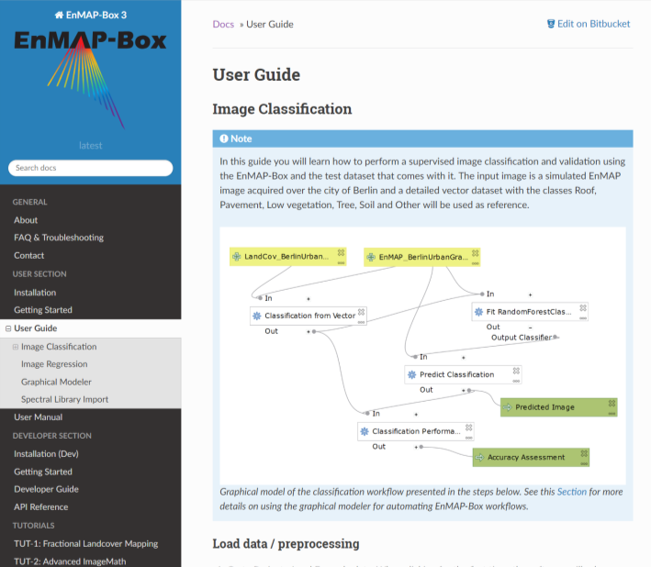
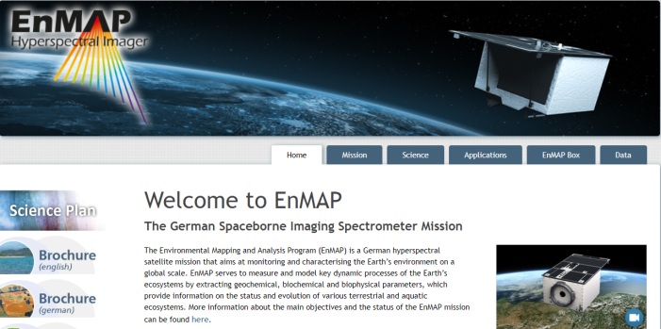
EnMAP-Box 3 - find us on the web
> WGCapD-8 > Michael Bock • CB Support to hyperspectral remote sensing > 06.03.2019
Read the Docs: enmap-box.readthedocs.io
Bitbucket: bitbucket.org/ENMAP
EnMAP Project: www.enmap.org

Slide 20
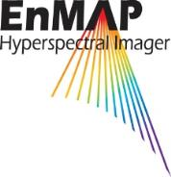
Thank you

