Slide 1

Indian SAR Missions & CB Support
Committee on Earth Observation Satellites
Raj Kumar
Space Applications Centre, ISRO
WGCapD-8
Dehradun, India
March 6-8, 2019
rksharma@sac.isro.gov.in

Slide 2
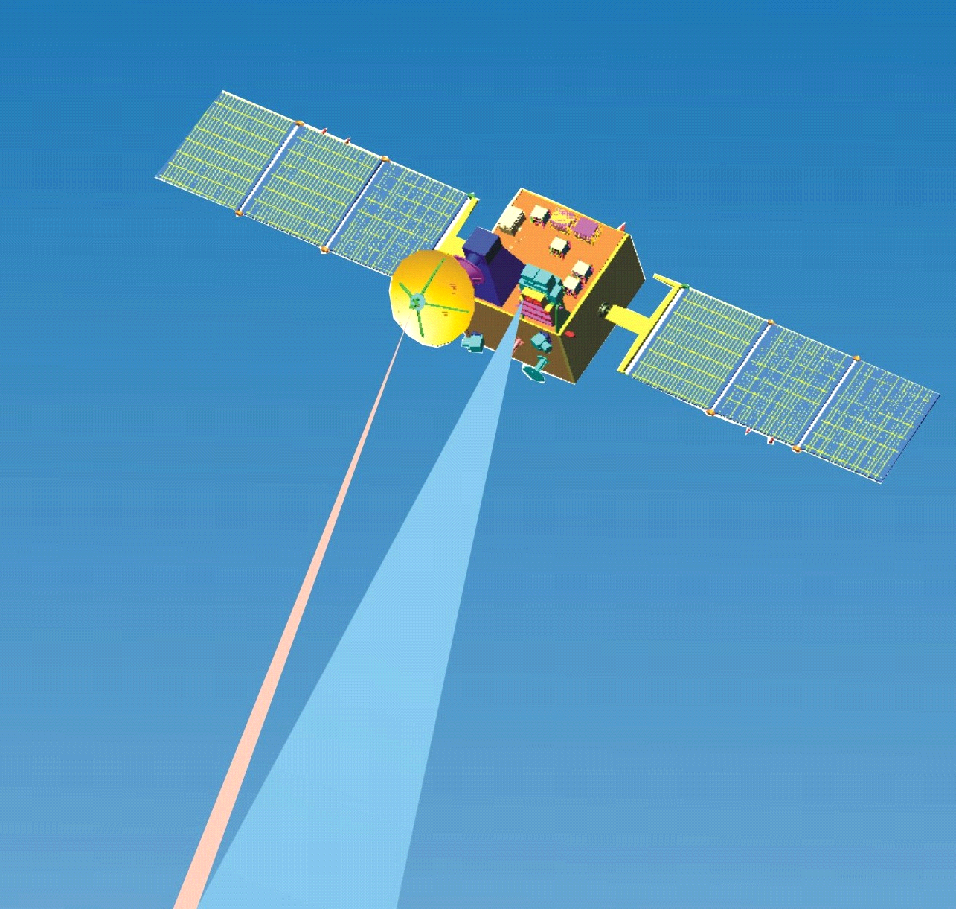
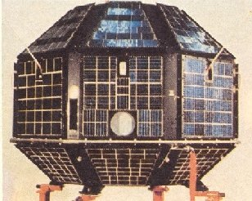
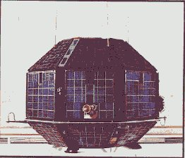
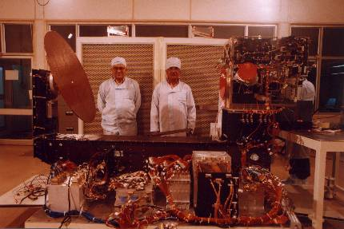
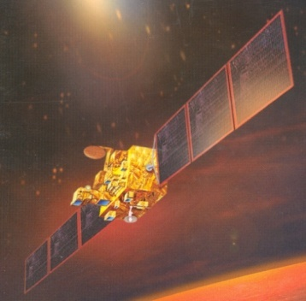
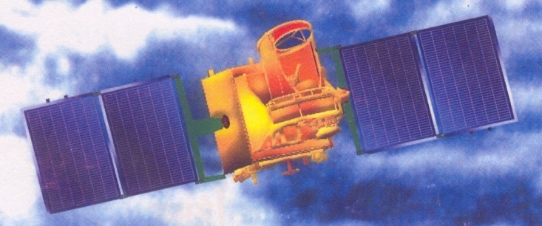
Indian Microwave Remote Sensors Activities
  Development and operation of state-of-the-art Microwave Sensors
    Active
    Passive
    Spaceborne, Airborne and Ground applications.
  SARs,
  Wind Scatterometer,
  Radiometers,
  Altimeters,
  GPRs,
  Sounders
Bhaskara-1 1978
OCEANSAT-1 MSMR
1996-1999
OCEANSAT-2 SCATTEROMETER
2009-2014
Bhaskara-2
1981
ASAR
1989-1993
MEGHA-TROPIQUES
2011
Notes:
Bhaskara 1 & 2 had SAMIR (microwave radiometer) working at 19.35 , 22 & 31.4 GHz for study of ocean surface study & study of water vapour, liquid water content in the atmosphere.MSMR 6.6 GHz- sea surface temp, 10.65- wind speed, 18-precipitation, 21- liquid water content in atm.

Slide 3
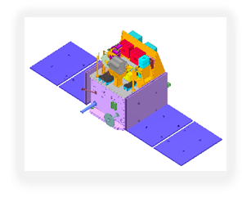
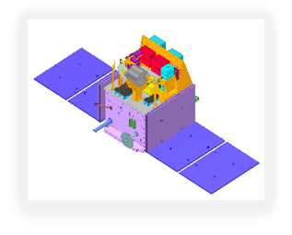

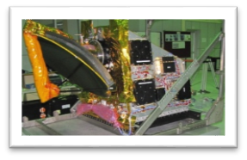
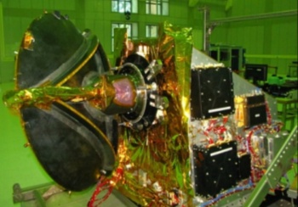
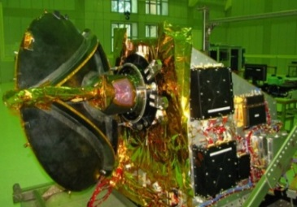

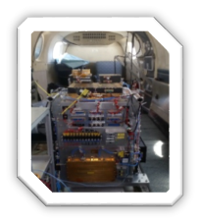
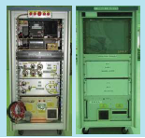
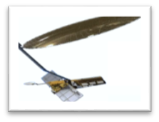
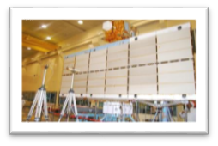
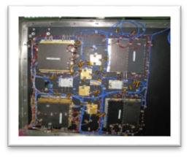
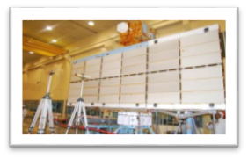
ISRO’s Array of Microwave Sensors
Radiometers
ATMSAT 2 (2022)
MEGHA-TROPIQUES
2011
ATMSAT 1 (2021)
Scatterometers
SCATSAT-2 (2020)
SCATSAT-1 (2016)
OS-3 & 3A SCATTS
(2018-19)
OS-2 SCATT (2009)
Microwave Sensor Payloads
L/S Airborne
SAR (2017-18)
Airborne SARs
DMSAR (2007-2012)
Space SARs
S-band SAR
(NI-SAR)
2019-20
C-band SAR
(RISAT-1A & 1B)
2019-20
C-band SAR (RISAT-1)
2012
CY-2 L/S SAR
2018

Slide 4
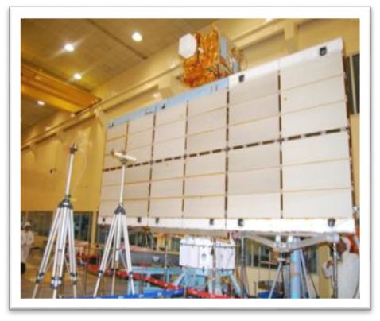
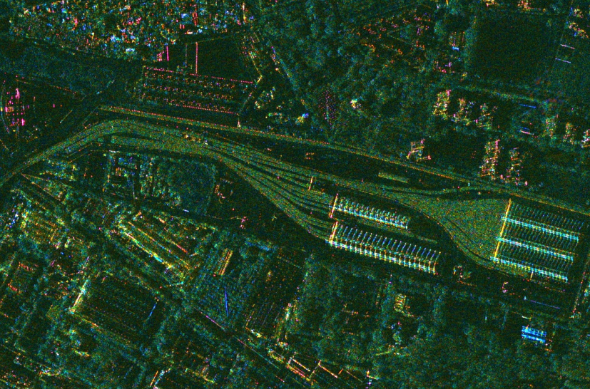
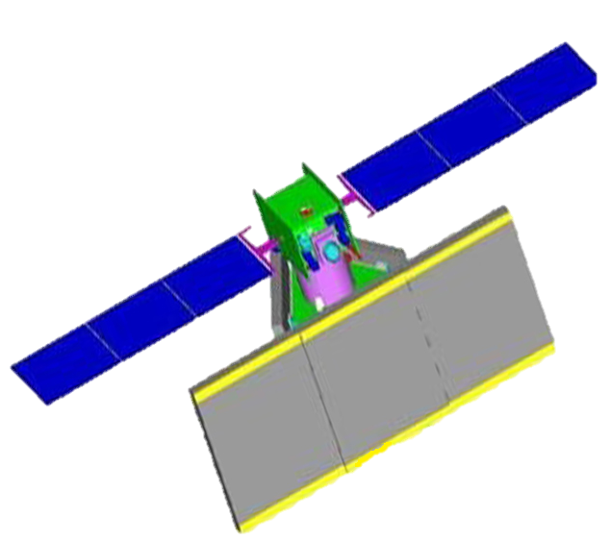
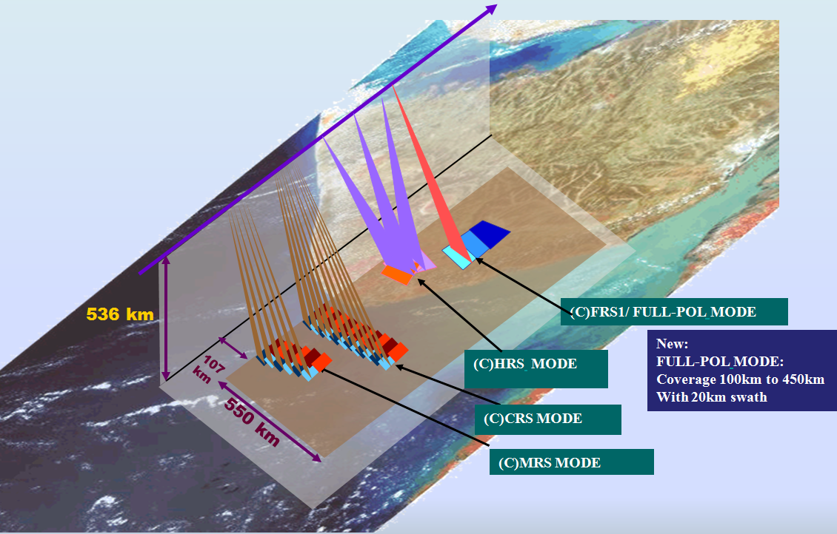
Earth Observation Space-borne SARs
RISAT-1
RISAT-1
HRS Mode
C-band SAR (RISAT-1) 2012
RISAT-1A
C-band SAR (RISAT-1A) 2019

Slide 5
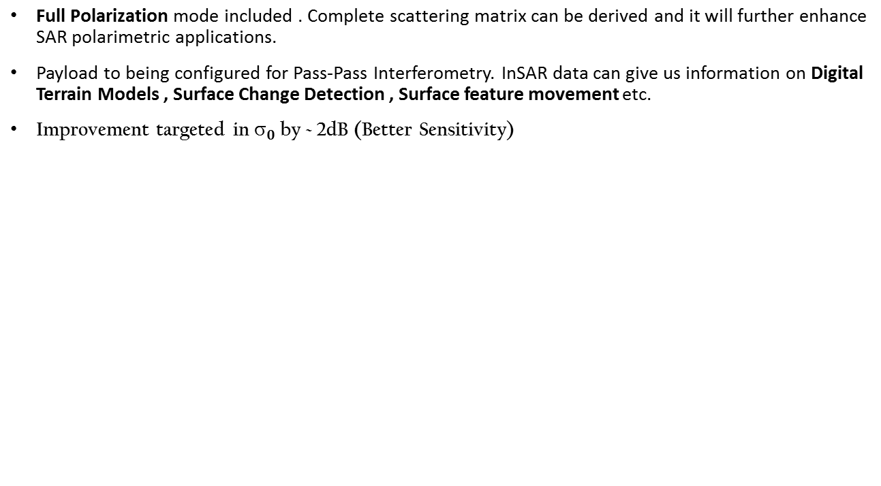
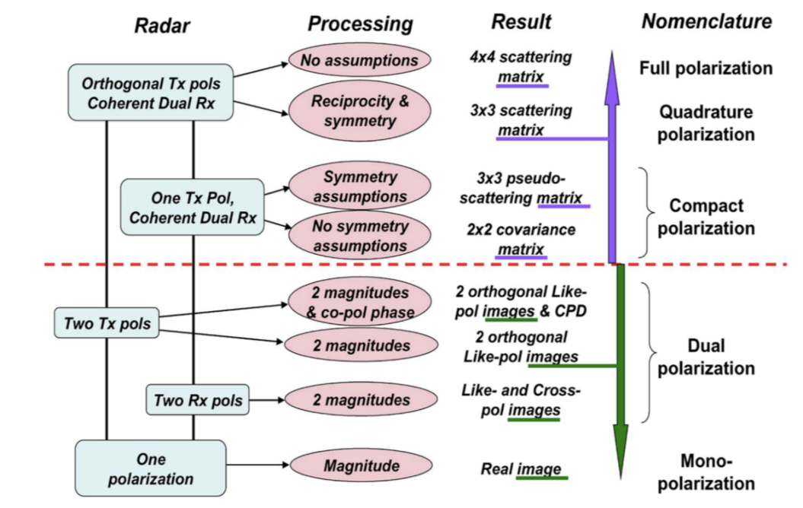
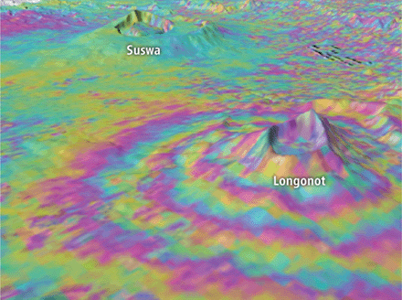
RISAT-1A Increments
Polarization chart for SAR(courtesy Renay et al).
InSAR detecting a volcano in Kenya.[Sparks et al., 2012; observations from Envisat ERS-1 & ERS-2].

Slide 6
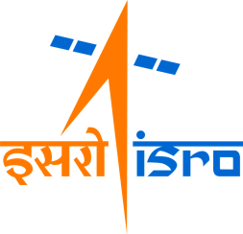
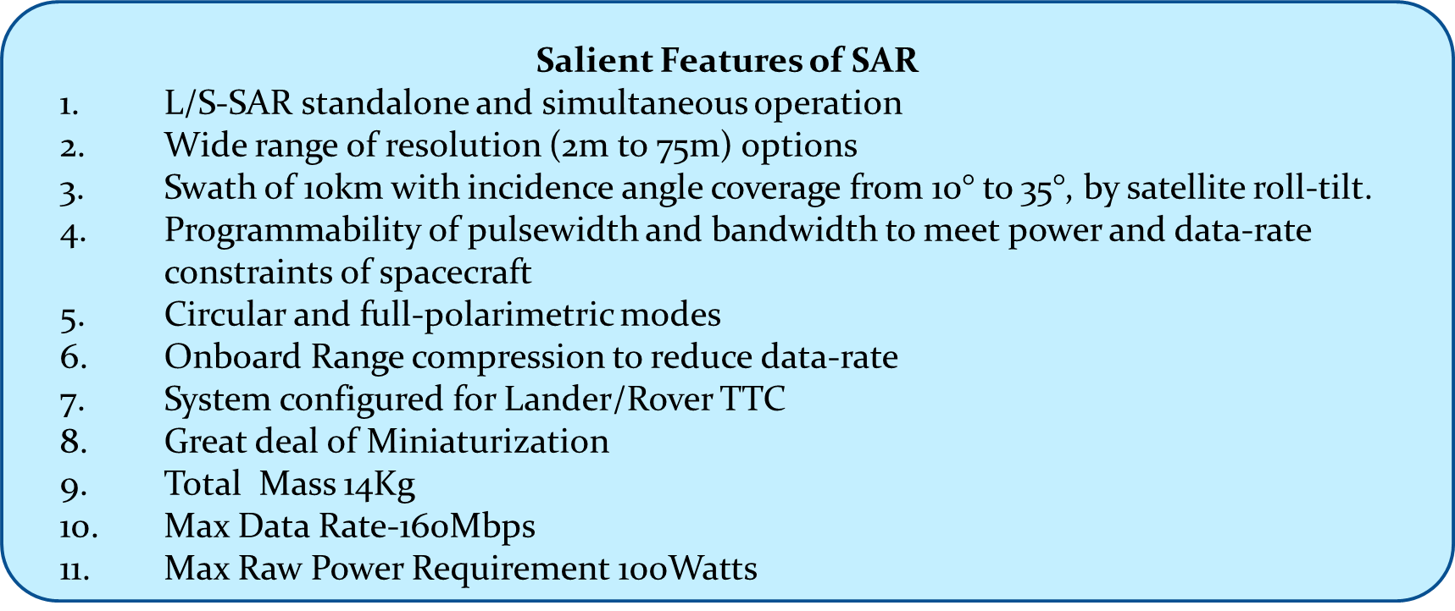
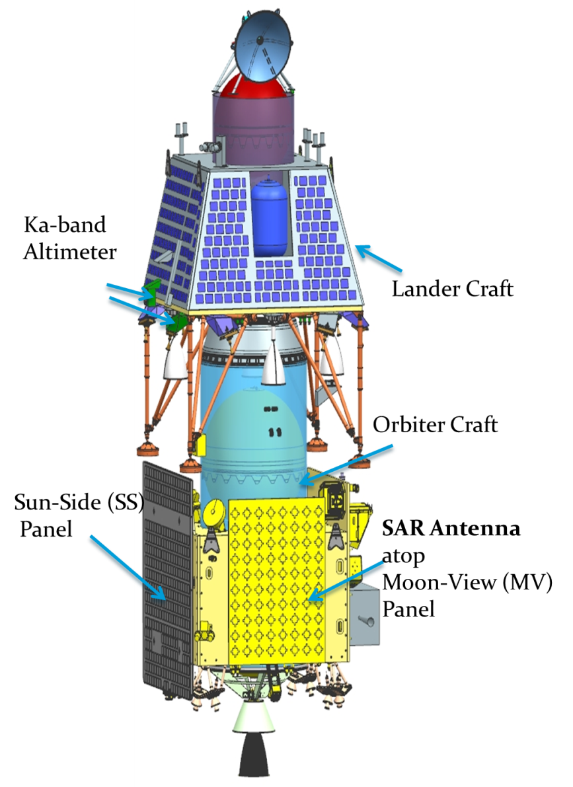
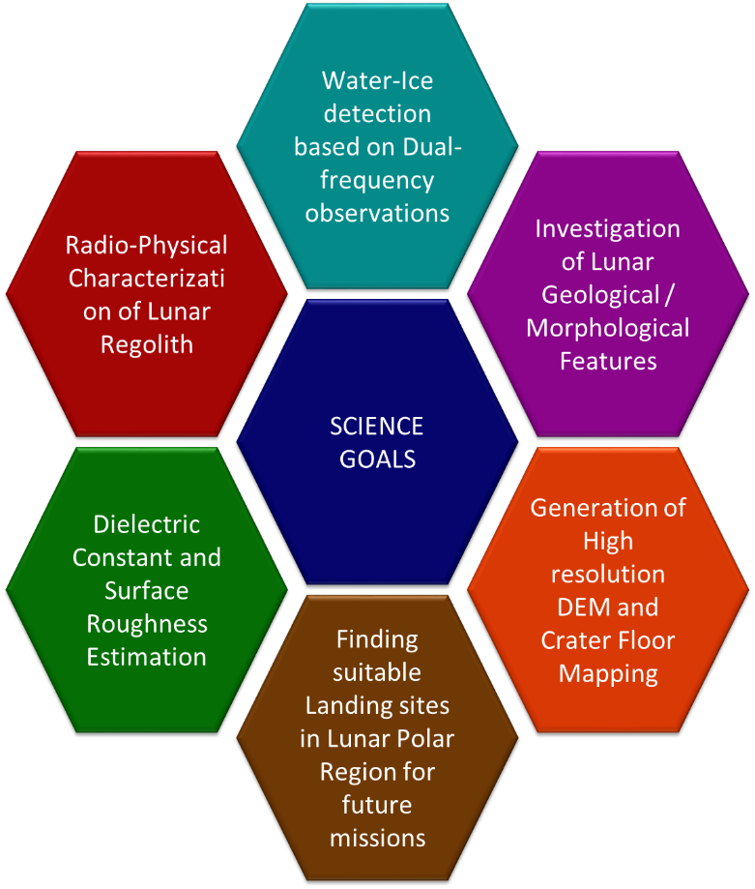
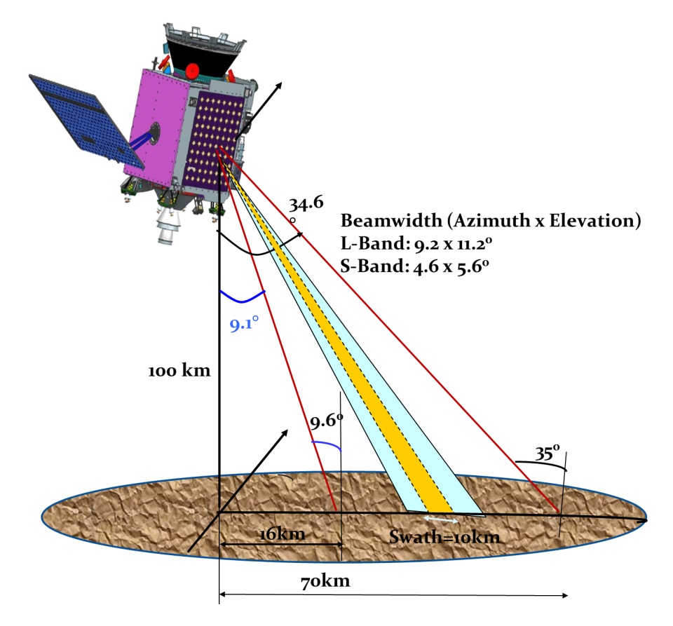
Chandrayaan-2 Dual FrequencySAR

Slide 7
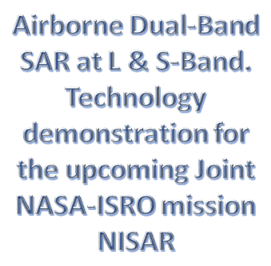
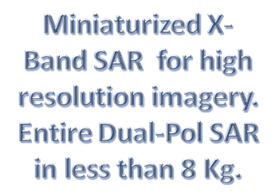
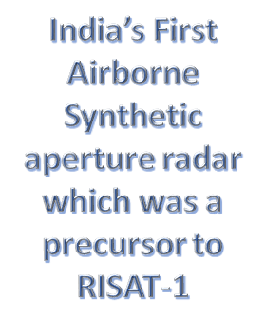
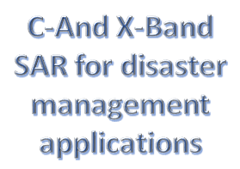
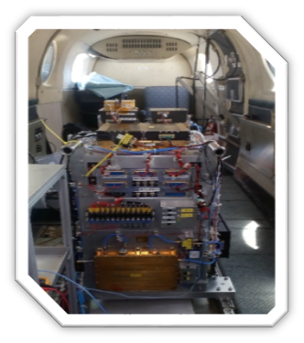
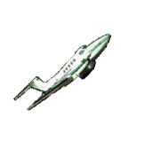
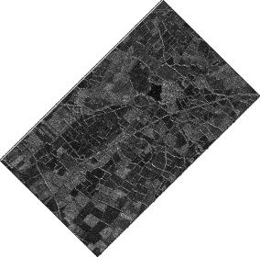
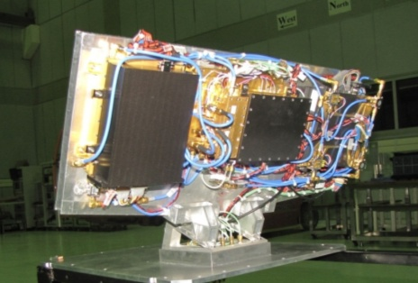
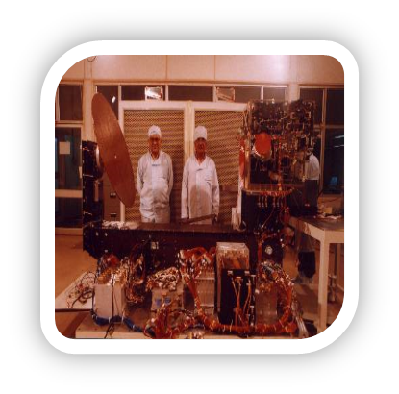
Earth Observation Air-borne SARs
X-Band Minisar
DM Airborne SAR
2007-2011
L & S-Band SAR
ASAR
1989-1993

Slide 8
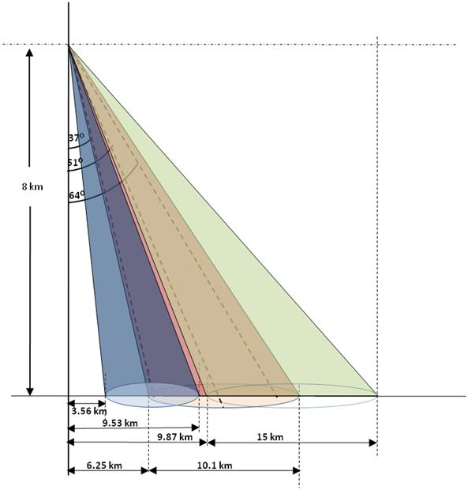
L&S Band Airborne SAR System
Geometry

Slide 9
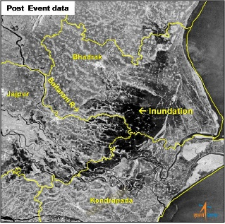
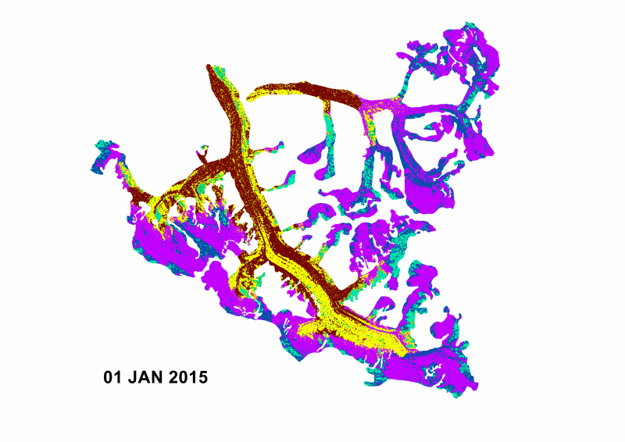
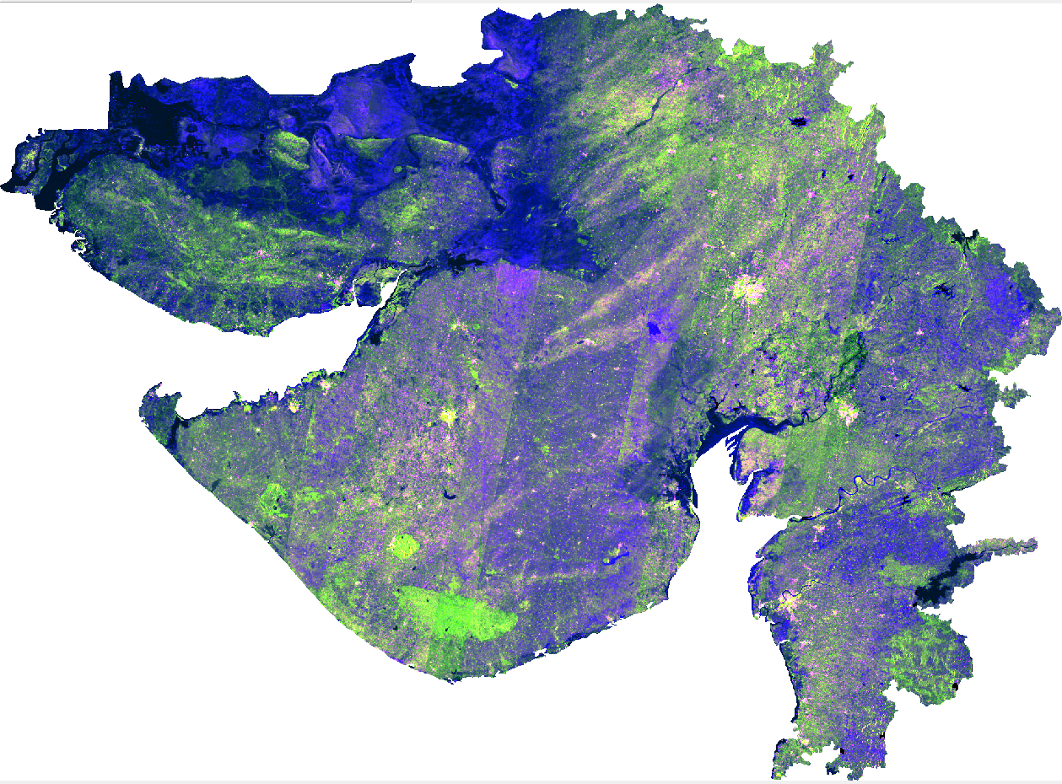
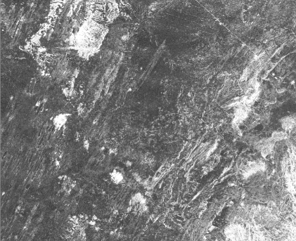
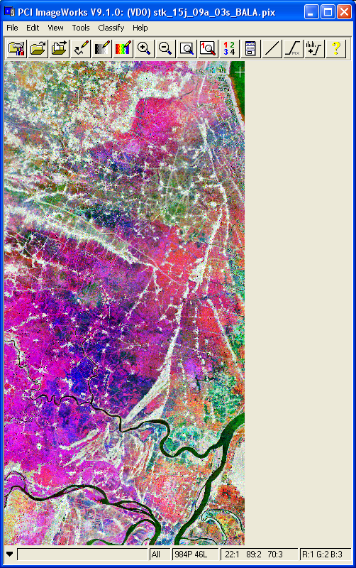
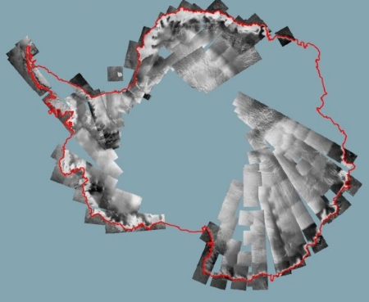
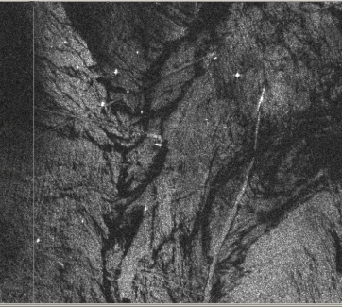
SAR APPLICATIONS
Landuse/
Landcover
Terrain
Floods
Soil Moisture
Snow & Glaciers
Operational
RISAT-SAR
Forestry
Gujarat
Kinnoi Fault
Geology
Quasi- Operational
C-band SAR Image
Technique Development
Capacity Building
Agriculture
Polar Studies
Early
rice
Very Late rice
Oceanography
Late rice

Slide 10
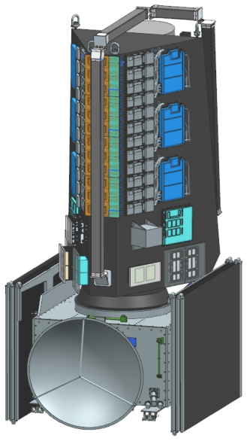
NISAR
S-SAR Antenna Beams 1 to 24
S-SAR Range Imaging Geometry
NISAR Satellite
Beam #24 Projected at Near-End of Feed
Tx Beamwidth 9.3⁰
Reflector
Beam #1 Projected at Far-End of Feed
37⁰
37⁰
Rx Beam #1
747kms
Rx Beam #24
S/C
Feed
Beam #24
Beam #1
Nadir Axis
425kms
1
230kms
24
425kms
230kms
699kms
699kms
Parameters | L-band SAR |  | S-band SAR
Orbit | 747 Km with 98.5° Inclination
Frequency (wavelength) | 1.25GHz (24cm) |  | 3.20 (9.3cm)
Repeat cycle | 12 days
Time of Nodal Crossing | 6AM / 6PM
Polarization | Single (SP), Dual (DP), Circular (CP), Quad (QP) and Quasi-quad pol (QQP)
Incidence angle range | 33 – 47 deg
Available Range Bandwidths | 5 MHz, 20 MHz, 40 MHz, 80 MHz | 10 MHz, 25 MHz, 37.5 MHz, 75 MHz
Resolution (Azimuth × Slant range) | 6.9m × 7.5m (for 20MHz bw) 6.9m × 1.9m (for 80MHz bw) | 6.4m × 6m (at 25MHz bw) 6.4m × 2m (for 75MHz bw)
Max. Swath width | > 240 Km
Data and Product Access | Free & Open

Slide 11

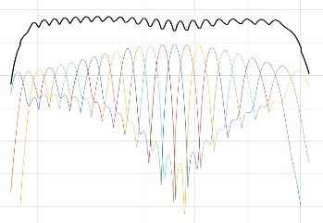
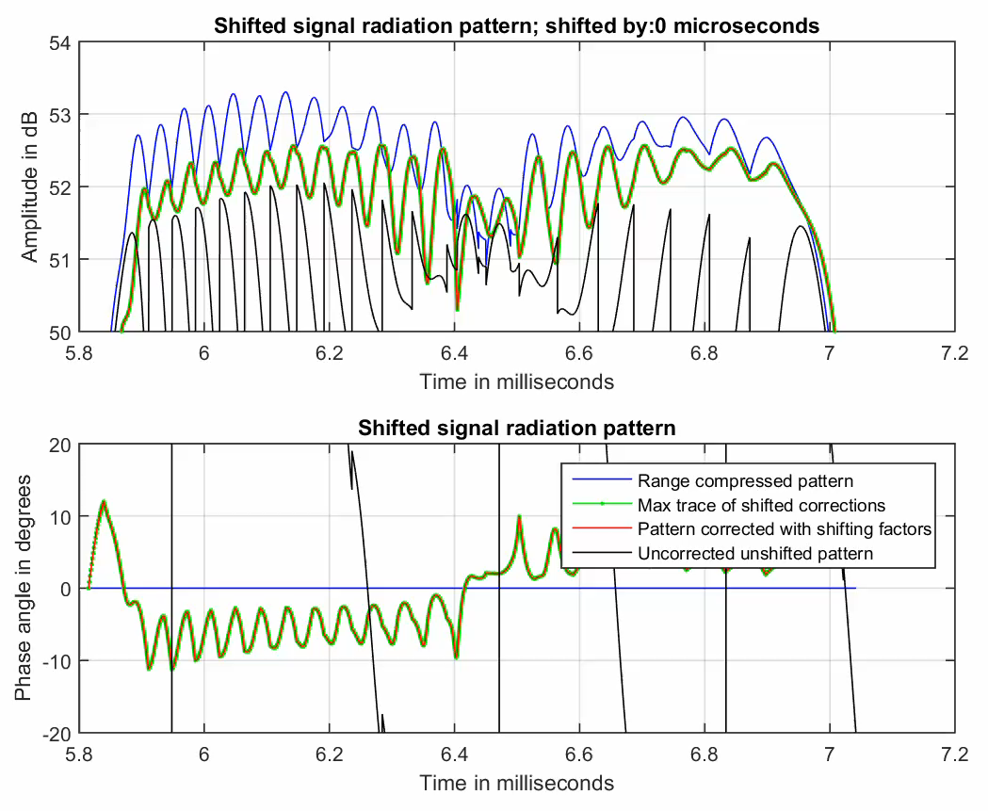
S-SAR
Science require frequent coverage over global targets
NISAR would acquire sufficient swath with high resolution
New SweepSAR technology being implemented by both JPL and ISRO
S-SAR Operation:
Thermal constraints ( 0 to +40degC / 45degC thermal design limit)
Data Volume (>3Gbps Max.)
Desired Science requirement
  4 Orbits / 14 Orbits – 15Minutes over SAARC and Antarctica regions.
  10 Orbits / 14 Orbits - 2 Minutes globally / orbit
Thermal analysis of S-SAR
  14 Orbits / 14 Orbits – 10 Minutes over SAARC and Global regions
Comfortable Thermal Margins to meet desired science requirements
Payload to JPL by end 2019
Launch by December 2021
θ₁₂
θ₁₁
12
11
P
420kms
700kms
Beam 11 Data
Beam 12 Data
3-Beam Overlap DBF
Notes:
Emphasis:
New technology to allow fast repeat, wide swath, full resolution.
Someone might ask about receiver blanking leading to gaps in the swath. It is true if we have fixed PRF we’ll have 2 or 3 10 km gaps in the swath. We can either suffer it, with ascending descending coverage filling in almost all gaps, or we can dither the PRF to fill them in. We are studying the impacts in detail now.

Slide 12
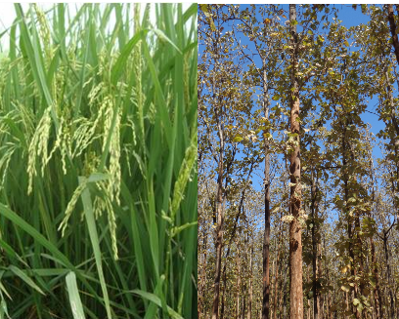





NISAR: Proposed Applications
Ecosystem Structure: 1.1 Agriculture biomass & Crop monitoring; 1.2 Forest biomass; 1.3 Forest disturbance; 1.4 Mangroves / Wetlands; 1.5 Alpine vegetation; 1.6 Vegetation phenology; 1.7 Soil moisture; 1.8 Ecosystem stress assessment
Land Deformation: 2.1 Inter-seismic / Co-seismic deformations; 2.2 Landslides; 2.3 Land subsidence; 2.4 Volcanic deformations
Cryosphere: 3.1 Polar Ice Shelf / Ice sheet; 3.2 Sea Ice Dynamics; 3.3 Mountain snow/ glacier 3.4 Glacier dynamics/ hazard (Himalayan Region); 3.5 Climate response to glaciers; 3.6 Sea–Ice advisory on safer marine navigation in Antarctica region
Coasts & Ocean: 4.1 Coastal erosion / shoreline change; 4.2 Coastal subsidence and vulnerability to sea-level rise; 4.3 Coastal bathymetry; 4.4 Ocean surface wind; 4.5 Ocean wave spectra; 4.6 Ship detection; 4.7 Coastal watch services; 4.8 tropical cyclone
Disaster Response: 5.1 Floods; 5.2 Forest fire damage assessment; 5.3 Coastal oil spill; 5.4 Earthquakes / Others
Geological Applications: 6.1 Structural & Lithological mapping; 6.2 Lineament mapping; 6.3 Paleo-Channel study; 6.4 Geomorphology; 6.5 Land degradation mapping; 6.6 Geo-archaeology; 6.7 Mineral explorations

Slide 13







ISRO Observation Plan
Background Land
Agriculture & Forest
Coastal Applications
Ocean Applications
Important Obs. Modes
Background Land (Systematic Coverage)
S (DP/CP) 37.5/25 MHz;
L (DP) 20+5 MHz
Period of Obs.
Jan – Dec; All 30 cycles
Agriculture, Forest & Wetland
S (CP) 25 MHz; L (QP) 40+5 MHz
Deformation Monitoring
Disaster Management
Himalayan Snow & Glacier
Jan – Nov; 16/30 cycles
Coasts / Coastal Ocean
S (CP) 25 MHz; L (VV+VH) 20+5 MHz
Jan – Dec; Every Alternate cycles
Ind ocean-Indonesian volcanic arc
Indian Ocean
S (DP-VV+HV) 10 MHz
L(SP) 5 MHz
BoB: Jun – Dec; All cycles
Arabian Sea: Apr- Sep; All cycles
High Resolution Urban / Landslide
S (SP) 75 MHz; L (DP) 40+5 MHz
Polar Science (ISRO targets)
Polar Science (ISRO+ Joint targets)
Deformation Studies
S (DP) 37.5 MHz; L (DP) 20+5 MHz
svalbard
Jan – Dec; Every Alternate cycles
Bohai bay
Ice Charactn (Ant; Svalbard; Bohai)
S (CP) 25 MHz; L (VV+VH) 20+5 MHz
Oct-Apr (Antarctica); Dec-May (Svalbard & Bohai)
Polar Region (Antarctica + Greenland)
S (CP) 25 MHz; L(SP) 80 MHz
Indian Research Stns
Ant: Every/ alternate cycle; Greenland: every cycle

Slide 14

ISRO Targets over India and Surroundings
These exclude polar targets
India + neighbors boundary
Agriculture/ Forest/ wetland
Jute crop
Alpine forest
Seismic Deformation
Land Subsidence
Landslide
Urban subsidence
Volcanic deformation/ studies
Coastal region (sea 300km)
Coastal habitat
Coastal deformation
Coastal mud bank
Coastal region (land, 100 km)
Ocean – Arabian Sea
Ocean – Bay of Bengal
Disaster – floods
Disaster – forest fire
Disaster – oil slick
Cryosphere - Himalayas
Snow
Glacier
Himalayas
Seismic Deformation
Land
Subsidence
Himalayas
Urban
Flood
Forest Fire
Agril.
Forest
Wetland
Oil
Slick
Coastal Ocean
Coastal Ocean
Landslide
Arabian Sea
Coastal
Habitat
Bay of Bengal
Mud bank
Volcano

Slide 15


NASA Polar Cryosphere Targets
(Targets of ISRO’s Interest: Land Ice & Sea-Ice Q1-Q4)
Svalbard
Bohai Bay
Indian Stations in Antarctica
Sea Ice Q1 (L- single-pol : 5 MHz) - same as NASA requirement
Priority Ice: L (SP) 80 MHz-half swath – same as NASA reqmt
Sea Ice Q2 (L- single-pol: 5 MHz) - same as NASA requirement
Svalbard Ice Characterization: S (CP) 25MHz & L(VV+VH) 20+5MHz; Dec-Mar, every 12 days
Sea Ice Q3 (L- single-pol : 5 MHz) - same as NASA requirement
Sea Ice Q4 (L- single-pol : 5 MHz) - same as NASA requirement
Bohai Bay Ice Characterization: S (CP) 25MHz & L(VV+VH) 20+5MHz; Dec-Mar, every 12 days
Ice Characterization: S (CP) 25MHz & L(VV+VH) 20+5MHz; Sep-Apr, every 3days
Land Ice Greenland: S (CP) 25MHz; Dec-Mar, 2 sets of mosaics
L (SP) 80 MHz, Half swath (same as NASA requirement)
Land Ice Antarctica: S (CP) 25MHz; Jul-Sep, 2 sets of mosaics
L (SP) 80 MHz, Half swath (same as NASA requirement)

Slide 16






CALIBRATION SITES (Point target Sites)
Indian Sites
International Point Target Sites
Rosamond CR array, California, USA
Australian CR array, Queensland
Orissa
Amrapura,
Little Rann of Kutch
Distributed Target Sites
Desalpar, Rann of Kutch
Ahmedabad
IMGEOS, Shadnagar
Amazon rainforest
Congo rainforest
SAC-Bopal
&
SAC-Ground
Image Courtesy: Google Earth
Notes:
It is planned to permanently deploy different types and sizes of corner reflectors at additional sites (educational institutes, RRSCs) in each state of India to cover all the beams of S-band.
In the first phase, permanent deployment of CRs in six Indian states (Gujarat, West Bengal, Rajasthan, Chhatisgarh, Karnataka and Madhya Pradesh) has been initiated.
For L-band beams, campaign modes will be carried out in various Indian sites in joint-mode with S
It is planned to develop point target site at Antarctica (near Indian stations Bharti and Maitri -band for the external calibration.

Slide 17









Calibration
Response of perforated CR in L-band
airborne image of 14th February 2018
Detachable Panels
Assembled 2m Perforated CR
SAC-Bopal New Campus
SIMULATED NISAR Coverage and response of Amrapur
SAC-Bopal
CAL-VAL Site
Deployed Perforated CR
Perpendicularity Check
Patan
Amrapur
Amrapur
Customised & Built perforated 2m CR, based on the design by JPL
Compact light weight detachable CR design is in progress
90cm CR planned to be deployed in Antarctica, Designed & developed in SAC
In-house development of ARC in progress
Ground Photo
Amrapur

Slide 18

Science Plan and Research Announcement for L&S Airborne SAR
Region-wise distribution of Project Proposers
Airborne SAR R.A. Project Proposal Statistics:
77 Proposals; 45 Institutions
No. of Projects
(Total: 77)
1 - 2
3 - 4
5 - 8
9 - 10
11 - 15

Slide 19
L&S Airborne SAR Flight Campaign-2017/2018
Phase1 | June 2017
Area | Gujarat Sites (8 sites)
Base | Ahmedabad
Phase2 | February 2018
Area | Andra/Telengana (5 sites)
Base | Hyderabad
Themes
Agriculture
Soil Moisture Study
Urban Applications
Hydrology/Flood Mapping
Wetland Mapping
Coastal Applications
Oceanography
Mangroves
Geological Applications
Forest
Ph-I
Total sites: 66
Ph-II
Phase-I: June 2017, 8 sites
Phase-II: March 2018, 05 sites

Slide 20

Possible targets for the ISRO L+S band airborne SAR flights
(Nominal site locations)
Beaufort Sea
Sea Ice site
Massachusetts
Harvard Forest area
forest AGB & veg characterization
Alaska Glaciers
Tennessee/N. Carolina
Ecology sites
forest AGB and disturbance mapping
Louisiana/Mississippi/Alabama
Ecology sites
Texas/Louisiana Offshore oil slick sites
Crop, forest and wetland applications

Slide 21
Proposal for L&S airborne SAR Campaign over USA & Canadian targets
  NASA and ISRO plan observations in the USA by ISRO L&S band SAR in FY 2019 on a NASA aircraft
  Some acquisitions will be designed to assess SAR calibration for UAVSAR and ISRO L+S.
  Many of the joint sites are likely to coincide with the sites identified in this UAVSAR campaign
  Some of the ISRO SAR flights could either duplicate or substitute for UAVSAR acquisitions
Exploring Options for Accommodating L+S ASAR on NASA Aircraft
Construct new aircraft radome
• Modify aircraft to accommodate radome
• Modify aircraft to accommodate antenna
• Route antenna cables to cabin
• Place radar electronics in cabin
Mount antenna to UAVSAR pod
• Construct new pod radome
• Route antenna cables to cabin
• Place radar electronics in cabin

Slide 22


Outreach Programs
Satellite Meteorological and OceAnographic Research and Training (SMART)
Training & Research in Earth-Eco Systems (TREES)
ISRO’s initiative to promote use of Indian EO data & products for research in Satellite Meteorology & Oceanography and Earth eco-system studies among students, researchers & academia
Research Programme
Training Programme
Fields of
Research
Processes
Retrieval
Assimilation
NWP
Vegetation Dynamics
Hydrology
Digital Image Processing and m/c learning
Student & Researchers
University
Institutes
R & D Organ.
Research Initiation Programme
Challenges
Training
Popularise ISRO Missions, Data & Products
SMART / TREES
Advance Research Programme
Faculty
Teachers
Trainers
IMD
NCMRWF
INCOIS
IAF
NAVY
State RS Centers
Data Exploration Programme
Operational Agencies
Outreach activities provide:
Familiarization with Indian EO data
Short-term advanced training courses
Long duration 3-9 months - Research
Data analytics and advanced visualization
State-of-the-art computing facilities
Research guidance
Subsidized accommodation & food

Slide 23







TREES & SMART: Research and Training opportunities at EPSA
Participants Trained : 723
Research Projects Completed : 148
Trainings : 34
Generation of 3D building model & shadow analysis
ORTHOSEG
Crop Suitability Analysis for UP
Global analysed wind fields from
ScatSat-1 and its application
AltiKa derived Global ship count
Mar,13 to June,18 at1° x 1°
Convective Overshooting using Satellite Data
Human Discomfort
Index
Effect of ships on scatterometer measurements

Slide 24

SMART Research Programme – Summary (2016-Present)
Total Students Trained – 93
[One month to 9 months]
Universities/ Colleges
Assam University (1)
Anna University (18)
University of Madras (7)
Nirma University (4)
Indus University (4)
Annamalai University (1)
Alagappa University (1)
Charusat University (1)
Pune University (2)
Central Uni. of Haryana (1)
Central Uni. of Jharkhand (5)
Gujarat University (1)
Mangalore University (2)
Indian Maritime University (2)
Banaras Hindu University (1)
Sardar Patel University (2)
Cochin University (5)
Madurai Kamaraj University (1)
IIT-BHU (1)
IIT-Bhubaneswar (4)
IIT-Bombay (1)
IIT-Kharagpur (5)
IIST-Trivandrum (1)
IISER, Bhopal (1)
SV-NIT (3)
U V Patel College, Mehsana (2)
St. Albert’s College, Cochin (5)
Atharva College, Mumbai (1)
PDPU, Gandhinagar (1)
LDRP College, Gandhinagar (1)
MPSTME, Mumbai (1)
Dharmsinh Desai University (1)
Andhra University, Vizag (1)
PSG College, Coimbatore (1)
NIT, Warangal (1)
IITM-K, Trivandrum (1)
Amity University, Noida (2)

Slide 25



SMART Outreach Activity at Universities / IITs
Totally 530 students sensitized since 2016
Sl No | Dates | University / Colleges | No students attended
1 | 24-25 July 2017 | Cochin University of Science & Technology (CUSAT), Cochin | 100
2 | 26-27 July 2017 | Anna University, Chennai and University of Madras, Chennai | 200
3 | 19-20 March2018 | Savitribai Phule Pune University, Pune | 50
4 | 05-06 September 2018 | Department of Meteorology and Oceanography, Andhra University, Vishakhapatnam | 100
5 | 07-08 September 2018 | School of Earth, Ocean and Climate Sciences, IIT-Bhubaneswar | 80

Slide 26




Visualization of Earth Data and Archival System (VEDAS)
Training & Research in Earth-Eco Systems (TREES)
Training Title | Start Date | End Date | Participants | Institutes
Polarimetric SAR data Processing and Analysis | 20-Dec-16 | 21-Dec-16 | 21 | 12
SAR and Hyper-Spectral Data Analysis for Forest Applications | 30-Oct-17 | 03-Nov-17 | 24 | 13
SAR Data Processing and Analysis for Land Applications with Special Emphasis on L & S Bands | 06-Aug-18 | 10-Aug-18 | 32 | 27
SAR Data Processing and Analysis for Land Applications with Special Emphasis on L & S Bands | 24-Sep-18 | 28-Sep-18 | 25 | 19
Total 102 Participants from 4 Trainings

Slide 27

CSSTEAP-SATMET- Activities
Country Name
Azerbaijan
Bangladesh
China DPR Korea
India
Indonesia
Iran
Kazakhstan
Kyrgyz Republic
Malaysia Maldives
Myanmar
Mongolia
Nepal
Papua New Guinea
Philippines
Republic of Korea
Sri Lanka
Tajikistan
Thailand
Uzbekistan
Vietnam
Centre for Space Science and Technology Education in Asia and Pacific- CSSTEAP- (Affiliated to UN)
SATELLITE METEOROLOGY AND GLOBAL CLIMATE
No. of Participants
Year 1998 - 17
Year 2000 - 21
Year 2002 - 19
Year 2004 - 15
Year 2006 - 18
Year 2008 - 16
Year 2010 - 14
Year 2012 - 14
Year 2014 - 17
Year 2016 - 13
----------------
Total - 164
from 22 Countries

Slide 28

MIDAS (MIcrowave Data Analysis Software)
Written in C/C++
Capable GUI in JAVA
SAR radiometric analysis tools like SAR image quality parameter estimation and impulse
Other modules like σº, γº generation, etc
Support for full & Hybrid-pol decompositions
Support for RISAT-1 hybrid pol analysis and various spaceborne and L&S airborne sensor
Polarimetric speckle filter integrated (POLSAR refined Lee)
Modular and easily extensible
Applications such as Glacier, Ship detection, Oil Spill, Supervised Classifier, Polarimetry based Crops discrimination
SAR Polarimetry (PolSAR)
SAR interferometry (InSAR)
Polarimetric SAR interferometry (PolInSAR)

Slide 29


