Slide 1
NASA-ISRO SAR Mission and CB Support
Committee on Earth Observation Satellites
NASA
CEOS WGCapD-8 Annual Meeting
Agenda Item 15
Working Group on
Capacity Building & Data Democracy
Indian Institute of Remote Sensing
Indian Space Research Organisation
Dehradun, India
March 06th – 08th, 2019

Slide 2
NISAR Science
Dynamics of Ice: Ice sheets, Glaciers, and Sea Level
Will there be catastrophic collapse of the major ice sheets, including Greenland and West Antarctic and, if so, how rapidly will this occur?
What will be the resulting time patterns of sea-level rise?
How are alpine glaciers changing in relation to climate?
Ecosystems and Biomass Change
How do changing climate and land use in forests, wetlands, and agricultural regions affect the carbon cycle and species habitats?
What are the effects of disturbance on ecosystem functions and services?
Solid Earth Deformation: Hazard Response
Which major fault systems are nearing release of stress via strong earthquakes?
Can we predict future eruptions of volcanoes?
What are optimal remote sensing strategies to mitigate disasters and monitor/manage water and hydrocarbon extraction and use
Coastal Processes: India
What is the state of important mangroves?
How are Indian coastlines changing?
What is the shallow bathymetry around India?
What is the variation of winds in India’s coastal waters?

Slide 3
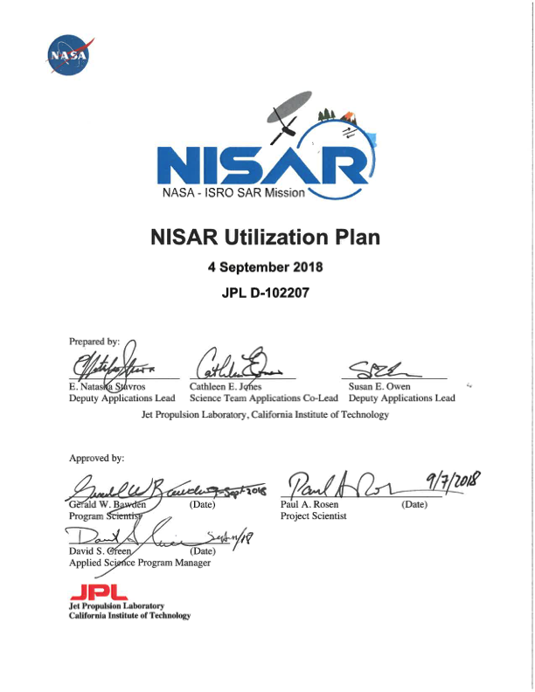
NISAR Applications/Utilization
NISAR promises to support a wide range of applications for other users
Utilization Plan addresses engagement with stakeholders beyond the NASA science community
Addresses capacity building through
Development of sample products
Targeted workshops for understanding end user needs and providing training

Slide 4
NISAR Status With Respect to Training
Participant in SAR Literacy and Training Workshop October 2018
For Mission System CDR (October 2019)
Simulated NISAR products L0-L2
Project-distributed L0-L2 workflow for these products based on ISCE open source software
Updated UNAVCO ISCE/GIAnT Short Course materials in Jupyter Notebooks
Many L3 ATBD’s in Jupyter Notebooks
Many Validation Workflows in Jupyter Notebooks

Slide 5
NISAR Status With Respect to Training
Planning a Science Workshop to socialize products and software
Developing a new course in geodetic imaging for NASA Solid Earth program tailored to NISAR observations
Discussing Joint NASA/ISRO NISAR training opportunities
Port UNAVCO course to Indian community
Repeat of successful 2018 NASA/ISRO NISAR/SMAP Training Workshop
Repeat of successful 2018 SERVIR training on ecosystems

Slide 6
NISAR Capacity Building Approach
Who are you targeting?
NASA/ISRO Science Community
Utilization Stakeholders such as operational agencies, companies, and disaster response
What outcomes are you trying to achieve?
Improved SAR and derived product literacy and understanding of their value
What best practices do you follow?
Focus on a limited set of high-value stakeholders
Develop training from theory through application using functional workflows
Jupyter notebooks

Slide 7
NISAR Capacity Building Approach
What evidence do you measure to show that capacity is built?
Surveys asking for feedback on workshops and courses
Beginning formal assessment
Who are your implementing partners?
ISRO
UNAVCO
Science Team
TBD Agencies
What are the potential areas for collaboration and linkages?
Course development
Course deployment
Product development and assessment

Slide 8
Backup

Slide 9
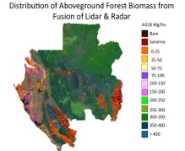
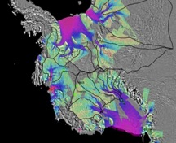
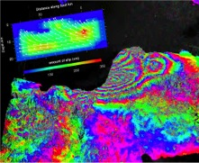
NISAR Mission Overview
Mission Science
Major partnership between US National Aeronautics and Space Administration (NASA) and Indian Space Research Organisation (ISRO)
Baseline launch date: No earlier than January 2022
Dual frequency L- and S-band Synthetic Aperture Radar (SAR)
L-band SAR from NASA and S-band SAR from ISRO
NASA 4 Gbps Ka-band telecom system to polar ground stations (> 26 Tbits/day downlink capability)
ISRO I3K Spacecraft with 2.8 Gbps telecom system
ISRO Geosynchronous Satellite Launch Vehicle (GSLV) Mark-II (4-m fairing)
3 years NASA science operations (5+ years consumables)
All science data (L- and S-band) will be made available free and open
Ecosystems
Biomass disturbance; effects of changing climate on habitats and CO₂
Cryosphere
Ice velocity, thickness; response of ice sheets to climate change and sea level rise
Solid Earth
Surface deformation; geo-hazards; water resource management
Notes:
Emphasis:
The partnership has major contributions from both parties, enabling the mission.
ISRO considers this a science mission and adheres to NASA”s open data policy

Slide 10
NISAR: ISRO Proposed Applications
Ecosystem Structure: 1.1 Agriculture biomass & Crop monitoring; 1.2 Forest biomass; 1.3 Forest disturbance; 1.4 Mangroves / Wetlands; 1.5 Alpine vegetation; 1.6 Vegetation phenology; 1.7 Soil moisture; 1.8 Ecosystem stress assessment
Land Deformation: 2.1 Inter-seismic / Co-seismic deformations; 2.2 Landslides; 2.3 Land subsidence; 2.4 Volcanic deformations
Cryosphere: 3.1 Polar Ice Shelf / Ice sheet; 3.2 Sea Ice Dynamics; 3.3 Mountain snow/ glacier 3.4 Glacier dynamics/ hazard (Himalayan Region); 3.5 Climate response to glaciers; 3.6 Sea–Ice advisory on safer marine navigation in Antarctica region
Coasts & Ocean: 4.1 Coastal erosion / shoreline change; 4.2 Coastal subsidence and vulnerability to sea-level rise; 4.3 Coastal bathymetry; 4.4 Ocean surface wind; 4.5 Ocean wave spectra; 4.6 Ship detection; 4.7 Coastal watch services; 4.8 tropical cyclone
Disaster Response: 5.1 Floods; 5.2 Forest fire damage assessment; 5.3 Coastal oil spill; 5.4 Earthquakes / Others
Geological Applications: 6.1 Structural & Lithological mapping; 6.2 Lineament mapping; 6.3 Paleo-Channel study; 6.4 Geomorphology; 6.5 Land degradation mapping; 6.6 Geo-archaeology; 6.7 Mineral explorations

Slide 11
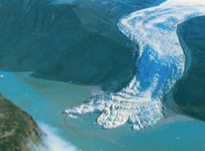
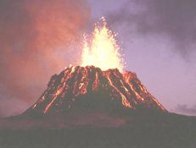
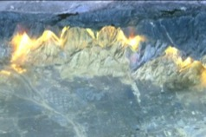
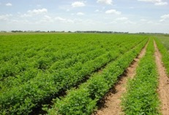
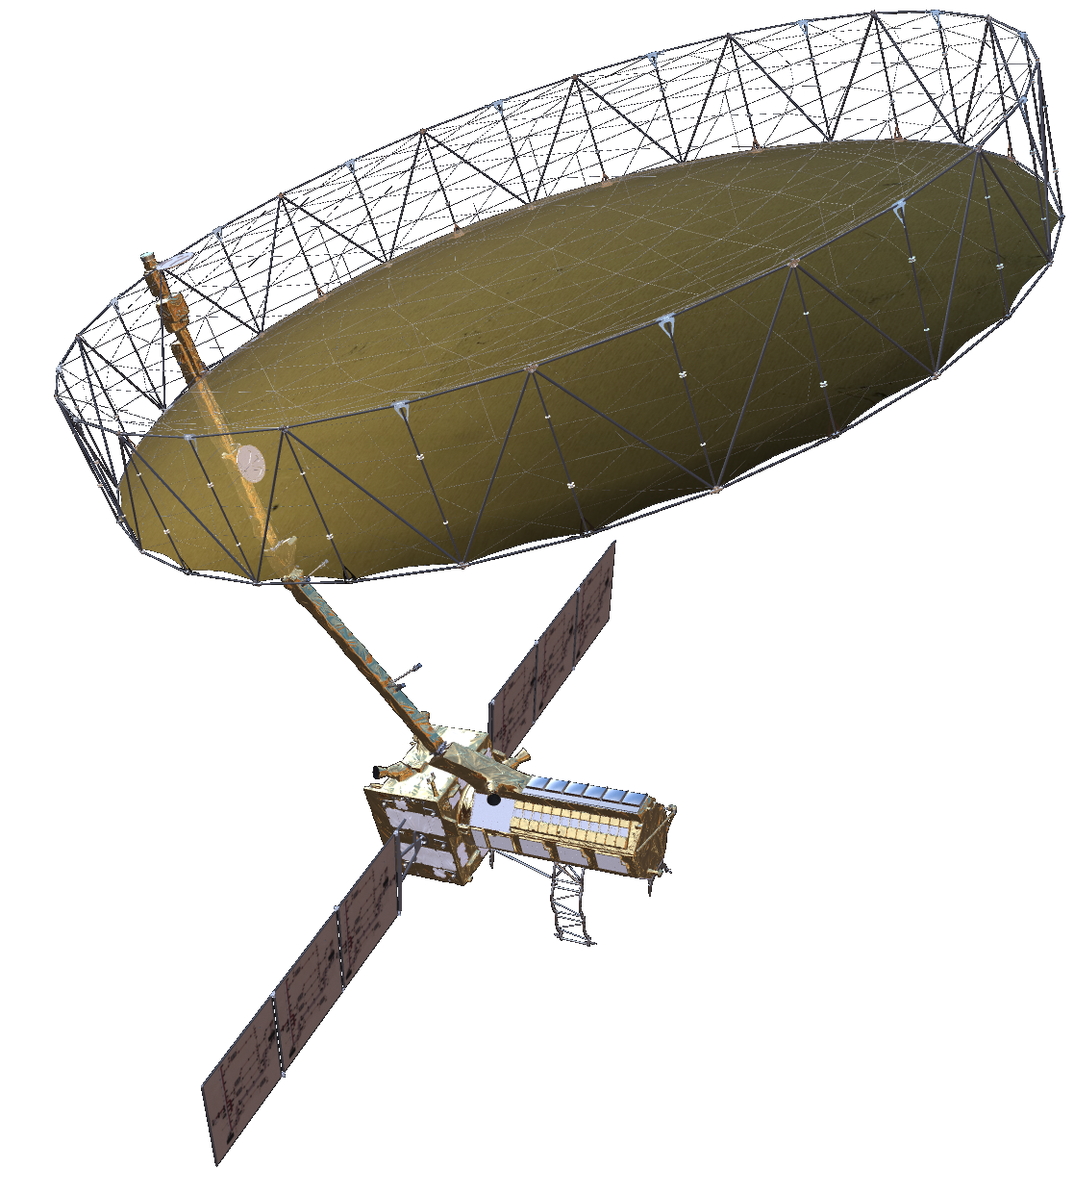
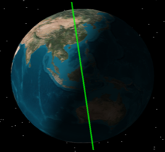
NISAR Characteristics
NISAR Characteristic: | Enables:
L-band (23 cm wavelength) | Low temporal decorrelation and foliage penetration
S-band (9 cm wavelength) | Sensitivity to light vegetation
SweepSAR technique with Imaging Swath > 240 km | Global data collection
Polarimetry (Single/Dual/Quad) | Surface characterization and biomass estimation
12-day exact repeat | Rapid Sampling
3 – 10 meters mode-dependent SAR resolution | Small-scale observations
3 yrs (NASA) / 5 yrs (ISRO) science operations | Time-series analysis
Pointing control < 273 arcseconds | Deformation interferometry
Orbit control < 500 meters | Deformation interferometry
> 10% (S) / 50% (L) observation duty cycle | Complete land/ice coverage
Left-only pointing (Left/Right capability) | Uninterrupted time-series Rely on Sentinel-1 for Arctic
Observation Geometry
747 km
33º
6 AM / 6 PM
47º
Earth surface
>240 km

Slide 12
NISAR Systematic Observations
Repeated every 12 day cycle for the life of the mission
No target conflicts: overlapping targets uses union of all modes specified
Colors indicate different radar modes
Persistent updated measurements of Earth
41 Tbits / day total L+S band science data downlink
120 Tbytes / day total L+S band L0-L2 data products
J. Doubleday
P. Sharma, JPL

Slide 13
NISAR Global Product Suite
26-35 Tbits of raw L-band data per day on average
3-6 Tbits of raw S-band data per day on average
L-SAR L0a, L0b, L1, and L2 science products
S-SAR L0 science product of data downlinked through NASA Ka-band
Free and open archive in Alaska Satellite Facility DAAC
L0
L1
L2
MLD
Polarimetric products
COV
GCOV
RAW
RSD
SLC
GSLC
Geocoded SLC
IFG
Interferometric products
UNW
GUNW

