Slide 1
CEOS Update
Committee on Earth Observation Satellites
Steven Hosford
WGCapD-8
Agenda Item #7
6th March 2019

Slide 2
Summary
Introduction to CEOS
CEOS annual cycle
Institutional Relationships
Organisational structure
Summary of 2018 achievements and focus areas in 2019
Notable evolutions in 2019 for WGCapD
SIT-34
CEOS Leadership updates

Slide 3
Introduction to CEOS
Viewing Earth, serving society
The Committee on Earth Observation Satellites (CEOS) ensures international coordination of civil space-based Earth observation programmes
62 members and associate members
170 missions currently operating
155 missions under development

Slide 4
Introduction to CEOS
Three primary objectives:
Optimise benefits of EO through cooperation between CEOS Agencies in mission planning and the development of compatible mission outputs
Provide a focal point for international coordination of space-based Earth observation
Serve as a forum for exchange for technical and policy information to encourage complementarity and compatibility among space-based Earth Observation systems

Slide 5
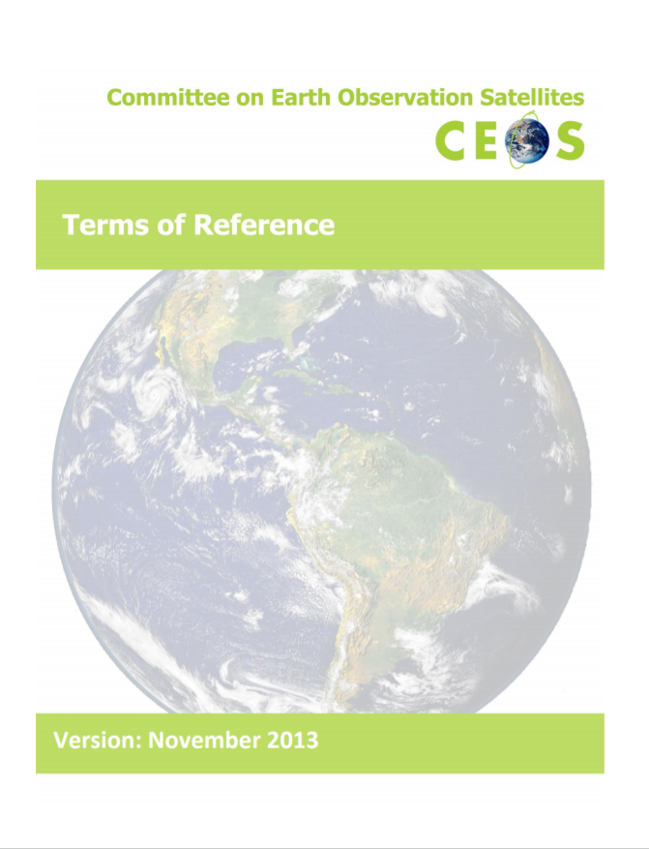
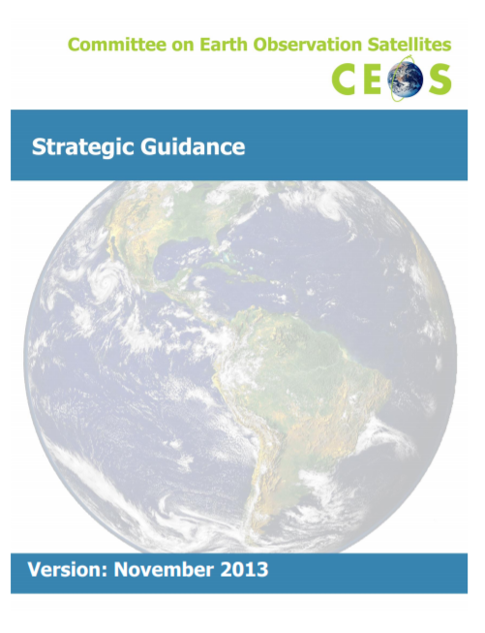
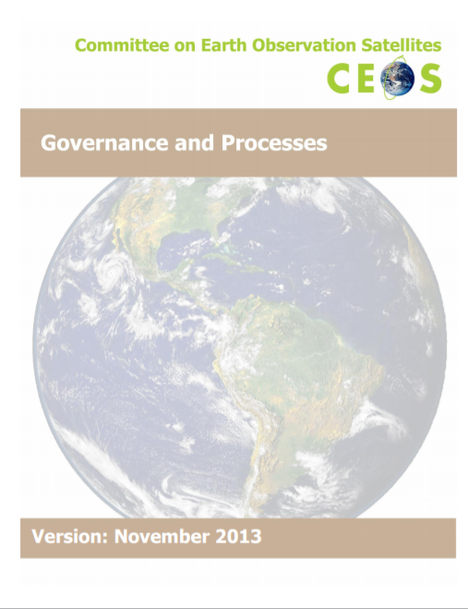
Introduction to CEOS
Governing documents

Slide 6
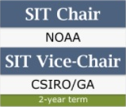
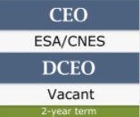
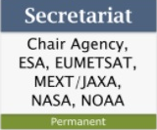
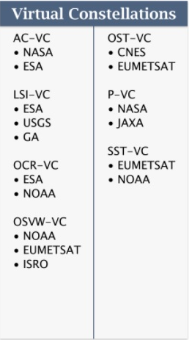
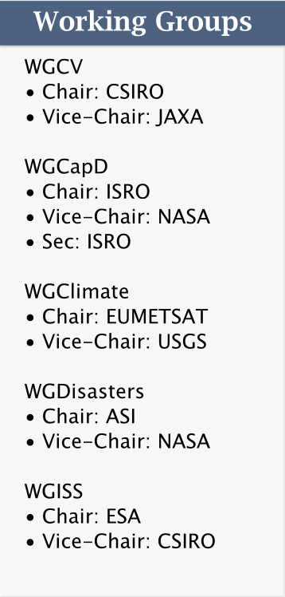
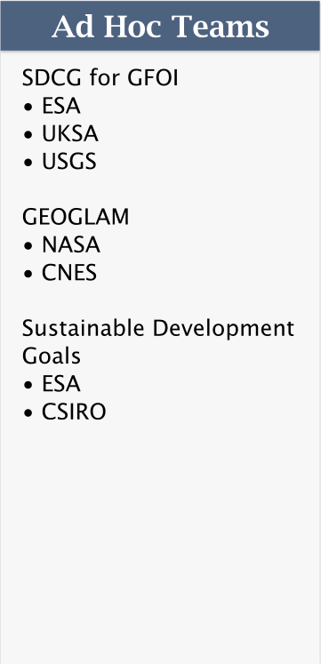
Organisational structure
CEOS Leadership
Support roles
Working Groups
Virtual Constellations
Ad-hoc Teams

Slide 7
CEOS Annual Cycle
July
June
Living Planet Symposium
Milan, 13^{th –} 17th May
August
May
April
SIT Technical Workshop, 2019
TBD, 9th-13th Sept
September
SIT-34, Miami, USA,
2nd-4th April
March
WG/ADT meetings
CEOS 33rd Plenary, Hanoi,
14th-16th Oct
October
WGClimate-10, Marrakech 19-22 March
WGCapD-8, Dehradun &
WGDisasters-11, Athens,
4th-8th March
WGISS, Munich, 22nd-25th Oct
Update CEOS Work plan
November
February
GEO-XV Plenary, Kyoto, 31st-1st Nov
CEOS/GEO bilateral
Freshwater from Space, Delft, 13th-15th November
December
January
LSI-VC-7, Hanoi, 14th-15th Feb

Slide 8
Institutional relationships
CEOS is GEO’s “space arm” coordinating the provision of space data to the Global Earth Observation System of Systems
CEOS seeks to benefit from GEO’s “convening power”
Strong institutional relationship on all levels
Annual bilateral meeting arranged with GEO Secretariat to align work
CEOS Climate work feeds into the UN Framework Convention on Climate Change through the Subsidiary Body for Scientific and Technical Advice (SBSTA)
SBSTA is one of two SBs which supports the work of the COP

Slide 9
Institutional relationships
UN International Strategy for
Disaster Reduction – Sendai framework
CEOS contribution through activities from the WG on Disasters, since 2011 in order to promote & enhance the use of EO data in all phases of Disaster Risk Management, with focus on Disaster Risk Reduction.
Use of EO satellite data is recognized as key for DRR in “Sendai Framework for Disaster Risk Reduction 2015-2030”
Several activities with strong involvement of user communities and major non-space stakeholders e.g. World Bank GFDRR.
UN Sustainable Development Goals
EO can support several of the 17 SDG goals (2, 6, 11, 14 and 15) and associated targets and indicators.
On indicators, cooperation with UN agencies
and National Statistical Agencies
Dedicated CEOS Ad Hoc Team on SDG

Slide 10
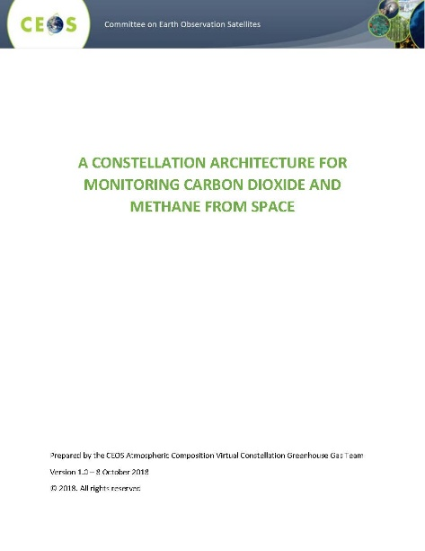
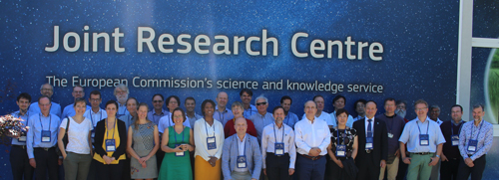
CEOS Chair 2018 Priorities
- European Commission
#1 Laying the foundation for an international CO2 and GHG emission monitoring system
AC-VC whitepaper on defining an optimum constellation for CO2 and GHG monitoring
Advance the relationship with CGMS for an operationally implemented and sustained observation capability
Place the space segment in the broader context of a fully sustained system for CO2 monitoring.
Key event:
Interfaces Between CEOS Agencies and the GHG Monitoring System
June 18th - 19th, 2018 @ JRC, ISPRA

Slide 11
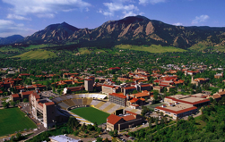
CEOS Chair 2018 Priorities
- European Commission
#2 Bring the benefits of Future Data Architectures to the present
Analysis Ready Data (ARD)
Data Cubes
EO Platforms
User Metrics / Resources Inventory
EO Data Analytics
Key event:
CEOS Future Data Architecture Big
Data Workshop in Boulder on 26 April
organised by the EC.

Slide 12
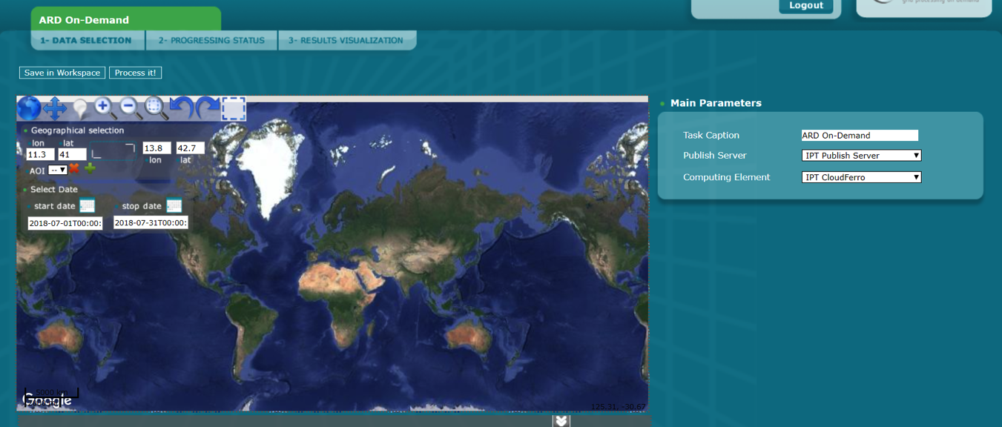
ARD-on-demand
Example: demonstrator of ARD-on-demand
Made–to–measure Analysis Ready Data
Processed the way the user wants and
Applied to the data streams the user is interested in
TEST RUNS POSSIBLE - steven.hosford@esa.int
Set Atmospheric correction:
Sen2Cor
LaSRC
ICOR
MAJA
Set Projection
Set File format
Sentinel 2 Landsat 8
Notes:
Animations:
Click One – Processed the way + parameters
Click Two – applied to … + data sources
Click Three TEST RUNS Possible

Slide 13
CEOS Chair 2019 Priorities
- VAST/VNSC
VAST/VNSC seek to integrate a number of ongoing CEOS activities and data in support of the target applications for a targeted region
Priority focus areas:
Carbon Observations (forested regions)
Observations for Agriculture (rice)

Slide 14
Evolutions relevant to WGCapD
WGCapD is one of three agency “core business” working groups (beside two thematic WGs and 7 measurement focused Virtual Constellations)
Move toward “services” in addition to “project based” approach
Examples are for WGISS Connected Data Assets, for WGCV RadCalNet
Interest for WGCapD?
CapD training/resource catalog as discussed and endorsed at Plenary
Others?
Embed CEOS entity work planning in CEOS Work Plan (e.g. using sub-deliverables). Should reduce reporting burden.

Slide 15
Organisation of SIT-34
SIT 34, Miami, FL
Tues 2nd April. Side meetings.
Wed 3rd April. DAY1 - Opportunity at SIT for all CEOS entities to
“Big picture” organisational matters and interfaces with partners
CEOS Work planning
Session 3: Partnerships
Thurs 4th April. DAY2 – Data and thematic discussions, followed by a revisiting of required updates to CEOS governance
http://ceos.org/meetings/sit-34
Session 3: Partnerships (con’t) Key Questions and Discussion Points – Hear the latest directions from GEO, GCOS, WMO, and consider how CEOS engages with the Work Programme and GEO Week 2019 (Plenary, Ministerial). Updates on CEOS partner-related efforts GEO-LEO, and via the WGCapD.
3.9 | 2:50 – 3:00 10 min | Working Group on Capacity Information Building and Data Democracy (WGCapD) | Nancy Searby, WGCapD Vice Chair (NASA)

Slide 16
Leadership updates
CEOS Entity Leadership changes to come
2019 CEOS Chair – Vietnam National Space Centre
2020 CEOS Chair – Indian Space Research Organisation (ISRO)
2019 CEOS SIT Chair – NOAA
2020 CEOS SIT Chair – CSIRO
Search continues for a Deputy CEOS Executive Officer to replace current CEO
WGClimate Chair to extend mandate for 1 year
WG CalVal Chair changed last week (incoming Cindy Ong, CSIRO)
All other CEOS WGs looking for new Vice-Chairs in Oct 2019

Slide 17
Questions?

