Slide 1

Activities of IIRS, Dehradun
Committee on Earth Observation Satellites
Prakash Chauhan, IIRS/ISRO
CEOS WGCapD-8 Annual Meeting
Agenda Item 1
Working Group on
Capacity Building & Data Democracy
Indian Institute of Remote Sensing
Indian Space Research Organisation
Dehradun, India
March 06th – 08th, 2019

Slide 2
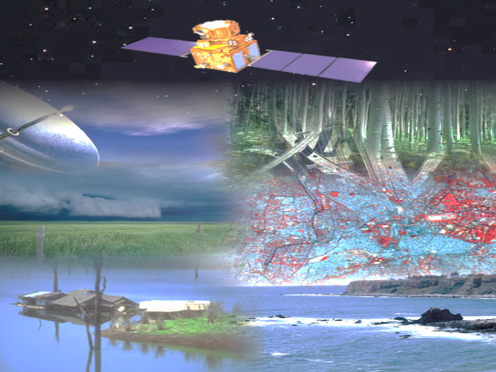
Indian Space Programme: Dimensions
Vision: Harness space technology for national development, while pursuing space science research and planetary exploration
Space Transportation
PSLV
GSLV
Reusable LV
Modular LV
Capacity building
Space Infrastructure
Human Resource Development
Indigenization
Technical Infrastructure
International Cooperation
Industry, Academia,
Outreach
Earth Observation
Communication
Navigation
Space Science & Planetary Missions
Space Applications
Socio economic Security, Sustainable Development, DRR & Governance
Synergistic Applications
(EO, SatCom & Navigation)

Slide 3
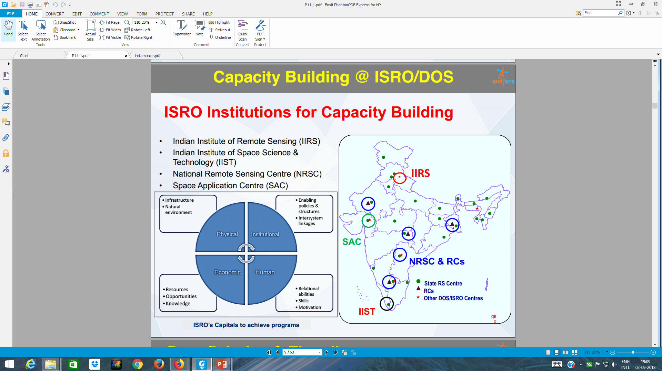

Slide 4
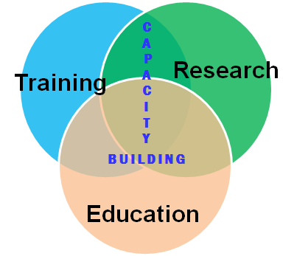
Mandate
Capacity Building through training, education and research in the field of Remote Sensing, Geographic Information System (GIS) technology and applications.
EDUCATION FOR ACQUIRING KNOWLEDGE AND TRANSLATING THIS INTO PRACTICAL APPLICATIONS FOR SOLVING REAL-WORLD PROBLEMS
IIRS is one of the Central Educational Institutions of Excellence
[Parliament Act, 2006]

Slide 5

Activities
Education
Training
(Currently –
68 participants in 3 courses )
M.Tech.*
M.Sc.**
Training
(Currently - 96 participants in 17 courses )
PG Diploma
Teachers (NNRMS)
Decision Makers
International
MEA-ITEC
Certificate Courses
Ph.D.#
Centre for Space Science & Technology Education in Asia & the Pacific
Customized Courses
Research & Projects
DOS Projects
User Projects
Outreach
Distance Learning
User Meets
Technique Development Project
Internship (External Students)
Contribution to National & Int. Professional Societies
Workshops/ Conferences/ Seminars
*Affiliated to Andhra University, Visakhapatnam
(New Affiliation with JNU is under progress)
** Affiliated to University of Twente, The Netherlands
#with Forest Research Institute, Doon University,
Kumaun University & other institutes/universities

Slide 6

IIRS Training & Education Programmes
Training Programs
PG Diploma (10 months, 9 Specialisations)
Certificate Course for University Faculty
(8 weeks, NNRMS–ISRO Sponsored)
Certificate Course (8 weeks) (ITEC/MEA)
Decision Makers Course (1 week)
Special /Tailor made Courses (for User Depts.)
Education Programs
M .Tech. in RS & GIS (8 Specialisations)
(Affiliated to Andhra University)
M.Sc. in Geo-information Science & Earth Observation (Specialisation – Geoinformatics)
(JEP with ITC, University of Twente, The Netherlands)
Outreach Program
Live & Interactive courses
E-Learning courses
Outreach Program
Live & Interactive courses
E-Learning courses
Guidance to UG/ PG/ Ph.D. students

Slide 7
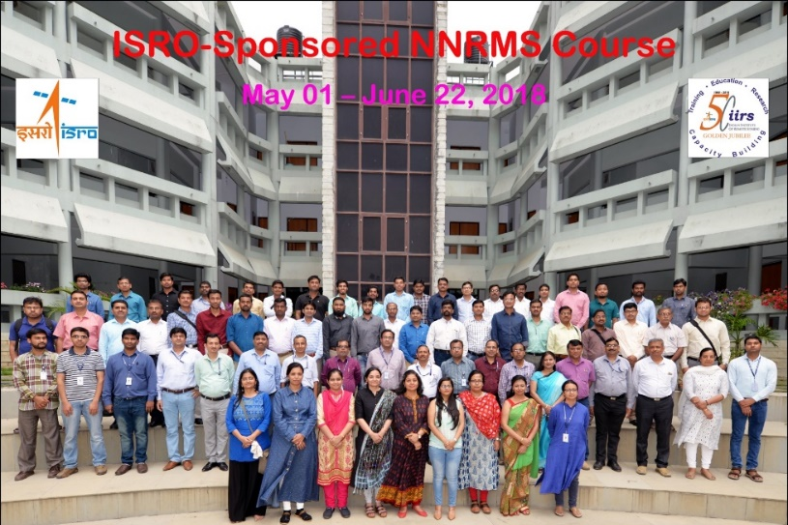
Postgraduate Diploma
Postgraduate Diploma
Remote Sensing & GIS in Natural Resources Management
Learning Outcome: To develop an understanding of appropriate tools and skills to handle and apply them to carry out an independent project.
Target Group: Govt. officials & Fresh Graduates
Duration of course: 10 months
Specialisations in (09) disciplines, namely:
  Agriculture and Soils;
  Forest Resources & Ecosystem Analysis;
  Geosciences;
  Geoinformatics;
  Marine & Atmospheric Sciences;
  Photogrammetry & Remote Sensing
  Urban & Regional Studies;
  Water Resources
  Natural Hazard & Disaster Risk Management
  Spatial Data Analytics ( 2019 onwards)
  Focus on skill development with hands-on, pilot studies & human resources to industry
Beneficiaries: >1700
Government Trainees: > 1200

Slide 8

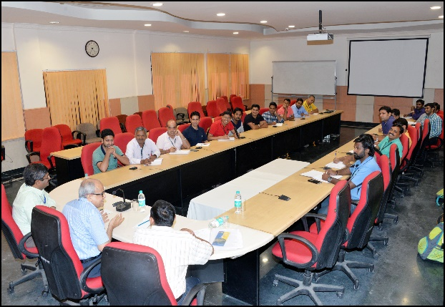
Certificate Course for University Faculty
Duration: 8 Weeks (May-June, every year)
Specialisations in (08) disciplines, namely:
  Soils & Land Use Planning ;
  Forestry / Ecology / Wildlife/ Env. Sciences;
  Geosciences;
  GIS Technology & Advances;
  Coastal & Ocean Sciences;
  Cartography and Mapping
  Urban & Regional Studies;
  RS& GIS in Water Resources
Impact:
Many of the faculty trained by IIRS have started RS & GIS courses in their institutes
Developed interest for long-term/specialised courses & choosing career in Geospatial technology
Supporting IIRS in Distance Learning Program (DLP) courses as Coordinators

Slide 9
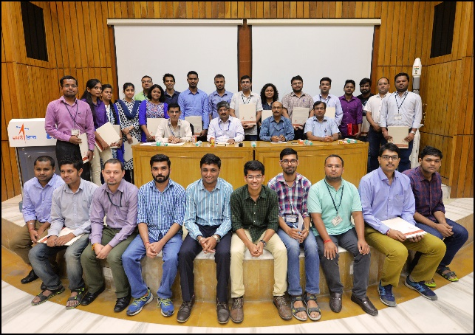
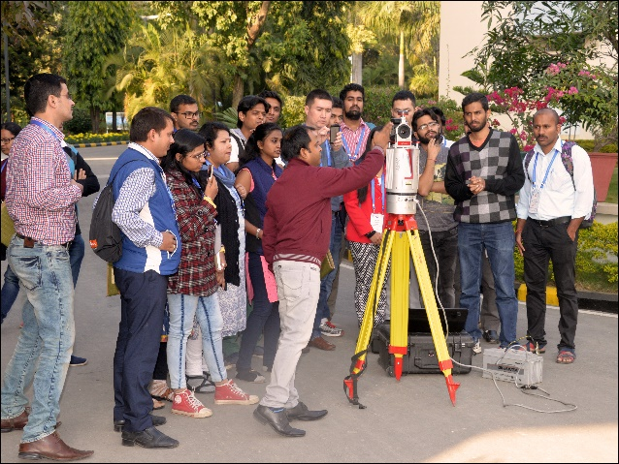
M.Tech. in Remote Sensing & GIS
Learning Outcome: To provide understanding of Geospatial technology and its applications and develop research skills.
Duration: 24 months
Target Group: Govt. officials & Fresh Graduates
Uniqueness:
Specialisations: 08
Strong focus on Research (14 months)
Affiliation: Andhra University
Beneficiaries: ~293
Govt. Trainees: ~30
M.Sc. in Geoinformatics
Learning Outcome: To develop understanding of Geo-information science and Earth Observation with specific focus on developing research skills
Collaboration: University of Twente, The Netherlands (IIRS-ITC JEP, since 2002)
Target Group: Fresh Graduates & Govt. officials
Uniqueness:
    - International exposure to students (4.5 months)
    - Joint Research supervision (IIRS & ITC)
Beneficiaries: ~190
Govt trainees : 22

Slide 10
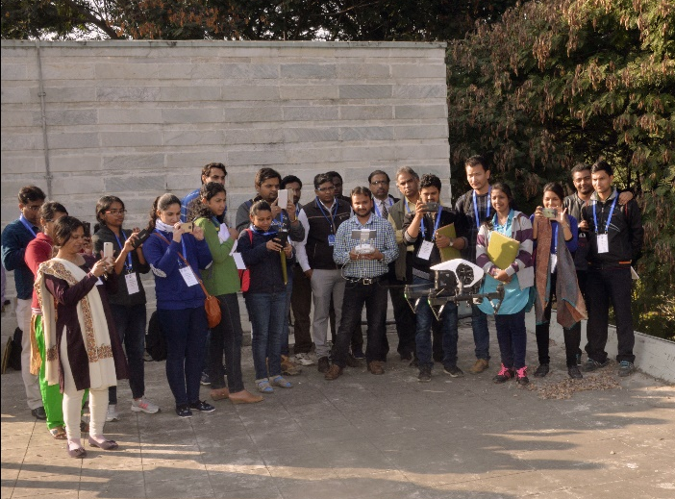
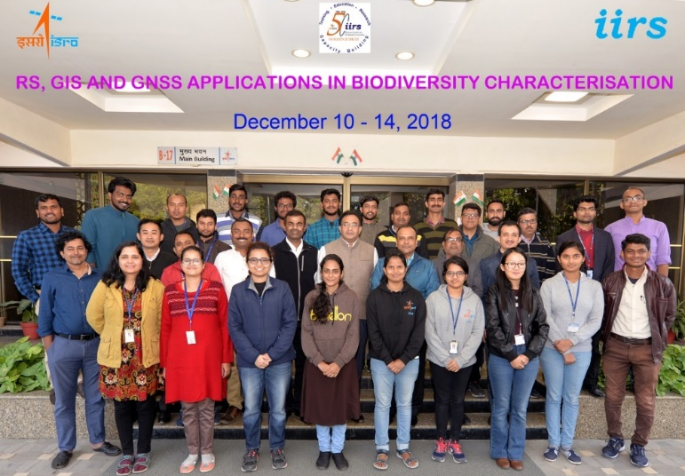
Special/ Customised Courses
Customised courses for various Users/ Stakeholder Departments (1 to 8 weeks)
Ministries of GoI: Agriculture & Farmers’ Welfare; Environment, Forest & Climate Change; Human Resources Development; Housing & Urban Affiars; Mines; Electronics & Information Technology; Statistics & Programme Implementation; Water Resources, River Development & Ganga Rejuvenation; Rural Development; Home Affairs; Railway; AYUSH; etc.
Special Courses/Workshops/Summer Schools/ Tutorials:
  Hyperspectral, Microwave & UAV Remote Sensing and Applications; Citizen Science; Atmospheric Remote Sensing; Urban Floods; Health GIS; Open Source GIS; Laser Remote Sensing, etc.
Beneficiaries: >4000

Slide 11

iirs
Special Courses Conducted on User Request
(January 2018 to January 2019)
Course Name | Duration | Participants
Special Training Course on Atmospheric Remote Sensing for Weather & Climate | 02.01.2018 to 12.01.2018 | 49
Special Course on Remote Sensing Analysis & Python Programming | 22.01.2018 to 16.02.2018 | 12
Special course on GIS Based Utility Mapping of ISRO/DOS Campuses | 09.04.2018 to 13.04.2018 | 26
Special Course on Customised Training Programme on Applications of Geospatial Technology for JNTU, Hyderabad | 21.05.2018 to 25.05.2018 | 23
Special Course on Space Technology Applications in Disaster Management Support | 26.06.2018 to 29.06.2018 | 10
Summer School on Usefulness of Remote Sensing & GIS for Environmental Studies | 18.06.2018 to 22.06.2018 | 49
Special Course on Geospatial Inputs for enabling Master Plan Formulation | 09.07.2018 to 20.07.2018 | 41
One week orientation course for Range Forest Officers on applications of Remote Sensing & GIS in forestry | 30.07.2018 to 03.08.2018 | 30
Remote Sensing and GIS Application for Scientist/Engineers of ISRO/DOS Centres | 06.08.2018 to 10.08.2018 | 23
One week refresher course for IFS Officers on Advances in RS & GIS and GNSS Applications in Forestry | 27.08.2018 to 31.08.2018 | 16
Geospatial Inputs for Enabling Master Plan Formulation under AMRUT | 12.09.2018 to 14.09.2018 | 33
Geospatial Inputs for Enabling Master Plan Formulation under AMRUT | 08.10.2018 to 02.11.2018 | 21
Special Course on RS, GIS & GNSS Application for Disaster Management | 30.10.2018 to 02.011.2018 | 13
One week Training Course on RS, GIS and GNSS Applications in Biodiversity Characterisation Project | 10.12.2018 to 14.12.2018 | 15
Geospatial Inputs for Enabling Master Plan Formulation under AMRUT | 12.12.2018 to 14.12.2018 | 42
Geospatial Inputs for Enabling Master Plan Formulation under AMRUT | 07.01.2019 TO 18.01.2019 | 37
Short Course on Remote Sensing with special emphasis on Digital Image Proc. (ITEC-Sponsored) (S-RS) | 07.01.2019 to 01.03.2019 | 22
Short Course on Remote Sensing and Image Interpretation (C-RS) | 07.01.2019 to 01.03.2019 | 7

Slide 12
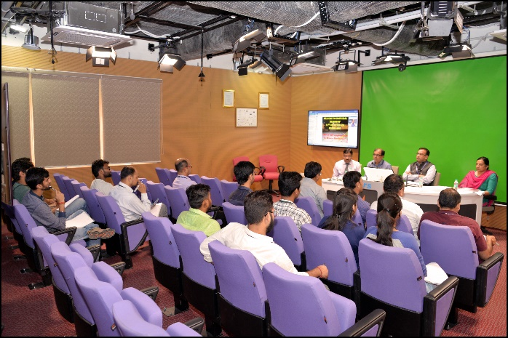
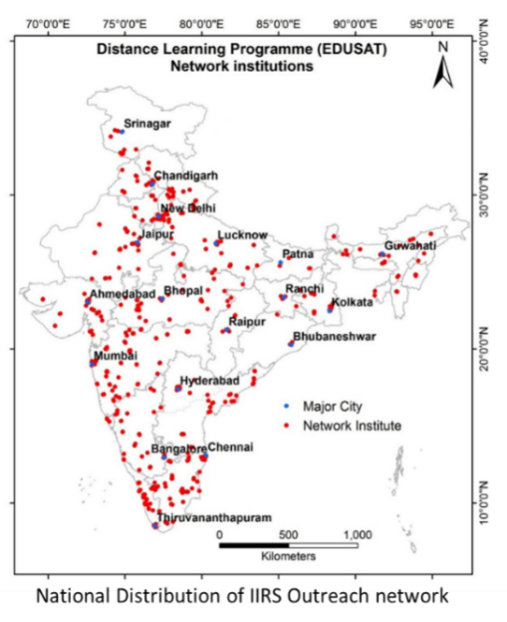

Distance Learning Programme
(https://www.iirs.gov.in/IIRS-Outreach-Programme)
Interactive Classroom Basic, theme-oriented & advanced courses/workshops
Network institutions: ~800
E-Learning courses
Self-paced, anytime/any-where (100 hrs content)
1 & 4 months courses
Bilingual contents: Hindi and English
Beneficiaries:
Live & Interactive courses: >70,108
E-learning courses: > 4,440 (incl. 261 from 47 countries)

Slide 13
International Training Programmes
ITEC Programme: Two Regular 8-week Courses (since 2001)
Remote Sensing with emphasis on Digital Image Processing
Short course on Geoinformatics
ASEAN-India Space Cooperation Programme:
PGD (RS & GIS, SATCOM, SATMET, Space & Atmospheric Sciences)
2 and 4 weeks short courses (DRR, Satellite Engg. & Small Satellites)
CSSTEAP Programme: Long- & Short-term RS & GIS courses
Other Programme: Customised courses for MEA, ANTRIX (Tajikstan, Armenia, Zambia, Azerbaijan, Kazakhstan, Bangladesh, etc.)
Achievements
On campus courses: Trained 11,118 professionals, including 1,151 from abroad (96 countries), 483 students have graduated in the M.Sc./ M.Tech.
Outreach Programme: 750 institutions, 62,143 participants benefited from live & interactive and 4,314 from E-learning courses

Slide 14
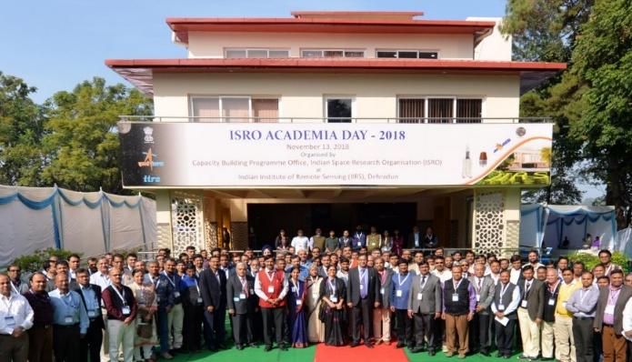
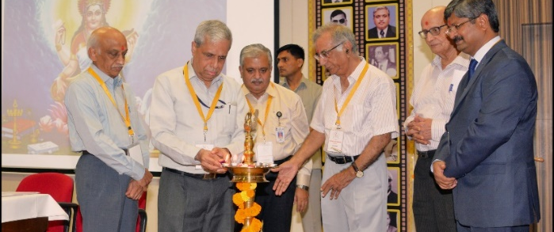
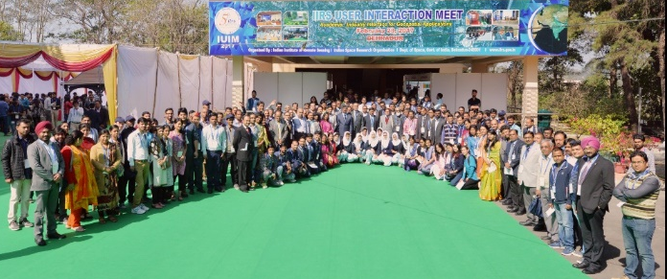
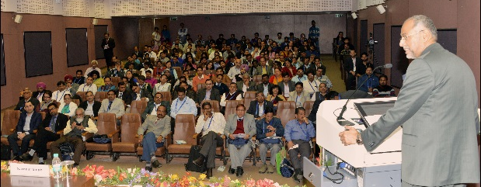
Recent Outreach Activities
IIRS User Interaction Meets: Annual event, Six Meets on different themes conducted from 2013-18
ISRO Academia Meet : Conducted by ISRO Hq and hosted at IIRS Dehradun Nov 13, 2018.
ISPRS TC-V Mid-Term Symposium & Pre-Symp. Tutorials, Nov. 20 - 23, 2018
ISRO-JAXA Space Education Seminar for School Teachers, Nov. 16 - 17, 2018
Workshop on Popularisation of Remote Sensing: August 11, 2018 ( Drawing competitions for School Participants)
Contribution to CEOS-WGCapD: Webinar series conducted, 252 participants from 53 Countries benefitted
38th Asian Conference on Remote Sensing: Oct. 23 -27, 2017 (967 delegates from 53 countries)
ISPRS Summer School: Oct. 30 - Nov. 3, 2017

Slide 15
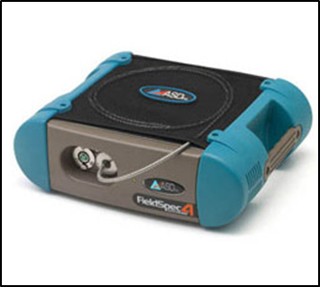
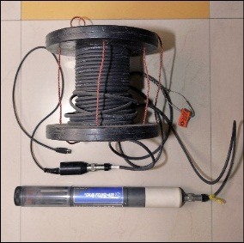
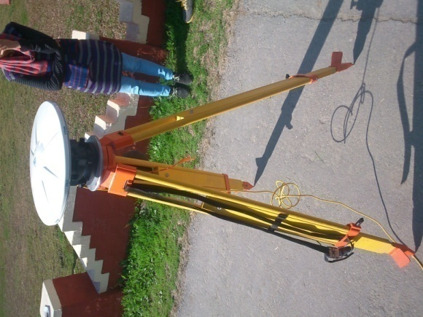
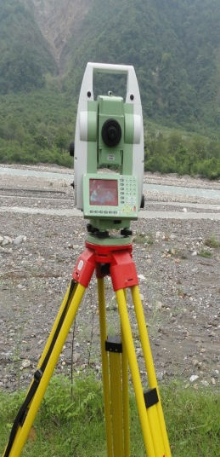
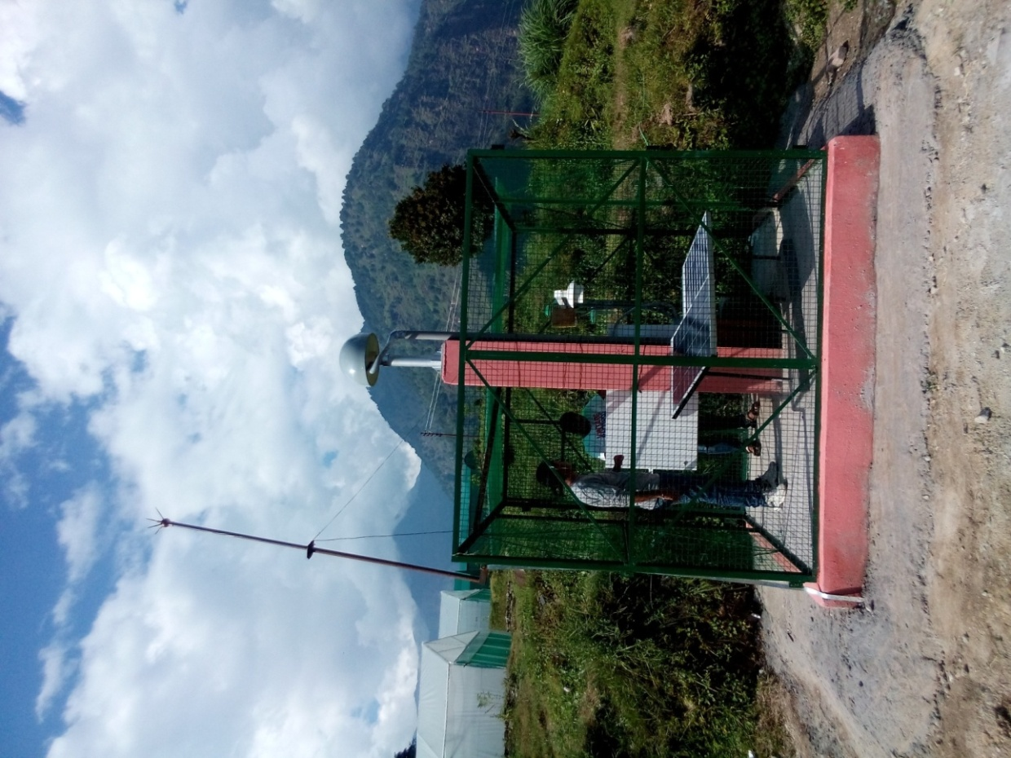
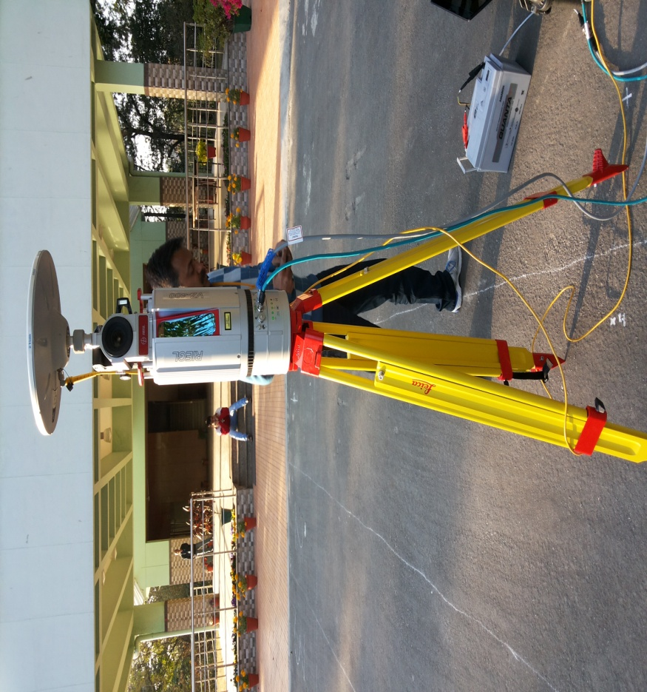
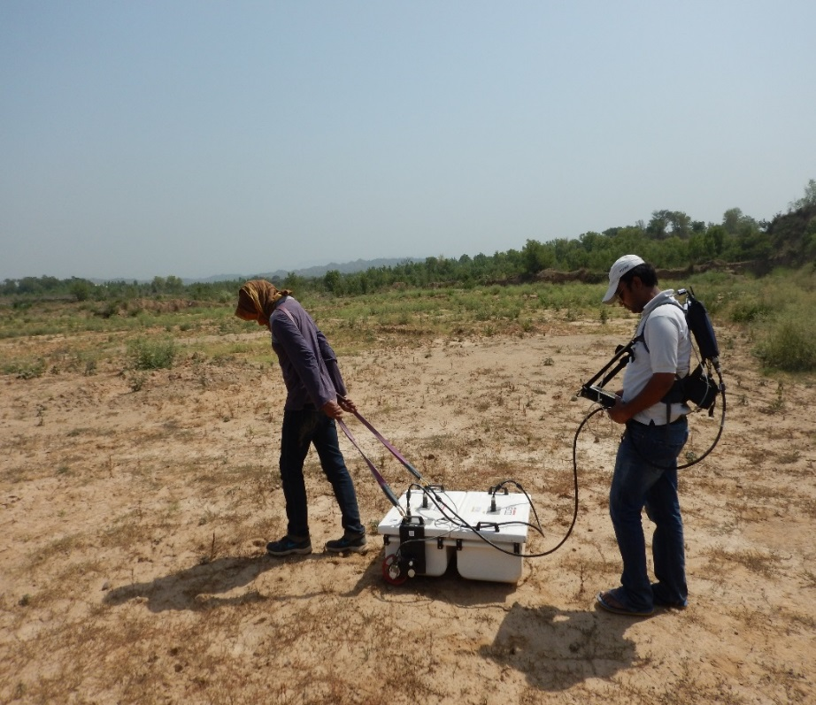
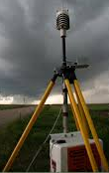
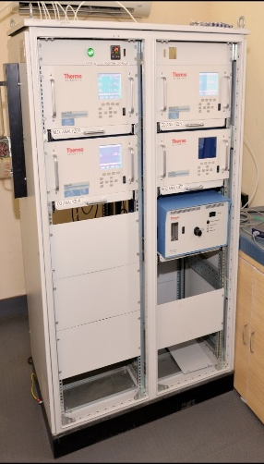
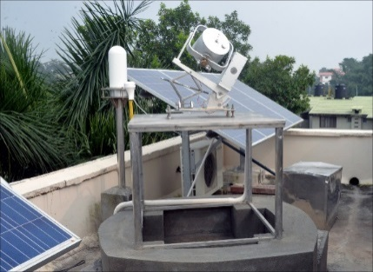
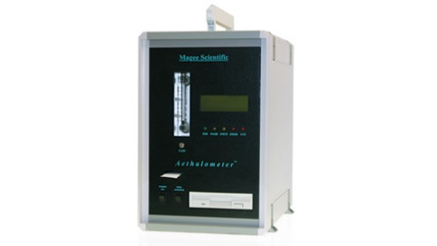
Research Facilities
TROLL 9500
(for Water Quality Parameters)
GPS
TLS
Total Station
CORS
Spectro-radiometer
Multiwavelength Solar Radiometer (for AOD)
Portable Weather Station
Snow Pack Analyser, Manali H.P.
Aethalometer
(for Aerosol Black Carbon conc.)
Ground Penetrating Radar (GPR)
Trace gas laboratory
(O3, CO, Nox)

Slide 16
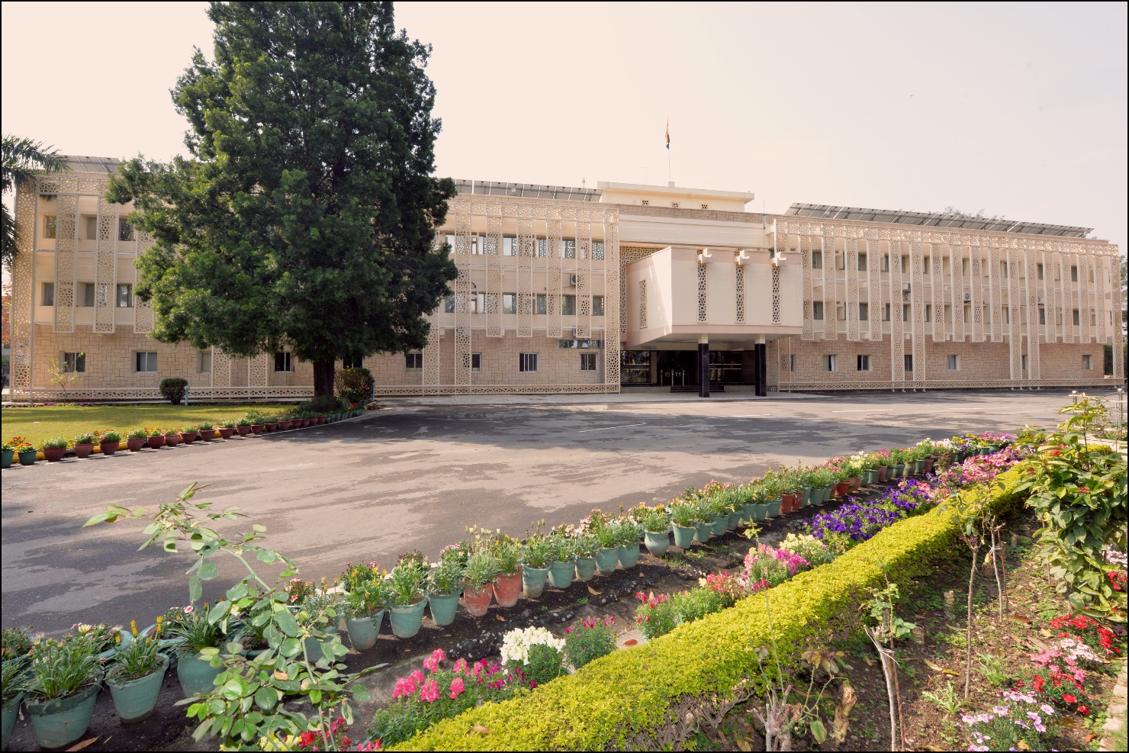
Welcome to Gateway to Himalaya
Indian Institute of Remote Sensing, Dehradun
Thank You

