Slide 1

Agriculture Monitoring
Committee on Earth Observation Satellites
Alyssa Whitcraft
Agenda Item #31
CEOS 7th Working Group for Capacity Building and Data Democracy (WGCapD) Annual Meeting
INPE São José dos Campos, Brazil
6-8th March, 2018

Slide 2
Many Activities Worldwide
Global Programme = GEOGLAM
Regional Networks
GEOGLAM Latinoamérica, AmeriGEOSS Food Security & Sustainable Agriculture
Asia-RiCE
AfriGAM
EuroGEOGLAM/EuroGEOSS
Some Contributing Funded Activities
NASA Earth Observations for Food Security and Agriculture
ESA Sentinel-2 for Agriculture
China Digital Belt & Road Initiative
EC H2020 “AfriCultuReS”
Related Networks & Actors
AMIS, GODAN, AgMIP, IICA
All of the national, regional, and global monitoring organizations

Slide 3
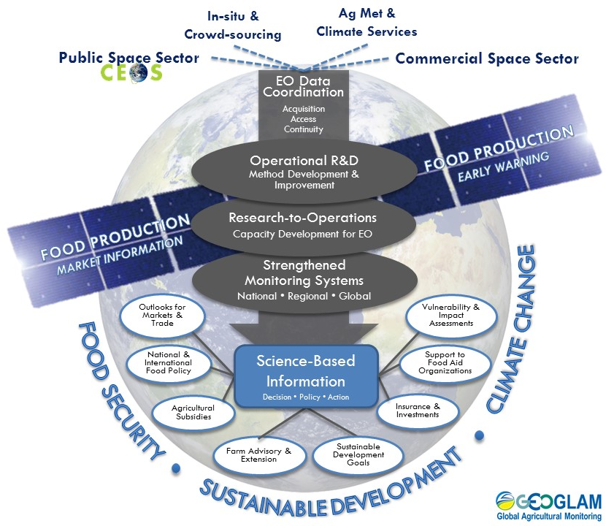
Workflow Diagram for GEOGLAM
(reminder)
A flow from data through methods to information to decisions
BUT
The decisions at the bottom drive all information, methods, and data needs!
Capacity development is positioned as CRITICAL step to operational monitoring [our goal]

Slide 4
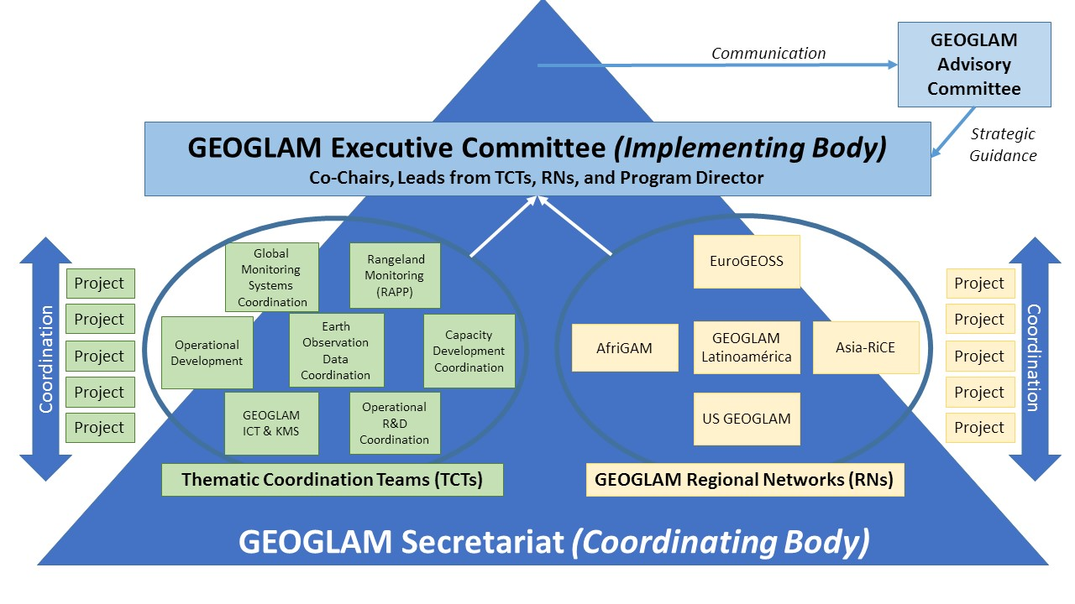
GEOGLAM – Global Level
Governance Model

Slide 5
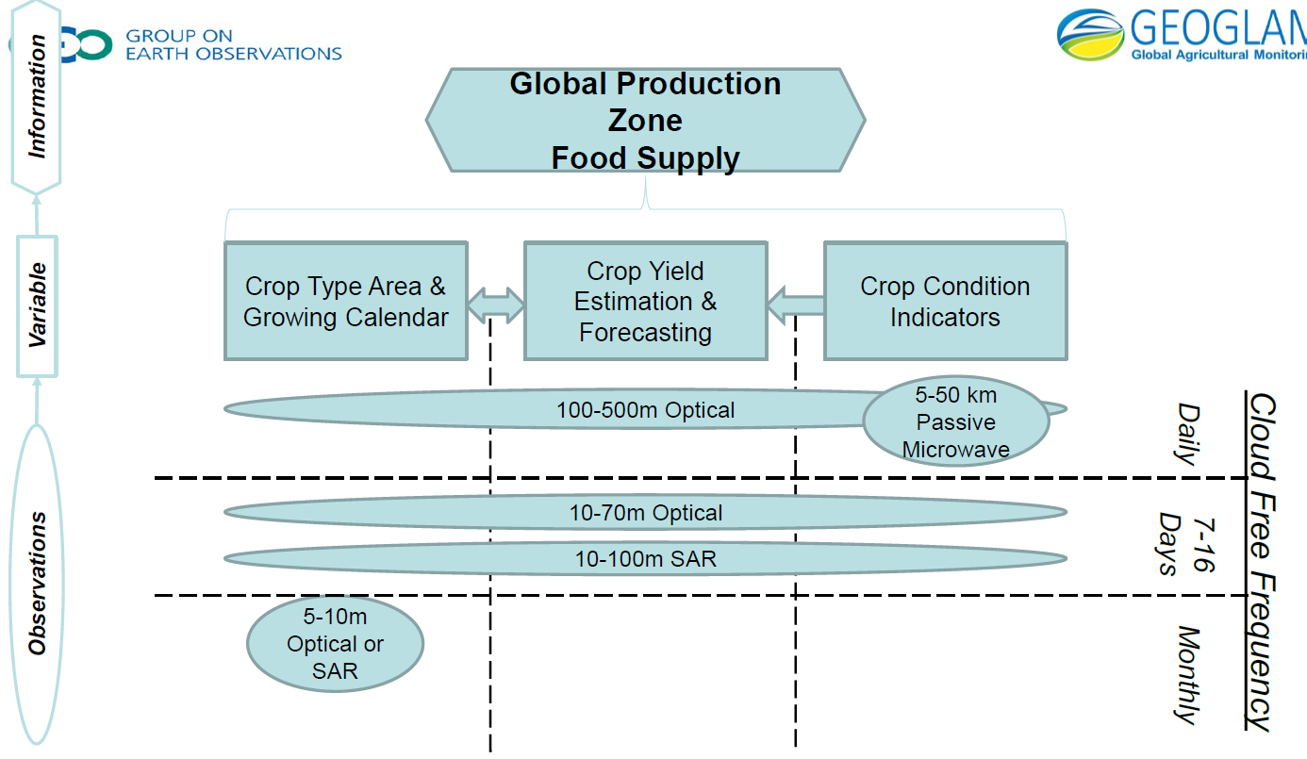
GEOGLAM – Global Level
Program-wide News
New Director: Ian Jarvis (formerly AAFC)
  2 year term with German support
New working area: Knowledge Management System & ICT – RADI-China Leadership (Xin Zhang)
New leadership: Capacity Development – ITC-NL (Andy Nelson)
Renewed focus: User Requirements (17-18 April 2018, EC JRC)
  Information Need
  Reporting chain
  Variables
  EO specifics
  Discovery, Access
  Visualization
  Utilization

Slide 6
GEOGLAM – Global Level
Capacity Development Update
Focus remains on developing institutional capacity alongside individual capacity
  The holistic requirements assessment supports this
Outcomes of April 2018 GEOGLAM User Requirements meeting include “implementation priorities” for operationalization and technology transfer
  “End-to-end” → needs assessment, research gaps, data services, feedback to CEOS on acquisition, services (e.g. Data Cube, ARD), and training requirements.
The avenue for capacity development is via regional networks
  Asia-RiCE, AfriGAM, AmeriGEOSS/G-LA
A new Capacity Development lead → ITC Netherlands (Andy Nelson)

Slide 7
GEOGLAM Latinoamérica & AmeriGEOSS – Regional Level
We now have funding for GEOGLAM Latinoamérica and AmeriGEOSS Food Security & Sustainable Agriculture WG development, coordination, and implementation (thanks, NASA!)
  PI on NASA Project → Alyssa Whitcraft (UMD)
    G-LA Coordinator & FSSA WG Lead: Alyssa Whitcraft (UMD)
  G-LA Lead: Carlos Di Bella (INTA)
  Proposed joint working group, or “co-community”
4 Activities Particularly Relevant to CEOS WG CapD:
    Americas Ag CoP Growth; All things WG-related
    Stakeholder Identification and Multi-level, Repeated Needs Assessment (parallel activity with GEOGLAM, EOFSAC)
    Linking with Related Working Groups and Activities (e.g. CEOS WGCapD, GEO CB WG, GEOGLAM CapDev)
    Comprehensive Capacity Development Plan
      Hilcea Ferreira (INPE)
      Anyone welcome to participate from WGCapD ☺

Slide 8
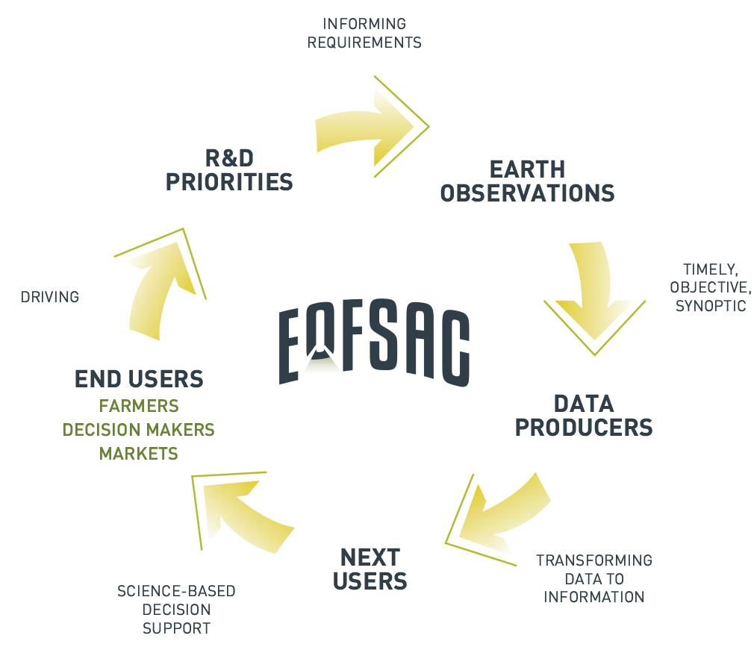



NASA EOFSAC
Earth Observations for Food Security & Agriculture Consortium
New 5 year NASA program located at UMD
  PI: Inbal Becker-Reshef; Funded by NASA Applied Sciences Division
Over 40 partners from around the world
  Governmental, Intergovernmental, Nongovernmental Organizations
  Public, Research, For-Profit, Humanitarian, Defense Sectors
Sample activities:
  Research: quantitative estimation of agricultural, environmental variables; yield gap; socioeconomic valuation of EO
  Needs Assessment: stakeholder needs guide activities
  Capacity development: heavy research-to-operations emphasis
  Outreach & Communication: esp. new, un-targeted communities
  Analysis/Visualization Tool → “EOFSAC Portal”
  GEOGLAM Coordination: Crop Monitor, CEOS Ad Hoc WG on GEOGLAM

Slide 9
Other Activities & Interactions
Training at UMD this week (5-9 Mar 2018) – Crop Mask Generation
  Argentina (MAGyP), Brazil (CONAB), Chile (MinAg-INIA), Brazil (CONAB), Mexico (SIAP)
  Led by Matt Hansen under EOFSAC
15 March 2018 → Sen2Agri Webinar (introductory) - http://www.esa-sen2agri.org/on-line-trainings-in-march/
In the Americas:
  IICA (Inter-American Institute for Cooperation on Agriculture)
    AgriPerfiles (link to CB Web Portal)
  Matching funding for other funded activities (IICA, Fontagro)
  Procisur, Procinorte
Scoping interaction with AgriCultuReS (African network)

Slide 10
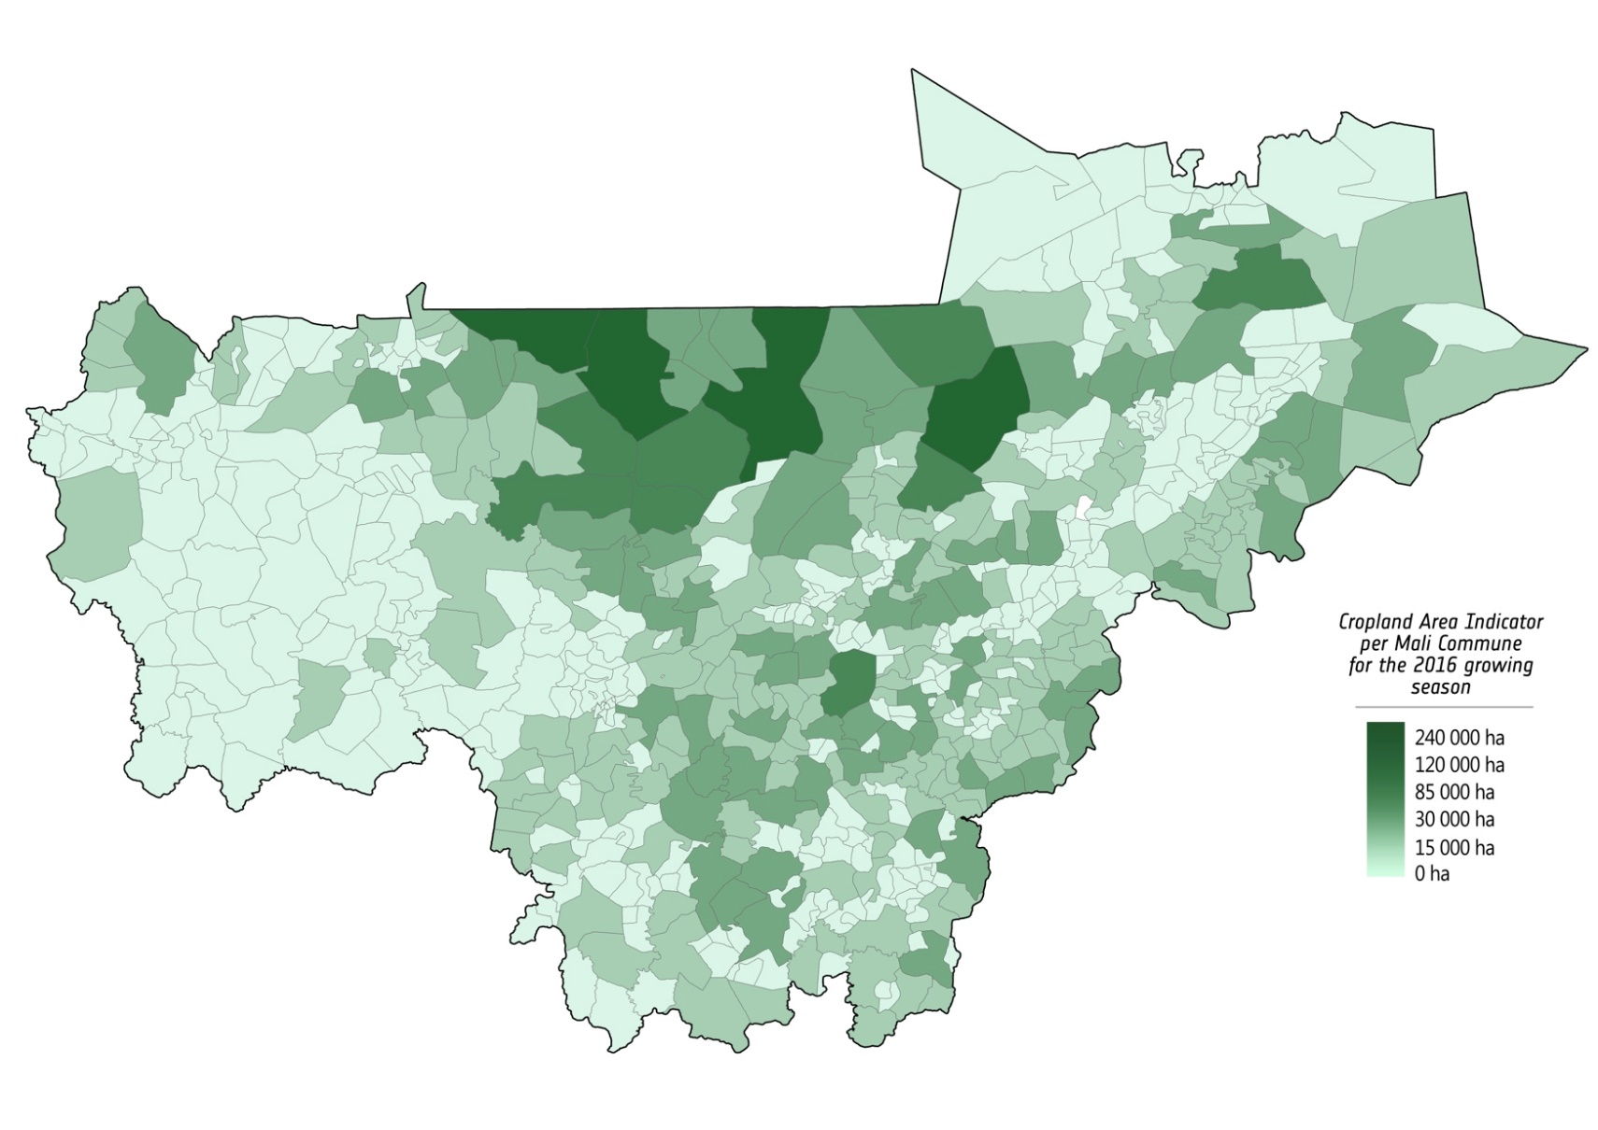
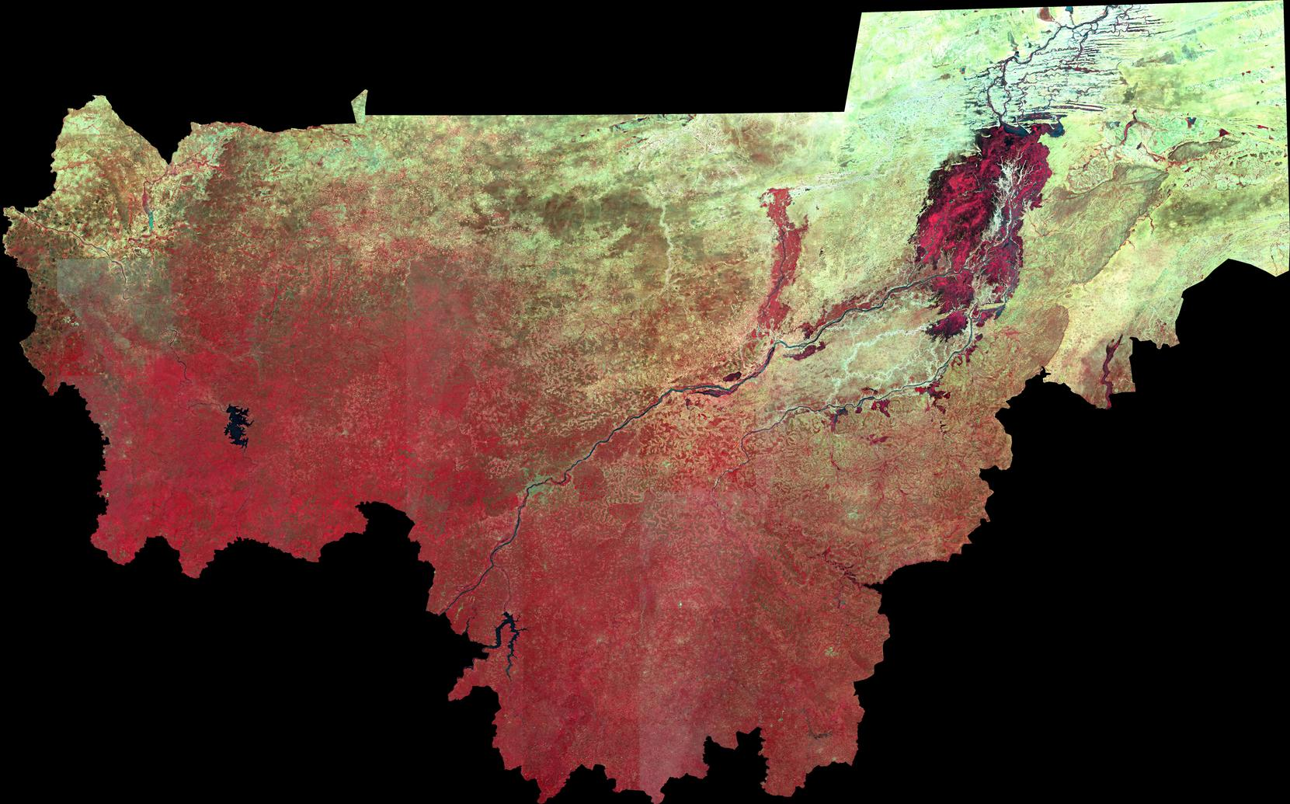
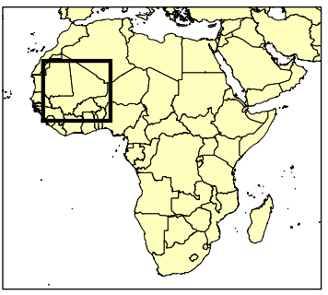
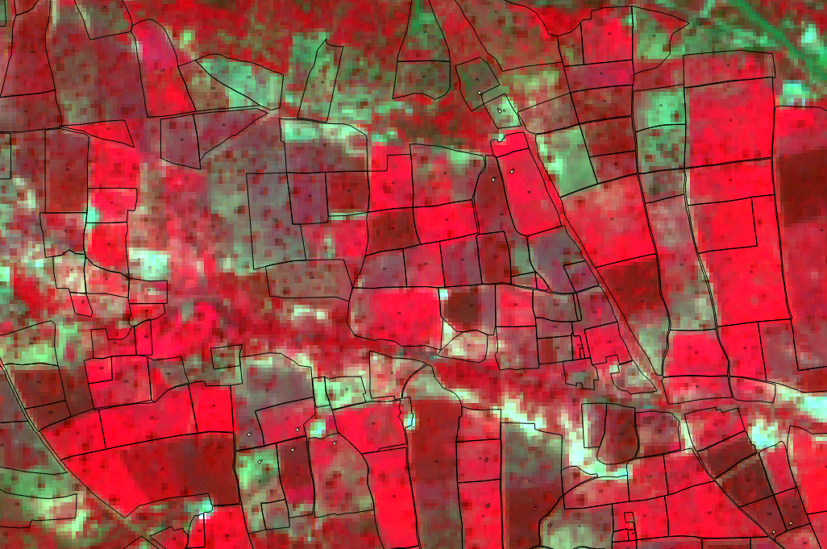
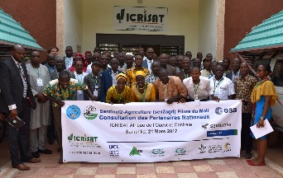



Mali: Food Insecure Country
National Statistics
November 2016
5/10/2016-25/11/2016
Notes:
50 days composite S2&L8
Based on open source Sen2Agri processing system

Slide 11
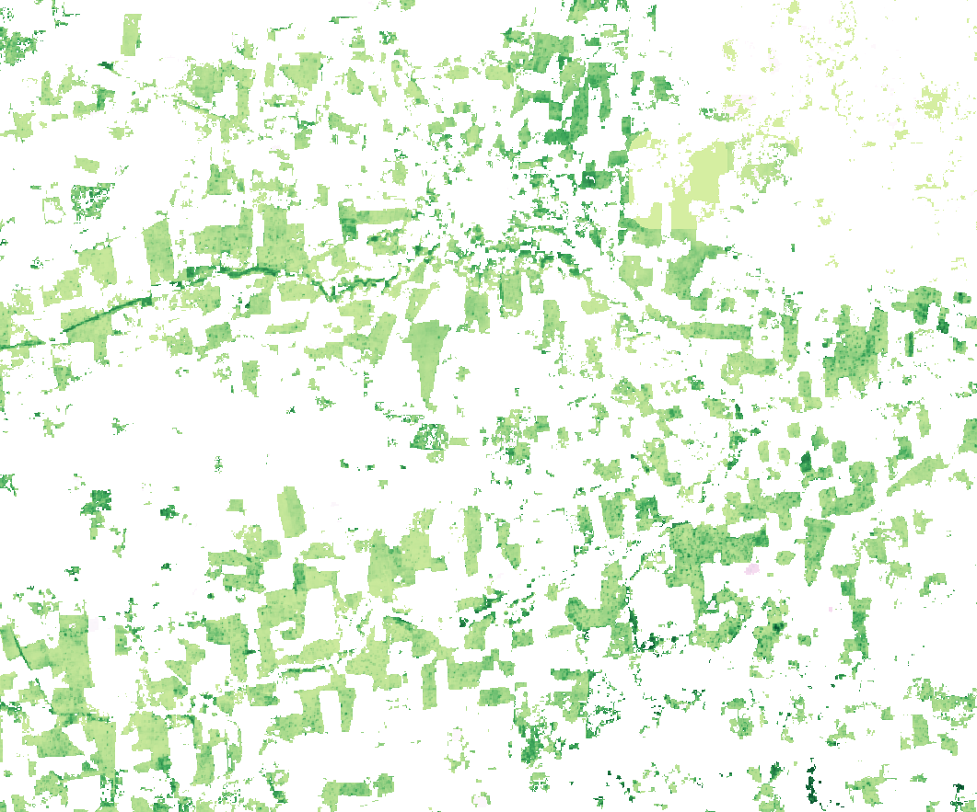
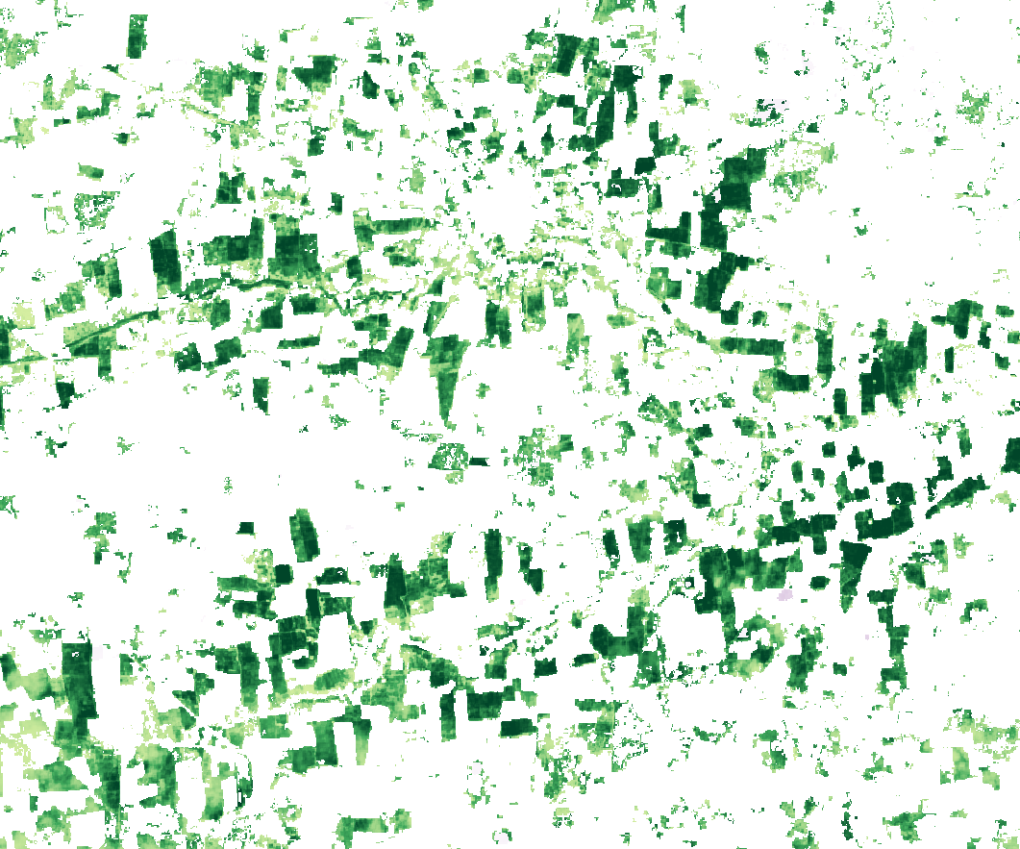
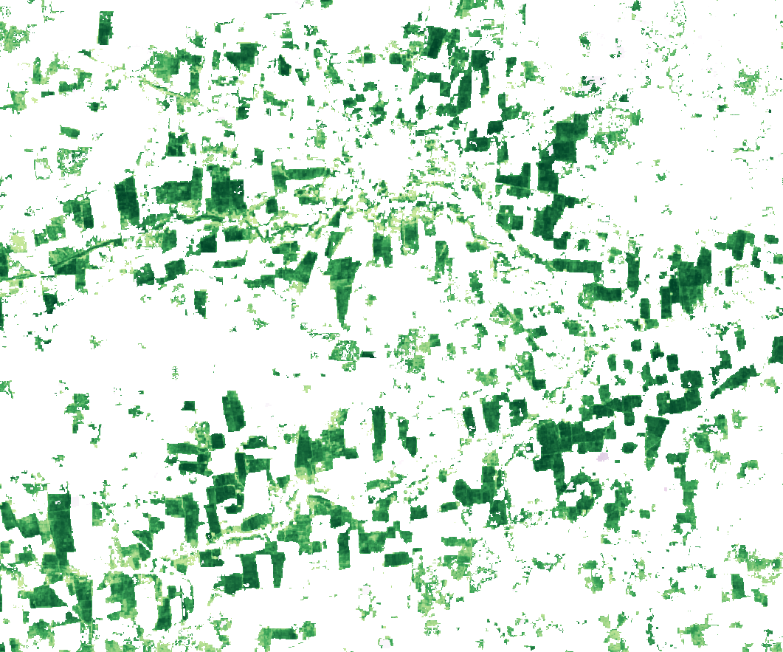
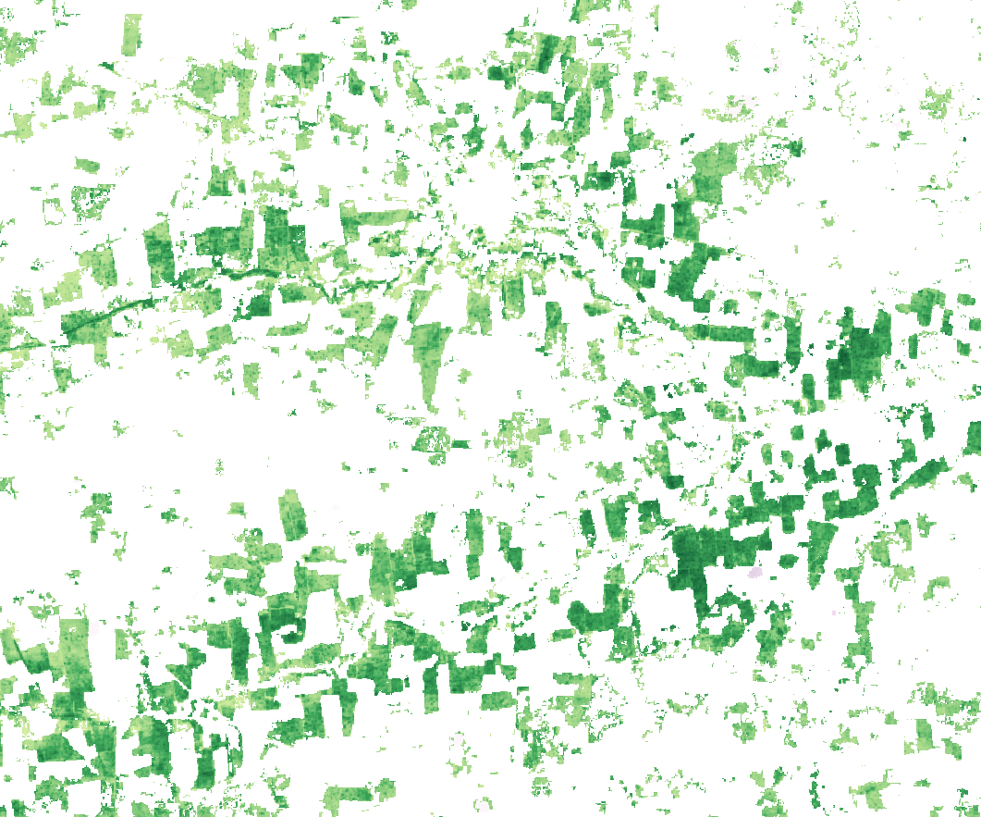
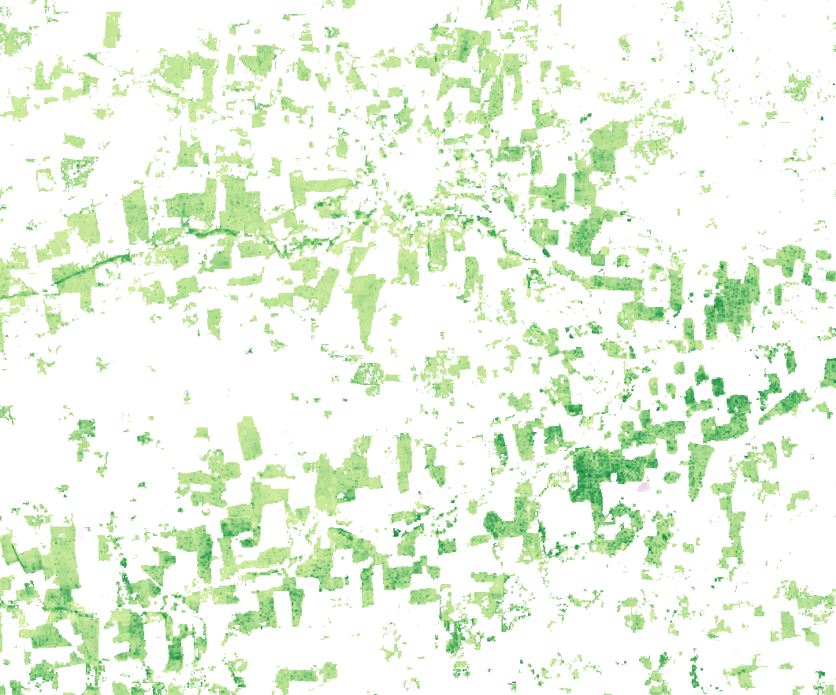
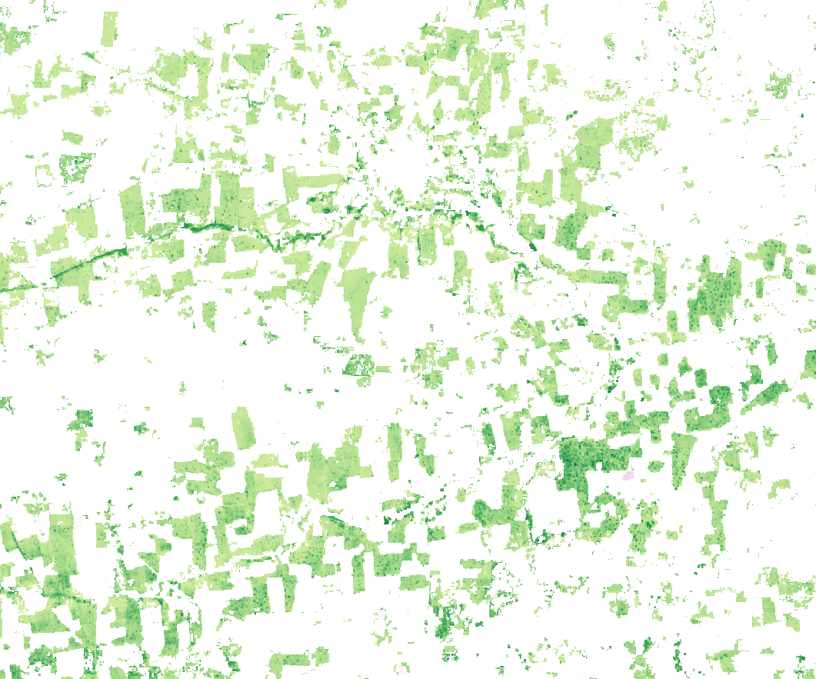

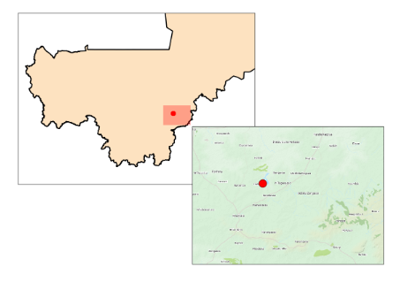
Growth Monitoring at Field Scale
4
17/07/2016
25/10/2016
05/09/2016
3
26/08/2016
05/10/2016
2
15/11/2016
1
0
Koutiala
Notes:
LAI masked by crop type – here cotton, one of the biggest cash crops of Mali

Slide 12

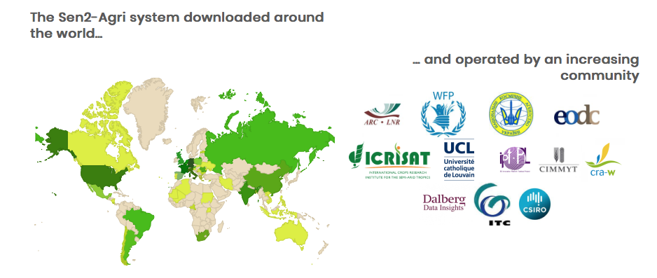
Sen2Agri Goes Public
Sen2Agri processing system available as open source
OS license - GNU GPLv3
Sen2Agri Version 1.7 is published on Sen2Agri website:
http://www.esa-sen2agri.org/resources/software/
http://www.esa-sen2agri.org/resources/technical-documents/
Ongoing Online trainings – Next on the 15th of March
  Registration: http://www.esa-sen2agri.org/on-line-trainings-in-march/
422 DOWNLOADS

Slide 13


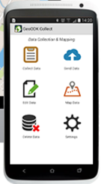
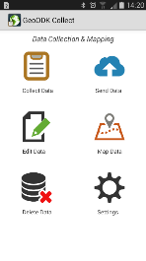
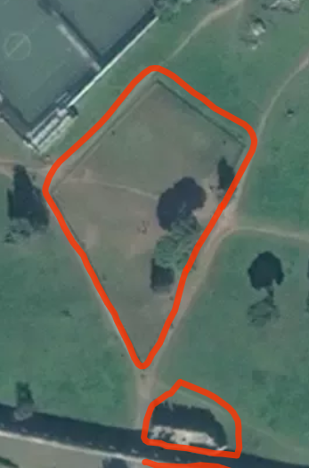

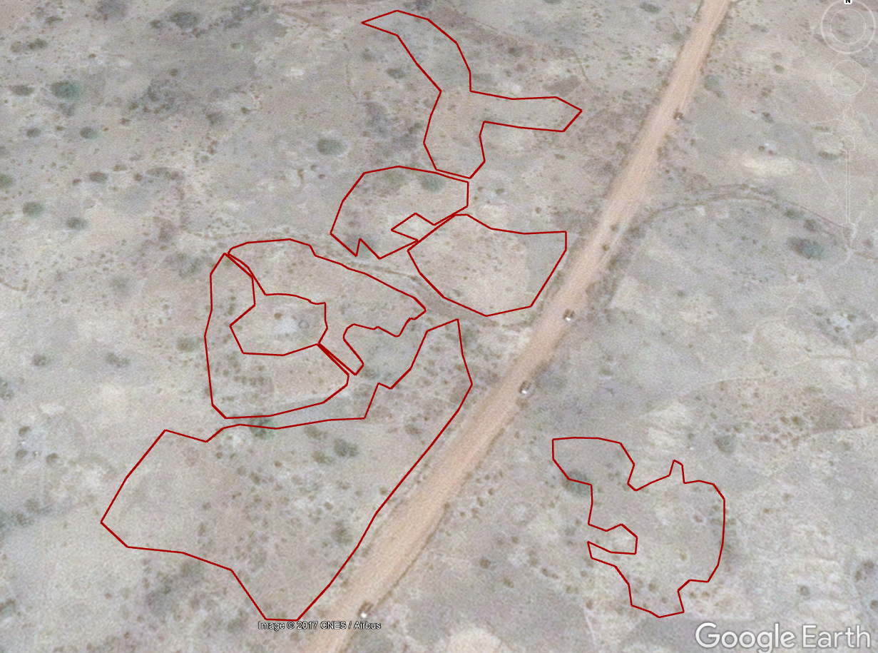
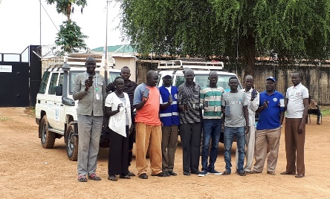
Sen2Agri in the Cloud
Open Source
Fully scalable
Close to the Data
(reduced bandwidth)
Cloud Technology
(IPT / EODC DIAS)
Continuous Monitoring
In-situ Data
GeoODK
Operational context
(e.g. timeliness)
South Sudan
(Sept. 2017)
WFP
Household surveys
Notes:
WFP Household surveys - Thousands of samples
Operational context – direct field data integration helps to deliver timely
Integration of crop type data collection in WFP teams collecting household data across the country in mid November (FSNMS).
400+ villages visited, data collection to take place as households are interviewed.
Potential to capture several hundred samples

Slide 14
Supplemental Materials

Slide 15
