Slide 1
Open data and innovation for Zero Hunger Aim
Committee on Earth Observation Satellites
Suchith Anand
Global Open Data for Agriculture and Nutrition
CEOS 7th Working Group for Capacity Building and Data Democracy (WGCapD) Annual Meeting
INPE São José dos Campos, Brazil
6-8th March, 2018

Slide 2
Capacity development
Inclusive – for all levels from students to those without formal education
Empowerment
Lowering the barriers
Spread Awareness on available resources
Building partnerships and synergies with like minded organisations

Slide 3
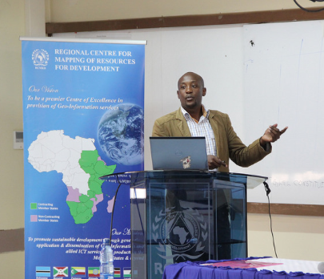
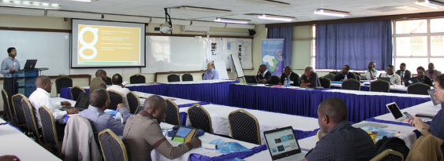
Examples
GODAN AgriGIS Hands on workshop and ThinkTank @RCMRD, Nairobi, Oct 2016

Slide 4
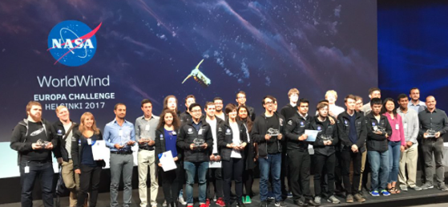
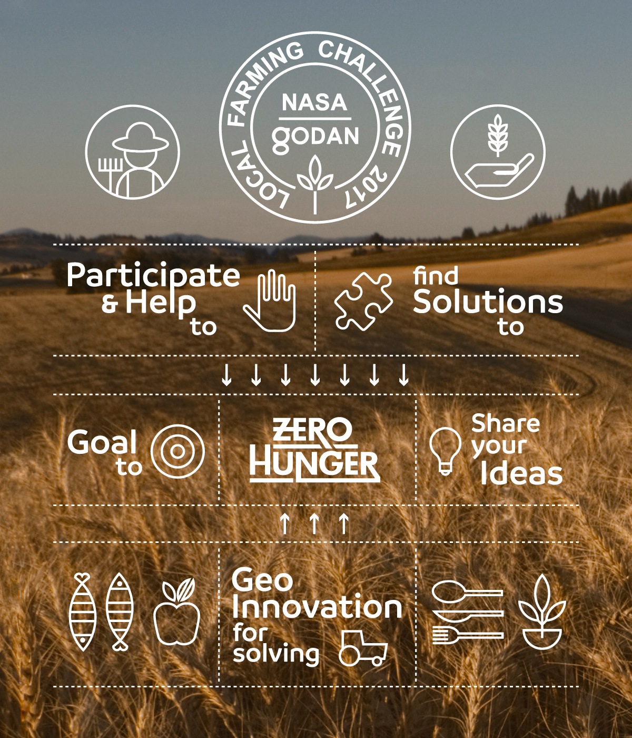

Slide 5
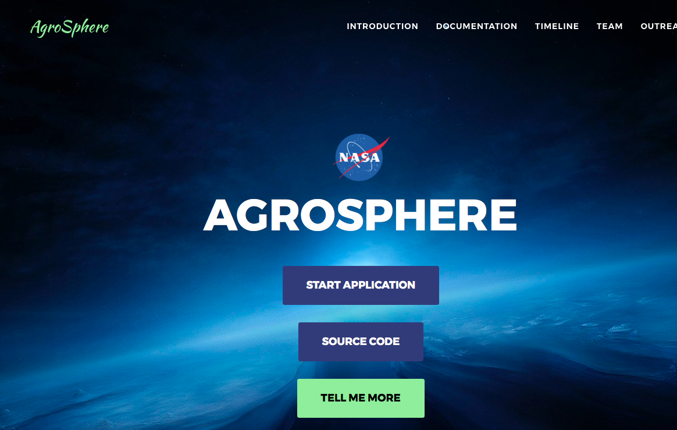
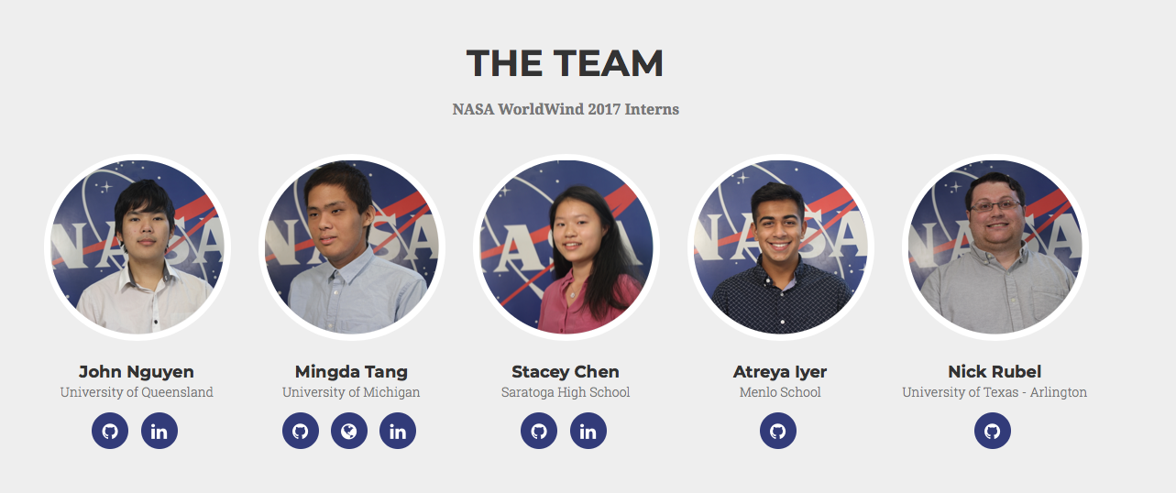
Winner of GODAN Local Farming challenge 2017 - Agrosphere
https://worldwind.arc.nasa.gov/agrosphere/about.html

