Slide 1

Capacity Development in Open data and AgriGIS
Committee on Earth Observation Satellites
Suchith Anand
Global Open Data for Agriculture and Nutrition
CEOS 7th Working Group for Capacity Building and Data Democracy (WGCapD) Annual Meeting
INPE São José dos Campos, Brazil
6-8th March, 2018

Slide 2
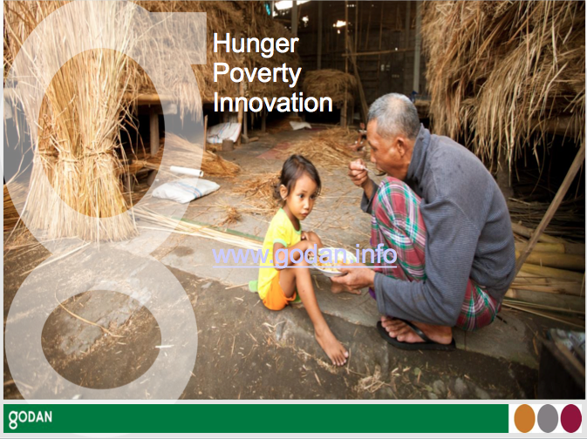
Capacity development
How can we build Capacity Development synergies to ensure Zero Hunger for all?
Need for multidisciplinary inputs as well as local practices into the capacity development process.
The training programs and platforms used should be focussed on reducing digital divides so that researchers in developing countries can also benefit.

Slide 3
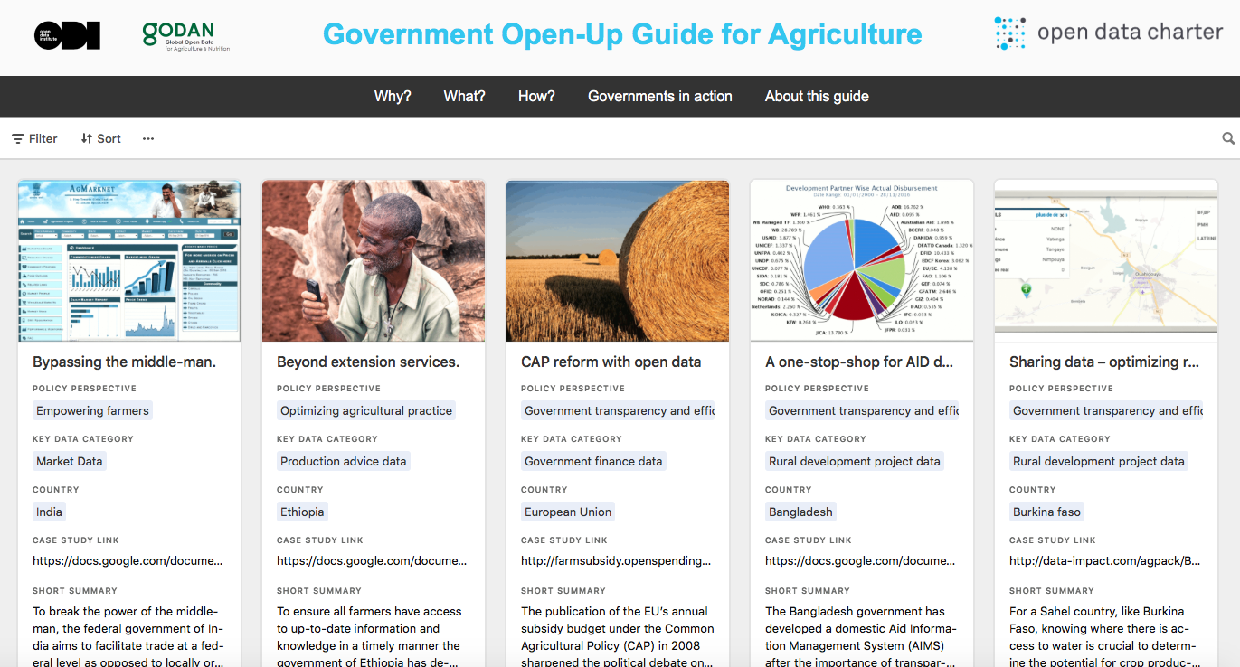
AgPack – example of open data Capacity building tool
http://data-impact.com/agpack/

Slide 4
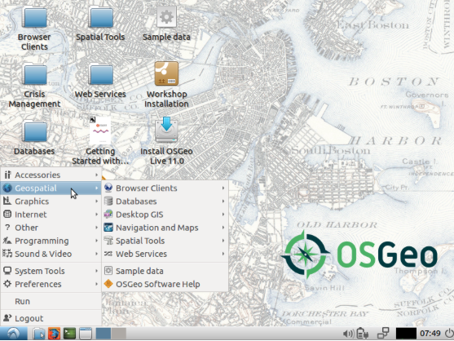
Open tools and resources for AgriGIS capacity development
Teachinghttps://www.osgeo.org/initiatives/geo-for-all/in-your-classroom/
Researchhttps://www.osgeo.org/initiatives/geo-for-all/in-your-research/
Projectshttps://www.osgeo.org/initiatives/geo-for-all/for-your-class-project/
OSGeo Live is self-contained bootable DVD, USB thumb drive or Virtual Machine based on Lubuntu, that allows you to try a wide variety of open source geospatial software without installing anything. It is composed entirely of free software, allowing it to be freely distributed, duplicated and passed around.
See all contents at https://live.osgeo.org/en/overview/overview.html

