Slide 1
Land Cover Land Use Change (LCLUC) training initiatives
Committee on Earth Observation Satellites
Nancy Searby/NASA, Francesco Sarti/ESA, Garik Gutman/NASA, and Krishna Vadrevu/NASA
Agenda Item #28
CEOS 7th Working Group for Capacity Building and Data Democracy (WGCapD) Annual Meeting
INPE São José dos Campos, Brazil
6-8th March, 2018

Slide 2
Land-Cover/Land-Use Change Program
LCLUC is an interdisciplinary scientific theme within NASA’s Earth Science program. The ultimate vision of this program is to develop the capability for periodic global inventories of land use and land cover from space, to develop the scientific understanding and models necessary to simulate the processes taking place, and to evaluate the consequences of observed and predicted changes
LCLUC program at NASA HQ supports GOFC-GOLD initiative
Through a grant to START
Through Program Manager involvement in all activities
http://lcluc.hq.nasa.gov

Slide 3
LCLUC is a global program supported through regional partnerships to enhance
Regional scientists’ access to NASA assets
NASA scientists access to national data and facilitate field data collection
LCLUC is a catalyst for regional science initiatives through
Networks by leveraging national/local knowledge and resources and strengthening NASA research projects
Workshops focused on societal priorities and policy-relevant land-use science
LCLUC is a promoter of regional capacity building through
NASA data-use training
International data sharing

Slide 4
Global Observation of Forests and Land-cover Dynamics: GOFC-GOLD
Coordinated international effort to ensure space-and ground-based forest cover and other land-cover observations for the global monitoring of terrestrial resources and studies of global change
Network of participants implementing coordinated research, demonstration and operational projects
Vision to share data, information and knowledge, leading to informed actions and decision support
Long-term process of building an improved match between observations, data products and users’ needs
Implementation Teams (IT)
Land Cover Characteristics and Change
Fire Monitoring and Mapping
Working Groups (WG)
Working Group on Reducing Emissions from Deforestation and Forest Degradation (REDD)
Group on Biomass Monitoring
Regional Networks
Interface between IT and regional data users

Slide 5
GOFC-GOLD Regional Networks
3
9
5
2
10
1
6
4
7
8
Currently active GOFC-GOLD regional networks. 1.Southeast Asia Regional Research and Information Network (SEARRIN); 2. South Asia Regional Information Network (SARIN); 3. South Central European Regional International Network (SCERIN); 4. Red Latinoamerica de Teledeteccion e Incendios Forestales (RedLaTIF); 5. West African Regional Network (WARN); 6. Observatoire Satellital des Forets d’Afrique Central (OSFAC); 7. Miombo Network (MIOMBO); 8. Southern Africa Fire Network (SAFNET); 9.Caucasus Regional Information Network (CaucRIN); 10.Mekong Regional Information Network (MekRIN)

Slide 6
GOFC-GOLD Regional Networks, Activities and Priorities at the Networks Summit: Tbilisi, Georgia, September 13-16th, 2017 (see Earth Observer, Jan-Feb, 2018)

Slide 7
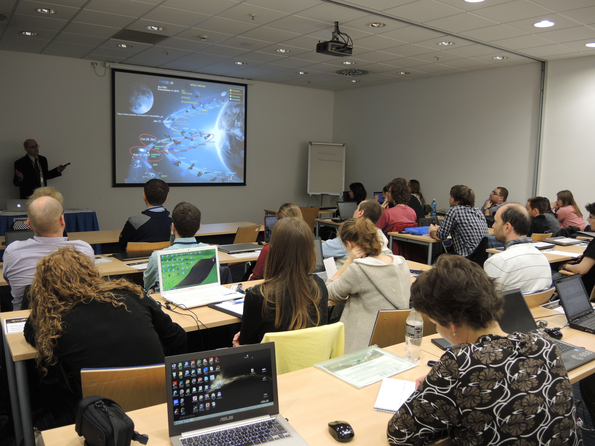
Trans-Atlantic Training (TAT) Initiative
NASA-ESA regular training sessions in Eastern Europe for students and post-docs, open for any early career satellite data users and stakeholders
Five TAT sessions by now
June 2013 in Prague, Czech Rep.
June 2014 in Krakow, Poland
April 2015 in Prague, Czech Rep.
July 2016 in Zvolen, Slovakia
June 2017 in Pecs, Hungary
6th: planned for June 2018 in Zagreb, Croatia
As a rule, TAT is conducted in conjunction with the GOFC-GOLD South-Central East European Regional Information Network (SCERIN) workshops
Co-funded by NASA and ESA
Various, state-of-the-art remote sensing methods and applications over land
Forestry, Agriculture, Urban
Lectures and hands-on practical exercises from NASA and ESA optical and microwave experts
TAT-2015 in Prague: Introductory lecture by G. Gutman on the current NASA space assets for studying land surface processes

Slide 8
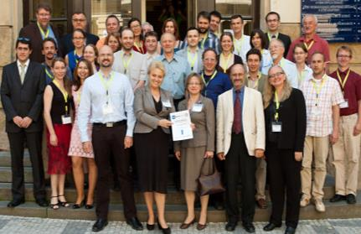
Capacity Building in the frame of International Cooperation with other space agencies
ESA Cooperation with NASA (Trans-Atlantic Training on Land Cover Land Use Change LCLUC in Baltic Countries and Eastern Europe). Every year, we run a joint training event with about 50-60 participants in a new country. ESA speakers cover more SAR and the new SENTINELS, whereas NASA speakers cover more NASA EO missions applications
Last TAT training event in Hungary, June 2017
Next TAT training event in Croatia, May-June 2018
Some links:
http://web.natur.cuni.cz/gis/tat/
http://www.nyme.hu/lcluc_training.html?&L=4
https://web.natur.cuni.cz/gis/lucc/
This model could be enlarged to future CEOS events in Asia, as proposed by G. Gutman, NASA LCLUC programme manager

