Slide 1
Recovery Observatory (RO) pilot Haiti Hurricane Matthew RO Status and Capacity Building requirements Presentation to WG CapD #7 March 7th, 2018 Helene de Boissezon, CNES
Committee on Earth Observation Satellites

Slide 2
CEOS Working Group Disasters
CEOS WG Disasters created in 2014 after recommendation from ad hoc group to increase role of CEOS in supporting use of satellites for full cycle of disaster risk management (not just “response”)
WGD includes both CEOS agencies and a large community of practitioners and EO users (private, public, commercial, non profit…)
Under WGD, six « Pilots » (4 thematic, 2 transverse) :
Seismic hazards (ESA, INGV) – Pilot completed, Demonstrator under definition;
Volcanoes (ASI, USGS) – Pilot completed, Demonstrator under definition;
Flood (NASA, NOAA) – Pilot completed, Demonstrator under definition;
Landslides (NASA, USGS, EOST) – Pilot ongoing;
Recovery Observatory (RO) (CNES) – Pilot ongoing;
GEO-DARMA (ESA) – data access for Disaster Risk Reduction at regional level (multi-hazard, full cycle) – on going project;

Slide 3
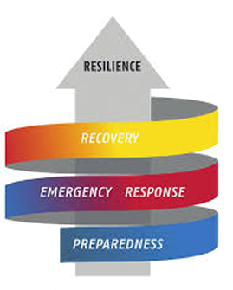
Earth Observation in Disaster Risk management cycle
Earth Observation is already part of “emergency response”, but there is little or no contribution to the “post-crisis” part of the DRM cycle.
Concept of “Recovery Observatory”
Access to EO derived products in the Recovery phase
EO data acquired during the full Recovery period (months, years)
Strong ties to local users and to international organisations
CEOS WG Disasters “Recovery Observatory” (RO) pilot :
High-profile demonstration in a real case of value of using satellite EO to support Recovery from a major disaster :
Near-term (rapid assessments, post PDNA);
Long-term (major recovery planning and implementation, estimated 3-4 years);
Definition of a generic and replicable RO , for further use by international stakeholders (best practice, recommendations, ITT …).
Notes:
3

Slide 4
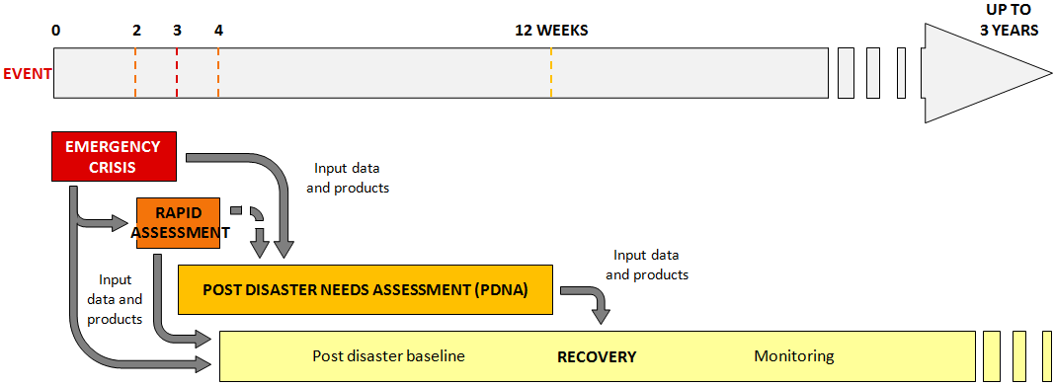
The Recovery Observatory and the post-crisis period
“Urgent response”:
Charter, Copernicus, Sentinel-Asia
“Recovery Observatory” : long-term recovery monitoring
1st operational demonstration in CEOS context

Slide 5
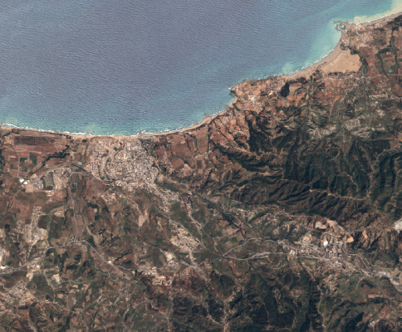
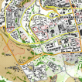
Imagery FOR A Recovery Observatory
Collection of satellite images and maps at several scales
during 3 to 4 years after a major disaster
Overview area
Mid-scale products from Sentinel data at 10m resolution
Change in landcover, open spaces
Vegetation loss or re-growth
Agriculture
Update frequency:
every 10 days to 6 months
Overview
AOI
Urban
zoom 1
Urban
zoom 2
Hot spot zooms
Large scale products from very high resolution data
Urban areas, housing, ….
Transport infrastructure, coastal areas, …
IDP camps, …
Specific areas of interest
Update frequency: every 2 to 4 months
Ancillary data remain indispensable: terrain validation data, aerial and drone data, statistics, cartography, ….

Slide 6
Recovery Observatory – possible EO derived products
Baseline mapping | Monitoring
Buildings, shelters | Buildings footprint mapping Building attributes (roof type, height indication, collapsed or partially collapsed) Indicate density of damaged buildings Urban blocks with indication of damage | Building removal and construction Change in urban land use, morphology and density Indicate type of dwelling reconstruction
Camps | Location of spontaneous and organized gathering areas Location of temporary dwellings Land use, open spaces | Camp removal and installation Tent removal and installation New land use / open spaces
Transport | Accurate transport network mapping with detailed metadata (type, damage level) Accessibility analysis Proximity analysis Traffic activity analysis | Rebuilt transport facilities New transport facilities Removal of transport facilities Accessibility analysis Proximity analysis Traffic activity analysis
Infrastructures | Mapping of utilities and services infrastructures (administration, education, healthcare, power - water - sanitation facilities…) with detailed metadata (type, level of damage) | Recovered infrastructures Infrastructure removal and construction
Environment | Landcover, open spaces Affected landcover (e.g. burn scar with fire damage severity…) | Change in landcover, open spaces Indicate loss of vegetation Vegetation re-growth
Topography | Risk analysis (vulnerability to flood, to water run-off risk, to soil erosion…) | Risk analysis
Mainly EO based
Significant external input required

Slide 7
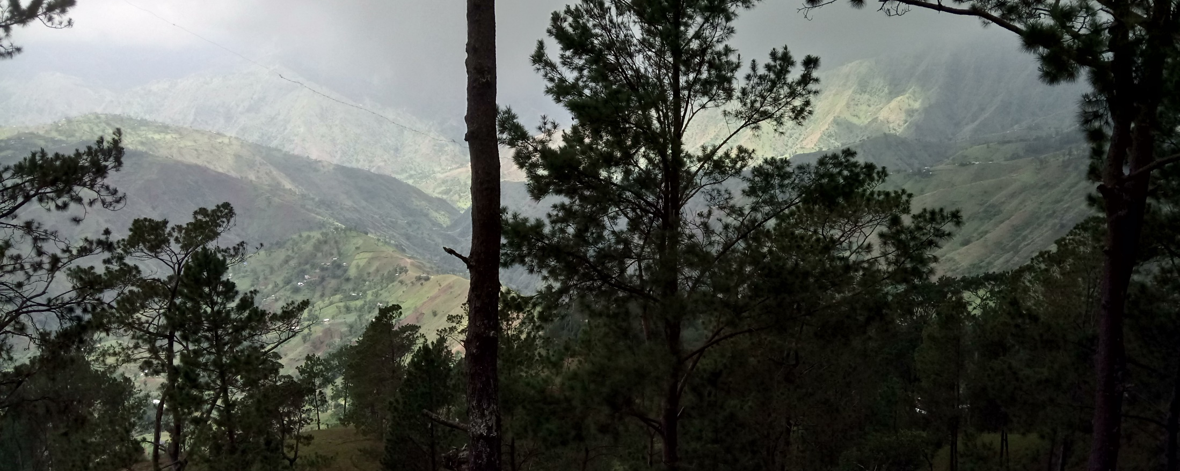
RO Status Overview
A Reminder of Haiti’s diversity
Triggering of the RO decided by CEOS Chair in consultation with CEOS Principals, December 22, 2016, after Hurricane Matthew - October 2016
Mission #1 to Haiti 30 Jan-2 Feb 2017 to establish RO
Mission #2 to Haiti 29 May – 2 Jun 2017 to meet RO users and get feedback from first products
Mission #3 to Haiti 5 Dec - 8 Dec 2017 dedicated to technical work

Slide 8
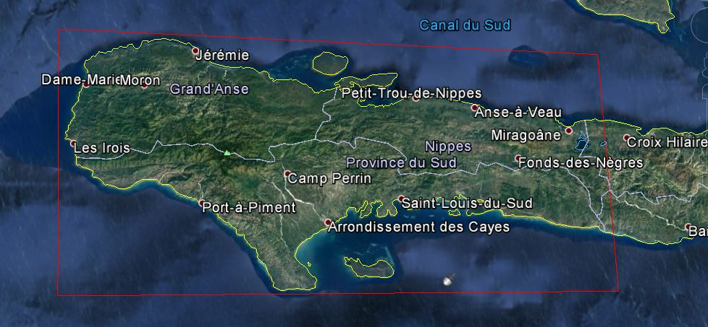
Haiti RO to cover three departments: Grand’Anse, Sud, and Nippes
CNIGS
CIAT
ONEV

Slide 9
RO Status Overview
Infrastructure
Product definition, image requirements
RO Haiti Triggering
22/12/2016
Generic
RO
Early RO evaluation
2015 2016 2017 2018 2019 2020
jfmamjjasond jfmamjjasond jfmamjjasond jfmamjjasond jfmamjjasond jfmamjjasond
PDNA
ROOP
Lessons learned
Hurricane
Matthew
04/10/2016
Today
Malawi, Nepal
Demonstrators
Missions to Haiti (2 to 3 per year)
1st mission
31 Jan–3 Feb
Technical
Review
5-8 Dec
1st Workshop
29 May–2 Jun
2nd Workshop
7-11 May 2018
External Missions
WB Washington (date TBC)

Slide 10
RO User Workshop #1
May 2017
Protected natural areas : Macaya Park
Health (New)
Landslides, Seismic risks (with ASI / EOST)
Watersheds, flooding
(wwith CIMA)
Infrastructure and road communication : 1st -> Jérémie
Land use
Technical web infrastructure
7 working session in Haitian offices (CNIGS, CIAT, ONEV, BME…)
Second loop on several products (Watersheds, Built up areas in Jérémie and Les Cayes, and Macaya Park change detection)
Definition of needs relating to health (vector borne disease, water quality)

Slide 11
RO Thematic products –
Main actors (CEOS and Haiti)
Produit | Key User | First Elaboration | Satellite data | Focal Point | Institution
Cartography of the building (Jérémie, Les Cayes, route d’Aquins) | CIAT/Ministry of Planning (MPCE) | Copernicus EMS; SERTIT (methodology); CNIGS (production); | Optical THR | Rose-May GUIGNARD | CIAT
 |  |  |  | Pierre Alexilien Versaille | MPCE/ CNIGS
Land Use | All (reference data) | CNIGS/CESBIO /SERTIT | Sentinel-2, HR Optical | Jacques Philemon MONDESIR | MPCE / CNIGS
Forest Evolution / Environmental Impact | Ministry of Environment (MDE) | Copernicus EMS | Sentinel-2, SPOT, Optique THR | Pierre Emmanuel PHILIPPE | MDE/ Directeur des forêts
 |  |  |  | Saint Phar JEAN | MDE/ ONEV
Agriculture | Ministry of Agriculture (MARNDR) | Copernicus EMS ; CNIGS/SERTIT | Sentinel-2, Optical HR, zoom THR | Ognel PIERRE-LOUIS | MARNDR/ DRFS
 |  |  |  | David TELCY | MPCE / CNIGS
State and monitoring of the Macaya Park | ANAP / ONEV (MDE) | Copernicus EMS ; SERTIT | Optical THR, radar THR | Sait Phar JEAN | MDE/ ONEV
State and monitoring of watersheds | ONEV (MDE) - Ministry of Agriculture (MARNDR) | CIMA Foundation | Digital terrain model 1m/20cm and Radar THR | Jean André PIERRE | MPCE/ CNIGS
 |  |  |  | Pradel FORMONVIL | MPCE/ CNIGS
 |  |  |  | Saint Phar JEAN | MDE/ ONEV
Landslide / Quarry monitoring | BME / Ministry of Public Works (MTPTC) | EOST | Optical HR/THR, Radar TerraSAR-X | Samuel GENEA | MTPTC/ BME
 |  |  |  | Eric CALAIS | ENS France

Slide 12
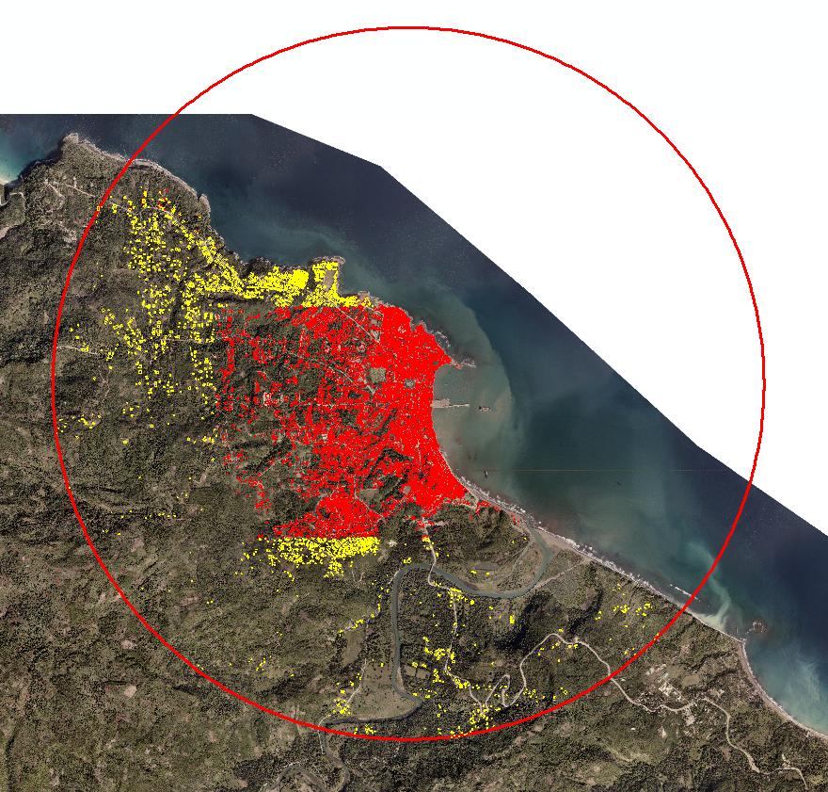
Technical Review #1 (Dec 2017)
Example of Infrastructure in Jérémie
Infrastructure and road communication : 1st -> Jérémie

Slide 13
Technical Review #1 (Dec 2017)
Example of Infrastructure in Jérémie
Infrastructure and road communication : 1st -> Jérémie
7584 buildings
2014 | 2016 | 2017 | Total
Not affected | Destroyed |  | 3219
In construction | Destroyed |  | 54
Not existing | Destroyed |  | 59
Not affected | Damaged |  | 1196
In construction | Damaged |  | 62
Not existing | Damaged |  | 49
 | Not affected | Not affected | 2037
 | Destroyed | Not affected | 2843
 | Destroyed | In construction | 111
 | Destroyed | Not existing | 303
Not affected |  | Not affected | 5719
Not affected |  | Not existing | 346
4 categories :
Not affected
In Construction
Not Existing
Damaged
Destroyed

Slide 14
Technical Review #1 (Dec 2017)
Example of Infrastructure in Jérémie
Infrastructure and road communication : 1st -> Jérémie
Neighborhoods that have access problems

Slide 15
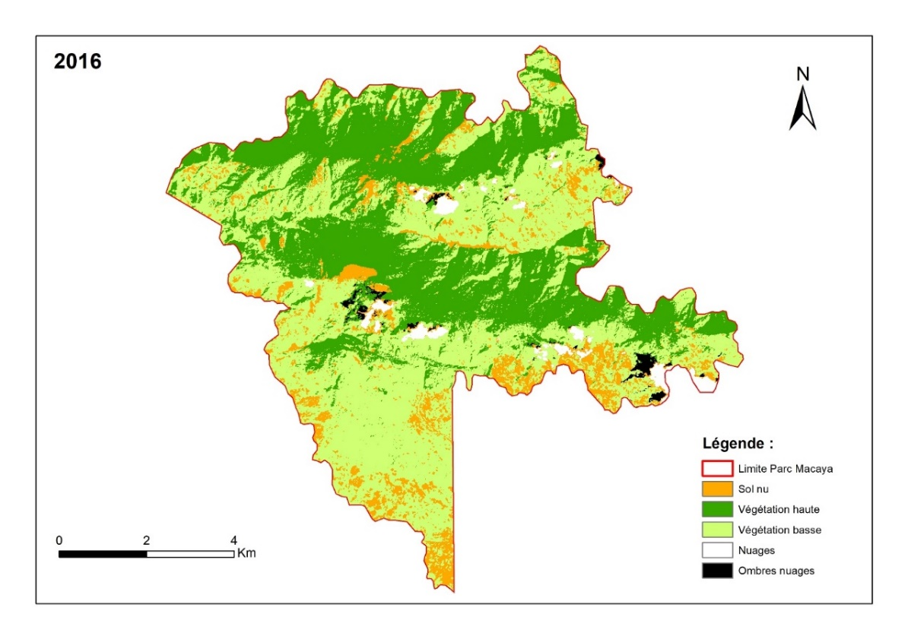
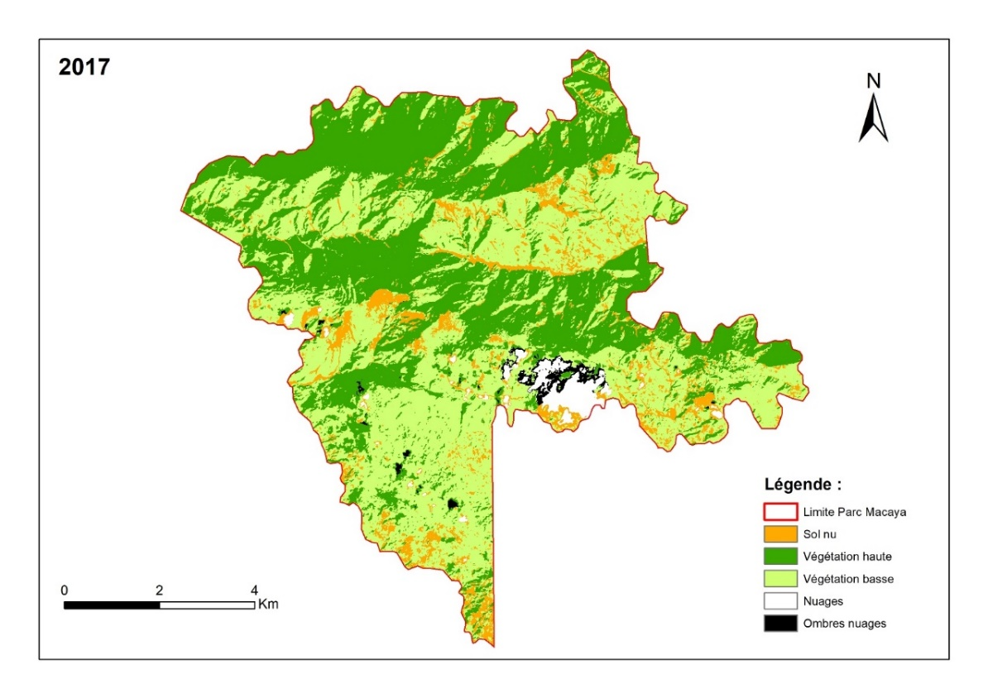
Produit exploratoire « Végétation »
Technical Review #1 (Dec 2017)
Example of Vegetation monitoring / Macaya Park
Preliminary Results
Bare land : 7,34 km²
High Vegetation : 26,71 km²
Low Vegetation : 35,83 km²
Other : 2,17 km²
Bare land : 6,18 km²
High Vegetation : 30,04 km²
Low Vegetation : 33,73 km²
Other : 2,11 km²
Parc Macaya : 72,06 km²

Slide 16
Capacity Building (CB) issue in RO
How to develop in RO local capacity related to EO derived products ?
RO success strongly related to sustainable local Training and CB :
CB development is critical for Haiti RO, and for future ROs in developing countries.
A specific RO Haiti CB roadmap is in development with Haitian partners, aiming at :
« Training local producers » : technical personnel to process EO images and produce EO derived products defined by RO
« Training local users » : institutional users (ministries, institutions) to be able to use the RO products to support decision making
RO CB roadmap should become generic and be included in the « generic and replicable RO », to be defined at the end of the pilot activities.
RO team is looking for partners to support RO CB activities.
Haitian partners are currently working on the RO CB roadmap (CNIGS lead), on identifying funding sources (WB, UNDP, donors, …)
Invitation to WGCapD to work with RO team ! We would really benefit from your experience, expertise and enthusiasm

Slide 17
Current status of Training and Capacity Building in RO Haiti
Informal ad hoc training performed during the 1st User Worshop and the 1st Technical Review in 2017 :
Charte internationale Espace et catastrophes majeures
Modélisation et évaluation d’impact multirisques en Haïti via RASOR
Series of general EO training dedicated to university (URGeo Master at UEH) in addition to the 2nd User Workshop (May 2018) :
Introduction aux technologies spatiales
Introduction à l’imagerie spatiale et à la réalisation de spatio cartes.
L’observation de la terre au service de la gestion des risques
Modélisation et évaluation d’impact multirisques en Haiti via RASOR
Dedicated RO Capacity Building issue is still on development
RO Haiti CB roadmap
And later : Generic RO CB roadmap

Slide 18
Next steps
Products validation by Haitian experts
Capacity building plan and dissemination
User Workshop #2 from May 7 to 11 2018
In Port au Prince and Les Cayes (local user workshop)
Consolidate links with Universities
Solicitation of new funding and new partners to augment applications and Capacity Building
RO promotion
Lessons learned applied to a generic and replicable RO, in consultation with international stakeholders (EU, WB, UNDP), and including CB activities.

