Slide 1

Sustainable Development Goals (SDGs)
Committee on Earth Observation Satellites
Eric C. Wood
Agenda Item #23
CEOS 7th Working Group for Capacity Building and Data Democracy (WGCapD) Annual Meeting
INPE São José dos Campos, Brazil
6-8th March, 2018

Slide 2

Sustainable Development Goals (SDGs)

Slide 3

Sustainable Development Goals (SDGs)

Slide 4
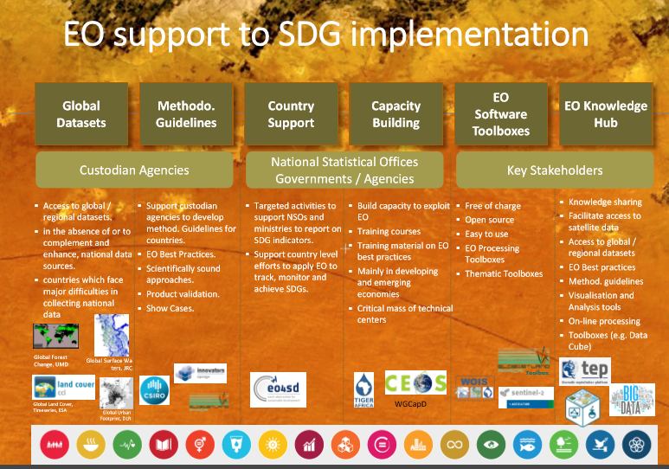
Sustainable Development Goals (SDGs)

Slide 5

The SDG vs. EO Theme DecisionMatrix

Slide 6
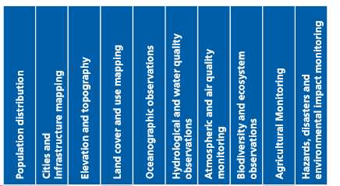
Sustainable Development Goals (SDGs)
The SDG vs. EO Theme Decisions Matrix

Slide 7
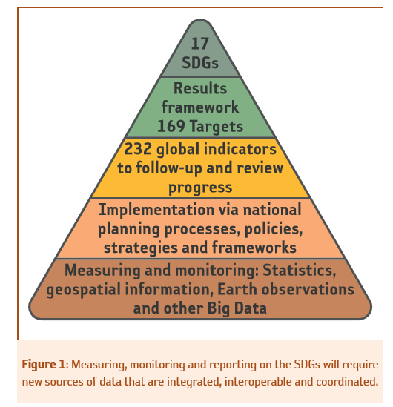
SDG Framework
Measuring,
Monitoring and Reporting

Slide 8
Most likely Targets and
Indicators EO can contribute to directly (or indirectly)

Slide 9

Components of Indicator 6.6.1
Sustainable Development Goals (SDGs)
Goal
Sub-indicators
Resulting state/health of ecosystems (6.6.1.d)
Quality of water in ecosystems (6.6.1.c) = (6.3.2)
Spatial Extent of water-related ecosystems (6.6.1.a)
Quantity of water in ecosystems (6.6.1.b)

Slide 10


GEO Initiative

Slide 11
Goals - GEO
Goals and Targets where GEO has strong and active communities with adequate resources and potential to deliver tangible outcomes within the 2017–2019 timeframe, namely:
SDG 2: zero hunger
SDG 6: clean water & sanitation
SDG 11: sustainable cities and communities
SDG 13: climate action
SDG 14: life below water
SDG 15: life on land

Slide 12
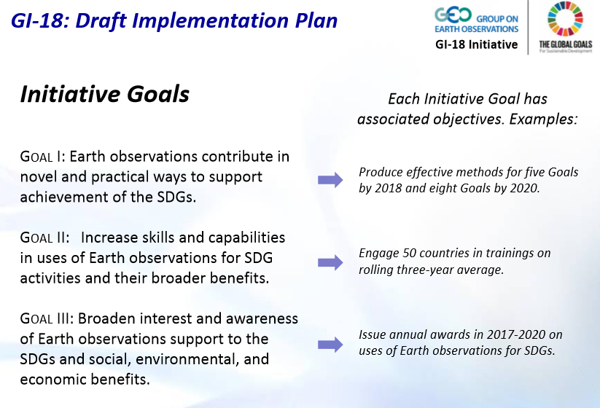
GEO Initiative

Slide 13
GEO – CB (General)
Capacity Building
A portfolio of capacity building activities provides support to institutions and individuals in the ideation, development, and implementation of methods. The activities build capabilities directly with the SDG methods and more broadly with accessing and applying Earth observations. Activities here draw on and contribute to GEO’s established capacity building activities and expertise, and they may examine inventive approaches, such as social media, to support the testing and refinement of methods by users.

Slide 14
GEO – Capacity Building
Capacity Building for SDGs
This element supports the use of Earth observations for the SDGs in all aspects, such as planning, tracking, and reporting. The portfolio includes virtual and physical activities, such as trainings, webinars, joint projects, applied research, and workshops, among many other successful capacity building practices. The element uses and supports GEO’s efforts to characterize user needs, especially in fostering effective ways to enable sustained uptake of the methods and related data access.

Slide 15
GEO – Capacity Building
)
Given the basis of the SDGs in statistical data, this element includes engagement with the SDG statistical community about Earth observations as well as capacity building within GEO and the Earth observations community about SDG statistical principles and practices.

Slide 16
The GEO Earth Observations for the Sustainable Development Goals (EO4SDG) Initiative
EO4SDG has also become a focal point for coordination across the breadth of the Group on Earth Observations (GEO) Work Programme including relevant Flagships, Initiatives and Community Activities.
In particular, the Initiative aims to advance a portfolio of national pilot projects in one or more GEO Member countries focused on integrating EO with national statistics to better measure, monitor and achieve the SDGs.
Implementation mechanisms include:
  capacity building activities to help provide support to institutions and individuals in the use of EO methods and data to achieve the SDGs;
  dissemination of data and information products to advance the provision, access, discoverability and applicability of EO for use with the SDGs;
  and outreach and engagement activities to promote the consideration and adoption of EO for the SDGs by nations and stakeholders.

Slide 17
The GEO Earth Observations for the Sustainable Development Goals (EO4SDG) Initiative
Co-Leads
  Lawrence Friedl, NASA Earth Science (USA)
  Chu Ishida, JAXA (Japan)
  Eduardo De La Torre, INEGI (Mexico)
Technical support:
  Argyo Kavvada, NASA Booz Allen Hamilton, GEO EO4SDG , CEOS SDG AHT (USA)

Slide 18
CEOS

Slide 19

CEOS and Space-based EO for SDGs

Slide 20

CEOS and Space-based EO for SDGs

Slide 21
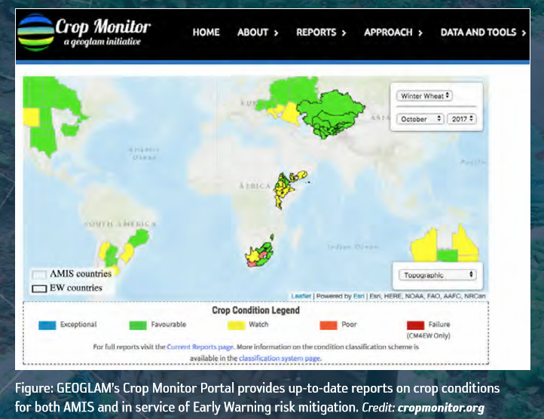
CEOS and Space-based EO for SDGs

Slide 22
CEOS and Space-based EO for SDGs

Slide 23
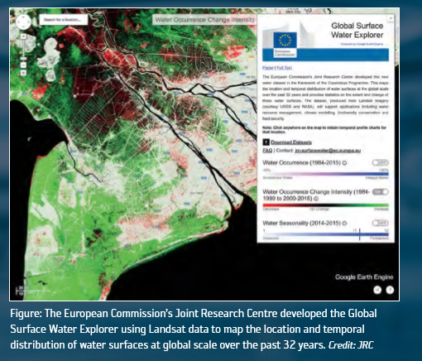
CEOS and Space-based EO for SDGs

Slide 24
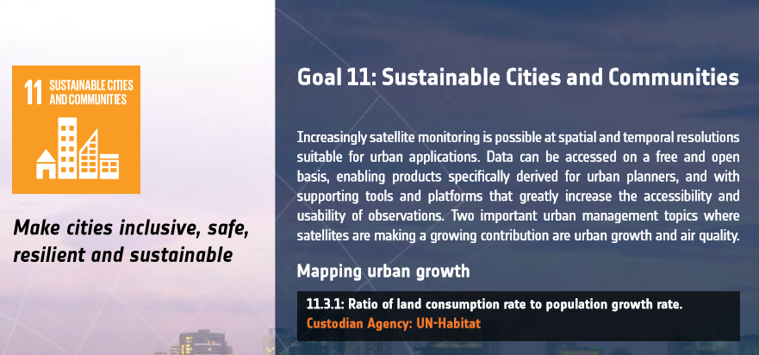
CEOS and Space-based EO for SDGs

Slide 25
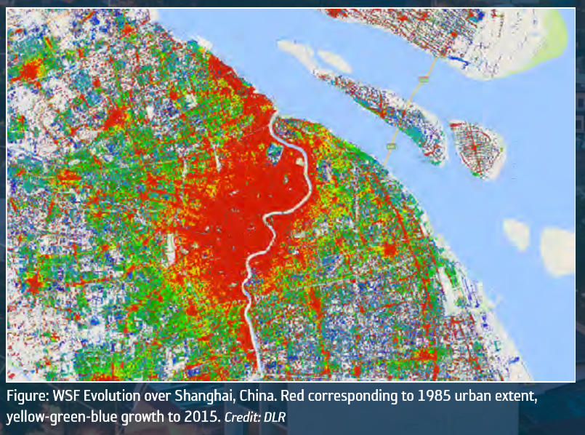
CEOS and Space-based EO for SDGs

Slide 26

CEOS and Space-based EO for SDGs

Slide 27
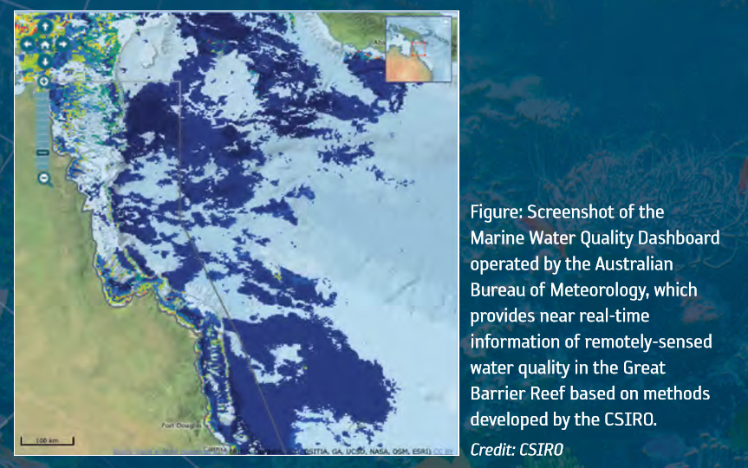
CEOS and Space-based EO for SDGs

Slide 28
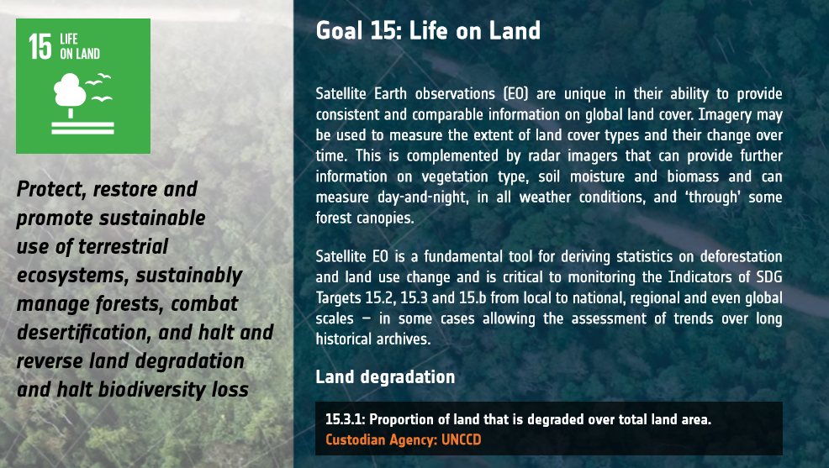
CEOS and Space-based EO for SDGs

Slide 29
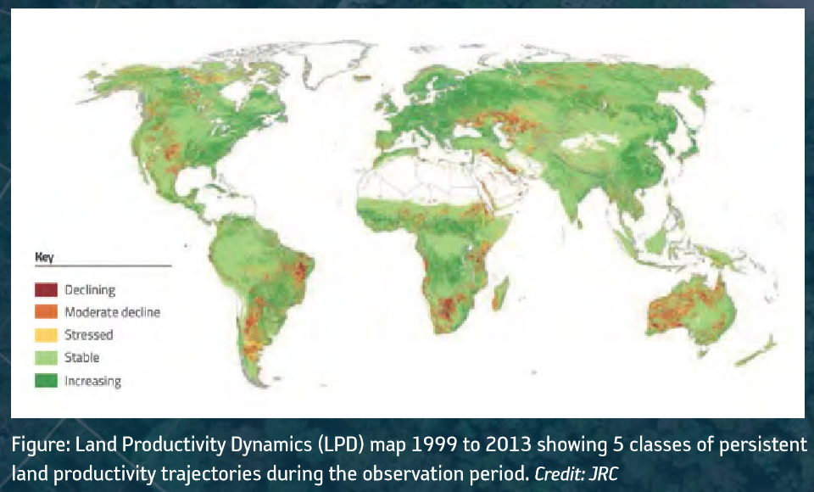
CEOS and Space-based EO for SDGs

Slide 30
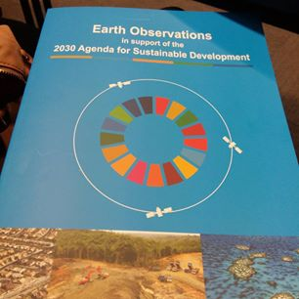
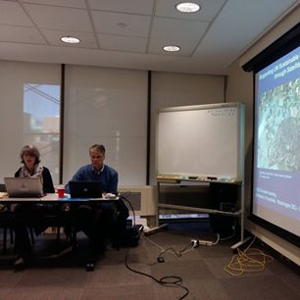
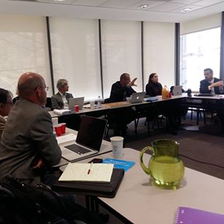
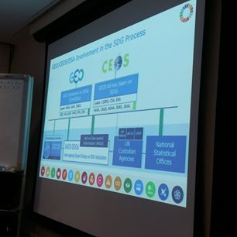
CEOS AHT SDG
Background
CEOS 30th Plenary (Brisbane, 2016) decided the creation of an Ad Hoc Team on SDGs (AHT SDG)
3 current co-leads : CSIRO (A. Held), ESA (M. Paganini), USGS (E. Wood)
Core team support: Flora Kerblat (CSIRO), Kim Holloway (NASA/CEOS SEO)
Today ~30 members (mailing list)
AHT SDG main outputs in 2017:
  AHT SDG Terms of Reference produced for noting at SIT-32 (Paris, April 2017)
  AHT SDG Implementation Plan (incl. ToR) produced for information at CEOS 31st Plenary
  Stock of CEOS activities on SDGs (CEOS Engagement Compendium):
  online survey, direct emailing, results compiling (in progress)
  Finalizing of CEOS EO Handbook “2030 Agenda for Sustainable Development and the Sustainable Development Goals” (ESA lead)

Slide 31
CEOS AHT SDG:
Terms of Reference (ToR)
The AHT SDG will assess, showcase and promote EO contribution
to SDG Targets and Indicators
CEOS AHT SDG – ToRs (summary):
Coordinate the efforts of CEOS agencies and channel CEOS support to the UN process on SDGs through GEO (showcases, promotion, etc.).
Provide a forum for sharing/communicating EO best practices in support to the SDGs in collaboration with GEO.
Analyse new opportunities for satellite-based EO to support SDG Targets and Indicators (methods, data, indicators), in part via enhanced engagement of CEOS agencies within the GEO initiatives and flagships.
Engage with relevant authoritative SDG stakeholders inside (eg. IAEG-SDGs/UNSD, UN GGIM, WGGI, Custodian agencies) and outside the UN system (eg. GPSDD, IISD, WBG, Foundations).
Use CEOS assets and bodies (WGCapD, AHT FDA, etc.) to build and strengthen EO capacities at all levels of the UN SDGs implementation.

Slide 32
AHT SDG 2017-19 Implementation Plan - Key elements
Compile & maintain a compendium of CEOS Agencies’ engagement on SDGs
Define a coherent, flexible and adaptive CEOS engagement plan on SDGs
Coordinate CEOS support to GEO-led SDG activities
Review and assess the contribution of EO to the SDG Targets and Indicators
Demonstrate, showcase and foster the added-value of EO in the SDG monitoring & reporting process
Facilitate uptake of EO by SDG stakeholders (eg. National Statistics)
Develop impactful Communication & Outreach activities on EO for SDGs

Slide 33
AHT SDG Implementation Plan
5. Showcase unique added-value of EO to other SDG stakeholders
With GEO
Objective: Demonstrate the value of EO for achieving the SDG targets and for reporting on indicators, though selected pilots that can lead to wider adoption by SDG stakeholders.
Why? To increase the use of Earth Observations in the overall SDGs landscape (targets and indicators) and by all actors (from global to local levels)
2017 activities:
Initiated SDG pilot projects in partnership with GEO (e.g. CEOS/GEO SELIS proposal to the GPSDD-WB Call on “collaborative data innovation for SD” on the use of data cube technology for SDGs).
2018+ activities:
Compile EO best case practices for SDGs starting with the 5 SDGs where GEO is the most actively involved: Zero Hunger (SDG 2), Water and sanitation (SDG 6), Sustainable urbanization (SDG 11), Life below water (SDG 14), Life on land (SDG 15).
Launch one or two national/regional large-scale SDGs pilot projects (in partnership with GEO EO4SDG and relevant GEO activities), starting from the methodological guidelines provided by the custodian agencies and engaging with key players (incl NSOs).
Develop EO capacity building/training in countries: online courses and webinars on the integration of EO in the SDGs monitoring (in partnership with GEO, custodians and NSOs).

Slide 34


CEOS AHT SDG Flyer

Slide 35

Integrated SDG CB

Slide 36

Integrated SDG CB

Slide 37

Integrated SDG CB

Slide 38
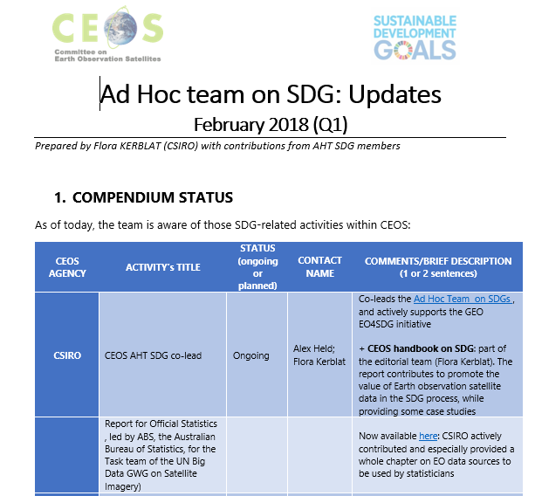
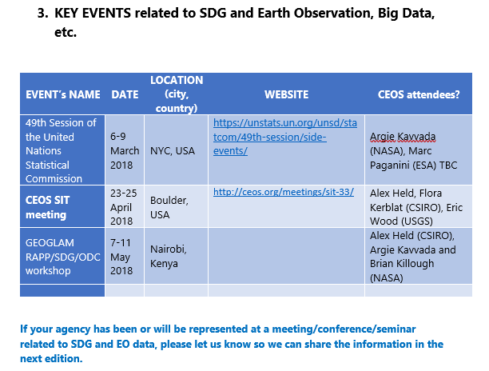
AHT SDG Quarterly Updates

Slide 39
Sustainable Development Goals (SDGs)
DISCUSSION
What is the Role for WGCapD ?

