Slide 1
Iniciativa AmeriGEOSS
Eric Madsen
Overview of Capacity Building Needs and Plans on AmeriGEOSS 2018 - 2020

Slide 2
Elements of CB in AmeriGEOSS
The model of CB is based on the following principles:
Pragmatism : In order to obtain practical results the CB activity will address specific problems- Annual National Objectives developed by country members provide the guide for CB activities. We leverage resources from partner members to achieve increase Capacity.
Means and Processes : Time to have an impact
Participation : Institutional Participation of the host countries
Multi-Dimensionality: Individual, Organizational, Institutional.
Environment :
As a positive conditioning factor
As an aspiration to transform the aforementioned Institutional level
Flexibility and Adapatation in diferent contexts: There is not a magic formula
Notes:
Pragmatism: Capacity Building activities will address specific needs identified by the GEO-country members
Means and Processes: Because CB is connected to specific issues, CB cannot be a matter of a webinar or a single training. Follow up by the instructor and instructor availability after the instruction is required.
Participation : The objective of the AmeriGEOSS CB activities is to build capacity in our member countries. Our target audience is government staff and connecting the academia to these activities for support.
Multi-Dimensionality: Our target is not only the individual, but also the organization for which the individual works, and finally the institucion (reinforcing the institutional/government)
Environment: We aspire to reinforce the National GEOs by providing a positive environment for progress.
Flexibility and Adaptation: We recognice the differences and particularities of the individual countries (and individuality among institutions) and therefore “one size does not fit all”. We adapt to the needs and ways to do CB by organization/country.

Slide 3
Leveraging our partner resources
WGCapD, GEO Country members, and academic Institutions through in-kind contributions at AmeriGEOSS Week.
USGEO: through programs such as NASA-DEVELOP, NASA-ARSET, NASA-ROSES, NOAA-GEONETCast, Federal Geographic Data Committee (FGDC)-AmeriGEOSS Platform.
Academic Networks ::
    US : América View , CUAHSI
    Global: GEOS4ALL
    Regional : GEO-CIEHLYC

Slide 4
AmeriGEOSS Week-2016
Training sessions organized by GEO-Colombia and CIEHLYC, and hosted by the Universidad Nacional de Colombia
Americas Caucus Meeting – June 7-8, 2016
  Participants: Colombia, United States, Canada, Belize, Argentina, Chile, Brazil, Ecuador, and GEO Secretariat
Four concurrent training sessions focused on capacity building and bringing GEO global initiatives to the region – June 7-10, 2016
  GEOGLAM
  GEONETCast and Introduction to Geostationary Observational Environmental Satellite – R Series (GOES-R)
  GEOGLOWS
  Disaster Risk Reduction and Synthetic Aperture Radar (SAR) Applications
  ~180 participants in total

Slide 5
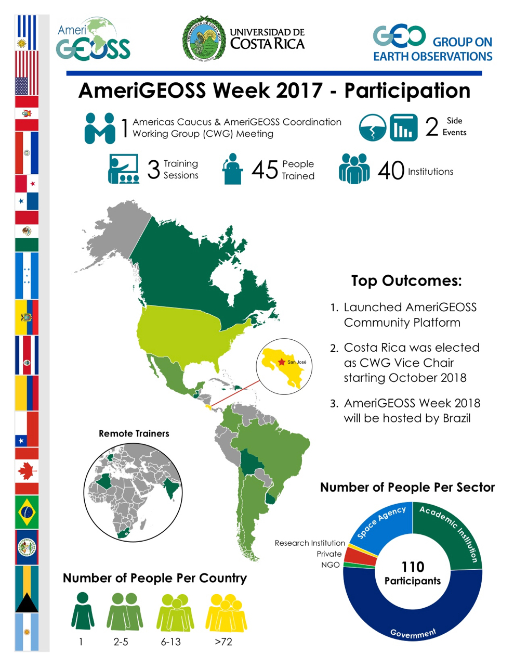
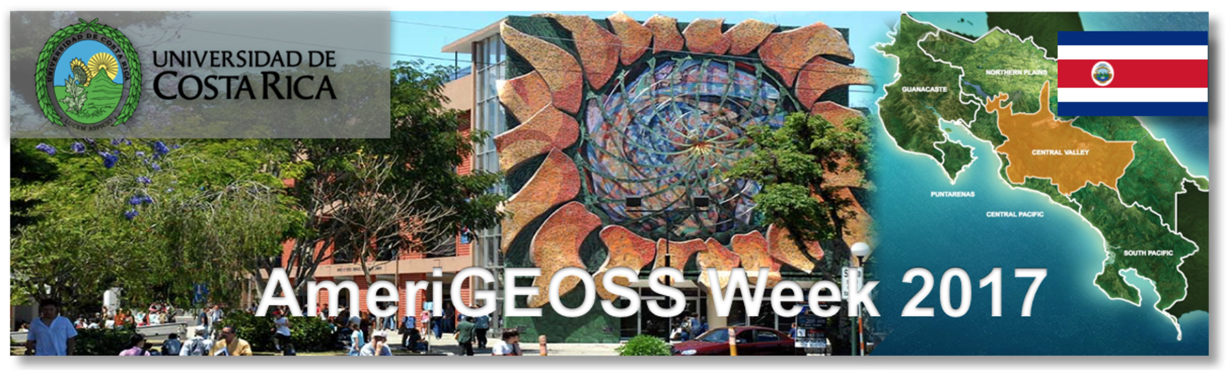
El Objetivo fue el de entregar entrenamiento en el uso de las Observaciones de la Tierra. La capacitación estuvo destinada al personal de instituciones gubernamentales y otros organismos tomadores de decisiones en la región.
La Semana AmeriGEOSS 2017 (Julio 31 – Agosto 4)

Slide 6
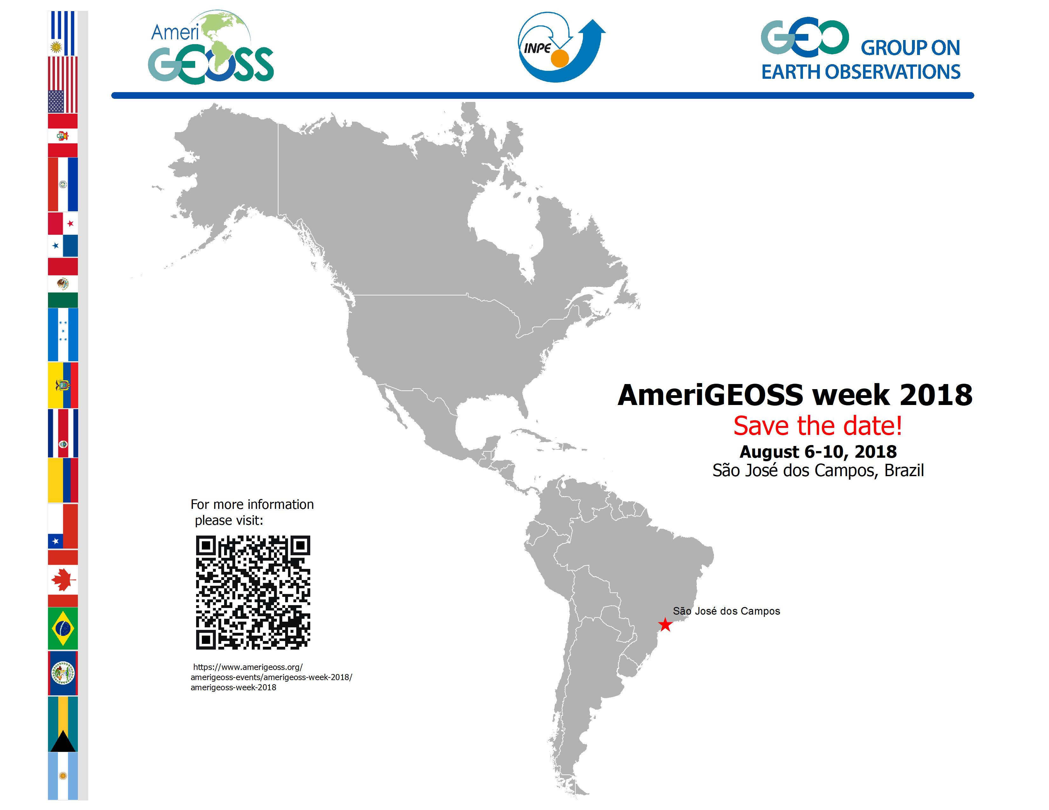

Slide 7
Capacity Building Needs in the Region
Varies by Country and by Institution.
Exist good knowledge in the use of Landsat and MODIS data.
Instruction in Spanish or Portuguese languages is always preferred over instruction in English.
Open source software is also preferred over proprietary software.
Academic Institutions (University level) seek to increase the number of RS courses in their curriculums. Academic networks are engaged in this effort but support is needed for the development of specific material.
Funding is the main issue for “in-person” trainings and for the development of specific material.
At the moment, the ministries of the Environment have the mandate to develop the Regional Environmental Indicators – parallel to SDGs. AmeriGEOSS and PNUMA are working together with the ministries and would welcome WGCapD support.

Slide 8
Thanks
Eric Madsen eric.madsen@noaa.gov

