Slide 1
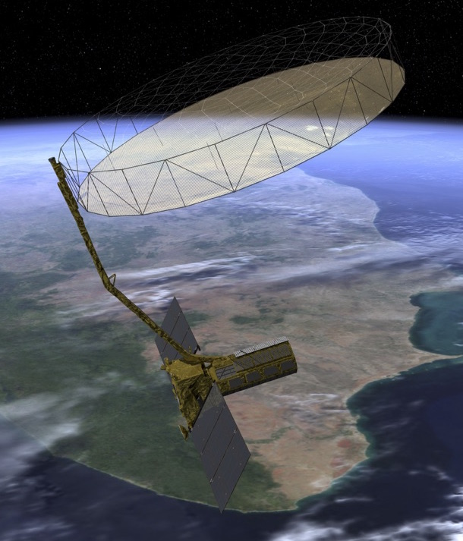
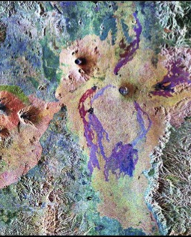


The NASA-ISRO SAR (NISAR) Mission
Paul A Rosen, NISAR Team
Jet Propulsion Laboratory, California Institute of Technology
WGCapD-7 Meeting
São José dos Campos, SP, Brazil
March 6-8. 2018
Copyright 2018 California Institute of Technology. Government sponsorship acknowledged.

Slide 2
Outline of Talk
NISAR overview
Announcement of Opportunity
Training, tools and workshops/conferences
CapD involvement in supporting NISAR in 2018-2020

Slide 3
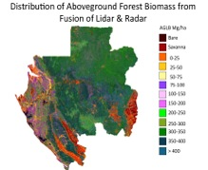
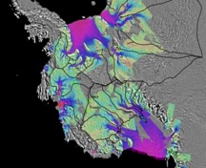
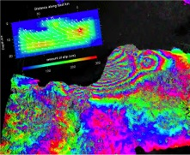
NISAR Mission Overview
Mission Science
Major partnership between US National Aeronautics and Space Administration (NASA) and Indian Space Research Organisation (ISRO)
Baseline launch date: No earlier than December 2020
Dual frequency L- and S-band Synthetic Aperture Radar (SAR)
  L-band SAR from NASA and S-band SAR from ISRO
NASA 4 Gbps Ka-band telecom system to polar ground stations (> 26 Tbits/day downlink capability)
ISRO I3K Spacecraft with 2.8 Gbps telecom system
ISRO Geosynchronous Satellite Launch Vehicle (GSLV) Mark-II (4-m fairing)
3 years NASA science operations (5+ years consumables)
All science data (L- and S-band) will be made available free and open
Ecosystem Structure
  Biomass disturbance; effects of changing climate on habitats and CO₂
Cryosphere
  Ice velocity, thickness; response of ice sheets to climate change and sea level rise
Solid Earth
  Surface deformation; geo-hazards; water resource management
Notes:
Emphasis:
The partnership has major contributions from both parties, enabling the mission.
ISRO considers this a science mission and adheres to NASA”s open data policy

Slide 4
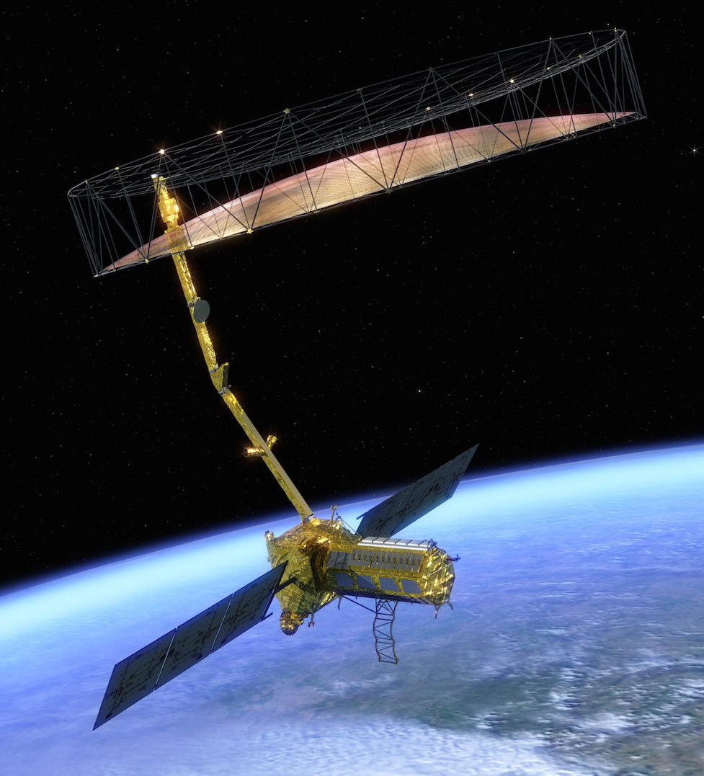

NISAR
NASA-ISRO SAR Mission
NISAR Characteristic: | Enables:
L-band (24 cm wavelength) | Low temporal decorrelation and foliage penetration
S-band (12 cm wavelength) | Sensitivity to lighter vegetation
SweepSAR technique with Imaging Swath > 240 km | Global data collection
Polarimetry (Single/Dual/Quad) | Surface characterization and biomass estimation
12-day exact repeat | Rapid Sampling
3 – 10 meters mode-dependent SAR resolution | Small-scale observations
Pointing control < 273 arcseconds | Deformation interferometry
Orbit control < 500 meters | Deformation interferometry
L/S-band > 50/10% observation duty cycle | Complete land/ice coverage
Left/Right pointing capability | Polar coverage, north and south
NISAR Uniquely Captures the Earth in Motion

Slide 5
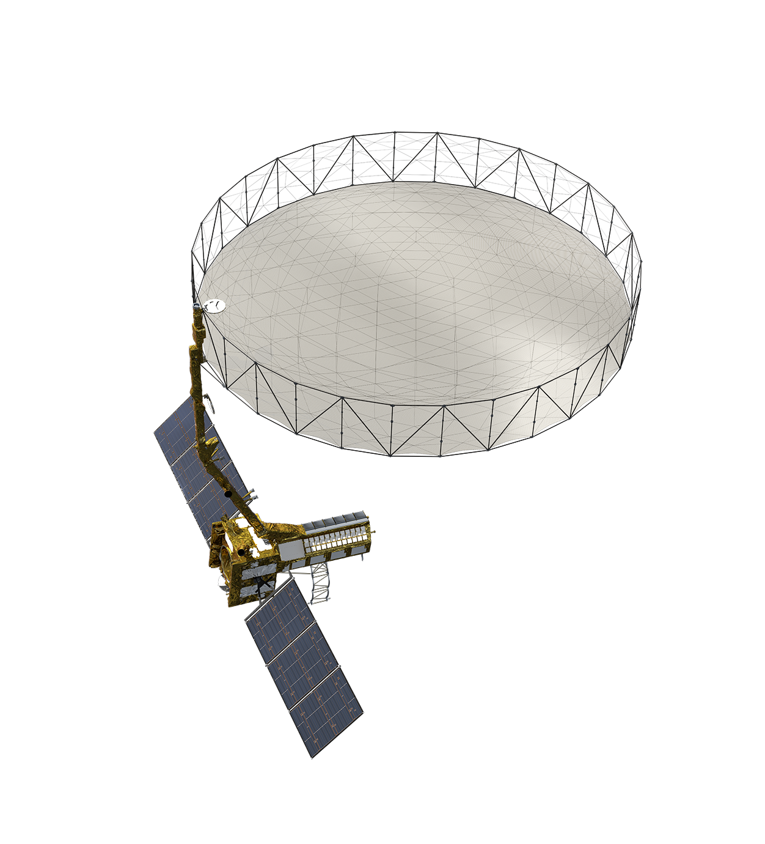
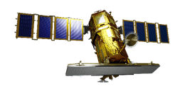
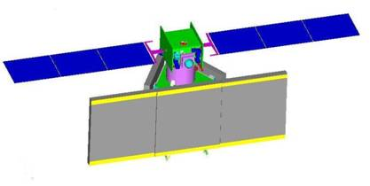
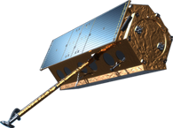
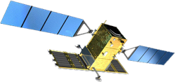

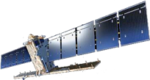
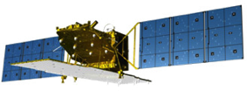
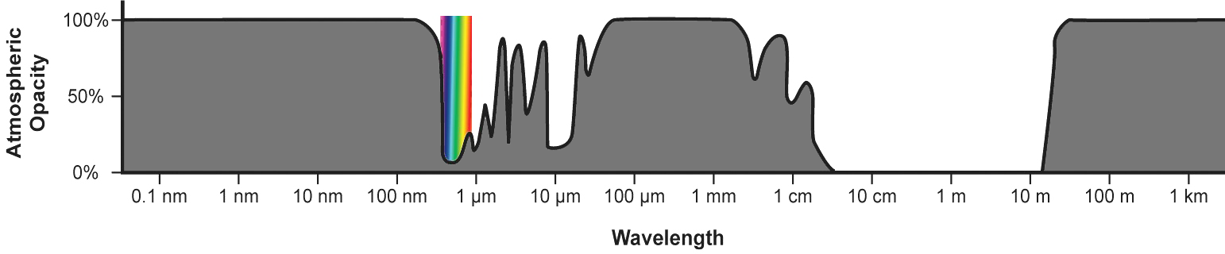
Atmospheric Windows & Some Current SAR Missions
KOMPSAT-5
RISAT-1 series
TerraSAR-X
COSMO-SkyMed
Radarsat-2
Sentinel-1
NISAR
ALOS-2
X-band
(3 cm)
C-band
(6 cm)
S-band
(12 cm)
L-band
(24 cm)
visible
γ-rays, x-rays
infrared
microwave

Slide 6
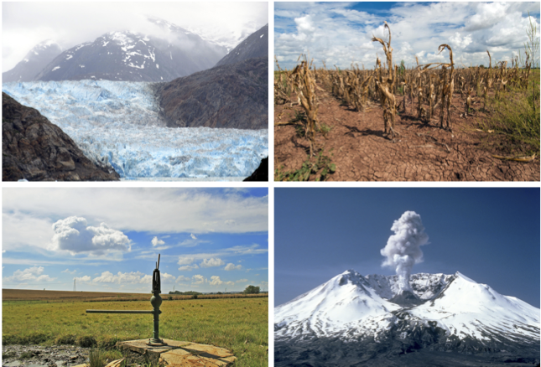
NISAR Science – Capturing the Earth in Motion
NISAR will image Earth’s dynamic surface over time, providing information
on changes in ice sheets and glaciers, the evolution of natural and
managed ecosystems, earthquake and volcano deformation,
subsidence from groundwater and oil pumping, and the human impact of
these and other phenomena.

Slide 7
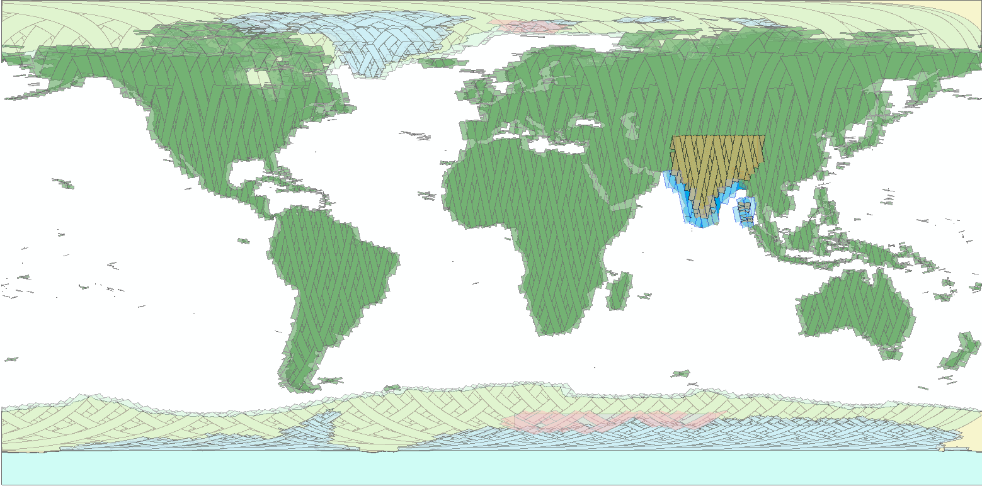
NISAR Systematic Free and Open Observations
L-band globally – S-band regionally
Repeated every 12 day cycle for the life of the mission
Planned launch: 2021
No target conflicts: overlapping targets uses union of all modes specified
Colors indicate different radar modes
Note: conceptual plan – does not reflect current detailed plan
C. Ballard, JPL
Persistent updated measurements of Earth
Global Raw data, Images, Interferometry and Polarimetry Products (50 PB)

Slide 8
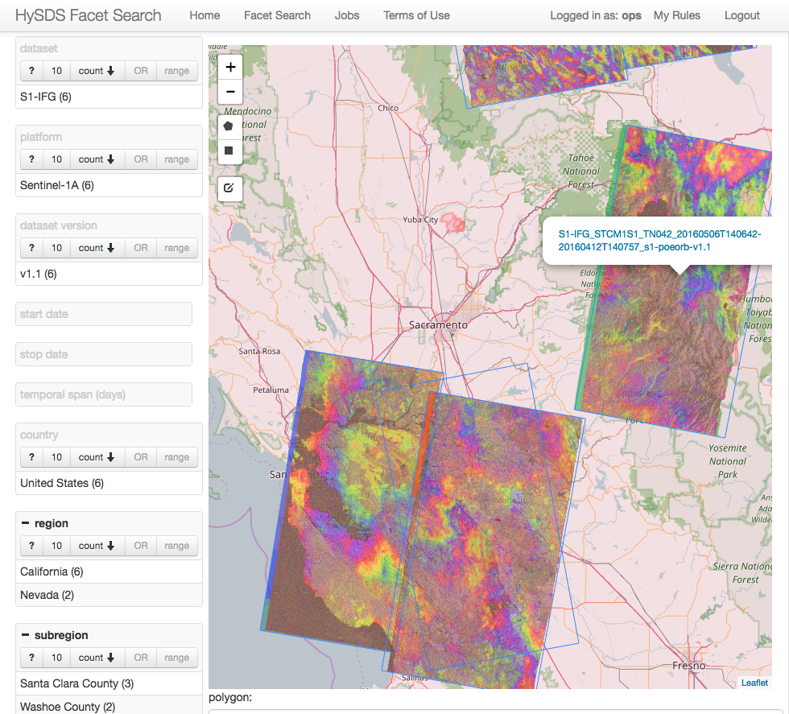
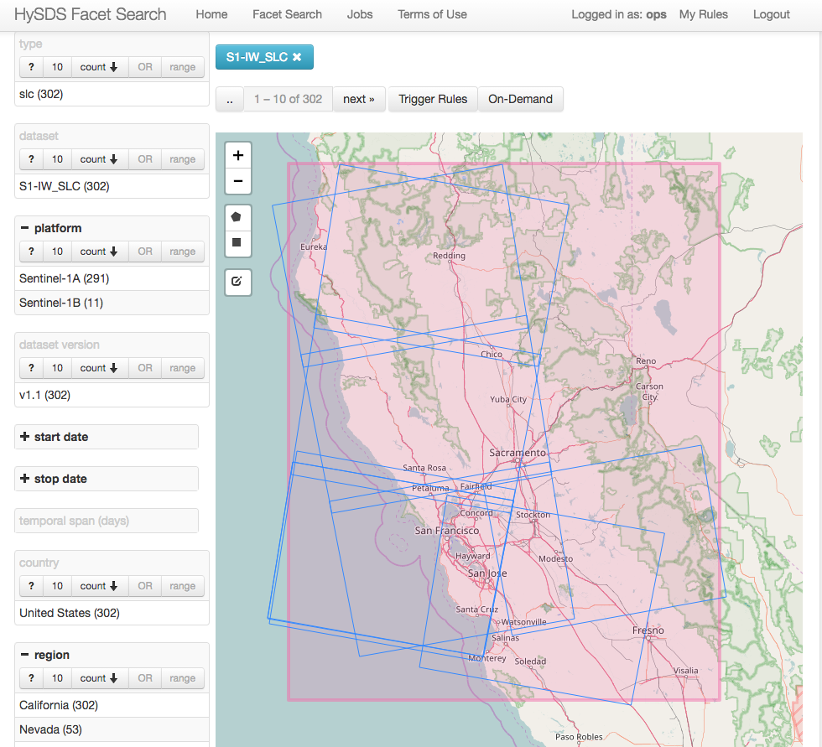
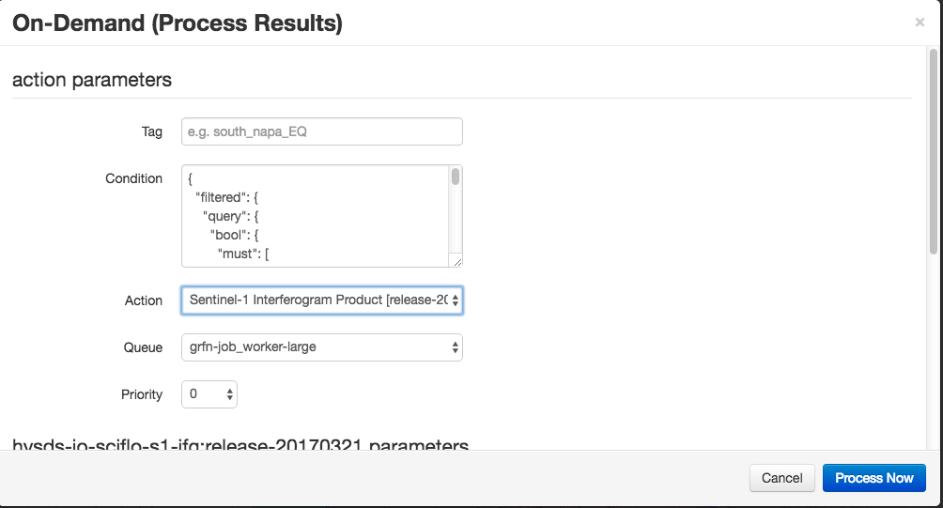
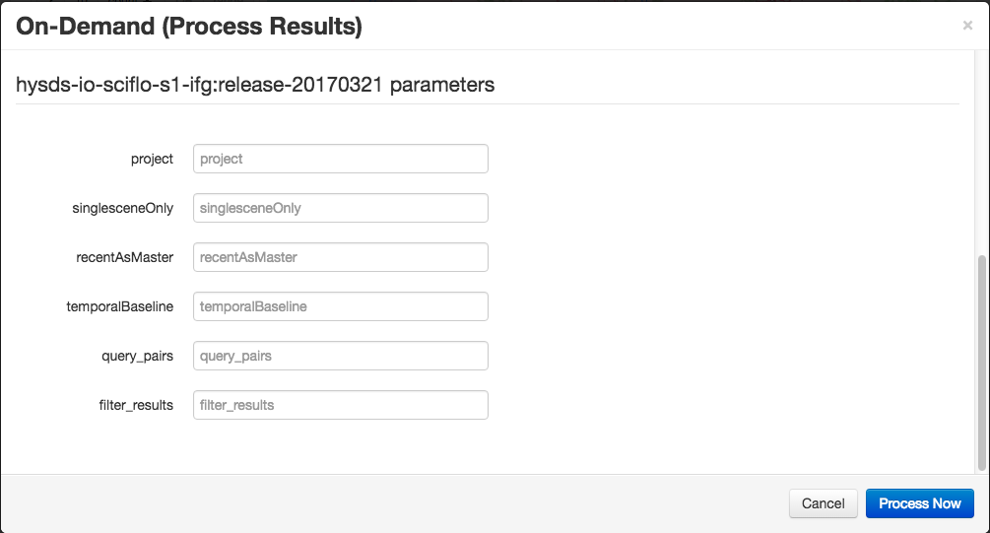
Data Processing and Access Moving to the Cloud
Cloud Processing and distribution allows scalability and localization with users
On-demand processing allows users to satisfy their needs without high-capability computing and networks.
On-demand Products Generated on and Distributed from Cloud
Selection of Data
Custom On-demand settings

Slide 9
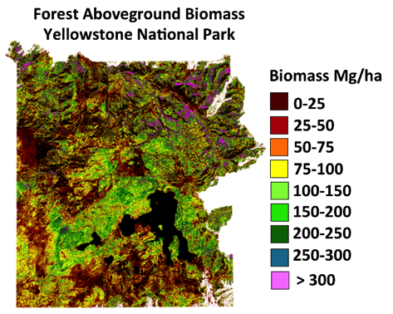
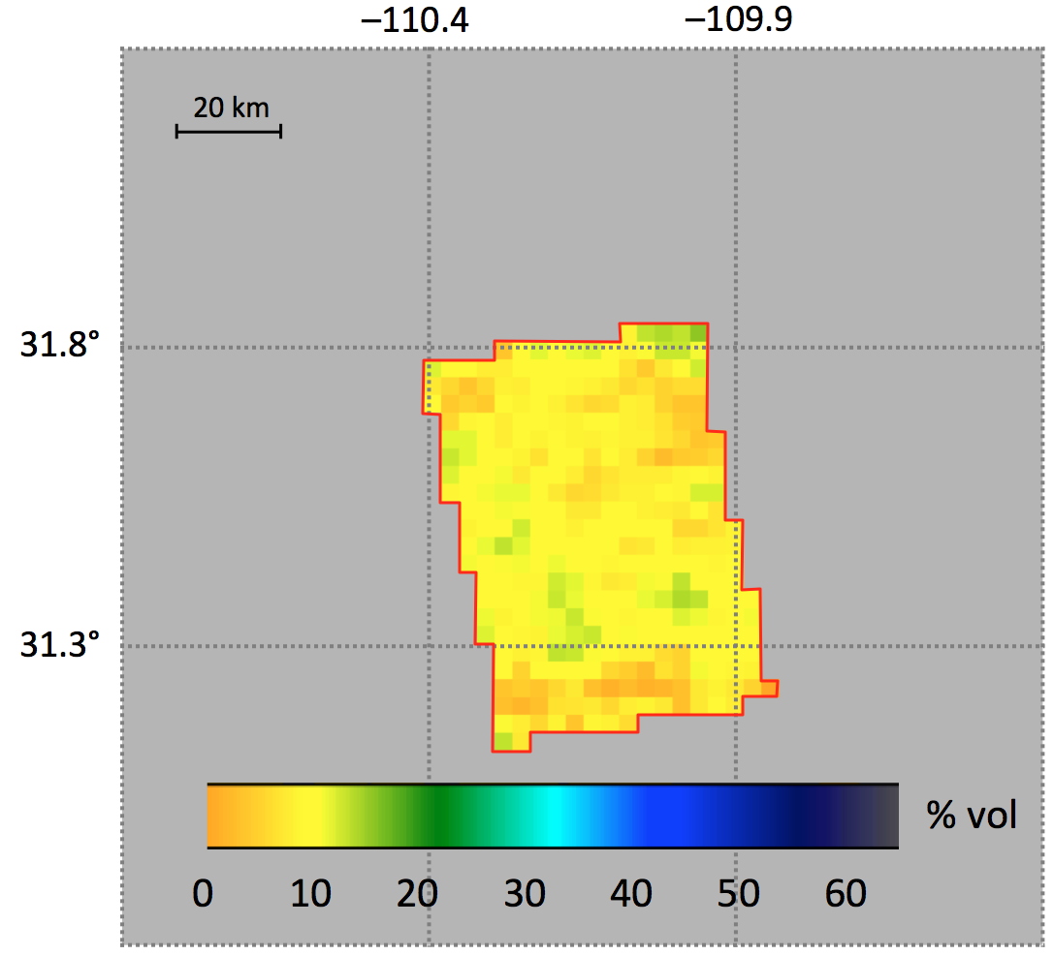
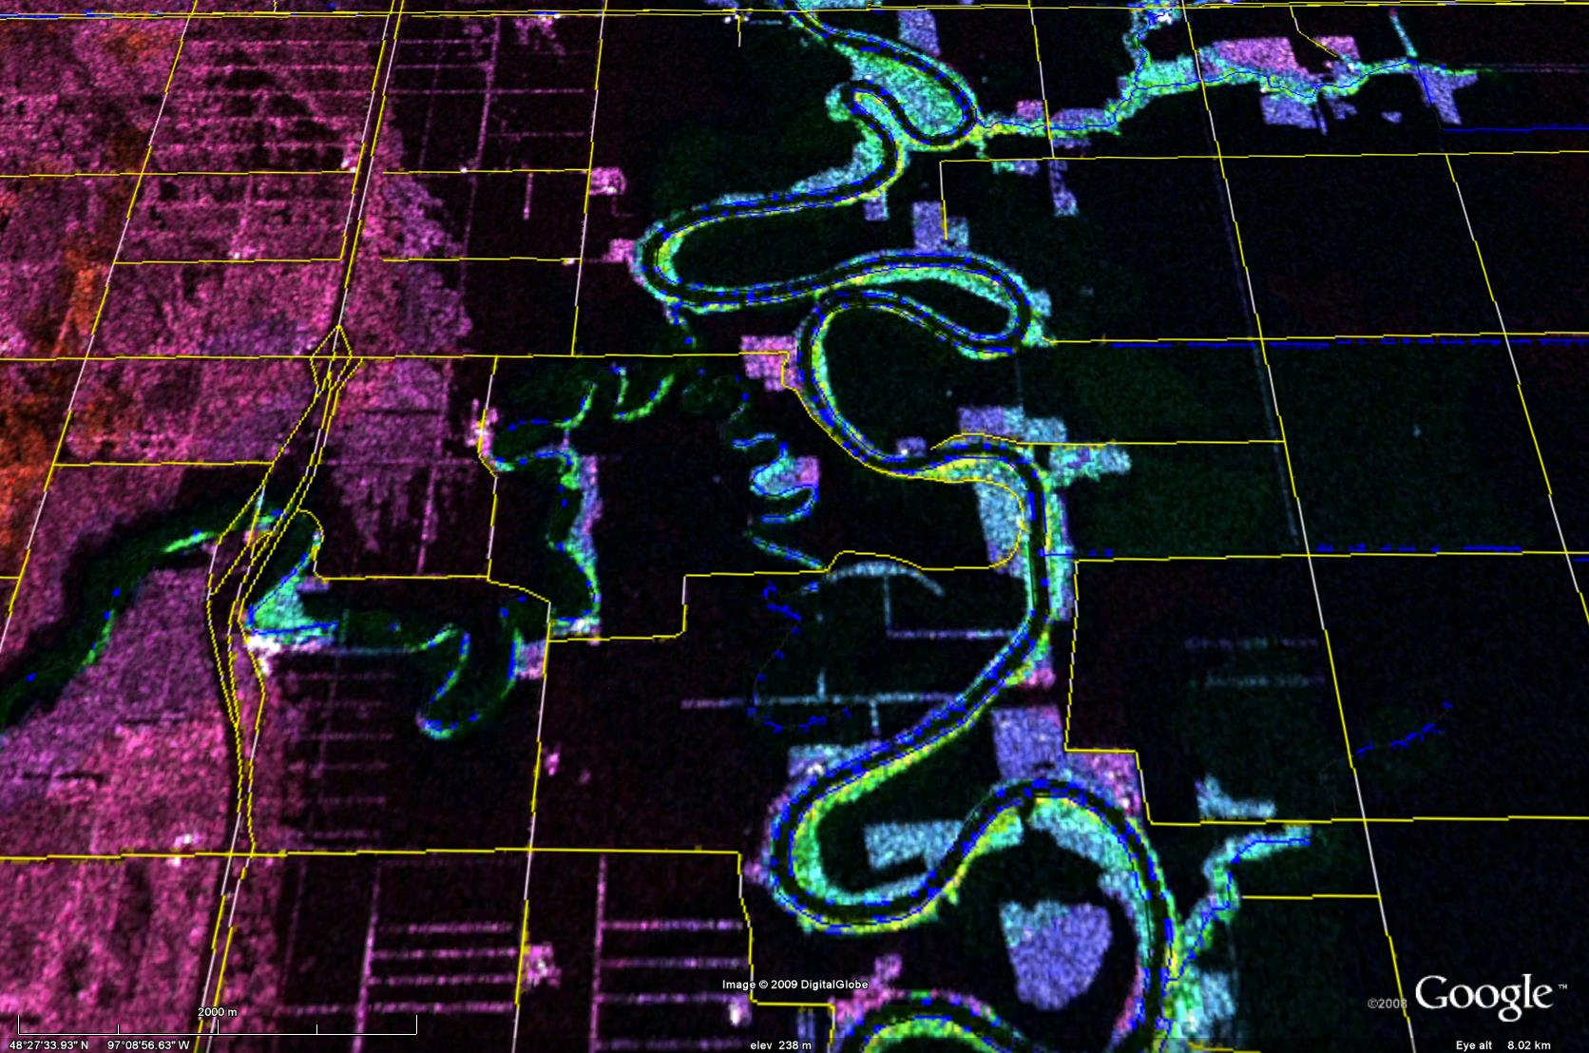
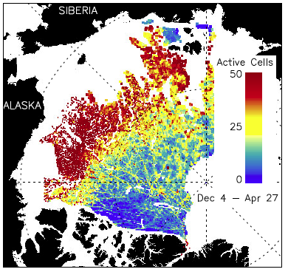
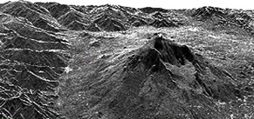
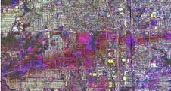

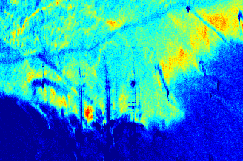
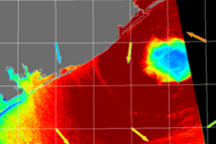
Some NISAR Applications Products
Volcanoes
Soil Moisture
Landslides
Flooding
Courtesy: S. Saatchi
Courtesy: M. Lavalle
Courtesy: G. Breckenridge/S. Nghiem
Courtesy: S.-H. Yun
Volcanic Eruptions
Tornado Damage
Courtesy: G. Bawden
Hurricane Winds
Courtesy: R. Kwok
Sea Ice Extent/ Ice and Ship Tracking
Oil Spills
DWH rig sitex
Courtesy: C. Jones
Courtesy: G. Bawden

Slide 10
NISAR Utilization Plan to be published Apr 2018
NASA plan to develop applications users
Synergize with ISRO’s UP
Workshops to gather user needs
  To date:
    Oceans and sea ice
    Critical infrastructure
    Subsurface Reservoirs
  Future:
    Forest applications
    Agriculture
    Urgent Response
http:/nisar.jpl.nasa.gov/applications

Slide 11
NISAR Utilization Components
Leveraging Applied Sciences, Educational, and Capacity Building investments at NASA
To date:
  Annual training in SAR and InSAR
  ARSET Training in SAR
  NISAR/SMAP soil moisture and agriculture workshop
  ARIA rapid response system prototype
  ISCE Open-source-for-research SAR processing code
Future:
  Simulated Products,
  GEO CBC AmeriGEOSS (F. Meyer)
  NISAR-specific workshops
  Envoys
  Webinars and workshops jointly with ISRO

Slide 12
NISAR and CapD
NISAR has potential to provide a wide range of capabilities in service of CapD initiatives
Synergistic Utilization Plan
Remote processing with web client
Distance learning and in-person training materials jointly developed by NASA and ISRO for students and teachers
Sample data products and scientific workflows
Project Envoys able to provide a personal connection to global regions

