Slide 1

ESA
Recent & Forthcoming
MOOCS in EO
Sentinel Webinars (RUS)
Committee on Earth Observation Satellites
F. Sarti, C. Stewart & R. Eckardt
Agenda Item 13
CEOS 7th Working Group for Capacity Building & Data Democracy (WGCapD-7) Annual Meeting
INPE São José dos Campos, Brazil
6-8th March, 2018

Slide 2
Content
Echoes in Space – The first MOOC on SAR

Slide 3

FREE OF CHARGE
START: 09-OCT-2017
OPEN TO ANYBODY
5 LESSONS
SELF-PACED LEARNING
CERTIFICATE FOR COMPLETION

Slide 4

5
12
Lessons
Tutorials
5771
1
Students
Certificate

Slide 5
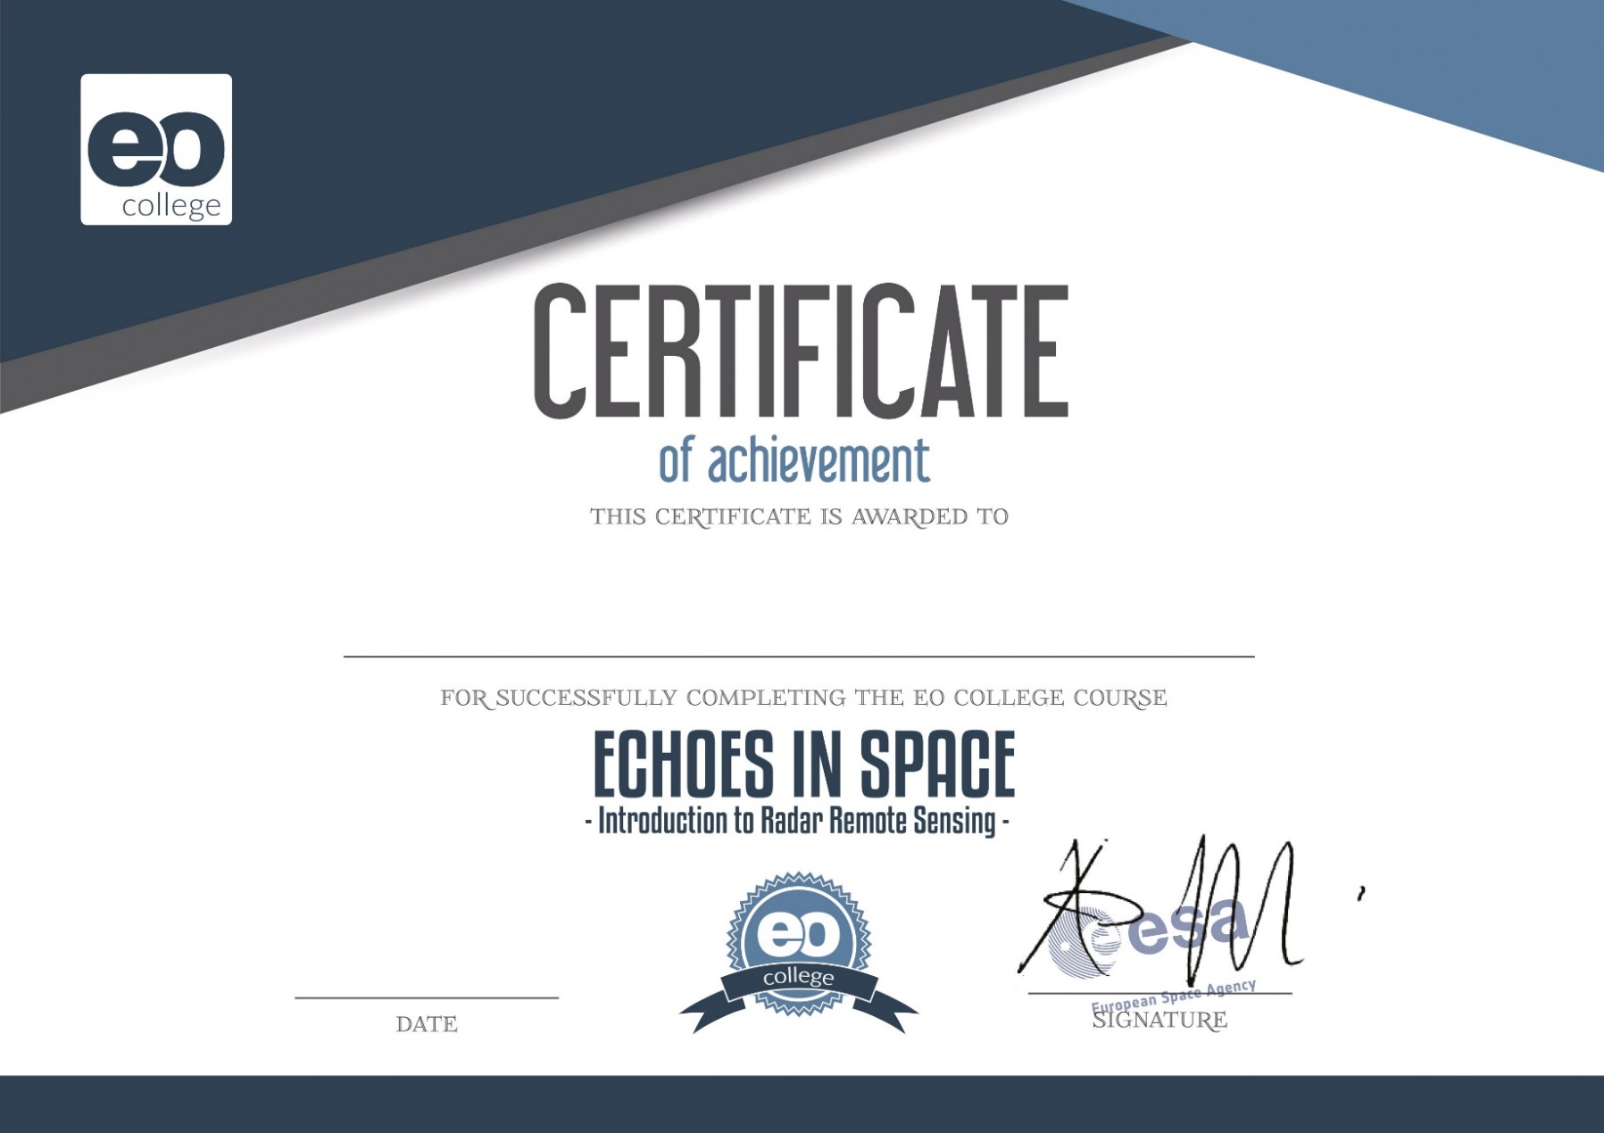

Slide 6
HiSTORY
Introduction
What is an active radar system?
What is radar?
Basics of active systems
Radar History
The SAR principle
What is an electromagnetic wave?
Sensors & Missions
Properties of EM Waves
The radar bands
The EM spectrum
Exsisting missions
Getting used to radar images
SAR image features
Comparison to optical images

Slide 7
GEOMETRY
The imaging geometry
Radar imaging geometry
Effects of imaging geometry
Interaction with the Earth surface
The scattering mechanisms
Important parameters
How to obtain and use radar data
Sentinel-1 data access
Intro to SNAP
Other data sources

Slide 8
Land
Theory
Settlements
Intro to Interferometry
Urban applications
Intro to Polarimetry
Urban Tutorial
Intro to time series
Forest
Agriculture
Forest applications
Agriculture Applications
Forest tutorial
Agriculture tutorial

Slide 9
Water
Theory
Oceanography
Scattering mechanisms
over water
Maritime Applications
Sea Ice
Sea Wind
Sea Waves
Water Bodies
Water body applications
Sea Surface Current
Water body tutorial
Oil Spill Mapping

Slide 10
Hazard
Theory
Seismic events
Subsidence Monitoring
Seismic introduction
Hazard monitoring
Volcano Tutorial
Flood monitoring
Wrap up
Flood applications
Processing tools
Flood tutorial
Final test

Slide 11
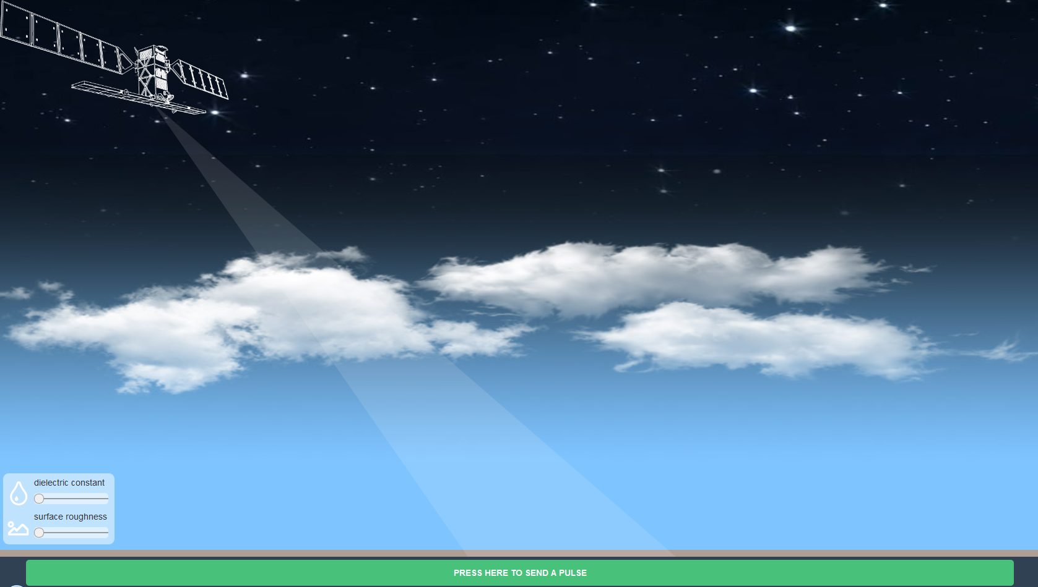
Content Highlight

Slide 12
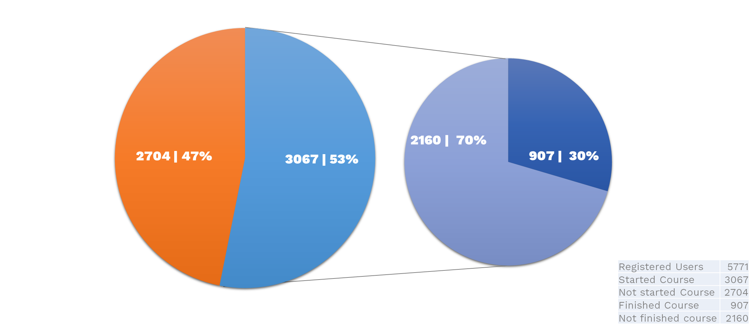
Completion rates

Slide 13
Completion rates

Slide 14
Content
ESA - Forthcoming MOOCS in EO Sentinel
Webinars (RUS)

Slide 15
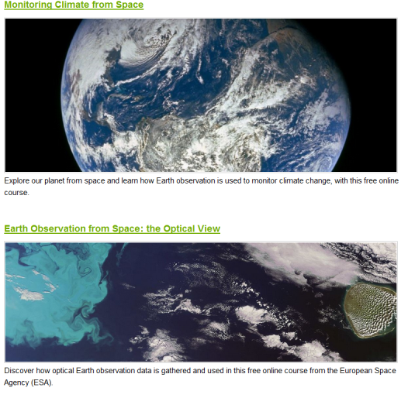
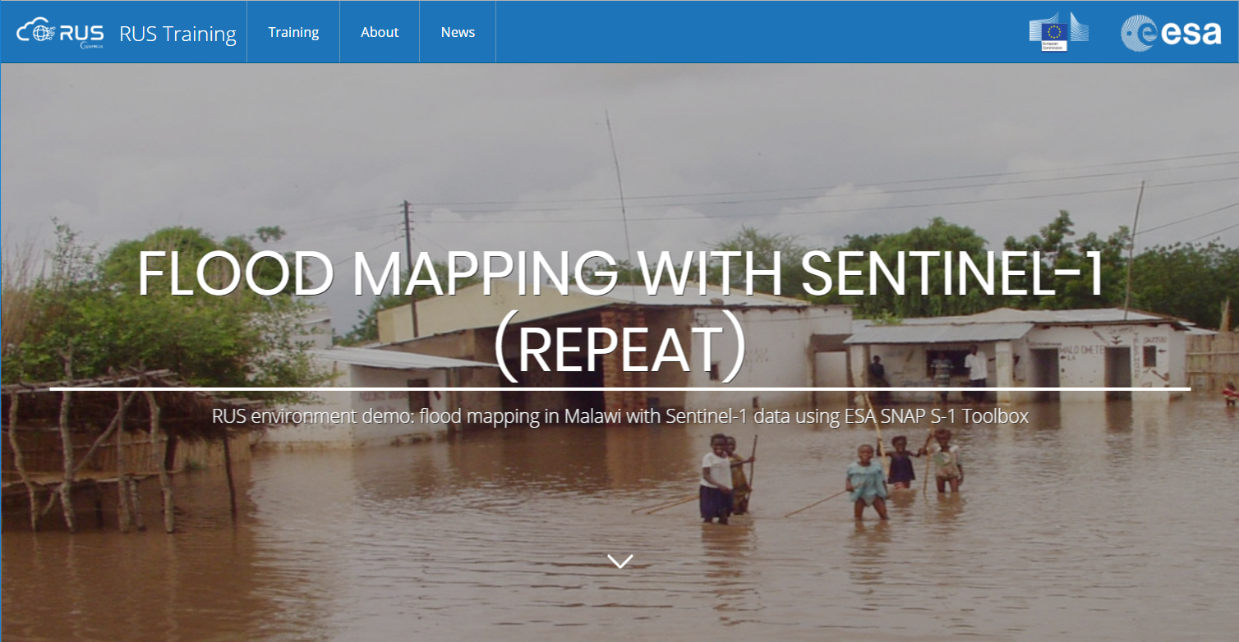
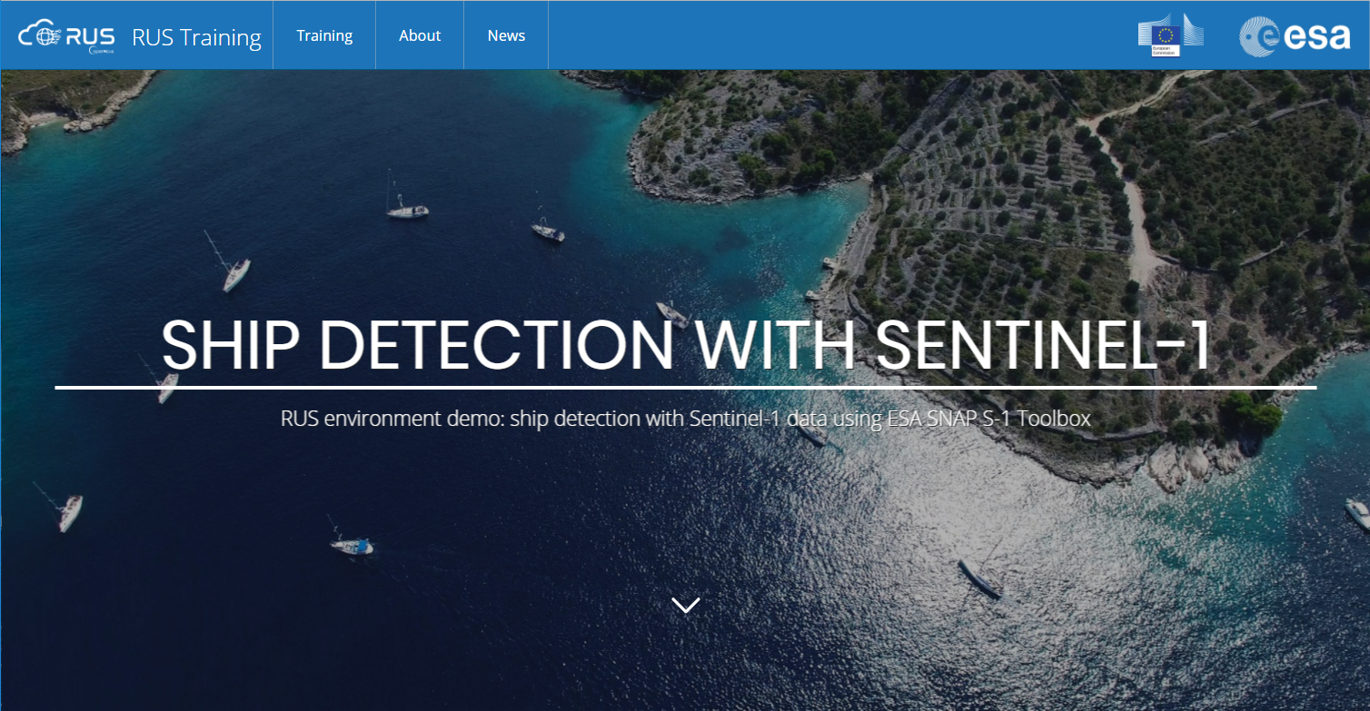
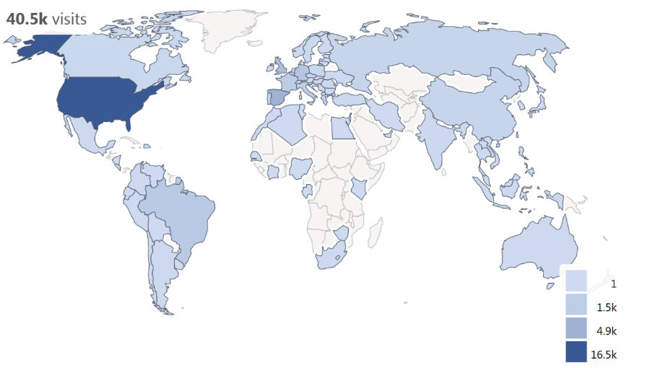
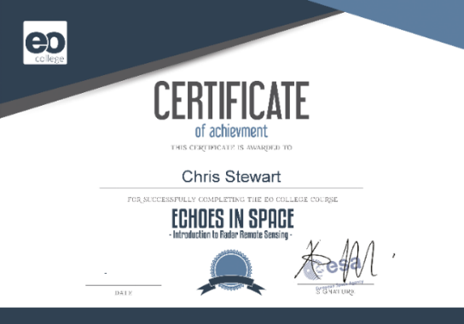
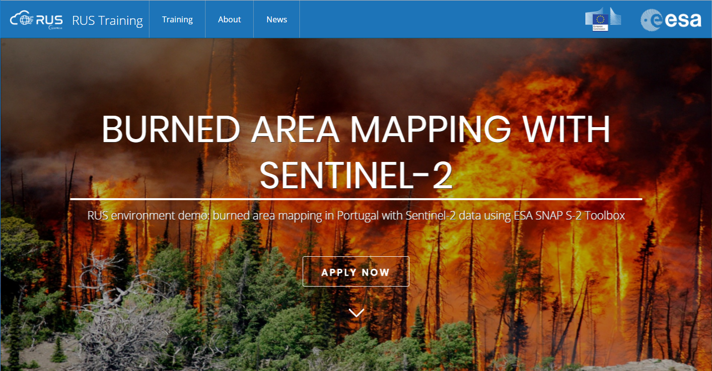
Capacity Building Activities
ESA EO E-Learning Courses
MOOCs
  Climate, Optical, Greenland, SAR and more in preparation (Land, Africa …)
EO Educational Platform
  EO Browser adaptation (Synergize)
Webinars
  RUS (Support contract to Sentinels users)
Almost 12000 registrations for ESA EO MOOCs in 2017, with completion rates up to 28%

Slide 16
Forthcoming MOOCs
In preparation:
Next run of the SAR MOOC with CSA for Canadian Applications (expected by the end of 2018 / beginning of 2019)
In the pipeline (no dates yet):
Next run of the Optical MOOC
CRYOSPHERE MOOC
LAND MOOC with many runs on the different Land Applications and with a specific run on AFRICA
MARINE MOOC
ATMOSPHERIC MOOC

Slide 17
Echoes in Space – SAR MOOC Re-run
Re-run of the ESA SAR MOOC including the contribution from CSA (currently in the definition phase)
on top of the previous SAR Applications addressed by the original MOOC, it will include also those relevant to the Canadian region, such as Water & Ice:
  rivers & lakes,
  ice and snow monitoring,
  ship detection and support to navigation in polar regions,
  iceberg monitoring,
  glacier monitoring,
  avalanches,
  marine applications ...
The course will include theory, relevant techniques and related exercises
Although the course will obviously address also the use of Radarsat data (as ESA TPM data) especially for applications requiring high-res & full pol C-band SAR data, it should maintain the original focus on the use of S-1 data

Slide 18

Land MOOC
 | MOOC LAND Remote Sensing
OBJECTIVES | Develop an interactive MOOC on EO data from Space, fostering the use of EO data, for LAND scientific studies, societal applications and services Provide basic information about EO data, its uses, types and challenges. • Reduce perceived ‘barriers’ for non-technical users. • Provide practical examples of usage of EO data. • Demonstrate the benefits of its use in real-world scenarios.
PRODUCTS | Several MOOC Runs on MOOC platform (eg. agriculture, forests, risks, tectonics) including one targeted to regional applications in Africa, promotion on the course to various communities, (NB in the future, depending on available funding, additional runs could be devoted to Latin America and to Asia/Pacific)
Amount /DURATION | Several years

Slide 19
Thanks for the attention and ….
… please do not hesitate to propose suggestions or requirements about future EO MOOCs (including Joint Development, Joint Funding …)

