Slide 1
Committee on Earth Observation Satellites
SAR-EDU &
EO College
Robert Eckardt (Friedrich-Schiller University Jena)
Agenda Item 12
CEOS 7th Working Group for Capacity Building and Data Democracy (WGCapD) Annual Meeting
INPE São José dos Campos, Brazil
6-8th March, 2018
1

Slide 2

COMMUNITY

COMMUNITY
✶

E-Learning
Local
Workshops

Slide 3
Local Workshops

Slide 4
Participants of the Summer School 2013 @ Dornburg Castle, Jena.
Established in 2013
40 -50 participants yearly
Focus on Applications
Interdiciplinary exchange

Slide 5
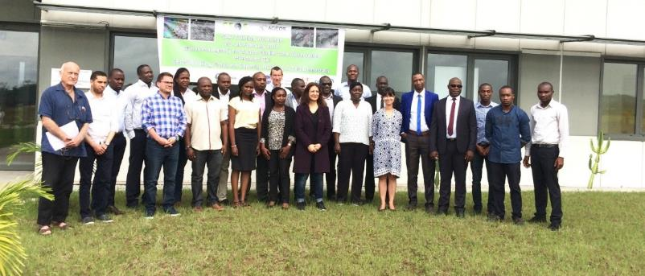

Slide 6
E-Learning

Slide 7
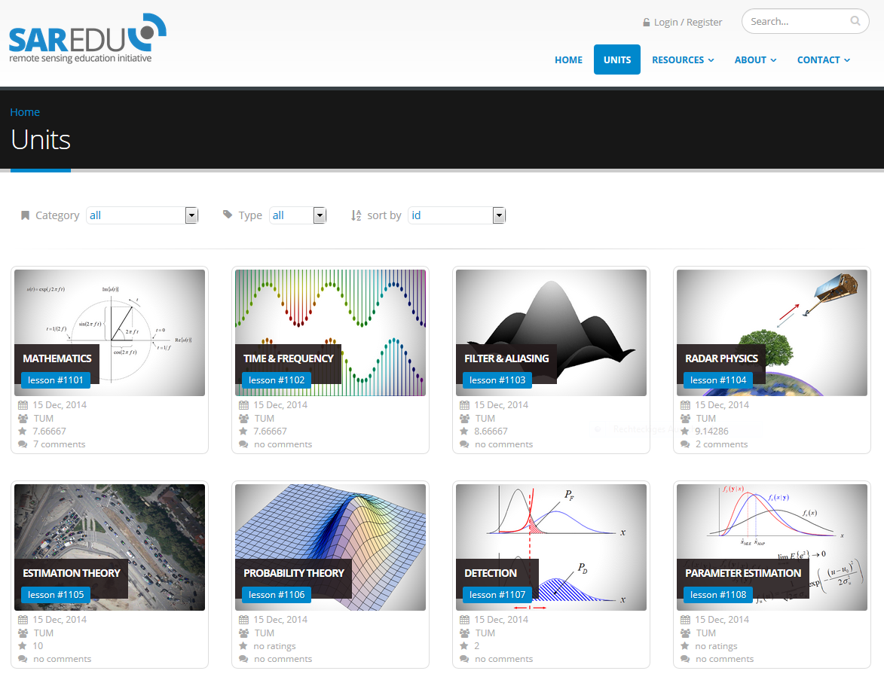

Slide 8
MATHE-MATICS
DATA
PROCESSING
SAR
IMAGING
BASICS
IMAGE
PROCESSING
INSAR
POLSAR
PASSIVE MICROWAVE
RADARGRA-MMETRY
METHODS
ANTHROPO-SPHERE
BIOSPHERE
CRYOSPHERE
HYDRO-SPHERE
LITHO-SPHERE
OCEANO-GRAPHY
APPLICATIONS

Slide 9
SAR-EDU Webportal
EO College

Slide 10


12


Tutorials

8
Courses
Resources
40
Lessons
Data


2300
24 h
Slides
Video

Slide 11

COMMUNITY

COMMUNITY


E-Learning
Community

Slide 12

Courses




Video
Resources
Interactive
Content
Quiz

Certificates

Slide 13


Courses
Resources

Discussion

Slide 14

Discussion


Course
Discussion
Discussion
Groups

Slide 15


Courses
Resources


Discussion
Articles

Slide 16

Articles




Read
Write
Bookmark
Follow
Authors



User
Community

Slide 18
State of the art

Slide 19
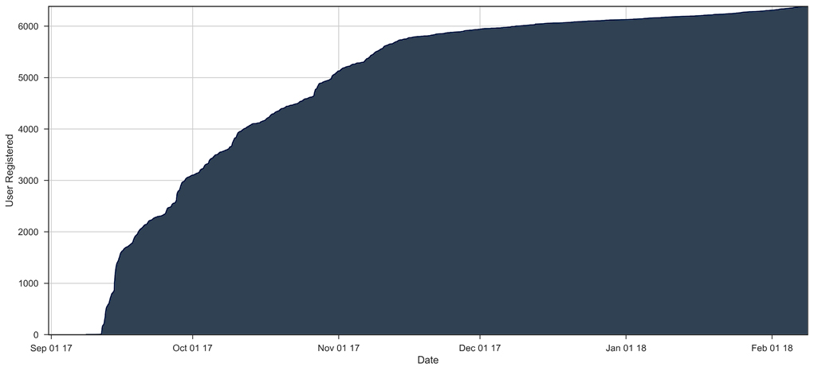



■
September 2017
> 6.300 registered users
> 22.000 h spent on page
> 570.000 pageviews

Slide 20
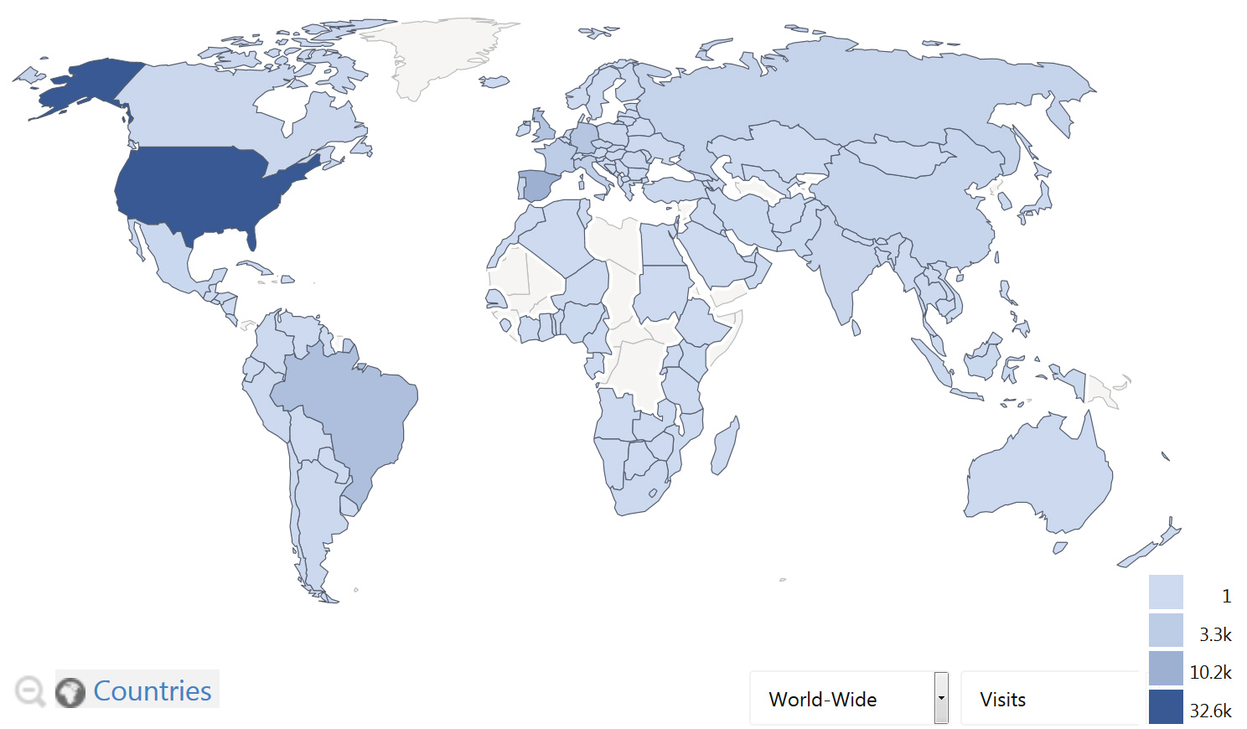
Geographicacl distribution
❑
Statistics partially based on Browser language

Slide 21
Geographicacl distribution – Unique Visitors

Slide 22
Use of the platform

Slide 23

Community E-Learning

Slide 24
FREE OF CHARGE
START: 09-OCT-2017
OPEN TO ANYBODY
5 LESSONS
SELF-PACED LEARNING
CERTIFICATE FOR COMPLETION

Slide 25

Community E-Learning
MOOC

Slide 26
?
MINI-MOOC
?
2018

Slide 27
eo-college.org
Friedrich-Schiller University Jena
robert.eckardt@uni-jena.de
Department for Earth Observation

