Slide 1
Technology & Tools Used for Capacity Building at USGS
Committee on Earth Observation Satellites
Eric C. Wood
Agenda Item #11.9
CEOS 7th Working Group for Capacity Building & Data Democracy (WGCapD-7) Annual Meeting
INPE São José dos Campos, Brazil
6-8th March, 2018

Slide 2
Agency Competencies
Technology, Tools & Methods
General Capacity Building Initiatives
Project related training where simple integrated discovery, visualization, and access (download) to Landsat and Sentinel data is required
Tools and Methods applied
Integrated LandLook Viewer (integrated Landsat and Sentinel imagery)
Previously stand alone Landsat Look and Sentinel Look Viewers, combined to make LandLook .
Will be live ~ April 1, 2018 at will most likely be the following url: https://landsatlook.usgs.gov/LandLook
Best Practices
Web accessible free download of Landsat and Sentinel scenes (~ 7.5miilion Landsat scenes, ~2.9 million Sentinel 2a and 2b scenes)
Appropriate technology for millions of non-power users

Slide 3
Capacity Building Expected Activities
Synergy with WGCapD’s plans
SAR Trainings:
NA
Non-SAR Trainings:
Generally project linked – not available to general public.
Exemplary: SilvaCarbon (discussed in another presentation)
Tools & Portals:
LandLook (previous slide)
COVE / Data Cube Trainings:
Any trainings on COVE? Data cube? NOT PRESENTLY
Status Updates for Collection & Coordination of CB Resources:
No support to GEOCAB, technology but not CB support for WGISS.

Slide 4
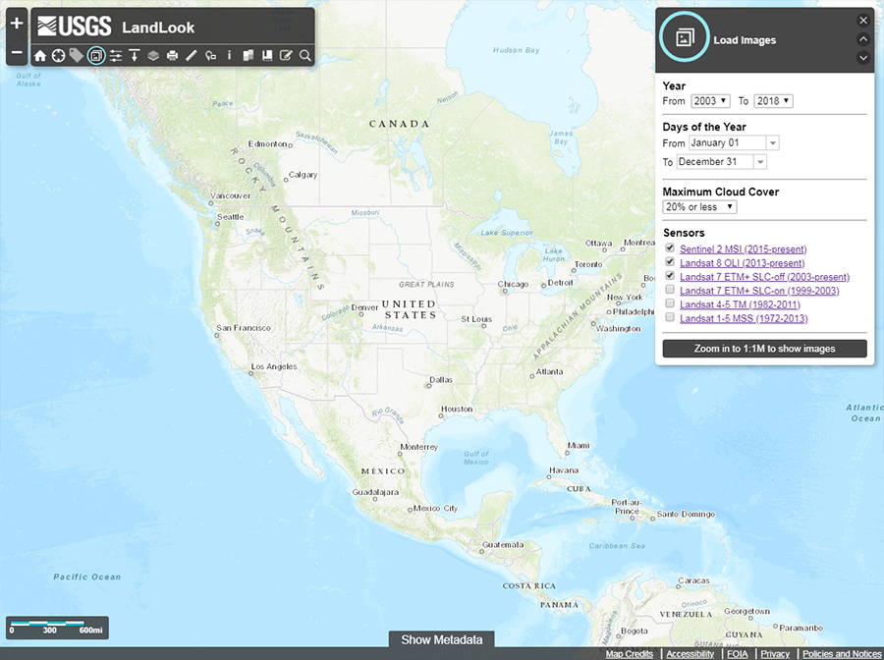
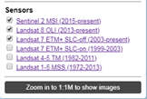
Sentinel & Landsat

Slide 5
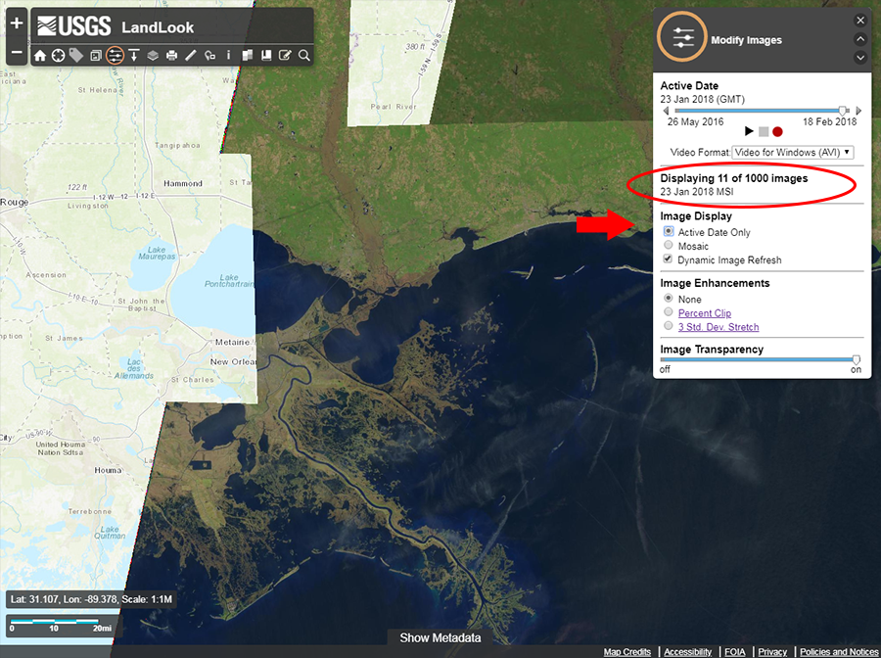
Sentinel Only

Slide 6
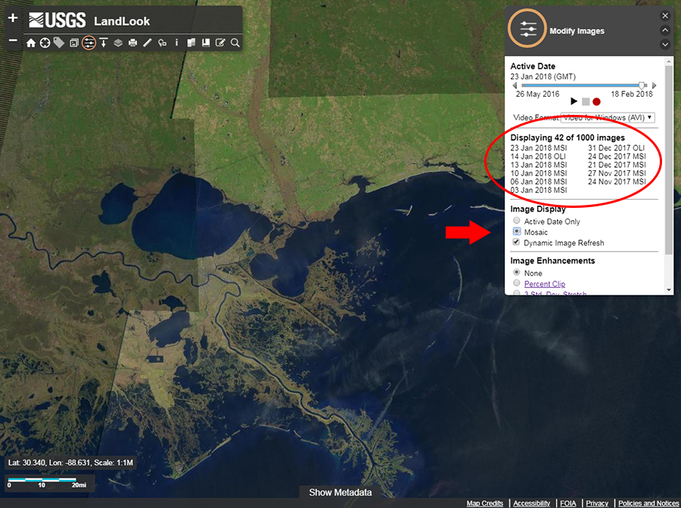
Sentinel with
Landsat backfill

Slide 7
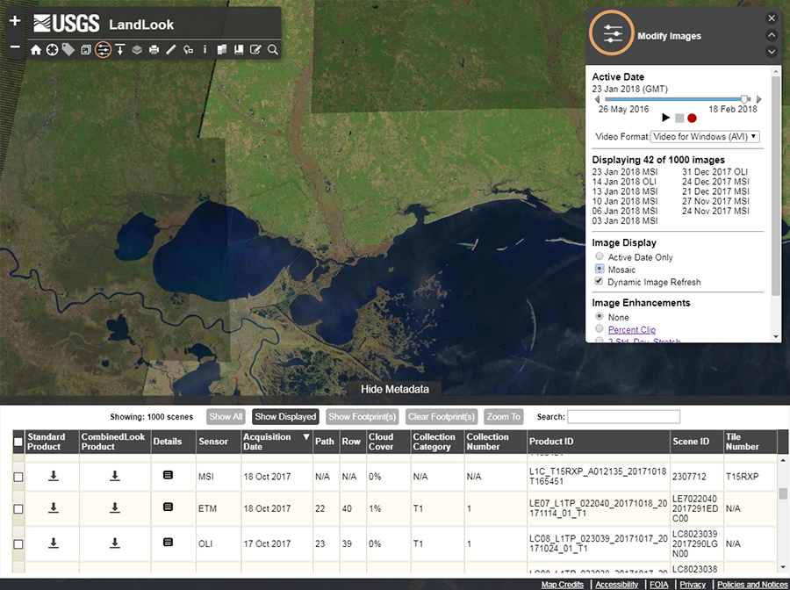
Sentinel & Landsat
Downloads

Slide 8
BACKUP SLIDES

Slide 9
LandsatLook and Sentinel2Look Viewers
Primary features include:
Quick and easy exploration of Landsat and Sentinel-2 browse image tiles at up to full resolution
Simple, interactive web map functionality (base maps, labels)
Extraction of the on-screen display as a graphical file
Access to full-tile metadata and archival (full band, full tile) image download
Optimization for mobile devices
Available at: https://landsatlook.usgs.gov/
and: https://landsatlook.usgs.gov/sentinel2

Slide 10
LandsatLook Viewer

Slide 11
Sentinel-2 MultiSpectral Instrument (MSI)

