Slide 1

Technology, Tools & Methods Used for Capacity Building at DLR
Committee on Earth Observation Satellites
Michael Bock & Dieter Hausamann
Agenda Item 11-4
CEOS 7th Working Group for Capacity Building & Data Democracy (WGCapD-7) Annual Meeting
INPE São José dos Campos, Brazil
6-8th March, 2018

Slide 2


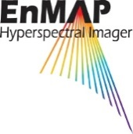

Capacity Building Activities
Technology, Tools & Methods
Portals & Projects by DLR Agency via German EO Program (BMWi)
SAREDU: SAREDU.dlr.de, will not be updated, all content moved to EO-College,
EO-College: EO-College.org, sustainable concept in cooperation with other agencies envisaged, several MOOCS by different parties in planning
SARbian, a compilation of freely available software for SAR Remote Sensing.
EnMap Portal: enmap.org, provides the free Enmap Toolbox, CB Material will be consolidated and distributed via EO-College Platform
FIS: Remote Sensing in Schools Portal: fis.uni-bonn.de Comprehensive learning portal on EO incl. research and analyses tools, useful for Entrance Level CB trainings too. A new portal will be launched soon.

Slide 3
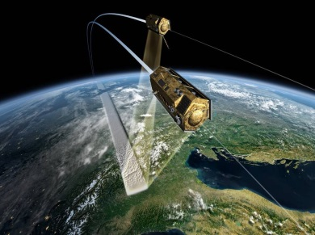
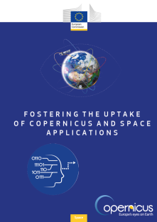

Capacity Building Activities
Technology, Tools & Methods
Scientific Data Portals of DLR
TSX/TDX Scientifc Portals: terrasar.science.dlr.de tandemx-science.dlr.de, 90m DEM to be released soon, Free Access for Capacity Buildung can be granted
Copernicus Data Portals & Projects
CODE-DE: Code-De.de Sentinel data Portal and Cloud processing platform.
FP-CUP: DLR Agency leads European project on Copernicus User Uptake (Slide)
Copernicus Academy support the European Commission in bridging the gap between skills and Copernicus data use (DLR, Universities Jena, Bochum ,Würzburg

Slide 4
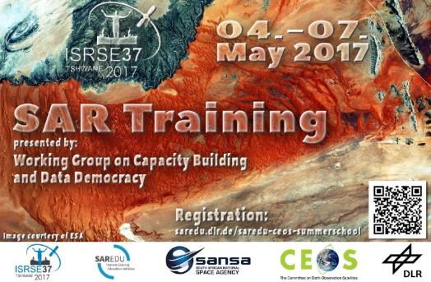


Capacity Building Activities
Technology, Tools & Methods
SAR Trainings:
2016-17: Support to organize 3 WGCAPD SAR Trainings in Africa
10/2017: 3 day SAREDU Course at Stellenbosch Uni.in South Africa
9/2018: SAREDU Summerschool (use of CODE-DE cloud proc. in prep.)
Q4/2018: Multilingual SAR Backscatter Mini- MOOC,
Other Training 2018 -2019 tbd. Focus on E-Learning EO-College
Other EO Trainings: see Presentation 30-4
EAGLE Graduate Programm
applied EArth Observation and Geoanalysis of the Living Environment
International master program of DLR chair at University Würzburg
Data Cube Trainings:
European data cube initiative is monitored, Future Trainings tbd.
Within project Big data cube Rasdaman datacube will be demonstrated

Slide 5
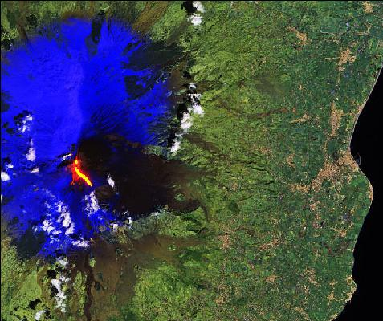

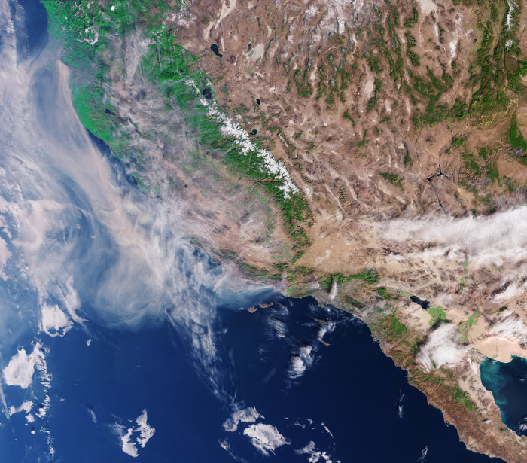

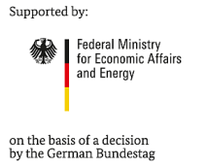



FIS – Remote Sensing in School Lessons
Project:
Earth Observation in School Lessons
funded by DLR
Interactive teaching materials for 5 STEM subjects
Comprehensive learning portal on EO incl. research and analyses tools
Update teaching material with Sentinel data
New teaching material based on Mini-MOOCs, virtual and augmented reality
ESA
Mount Etna, IT, 16/03/2017 (Sentinel-2A)
Larsen C Antarctica, 19/01/2017 (Sentinel-1A)
Forest fires in California, USA, 15/12/2017 (Sentinel-3A)

Slide 6

FP-CUP
Framework Partnership Agreement on Copernicus User Uptake (FP-CUP)
FPA contract expected April 2018
Consortium: 48 partners, 23 countries
Budget ~20 Mio € (2018-2021)
Actions start 2018
Five Lines of Action
1. Information and Training
2. Building an Active User Dialogue
3. Developing Downstream Applications
and Services
4. Piloting Downstream Applications and Services
5. Promoting National and Multi-National Innovation Actions

Slide 7
Information and Training
Target Group(s)
Type of Actions (information)
Type of Actions (training)
Professionals (users in public/private sector)
Scientists (multipliers);
Teachers and professors
EO professionals (developers)
Students (tertiary/secondary)
User workshops
Seminar series
Information portals
Publications
Web-stories
Videos
Apps and games
Social media
Connecting domain-specific working procedures
…
in national languages
Specific national audiences
Involve Copernicus Relays
developing modules for university/cont’d education
courses for specific domains
online resources (software, data bases, curricula, MOOC)
programmes supporting the exchange of personnel among different institutions
…
Involve Copernicus Academy
Priority
New topics
Multi-national reach
National or lower levels

Slide 8







CODE-DE:
Copernicus Data and Exploitation Platform
Deutschland (Germany)
Current duration: 01.07.2016 – 31.03.2019
(In discussion: operations until end 2019)
Phases:
  Data Access: March 2017
  Processing 1: Nov 2017 (open/public solution)
  Processing 2: May 2018 (dedicated 3rd party solution +
  connection to Open Telekom Cloud)
Contact: vanessa.keuck@dlr.de

Slide 9
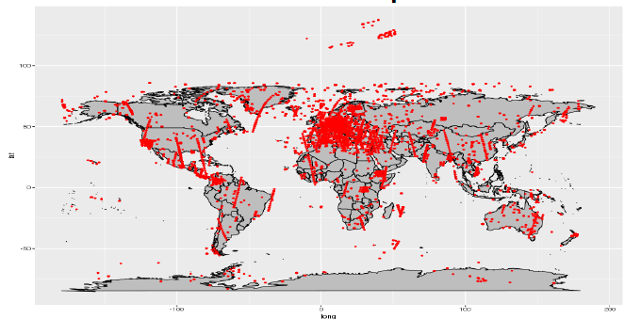

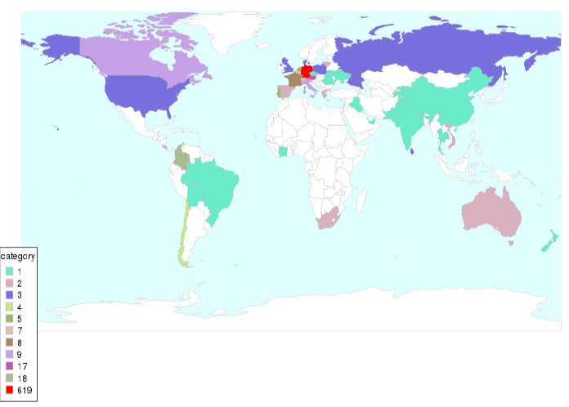
CODE-DE – Access and distribution
Sentinel Data,
Copernicus Service Products and Tools
Operation since March 2017
794.000 GiB data volume
(rolling archive)
760 users
58.000 downloaded products
19 open source tools
(as of 31.01.2018)
Geographical distribution of downloaded products (03.2017-01-2018)
Origin of users

Slide 10
Way forward in CODE-DE
Successful installation of further CODE-DE components
  Geoclient improvements (i.e. visualization of different band combinations)
  Implementation of 3rd party processing applications incl. coupling to Open Telekom Cloud (OTC)
  Integration of Sentinel-3, Sentinel-5P and RESA (Rapid Eye)
  Integration of further tools
  In discussion: use in the framework of special SAR trainings, (Sentinels and TerraSAR/ TanDEM-X)
Routine operations (until end 2019 (tbd)
From 2019 onwards Hybrid DIAZ –CODE-DE solution possible

Slide 11
The European Commission has launched two Networks to contribute on spreading awareness and knowledge about Copernicus across and outside the EU:
  the Copernicus Relays
  the Copernicus Academy
The Copernicus Academy Members will support the European Commission in:
  bridging the gap between skills and data use
  Enable the uptake of Copernicus data in new sectors
The aim is to
  foster the development of interdisciplinary masters and educational classes,
  Skills boosting programmes for vocational training, industry-university traineeships and the creation of spin-offs.

Slide 12
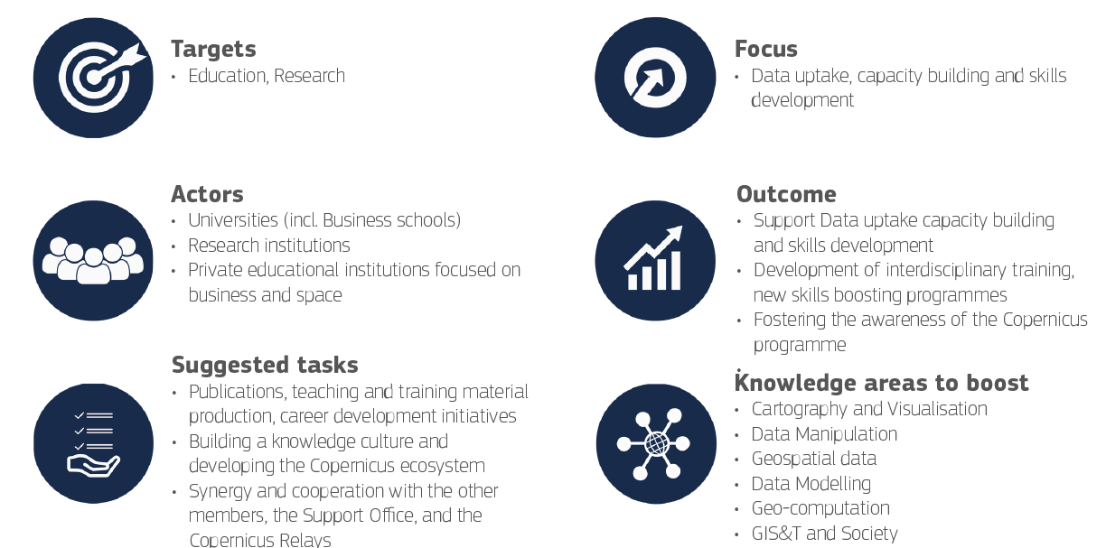

Slide 13
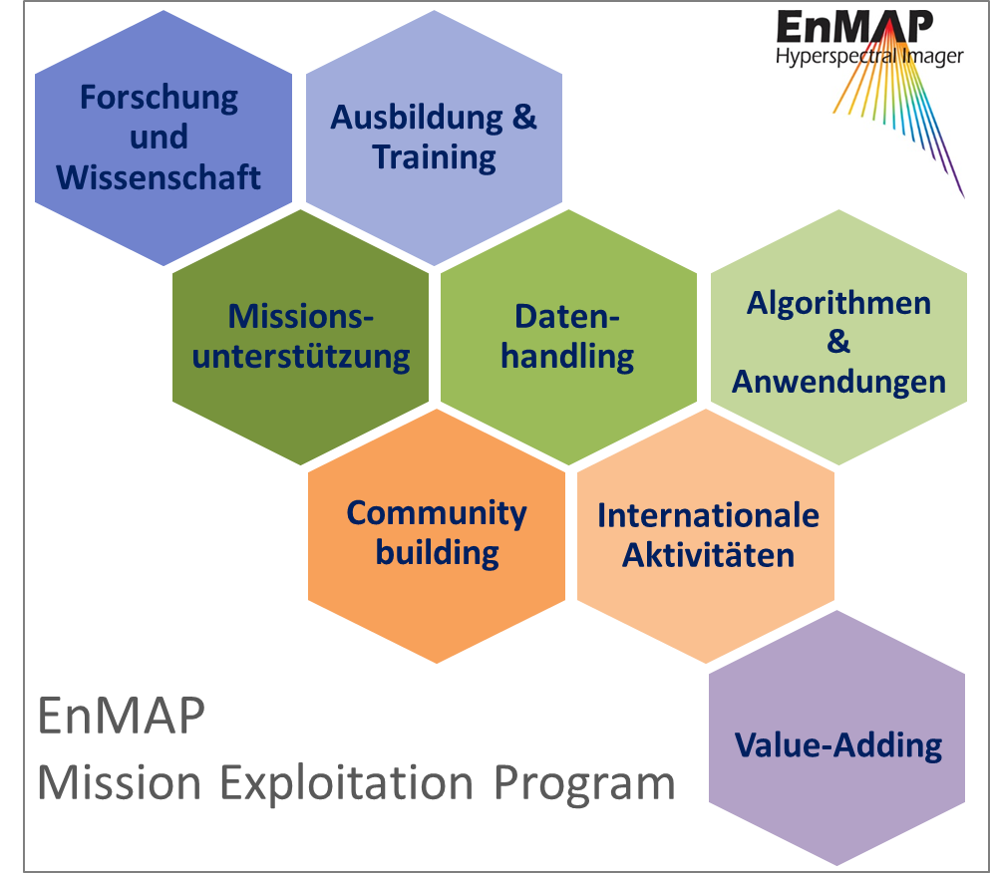
Das EnMAP Use Preparation program
Program objectives:
Scientific exploration
Support scientist by developmengt and analysing
New appication areas
Raise Awareness form Enmap
Fast data access
Support international cooperations
Synergien with other Mission
contact stefanie.schrader@dlr.de
Notes:
Program goals:
Raising scientific knowledge
Supporting the science community to develop new data products, algorithms and services
Supporting the discovery of new application fields
Raising awareness of the EnMAP mission
Ensuring easy and fast access towards EnMAP data
Enable easy data processing capabilities
Supporting national and international cooperation
Explore synergies with other missions

Slide 14
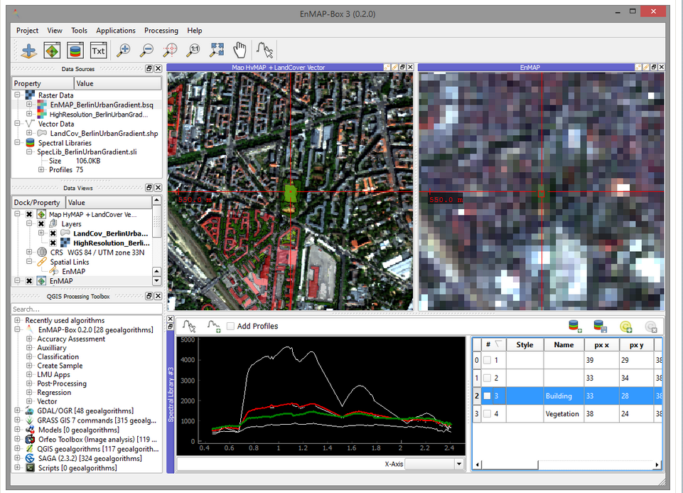
EnMAP Box
Software for Prozessing and Analysing of hyperspecztral data
Algorithms for: Agriculture, Forestry, Ecosystems, Geology water and Atmospheric correction
open source Software
QGIS plugin available (Beta-Version)
Download: www.enmap.org/?q=enmapbox

Slide 15
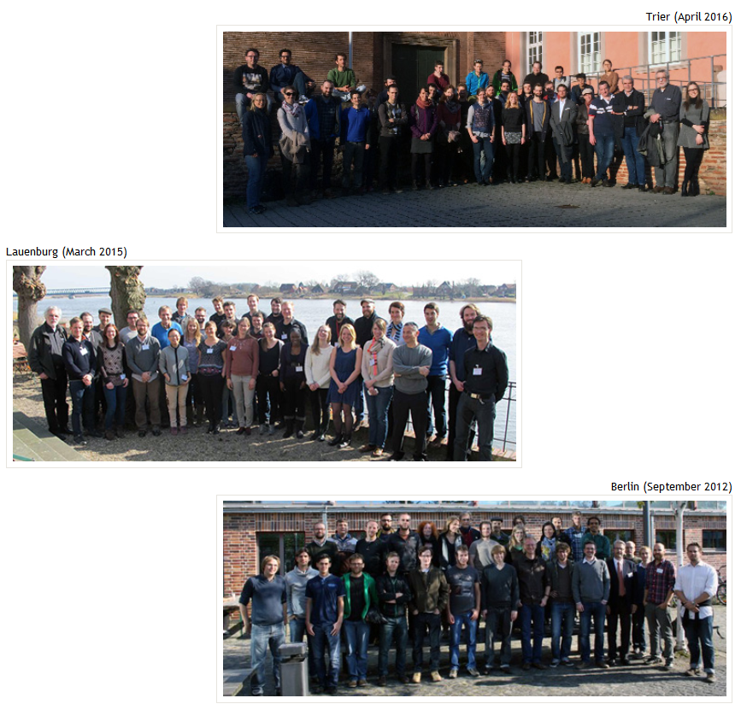
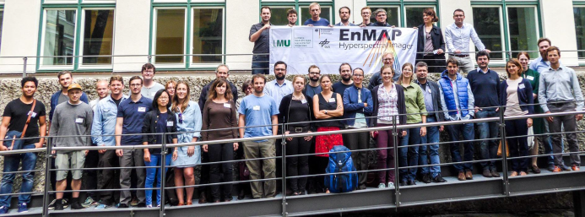
EnMAP – Education and Training
Summerschools & workshops
Tutorials, Fieldguides,
Tools for EnMAP Box
EnMAP PhD Programm
  Mehr als 30 PHD students till 2010

