Slide 1
Technology, Tools & Methods Used for Capacity Building at ESA
Committee on Earth Observation Satellites
Name F. Sarti and C. Stewart
Agenda Item 11 - 1
CEOS 7th Working Group for Capacity Building & Data Democracy (WGCapD-7) Annual Meeting
INPE São José dos Campos, Brazil
6-8th March, 2018

Slide 2
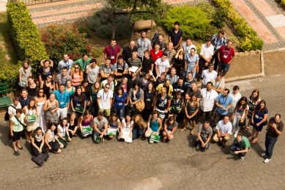
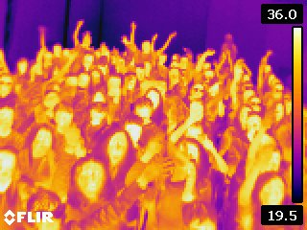
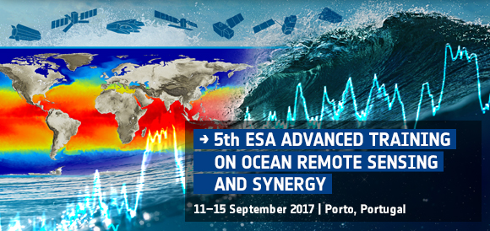
Capacity Building Activities
Technology, Tools & Methods
SAR Trainings & Non-SAR Trainings:
Large number of training courses devoted to ESA Remote Sensing missions and Sentinels, mostly in Europe, but also worldwide (see: https://earth.esa.int/web/guest/eo-education-and-training with material online)
ESA Face to Face Events for ESA EO Education and Outreach include:
Outreach Activities
School Labs
Open Days
Researcher’s Night
Summer Schools
Advanced Courses
Hackathons (EO SW development)
Cooperation programmes with China (Dragon)
CB in Africa (TIGER)
Capacity Building Courses
CEOS WGCapD
ESA European Cooperating States

Slide 3
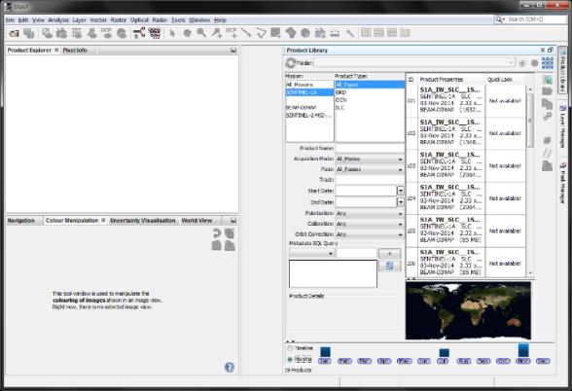
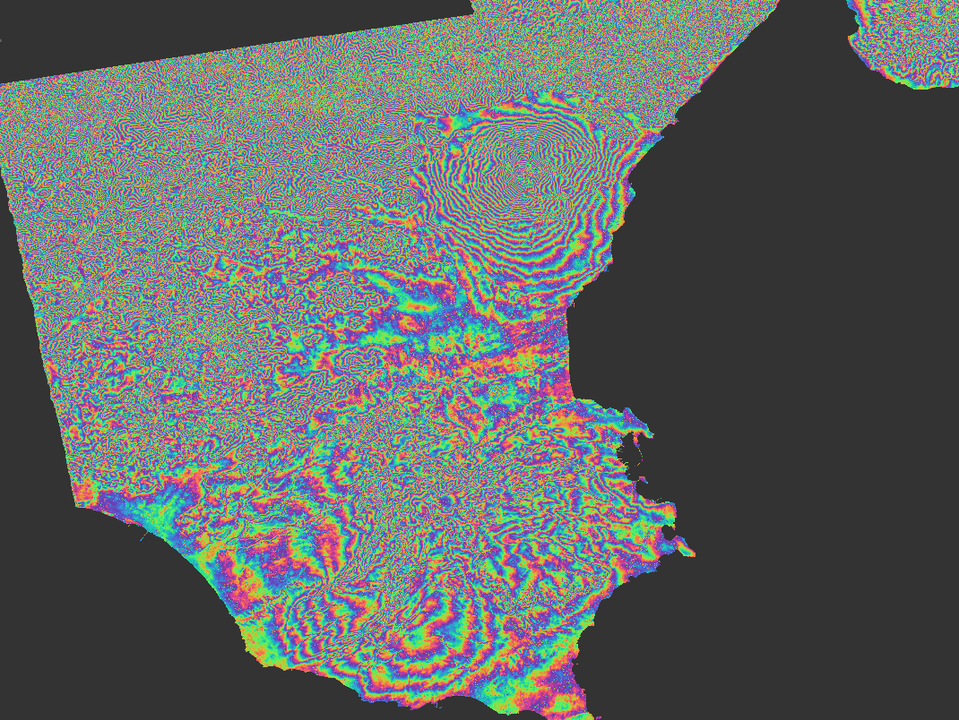
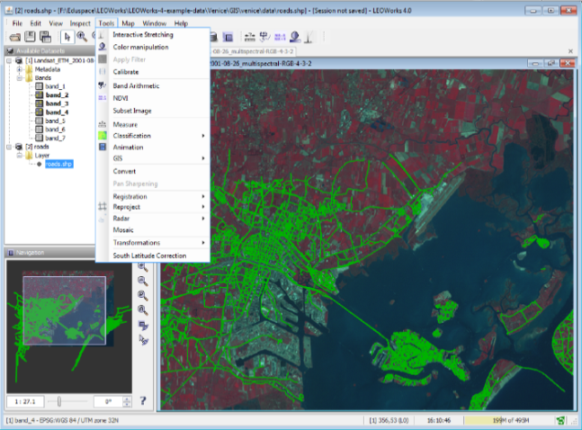
Capacity Building Activities
Technology, Tools & Methods
ESA EO educational Tools :
COVE / Data Cube Trainings:
No training activities yet, to be discussed within WGISS (ESA Chair: M. Albani)
Status Updates for Collection & Coordination of CB Resources:
All CB material developed by ESA is on: https://earth.esa.int/web/guest/eo-education-and-training (apart from MOOCs, for the time being).
RUS Webinars: https://rus-copernicus.eu/portal/category/events/training/
OS Toolboxes:
LEOWorks (specific for high school to university education)
Sentinel Application Platform (SNAP)
Broadview Altimetry Toolbox (BRAT)
GOCE User Toolbox (GUT)
Atlases
School Atlas
Water Atlas
Apps (for IOS and Android)
Sentinel
Proba V
Educational material for CCI Visualisation App
Space App Camps (ESA Copernicus Office or ESA jointly with NASA)
Possible use of ESA TEP (Thematic Exploitation Platforms) for training purposes; use of ESA Virtual machines for training
S1A TOPS Interferogram Mt. Etna produced using SNAP

Slide 4
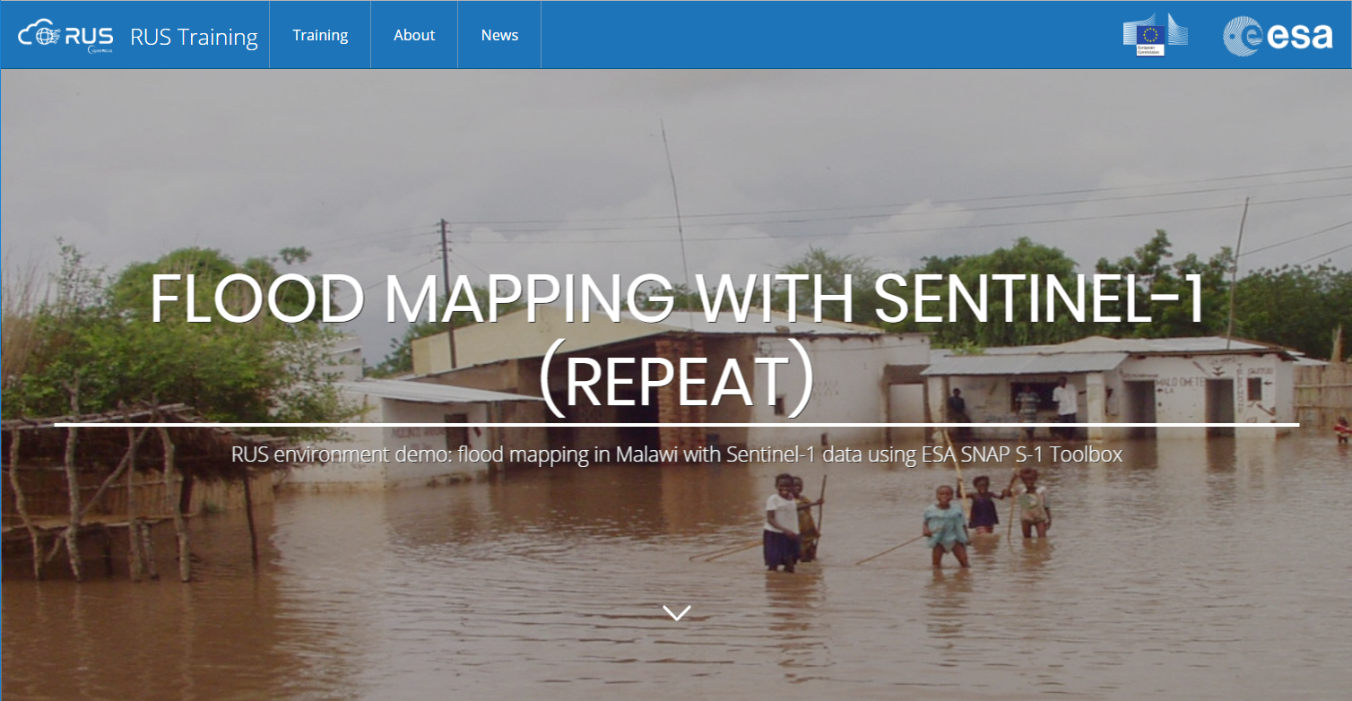
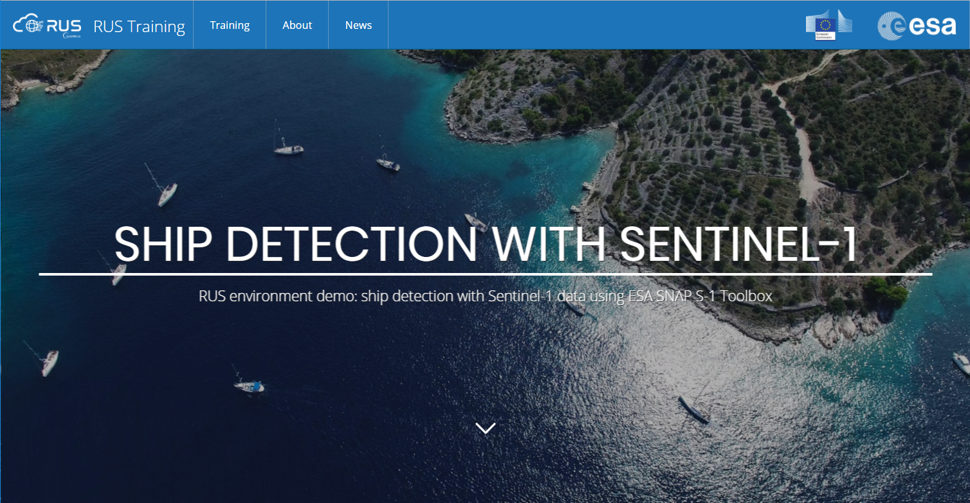
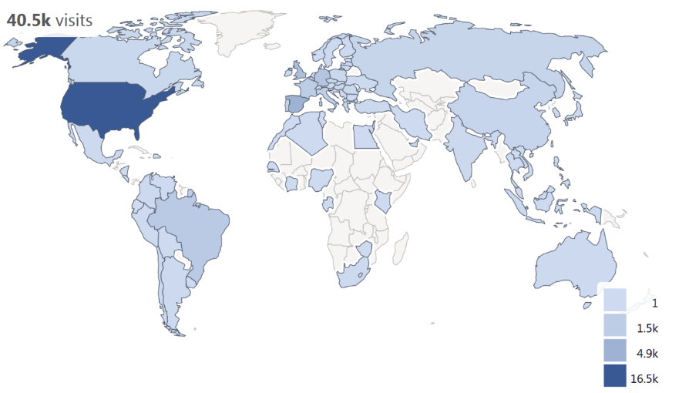
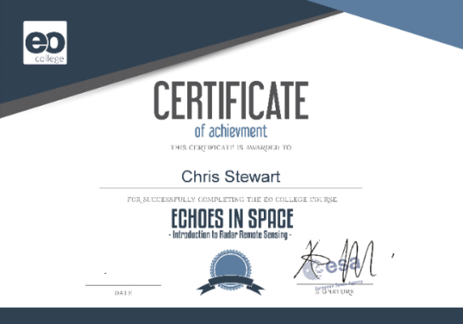
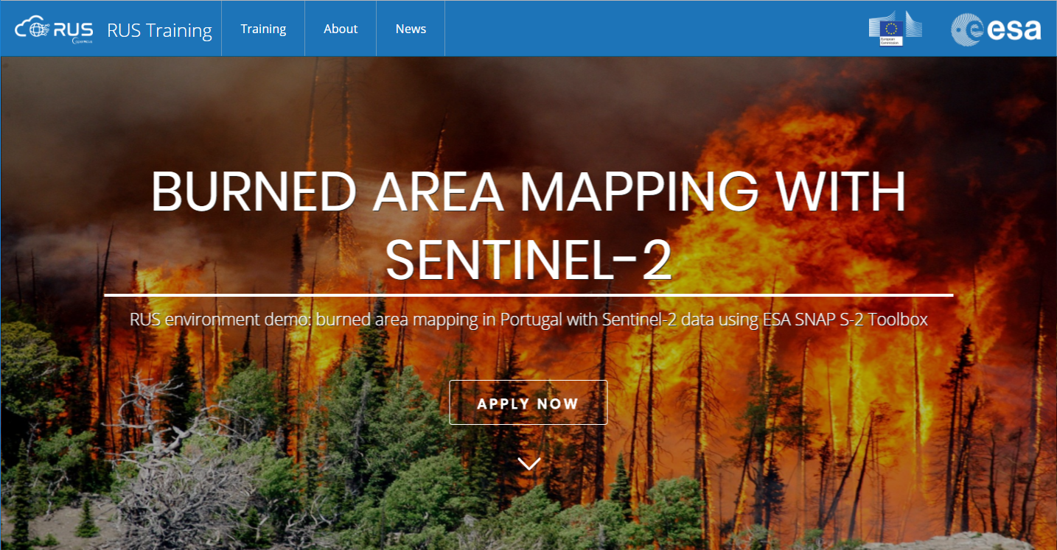
Capacity Building Activities
ESA EO E-Learning Courses
MOOCs
Climate, Optical, Greenland, SAR and more in preparation (Land, Africa …)
EO Educational Platform
EO Browser adaptation (Synergize)
Webinars
RUS (Support contract to Sentinels users), CEOS WGCapD
Almost 12000 registrations for ESA EO MOOCs in 2017, with completion rates up to 28%

Slide 5
Capacity Building Activities
Technology, Tools & Methods
Future Planning:
Year | Regions | Activity | Themes Covered | EO Involved
2018/Oct | Americas: Argentina | Trainings | X, L, C band SARs | Sentinel1, SAOCOM, TSX, CSK, Palsar
2018 | Africa | TIGER planning | Water resource management
2018 | Asia : China | DRAGON planning
2018 | Asia | NASA proposals for joint courses
2018 | Europe | See next slide
2019 | Americas | Nothing planned yet
2019 | Africa | TIGER planning | Thematic Area 1, Thematic Area 2, etc. | Satellite 1, Satellite 2, etc.
2019 | Asia : China | DRAGON planning
2019 | Asia | NASA proposals for joint courses
2019 | Europe | See next slide
Future Coordination:
What future trainings should the WG be considering relating to upcoming missions:
Future Sentinels and Earth Explorers
SAOCOM (TBC Conae)

Slide 6
Capacity Building Activities
ESA EO courses planned in Europe
Courses 2018 | Location | Date | Status (confirmed or TBD)
EGU/GIFT Workshop (Earth Science) | Vienna | 2018/04/09-11 | yes
Joint ESA/NASA Trans-Atlantic Training (“TAT”) on LCLUC | Zagreb | 2018/06/07-09 | yes
Earsel Workshop on Archaeology | Cyprus | 2018/06/27-29 | yes
Advanced Cryosphere Training Course | ESA Member State | 2018/06 | yes
Request from UNOOSA to participate with lecturers to UNOOSA / CEU “Innovations in Disaster Risk Reduction” | Budapest | 2018/06/25-29 | TBC
PECS Sentinel Training (S1, S2, S3 applications to central Europe) | Slovakia | 2018/09/03-07 or 17-21 | yes
Request from UNOOSA to participate with lecturers to UNOOSA / CEU “Geospatial Solutions for Water Management” | Budapest | 2018/07/02-06 | TBC
Two Sentinel tutorials in the frame of IGARSS 2018 (S1, S2, S3 applications ) | Valencia | 2018/07/22 | yes
ESA EO Summer School (Earth System Science) | ESRIN | 2018/07/30-08/10 | yes
Advanced Land Training Course (S1, S2, S3) | ESA Member State | 2018/09 | yes
Courses 2019 | Location | Date | Status (confirmed or TBD)
School Lab at Living Planet Symposium 2019 | Milan | 2019/05 | yes
ADM-Aeolus training | ESA Member State |  | yes
Advanced Atmospheric Training Course | ESA Member State |  | TBC
Advanced Ocean Training Course | ESA Member State |  | TBC

Slide 7
Thanks for the attention and ….
… please do not hesitate to make suggestions for new tools, new technologies and EO educational projects in cooperation with other CEOS WG CapD members. Such as:
Educational Web Channel on given EO applications, maybe jointly with National Geographic or other attractive partners ?
Joint activities with major international scientific partners like GEWEX, SOLAS, AGU/EGU ….?

