Slide 1

Open Data Cube Initiative
Kim Holloway
Agenda Item # 08
CEOS 7th Working Group for Capacity Building and Data Democracy (WGCapD) Annual Meeting
INPE São José dos Campos, Brazil
6-8th March, 2018

Slide 2
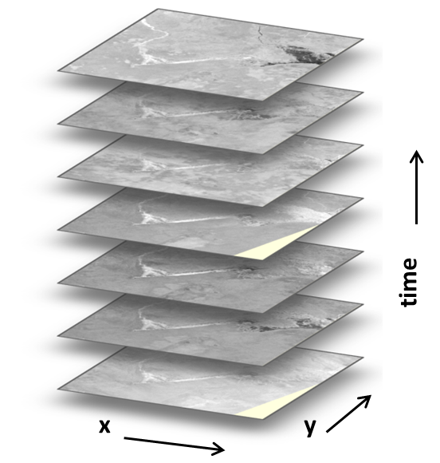
What are Data Cubes?
What are Data Cubes?
Data Cube = Time-series multi-dimensional
(space, time, data type) stack of spatially
aligned pixels ready for analysis
Analysis Ready Data (ARD) ... Dependent on
pre-processed products to reduce the
burden on users
Open source software approach allows free
access, promotes expanded contributions,
and increases data usage.
Unique features: exploits time series,
increases data interoperability, and supports
many new applications.
Notes:
Data Cube = Time-series multi-dimensional
(space, time, data type) stack of spatially
aligned pixels ready for analysis
Analysis Ready Data (ARD) ... Dependent on
pre-processed products to reduce the
burden on users
Open source software approach allows free
access, promotes expanded contributions,
and increases data usage.
Unique features: exploits time series,
increases data interoperability, and supports
many new applications.

Slide 3
ODC CB Activities 2017
SERVIR Data Cube Training Workshop –
February, Huntsville, AL, USA
Vietnam Data Cube Training –
April, Hanoi, Vietnam (supported by CSIRO)
IGARSS Data Cube Workshop –
July, Fort Worth, Texas, USA
GEO Plenary – CEOS exhibition booth and Data Cube Sessions – October, Washington, D.C., USA

Slide 4
SEO CB Activities 2018
Swiss Data Cube “Hackathon” and OpenGeneva Event
- April 11-13, Geneva, Switzerland
African Regional Data Cube Training
- May 9-11, Nairobi, Kenya
- Hands-on training for 5 countries
NASA DEVELOP Student Project
- June 4 to August 10, NASA Langley, Hampton, VA, USA
- Data Cube applications for Colombia (details TBD)
IGARSS Data Cube Workshop
- July 22, Valencia, Spain
- One-day hands-on training for diverse global users
GEO Plenary – CEOS exhibition booth and Data Cube Sessions
– October 31 to November 1, Kyoto, Japan
AGU – Open Data Cube poster, NASA Hyperwall presentation (TBD)
- December, Washington, D.C.
Notes:
Hackathon /OG event : using the existing swissdatacube, people will come in from indistry and academia to sort of pay with the cube and see what they can do with it… come up with new algorithms etc.
African regional data cube training in nairobi... Hands on training for 5 countries... More stuff coming on this.
DEVLEOP student project... Gonna put togther a project on dc apps for colombia as a good start... But ultiately would like to have develop students using data cubes every summer in new parts of the world
Igarss with one day training session
GEO, as usual... With data cube sessions like we did this past year that were extremely popular and generated lots of discussion and new project opportunties
AGU – poster /presentation

Slide 5
The Data Cube Vision
A solution supporting priority objectives …
  Build capacity of users to apply CEOS satellite data
  Support GEO and United Nations agendas
Customer focused …
  Easy to install and maintain with training materials
  A brand that people know and trust
Scalable solution …
  Operational Data Cubes in
  20 countries by 2022
  Partnerships with …
  Google, Amazon
Notes:
So what’s the vision really… high level...
We’re doing things to target the un agenda and SDGs... Talking with GEO...

Slide 6
The “Road to 20”
3
6
31
Operational
Under Development
Under Review or Expressed Interest
40 total countries in the first year!
Notes:
Still on the road to 20…
Currently talking with 40...
And some of these folks are peopel who have contacted us to say theyr’e interested in a cube... But then, never say anything again...
We’ve focused our energy and resources on those who come to us with the need and strong desire... So we arent’ chasing after others to do this... We want to help the people who REALLY want to do this and are wanting to dedicate time and energy to it...

Slide 7
Country Highlights
Operational: Australia, Switzerland, Colombia
In Progress: United Kingdom (support from UK Catapult), Uganda (support from UK Rhea), Vietnam (support from CSIRO, SEO, Symbios), Taiwan (TBD), Georgia and Moldova (support from Swiss Data Cube team)
African Regional Data Cube (ARDC): Ghana, Kenya, Senegal, Sierra Leone, Tanzania ... Early release in March at GPSDD event (Bristol UK) and full release in May in Nairobi, Kenya. More on the next few charts ...
Uruguay – Primary focus is validation testing of water quality and land classification. Linked to a World Bank project.
Cambodia – Starting a new project with Geoscience Australia (GA)
Mexico – CSIRO working with CONABIO
Pacific Islands (Vanuatu, Solomon Islands, Nauru, Samoa) – UK Catapult capacity building project includes UNEP-GRID (Swiss Data Cube) team and CSIRO (for Samoa).
Guatemala – New contact in Jan 2018 (palm oil plantations, water management)
Japan – Working with GA and CSIRO to support rice monitoring
South Africa – Contacted by SANSA in late 2017. Sample CBERS and SPOT data.
Notes:
But here are some details on what we’re actively doing with these countries… and if it’s not on here... There’s not really much going on...
Aus switz colomb... Going great.
In progress getting closer
UK Catapult is a group in UK gov... hleping the UK get a cube set up.... UK Rhea is helping uGanda getting a cube set up.. .we aren’t really involved with that. Bu tuK is doing that.
CSIRO/we are working with Vietnma.
Taiwan has slowed down a bit.
SDC team is doing a cb project funded thru the uN to help Georgia and Moldova implement a cube... So that’s really cool...
Afric Reg DC early release in March at the GPSDD HQ to do an early unveiling of multiple cubes for thse five countries... And then, full realeae in May during an onsite CB trainng
Uruguay linked to World Bank project... But another cool thing is we’ve actually used the cove tool to tell these folks when landsat sees their water quality testing sites… and we’re gettin gthem to take samples on those days and getting some cool results looking at those comparisons... But anyway... Yes, cube there.
Camobida worked by GA.
Mexico worked by CSIRO with CONABIO.
So yea... Pacific islands cube project going on, guatemala, japan... South africa...
But baically we’re building a big comunity where a few people got started and they’re spreading it. So when soeone comes to us and says “we want help implementing a cube”... We can kind of have one of our cube partners in that region implement that.

Slide 8
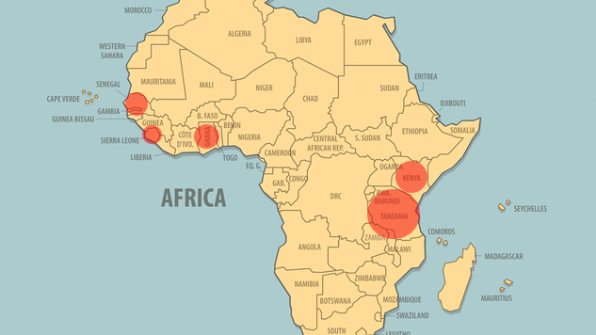
African Regional Data Cube
Ghana, Kenya, Senegal, Sierra Leone, Tanzania
Notes:
Just to see where the african regional data cubes are.. .and the circle size is the size of the actual cube coverage.

Slide 9
ARDC Stakeholders
Who are the stakeholders and their roles for the African Regional Data Cube (ARDC)?
GPSDD (Global Partnership for Sustainable Development) ...
Primary lead and initiator of the ARDC
Strathmore University ... Responsible for core ARDC operations and data management
Amazon ... 2-year grant providing AWS credits for deployment and operations
NASA (CEOS SEO) ... Technical lead for initial deployment, training and implementation
UK-Catapult ... Potential to support Sentinel-2 data acquition, processing (via ARCSI), and ingestion in the cube + capacity building for Strathmore
UK-Rhea ... Potential to merge their Uganda Data Cube with the ARDC and add application algorithms and capacity building for users
GEO ... Promotion of the ARDC among African users and relevant global groups
Radiant Earth ... Interested in using the cube to develop and test algorithms for the region with a focus on agriculture
Afri-GEOSS and Afri-GAM ... TBD
Notes:
Lots of folks involved….
GPSDD is the primary lead.. They actually came to brian at the GEO meeting in washington (Aditya)
Strathmore was also at the geo meeting and they’re gonna take on managing the data and the cube for all the ARDC cubes... Itwill all be in teh cloud... So they’ll just be troubleshooting and addin gmore data.. Just making sure it’s running...
Amazon is giving us a 2-year grant...
The SEO is doing initial deployment training and ipmlementation...
UK Catapult will show the users how to do some senintel 2 data acquisition processing, and ingestion int othe cube plus some capacity building for strathmore...
Uk rhea has a cube they want to merge and add application algorithms and cb for users...
GEO is going to help promote it
Radiant earth is a new start up NGO funded by Gates foundation and a bunch of other philantrhopic groups and they just care about glboal cb with sat data and they want to build algorithms for the region for agriculture and use our cube to help...
And there are company’s out there like that ... That want to build algorithms and teach users how to use them... So we’re going to let them...
So if one thought is if we have some good connections at Afri-GEOSS and Afri-GAM... We’d like to get more closely linked with them in some way if there some value there... Even if it’s just to promote that this project is happening... Let in-country representatives and organizations know...
The govs are gonna know in the begininign but they’re probably going to release to anyone...
So if you can help us link with your contacts at Afri-GEOSS, Afri-Gam... That would be helpful.

Slide 10
Potential WGCapD Involvement
The Open Data Cube initiative plans a number of capacity building activities that could involve WGCapD
The Open Data Cube team is planning to update the website (https://opendatacube.org) to include a Data Cube Learning Center with formal training modules, videos, user forums and case studies.
The SEO (with help from Kim) started a new Open Data Cube Twitter account (@OpenDataCube). Getting more followers from other CEOS Agencies and “tagging” the Open Data Cube on related tweets, would be helpful.
What is needed for the future?
  Language translation (Spanish, French) for Open Data Cube documentation and training elements
  Python programmers distributed around the world with the ability to support country-level deployments, troubleshooting and algorithm development and validation testing
Notes:
So how can WGCapD get involved…
Well... There’s lot sof potnetial...
But it also sort of depends on what resouorces you have and what expertise you have, what desire you have, etc....
But you see we have a lot of CB activities going on ... So if anyone wants to somehow get involved in any of that or sees some possible synergies... We’d love to hear from you ...
e.g. If there’s interest... We welcome you to join in at the ODC training in Nairobi in May – Please come and learn at that training... Great opportunity to get deeper into it.
We have a dc learning cetner that is sparsely pouplated... But we’d like to have trainign modules there... A more highly populated and used user forum... There are some case studies there... One thing you could do is to help us organize that content... Make it more effective... Apply the WGCapD lessons learned to what a real website learning center should look like... If anyone has some experience and expertise in highly successful learning on the web...
We have an ODC Twitter account... So please tag ODC and rewteet ODC posts... One thought would be that maybe WGCapD should start and maintain a Twitter account that amplifies CB opporutnities and ODC trainings and more... With a CB focus… since the CEOS twitter account alone doesn’t do all CB tweets...
IDEALLLy PIE in the SKY support?
We could REALLY use Spanish/French translation that would help us reach a braoder aduience. So if you guys know of or have an interest in supproting that...
And... We need python prormmers. Really hard to get and hard to keep... so if you have python programmers interested in supporting such globally, impactful work… that would be an INCREDIBLE contribution...
So that’s what’s going on... What’s needed... And from here I guess it’s really just up to you as a group... Do you see a place where WGCapD fits in well, or wants to fit in well... If not... That’s okay... But if so... That would be great too.

