Slide 1

VLab activities at CPTEC -INPE
Committee on Earth Observation Satellites
Natália Rudorff (CPTEC/INPE)
CEOS 7th Working Group for Capacity Building and Data Democracy (WGCapD) Annual Meeting
INPE São José dos Campos, Brazil
6-8th March, 2018

Slide 2
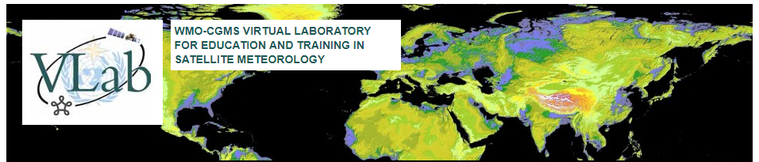
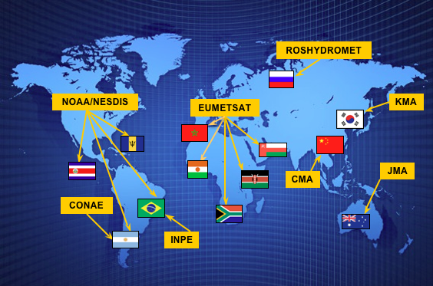
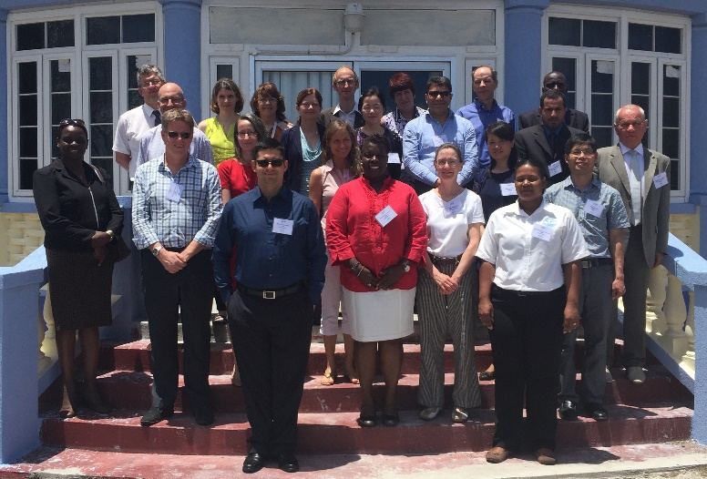
The Virtual Laboratory - VLab
Virtual Laboratory for Training and Education in Satellite Meteorology
VLab Centers of Excellence
CoE Brazil since 2007
Barbados, May 2016
World Meteorological Organization (WMO) and the Coordination Group for Meteorological Satellites (CGMS)

Slide 3
VLab CoE Brazil
Activities
Online and face to face training on Satellite Meteorology for National and Regional Operational Services in Brazil – WMO Region III
Collaboration with trainings events organized by other CoEs (RA III and IV)
Collaborative Projects: CM4SH
Portuguese translation and exchange training resources with other CoEs
Regional Focus Group of Americas and the Caribbean (online discussions)
Calendar of Events: website, fanpage, WMO VLab and Global Campus
VLab virtual and face to face meetings
Reports: WMO-CGMS VLab

Slide 4
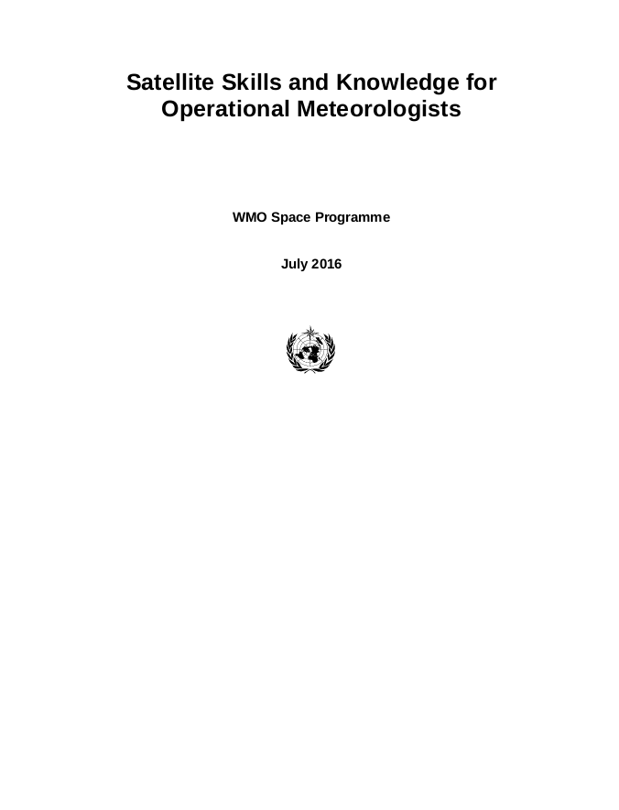
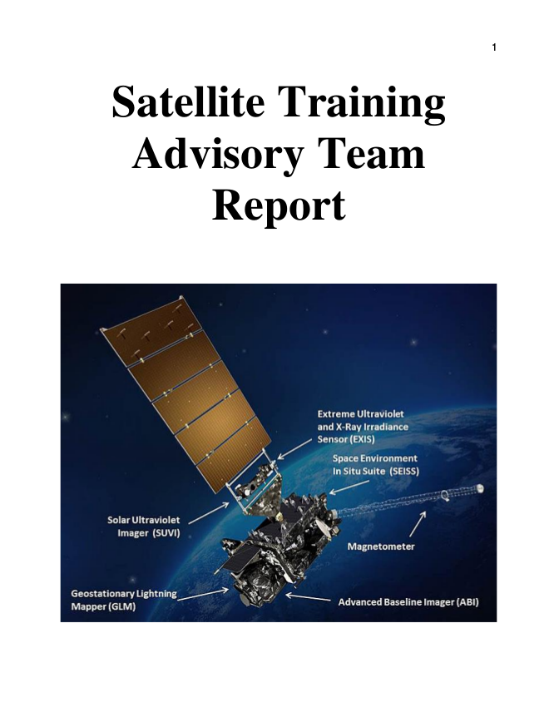
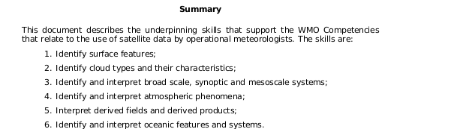
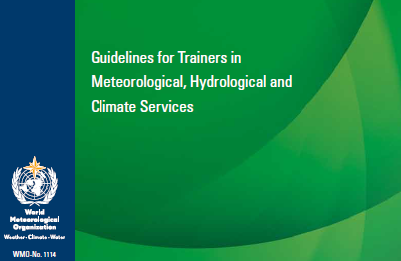
Training Guidelines
WMO Competency requirements: satellite skills and knowledge; objectives; learning outcomes; evaluation.

Slide 5
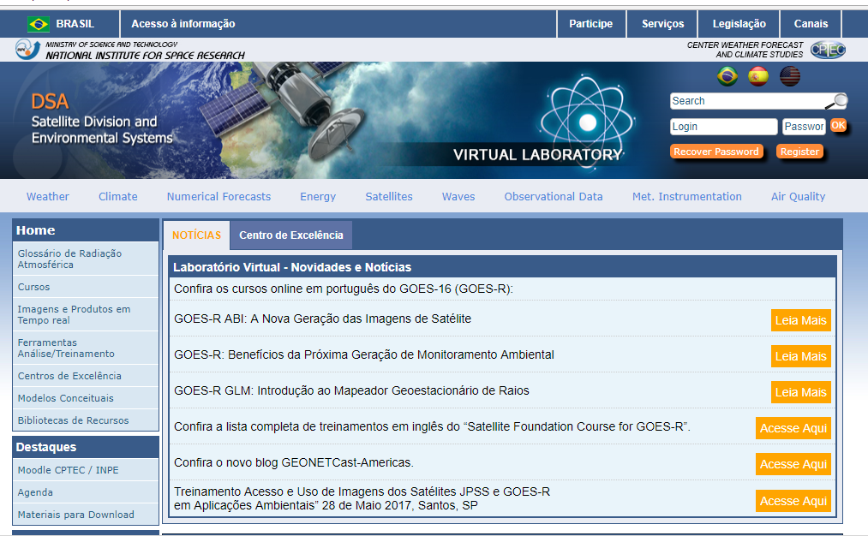
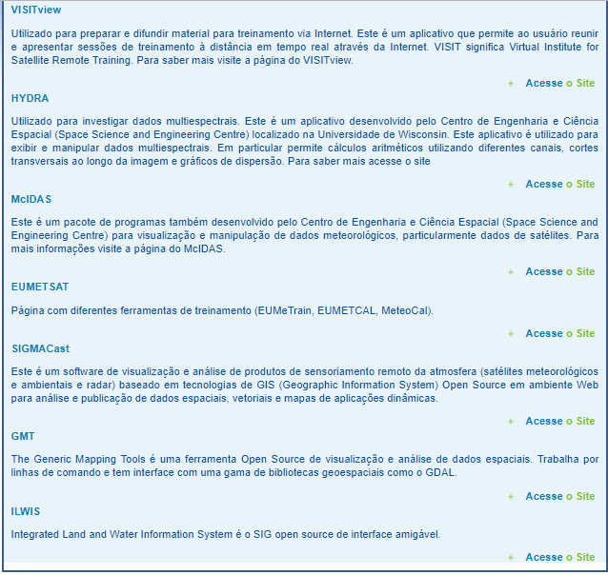
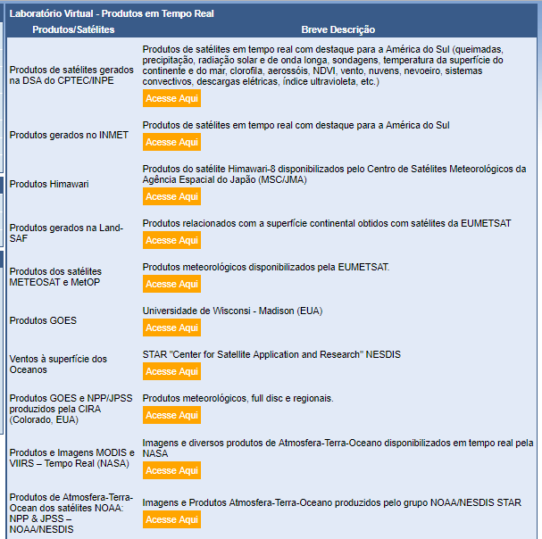
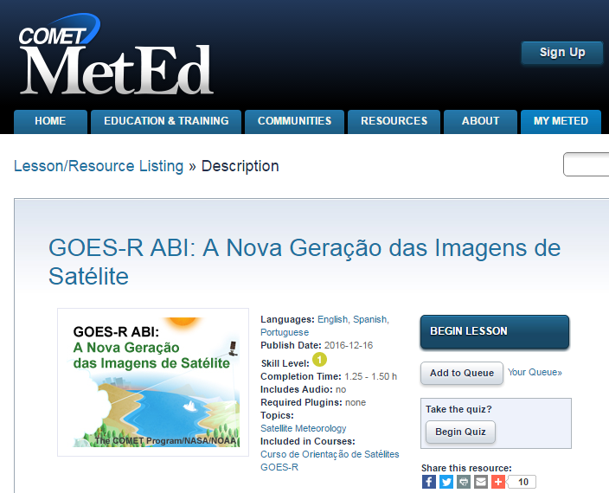
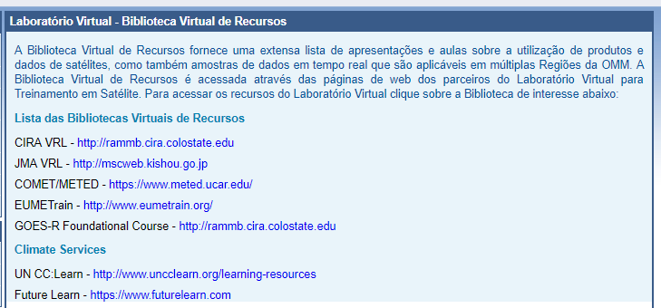
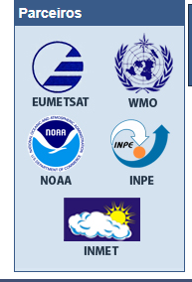
VLab user interface
CoE Brazil VLab Webpage
Hosted by the Satellite and Environmental Systems Division (DSA/CPTEC/INPE)
Image Processing and Visualization Softwares
http://webaula.cptec.inpe.br/visitview/
NRT Imagery and Products

Slide 6
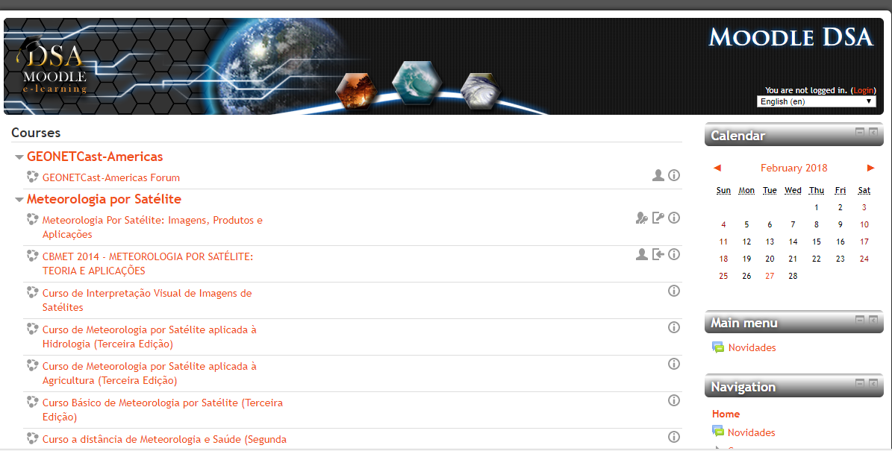
VLab user interface
Tools and Resources: Moodle and Adobe Connect (National Network for Education and Research-RNP)

Slide 7
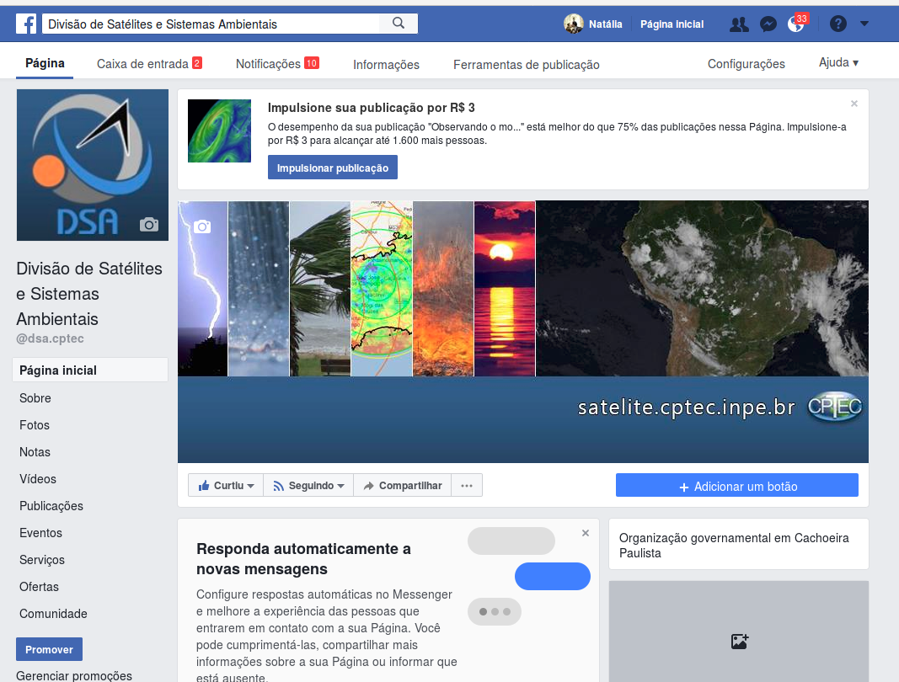
VLab user interface
Fanpage: Satellite and Environmental Systems Division
News
Videos
Short case studies
User interaction (questions, feedbacks, requests)
Main point of contact:
Silvia Garcia
Notes:
Advertise training and share videos

Slide 8
2017 Training events
Training Access and Use of JPSS and GOES-R Imagery for Environmental Applications, May, 2017, Santos-SP, BR, Brazilian Remote Sensing Symposium (SBSR);
Training on GOES-16 for Operational Meteorological Services, October 2017, CPTEC, Cachoeira Paulista, SP, Brazil;
Storm Nowcasting using SOS-Rain app, November, 2017, CPTEC, Cachoeira Paulista, SP, Brazil;
Collaborative trainings:
Satellite Fire Detection and Monitoring, September, 2017, São José dos Campos-SP, BR. (OBT, SELPER)
Aplicaciónes de imágenes y productos de satélites a la meteorología de latitudes médias, September-October, 2017, Santa Cruz de la Sierra, Bolívia (EUMETSAT)

Slide 9
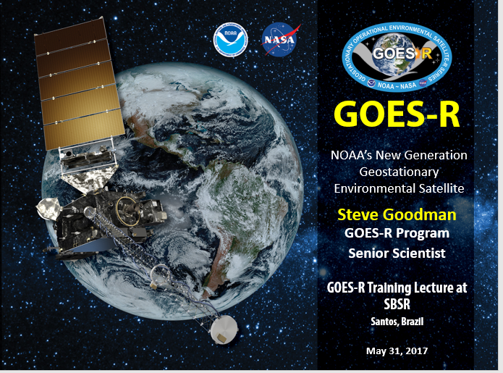
Face to face training
Training Access and Use of JPSS and GOES-R Imagery for Environmental Applications
May, 2017, Santos, SP, BR, Brazilian Remote Sensing Symposium
7 Instructors (INPE, USP NOAA and WISC experts)
20 participants: civil defense, meteorological and agriculture services and universities
Plenary session with NOAA experts: Dr. Harry Cikanek diretor of STAR; Steven Goodman (GOES-R) and Mitchell Goldberg (JPSS)

Slide 10
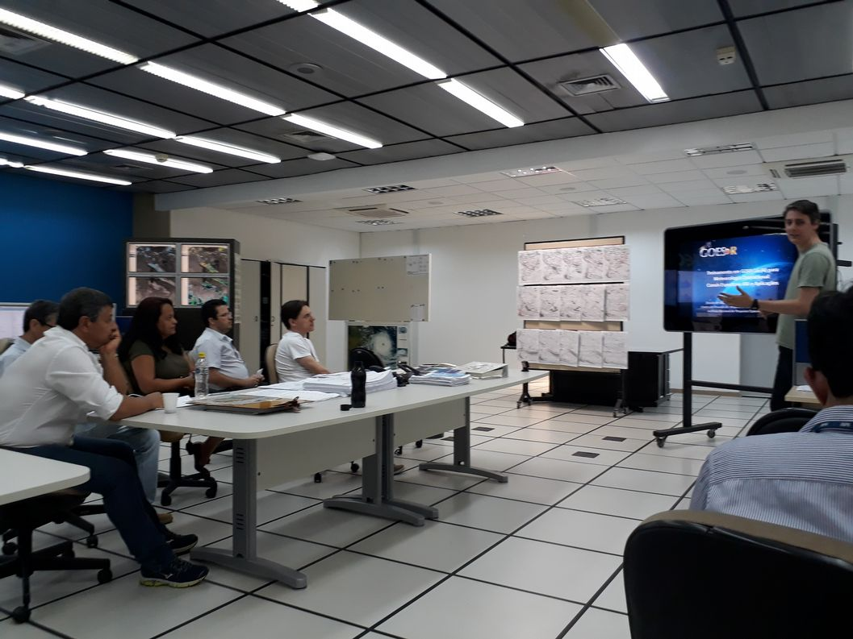
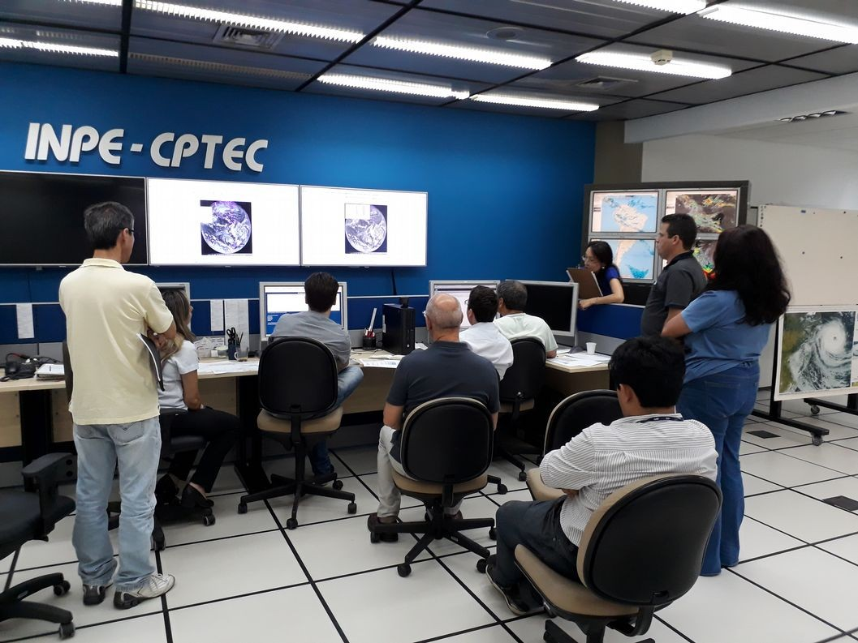
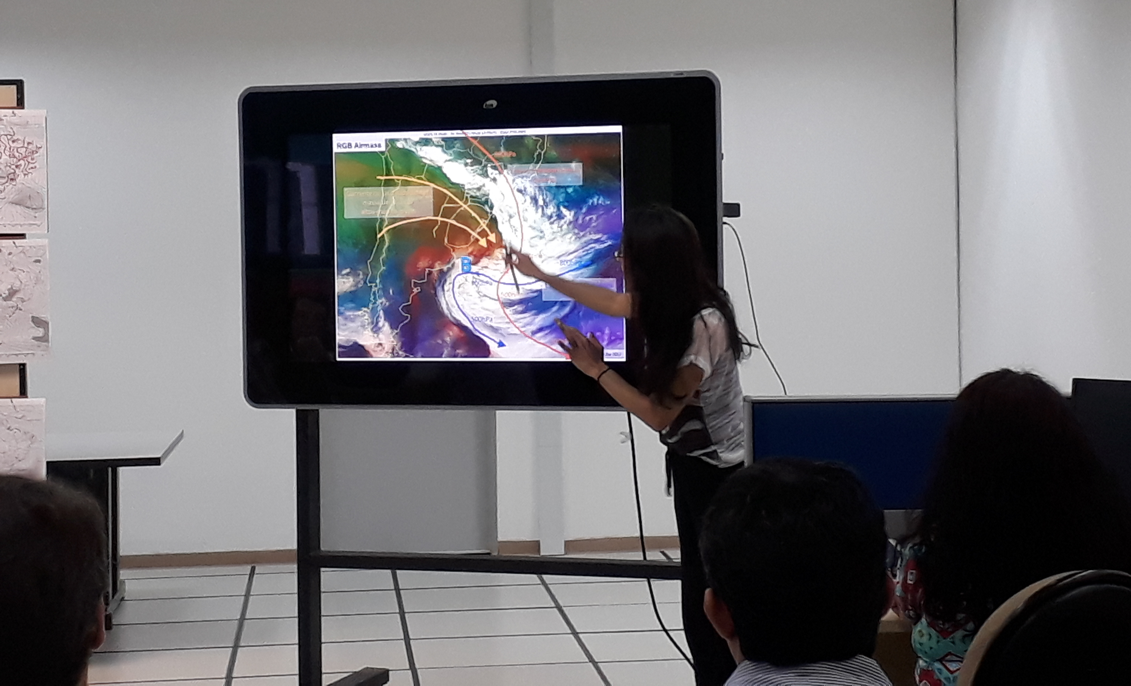
Face to face training
Training on GOES-16 for Operational Meteorological Services
October 2017, CPTEC, Cachoeira Paulista, SP, Brazil;
4 Instructors (INPE)
13 participants: CPTEC operational meteorologists

Slide 11
2018 Training Events
GOES-16 (ABI and GLM) imagery and products for operational meteorology, online course, 2018;
GEONETCast-Americas Workshop, AMERIGEOSS week, August, 2018, Cachoeira Paulista-SP, Brazil.
We will host the AMERIGEOSS week which should also have a workshop on GOES-16 data and product usage organized by NOAA experts

Slide 12
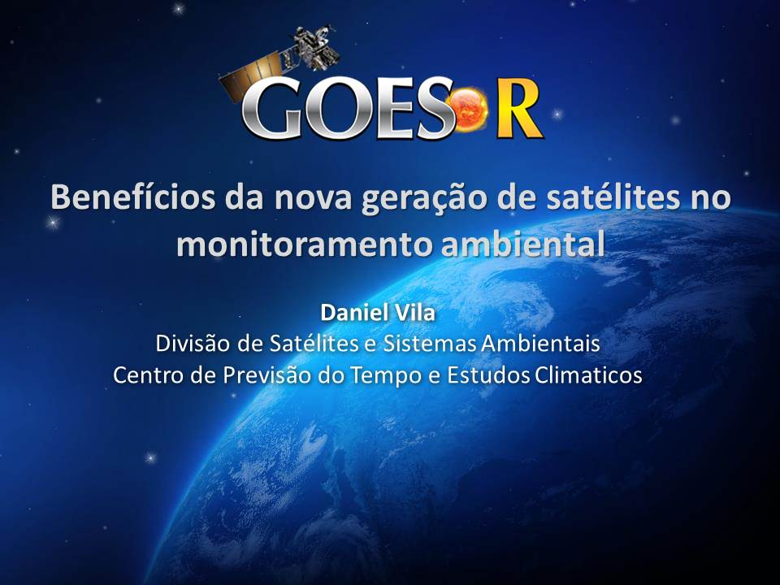
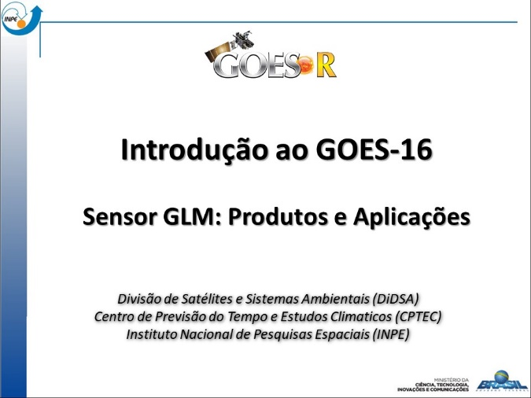
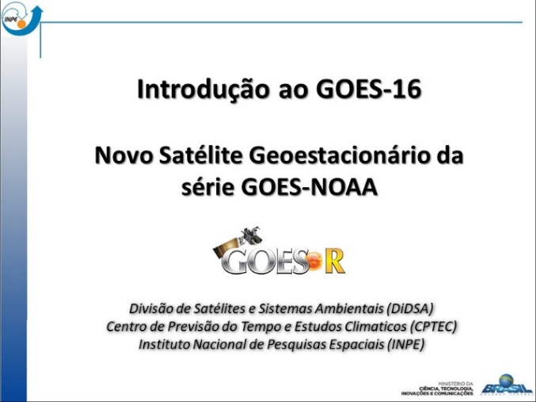
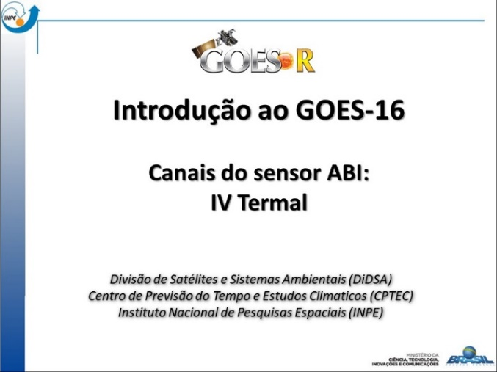
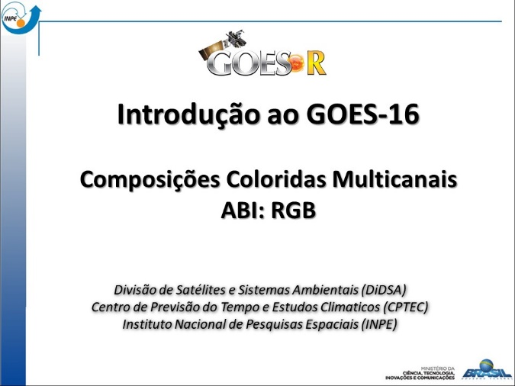
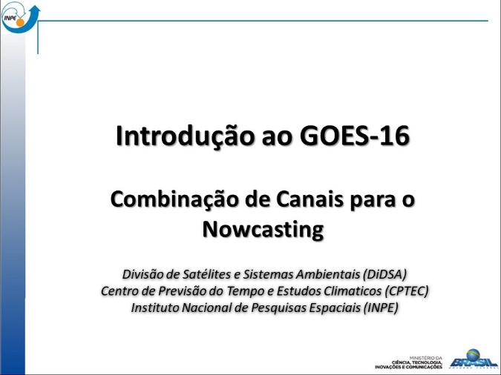
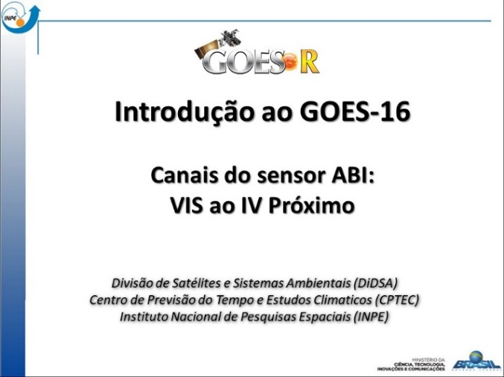
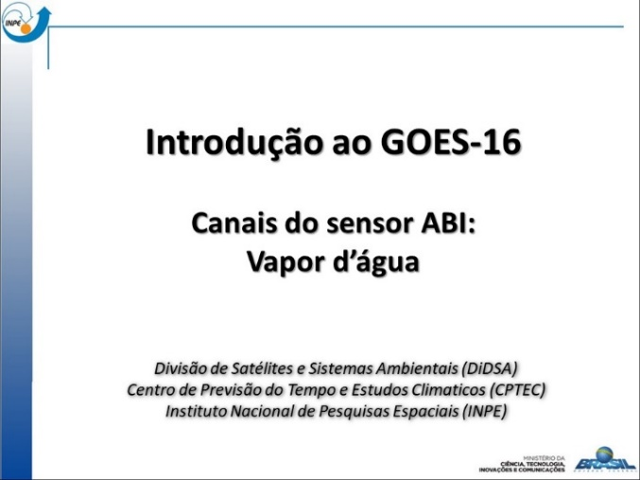
Short Videos for User Awareness and Training
“Benefits of the Next Generation Environmental Satellites: GOES-R” (May, 2017)
“Introduction to GOES-16”, (March, 2018), inspired on the “Foundation Course for GOES-R (CIRA)”

Slide 13
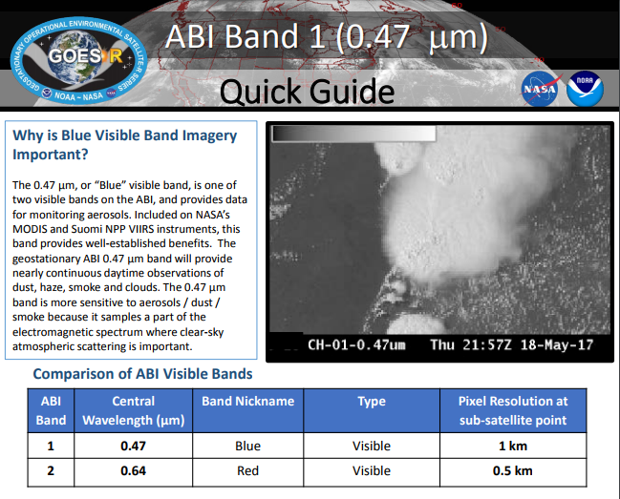
Other Training Resources
Preparation of Quick Guides for ABI channels and products (inspired on GOES-R mission)
Preparation of South American Case Studies with the new ABI channels and products
Conceptual Models for the Southern
Hemisphere
Portuguese translation of resources
organized by other CoEs

Slide 14
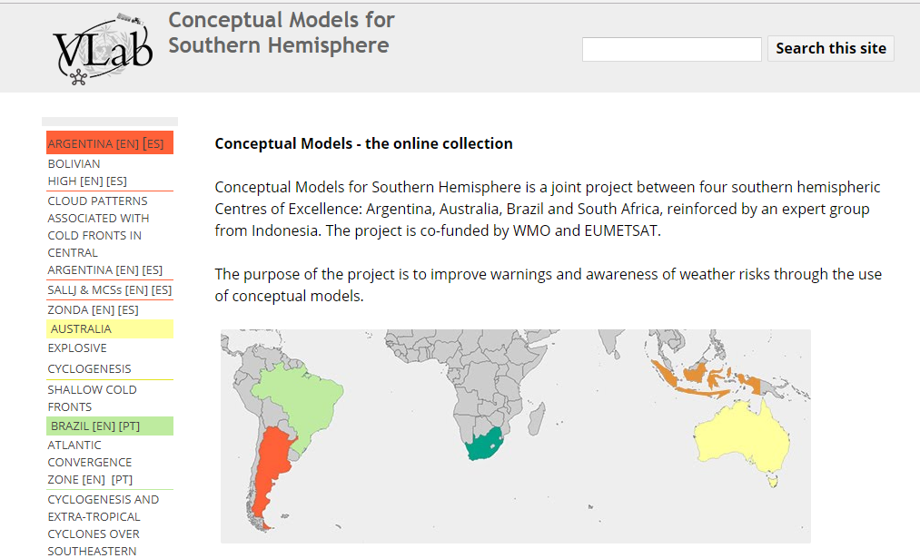
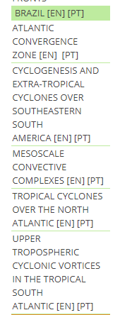
Building Resources with other CoEs
Conceptual Models for the Southern Hemisphere (CM4SH)
English and Portuguese versions

Slide 15
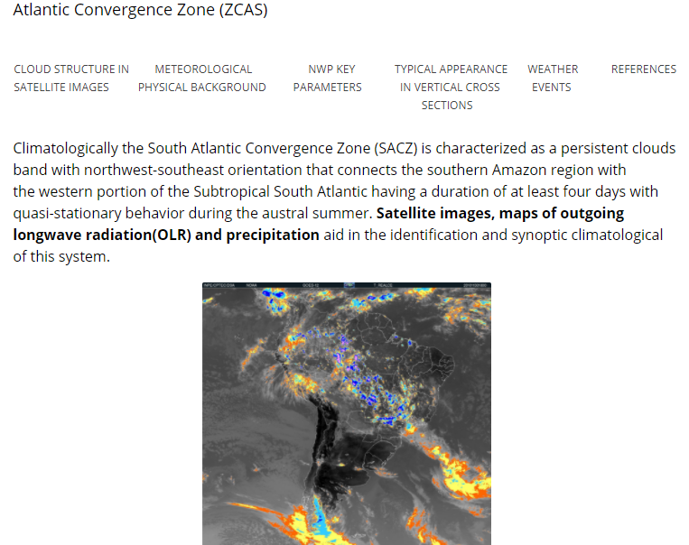
Building Resources with other CoEs
Conceptual Models for the Southern Hemisphere (CM4SH)
English and Portuguese versions

Slide 16
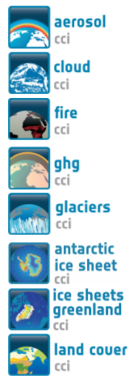
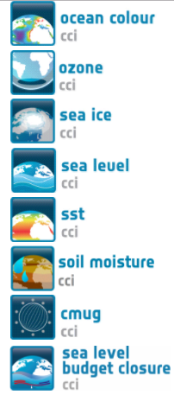
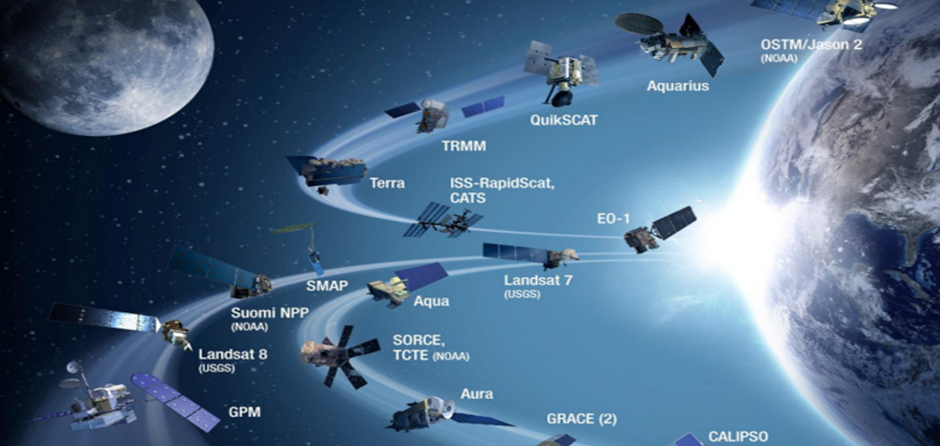
Building resources with other CoEs
Monitoring Climate Change with Satellites
Caribbean Institute for Meteorology and Hydrology (CIMH)
Ms. Kathy-Ann Caesar
kacaesar@cimh.edu.bb
Portuguese translation

Slide 17
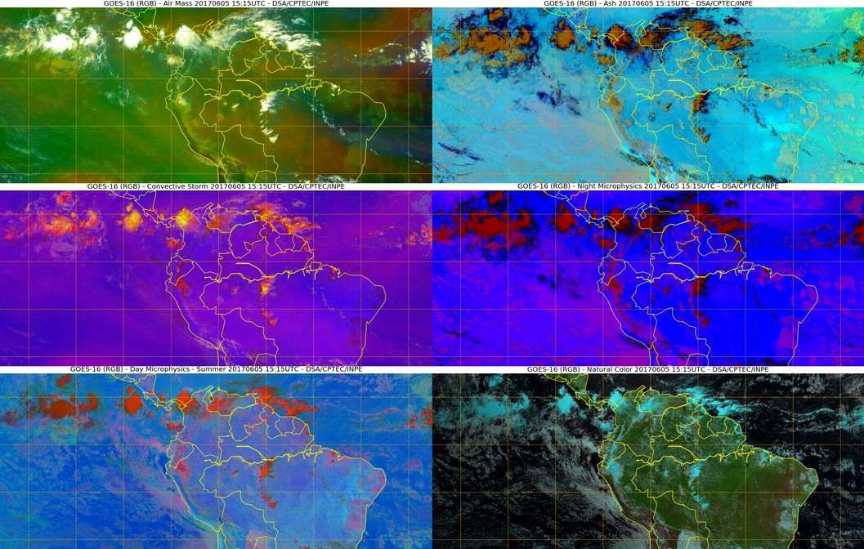
Train the trainers
Train the trainers workshop, NY, USA, July, 2017
RGB Workshop, Japan, November 2017
(participation supported by WMO)

Slide 18
Challenges and ongoing efforts
Make attractive and informative online training resources
Effectively attend user requirements and WMO competencies
Improve training evaluation (feedbacks and learning outcomes)
Elaborate South American case studies with new channels and products of Next Generation Environmental Satellites
Train the trainers (e.g. RGB workshops)
Collaborate with Portuguese speeking countries at other Regions (Africa)
Collaborate with Spanish speaking countries at the same Region (RA-III and IV)

Slide 19
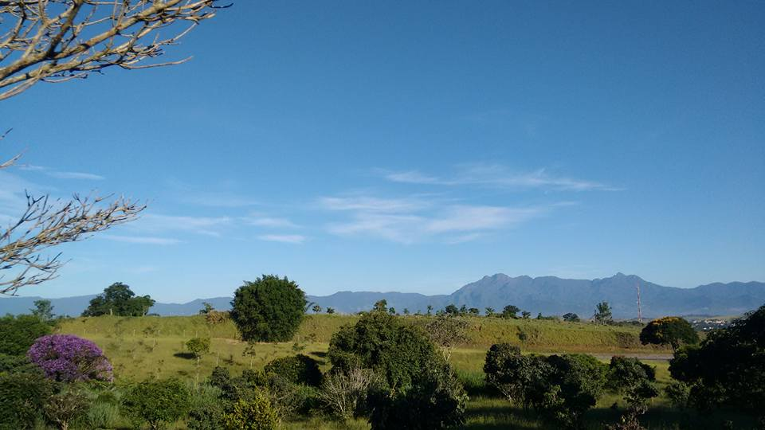
Thank you for your attention!
Natália Rudorff
natalia.rudorff@inpe.br
Divisão de Satélites e Sistemas Ambientais (DSA)
Centro de Previsão de Tempo de Estudos Climáticos (CPTEC)
Instituto Nacional de Pesquisas Espaciais (INPE)

