Slide 1
WGCapD-5 Annual Meet, 2016
Capacity Building on Geospatial technologies
and their applications in G-Governance
Senthil Kumar-ISRO
WGCapD-5 Agenda Item: 08
Hampton, Virginia, USA
March 29th – April 1st, 2016

Slide 2
Geo-Spatial Technology – Road Map
Smart Cities
Smart Automobiles
Defense Surveillance
Disaster Risk Management
Internet of Things
Some Challenges ahead …
Two-thirds of the World is yet to be mapped..
2D/3D city maps, Road and Utility Networks, Thematic maps…
Integration of disparate sources, applications and data bases in real time….

Slide 3
Vision of G-Governance
Centered on 3 Key Areas
Digital Infrastructure as a Utility to Every Citizen
Governance & Services on Demand
Digital Empowerment of Citizens
- especially applicable for developing countries, and
to countries with economics in transition

Slide 4
Vision of G-Governance
Vision Area 1: Infrastructure as a Utility to Every Citizen
High speed internet as a core utility
Cradle to grave digital identity -unique, lifelong, online, authenticable
Mobile phone & Bank account enabling participation in digital & financial space
Easy access to a Common Service Centre
Shareable private space on a public cloud
Safe and secure Cyber-space

Slide 5
Vision of G-Governance
Vision Area 2: Governance & Services On Demand
Seamlessly integrated across departments or jurisdictions
Services available in real time from online & mobile platform
All citizen entitlements to be available on the cloud
Services digitally transformed for improving Ease of Doing Business
Making financial transactions electronic & cashless
Leveraging GIS for decision support systems & development
Technology for Planning
GIS based decision making
National GIS Mission Mode Project

Slide 6
Vision of G-Governance
Vision Area 3: Digital Empowerment of Citizens
Universal Digital Literacy
Universally accessible digital resources
All documents/ certificates to be available on cloud
Availability of digital resources / services in regional languages
Collaborative digital platforms for participative governance
Portability of all entitlements through cloud

Slide 7
Electronic Delivery of Services
iirs
Technology for Education – e-Education
All Schools connected with broadband
Free wifi in all schools (250,000)
Digital Literacy program
MOOCs – develop pilot Massive Online Open Courses
Technology for Health – e-Healthcare
Online medical consultation
Online medical records
Online medicine supply
Pan-India exchange for patient information
Pilots – 2015; Full coverage in 3 years
Technology for Planning
GIS based decision making
National GIS Mission Mode Project
Technology for Farmers
Real time price information
Online ordering of inputs
Online cash, loan, relief payment with mobile banking
Technology for Security
Mobile Emergency Services
Technology for Financial Inclusion
Mobile Banking
Micro-ATM program
CSCs/ Post Offices
Technology for Justice
e-Courts, e-Police, e-Jails, e-Prosecution
Technology for Security
National Cyber Security Co-ordination Center

Slide 8
Motivation: Alignment with CEOS Strategic Goals
Proposed CEOS Chair Initiative for 2016 (Version 2.1. 15 oct.,15)
“Space Agencies are convinced as to the potential of EO as an information source in support of many sectors of Governments, intra-Government and industry”.
Opportunity: Build Capacity for EO products: CEOS will actively promote availability of civil EO data and endeavour to build capacity to use the resulting products.
CEOS to remain forward thinking and adaptive participant in EO community and inter-governmental forums to maximize the societal benefits it delivers.
CEOS reconfirms its commitment to lead as a catalyst by fostering new technologies, measurement capabilities, innovative and integrated approaches to satellite data…

Slide 9
Motivation: Alignment with GEO Strategic Goals
Proposed CEOS Strategiv Plan 2016-2025: Implementing GEOSS

Slide 10
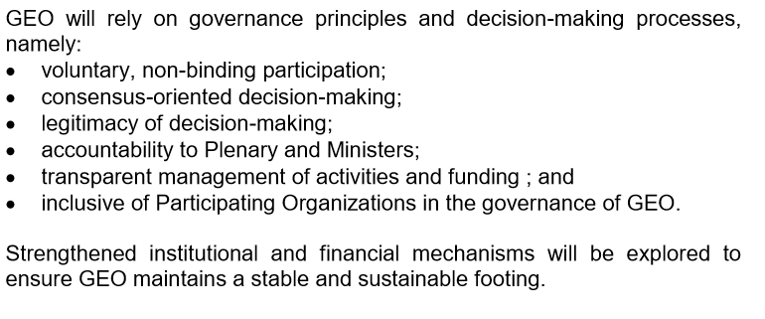
Motivation: Alignment with GEO Strategic Goals
Proposed CEOS Strategiv Plan 2016-2025: Implementing GEOSS
GEO will advocate the value of EO, engage communities and deliver data / info in support of 8 SBAs (Biodiversity & Ecosystem Sustainability, Disaster, Energy & Mineral Resources management, Food security and Sustainable agriculture, Infrastructure and Transport Management, Public Health Surveillance, Sustaiable Urban Development and Water Resources Management)

Slide 11
Success Story: ISRO's Geo-portal Bhuvan:
Gateway to Indian Earth Observation
ISRO’s Geo-portal, Bhuvan is providing visualisation services and Earth observation data to users in public domain.
Besides, the portal also services several users for their remote sensing application needs.
Bhuvan made a modest beginning in 2009 with simple display of satellite data and basic GIS functionality with many thematic maps on display
Bhuvan, as a platform, is open and being used by a diverse user community.
The Government agencies use this platform to share and host their data as per their requirements, enabling specific applications of their choice.
The crowd sourcing services are very popular for field data collection of various government programmes.

Slide 12
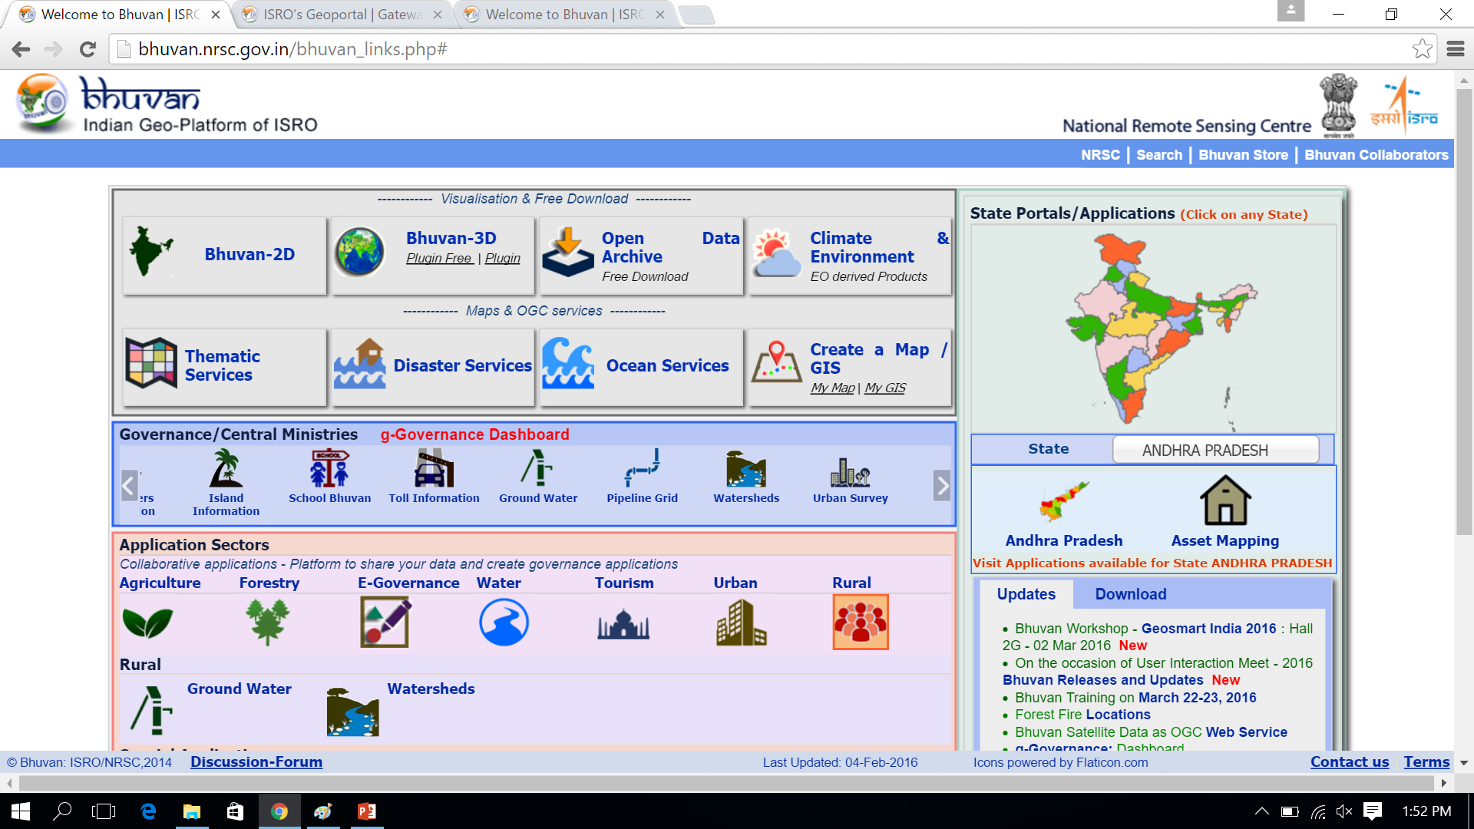
India’s Geo-Platform Services
Portal: bhuvan.nrsc.gov.in

Slide 13
India’s Geo-Platform Services
As per the recent direction from the Government on the most effective use of space technology by user ministries, more than 20 ministry portals are unveiled, and have been discussed during the National meet on the use of space technologies, chaired by Hon’ble Prime minister of India. Many of the Ministries/Departments have linked their web portals to Bhuvan for online services.
Bhuvan has become a popular platform that hosts one of the largest repositories of GIS map and services in the country.
Bhuvan is also acting as a clearinghouse for satellite data and value added products. They are effectively used for scientific studies and help students, researchers and organisations to take up the scientific projects for applied research. 3.6 lakh products have been downloaded by users in the last three years and the NRSC Open EO Data Archive, as clearing house, has become widely popular.
This includes scientific products generated by studying land, ocean and atmosphere under National Information System for Climate and Environmental Studies (NICES).

Slide 14
India’s Geo-Platform Services

Slide 15
http://bhuvan.nrsc.gov.in/governance/mdws_pipeline/pipeline.php

Slide 16
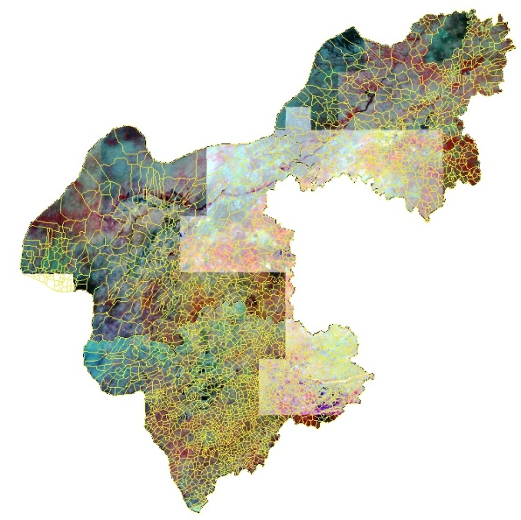
Space Technology in Health Ministry
Success Stories of Geospatial tools for G-Governance
Mapping malaria risk using Landscape features
Presence of irrigation tanks (>5%) within 1 km, vegetation cover ( >20 %), low barren area (< 10%) were associated with high malaria endemic.
With images of IRS P6 MX, villages categorized
into high ( ) and low ( ) malarious villages
in Kallembella (Sira Taluka , Tumkur)
Microstratification of malarias areas in Rajasthan

Slide 17
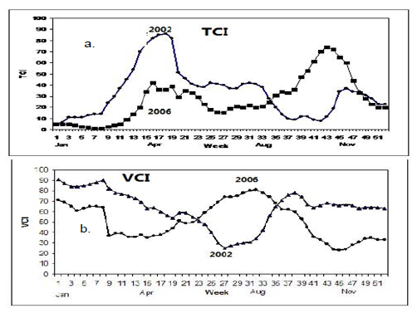
Past & Current Usage of Space Technology
Success Stories of Geospatial tools for G-Governance
EO based Parameters for Decision Making:
Temperature Condition Index for early warning of malaria outbreak in Tripura
The most sensitive periods of
malaria to the environment are the end of March‐ early
April (weeks 14‐ 17) using TCI, second half of June
(weeks 23‐ 26), using both TCI and VCI and mid
October (weeks 42‐ 44) using TCI.
TCI < 40 in March/April was critical in outbreak year ,2006
(Nizamuddin et al 2013)

Slide 18
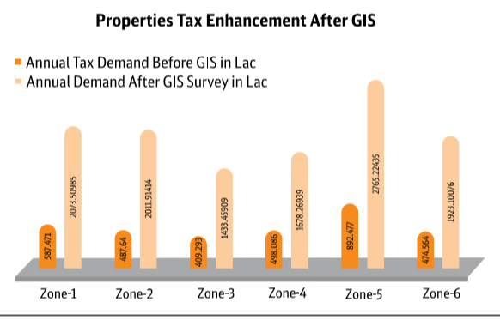
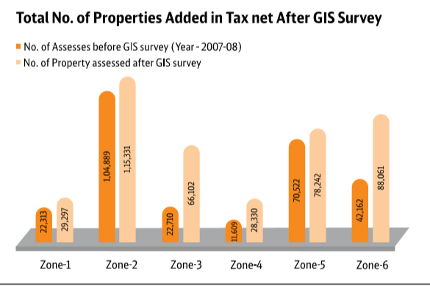
Success Stories of Geospatial tools for G-Governance
Success stories/ projects become part of capacity building to bring awareness of benefits
Professional training needed for geoprocessing of satellite images and WebGIS tools development.
Training of administrative and contractual staffs

Slide 19
Proposed Objectives
Capacity Building to promote the use of Geospatial tools for Sustainable Development Programs to developing countries, and to countries with economics in transition.
To whom it is addressed?
Building critical mass of people with right capacity to manage the environment and natural resources in a sustainable manner.

Slide 20
Back References …
Capacity Building for Geoinformatics in Africa – ITC, Netherlands initiative
Effective Approach for Capacity Building in GIS and RS Technologies in Developing Countries – Asian Inst. Of Tech., Thailand + JAXA
Building Capacity to use Geospatial technology for Development in Africa: Lessons from the Ugenda GIS Project
Role of Geospatial Technology in Environmental Sustainability in Nigeria
UNEP – Strategy for Capacity Building for Sustainable Development – brings out importance of building partnerships with Govt., NGOs, people participation
OCHRE program of New South Wales Government on Capacity Strengthening Policy for Local Decision Making
...........

Slide 21
G-GOVERNANCE and GST
G-governance makes use of geospatial technology to spatially enable policy-makers take informed decisions.
Geospatial technology enables users to understand problems better because it presents issues visually, in a more understandable manner, data integration for better governance.
Many success stories of use of GST in Governance:
For example, can we integrate land records with urban solutions and determine how much property tax should be collected from a region? Geospatial solutions facilitate such integrated views which can help the government increase revenues and deliver better services.

Slide 22
Mandate
CB programs should make a clear contribution to achieving sustainable development on the focus of the programs (i.e. water, climate, trade, urban, impact assessment, etc.).
Clear understanding of objectives essential between providers and beneficiaries -
to effectively target activities,
reduce redundancy,
improve synergies
ensure that capacity building genuinely meets the needs of countries’
However, questions such as: “What capacities should be built, for whom, on what topics, and to what end?” remain..

Slide 23
Dimensions of CB
Program Tiers:
Building awareness,
Building analytical capacity
Building decision-making capacity
Target Tiers:
Human capacities
Institutional capacities

Slide 24
Tiers in Detail: What to accomplish?
K-12 CapD:
Digital Geography (2-D, 3-D simulation/visualization)
ICT Basics – e-based services for governance
Mobile education training (tutor-student)
Success stories of GST in national/regional govt sectors
Training of Teachers / Mentors – periodic refreshers’ ones

Slide 25
Tiers in Detail: What to accomplish?
UG/PG CapD:
Developmental of 2-D, 3-D models for visualization
ICT advances – Developing e-based governance services
Mobile Applications, Crowd sources and PPGIS
Big data analytics, Data Access and Data Mining
Projects on Success stories of GST in Natl/regional Govts.

Slide 26
Tiers in Detail: What to accomplish?
Professional CapD:
Integrated information for governance (LEO, GEO, ground)
Theme specific pilot projects – NRM / DRM
Advanced GIS for health, water, Road, atmosphere, …
Space Law, Data Policies, International charters
CEOS and Groups activities in SBAs.

Slide 27
Tiers in Detail: How to accomplish?
Structured Training Programs
Caravan Training Programs
Mini-Projects
Tailor-made Training Programs
Outreach Programs (MOOCs)
Interactive Workshops

Slide 28
CB Approaches for GST in G-Governance (2)
Moving as much as possible from the presentation based discussion style into an interactive workshop style, using exercises, case studies, field visits and other elements of experiential learning to actually build capacities..
if workshops – not to be just one-off events but be embedded in long-term programs, comprising a series of workshops that reflect beneficiary countries’ priorities, and using a range of capacity building approaches in parallel

Slide 29
CB Approaches for GST in G-Governance (3)
Stronger emphasis - to be put on learning-by-doing as well as formal education.
Projects / success stories - a promising option for effective capacity building including all dimensions and targets mentioned.
An essential feature of this approach would be that a team of professionals from different institutions in a country is put in charge to complete a project – for example to assess a policy - receiving targeted financial and technical assistance.
Eventually, greater opportunities for CB lie with the future decision makers - the students, pupils and children.
Notes:
To actually build decision-making and institutional capacity, in addition to training
Projects or success stories, focused on an issue of priority, and comprising a set of different activities - a promising option for effective capacity building including all dimensions and targets mentioned above.
An essential feature of this approach would be that a team of professionals from different institutions in a country is put in charge to complete a project – for example to assess a policy - receiving targeted financial and technical assistance. This will provide individuals and institutions with an opportunity - through a learning-by-doing experience – to develop their managerial and analytical skills in the course of the project, while additional training can be provided where necessary

Slide 30
Integrated Approach
Focus on Capacity Building
Education, training, employment, mentoring
Experience, active learning …
Individual
Focus on empowerment and participation
Recognize diversity in communities, need for tailored plans and strategies
Leadership and personal development, esp. young people
Identification of communities’ assets and strengths as starting point of planning
Training in governance and skills to enable participation in processes to identify community needs & negotiate programs
Community

Slide 31
Integrated Approach(2)
Focus on Governance, management / leadership development, resourcing
Staff training and development…
Management and leadership development,
Adequate training for Govt. contracted services, simplify Govt. coordinated funding
Governance training
Organizations
Focus on ways of working and creating an enabling environment
to promote coordination and agreed policy guidelines between and within govt.
Shift from program focus to particular community / place focus and develop tailored plans
Develop new role as enabler, facilitator, supporter rather than deliverer
Staff development to build new skills and abilities…
Government

Slide 32
Summary
Need to increase capacity building at all levels on the use of Geospatial technology tools for good governance
It has direct link towards GEO/CEOS for their proposed future strategic plans.
Work Plan needs to be done on the use of technology and put to CEOS for endorsement and support
Innovative means of Program and Training Tiers to be addressed

Slide 33
Discussions
Floor Open for Discussions
Thank You for kind attention

Slide 34
RESPONSIBILITIES OF MUNICIPALITIES
Typical Functional responsibilities of Municipalities
Urban planning including town planning
Regulation of land use and construction of buildings.
Planning for economic and social developments.
Roads and bridges.
Water supply for domestic, industrial and commercial purposes.
Public health, sanitation, conservancy and solid waste management.
Fire services.
Urban forestry, protection of environment and promotion of ecological aspects.
Safeguarding the interests of the weaker sections of the society, including the handicapped and mentally retarded.

Slide 35
RESPONSIBILITIES OF MUNICIPALITIES (2)
Slum improvement and up-gradation.
Urban poverty alleviation.
Provision for urban amenities and facilities such as parks, gardens and playgrounds.
Promotion of cultural, educational and aesthetic aspects.
Burial grounds and cremation grounds.
Cattle ponds: prevention of cruelty to animals.
Vital statistics including registration of births and deaths
Public amenities including street lighting, parking lots, bus stop and public conveniences.
Regulation of slaughterhouses and tanneries.

Slide 36
Urban Development System
Various agencies related with urban development-
Municipal corporation/ Municipalities
Town & Country Planning Department
Urban Development Authority
Electricity Board
Water Supply Board
Telecommunication Department
Public Works Department (PWD/ CPWD)

Slide 37
Key Agencies
Other agencies related with information generation-
Land revenue/ Land records
Income Tax Department
District National Informatics Center
District Statistical Office
Horticulture/ Forest Department

