Slide 1

WGCapD-5 Annual Meet, 2016
Program for Distance Education Courses: Webinars / Online Hands-on Course
Senthil Kumar-ISRO
Angelica Gutierrez-NOAA
Hilcea Ferreira-INPE
WGCapD-5 Agenda Item: 08
Hampton, Virginia, USA
March 29th – April 1st, 2016

Slide 2
CapD Webinar Series

Slide 3
WGCapD & WG-Disasters DE Course:
2015 Webinar Series on RS Technology for Disaster Management
Introduction to Webinars Series
  Overview of CEOS/WGCapD
  Where CEOS can help: Datasets and Useful Tools: CEOS Visualization
  International Collaboration for DRM
Introduction to Disasters: Causes, effects, monitoring, mitigation, and management. Methods of hazard, vulnerability, and risk assessment and the role of geospatial data.
Space-based EO systems and their applications for hydro-meteorological disasters (floods)
Space-based EO systems and their applications for geological disasters (earthquakes, landslides, and volcanoes)
Continued…

Slide 4
WGCapD & WG-Disasters DE Course: (2)
2015 Webinar Series on RS Technology for Disaster Management
Space-based EO systems for environmental disasters (forest fires)
Real Time Monitoring of Global Precipitation from Space: New Technologies Applied to Heavy Rainfall Risk Reduction
Concepts and applications of internet GIS and Sensor Web (network of sensors) for disaster management. Example of an open source tool (TerraMA² - computational platform for developing Monitoring, Analysis and Alert systems)
Rapid mapping and emergency services (Disaster)

Slide 5
Feedback: WGCapD & WG-Disasters DE Course
  1. Data handling and software skill
  Provision of some assignments to work on using the software discussed in the Moodle.
  More practical examples and tutorials on software used to get required results that matter.
  Further demonstrations & techniques in software used for analyzing data.
  Practical classes on programming.
  A module that provides an introduction to image processing.
  2. Data Access
  Include real processing of data instead of results. Demonstrate how to derive maps and products.
  3. E-resources and Books
  Provide additional reference resources and/or e-books.
  4. Language
  Can we go for more languages of instructions ?

Slide 6
Feedback: Awareness about course

Slide 7
Feedback: Suggested topics to be covered
  Using Remote Sensing in Agriculture especially by small scale farmers.
  Newly available Satellites and accessing historical data archives.
  Another area to look into could be the orbital environment, where more disasters will happen.
  Early warning.
  Crowdsourcing and disaster management.
  Nowcasting of meteorological disasters.
  Flood monitoring.
  Software and techniques used for analyzing the data.
  Another session about the use of bandwidth and channel in the satellite image.
  Application of RS GIS in flood management.
  Image processing/analysis.
  Modeling of remote sensing data for disaster management.
  Application of GIS in epidemiology.
  Real Time Monitoring of Forest Fire .
  Image processing .
  Oil spills, disaster project management, disaster chain of command.
  Remote sensing for disease outbreaks; public health issue. If we have a major disaster it can lead to a disease outbreak, so how can we handle such advanced remote sensing techniques for disaster management.
  Remote Sensing in Municipals Waste Management.
  Radar applications in natural resources monitoring.
  Flood simulations.

Slide 8
Feedback: Strengths and weaknesses
Strength | Weakness
All, the whole course was so informative. | None, all of them were very helpful
The review of the types of data publicly available. Some ideas on how to get it and how to use it. I have appreciated this opportunity. | The quizzes were ok for self-assessment. However, I didn’t like having to wait to get the correct answers.
The experience of the instructors and the exchange of contacts with the other participants. | Just to say there were not African examples of studies applicable to Africa.
I find most helpful the parts of the course that give us information about access of data.
The recordings.
The case studies.
The explanations of the experts when giving the presentation.
The explanation of the different platforms using remote sensing and satellite imagery.
The last module on International Space Charter was of great interest to me.
Module 3 and Module 6 were the most useful modules (floods and forest fire)

Slide 9
Thank you All for good work done
NAME | INSTITUTION | ROLE
Hilcéa Ferreira | INPE | Coordinator/Instructor
S.P.Aggarwal | IIRS/ISRO | Coordinator/Instructor
Marie-Josee Bourassa | CEOS CEO | Contributor
Kim Holloway | CEOS SEO | Contributor/Instructor
Guy Aube | CSA | Contributor
Antonios Mouratidis | ESA | Instructor
Ivan Petiteville | ESA - WGDisasters | Contributor
Jesus A. G. Bernal | INAOE/CRECTEALC | Contributor
Claudia Lucaccioni | INPE | Moodle Tutor
Daniel Vila | INPE | Instructor
Alberto Setzer | INPE | Instructor
Fabiano Morelli | INPE | Instructor
Laercio Namikaya | INPE | Instructor
Su-Yin Tan | University of Waterloo and ISU(International Space University) | Instructor
Ana Prados | NASA | Instructor
Amita Mehta | NASA | Instructor
Nancy D. Searby | NASA | Contributor
Phila Sibandze | SANSA | Contributor
Lorant Czaran | UNOOSA | Contributor
Brenda Jones | USGS - WGDisasters | Instructor
Eric Wood | USGS | Contributor

Slide 10
Next….?
Webinar series repeat - with advance topics and hands on
Webinar series on other topic ? (NRM, GST for G-Governance etc.)
3 months’ e-learning programme on NRM/DRM/GST/…/?
Support on CB part to
  WG Disaster
  WG CV
  WG Climate
  VCs
  GEO Subgroups

Slide 11
Proposals
WS 1 : EO systems & applications for NRM (“Advances in Data & Tools”)
          Agriculture
          Water Resources
          Forestry
          Geology
          …….
WS 2 : EO systems & applications in DM (“Advances in Data & Tools”)
          Floods
          Land Slides
          Earthquake/Tsunami
WS 3: SAR data processing and applications (“NEW”)
WS 4: Ocean Scatterometer Data Processing and Applications (“NEW”)
WS 5: Geospatial Technology for G-Governance (“NEW”)
WS 6: Support to WGs and VCs (“NEW”)

Slide 12
How to make Webinars unique?
Telecon Discussions on webinars conducted by NASA and other space agencies’ – post the meeting and e-mail exchanges from Eric, Nancy and Angelica to come out on following points for consideration
Points to Ponder
  To whom are we trying to accomplish
  What is the best way to accomplish
  How do we measure that it is the best way

Slide 13
Points to Ponder
Ways To Accomplish:
Regional (geographic) context (models and data)
Awareness on International Charter support – especially on Disaster webinars
Multi-lingual (Spanish, Chinese, Arabic, Russian…)
Digital Content Generation for
  Awareness needs
  Skills Development needs
Modes
  Synchronous (online, interactive, face-to-face)
  Asynchronous (e-learning, outreach)

Slide 14
Points to Ponder
Whom To Accomplish:
Sr. No. | PURPOSE | PRIME FOCUS
1 | Human Resource Development | Supply of Technical and Professional Personal (K12, UG/PG students, Teachers)
2 | Organizational Strengthening | Strengthen Govt./NGOs Management Capacity on Geo-ICT solution (systems, processes) Strategic Management Principles (professional, field managers, trainees…)
3 | Institutional Strengthening | Strengthen Capacity of Organizations to Develop appropriate Mandates & Modus Operandi Legal & Regulatory Frameworks (Decision makers, Local & National Govt. / NGO Administrators, Law and Policy staffs, …)

Slide 15
Points to Ponder
What to Accomplish?
1) SAR / Geoinformatics Tutorial Webinars
Process Context | Sensors & Data Acquisition | Processing & Modeling | Storage & Retrieval | Dissemination & Use
Application Domain
Technology
Information Management
Institutional Setting & policy
Second Priority
Second Priority
Second Priority
Second Priority
First Priority
First Priority
First Priority
First Priority
Second Priority
Second Priority
Second Priority
Second Priority
Third Priority
Third Priority
Third Priority
Third Priority

Slide 16
Points to Ponder
What to Accomplish?:
2) Disasters / Geoinformatics Management Programs
Process Context | Sensors & Data Acquisition | Processing & Modeling | Storage & Retrieval | Dissemination & Use
Application Domain
Technology
Information Management
Institutional Setting & policy
Second Priority
Second Priority
Second Priority
Second Priority
Second Priority
Second Priority
Second Priority
Second Priority
First Priority
First Priority
First Priority
First Priority
Third Priority
Third Priority
Third Priority
Third Priority

Slide 17
Points to Ponder
What to Accomplish:
3) Natural Resources Management Programs
Process Context | Sensors & Data Acquisition | Processing & Modeling | Storage & Retrieval | Dissemination & Use
Application Domain
Technology
Information Management
Institutional Setting & policy
First Priority
First Priority
Second Priority
Second Priority
First Priority
First Priority
Second Priority
Second Priority

Slide 18
Points to Ponder
What to Accomplish:
4) Urban Planning / Land Administration Programs
Process Context | Sensors & Data Acquisition | Processing & Modeling | Storage & Retrieval | Dissemination & Use
Application Domain
Technology
Information Management
Institutional Setting & policy
Second Priority
First Priority
First Priority
First Priority
Third Priority
Second Priority
Second Priority
Second Priority
Third Priority
Third Priority
Third Priority
Third Priority
and so on ……

Slide 19
CapD: Interactive & Outreach Programs –
ISRO initiative

Slide 20
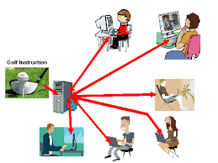
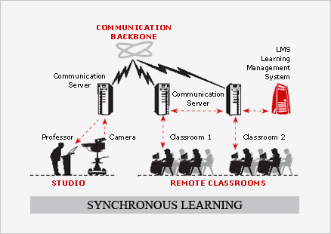

Models for e- learning based education system
iirs
Synchronous e-learning- occurs in real-time, with all participants interacting at the same time through some media;
Interactive Webinars, EDUSAT …
Asynchronous e-learning- is self-motivated and allows learner to engage in the exchange of ideas or information without the dependency of other participants or trainer at the same time;
Learning at
anytime, anywhere
Night Day

Slide 21
IIRS Distance Learning Programs
iirs
Under Distance Learning programs, two modes :
  Live and Interactive Classes (EDUSAT Programme) (cMOOC).
  Online E-learning Programme using MOOC (Massive Open Online Courses) (xMOOC).

Slide 22
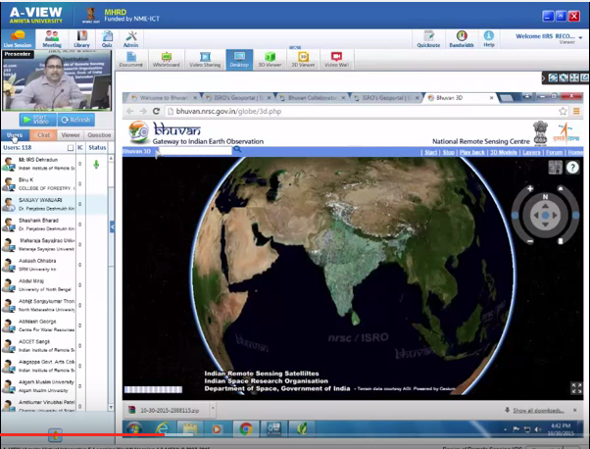
Live and Interactive lecture Delivery
Teaching tools
Faculty
Contents
Interaction tools
Participants

Slide 23
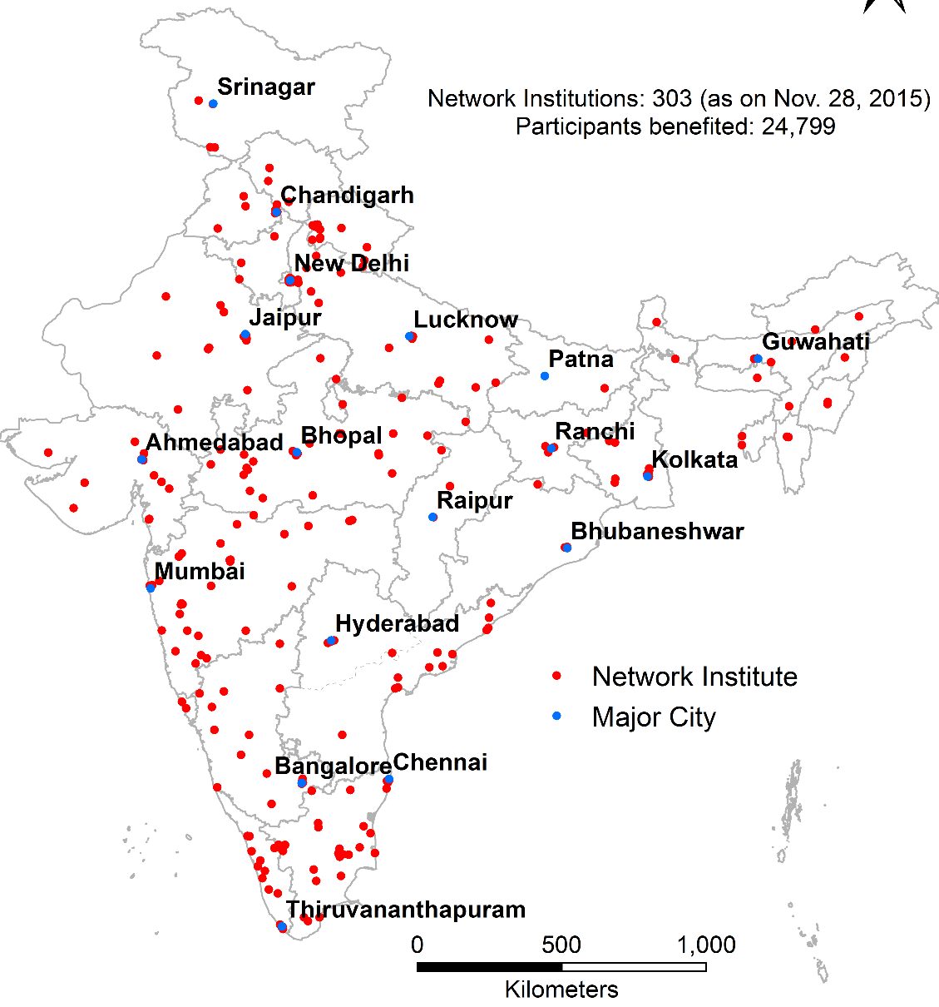
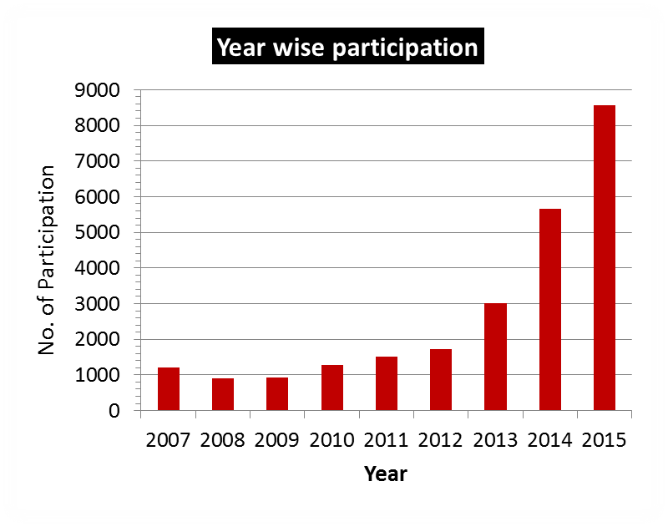
DLP: Internet / Satellite based Live & Interactive Courses
Twelve Weeks Certificate Course on ‘Basics of Remote Sensing, GIS and Global-Navigation Satellite System’ (Aug-Nov)
Four Weeks Specialized course on different themes (Feb-March)
No course Fee
About 29895 participants benefited
Network Institutions
(352 till Feb. 2016)
Target Groups
Central/ State Universities
Research Institutions
Central/ State Govt. organisations
Individuals

Slide 24
IIRS Online Hands-on Program….
Indian Institute of Remote Sensing (IIRS) has initiated its interactive distance education based capacity building under IIRS outreach programme in the year 2007.
Over 30,000 students and researchers from 350+ universities / Institutions across the country have been trained in the field of geospatial technology.
This was accomplished through ISRO's communication satellites, satellite interactive terminals and A-View software.

Slide 25
IIRS EDUSAT Program (Cont.)
Around 70 broadcast and interactive networks have been established by ISRO, covering 20 States having more than 50,000 classrooms. Program is broadcasted live and interactive mode.
SIT and ROT terminals have been used at the user end to receive and interact with Teaching end (IIRS).
University coordinators are identified to facilitate participation, attendance, providing RS & GIS Lab and conducting examination etc.

Slide 26
IIRS Outreach Program (Cont.)
Course reading materials are distributed well in advance to the participants.
A total of ~3000 to 6000 participants participates on an average in each program from 150 to 300 Institutions /Universities.
Annual IIRS User Interaction Meet (IUIM) is being organized by inviting coordinators and participants to obtain feedback for further improving the program.

Slide 27
IIRS e-learning Portal (using MOOC)
Technology for Education – e-Education
Learning at
anytime, anywhere
http://elearning.iirs.gov.in

Slide 28
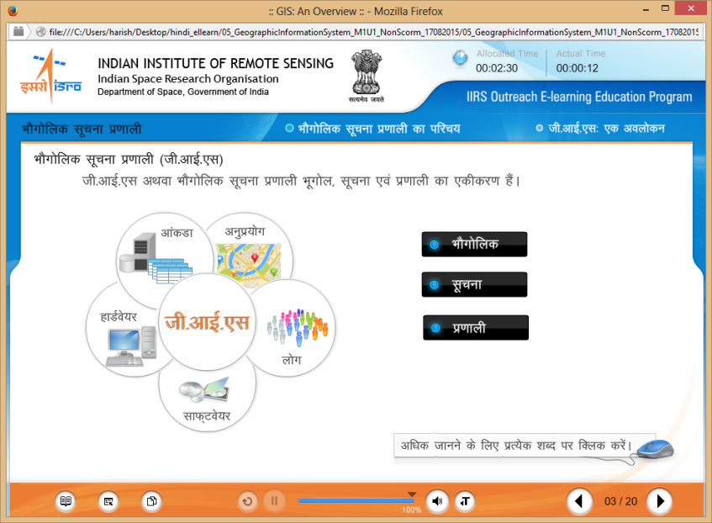
DLP: Internet Based e-Learning Courses
Technology for Education – e-Education
Self-paced, any-time/any-where learning
Four months Comprehensive Certificate Course on ‘Remote Sensing and Geo-information Science’
One month fundamental Certificate Courses on (1) Remote Sensing; (2) GIS; (3) Digital Image Processing; and (4) Photogrammetry
Registration – Free and Open to All
Topics
Image Statistics
Basic Remote Sensing
Photogrammetry and Cartography
Digital Image Processing
Geographical Information System
Global Navigation Satellite System
Customization of Geospatial Tools
Applications of Geospatial Technologies

Slide 29
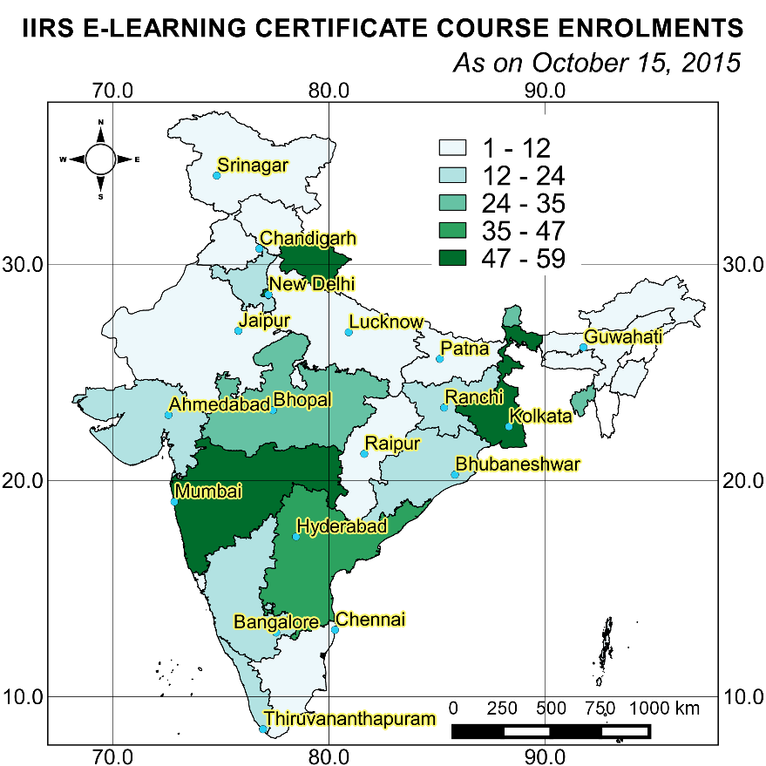
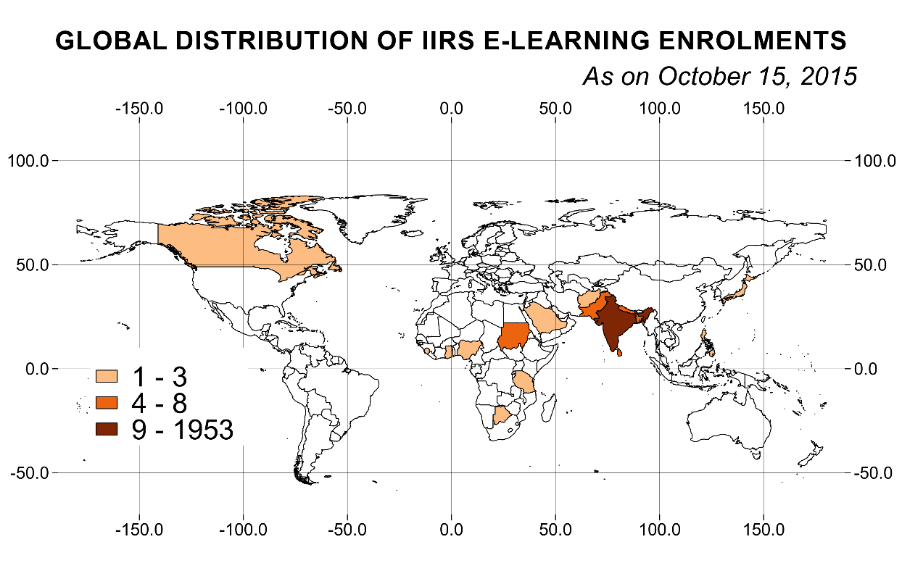
DLP: Internet Based e-Learning Courses
Technology for Education – e-Education
India: 1953
Foreign: 86

Slide 30
Course Objectives and Target Groups….
Introduce Geoinformatics and its applications to university postgraduate students / researchers / faculty and to generate interest with further scope of perusing the career in the domain of geospatial technologies.
Facilitate the universities to avail with one of the best teaching faculty of IIRS / guest faculty (India) in RS, GIS, GPS and related technologies.
Target Groups
Central/ State Universities;
Research Institutions;
Central/ State Govt. organisations;
Individuals.

Slide 31
Summary
Excellent facility in place for easy and uninterrupted interaction to make the EDUSAT program as lively as possible
Our E-learning (async) program supports and complements for those who cannot participate
Good benefits for learners to build their career in the field of Geospatial technology – Alumni: as standing e.g.
Strongly encourage to upgrade by taking regular courses at places like IIRS for strong leaders…

Slide 32
Summary
Good Discussion during telecon – followed by mail exchanges of views/suggestions
Overall Acceptance to have new and unique WGCapD Webinar series in 3-Yr Plan
Modus Operandi to arrive best and unique practices is being worked out
Finalization and Work Plan on Modes, Targeted Users, Themes (incl. WGs, VCs) in this Meet.

Slide 33
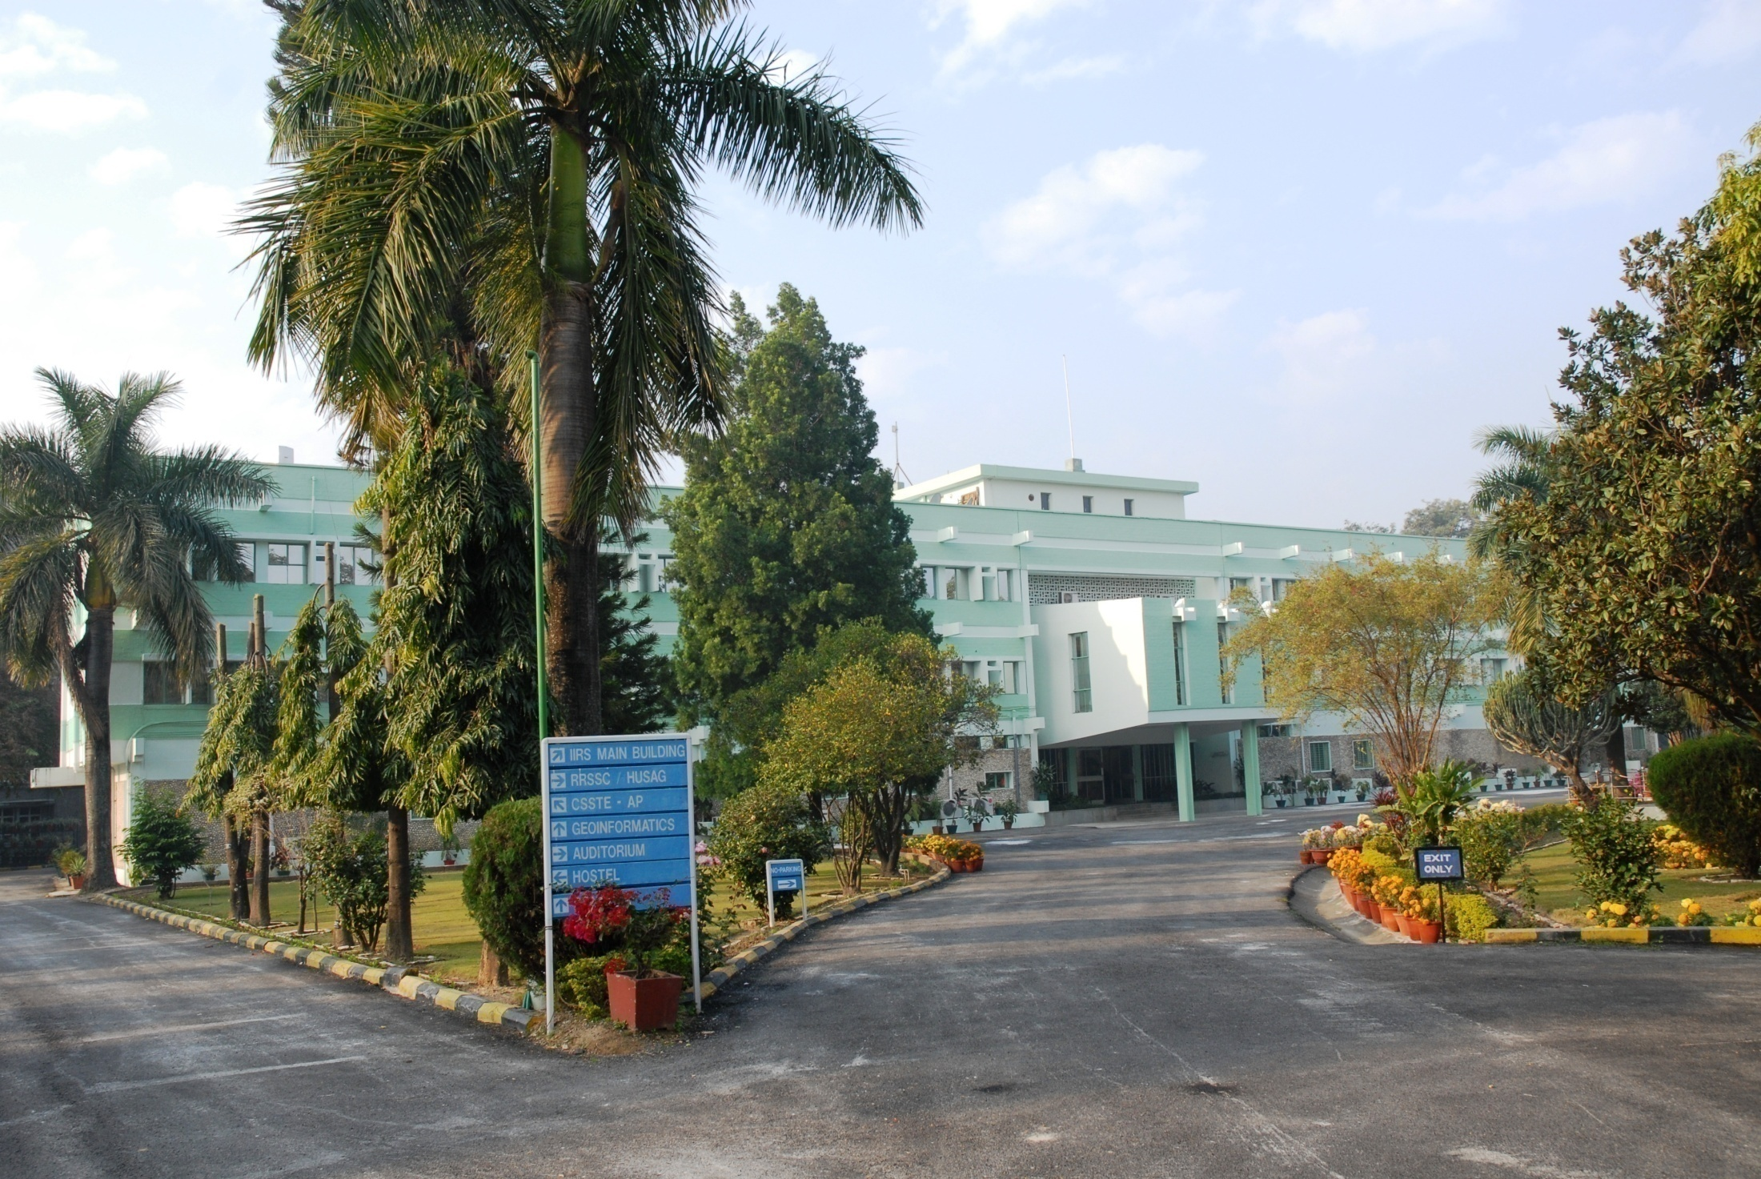
iirs
An ISO 9001-2008 Institute
THANK YOU
www.iirs.gov.in

Slide 34
Discussions
Floor Open for Discussions
Thank You for kind attention

Slide 35
Basic qualification for IIRS e-learning courses
iirs
For learner no basic qualification is required.
For certifications following qualification is required:
Persons who have successfully completed graduation or 3 years diploma after 10th standard or equivalent are eligible.
or
Working Professionals with 10+2 educational qualification and minimum 5 years experience in geo-spatial domain or related areas.

