Slide 1

Committee on Earth Observation Satellites
SAR training workshops
- considerations
ESA
F. Sarti
Day 1 – point 7
CEOS WGCapD-5
CEOS Systems Engineering Office (SEO), Hampton, VA, USA
March 30th – April 1st, 2016

Slide 2
The 5th Meeting of the CEOS Working Group on
Capacity Building & Data Democracy (WGCapD-5)
The CEOS Systems Engineering Office (SEO), Hampton, VA, USA
March 30th – April 1st, 2016
C-band archive and TPM
ESA can offer a huge, nearly worldwide SAR archive in C-band from the ERS family (starting in 1991) and ENVISAT ASAR.
Datasets can be obtained for free anytime via project proposal (or via education cat-1 projects that can be set up ad hoc for our WG). With more restrictions, some TPM SAR data can be accessed in the same way.
https://earth.esa.int/web/guest/pi-community/apply-for-data/full-proposal

Slide 3
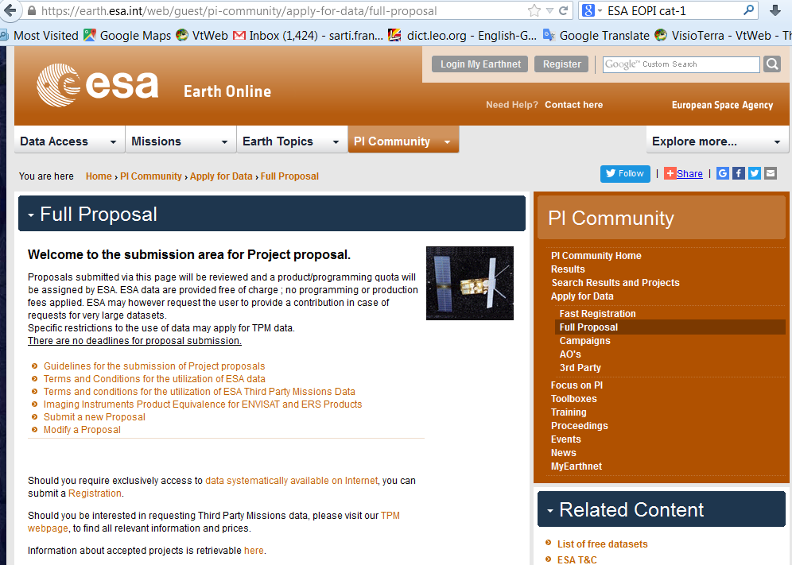
The 5th Meeting of the CEOS Working Group on
Capacity Building & Data Democracy (WGCapD-5)
The CEOS Systems Engineering Office (SEO), Hampton, VA, USA
March 30th – April 1st, 2016
C-band archive

Slide 4
The 5th Meeting of the CEOS Working Group on
Capacity Building & Data Democracy (WGCapD-5)
The CEOS Systems Engineering Office (SEO), Hampton, VA, USA
March 30th – April 1st, 2016
C-band Sentinel-1
Sentinel-1 is a two satellite constellation providing C-Band SAR data continuity following the ERS and Envisat missions. S-1a launched in April 2014, followed by S-1b (planned end of this month)
Data can be obtained from a datahub with free registration: https://scihub.copernicus.eu/dhus/#/home
ESA has just found an agreement with NASA, NOAA and USGS to make Sentinel data available to them.

Slide 5
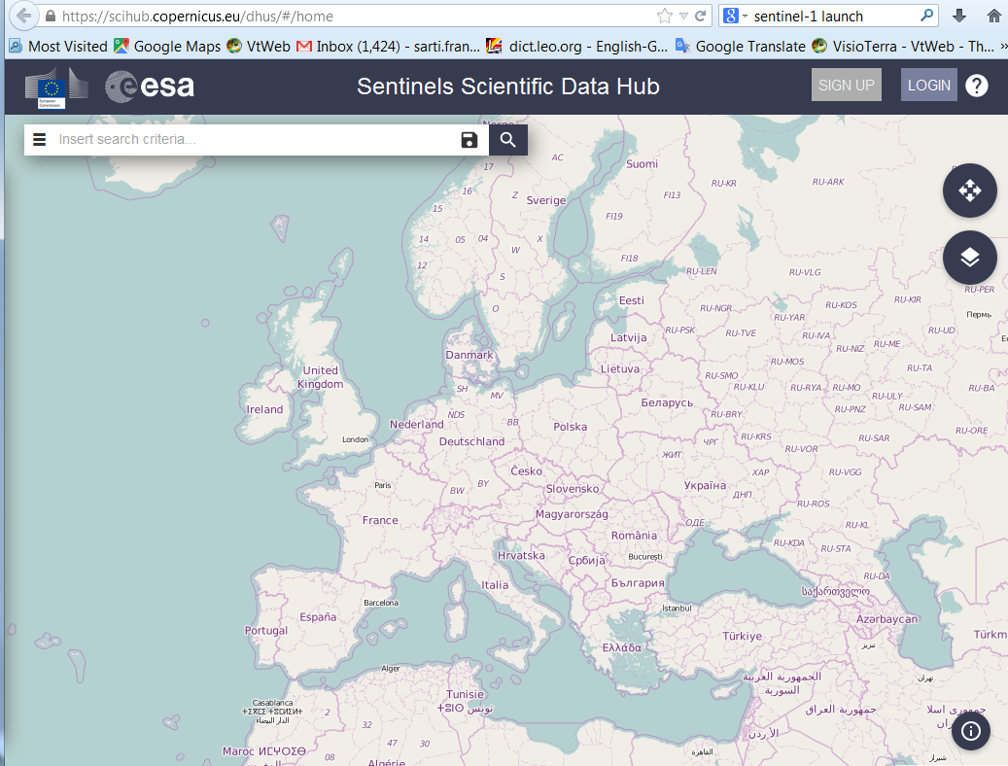
The 5th Meeting of the CEOS Working Group on
Capacity Building & Data Democracy (WGCapD-5)
The CEOS Systems Engineering Office (SEO), Hampton, VA, USA
March 30th – April 1st, 2016

Slide 6
The 5th Meeting of the CEOS Working Group on
Capacity Building & Data Democracy (WGCapD-5)
The CEOS Systems Engineering Office (SEO), Hampton, VA, USA
March 30th – April 1st, 2016
Sentinel and SAR free processing SW
ESA provides a free SW package (SNAP) for all Sentinel Toolboxes (jointly developed by Brockmann Consult, Array Systems Computing and C-S), ideal for Earth Observation processing and analysis, widely used in all ESA training courses.
http://step.esa.int/main/toolboxes/snap/

Slide 7
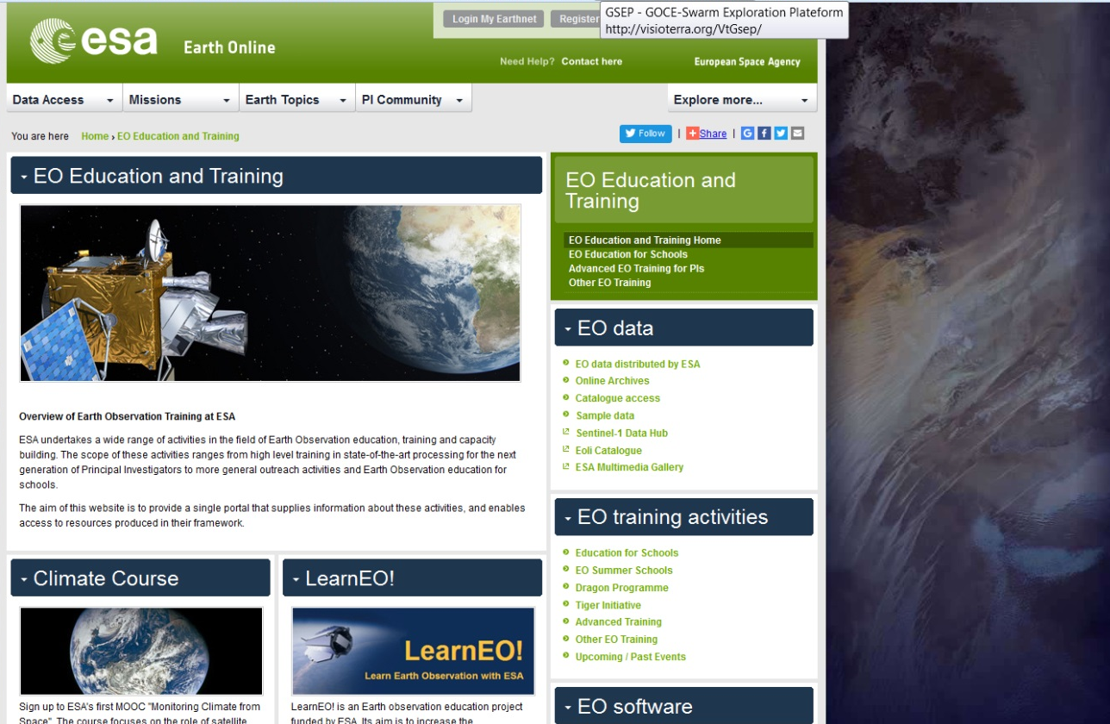
The 5th Meeting of the CEOS Working Group on
Capacity Building & Data Democracy (WGCapD-5)
The CEOS Systems Engineering Office (SEO), Hampton, VA, USA
March 30th – April 1st, 2016
ESA SAR training online
ESA provides a number of training courses every year. Most presentations and exercises are made available online on:
https://earth.esa.int/web/guest/eo-education-and-training

Slide 8
The 5th Meeting of the CEOS Working Group on
Capacity Building & Data Democracy (WGCapD-5)
The CEOS Systems Engineering Office (SEO), Hampton, VA, USA
March 30th – April 1st, 2016
ESA SAR training online
And in particular:
https://earth.esa.int/web/guest/eo-education-and-trainingweb/eo-edu/pis-advanced-training
https://earth.esa.int/web/guest/eo-education-and-trainingweb/eo-edu/university-undergraduate-level
An extensive list was provided by C. Stewart to our WG. Some of the existing exercises, targeting both basic SAR processing and applications (including disasters) can be modified ad hoc for our WG if requested

Slide 9
The 5th Meeting of the CEOS Working Group on
Capacity Building & Data Democracy (WGCapD-5)
The CEOS Systems Engineering Office (SEO), Hampton, VA, USA
March 30th – April 1st, 2016
Videos, webinars, MOOCs
On top of presentations, ESA and DLR offer a number of videos about SAR training (see https://earth.esa.int/web/guest/eo-education-and-trainingweb/eo-edu/pis-advanced-training
and https://saredu.dlr.de/ )
On top of the material in English, ESA is also preparing a set of videos in French about SAR theory (Prof J.P.Rudant) with practical exercises (soon on the web) for French-speaking countries
On request, ESA can also contribute to SAR webinars

Slide 10
The 5th Meeting of the CEOS Working Group on
Capacity Building & Data Democracy (WGCapD-5)
The CEOS Systems Engineering Office (SEO), Hampton, VA, USA
March 30th – April 1st, 2016
Videos, webinars, MOOCs
ESA just started creating MOOCs on Climate Change (1st and 2nd edition done already, soon 3rd - see http://www.esa.int/Our_Activities/Observing_the_Earth/Space_for_our_climate/Join_the_virtual_classroom ) and will soon start with DLR a MOOC on SAR.
WG CApD users welcome in the Climate Change and SAR MOOC’s !

Slide 11
The 5th Meeting of the CEOS Working Group on
Capacity Building & Data Democracy (WGCapD-5)
The CEOS Systems Engineering Office (SEO), Hampton, VA, USA
March 30th – April 1st, 2016
Possible additional presentations
A dedicated presentation about MOOC concept / results (for Climate Change) can be given by ESA if the agenda allows….
A dedicated presentation about SAR-Edu can be given by DLR if the agenda allows….

Slide 12
The 5th Meeting of the CEOS Working Group on
Capacity Building & Data Democracy (WGCapD-5)
The CEOS Systems Engineering Office (SEO), Hampton, VA, USA
March 30th – April 1st, 2016
Organization of SAR training workshops for WG CapD
Requests for SAR Training / workshops have been expressed already to ESA by several WG CapD members:
SANSA (Phila, Jane) for Zambia (EN) and Gabon (FR) for 2016 (& 2017?). At regional level, hosted by the National RS Center of Zambia and the Gabon Space Agency respectively. Including basic SAR processing steps and relevant applications for the region, with practical hands-on
CONAE (Graciela Salmuni) for 2016-2017
NOAA (Angelica G.) & GEOGLAM (Alyssa W.) expressed their interest to have a SAR training at the Bogotà Workshop 7-10 June 2016

Slide 13
The 5th Meeting of the CEOS Working Group on
Capacity Building & Data Democracy (WGCapD-5)
The CEOS Systems Engineering Office (SEO), Hampton, VA, USA
March 30th – April 1st, 2016
Organization of SAR training workshops for WG CapD
Setting dates:
Two workshops in Africa (Gabon, Zambia): ideally one in Autumn 2016 (possible slots for ESA speaker in Gabon: 25 Sept - 4 Oct or 14 - 23 Oct), one in 2017
SAR MOOC …. Whenever ready, sometimes in 2017
GEOGLAM Bogotà on 7-10 June 2016 will be hard – unless via webinar in Spanish, use of SAR and S-1 for disaster monitoring in Lat Am (or with an expert mission of a SELPER expert). Possibly SAR-Edu material already translated in Spanish (TBC by DLR)

Slide 14
The 5th Meeting of the CEOS Working Group on
Capacity Building & Data Democracy (WGCapD-5)
The CEOS Systems Engineering Office (SEO), Hampton, VA, USA
March 30th – April 1st, 2016
Organization of SAR training workshops for WG CapD
Funding resources from ESA side:
ESA Copernicus office (20K for participants in Africa, in case of workshops about Sentinel data)
ESA EO Education for 1-2 expert missions in 2016 (e.g. an ESA P.I. from AUF for Gabon, French-speaking)
ESA EO funding for one SAR MOOC together with DLR (though not uniquely for the purposes of our WG)

Slide 15
The 5th Meeting of the CEOS Working Group on
Capacity Building & Data Democracy (WGCapD-5)
The CEOS Systems Engineering Office (SEO), Hampton, VA, USA
March 30th – April 1st, 2016
Organization of SAR training workshops for WG CapD
Recommendations:
In order to fully exploit the potential and synergy of the different SAR systems (band, resolution and polarisation variety) for the different applications, a joint action of ESA, DLR (X-band HR, maybe AfriSAR data over Gabon), CSA (C-band HR), NASA (polarimetry), JAXA (L-band), ISRO … is necessary, also because of the many requests.
Different mechanisms can be combined: classical workshop, webinars, MOOC, expert missions
Train the trainers (primary target participants) and at regional level
Include practical hand-on with free SW with exercises on relevant SAR applications for developing countries

Slide 16
The 5th Meeting of the CEOS Working Group on
Capacity Building & Data Democracy (WGCapD-5)
The CEOS Systems Engineering Office (SEO), Hampton, VA, USA
March 30th – April 1st, 2016
Thank you

