Slide 1
Meeting Strategy
Committee on Earth Observation Satellites
South African National Space Agency
WGCapD-5 Agenda Item 3
Working Group on
Capacity Building & Data Democracy
Hampton, Virginia, USA
March 29th – April 1st, 2016

Slide 2
WGCapD-5
Meeting Strategy
To provide a clear direction on where we want the group to go, affirm our 3 Year Strategy Plan and endorse our commitment to the 3 Year Work plan
Expected Major Outcomes
Setting dates for the two SAR training workshops
Course outline for the SAR training workshops
Establish a consensus on on-line training approaches eg webinars and others
Revisit on going activities eg Practical EO education targetting major conferences, GeoCab Portal etc
Clarify how CapD supports CEOS VCs and other Working Groups
Discussion on Capacity Building best Practises
Clarify and agree on how to support AfriGEOSS and AmeriGEOSS
Plan/Discuss how to resource all these activities

Slide 3
WGCapD 3 Year Strategic Plan
Committee on Earth Observation Satellites
South African National Space Agency
WGCapD-5 Agenda Item 4, 5 and 6
Working Group on
Capacity Building & Data Democracy
Hampton, Virginia, USA
March 29th – April 1st, 2016

Slide 4
WGCapD-5
Hampton, Virginia, USA March 29th – April 1st, 2016
Presentation Outline
CEOS Mission
WGCapD Objectives
Chair Initiatives (CEOS CEO, Chair, SIT and WG & VCs)
WGCapD 3 Year Plan Origin and Objectives
WGCapD 3 Year Plan Details
Conclusion

Slide 5
CEOS Mission
Mission:
CEOS ensures international coordination of civil space-based Earth observation programs and promotes exchange of data to optimize societal benefit and inform decision making for securing a prosperous and sustainable future for humankind.
CEOS Priorities (Relevant to WGCapD)
CEOS Agencies affirmed their intention to continue to enhance their cooperation to respond effectively to Earth observation users’ needs by achieving integration across the full range of Earth observations, by closing important observational gaps, and by promoting the sharing of CEOS Agency data, and improving access to and use of such data.

Slide 6
CEOS Expected Outcomes 2016
Climate Monitoring, Research, and Services
Carbon Observations, Including Forested Regions
Observations for Agriculture
Observations for Disasters
Observations for Water
Capacity Building, Data Access, Availability and Quality
Advancement of the CEOS Virtual Constellations
Support to Other Key Stakeholder Initiatives
Outreach to Key Stakeholders
Organizational Issues

Slide 7
WGCapD Mission Statement
The WGCapD will build upon the CEOS Data Democracy Initiative in an effort to increase the capacity of institutions in less developed countries for effective use of Earth Observation data for the benefit of society and to achieve sustainable development.
The WGCapD will support CEOS efforts toward providing wider and easier access to Earth Observation data, increasing the sharing of software tools eg open source software and open systems interface, increasing data dissemination capabilities, transferring relevant technologies to end users, and providing intensive capacity building, education, and training.

Slide 8
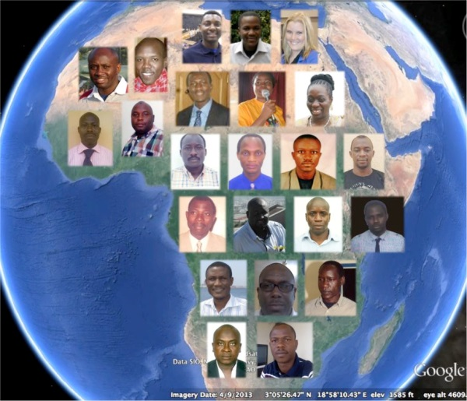
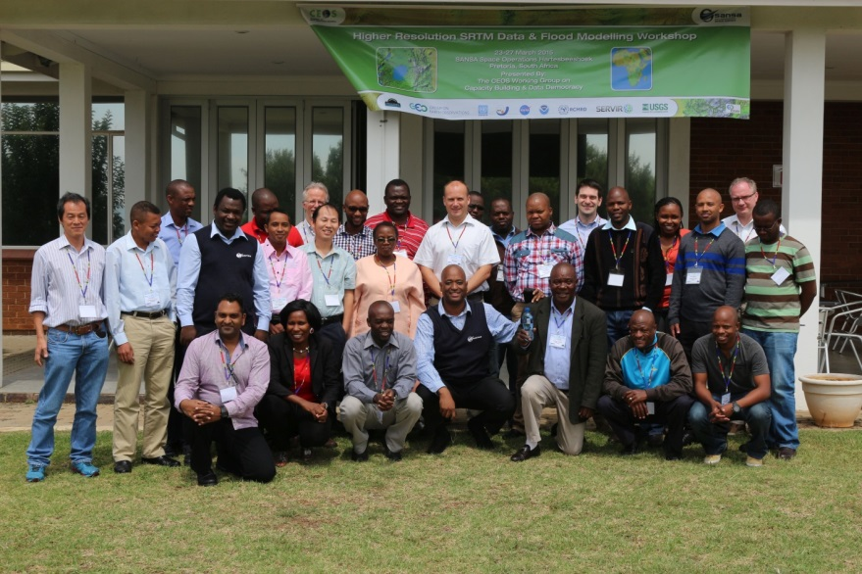
WGCapD Chairs Initiatives (204-2016)
INPE (2013-2014): E-Learning education for learners
USGS (2014-15): SRTM Workshops
Success depends on
Cooperation in CEOS, agencies in WGCapD and financial support from GEO, UNOOSA and SWF
SANSA (2015-16): SAR Training in Developed Countries

Slide 9
WGCapD 2014-15 Summary of Activitiess
CB-1 | Digital Elevation Model (DEM) workshops | Q4 2015
CB-2 | Provide practical EO education for students and teachers (2016) | Q4 2016
CB-3 | E-learning courses on remote sensing technologies | Q4 2016
CB-4 | Capacity Building Portal | Q2 2015
CB-5 | Implement the TanDEM-X Edu Project (No data release) (SAR) | Q3 2016
CB-6 | CB-6: Capacity Building for Disaster Management - Pilot Course | Q4 2016
CB-7 | Release of newsletters and mail-outs (2016) | Q4 2015
CB-9 | Development and release of webinars | Q4 2015
CB-2,4, 5, 7, 9:
Included in 2016 Plan

Slide 10
WGCapD 3 Year Strategic Plan: Origin and Objectives
Originated in 2015 at the 4th Annual Meeting in Pretoria
Agreed on the following 4 objectives:
Increase access to data, products, and tools and ability to use them through targeted training workshops;
Build awareness of new mission datasets, and how to use them within the context of existing datasets;
Support CEOS WGs and VCs on their own capacity building initiatives. (vs CapD doing it for them
Improving communications and coordination between Agency and WG/VC/CapD capacity building and education activities as well as related international activities such as -GEOCAB Portal and
Work with international stakeholders such as UNOOSA and other UN agencies to support needs in emerging space agencies or other—including user needs

Slide 11
WGCapD 3 Year Plan: Details
WGCapD Objectives/Deliverables: 2016-2018
Objective/Deliverable | Projected Completion Date | Background Information
CB-1: Develop and submit the WGCapD Work plan 2016-2018 to CEOS | Q2 2016 | WGCapD has embarked on a process of refining and consolidating its activities through a strategy session that took place in Pretoria in 2015. This process resulted in the production of a three year Work plan that guide the Working group activities | SANSA, ISRO, NASA, USGS
CB-2: Build awareness and demonstrated the value and applications targeting teachers, students and practitioners in major conferences eg The Living Planet Symposium | On going | WGCapD members will target major Earth observation and other relevant conferences and workshops and provide training sessions for students and teachers. This effort will also include demonstrations on the value of Earth observation (Objective 1 and 4) | ESA, DLR
CB-3 Build awareness of new CEOS missions and datasets. | Ongoing | Within the context of support to CEOS/GEO projects , Using webinars, the CEOS Website, newsletters, listerves , social media, etc. to improve access to new CEOS Missions and datasets (Objective 4) | SEO, USGS
CB-4: Continue exploration and providing of appropriate E-learning courses in relevant application | Ongoing | Explore new approaches to delivering online capacity building for a wide variety of users, e.g. university educators, practitioners, and policy makers in developing countries; follow-up to initial e-learning pilot for select African countries in 2013 and 2015. (Objective 3) | INPE, ISRO, NOAA,

Slide 12
WGCapD 3 Year Plan: Details (Cont.)
Capacity Building, Data Access, Availability and Quality Objectives/Deliverables: 2016-2018
Objective/Deliverable | Projected Completion Date | Background Information | Responsible CEOS Agency
CB-5: Contribute to Capacity Building Portal (GeocabPortal) | Ongoing | Populate the Capacity Building Portal,; portal aims at increasing the awareness of the Capacity Building Inventory across CEOS and GEO. See GEONetCab site at http://www.geonetcab.eu/). (Objectives 3 and 4) | NASA, NOAA
CB-6: Create a planning document for the release of newsletters and mail-outs | Q3 2016 | WGCapD will significantly increase its communication through key channels such as its newsletter and mailing list, including promotion of appropriate material and activity of other CEOS Entities. (Objective 2 , 3) | SEO, SANSA, ISRO
CB-7: Survey of CEOS Capacity Building activities and a task report on capacity Building in CEOS + Document on best practices in Capacity building | Q4 2016 | In support of CEOS this working group will undertake a survey to establish capacity building best practices. A report highlighting key points, areas of consolidation and suggestions and best practices in capacity building will be produced. Part of this information will be obtained from a CB Summit to be held in conjunction with the WGCapD Annual Meeting. (Objective 1, 2, 3) | NASA, SANSA

Slide 13
[
WGCapD 3 Year Plan: Details (Cont.)
Capacity Building, Data Access, Availability and Quality Objectives/Deliverables: 2016-2018
Objective/Deliverable | Projected Completion Date | Background Information | Responsible CEOS Agency
CB-7: Survey of CEOS Capacity Building activities and a task report on capacity Building in CEOS + Document on best practices in Capacity building | Q4 2016 | In support of CEOS this working group will undertake a survey to establish capacity building best practices. A report highlighting key points, areas of consolidation and suggestions and best practices in capacity building will be produced. Part of this information will be obtained from a CB Summit to be held in conjunction with the WGCapD Annual Meeting. (objectives 2, 3) | NASA, SANSA
CB-8: SRTM- Training Workshops | Q3 2017 | Two more training SRTM in Disaster Management workshops are anticipated: one in Asia (possibly in Nepal) and another in Africa ( possibly in Gabon). Exact dates are still TBD. (Objectives 1, 2, 4) | USGS, SANSA,
CB-9: SAR Training Workshops | Q4 2016 | CEOS Agencies continue to release SAR data. WGCapD will provide 2 SAR (Data Access, awareness and processing) workshops in developing countries. Venues Zambia and ?? June/July for Zambia, ?? TBD. (objective 1, 2,4) | SANSA, ESA, DLR, NASA, ISRO

Slide 14
WGCapD 3 Year Plan: Details (Cont.)
Capacity Building, Data Access, Availability and Quality Objectives/Deliverables: 2016-2018
Objective/Deliverable | Projected Completion Date | Background Information | Responsible CEOS Agency
CB -10:A Capacity Building pilot activity on Geospatial technologies and their application in G-Governance | Q1 2017 | CEOS has identified a need for a capacity building activities in Governance. This knowledge is needed to support many GEO related actions including resources management, urban master planning, traffic and pollution flow control. (objective 1, 2,4) | ISRO, SANSA
CB-11 - Provide capacity building support to CSIRO and the CEOS Chair in the ”Future Data Architectures initiative. | Q4 2016 | CSIRO and the CEOS Chair are leading the 2016 Chair Initiatives, .”Future Data Architectures” and “Non-meteorological applications for next generation geostationary satellites”. (objective 1, 2,4) | USGS, ISRO, SANSA
CB-12 Support the DCEO in developing the CEOS component of GEO’s contribution to space based EO to meeting the Sustainable Development Goals | Q4 2016 | CEOS is supporting the definition of targets for the UN Sustainable development | DCEO, SANSA
CB-13 Provide CB support to regional GEO initiatives | Ongoing | AfriGEOSS, AmeriGEOSS. (Objective 4) | SANSA, NASA, USGS, ISRO

Slide 15
Conclusion
Affirm our commitment to the three year plan
Suggest some minor changes
Affirm dates and resources
Thank you
Jane Olwoch (SANSA) Chair
Senthil Kumar (ISRO)
Vice Chair

