Slide 1

Living Planet Symposium Prep – Reframing the K12 Strategy
Committee on Earth Observation Satellites
ESA, DLR et al.
WGCapD-5 Agenda Item #35
Working Group on
Capacity Building & Data Democracy
Hampton, Virginia, USA
March 29th – April 1st, 2016

Slide 2
WGCapD-5
Hampton, Virginia, USA
March 29th – April 1st, 2016
EO School Lab - General Concept
Institution | Recipient | Instructor | Process | Product
School | School Student | Teacher | Learning | Knowledge
School Lab | Sec. School Student Teacher | University Student Scientist | Attraction Stimulation Motivation | Interest Study Decision
University Vocational Education | University Student Scientist Administrator | Expert | Training | Expertise & Application
Education
Capacity Formation
Capacity Building

Slide 3
WGCapD-5
Hampton, Virginia, USA
March 29th – April 1st, 2016
Main efforts
Increase awareness for EO data at the secondary school level
Provide practical educational tools addressing remote sensing techniques and methods to analyse and process remote sensing data
Provide access to practical Earth observation education facilities managed by participating Agencies
Establish practical education showcases at international conferences
Create and deliver educational toolboxes, including software, Earth observation data, and tutorials for user-friendly image processing at the secondary school level, as well as the lower university level
Provide practical demonstrations for schools based on real experiments (e.g. use of spectrometers, radiometers, radar devices)
Educate the general public about the benefits/applications of EO

Slide 4
WGCapD-5
Hampton, Virginia, USA
March 29th – April 1st, 2016
Realization #1
EO @ School
in Germany
- supported by
DLR Space Directorate

Slide 5

FIS –
Remote Sensing in Schools

Slide 6
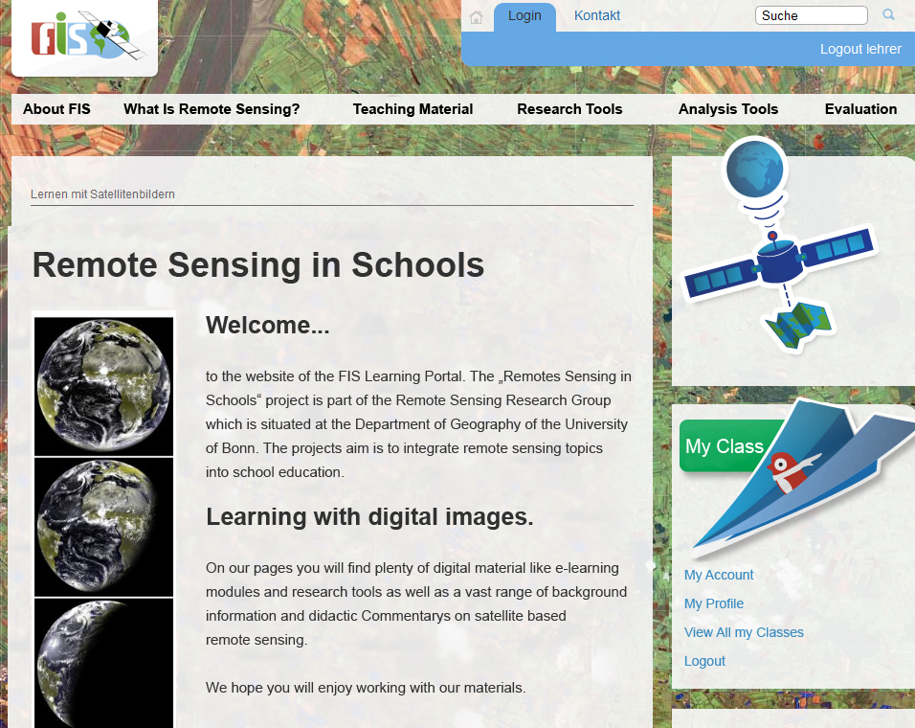
FIS – Remote Sensing in School Lessons
Learning Portal on Remote Sensing

Slide 7
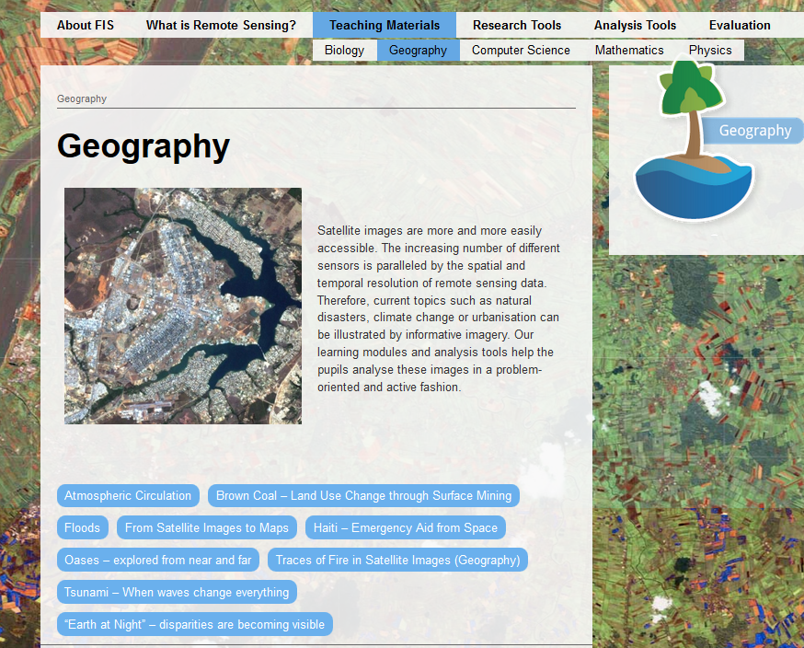
FIS – Remote Sensing in School Lessons
Teaching Materials

Slide 8
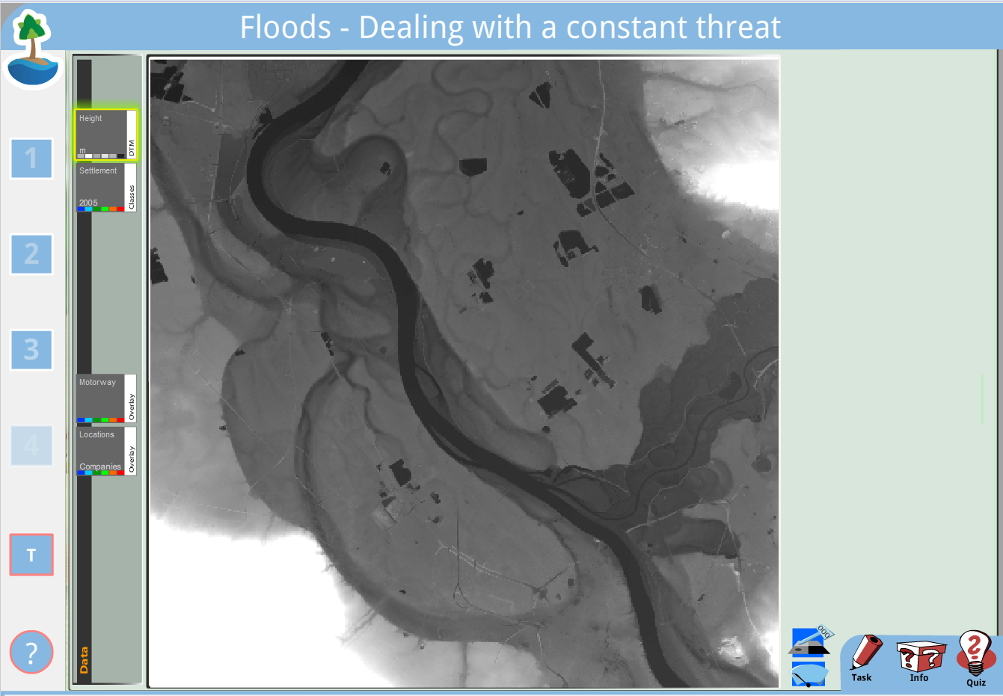
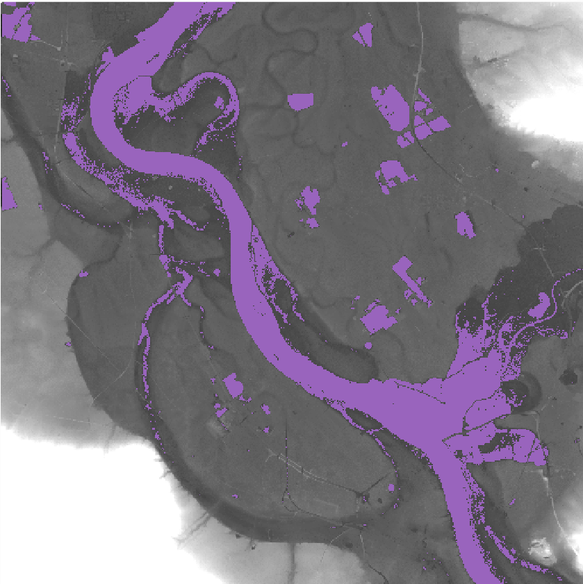
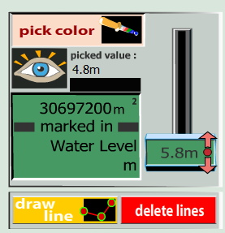
FIS – Remote Sensing in School Lessons
Teaching Materials – Floods-Dealing with a Constant Threat

Slide 9
Columbus Eye –
Live Videos of the ISS in Schools

Slide 10
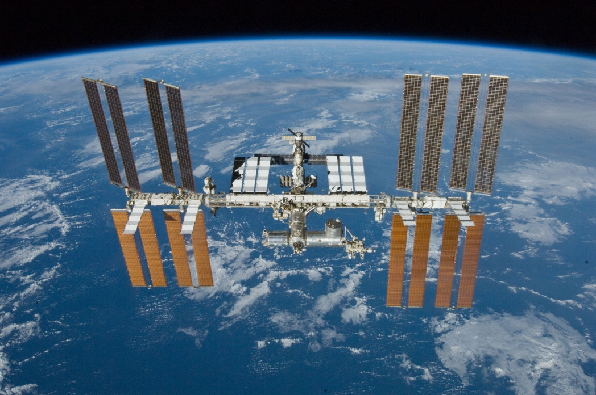
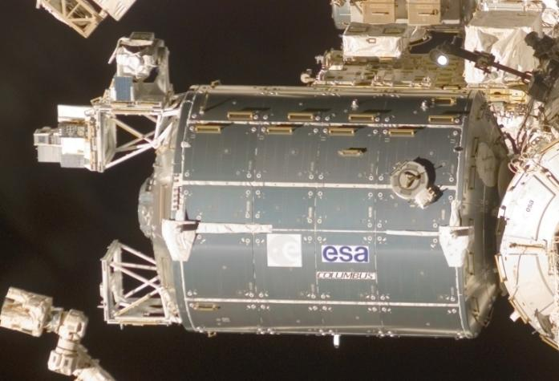
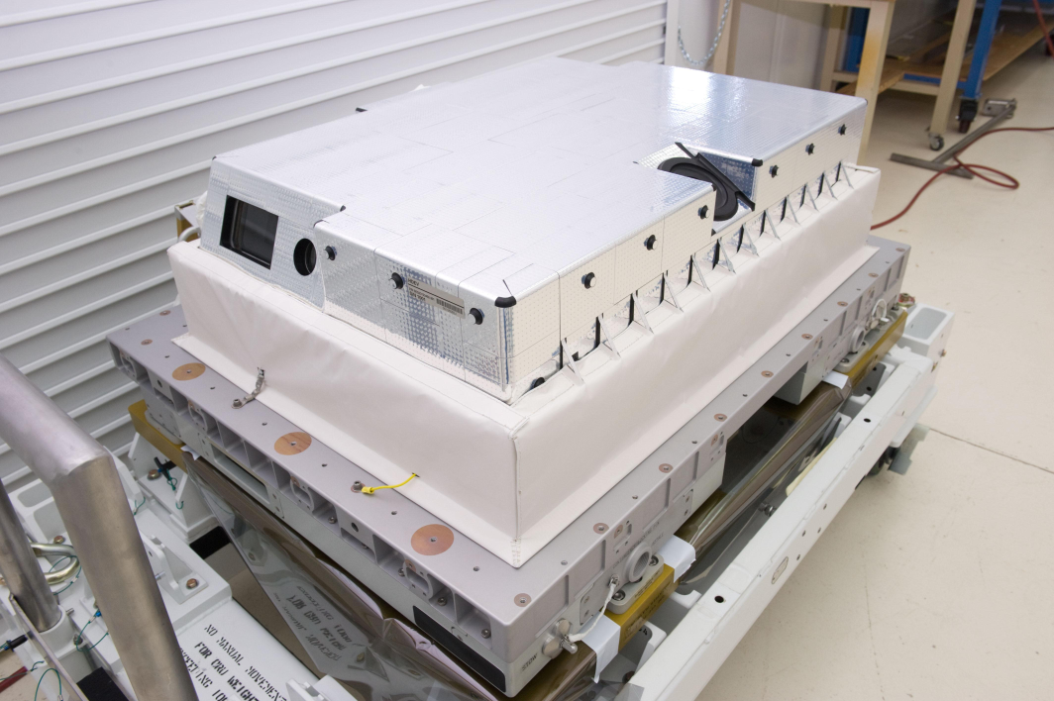
HDEV – High Definition Earth Viewing
4 HD-Video-Cameras on the Columbus External Payload Adapter
Mounted on ESA Columbus Laboratory on 30 April 2014
Ground resolution: ~ 280m
On-Orbit-Test of 4 commercial HD-Video-Cameras
During operating time the cameras are tested according to image quality
2 backward-, 1 forward- and 1 nadir-looking
Source: NASA

Slide 11
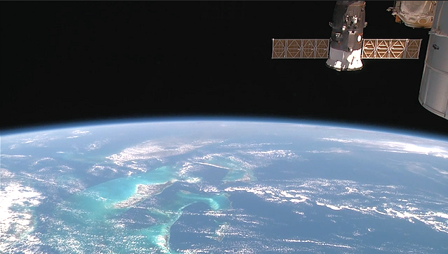
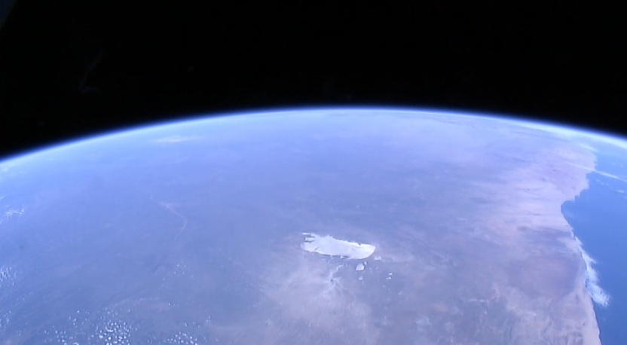
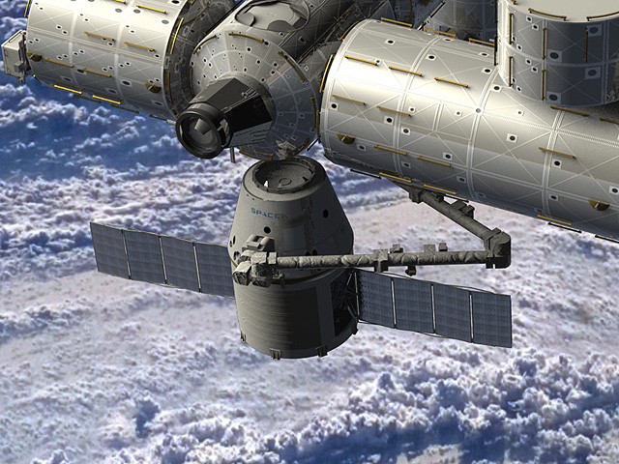
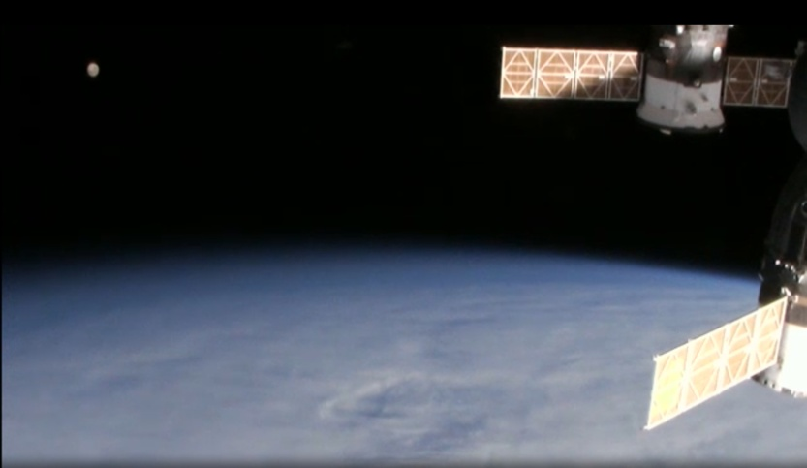
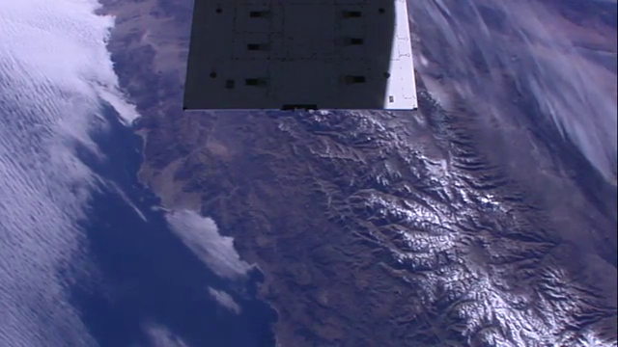
HDEV – High Definition Earth Viewing
Four Cameras – Three Perspecitves
Panasonic – Aft View (Florida)
Hitachi – Forward View (Namibia)
Sony – Aft View (overexposed)
Toshiba – Nadir View (Cuba)
Source: NASA

Slide 12
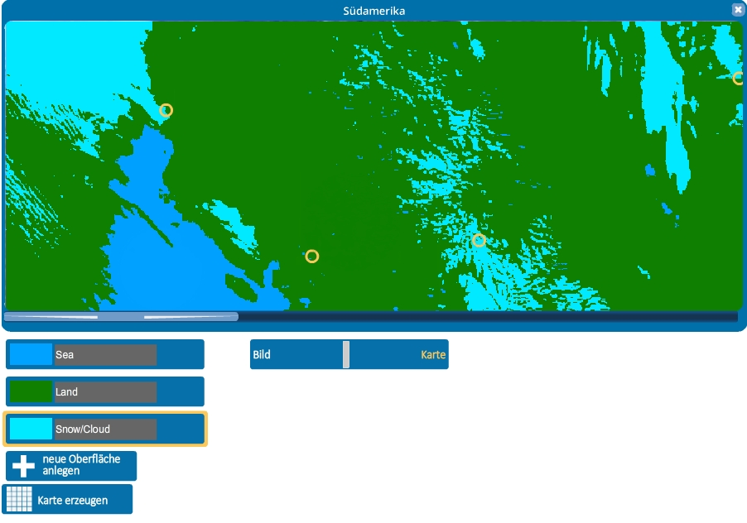
Columbus Eye – HDEV in Schools
Learning Tools on HDEV-Images of the ISS

Slide 13
Columbus Eye – HDEV in Schools
Communication within the Columbus-Eye project
Columbus Eye team
(Univ. Bonn)
HDEV cameras
program
create
exchange
Road Show
request
request
Data, teaching material, features
create?
create
use
Graduate students
(Univ. Bonn)
Secondary schools in Germany
exchange

Slide 14
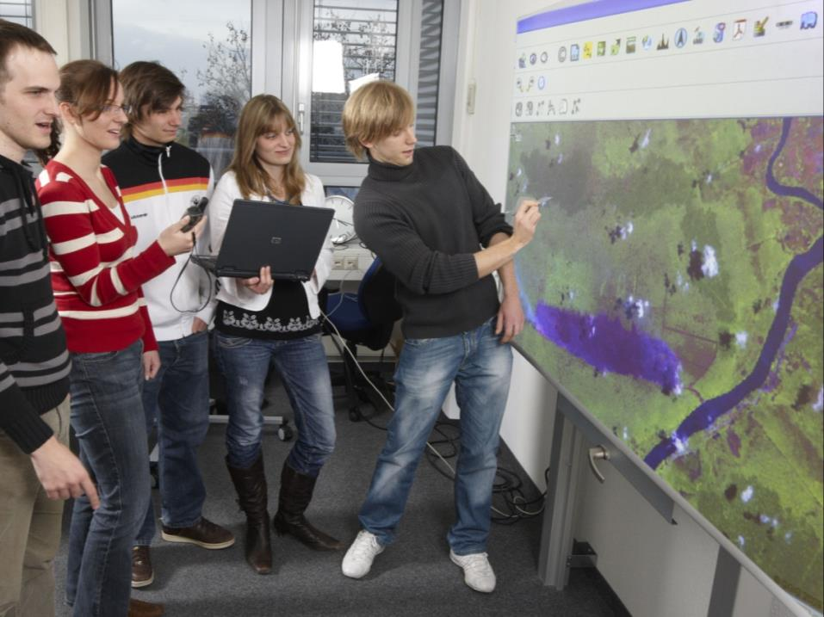





Best Practice from Germany – ^{r}geo: Heidelberg
Space Education & digital Geomedia
Fields of Competence & Aplications
of the Research Group for Earth Observation – ^{r}geo
Prof. Dr. Alexander Siegmund
University of Education & University Heidelberg
Dept. of Geography, Research Group for Earth Observation – ^{r}geo
Ort, Datum

Slide 15
Best Practice: Remote Sensing – from Elementary to Secundary
On the way: Adaptive Learning on EO
Web-based learning Environment: “Space4Geography”
Secundary II
over 10^{1h} grade
Learning with original Satellite Data
(pre-prozessing, analysing, classification etc.)
Web-based software: “BLIF”
Secundary I
5th to 10th grade
Learning with pre-processed Satellite Date (true/false color composits etc.)
Web-based Learning Platform: “GLOKAL Change”
(Geo)-Science & Space Education Research
Elementary
Learning on a Game Level
Web-based Learning Game: “SILC” – Satellite Image Learning Center

Slide 16



Space4Geography
Nationwide analysis of curricula and definition of relevant topics
Concept of the web-based learning environment
Learning modules
10 geographical key topics
Examplary application of remote sensing
Problem-oriented web-based learning
Interactive multimedia content, e.g. 3D-visualisations and animations prepared in cooperation with DLR/DFD
Web-based remote sensing software
Image processing and analysis (BLIF)
Geo-Mapserver
Satellite image database (RapidEye, TerraSAR-X, Landsat 5/7/8)
Evaluation
Testing phase (DLR_School_Lab Oberpfaffenhofen, GIS-Station)
Nationwide dissemination (promotion and training of multipliers)

Slide 17
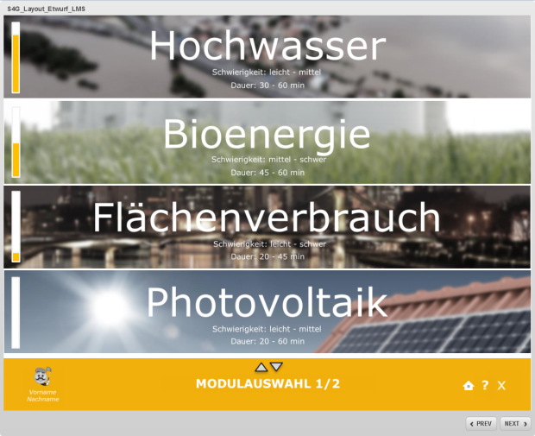
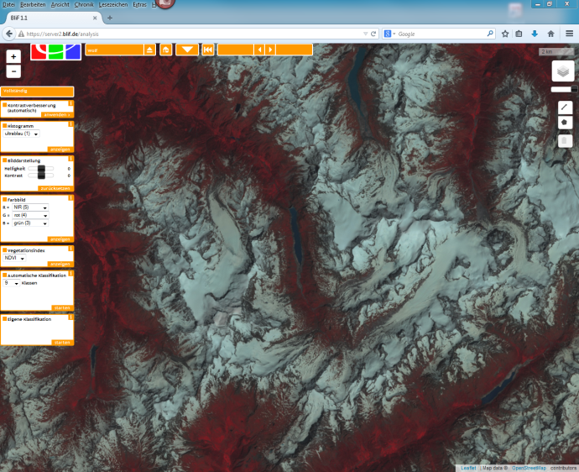
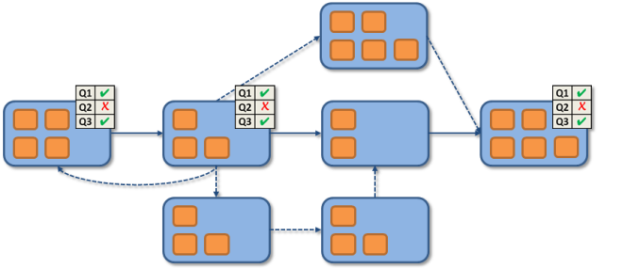


Space4Geography
Geographical Topics &
Environmental Challenges
Remote Sensing
Image Analysis
E-Learning
Educational Approach
Sek I + II Geography
Close link to the curricula
Topics: land use conflicts, urbanization, natural hazards, renewable energies, urban climate, deforestation, glaciers, agriculture,…
…with the integrated educational remote sensing software BliF
Provision of original satellite data: RapidEye, TerraSAR-X, Landsat, …
Processing chain:
  data import & AOI definition
  image enhancement
  band composites
  vegetation indices
  image classification & change detection
Multicodal & interactive
Individual learning: adapts and personalizes learning content to meet individual skills, needs and preferences of the learners
Instant feedback for the learners
Learning transfer & problem-oriented learning
Course management functions

Slide 18

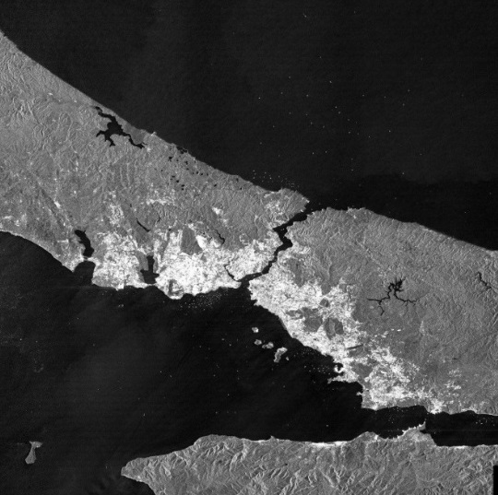
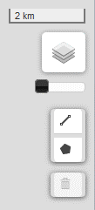
Active RS-Data: Analysing urban footprint with TerraSAR-X

Slide 19
WGCapD-5
Hampton, Virginia, USA
March 29th – April 1st, 2016
Realization #2
ESA Activities
Secondary Schools -
Training and Education
in the Frame
of International Cooperation

Slide 20
Education for secondary schools
Creation of Tools for secondary schools:
Books and posters (also for general public)
Atlases, i-books (also for general public)
Apps for Tablets (also for general public)
Multilingual web-based tools (EDUSPACE),
educational SW package for Image Processing and GIS (LeoWorks),
School Lab
Collection and distribution within ESERO project (European countries / curricula)

Slide 21
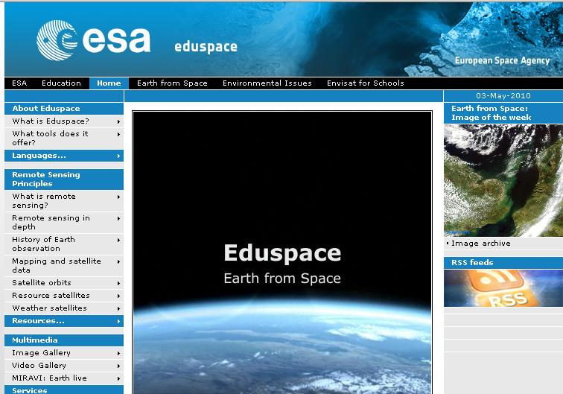
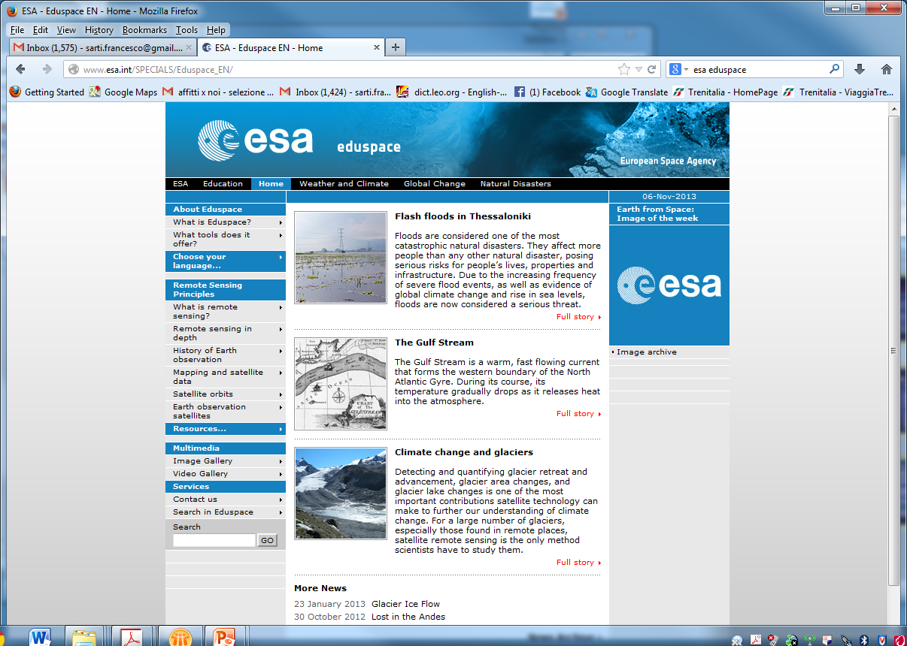
Eduspace: ESA web-based EO
Educational tool for secondary schools

Slide 22
Image Processing Software
LEOWorks 4.0
View images, histogram, pixel values, header info
Crop, invert, stretch, layer stack, etc
image arithmetic, filters
Classification, PCA, geometric correction, pan sharpening
Radar and optical module (multimission, including Sentinel data)
GIS tool
Open-source, Java-based

Slide 23
Satellite Data: Landsat TM
Available at Glovis / USGS
band 1
band 2
band 3
band 4
band 5
band 6
band 7

Slide 24
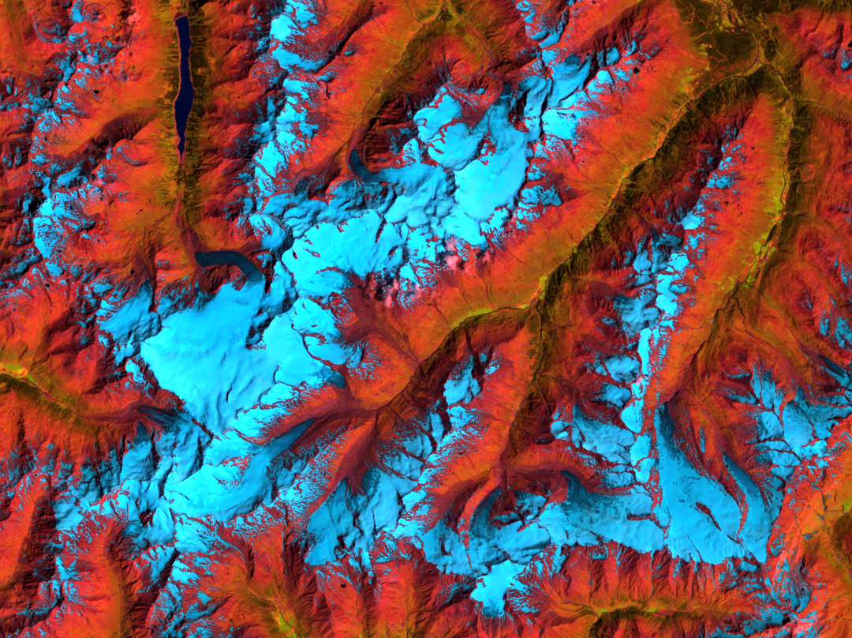
Ötztal Alpes, Austria
September 1986
Gepatsch reservoir
Gepatschferner
Vernagtferner
Hintereisferner
Landsat TM, RGB 5/4/3

Slide 25
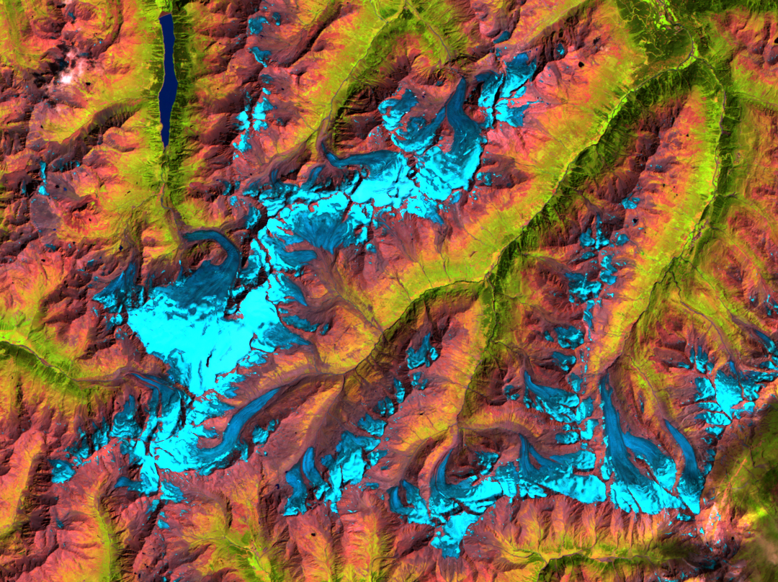
Ötztal Alpes, Austria
September 2003
open ice without snow layer
snow layer
Landsat TM, RGB 5/4/3

Slide 26
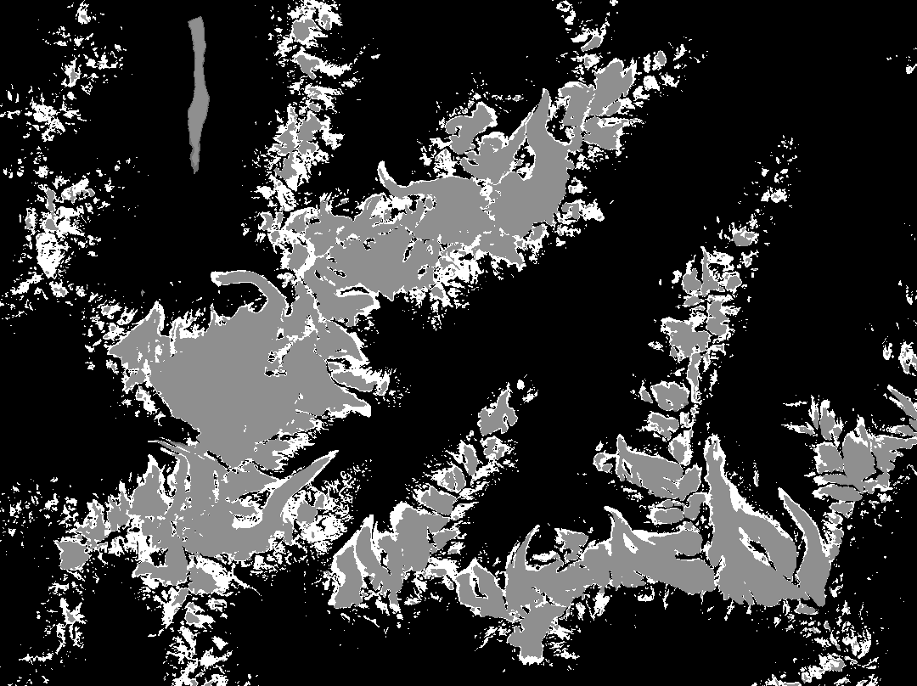
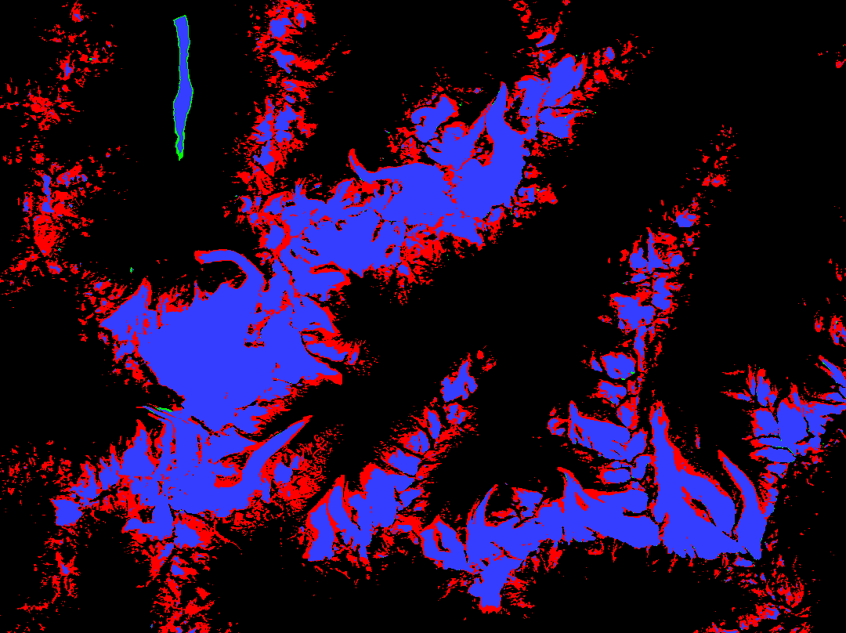
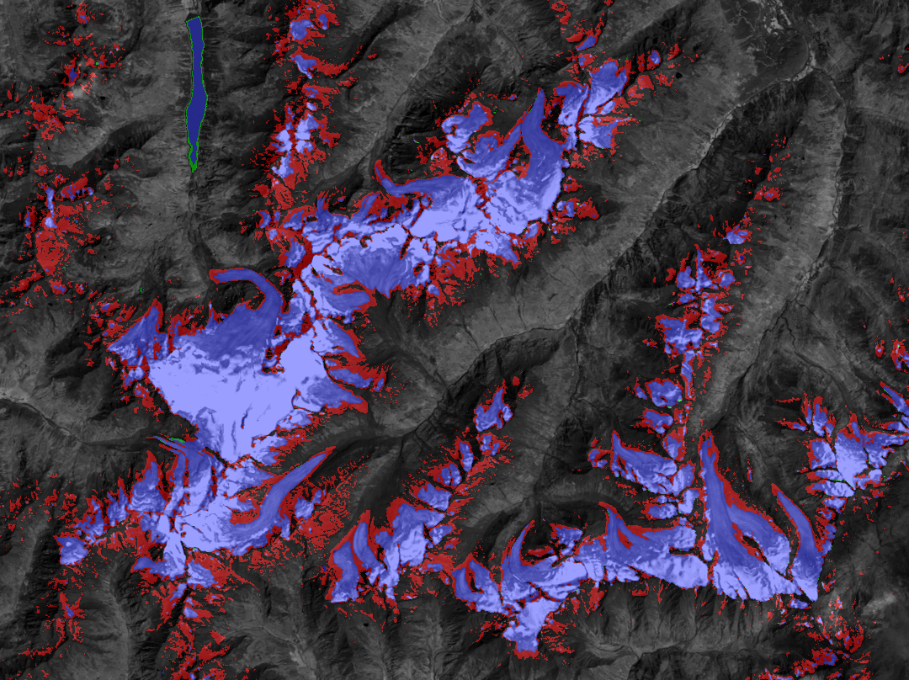
Change Detection
Combination – transparent overlay

Slide 27
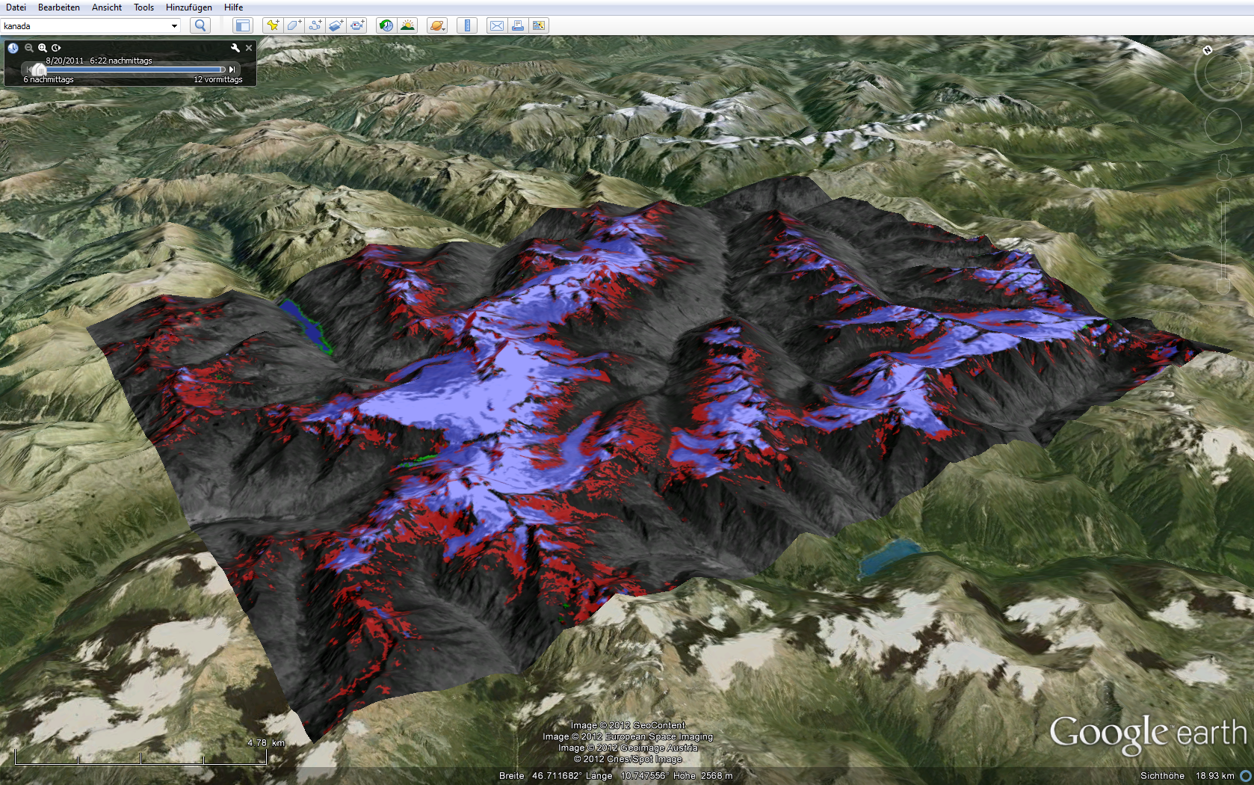
Change Detection export image to Google Earth

Slide 28
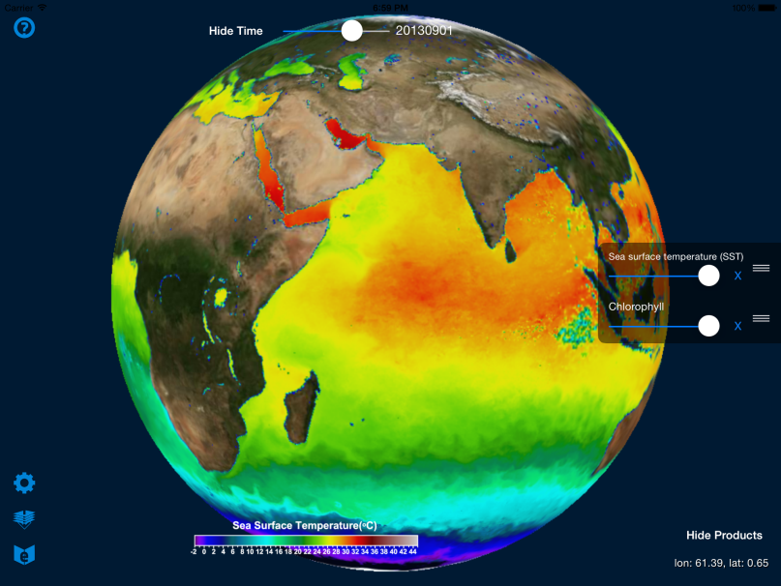
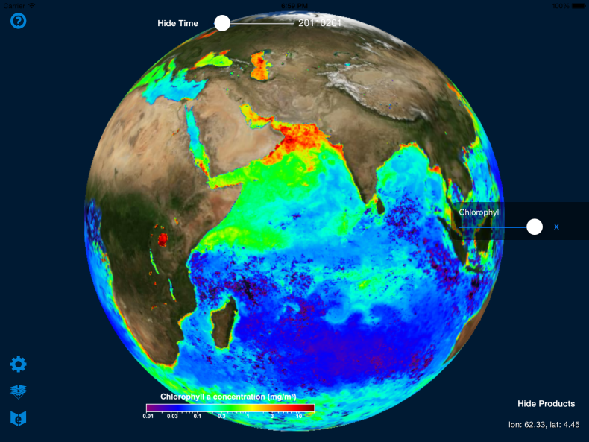
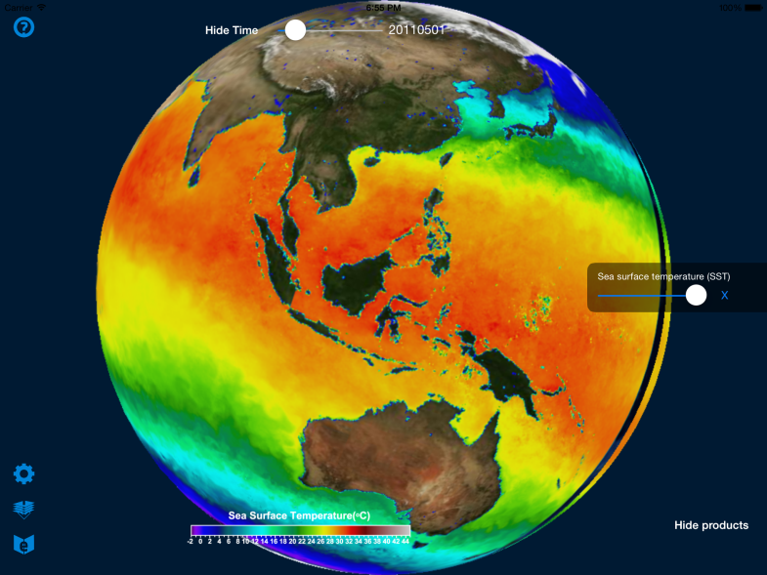
Educational App for EO
For iOS tablets (iPad, iPad mini)
Can be used as presentation tool and as support to school or educational labs/classes
Not on online stores at the moment

Slide 29


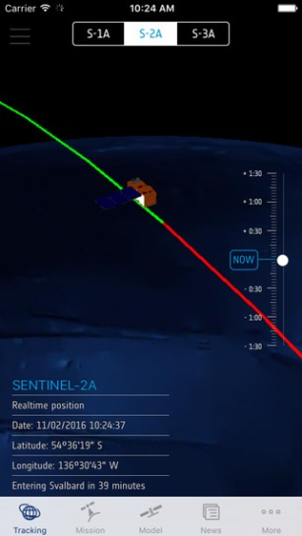
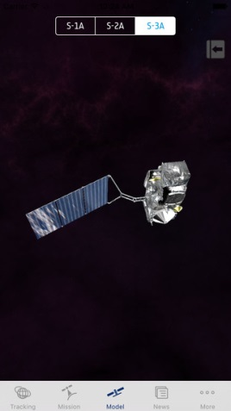
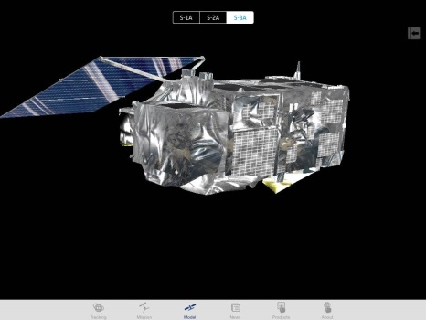
Sentinel App
For iPhone and iPad
Will be also on Google Play (Android phones, tablets) in April
See where the Sentinel satellites are in real-time
See the last and next time they have been and will be over your location; Move them to the time of the last data transmission and smoothly move them back to their current location over the 3D globe
Explore the Sentinel satellite 3D models
Get information and news about the Copernicus Programme
Get information about access to Sentinel data
Set Notifications to be warned when satellites are flying by.

Slide 30
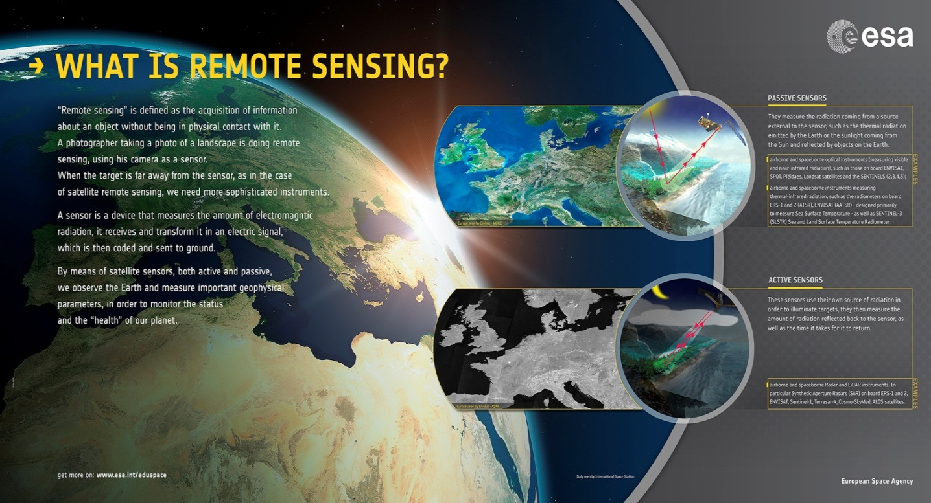
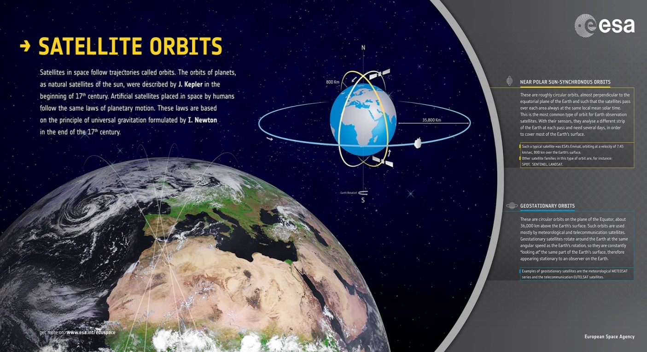
Creation of posters for schools

Slide 31
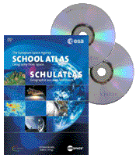
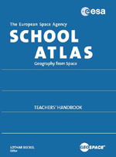
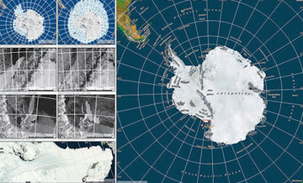
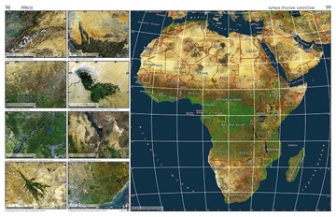
ESA School Atlas new ESA Water Atlas
Introduction to ESA; Earth Observation; Global Overview; Continental Overview; the Natural Sphere; The Cultural Sphere.
Annex: Teachers’ Handbook, DVD-ROMs with the original bands of the satellite data, handbook content and exercises, connected to Eduspace and its SW Leoworks

Slide 32
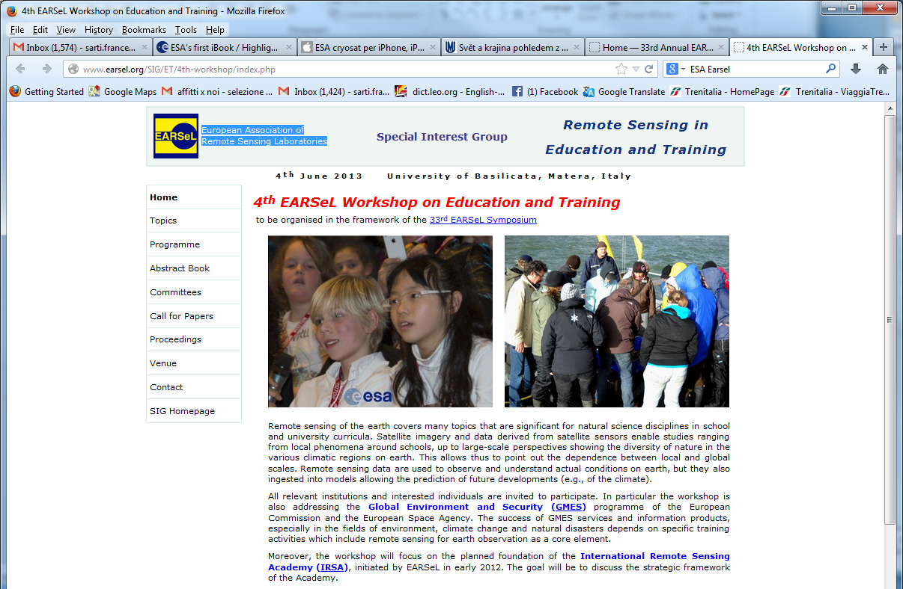
Training & Education in the frame of
International Cooperation: Earsel network
Long-term cooperation in organising joint Workshops for Secondary School teachers with Earsel (European Association of Remote Sensing Laboratories)
recent Earsel Workshop and Training in ESRIN on RS for Archaeology (Nov 2015)
Preparing Bonn (June 2016), Bejing (July 2016) and Krakow (Sept 2016) Earsel training events

Slide 33
ESA ESEROs - European Space
Education Resource Offices
Target: European students starting from an early age (primary and secondary education)
Goal: using the space context to make the teaching and learning of STEM subjects more attractive
ESERO offers an annual series of national or regional training sessions for both primary and secondary school teachers, offered in collaboration with national partners
Presently located in:
Belgium: Planetarium of the Royal Observatory of Belgium in Brussels
Czech Republic: Prague, with Charles University of Prague and others
UK: based at the National STEM Centre in York
Ireland: Dublin, with the Science Foundation Ireland
Netherlands: at the Nemo Science Learning Centre in Amsterdam,
Nordic ESERO: Denmark, Finland, Sweden and Norway (based at NAROM), Poland: in the Copernicus Science Centre in Warsaw,
Portugal: in the Knowledge Pavilion, Lisbon,
Romania: based in the Romanian Space Agency

Slide 34
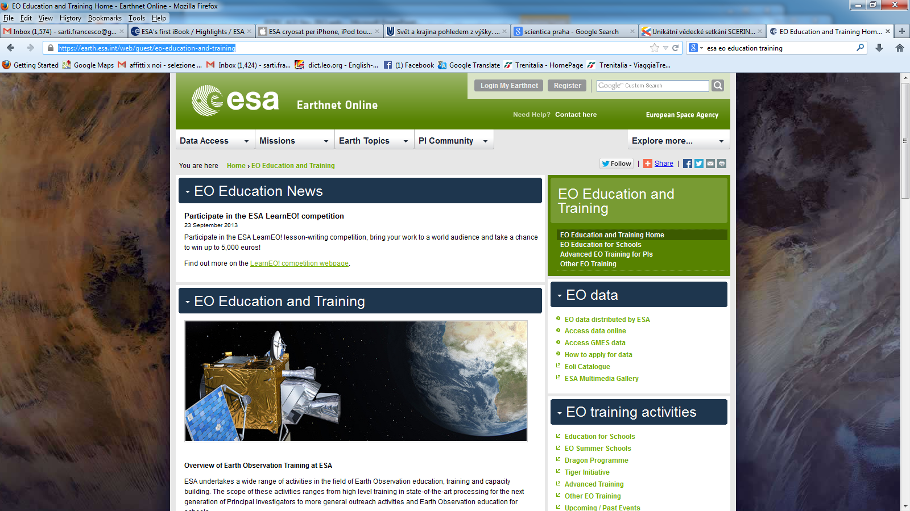
Training courses
- centralized web page
The content of most training courses can be linked from the central web page for ESA EO Education and Training:
https://earth.esa.int/web/guest/eo-education-and-training

Slide 35
WGCapD-5
Hampton, Virginia, USA
March 29th – April 1st, 2016
Realization #3
DLR_School_Lab

Slide 36



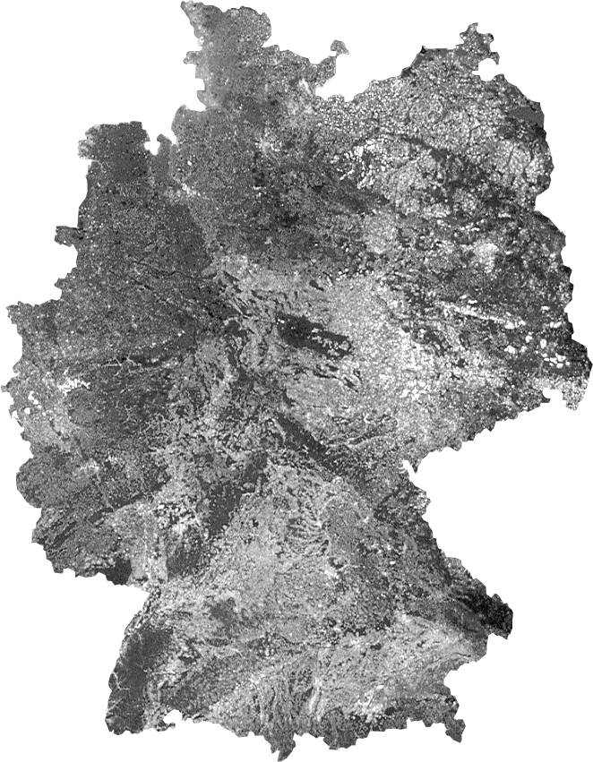
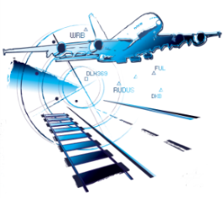

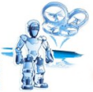


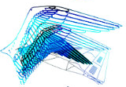
Promoting the Next-Generation Scientists
Stade n
n Hamburg
n Neustrelitz
n Bremen
n Trauen
Berlin- n
● Dortmund
n Braunschweig
Aachen 
n Göttingen
n Köln
n Bonn
● Dresden
n Lampoldshausen
Stuttgart n
Augsburg n
n Oberpfaffenhofen
Weilheim n

Slide 37
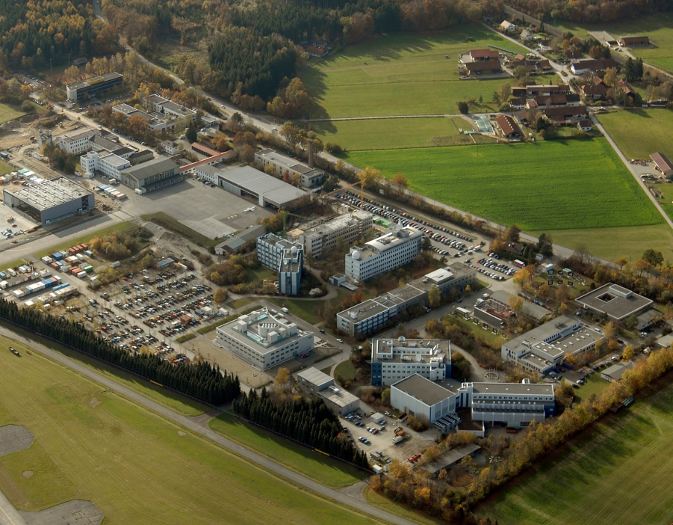
DLR Site
Oberpfaffenhofen
Employees: Approx. 1,700
Size of site: 245 000 m²
Research institutes and facilities:
Microwaves and Radar Institute
Institute of Communication and Navigation
Institute of Atmospheric Physics
Remote Sensing Technology Institute
Institute of Robotics and Mechatronics
Institute of System Dynamics and Control
German Remote Sensing Data Center
Space Operations and Astronaut Training
Galileo Control Center
Flight Experiments

Slide 38
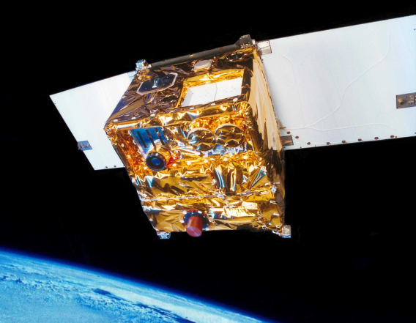
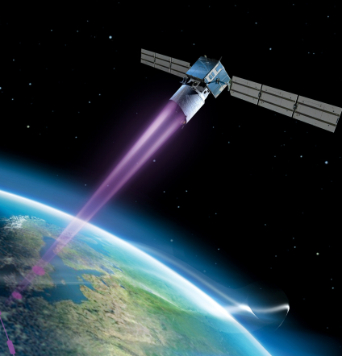
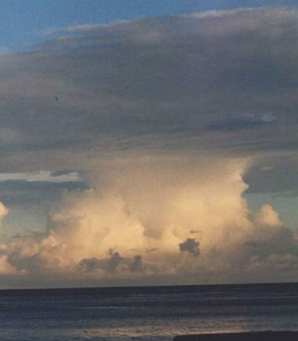









DLR_School_Lab
Oberpfaffenhofen

Slide 39
Experiments @ DLR_School_Lab Oberpfaffenhofen
Represent the Research of All 10 DLR Institutes
Experiment Institute
Infrared Technology Remote Sensing Technology
Laser Technology Physics of the Atmosphere
Radar Technology Microwave and Radar Technology
Optical Remote Sensing Remote Sensing Data Center
Weather and Climate Physics of the Atmosphere
Satellite Data Analysis Remote Sensing Data Center
Satellite Navigation Communication and Navigation
Robotics Robotics and Mechatronics
Virtual Mechanics System Dynamics and Control
Flight Team Simulator Flight Operations
Mobile Rocket Basis Space Operations
ASUROnaut Robotics and Mechatronics
Tunnel Boring Machine Technical University Munich

Slide 40


























The Team

Slide 41

13 High Tech
Experiments
Competent
Mentoring
Authentic
Ambience

Slide 42
Experimental Concept
…Representing the DLR-Institutes‘ Competence
➔ Authenticity
…Didactical Transfer
➔ Inquiry-Based Science Education
Notes:
Was ist mit Synergieeffekten zwischen DLR und dem School_Lab
Was ist der Arbeite der Pädagogen?

Slide 43
DLR_School_Lab Oberpfaffenhofen
13 years
30.000 secondary school students
3.000 teachers
3.500 MINT talents
300 teachers of the gifted

Slide 44
WGCapD-5
Hampton, Virginia, USA
March 29th – April 1st, 2016
Realization #4
EO School Lab
@ International Conferences
- an ESA-DLR Initiative

Slide 45
Our Goals
Attract (young) people to EO
  Technology
  Missions
  Software
  Data
  Applications
Create awareness for the usefulness of EO – especially in developing countries
Demonstrate advantage of combined expertise

Slide 46
Joint DLR/ESA EO Education stand
at IGARSS 2012 in Munich
Combined lab experiments, training sessions and 3D Demonstrations

Slide 47













Slide 48




Radar experiment
Spectroscopy
Infrared techniques
The DLR School Lab experiments presented at IGARSS.
(More info at: http://www.dlr.de/schoollab/desktopdefault.aspx/tabid-1991)
The School Lab was combined with ESA lectures and computer practicals based on Eduspace (http://www.esa.int/SPECIALS/Eduspace_EN/) in a joint ESA/DLR EO Education stand for school visits

Slide 49



EO training sessions for high schools delivered by ESA.
(More info at: http://www.esa.int/SPECIALS/Eduspace_EN/)

Slide 50


Slide 51

Living Planet Symposium 2013
Edinburgh, United Kingdom, 09 - 13 September
→ a DLR/ESA/UK Space Agency EO education stand based on IGARSS 2012

Slide 52


Slide 53


Slide 54


Slide 55


Slide 56

WGCapD-4 Annual Meeting
Pretoria, South Africa
March 18 - 20, 2015

Slide 57


Slide 58


Slide 59





(i) Education in the frame of International Cooperation with other space agencies
Creation of joint School Labs with ESA, DLR, UKSA and UK national space academy, Charles University.
  Such as IGARSS 2012 and LP Symposium 2013 and LP Symposium in May 2016. Demonstrating RS to schools using instruments such as: Field Spectrometer, Thermal camera, UV light, Stereo Optical Camera, possibly enriched by many other experiments and 3D / oculus technology

Slide 60

1) Global Issues from Above (EO tablet app)
For Android (now) and iOS (July 2016)
Czech and English,
other languages possible
Introduction to EO
and Global issues
applications

Slide 61



2) Two textbooks and 18 educational programmes for basic and secondary schools

Slide 62
The 5th Meeting of the CEOS Working Group on
Capacity Building & Data Democracy (WGCapD-5)
The CEOS Systems Engineering Office (SEO), Hampton, VA, USA
March 30th – April 1st, 2016
Thank you

Slide 63
USEFUL ADDRESSES
ESA education portal: www.esa.int/education
to order EO material: education@esa.int or eohelp@esa.int
Eduspace: www.esa.int/eduspace
ESA EO Education web page: http://eo-edu.eo.esa.int
DLR_School_Lab: http://www.dlr.de/schoollab/en/desktopdefault.aspx/tabid-1738/

Slide 64



► Remote Sensing
(introduction to principles and function)

Slide 65



► Global issues – EO applications
Diminishing tropical forests
Ocean pollution
Desertification
(Human stupidity)

Slide 66




4) E-learnings for basic and secondary schools

