Slide 1
Considerations for Leveraging Capacity-Building Activities
Committee on Earth Observation Satellites
Secure World Foundation
Laura Delgado López
WGCapD-5 Agenda Item # 27
Working Group on
Capacity Building & Data Democracy
Hampton, Virginia, USA
March 29th – April 1st, 2016

Slide 2
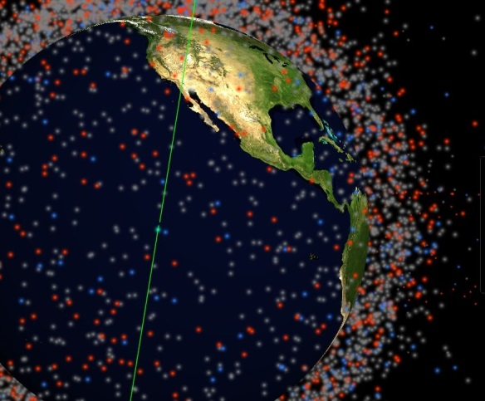
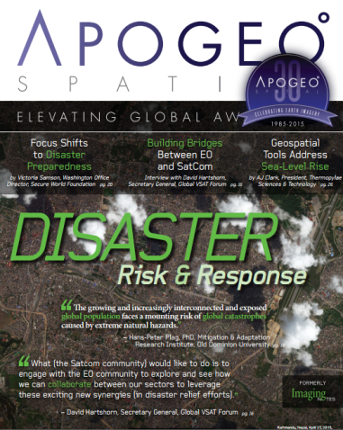
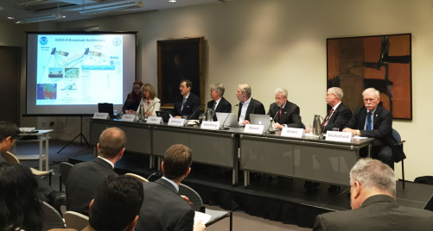
About SWF
SWF is a private operating foundation dedicated to the secure and sustainable use of space
Why space sustainability? Increasing reliance on space assets coupled with potentially destabilizing trends
SWF Focus Areas
Space Sustainability
Space Law and Policy
Human and Environmental
Security
SWFOUND.ORG
Screenshot from Stuffinspace.net; cover of Apogeo Spatial spring issue;
panelists at “Challenges in Sharing Weather Satellite Spectrum with
Terrestrial Networks” event held in Wash. D.C.

Slide 3
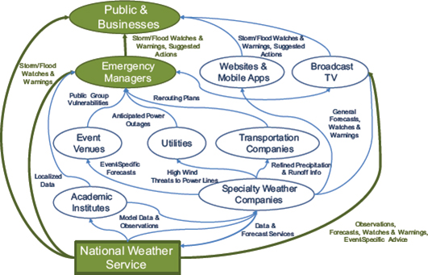
Data access: Open data sharing
Early recognition of link between accessibility of public data and societal benefit, scientific progress, and commercial exploitation
Definition of role of government in emerging information value chain – example: U.S. Weather Enterprise
Open access data policies now even more common – for agencies, for international programs, etc.
Assumption that accessibility = realizing value
Hypothetical figure of information value chain in U.S. weather enterprise. Credit: "4 Leverage the Entire Enterprise." Weather Services for the Nation: Becoming Second to None. Washington, DC: The National Academies Press, 2012.”

Slide 4
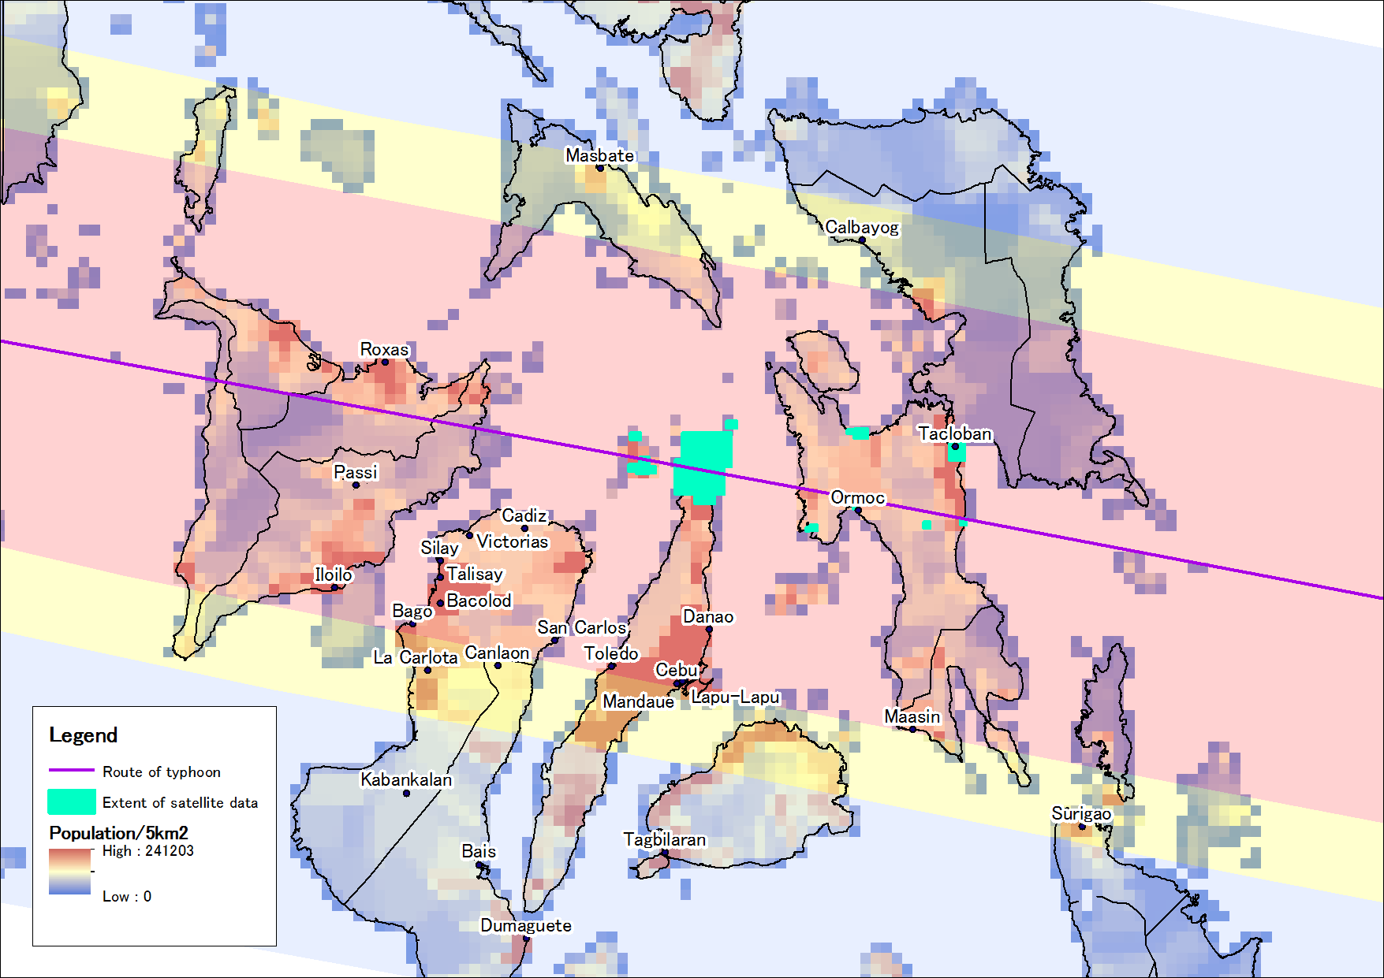
Persisting Challenges: Access is limited
Map of the Philippines showing extent of imagery available through International Charter “Space & Major Disasters” in the aftermath of Typhoon Haiyan and track of the storm. Credit: Asian Development Bank.

Slide 5
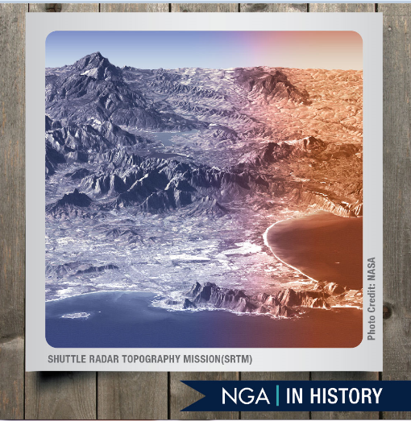
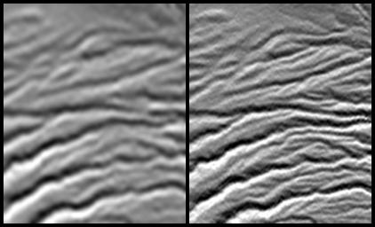
Access is sometimes unclear
“While the debates on open data and the diverse policy and legal documents on the subject widely employ the terms free, full and open, these terms are not always used in a consistent manner.”
Harris, R. and Baumann, I. (2015) Open data sources and satellite Earth observation. Space Policy (32), pp 44-53.
The release of certain datasets may not be immediate, may undergo review of access limitations or reusability restrictions.
Left image credit: NASA. Right image caption: Comparison of 90-meter and 30-meter SRTM digital elevation model data of a site in the Crater Highlands of Tanzania. Credit: NASA/JPL-Caltech/NGA.

Slide 6
Access policies must evolve
Important conversation in the United States resulting from new capabilities being developed/operated by private sector to complement traditionally government data flows
Key challenges: data quality, validity, reliability (including archiving); access and reusability restrictions
As these issues are addressed, clarity of access will be key for efficient data utilization
How can data access policies evolve to take advantage new technological trends, while maintaining progress towards greater sharing?

Slide 7
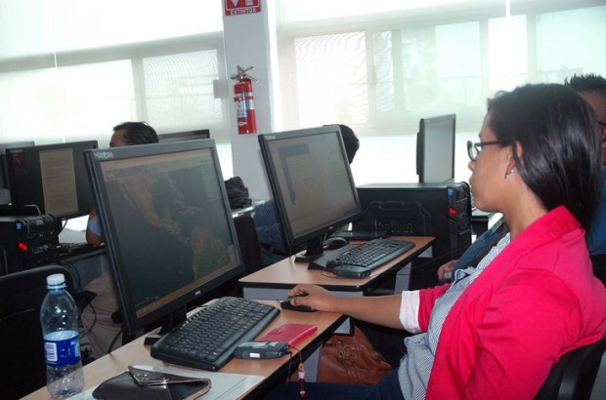
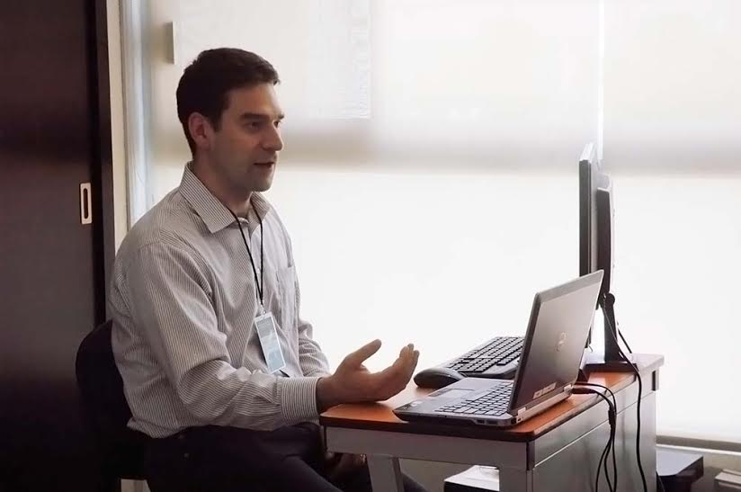
Obstacles to data utilization: Lack of technical resources
Pictures from 2015 SRTM-2 capacity-building workshops.

Slide 8
Limited public awareness
“Addressing Public Awareness to Improve Access to and Use of Space Applications” - Poster presented at GLAC 2014
Findings
Public awareness efforts can help advance the access to and use of space applications by:
Exposing potential users to the benefits of space applications and fostering valuable connections among user communities;
Influencing decision makers towards creating favorable conditions to make good use of trained personnel and technology solutions, specifically with respect to:
the enabling environment
the costs of organizational change
Recommendations
Improve coordination between capacity building and awareness efforts when targeting specific audiences
Develop hybrid programs that attract different audiences
Encourage the primary agencies responsible for space applications to mount an awareness campaign
Foster greater interaction among decision makers, users and general public
Develop measures of awareness at institutional, national and regional levels
Recognize that outreach/awareness efforts are important not just to share news and findings, but also in support of efforts to promote the access and use of space applications

Slide 9
Interagency bottlenecks
Interagency bottlenecks impact domestic utilization and international efforts
Also lack of coordination
Gaps analysis rarely government-wide
Expanding conversation to include preparedness/emergency response bodies, as well as non-space agencies (example: U.S. NSWP)
International impacts: limits to the spread of valuable information, best practices, and opportunities

Slide 10
Final considerations
Consider incorporating non-technical issues impacting the success of capacity building efforts – opportunity to raise awareness about data access policy/issues, institutions, programs, and policy-related issues impacting utilization
Incorporate coordination efforts into early planning
Coordination should include networks of contacts – spreading the word across different communities
Recognize impact of awareness efforts and consider incorporating sessions for decision makers to develop institutional buy-in.
Build on existing events when audience profile makes sense (also easier for funding agents)
Routinely engage trainees in discussion about obstacles they face to utilize information (technical and non-technical) to inform ongoing efforts.

Slide 11
Thank you
ldelgado@swfound.org
SWFOUND.ORG

