Slide 1

The Global Forest Observation Initiative – Capacity Building
A GEO Flagship
Douglas M. Muchoney, Ph.D.
Sylvia Wilson
U.S. Geological Survey
31 March 2016

Slide 2
Overview
Provide a brief description of GFOI CB objectives
Provide a brief description of GFOI CB principles
Update on where we are at currently
Way forward for implementation

Slide 3
Global Forest Observation Initiative
fostering the sustained availability and use of satellite data for forest monitoring to better manage forest resources
coordinating observations
assisting countries in the use of satellite data
Capacity Building in coordination with others such as UNREDD
Research & Development to address practical problems
CEOS (Committee on Earth Observation Satellites) has setup Space Data Coordination Group (SDCG)
Methods & Guidance on use of satellite and ground data to estimate GHGs
Assists with country specific requirements
Assures annual, wall-to-wall, worldwide long-term data
http://gfoi.org/

Slide 4
GFOI Principles
Wall-to-wall monitoring
Consistency with UNFCCC and IPCC
Affordable and Practical
Co-operation with Partners
Integration of ground data and remote sensing
Capture small changes
Follow IPCC guidelines
Vital for reporting REDD+ and GHGs to UNFCCC
Maps 5 REDD+ categories onto IPCC methods
Based on medium resolution data (10-30m)
Can use higher resolution data if needed
Coordination of capacity development (FAO…)
GOFC-GOLD
IPCC and UNFCCC
Captures leakage
Based on widely useable methods

Slide 5
GFOI Components
Space Data
GFOI works with space agencies through CEOS to ensures the long-term, world-wide acquisition of core satellite data
Capacity Building
GFOI provides capacity building in coordination with others such as UN-REDD. It supports the use of satellite and ground data to monitor forests, and estimate GHGs.
Methods and Guidance
Guidance on integrating remote-sensing and ground-based observations for estimation of emissions and removals of greenhouse gases in forests.
Research and Development
Identifying and promoting R&D needed for practical, global implementation of National Forest Monitoring
GFOI Office
Coordination and Management
helps countries meet their individual data needs

Slide 6
GFOI
Space Data
Methods & Guidance
Capacity Development
R&D
UN-REDD
FCPF
Bilateral, e.g. Australia-Kenya
Others
UNFCCC
GFOI Products
In-country implementation using GFOI products, some by GFOI partners some by other organisations

Slide 7
Space Data Coordination Group (SDCG): 3 Elements:
Implementation of Baseline Global Data Acquisition Strategy
Space Data Services Available
Data Supply in Support of GFOI R&D Activities
At least one annual national cloud-free optical coverage over each country.
Publicly open (“core”) satellite data, phased implementation - full global coverage by 2016
A coordinated strategy for national data acquisitions accommodating countries’ specific technical requirements, heritage, or experience.
Covers a wider range of satellite data sources, including commercial.
Includes support for science studies assisting the development and evolution of the MGD for GFOI.
Assuring the availability of consistent time-series of optical and radar (SAR) satellite data over global forest cover.

Slide 8

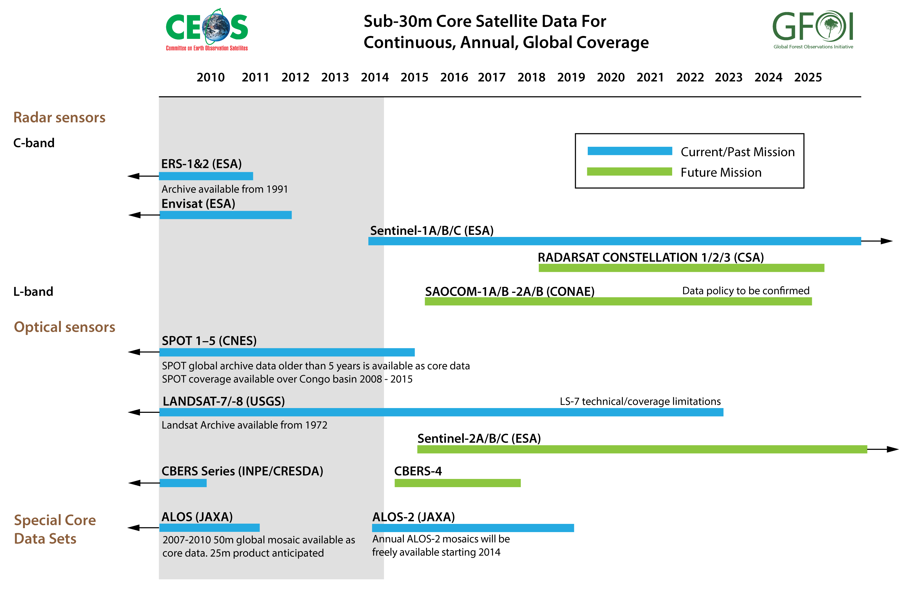
Core Data
8

Slide 9
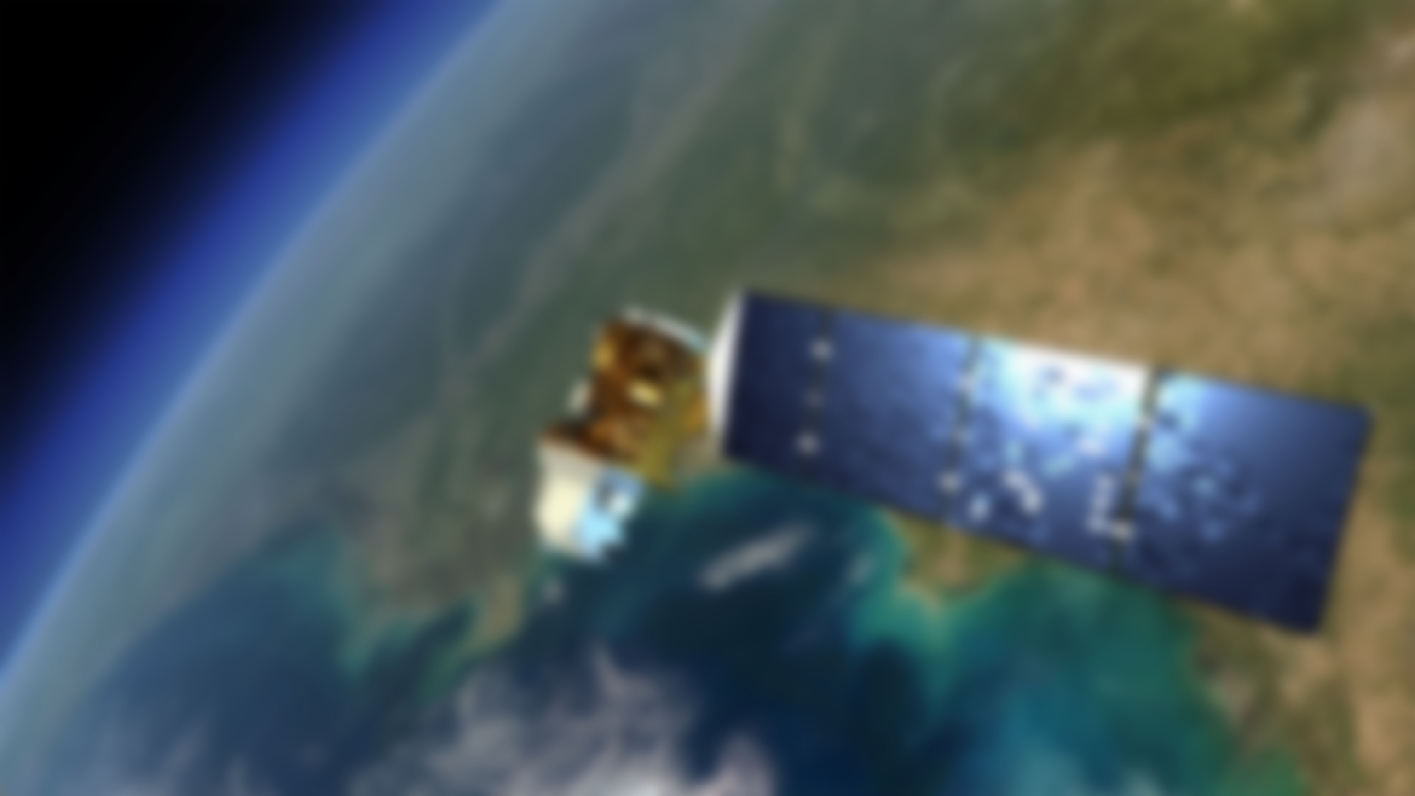
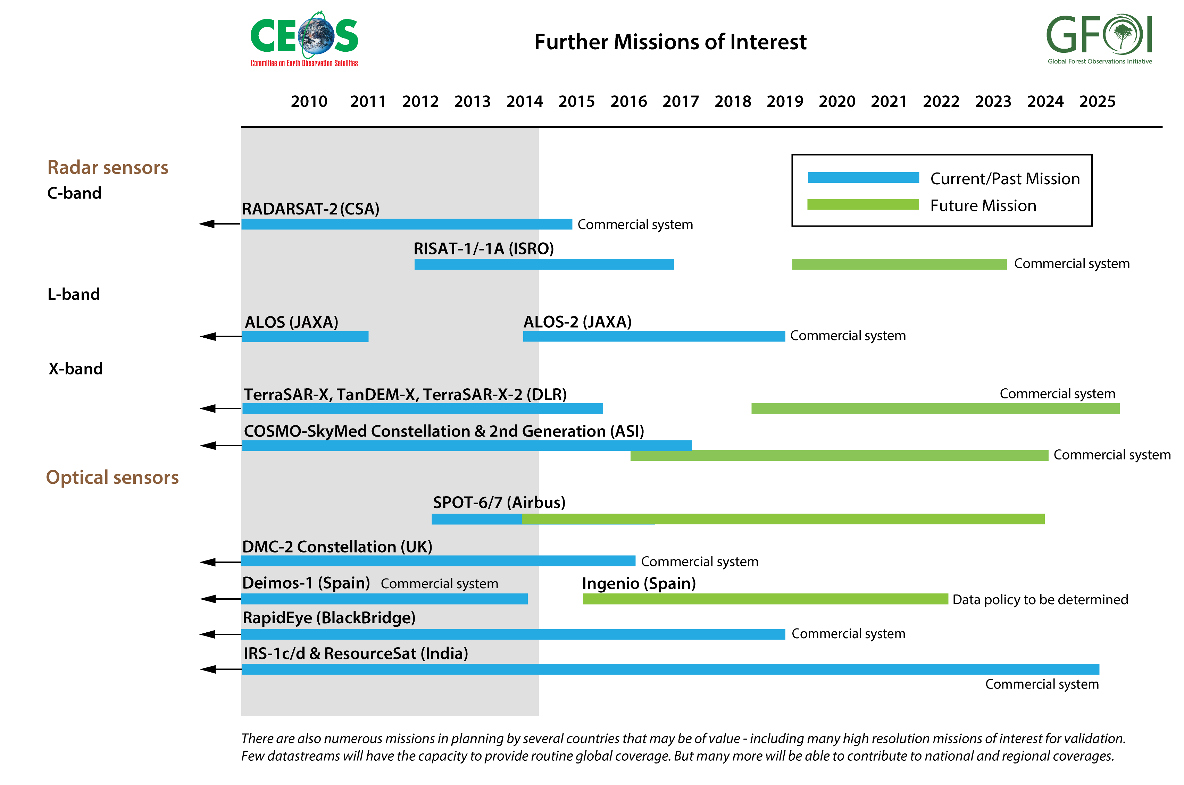
Contributing Data
9

Slide 10

Coordination of satellite data supply
Fundamental to GFOI objectives
Supports all countries participation in reporting
Ad-hoc SDCG established by CEOS in support of GFOI needs with good participation from necessary agencies
Good progress towards baseline global strategy
SDCG is an essential capability for CEOS/GEO
Notes:
Facilitation of forest observations in support of national forest information systems is a
fundamental objective for GFOI. CEOS established the Space Data Coordination Group to
support GFOI’s requirements in publicly available Earth Observation data.
The SDCG has followed its 2012 Work Plan generally to schedule:
Establishment of the SDCG and terms of reference (completed at 1st SDCG meeting Mar 2012).
Development of GFOI dataset requirements (draft developed Mar 2012, ongoing activity
to meet changing scenarios.)
Development of a first draft of the baseline global data acquisition strategy (draft to be
discussed at 2nd SDCG prior to submission for adoption at the CEOS Plenary October 2012).
Inform GFOI of data gaps which may require purchase/negotiation of alternative data sources
(October 2012 following CEOS Plenary endorsement)
Ongoing data acquisitions in support of FCT & National Demonstrator needs, with possible
expansion to include more REDD+ countries (during 2012/2013).
Initialising planning for national data acquisitions (late 2012/2013).
Liaise with GFOI on the development of interface(s) with commercial data providers and
possible data donors to optimise their acquisition strategies and donations (late 2012).
Concur with FCT/GFOI on data process/packaging and distribution process (late 2012/2013)

Slide 11
GFOI R&D Programme
GOFC-GOLD: http://www.gofcgold.wur.nl/
GFOI: http://www.gfoi.org/rd
Methods and Guidance only includes operational methods and approaches.
Component aims to stimulate R&D on developing approaches that are not operational but could be widely available and useful
R&D Workshops to discuss major topics, on-going work and how to promote further development, some with GOFC-GOLD
Identifying and provision of space data to meet R&D carried out through CEOS & SDCG
Identification of new approaches that can be included in future versions of the Methods and Guidance
Identifying funding opportunities

Slide 12
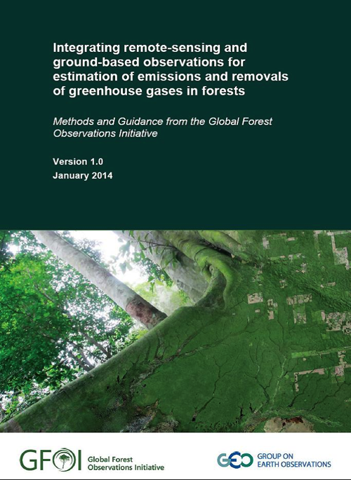
Methodological advice from GFOI
GFOI Methods and Guidance Document published in 2013
Provides operational link between IPCC methods and all the REDD+ activities identified by UNFCCC
Consistent with UNFCCC Warsaw Framework on REDD+
Coordinated UN-REDD, World Bank, IPCC and GOFC-GOLD
Consistent with the annual review of scientific developments provided by GOFC-GOLD Sourcebook
Aimed at technical implementers, negotiators and those responsible for REDD+ nationally
Supplementary documents being produced
For report and additional material see:
http://www.gfoi.org/methods-guidance-documentation

Slide 13
MGD Additional Material and Developments
Modules
Capacity Needs Assessment Tool (checklist of CB needs aligned with the MGD)
Relationship between GFOI, GOFC-GOLD Sourcebook, FCMC
MGD Decision Trees (Emissions Factors, Ground Sampling, Activity Data, Uncertainty)
Translation
Global Datasets
Improved cross-referencing with GOFC-GOLD Sourcebook
Open Source software linked to MGD
Inventory, approach donors, application development, testing, user manual, maintenance
Catalogue of existing training materials
On-line tool: MGD Portal
Spanish and French – end 2014
In-country use
Experience and feedback
Version 2 – revisions and updates

Slide 14
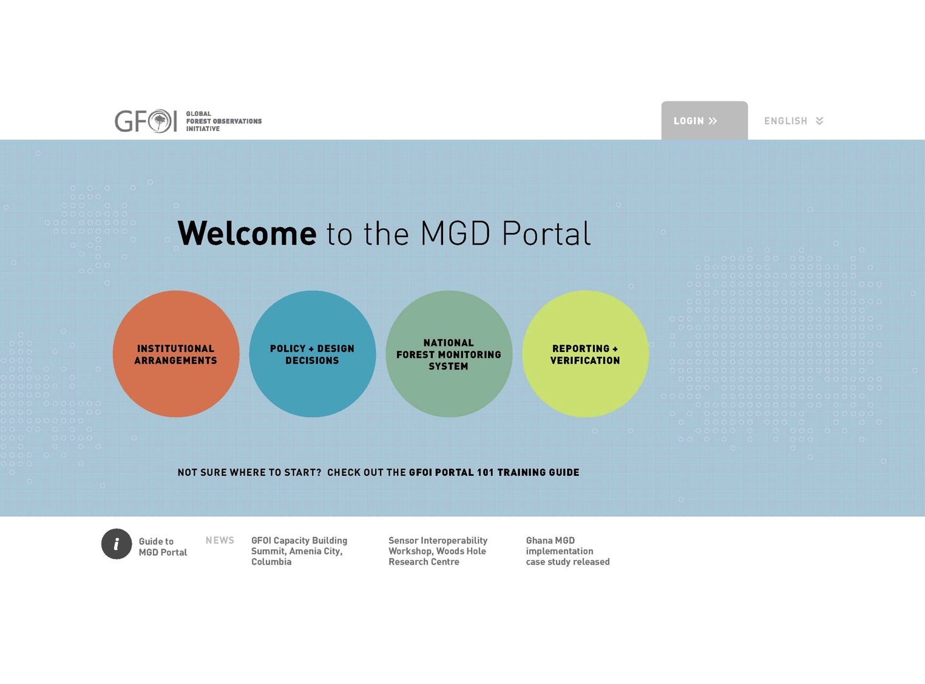
Notes:
1m

Slide 15
GEO Capacity Building: Strategic Target
Before 2015, GEO aims to: Enhance the coordination of efforts to strengthen individual, institutional and infrastructure capacities, particularly in developing countries, to produce and use Earth observations and derived information

Slide 16
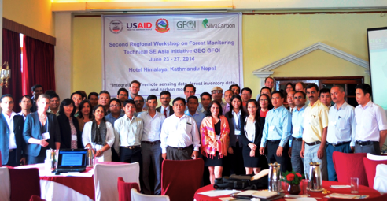
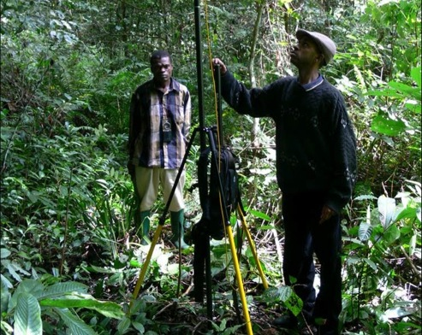
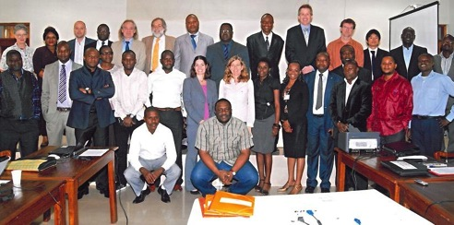
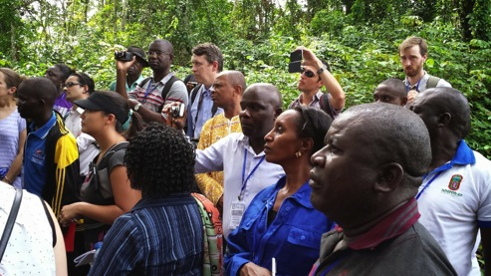
Capacity Building
In coordination with others including UNREDD, FAO and WB
Major effort through SilvaCarbon, other activities with Australia and Norway
Tailored to meet country needs and requests
Aims to build up networks of experts in countries
Programmes in South America, SE Asia and Central Africa
https://sites.google.com/site/talleresgeofct/
https://sites.google.com/site/gfoiseasiacapacitybuilding/home
https://sites.google.com/site/gfoiafricacapacitybuilding/home/

Slide 17








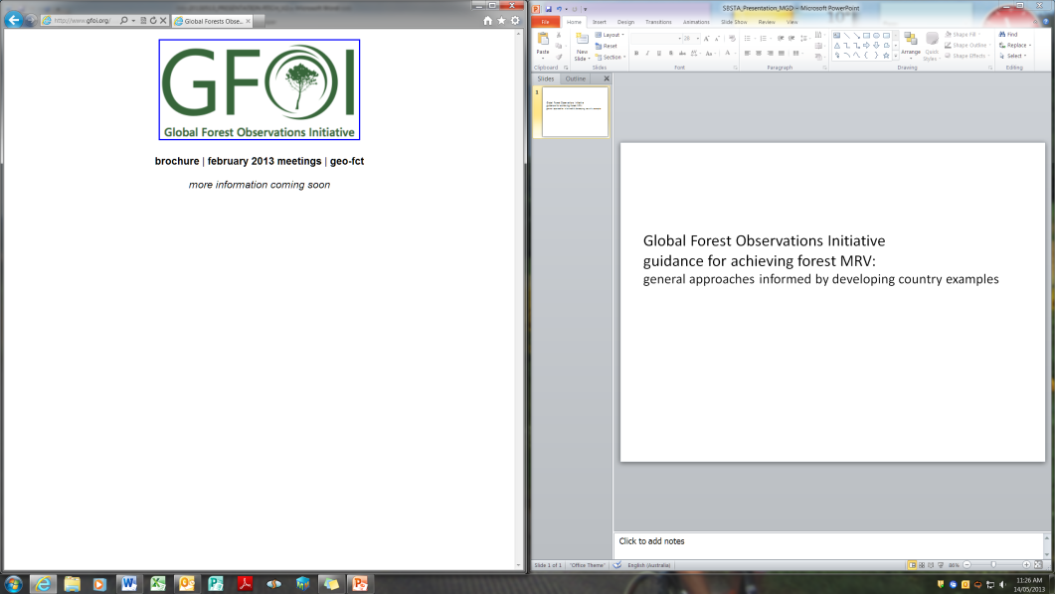
SilvaCarbon Program – US and FAO
Contribution to GFOI
Capacity building component of GFOI
USG Program that utilize the expertise of each USG agencies, and collaborate with Academia, NGOs and Industry.
Currently active in 3 regions, starting in 2011, and plan to be operative until 2019
Areas of work: Remote sensing, forest inventory implementation and analysis, and greenhouse gas inventory

Slide 18
GFOI CB objectives
Enhance the capacity of countries to initiate forest and terrestrial carbon assessment and monitoring, and to use management methodologies and technologies.
Strengthen the community of forest and terrestrial carbon technical experts.

Slide 19
Not…..
GIS 100
Isolated
One-off
Broadcast Seeding (semis direct)
Just classroom-style training

Slide 20
GFOI CB principles
Regional synergies
Thematic
Directed, Adaptive
Social networking and sharing
Broad participation
Developing a cadre and network of practitioners
Recognize “Deep-CB”

Slide 21
What approaches?
developing and delivering good practice guides, manuals, training, and tools;
facilitating learning exchanges, regional fora, and networks to enhance sharing among countries;
providing technical advice and assistance to governments (and others);
partnering with other donors and with International Organizations to multiply impact and reach.

Slide 22
Current capacity building coordination
With SilvaCarbon partners (USGS, USFS, EPA, NASA)
With partners outside of SilvaCarbon (programs developing capacity in the same regions as SC)
With GFOI partners (FAO, World Bank)
With Academia

Slide 23
Exchange of Information
High level (FAO, GFOI, Australia, Norway, SC meetings)
Technical level (through sharing capacity building activities)
Mechanism to inform major capacity building programs about bilateral initiatives and record progress

Slide 24
Linking capacity building with other GFOI components
Including Methods and Guidance documents in the capacity building plan by introducing training materials.
Linking the data needs from the countries with the acquisition strategy of the SDCG of GFOI.
Prioritizing the capacity building in the major areas of Research identified by the R&D component with countries input.

Slide 25
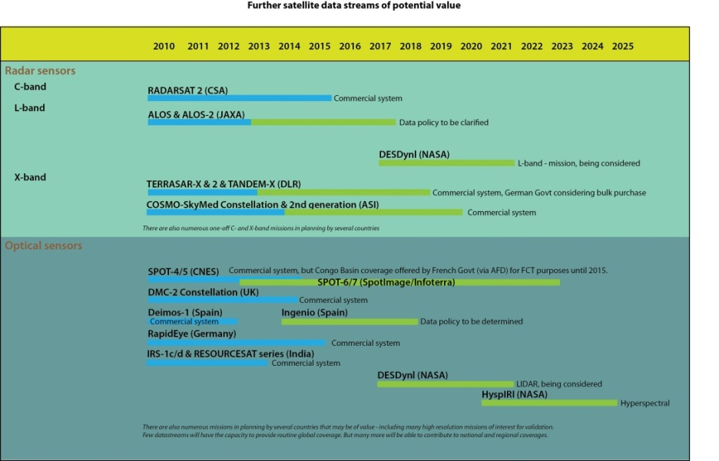
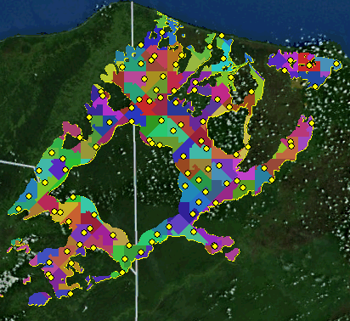
Major Technical Areas
Improved Forest Inventories
Improved remote sensing
Integration of remotely sensed and in situ data
GHG inventory and reporting (ALU tool)

Slide 26
Capacity Enhancement
Help nations develop capacity to utilise Earth Observation data in credible national forest monitoring systems
16 workshops in the Americas and Asia in 2011 to 2016
Ongoing bilateral collaboration
  Indonesia-Australia
  Kenya-Australia
  Norway-Tanzania
US SilvaCarbon plans geographic broadening in 2014 and 2015
Coordination with broader GEO Capacity Building Activities
Further develop the GFOI Capacity Building Plan

Slide 27
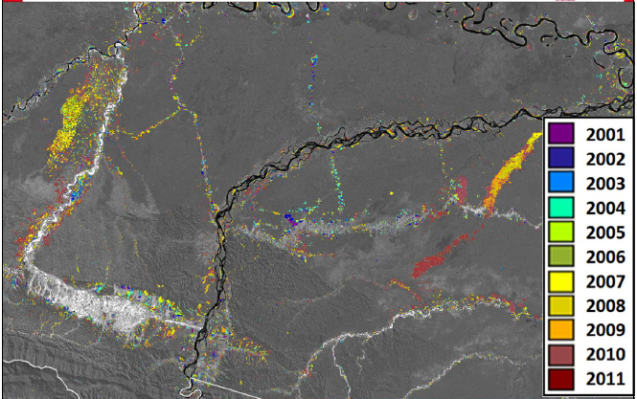
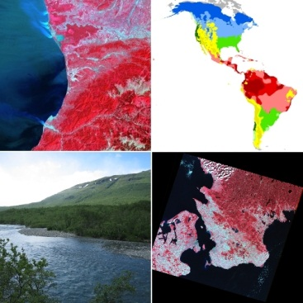


Multi agency cooperation for remote sensing capacity building
Agencies involved: USGS, USFS, and EPA
Countries: Colombia, Ecuador and Peru
Forest lost by mining in Madre de Dios
Source: Ministry of Environment, Peru
Forest change maps
Six IPCC land cover classes map
Accuracy assessment and validation of maps

Slide 28
Lessons learned
Only works with dedicated individuals tasked to support activities
Relationships are important, both institutional and personal
Adaptiveness
The convening power of GEO (GFOI)
Shared funding and technical support helps
There are lessons to be learned……

Slide 29
Thank you!
Douglas Muchoney (USGS): dmuchoney@usgs.gov
www.gfoi.org
www.ceos.org/sdcg
www.silvacarbon.org
#silvacarbon
https://sites.google.com/site/talleresgeofct/
https://sites.google.com/site gfoiseasiacapacitybuilding/home
https://sites.google.com/site/gfoiafricacapacitybuilding/home/

