Slide 1
Committee on Earth Observation Satellites
Capacity Building in EO at USGS
US Geological Survey / EROS
Eric C. Wood
Agenda Item #20
CEOS WGCapD-5
CEOS Systems Engineering Office (SEO), Hampton, VA, USA
March 30th – April 1st, 2016

Slide 2
The 5th Meeting of the CEOS Working Group on
Capacity Building & Data Democracy (WGCapD-5)
The CEOS Systems Engineering Office (SEO), Hampton, VA, USA
March 30th – April 1st, 2016
Background
USGS relies primarily on project based capacity building
Example: SilvaCarbon (GEO GFOI) – Silvia Wilson, Doug Machoney,

Slide 3
WGCapD Mission
The Mission of the WGCapD is to build upon the CEOS Data Democracy Initiative in an effort to increase the capacity of institutions in less developed countries for effective use of Earth Observation data for the benefit of society and to achieve sustainable development.

Slide 4
The 5th Meeting of the CEOS Working Group on
Capacity Building & Data Democracy (WGCapD-5)
The CEOS Systems Engineering Office (SEO), Hampton, VA, USA
March 30th – April 1st, 2016
Underserved Communities
Better access to Landsat data
Better access to other archived data (e.g. Sentinel)
CB in US for Indigenous communities
Native America Indians and Alaska Natives
Pacific Islanders

Slide 5
WGCapD “Pillars”
Data Access
Data Dissemination
Sharing of Software Tools
Training & Education

Slide 6
WGCapD “Pillars”
Data Access
Data Dissemination
Sharing of Software Tools
Training & Education

Slide 7
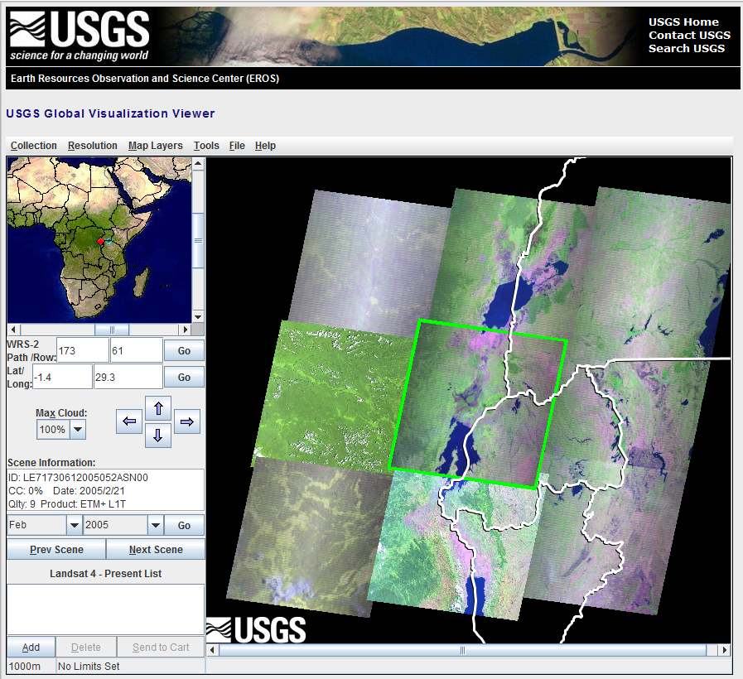
Landsat on GloVis

Slide 8
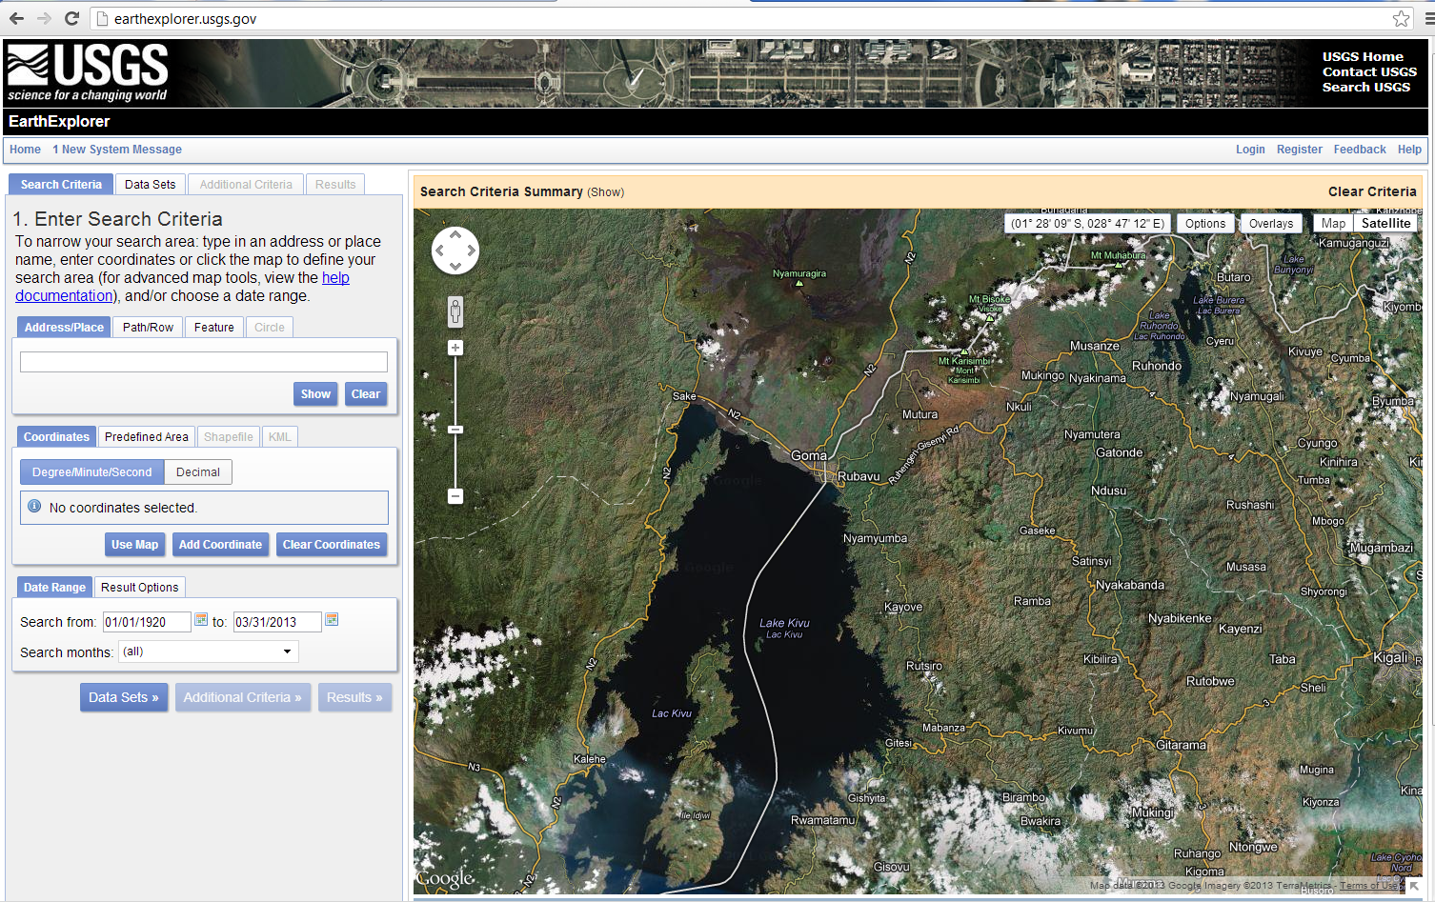
Landsat Imagery from Earth Explorer

Slide 9
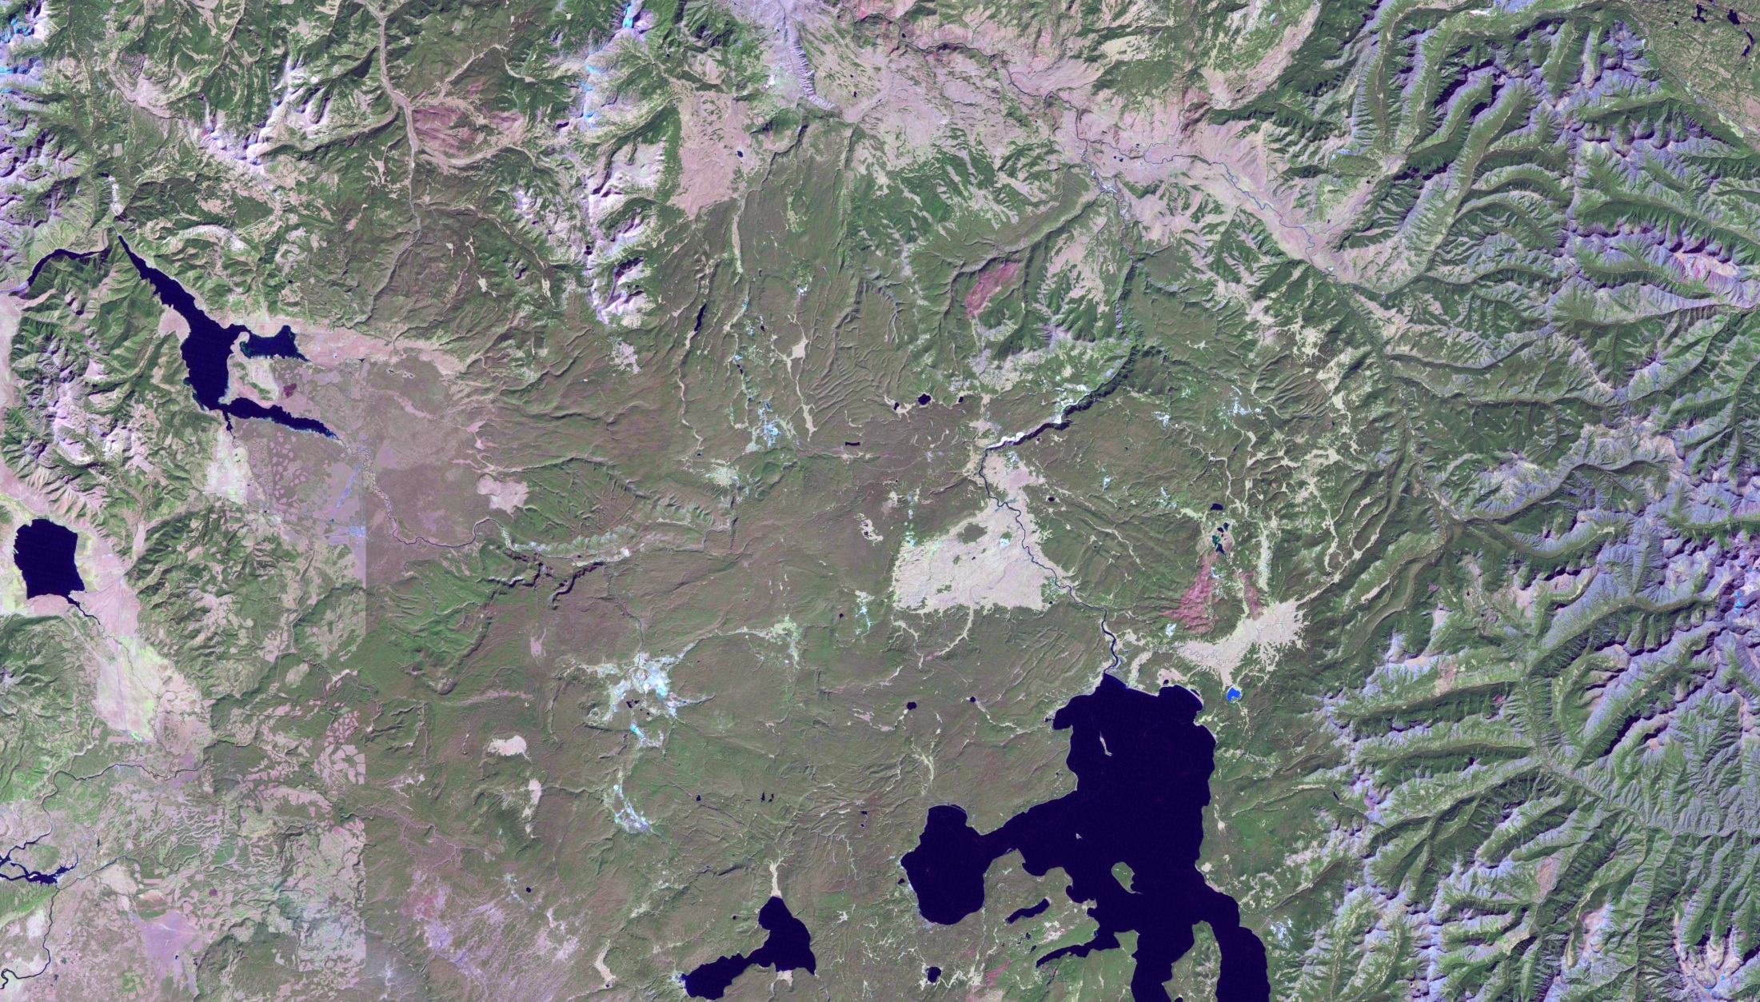
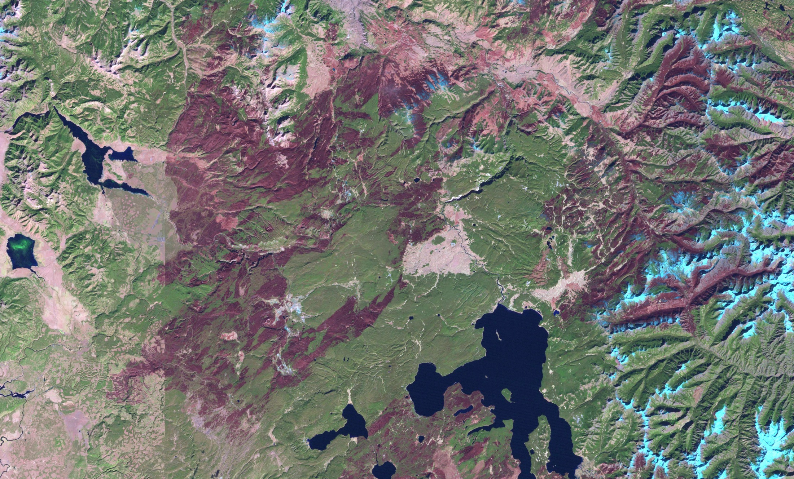
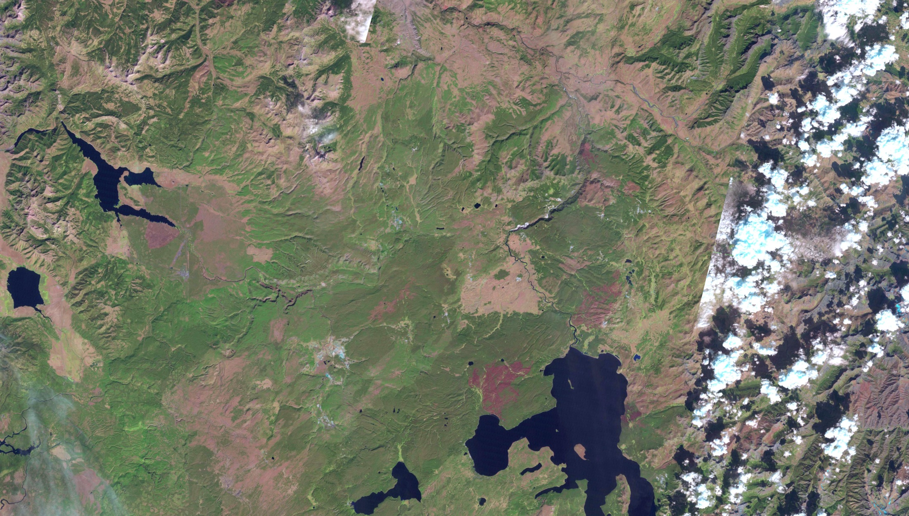
“But I just want a good browse image…..”

Slide 10
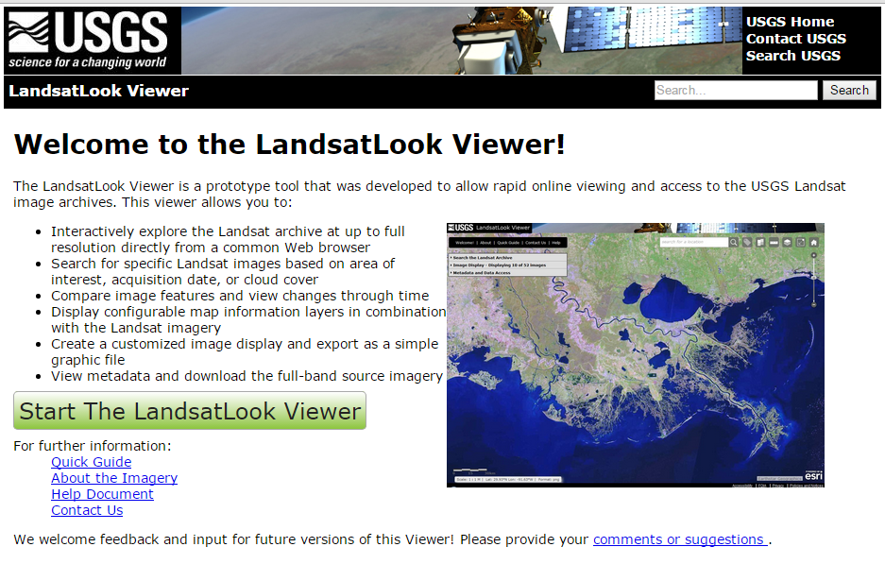

Slide 11
LandsatLook Overview
Background
The LandsatLook Viewer allows user to quickly and easily explore the complete Landsat archive… through time… at full resolution.
Web-based tool displays all or part of the Landsat archive
Based on full-resolution browse (FRB) image services
3-band RGB composites
Immediate public access (no need for registration, log-in, etc.)
Allows image viewing and extraction (“screen scrape”) in multiple formats
No need to download/transfer, unpack (gz/tar), layer stack, etc.
Notes:
You might want to be explicit that several of these features do not exist in our present viewers (GLOVIS, EE) , which makes LL a potentially important alternative for our expanding use of the LS archive.
Based on FRB services, no requirement to d/l means minimal impact on our networks

Slide 12
Full Resolution Browse
Full spatial resolution image and retains the map projection of the source data (normally polar stereographic for Antarctic scenes and UTM elsewhere).
Derived from Level-1T product
16-bit TOA reflectance data rescaled to 8-bits per band
3-band image consistent with legacy Landsat browse
band 6 (1610 nm), band 5 (865 nm) and band 4 (655 nm) for the red, green and blue components of the browse
The three bands are then combined to generate a 24-bit color image which is JPEG compressed with a quality of 75%.
Intended to satisfy broader use without the need for sophisticated processing
The TIRS browse is generated by extracting the 10.8 um band from the level-1 product and scaling to an eight bit grayscale image .
example

Slide 13
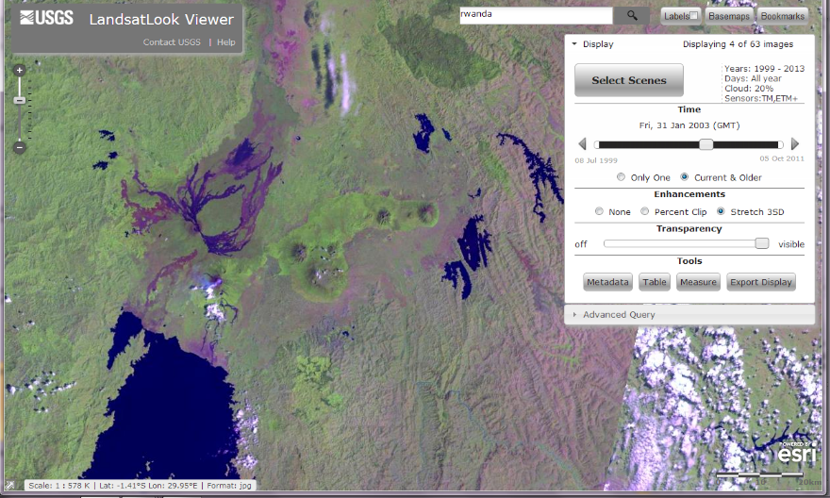
The LandsatLook Viewer
LandsatLook Viewer
All 3+ million scenes
1972 – today
3-band jpeg
Geographic information (xml/wld)

Slide 14
User Characterization
Target Communities
Emergency Managers (fire, flood, etc)
Need for very rapid and easy access – sometimes a quick look is enough
May be operating in low-bandwidth environment
CEOS Working Group on Capacity Building and Data Democracy
We know from CEOS eLearning activities that there is tremendous pent-up demand for easily accessible Landsat in developing countries
Focus on access and capacity to “underserved communities” (typically developing countries, but also US including tribal, K-12, etc)
Notes:
Who Does it Serve??? Who are the Users?
Say something here about who are the users, where are they coming from, what particular use case(s) LandsatLook is serving:
Actual AOI may be very small!!

Slide 15
User Characterization
Target Communities (continued)
General Public
Allows us to quickly demonstrate the vastness of the Landsat archive.
Provides the public with an easy to use tool for access and visualization
Allows for enhanced public engagement and full “democratization” of the Landsat resource by removing technical barriers to archive access
Includes the Landsat social media community (= highly enthusiastic and ‘engaged’)
Supports USGS role as recognized leader in distribution of free data

Slide 16
None of these examples would be our typical Landsat “power user”
May struggle with or avoid our present data distribution/download mechanisms
May lack the time or resources (bandwidth) to download a full-tile, full-band, full-resolution image (average Landsat 8 image = 1.2 Gb)
May lack the software tools, training, and expertise to understand how to manipulate, understand, or interpret the full-band imagery
May not have the tools, time, or resources to manage a full-res time series

Slide 17
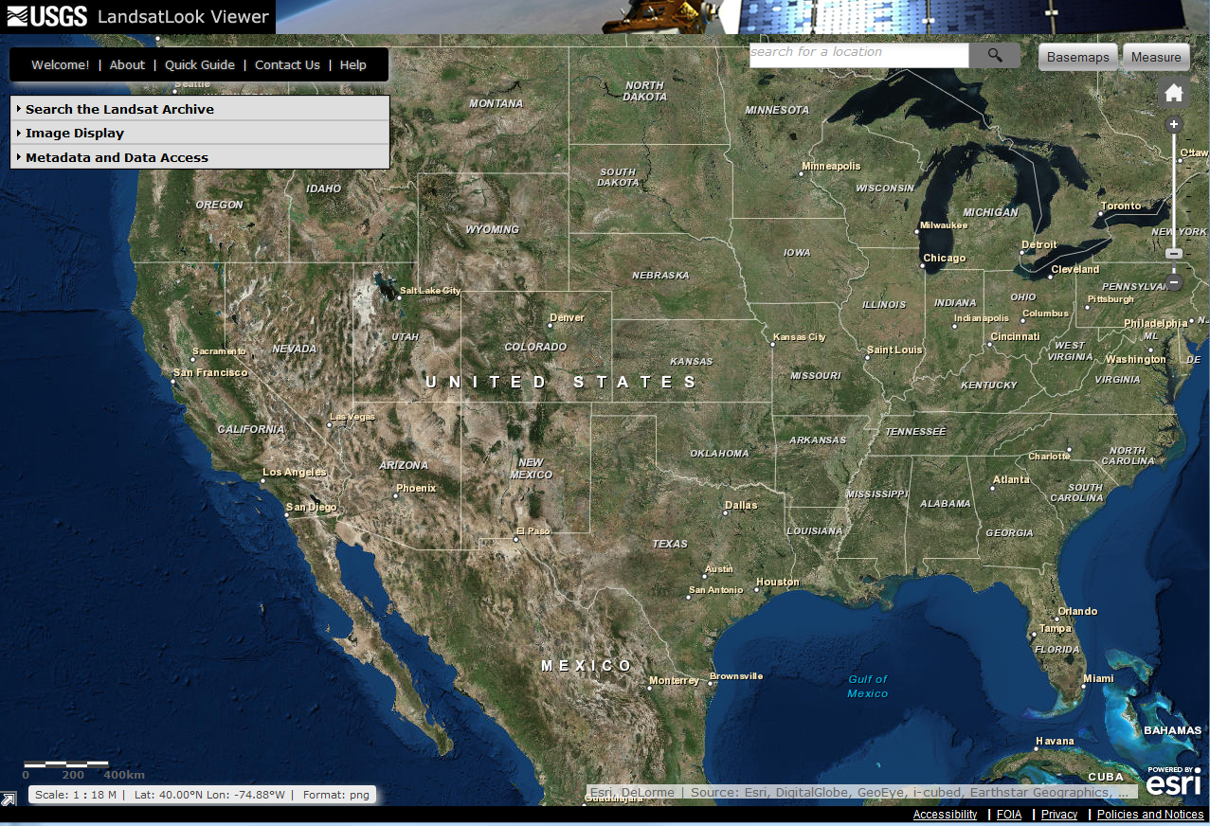

Slide 18
Current Interface

Slide 19
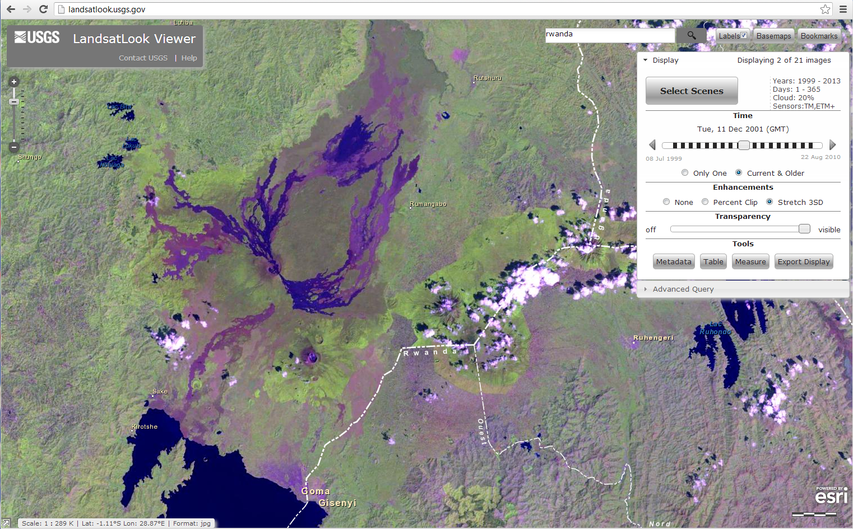
Current Interface
Overlay labels and boundaries
Search Results
Step through time
Adjust browse (transparency, stretch)
Get Metadata & Full-tile Imagery
GIS Tools
(Measurement & Location)
Export Display
(“Screen Scrape”)
Notes:
Lots of capability, trouble is the details…

Slide 20
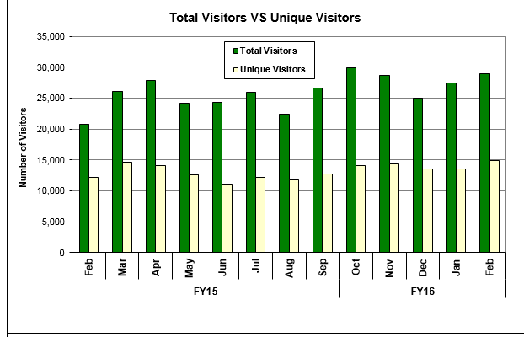

Slide 21
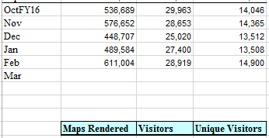

Slide 22
The 5th Meeting of the CEOS Working Group on
Capacity Building & Data Democracy (WGCapD-5)
The CEOS Systems Engineering Office (SEO), Hampton, VA, USA
March 30th – April 1st, 2016
Landsat Look Viewer
LandSat Look Instructional Video

Slide 23
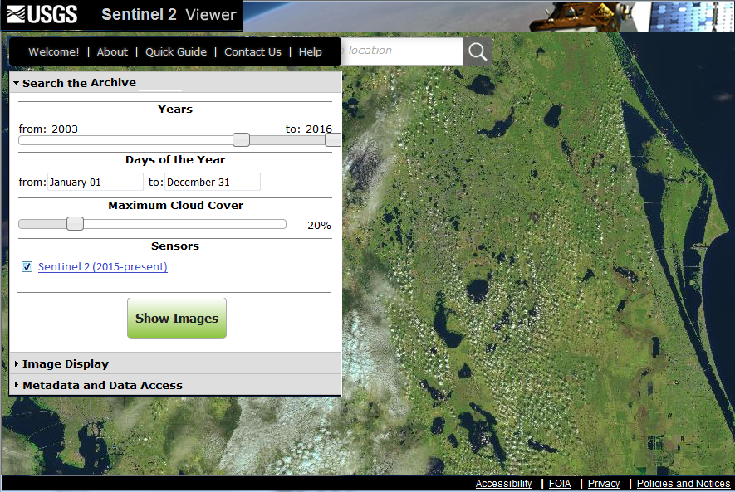
The 5th Meeting of the CEOS Working Group on
Capacity Building & Data Democracy (WGCapD-5)
The CEOS Systems Engineering Office (SEO), Hampton, VA, USA
March 30th – April 1st, 2016
Sentinel Look Viewer

Slide 24
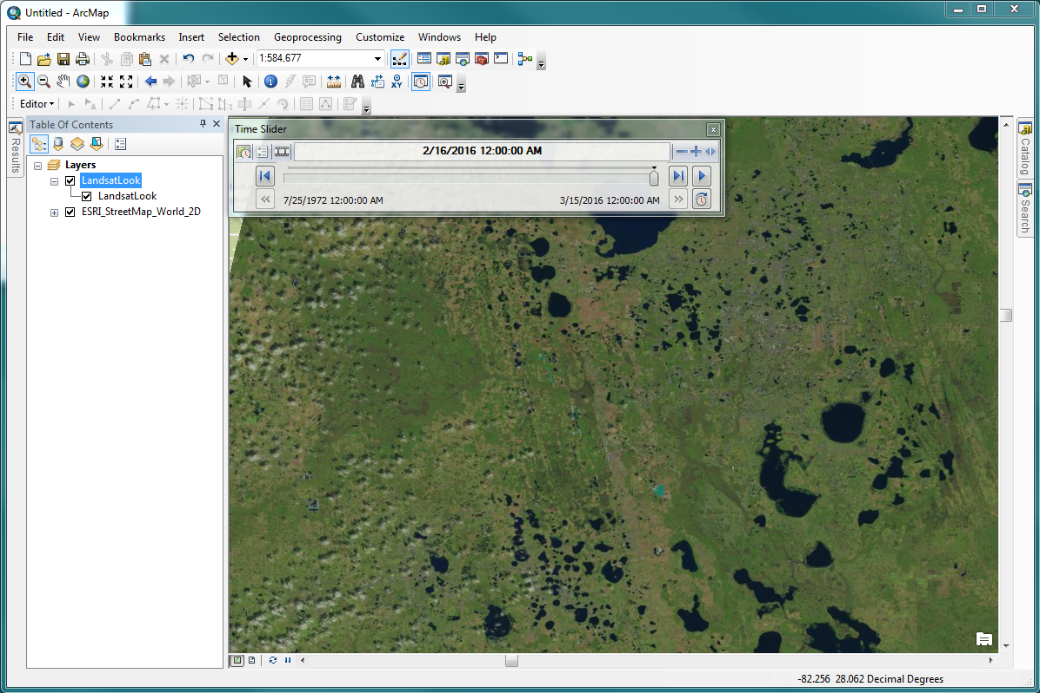
OGC Compliant Web Services

Slide 25
CB in US for Indigenous communities
Native American (Indians) and Alaska Natives
Pacific Islanders

Slide 27
Tribal Colleges and Universities

Slide 29
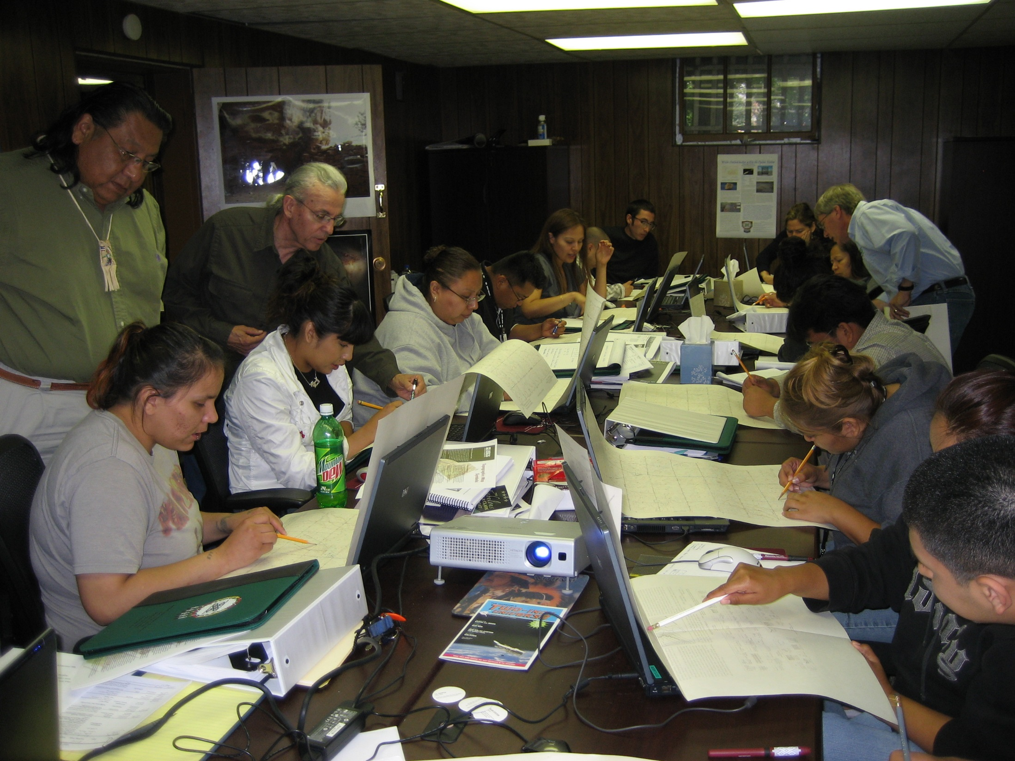
NASA Summer Rsch. Experience UTTC, June 2008

Slide 31
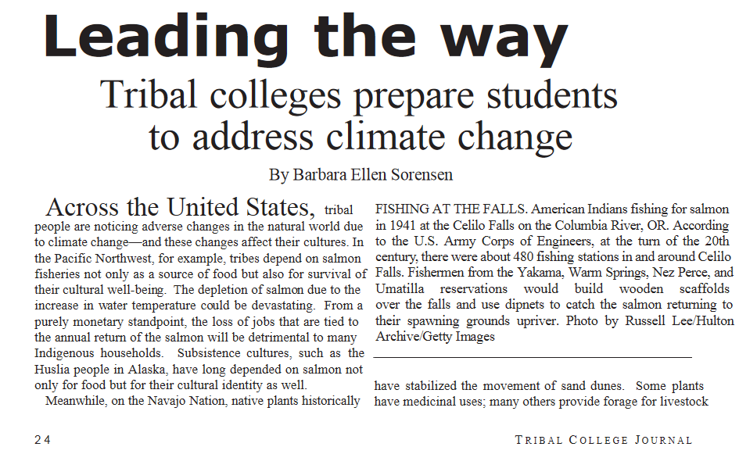

Slide 33
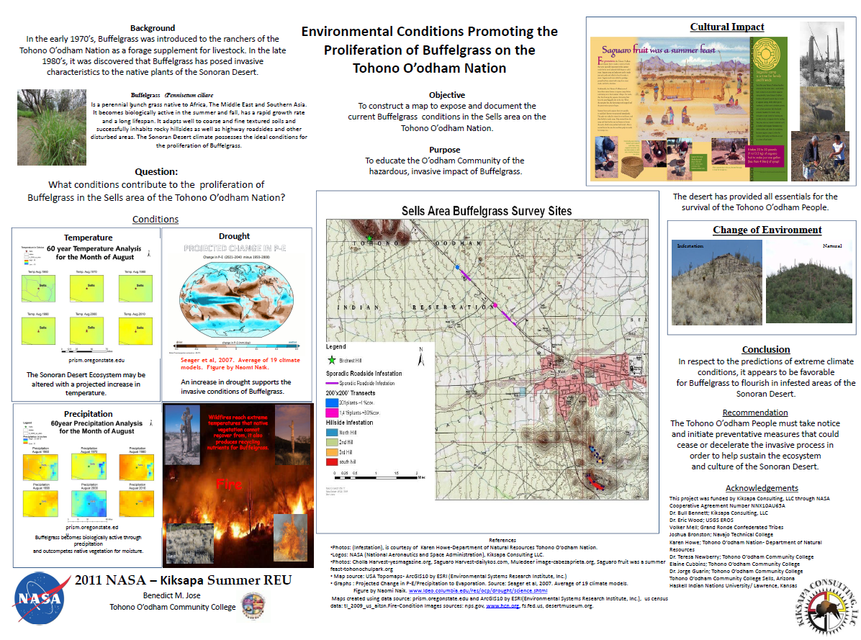

Slide 34
The 5th Meeting of the CEOS Working Group on
Capacity Building & Data Democracy (WGCapD-5)
The CEOS Systems Engineering Office (SEO), Hampton, VA, USA
March 30th – April 1st, 2016
Underserved Communities
TESNAR, SISNAR
Map of reservation, tribal colleges

Slide 35
TESNAR (Training)

Slide 36
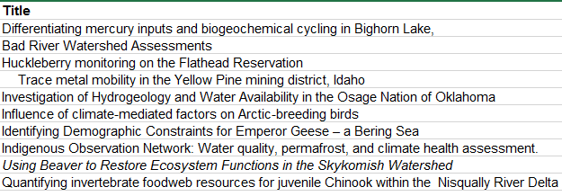
SISNAR (Internships)

Slide 37
The 5th Meeting of the CEOS Working Group on
Capacity Building & Data Democracy (WGCapD-5)
The CEOS Systems Engineering Office (SEO), Hampton, VA, USA
March 30th – April 1st, 2016
Underserved Communities
DOI Climate Science Centers
Grants
BIE funded liaisons

Slide 38
The 5th Meeting of the CEOS Working Group on
Capacity Building & Data Democracy (WGCapD-5)
The CEOS Systems Engineering Office (SEO), Hampton, VA, USA
March 30th – April 1st, 2016

Slide 39
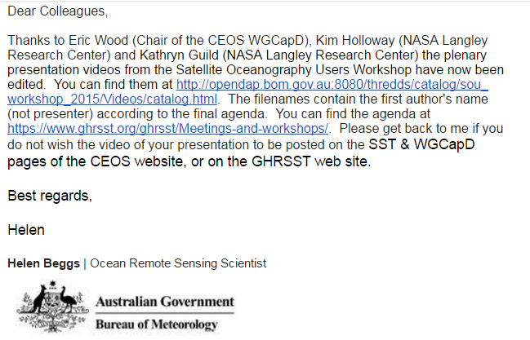

Slide 40
Thank You!

