Slide 1
Capacity Building Activities in Earth Observation at NASA
Committee on Earth Observation Satellites
Nancy D. Searby, NASA
WGCapD-5 Agenda Item #18
Working Group on
Capacity Building & Data Democracy
Hampton, Virginia, USA
March 29th – April 1st, 2016

Slide 2
NASA Applied Sciences’ Capacity Building Program
CBP Mission: To build individual and institutional capacity to access and apply Earth observations to end user data and information decision making needs.
Strategic Objectives
Expand the network of individuals and institutions aware of and able to access NASA Earth observations.
Increase the capabilities of individuals and institutions to use and apply NASA Earth observations in their management decisions and actions.
Enable sustained use of existing NASA Earth observations for decisions and actions, and the ability to incorporate new observations as they become available.
Build skills of Earth sciences community to define end user needs, collect and share robust feedback, build capacity and to assess impact of capacity building activities
Improve feedback of lessons learned through capacity building to Earth science research & analysis, applications, and data systems program management.
Monitoring & Evaluation
Results framework
Shared indicators
Surveys & assessments

Slide 3
NASA Capacity Building
Targets:
US and developing world analysts and decision-makers
Across all sectors, e.g. government, NGO, private sector
Non-traditional partners for NASA
Desired outcomes:
All who can use EO for decision-making have the skills to do so
Better decisions made and actions taken as the result of EO use
Specific targets and outcomes for ARSET, DEVELOP, and SERVIR

Slide 4
Capacity Building Program
SERVIR: Building international capacity with hubs in East Africa, Hindu Kush-Himalaya, Mesoamerica, and Mekong
Applied Remote SEnsing Training (ARSET): Online and hands-on NASA remote sensing training
DEVELOP: Dual workforce/local government capacity building using collaborative feasibility projects
Participating in Interagency & Global Capacity Building Activities
https://www.servirglobal.net/
http://arset.gsfc.nasa.gov/
http://develop.larc.nasa.gov/
Applied Sciences Program| NASA
Capacity Building Program

Slide 5
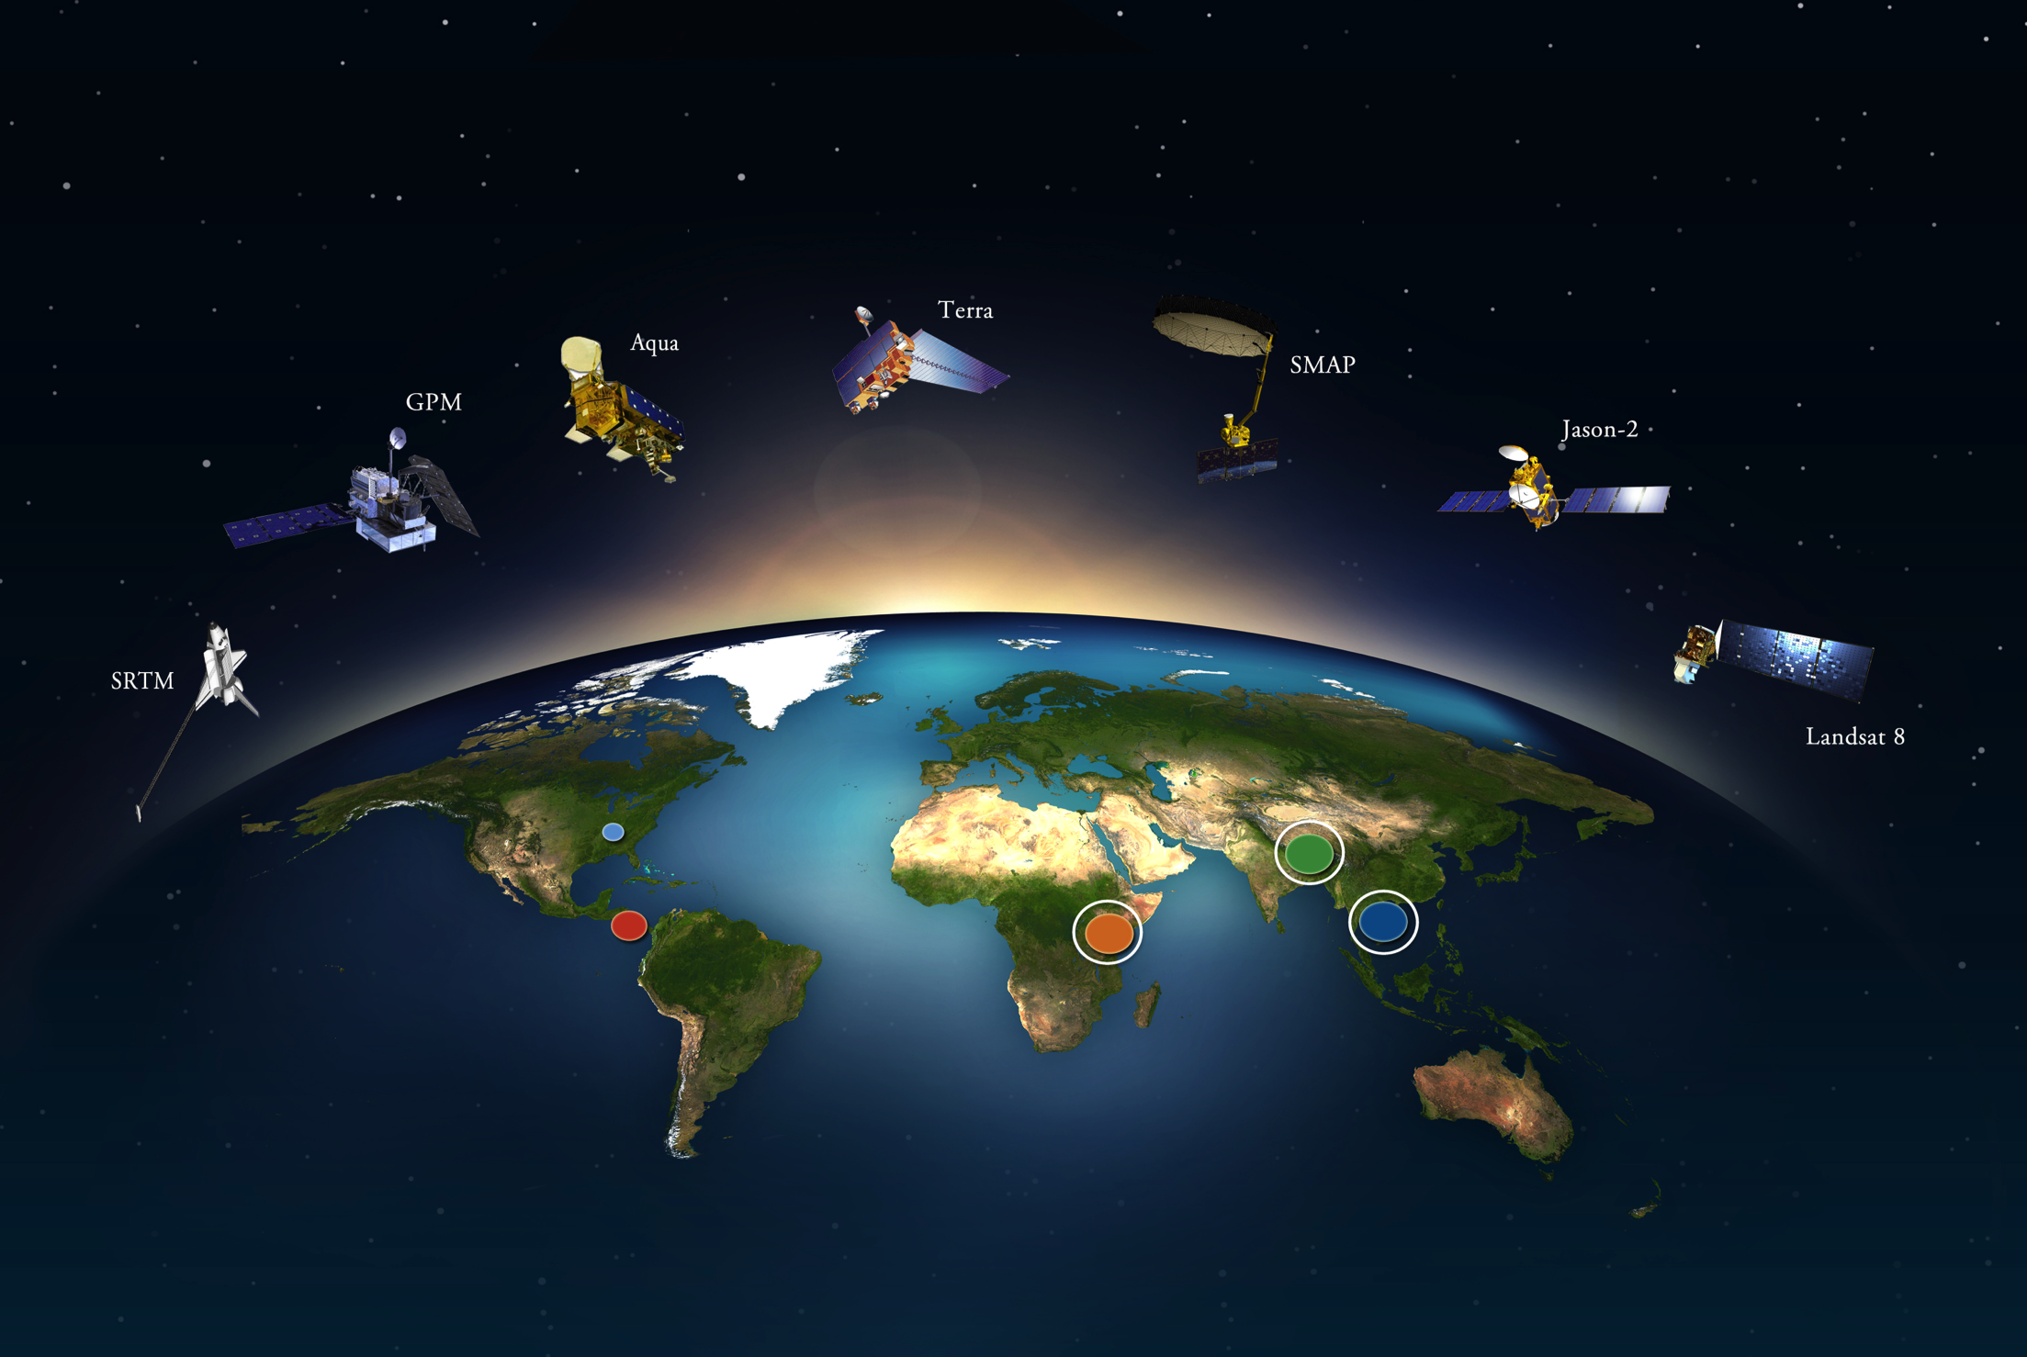
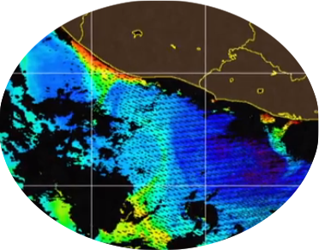
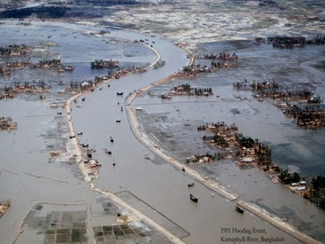
SERVIR
SERVIR is a joint development initiative of NASA and USAID, working in partnership with leading regional organizations around the globe, to help developing countries use information provided by Earth observing satellites and geospatial technologies for managing climate risks and land use.
Targets:
Hub institutions
National gov’ts
2016
Mesoamerica example:
Mapping of harmful microalgae
in El Salvador
Himalaya example:
Flood Forecasting
In Bangladesh
Africa example:
Frost mapping in Kenya
Applied Sciences Program| NASA
SERVIR
Notes:
Notes:
Around the world, SERVIR is improving awareness, increasing access to information, and supporting analysis. The examples shown here are just a few of the many products SERVIR offers to help manage challenges made more difficult by a changing climate.
Photo Left:
Fishermen in El Salvador need to avoid waters made unsafe by outbreaks of harmful microalgae. Thanks to SERVIR, satellite imagery helps locate the microalgae, allowing fishermen to avoid these areas.
Photo Middle
With Kenya third in the world in yearly tea production, the tea industry provides a living for about 4 million Kenyans, or about 10% of the total population. During winter months, these people sometimes face a subtle but pervasive enemy – frost. Frost can cause millions of dollars in damage to tea crops.
Thanks to SERVIR, satellite mapping in Kenya predicts potential frost areas, giving farmers time to prepare.
Photo Right
Satellite data reveals the river height upstream, so that flood risks downstream can be assessed 8 days in advance, as opposed to 3 days as currently done.

Slide 6
SERVIR: Best Practices
SERVIR uses an end-to-end approach to product development, identifying the specific problem to be addressed, characterizing the users who could benefit, their specific needs and capacities, and specifying how to best improve services to help them address the problem.
Describe the problem and identify stakeholders.
Define decision-making context.
What are the key decisions related to this problem?
What info is needed to make these decisions?
Is this info being provided? If so, by whom?
1. Describe problem/ identify stakeholder
2. Define the decision-making context
3. Characterize user capacities and needs
4. Describe activities already responding to these needs
6. Conduct M&E and product improvement
5. Specify opportunities to improve services
Characterize user capacities and needs.
Who will use the info to make these decisions?
Does user have access to necessary data or info?
Does user have needed hardware, software, skills to use it?
Describe related activities already responding to these needs.
5. Specify opportunities to improve climate services in terms of:
User engagement
Data access and management
Products and tools
Outreach, uptake, capacity building, and feedback
Coordination of ongoing efforts
Capacity Built?
Baseline Capacity Assessment
Independent evaluations
Success stories
Indicators
Conduct M&E and product improvement.
Applied Sciences Program| NASA
SERVIR

Slide 7
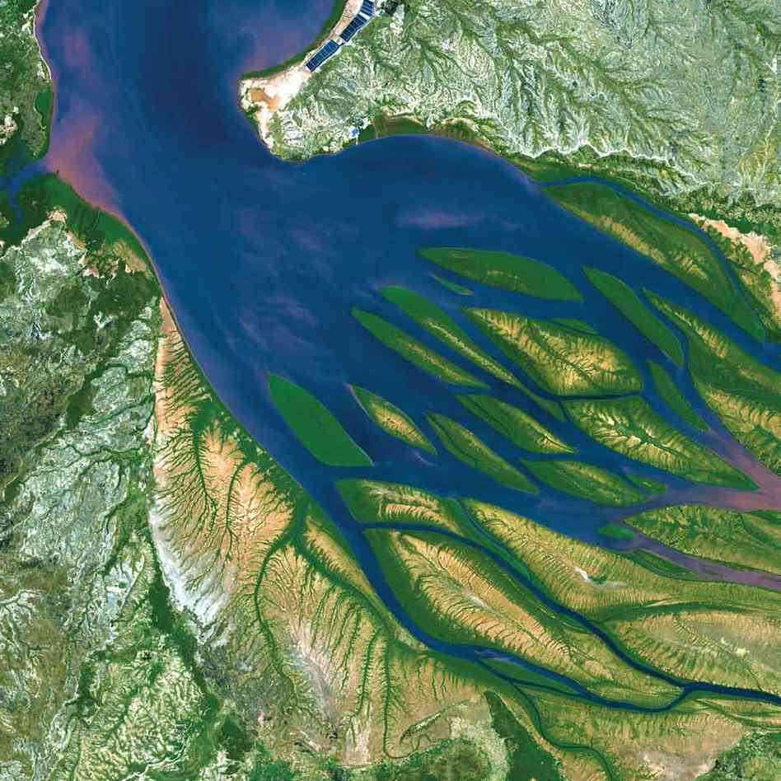
SERVIR Potential CEOS linkages
Past & ongoing activities with:
National Oceanic and Atmospheric Administration (NOAA)
U.S. Geological Survey (USGS)
Initial conversations with:
Japan Aerospace Exploration Agency (JAXA)
South African National Space Agency (SANSA)
Geo-Informatics and Space Technology Development Agency (GISTDA)
Vietnam Academy of Science and Technology (VAST)
Applied Sciences Program| NASA
SERVIR

Slide 8
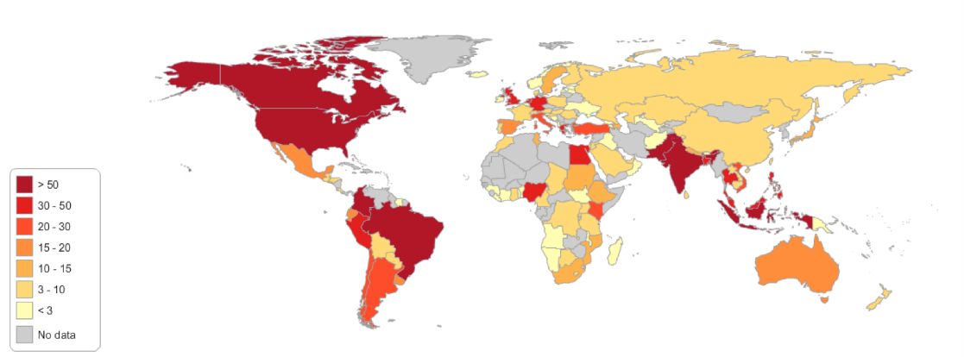
About ARSET
Online and on-site trainings tailored to applied environmental professionals (government, private sector)
Goal: build skills in the use of NASA Earth Science for environmental applications:
Air Quality
Disasters
Ecoforecasting
Health (beginning in 2016)
Water Resources
Wildfires
Target: decision-makers; webinars include broader participation
ARSET Impact (2009-2015)
67 trainings
4,900+ participants
1,600+ organizations
130+ countries
2015 Participants by Country
Website: http://arset.gsfc.nasa.gov
Twitter: @NASAARSET
Applied Sciences Program| NASA
Applied Remote Sensing Training Program
Notes:
“I think the largest benefit to me will be just learning the basics and gaining an understanding of what products and applications are available and how I potentially use these products to help with my responsibilities as a land manager.” -Participant of a 2015 Wildfire Workshop

Slide 9
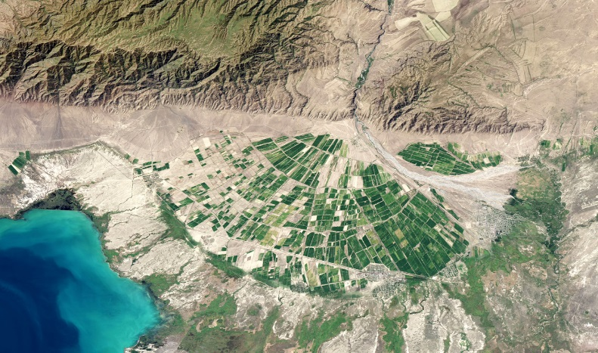
ARSET: Best Practices
Gradual Learning Approach
6-12 month collaboration with key partner or boundary organization(s)
Large focus on hands-on data access and analysis
Use of both web based tools and software (GIS, python)
Group projects are used in advanced online and on-site training
Ongoing participant assessment and program evaluation through surveys
Webinars & Hands-on Workshops
Assumes no prior RS knowledge
Examples: Fundamentals of Remote Sensing; Remote Sensing Observations for Flood Management
Basic Training
Webinars & Hands-on Workshops
Requires basic training
Tailored to a specific audience and/or region for a specific application
Example: Creating and Using Normalized Differential Vegetation Index from Satellite Imagery
Capacity Built?
Follow up surveys, interviews
Advanced
Training
Applied Sciences Program| NASA
Applied Remote Sensing Training Program

Slide 10
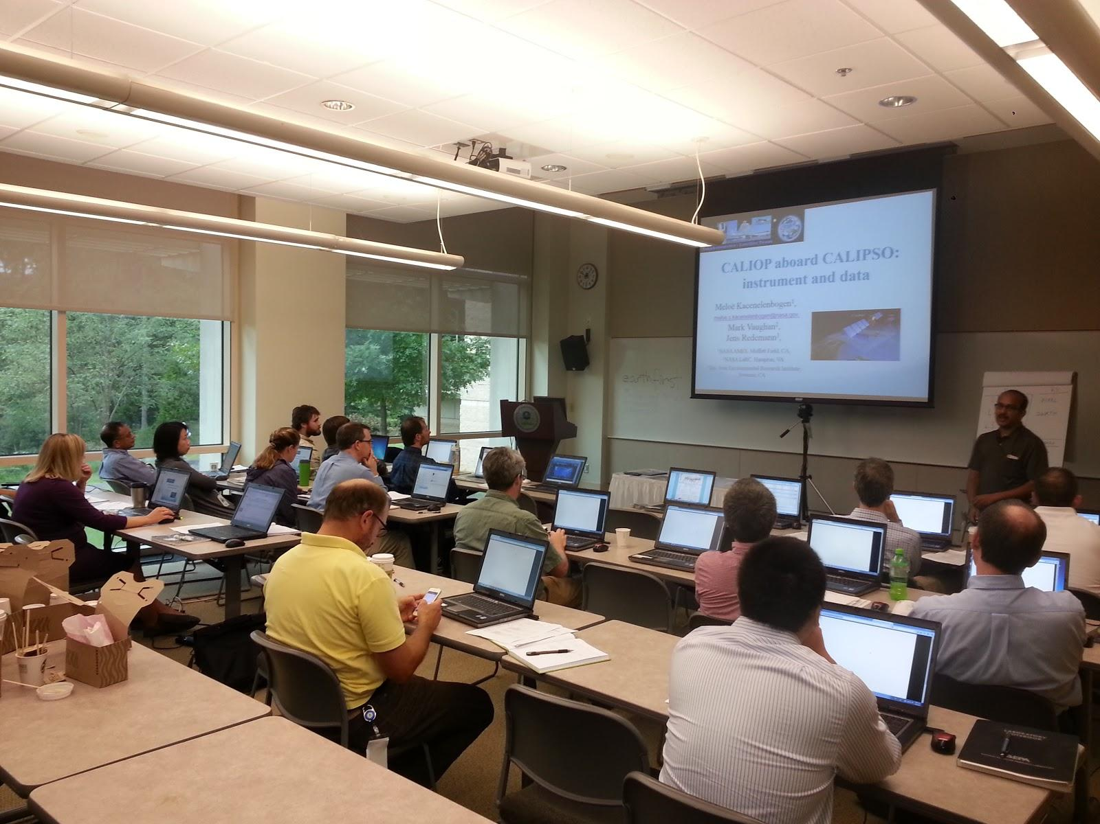
ARSET CEOS linkages
CEOS member agency participation in ARSET trainings:
AGEOS
DFD
DLR
ESA
GISTDA
INPE
ISRO
Joint Research Centre-European Commission
NASRDA
National Commission on Space Activities, Argentina
National Remote Sensing Centre, Zambia
Roshydromet, Russia
SANSA
ARSET participated in WGCapD e-Learning
Applied Sciences Program| NASA
Applied Remote Sensing Training Program
Notes:
CEOS member agency participation
Gabonese Agency of Study and Observation Space (AGEOS)
German Aerospace Center (DFD)
German Remote Sensing Data Center (DLR)
Geo-Informatics and Space Technology Development Agency (GISTDA)
National Institute for Space Research, Brazil (INPE)
Joint Research Centre-European Commission, Italy
National Space Research and Development Agency, Nigeria (NASRDA)
National Commission on Space Activities, Argentina
National Remote Sensing Centre, Zambia
Roshydromet, Russia
South African National Space Agency (SANSA)
Individuals from CEOS agencies who participated in trainings:
European Space Agency (ESA)
Indian Space Research Organization (ISRO)

Slide 11
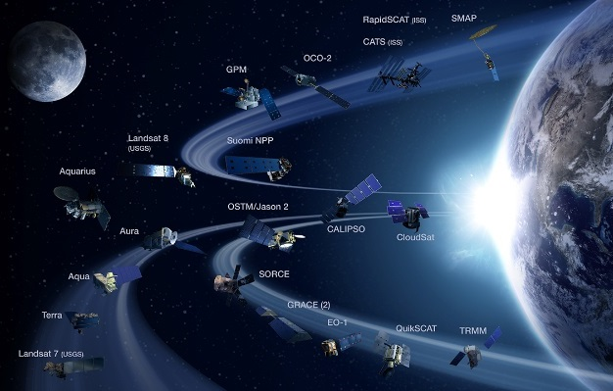
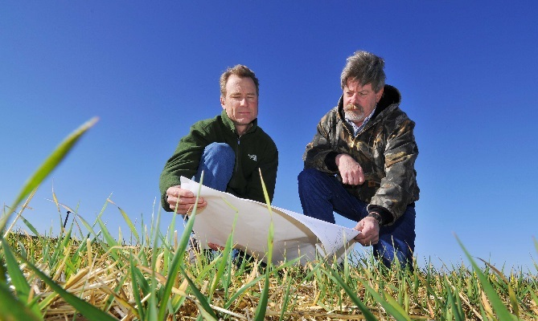
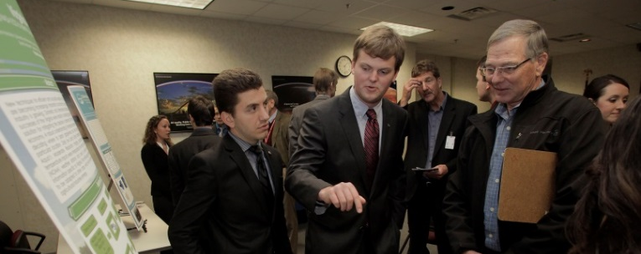
About DEVELOP
NASA Applied Sciences’ program that collaborates with decision makers to conduct 10-week rapid feasibility environmental research projects using NASA Earth observations.
DATA
NASA DEVELOP
DECISION MAKERS
DEVELOP
>
>
In 2015, DEVELOP had 393 participants (Target: young & transitioning professionals, veterans)
In 2015, DEVELOP conducted 93 projects with 153 end users & partners (Target: end users from all sectors)
DEVELOP is a dual-capacity building program:
Partners & Participants
Applied Sciences Program| NASA
DEVELOP National Program

Slide 12
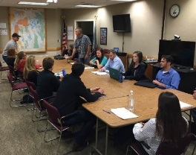
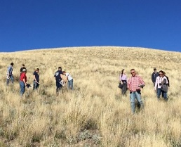
DEVELOP: Best Practices
Conduct rapid prototype Applied Science research projects using NASA Earth observing resources completed and delivered to partners over a 10 to 30-week period
Partnerships led by local, state, federal and/or international government entities who can benefit from NASA Earth observations to enhance decision making
Projects address actionable community environmental concerns
Strong end-user relations based on clear communication
Focus on specific study regions rather than a broad study area
Clear project expectations with partners prior to initiation of activity
Ensure highly leveraged project investments so NASA contributions are matched by partners
Attract and develop high caliber program participants who leave DEVELOP better prepared to contribute to society using NASA Earth science resources
Retain highly qualified Science Advisors and Mentors from NASA and partner organizations to ensure innovative and relevant project outcomes
Capacity Built? Exit surveys, product delivery, alumni follow up
Applied Sciences Program| NASA
DEVELOP National Program

Slide 13
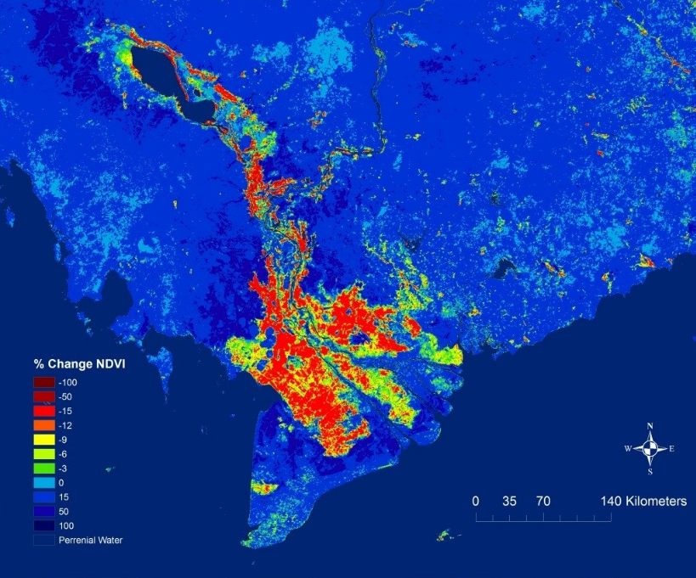
DEVELOP:
CEOS Collaborations
CEOS Members: Indirect support via strong collaborations with U.S. organizations (i.e., NOAA & USGS) that work with CEOS groups (WGs, VCs, and Ad Hoc Teams)
Prior collaboration with GEO
2009-2013
Mexico Water Resources and Human Health
Projects & Activities
Mekong Disasters – CEOS Flood Dashboard
North Central US Climate – CEOS Land Project Validation (LPV)
Supported CEOS remote sensing publication
Previous DEVELOP participant transitioned to CEOS support
Mekong Disasters: % change in NDVI between dry season and flood event
Potential Collaborations
Projects • Participants • Franchise
Applied Sciences Program| NASA
DEVELOP National Program

Slide 14
Overall Lessons Learned
To build capacity of Government & Professional End-users
Ask questions, listen to establish needs
Include training in all projects, and get high level buy in initially
Promote staff development and South-South collaboration at regional and national level
Establish cooperation mechanisms that facilitate government officials to receive regular training to mitigate turnover
Include academic professors and researchers to educate students and peers, mainstream applications, and serve as a technical backstop during government transitions
Build scientific capacity by offering intro to advanced trainings, pilot projects to attract further involvement and bottoms up app development
Build organizational/institutional capacity through long-term relationships, encouraging leveraged/in kind resources, a champion with influence, and consider sustainability and exit strategy at beginning of effort
Define desired outcomes, measure impact with questionnaires, indicators, independent evaluations

Slide 15
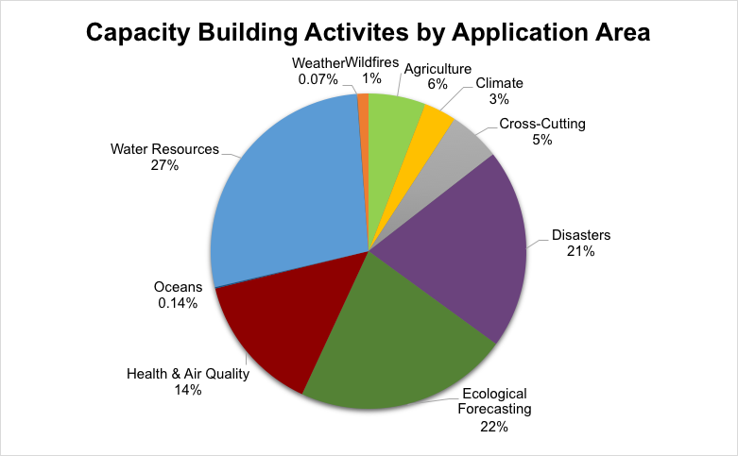
2015: 50 States, 135 countries, many applications areas
Geographic extent: Projects in specific geographic areas, end users from specific states/nations who participated in projects or training courses, and DEVELOP participant locations were aggregated to show where we work and in which applications areas.
Apps areas: water>ecological forecasting>disasters

Slide 16
Capacity Building Partners
SERVIR
team:
Applied Science Team, users
Many others, e.g:

Slide 17
67 Earth Observation Assets Employed by CBP
ALOS PALSAR
AltiKa
Aqua AIRS
Aqua AMSR-E
Aqua AMSU-A
Aqua MODIS
Envisat ASAR
ASCAT
Aura OMI
AVHRR
CALIPSO
CLARS
CMORPH-CDR
DMSP SSM-I
EO-1 ALI
ER-2 AVIRIS/MASTER
ER- 1
ERS-2
EUMETSAT METOP
GeoEye 1
GeoEye 2
GOES
GOSAT
GPM DPR
GPM GMI
GRACE
ICESat (GLAS)
ICESat-2
IKONOS
Jason Altimeter
Jason-2
Jason-3
Landsat 1 MSS
Landsat 2 MSS
Landsat 3 MSS
Landsat 4 TM
Landsat 5 TM
Landsat 7 ETM+
Landsat 8 OLI
Landsat 8 TIRS
LIS
Meteosat
PERSIANN-CDR
QuickBird
QuikSCAT
RADARSAT-1
Radarsat-2
SeaStar SeaWiFS
Sentinel-1
Simulated HyspIRI
SMAP Radar and Radiometer
SMOS MIRAS
SRTM (Space Shuttle)
Suomi NPP VIIRS
Terra ASTER
Terra CERES
Terra MISR
Terra MODIS
Terra MOPITT
TerraSAR-X
TRMM PR
TRMM TMI
TRMM VIRS
UAVSAR
WorldView 1
WorldView 2
WorldView

Slide 18
Thanks!
Capacity Building Element POCs
SERVIR: Dan Irwin, daniel.irwin@nasa.gov
DEVELOP: Mike Ruiz, michael.l.ruiz@nasa.gov
ARSET: Ana Prados, aprados@umbc.edu
Nancy D. Searby, PhD
Capacity Building Program Manager
Nancy.D.Searby@nasa.gov
NASA Applied Sciences Program
Appliedsciences.nasa.gov
Earth Science Data Access
Earthdata.nasa.gov
18
|‌ 18

