Slide 1

Committee on Earth Observation Satellites
CB activities in EO at ESA
ESA
F. Sarti
Day 2 – item 17
CEOS WGCapD-5
CEOS Systems Engineering Office (SEO), Hampton, VA, USA
March 30th – April 1st, 2016

Slide 2
Who do we target
Young professionals dealing with geoinformation
PhD and university students
Secondary schools
General public and decision-makers

Slide 3
ESA partners in CB, Education & Training activities – Earth Observation
In Europe
with many universities and public institutes in Europe (including non-ESA member states and PECS) and with Other Space Agencies
in the frame of International Cooperation
Within CEOS WG CapD, UN (UNOOSA, FAO, UNESCO..)
With Other Space Agencies worldwide
With International associations with an educational mandate like:
With Earsel, EGU/GIFT, SELPER
- With many countries in Asia, Africa and South America (including TIGER, Dragon programmes)

Slide 4
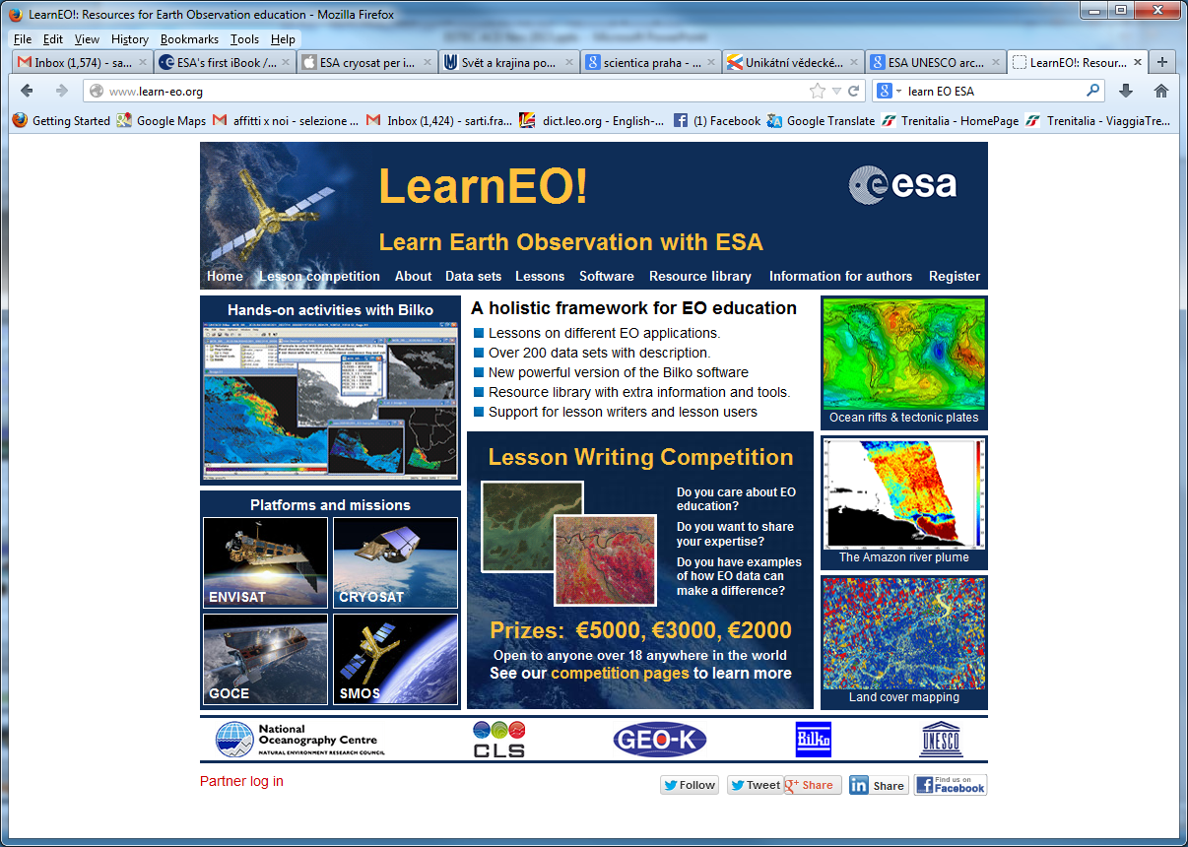
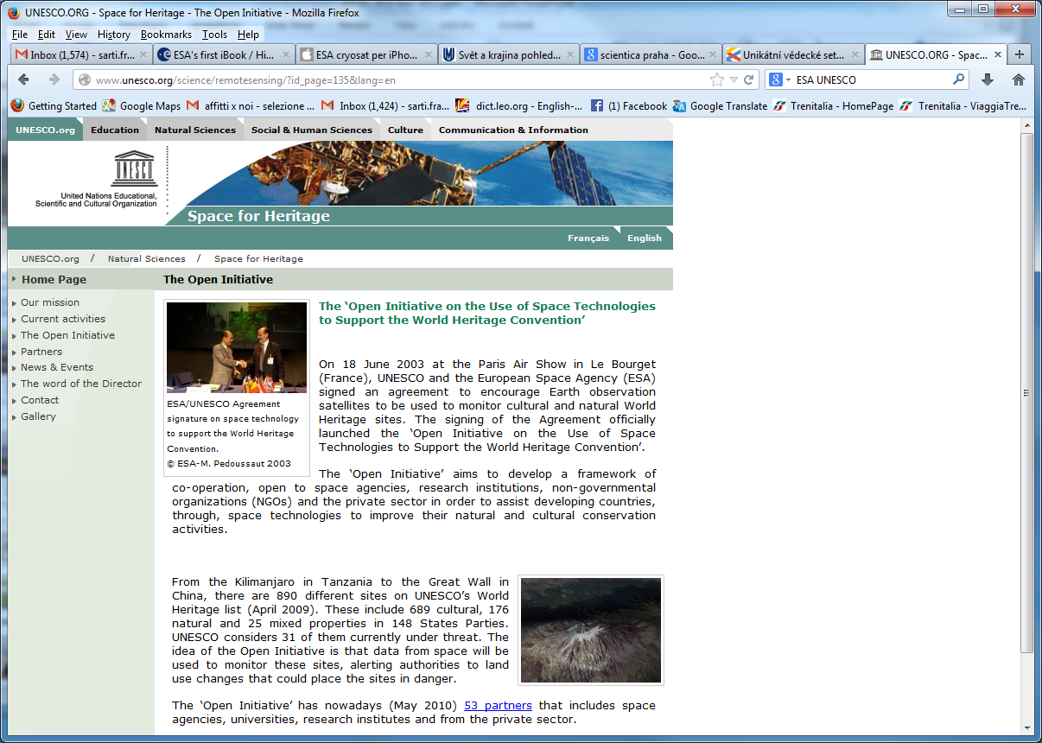
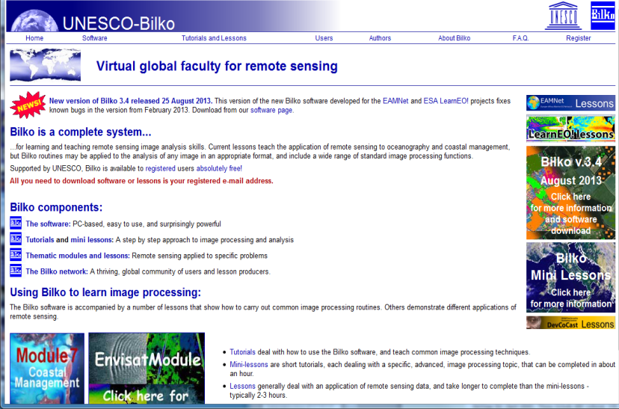
(i) Capacity Building in the frame of International Cooperation with UNESCO

Slide 5
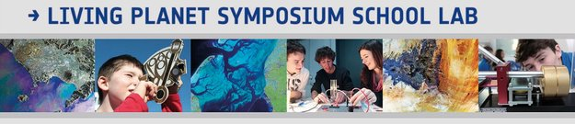
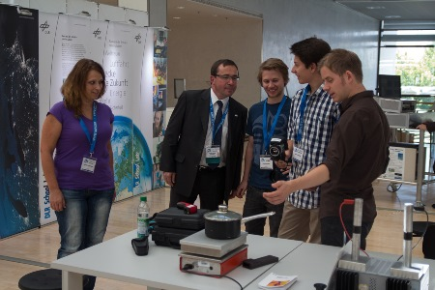
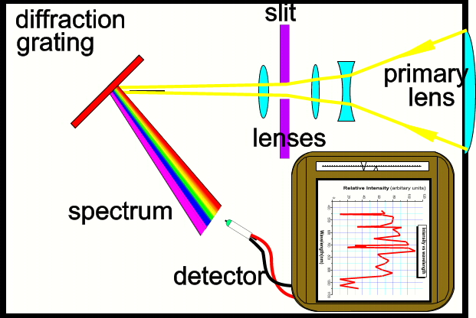
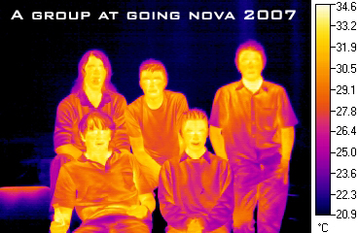
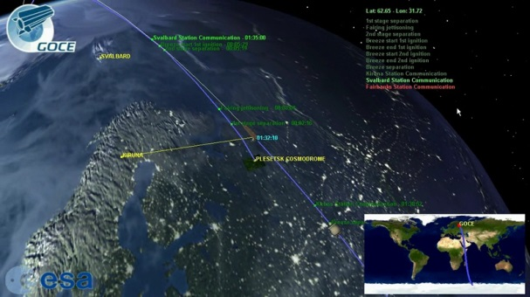
(i) Education in the frame of International Cooperation with other space agencies
Creation of joint School Labs with ESA, DLR, UKSA and UK national space academy, Charles University.
  Such as IGARSS 2012 and LP Symposium 2013 and LP Symposium in May 2016. Demonstrating RS to schools using instruments such as: Field Spectrometer, Thermal camera, UV light, Stereo Optical Camera, possibly enriched by many other experiments and 3D / oculus technology

Slide 6
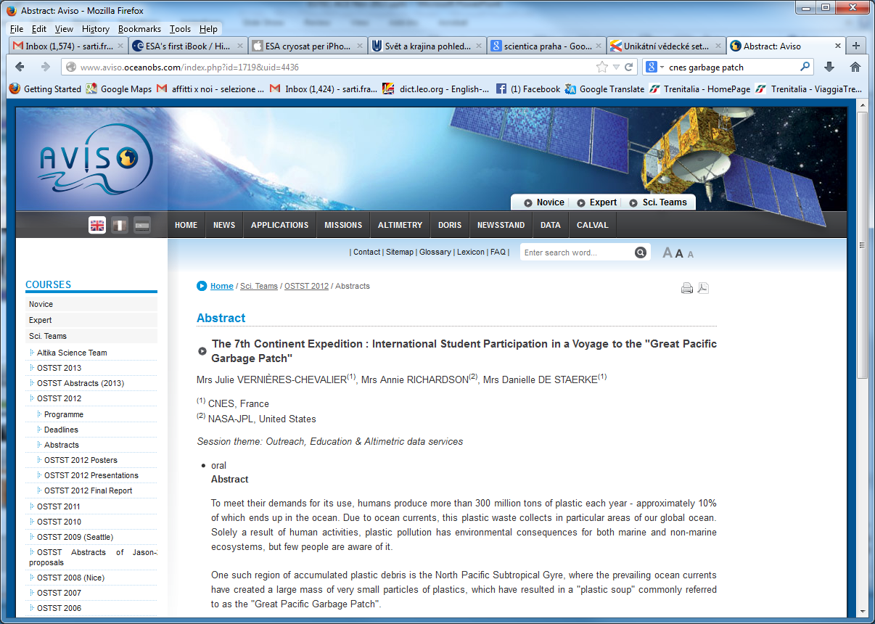
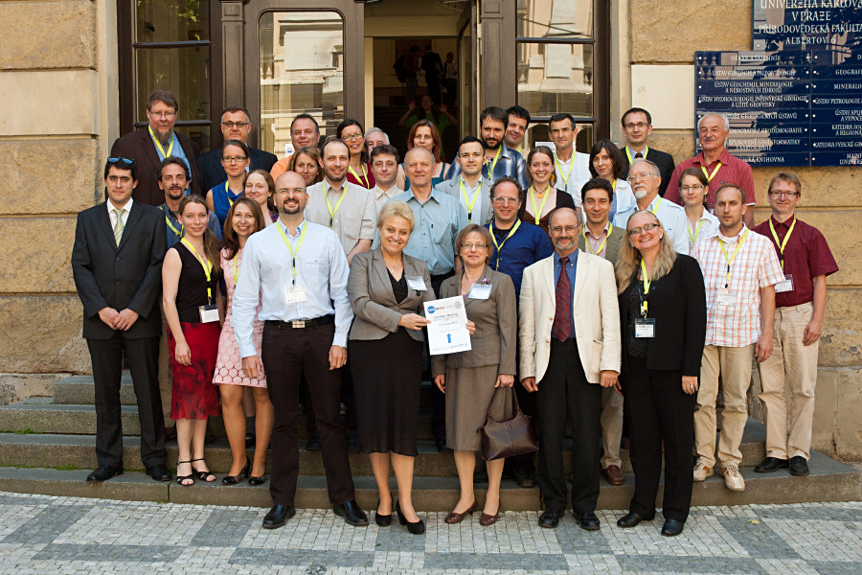
(i) Capacity Building in the frame of International Cooperation with other space agencies
Examples: Cooperation with NASA (Trans-Atlantic Training on LULC in Baltic Countries and Eastern Europe). Forthcoming TAT training event in Slovakia, July 2016.
See TAT http://web.natur.cuni.cz/gis/tat/
LCLUC workshop https://web.natur.cuni.cz/gis/lucc/

Slide 7
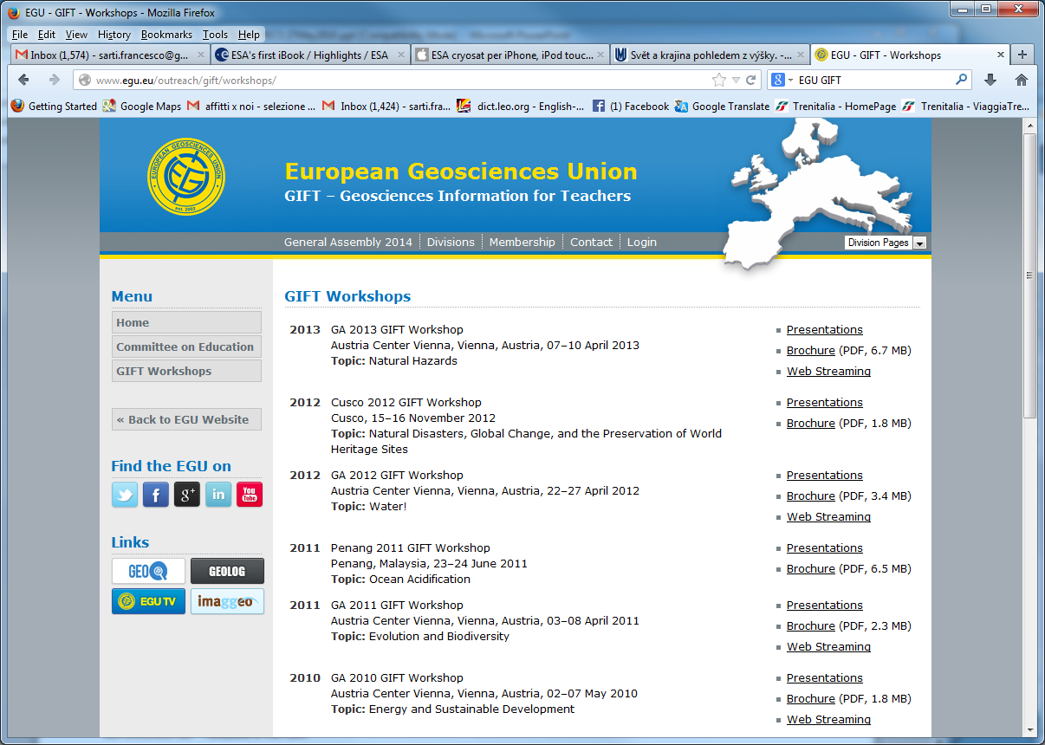
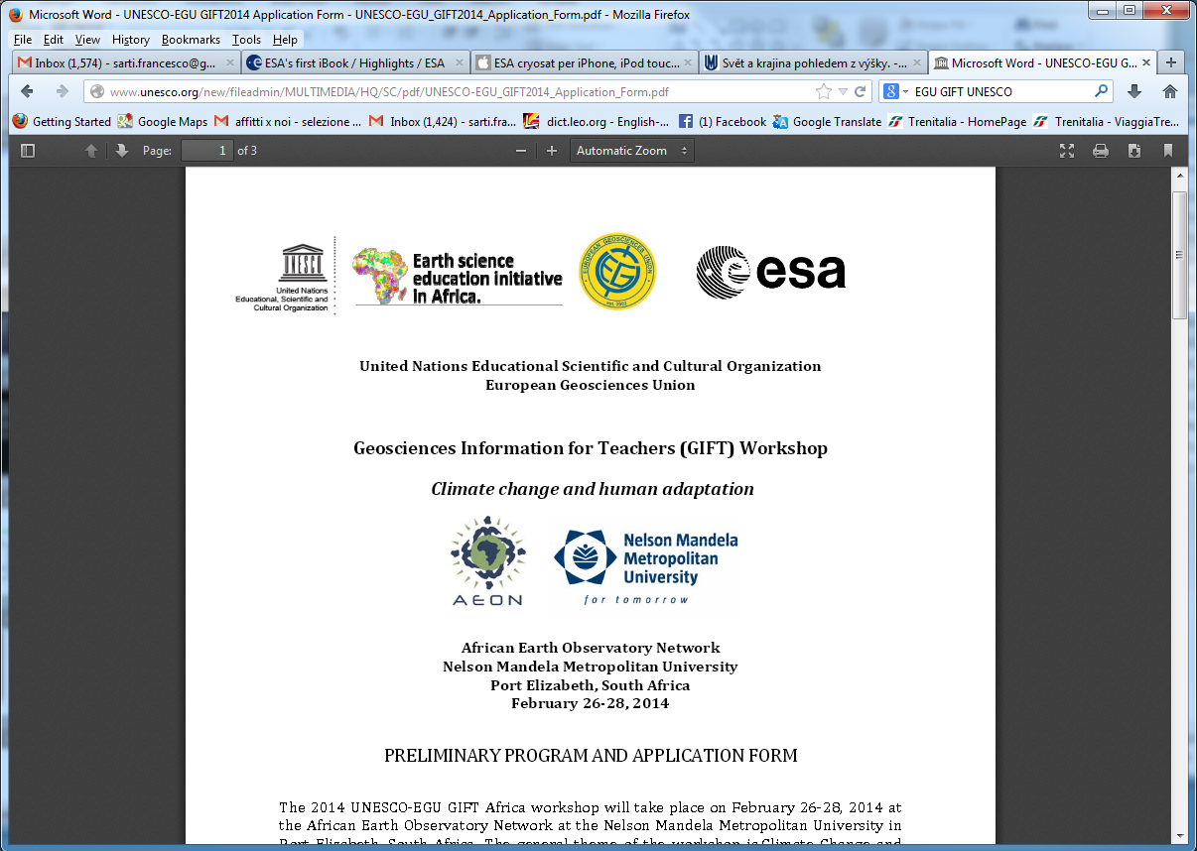
(i) Education in the frame of International Cooperation: EGU/GIFT network
6-years cooperation with EGU/GIFT (European Geosciences Union
GIFT – Geosciences Information for Teachers). Recently enlarged to Africa and South America (2016 events planned in Merida Mexico and Pretoria).
Workshops for Secondary School teachers selected worldwide

Slide 8
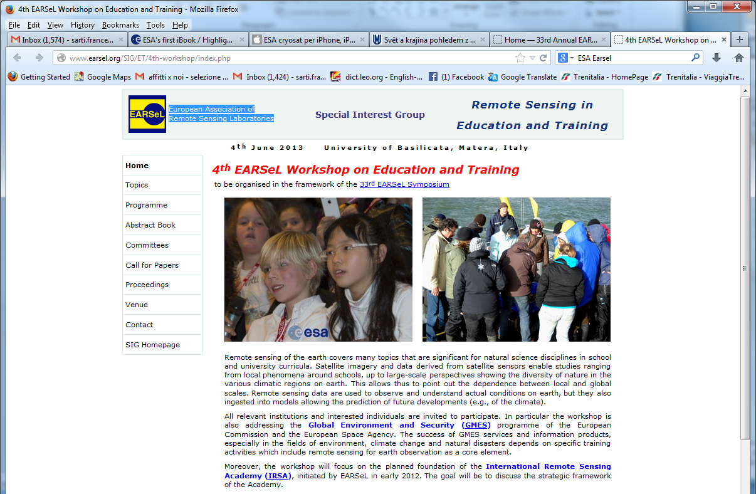
(i) Training & Education in the frame of International Cooperation: Earsel network
Long-term cooperation in organising joint Workshops for Secondary School teachers with Earsel (European Association of Remote Sensing Laboratories)
recent Earsel Workshop and Training in ESRIN on RS for Archaeology (Nov 2015)
Preparing Bonn (June 2016), Bejing (July 2016) and Krakow (Sept 2016) Earsel training events

Slide 9

(i) International cooperation with Africa
http://www.tiger.esa.int/training_main.asp

Slide 10
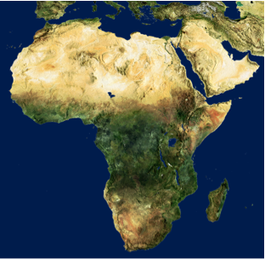
The TIGER Initiative:
Example - Hydrological Community
ESA launched TIGER in 2002 as a CEOS response to World Summit on Sustainable Development in Johannesburg.
TIGER objective:
“assist African countries to overcome problems faced in the collection, analysis and dissemination of water related geo-information by exploiting the advantages of Earth Observation technology”.
African Community:
TIGER involves more than 150 African Institutions in 42 countries who actively participate in TIGER development projects and capacity building actions;
Notes:
Investment of 11 Mio euro total budget
Reaching more than 150 African water authorities and research institutes

Slide 11
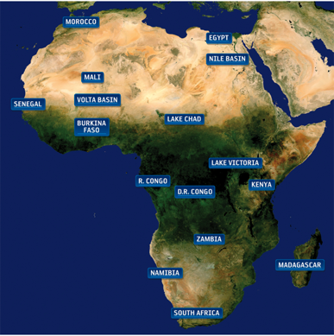
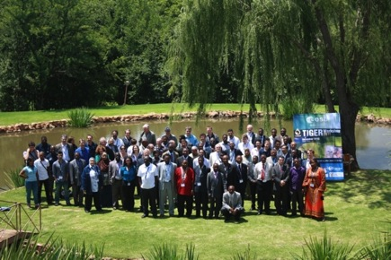
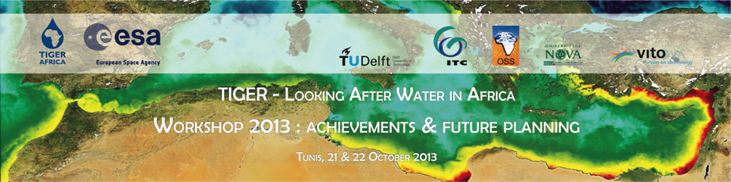
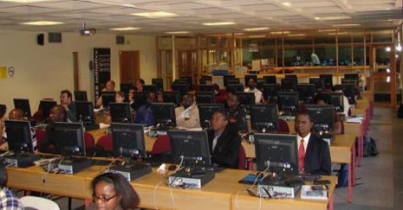
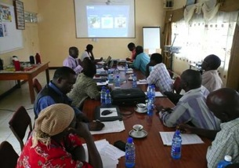
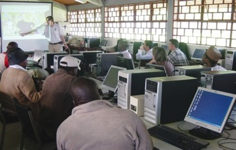
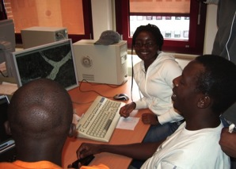
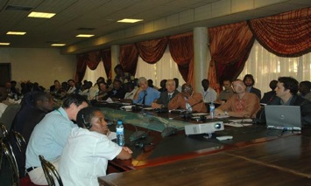
TIGER Capacity Building Facility (TCBF):
Developing African Knowledge and Scientific Capacity
Training Activities:
  Dedicated Training courses in Africa & Europe
  Empowerment of Regional Centres: AGHRYMET (Niger), RCMRD (Kenya), SANSA (South Africa); OSS (Tunisia)
  Partnership with UNDP Cap-Net for Training of Trainers
Water Research Component
  Support to many research projects in Africa
  Tailored technical support and research stages;
TIGER workshop 203, Tunisia

Slide 12
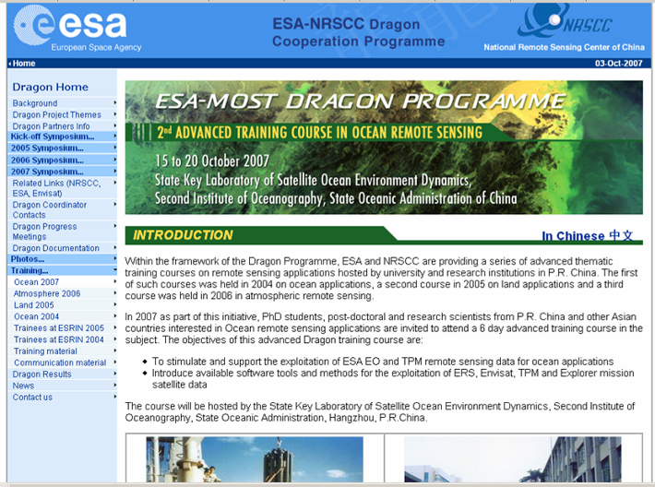
(i) International cooperation with China
DRAGON Training Courses

Slide 13


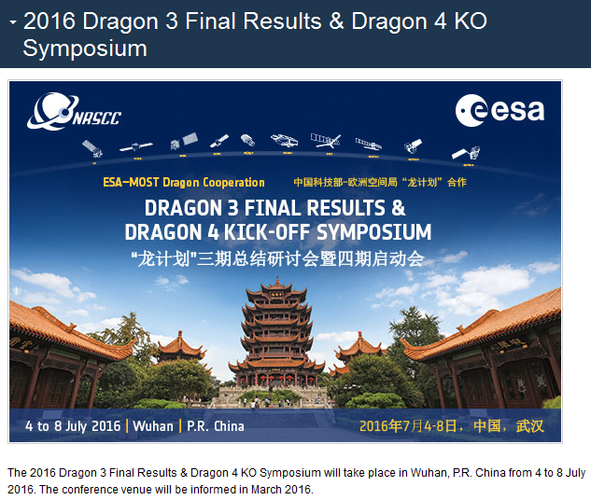
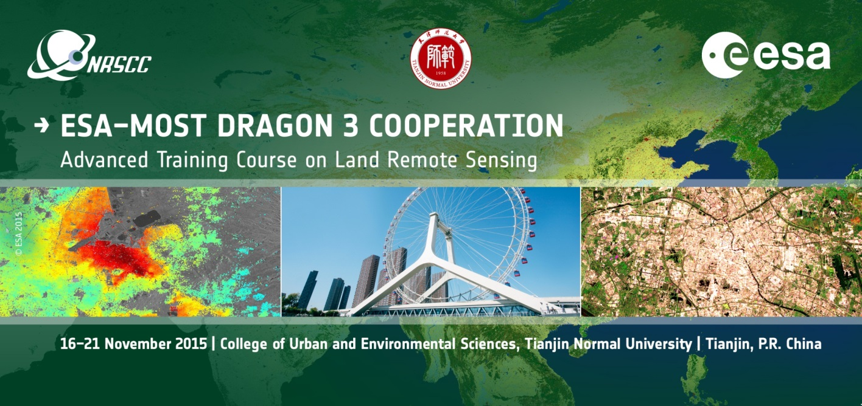
Recent DRAGON CB events

Slide 14
(ii) Training courses at University level in Europe
SAR Remote Sensing Training courses in PECS countries, 1-2 per year
Training courses about RS theory and applications (Land, Atmosphere, Ocean) in European countries (rotation mechanism), yearly basis
Summer Schools (RS Data Assimilation) in ESRIN for University and PhD level (every 2 years)

Slide 15
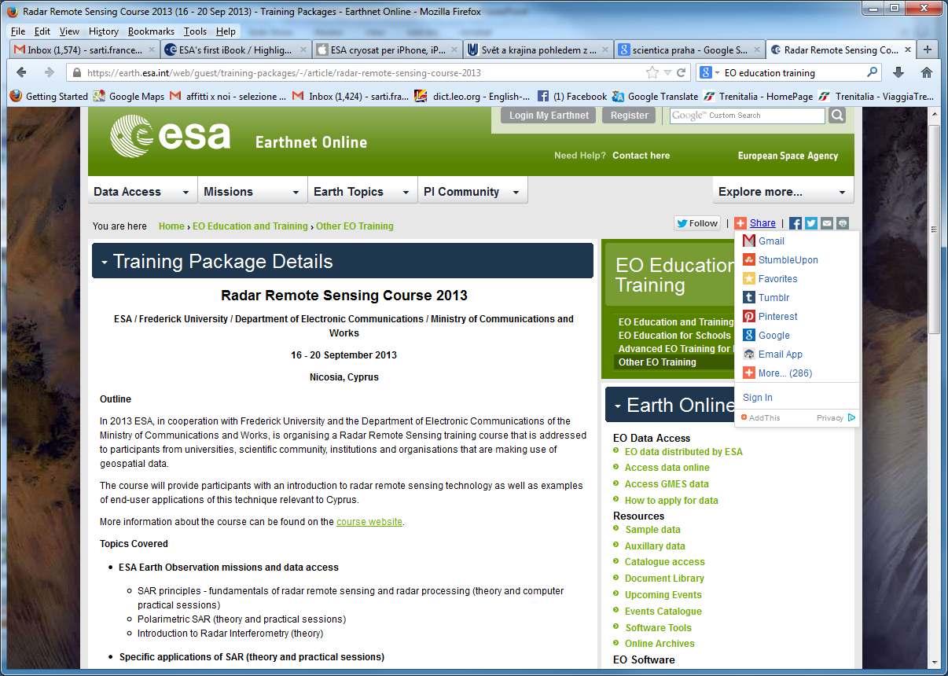
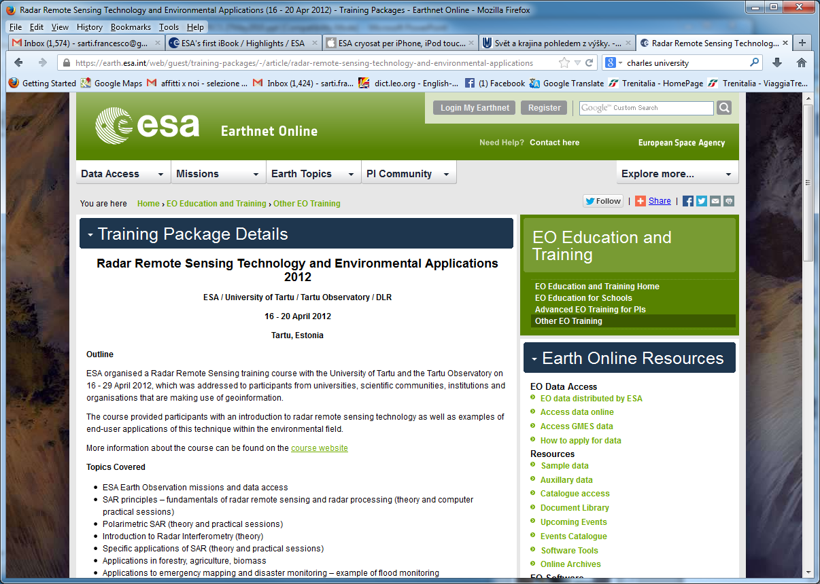
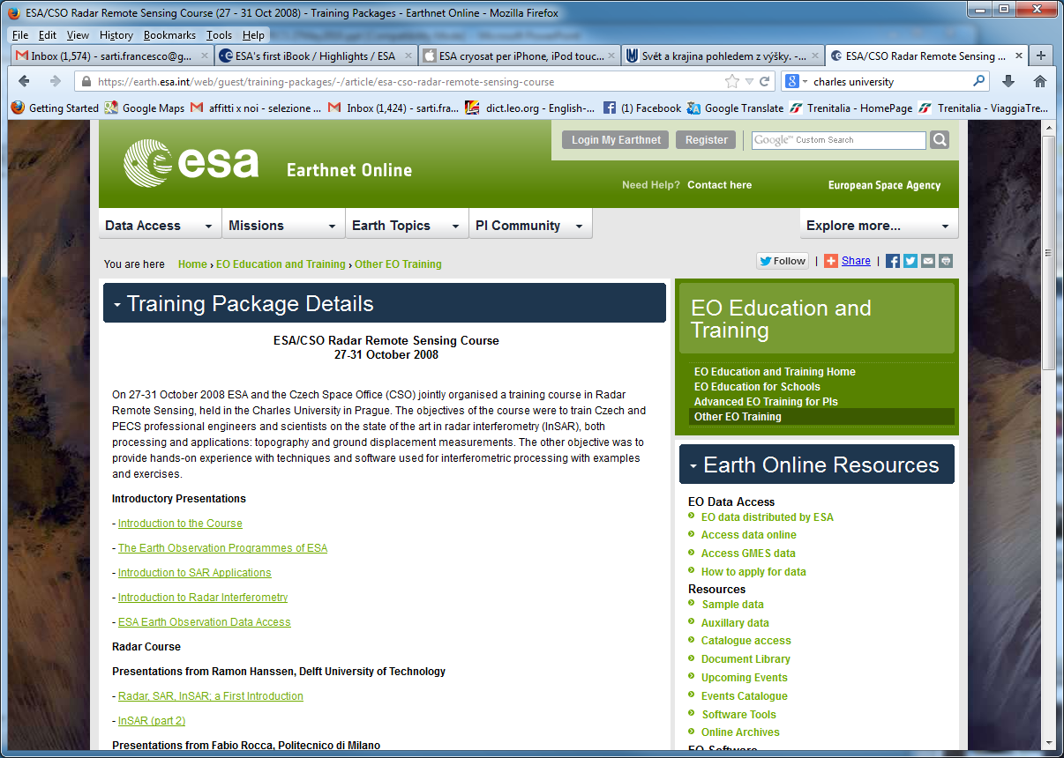
(ii) Radar training courses in PECS
Series of Radar Training Courses in PECS countries since 2008 (Univ. level)
Czech Republic (2008), Romania (2009), Poland (2010), Hungary (2011), Estonia (2012), Cyprus (2013), Malta (2014), Slovenia (2015), Bulgaria (May 2016) and Latvia (Sept 2016)

Slide 16

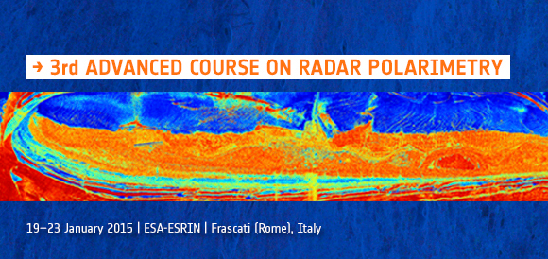
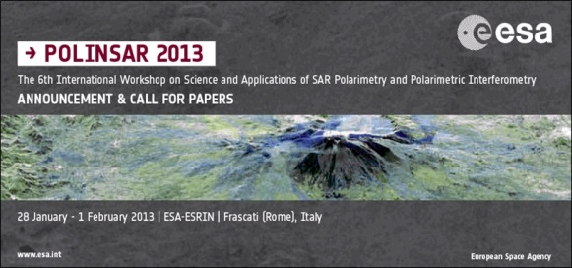
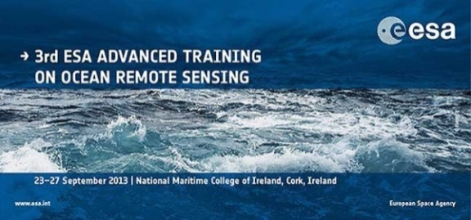
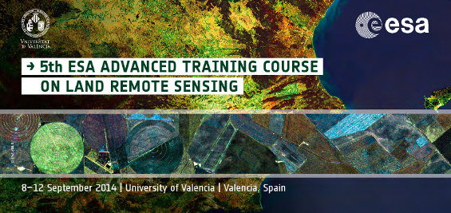
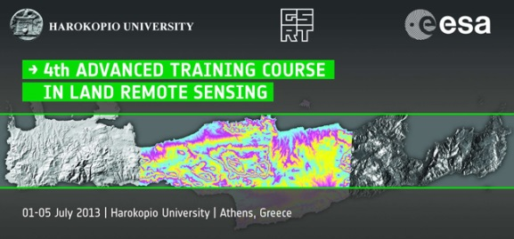
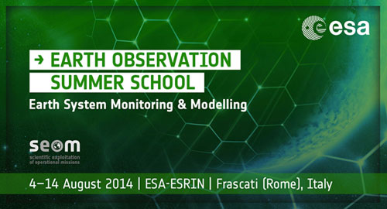
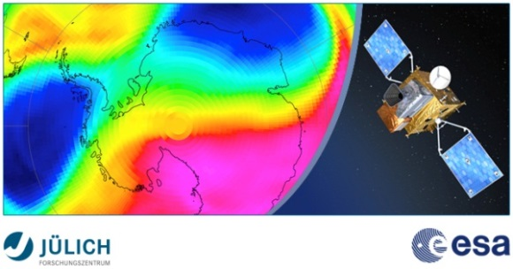
Innovative Training for
Next generation EO Scientists
Objectives
Training the next generation of European and Canadian Principal Investigators (PIs)
Teaching and demonstrating theoretical principles, processing algorithms, data products and their use in applications
Introducing tools and methods for the scientific exploitation of EO satellite data
Stimulating and supporting the scientific exploitation of ESA EO and Third Party operational missions

Slide 17
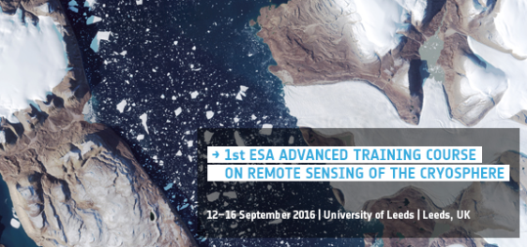
Innovative Training for
Next generation EO Scientists
1st ESA Cryosphere advanced training Land Remote Sensing 12-16 Sep 2016, Univ. of Leeds (UK) expected 100 applicants , 70 selected
http://seom.esa.int/cryotraining2016/

Slide 18
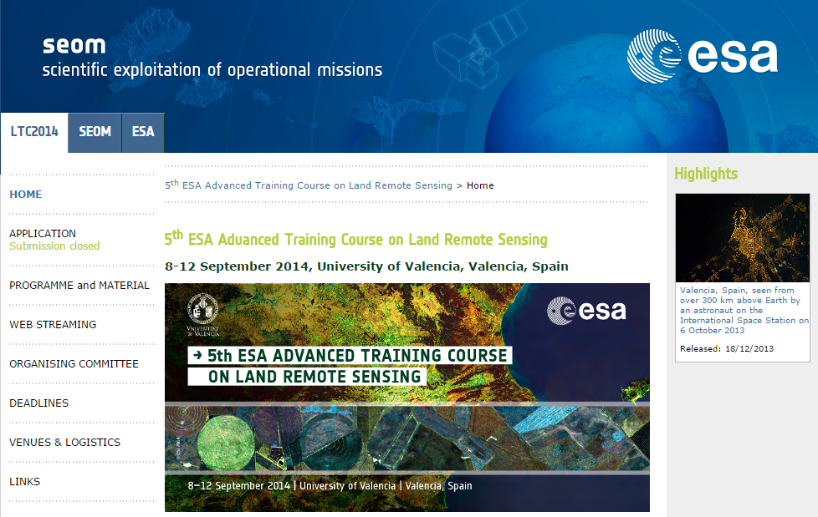
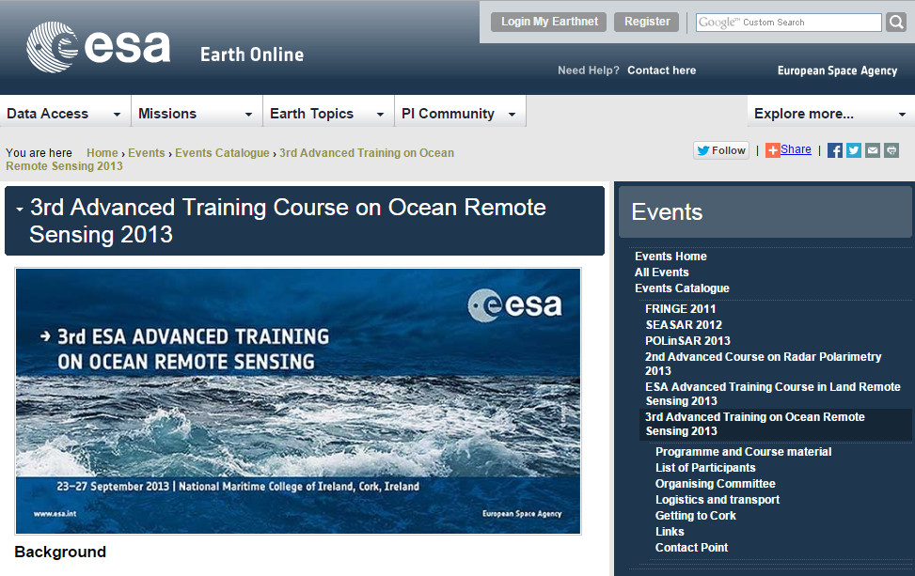
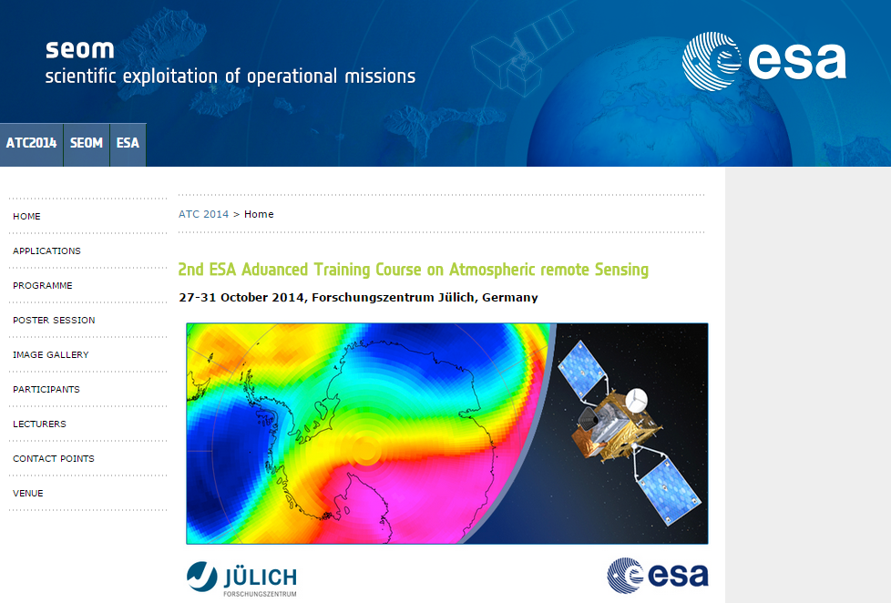
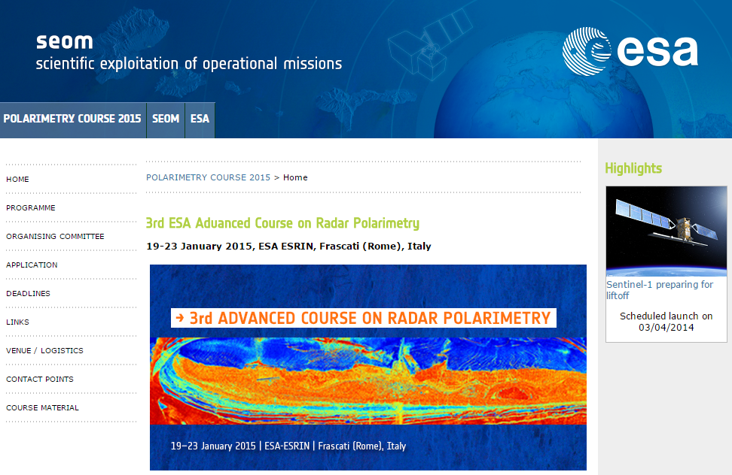
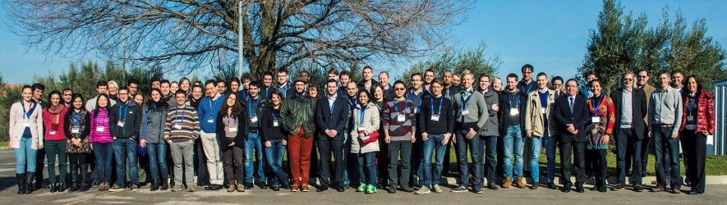
Previous Advanced Training Courses
Innovative Training for
Next generation EO Scientists
Land
Spain, Sep 2014
Ocean
Ireland, Sep 2013
Atmosphere
Germany, Oct 2014
Polarimetry
Italy, Jan 2015

Slide 19
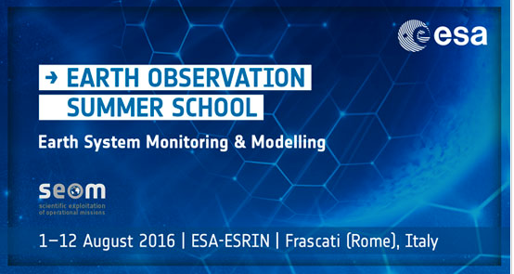
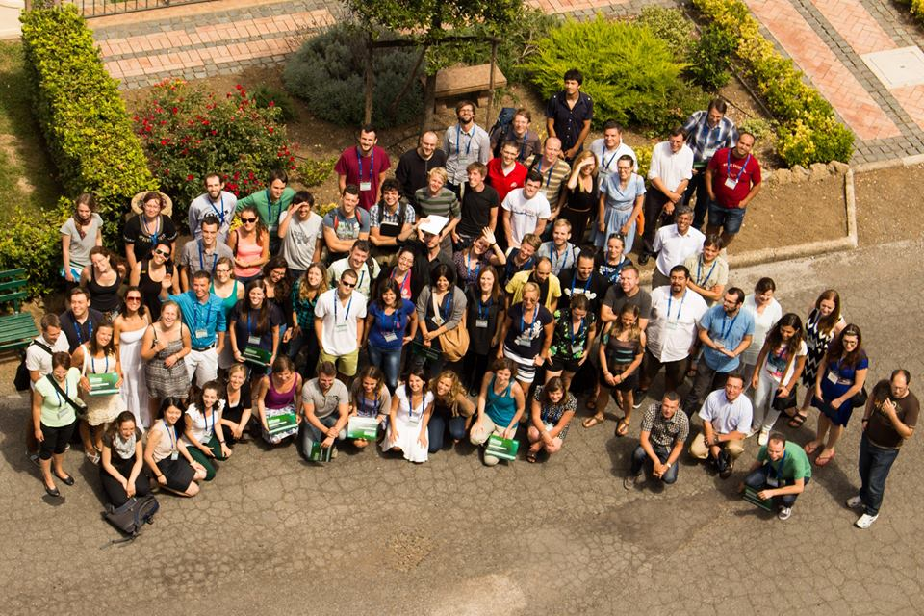
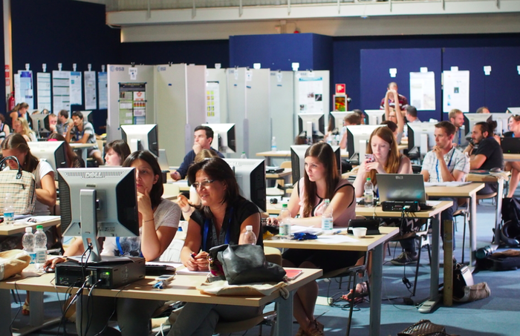
Earth Observation Summer School
https://earth.esa.int/web/eo-summer-school/home/
1-12 August 2016 Summer School ESRIN
70 early career scientists
will take part
Topics :
Global Observing Systems, Earth System Modelling, Data Assimilation, Global Change

Slide 20
(ii) video courses, University level, about EO and Climate Change
ESA recently started to create educational MOOCs for EO techniques &
Applications, starting with Climate Change and its impact

Slide 21
What is a MOOC?
Massive: no limitation on the number of participants. The record is 440,000!
Open: free and accessible for anyone with an Internet connection
Online: all activities are made online
Course: it has a specific topic, prepared by specialists, offering theoretical and practical content

Slide 22
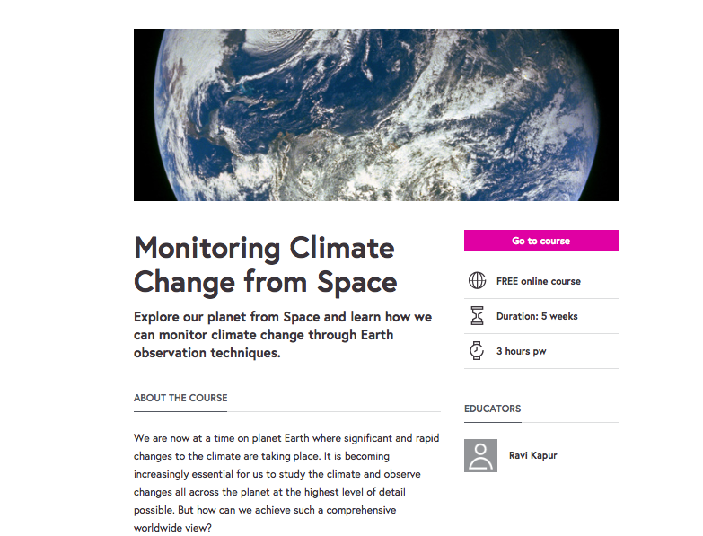
(ii) video courses, University level, about EO and Climate Change
ESA created with FutureLearn a MOOC explaining the use of EO applied to Climate Change and related issues, like Adaptation and
Environmental monitoring. Interactive, with Q&A. Two editions done, a 3rd will soon follow

Slide 23
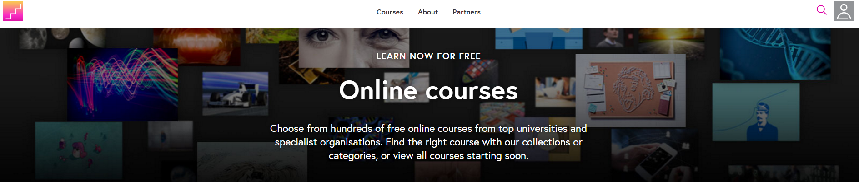
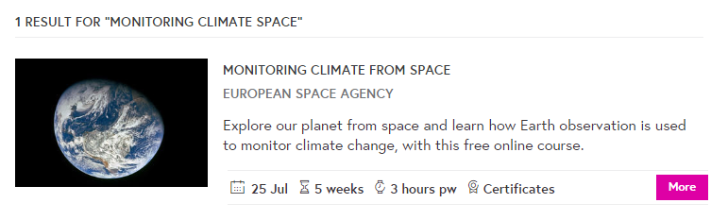
MOOC Climate from Space on Future Learn
presents the use of earth orbiting satellites to monitor the state of our climate and the impact of changes over time
→ educational, training and decision making purposes

Slide 24
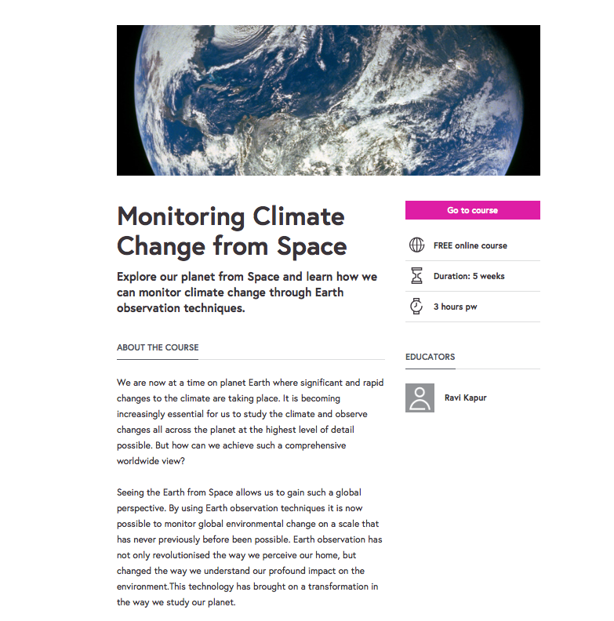
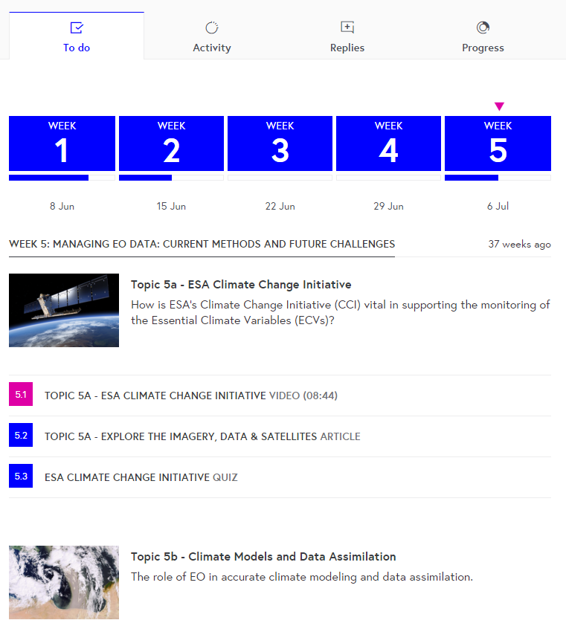

MOOC Climate from Space on Future Learn
https://www.futurelearn.com/courses/climate-from-space
10,000+ subscriptions, 50% active, completion rate of 30% (very high!)
MOOC 5-weeks course (June, 2015 / Dec, 2015) included videos, text, quiz, interactive exercises, satellite tracking app,

Slide 25
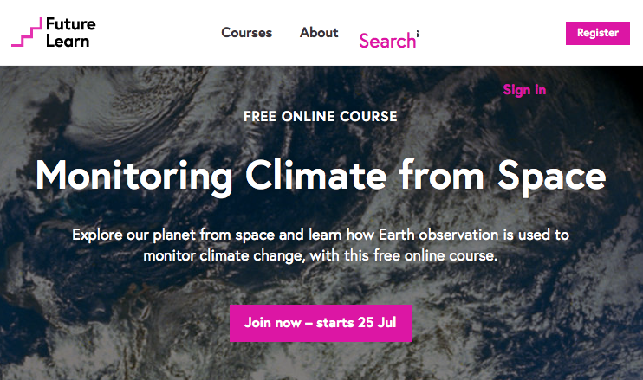
More MOOCs in preparation
3rd ESA MOOC on Climate from Space “Greenland special”
https://www.futurelearn.com/courses/climate-from-space
1st ESA MOOC “EO from Space: The Optical View” Launch on 12th September 2016
https://www.futurelearn.com/
1st ESA MOOC “EO from Space: The Radar View” Launch in 2017

Slide 26
Education for secondary schools
Creation of Tools for secondary schools:
Books and posters (also for general public)
Atlases, i-books (also for general public)
Apps for Tablets (also for general public)
Multilingual web-based tools (EDUSPACE),
educational SW package for Image Processing and GIS (LeoWorks),
School Lab
Collection and distribution within ESERO project (European countries / curricula)

Slide 27


(iii) Eduspace: ESA web-based EO Educational tool for secondary schools

Slide 28
(iii) LEOWorks 4.0
Image Processing Software
View images, histogram, pixel values, header info
Crop, invert, stretch, layer stack, etc
image arithmetic, filters
Classification, PCA, geometric correction, pan sharpening
Radar and optical module (multimission, including Sentinel data)
GIS tool
Open-source, Java-based

Slide 29


(iii) I-books, apps

Slide 30



(iii) Development of Apps for EO
Education and Outreach; Vegetation; Sentinels; ESA Ground Station)
Objectives:
Promote ESA EO data & missions
Educate & Stimulate the interest to EO
Illustrate role and relevance of EO
  Interactive, Intuitive, Continuously updated
  Supporting courses for students/teachers
  Possibility to integrate tutorials conceived by scientific institutes.
Living Earth

Slide 31





Sentinel App
For iPhone and iPad
Will be also on Google Play (Android phones, tablets) in April
See where the Sentinel satellites are in real-time
See the last and next time they have been and will be over your location; Move them to the time of the last data transmission and smoothly move them back to their current location over the 3D globe
Explore the Sentinel satellite 3D models
Get information and news about the Copernicus Programme
Get information about access to Sentinel data
Set Notifications to be warned when satellites are flying by.

Slide 32







Proba-V App
For Android phones, tablets
Will be also on App Store (iPhone, iPad) in April
Take a picture of a landscape
Associate the vegetation status derived from Proba-V NDVI products in your area to the picture
See graphics of the vegetation status evolution during the last 6 months (tap on picture icon or on map)
Build your picture gallery and see all your pictures on the map
Share the pictures on social media
Learn about Proba-V, get news and image of the week
UI available in several languages: English, Italian, Portuguese, Dutch, Spanish, German, etc.

Slide 33



Educational App for EO
For iOS tablets (iPad, iPad mini)
Can be used as presentation tool and as support to school or educational labs/classes
Not on online stores at the moment

Slide 34


NRT Image Viewing App
For Android Tablets
Planned to be on Google Play in the next few months
EO satellite images within 1 minute from acquisition on the palm of your hand!
Move easily between past acquisitions
Receive alerts when satellite is passing over you
Landsat-8 OLI data available. Sentinel-2, Proba-V coming soon

Slide 35




EO Missions (PDGS) App
For iOS tablets (iPad, iPad mini)
Used for ESRIN visits, not planned for online stores
Explore the Ground Stations, Processing Centres and Data Flows of Payload Data Ground Segments (PDGS)
Learn about the Lifecycle of an EO Mission, from User Needs Definition, to Planning, Acquisition, Archiving, Dissemination and Exploitation

Slide 36


(iii) Creation of posters for schools

Slide 37




(iii) ESA School Atlas, new ESA Water Atlas
Introduction to ESA; Earth Observation; Global Overview; Continental Overview; the Natural Sphere; The Cultural Sphere.
Annex: Teachers’ Handbook, DVD-ROMs with the original bands of the satellite data, handbook content and exercises, connected to Eduspace and its SW Leoworks

Slide 38

(iii) Creation of a school lab following the DLR model and promotion of experiments at school
Creation of joint School Labs with ESA, DLR, UKSA and UK national space academy, C Charles University.
  Demonstrating RS to schools using instruments (Field Spectrometer, Thermal camera, UV light, Stereo Optical Camera, possibly enriched by many other experiments) in connection with examples of satellite images and computer exercises

Slide 39
(iii) ESA ESERO project (European Space Education Resource Office )
Target: European students starting from an early age (primary and secondary education)
Goal: using the space context to make the teaching and learning of STEM subjects more attractive
ESERO offers an annual series of national or regional training sessions for both primary and secondary school teachers, offered in collaboration with national partners
Presently located in:
Belgium: Planetarium of the Royal Observatory of Belgium in Brussels
Czech Republic: Prague, with Charles University of Prague and others
UK: based at the National STEM Centre in York
Ireland: Dublin, with the Science Foundation Ireland
Netherlands: at the Nemo Science Learning Centre in Amsterdam,
Nordic ESERO: Denmark, Finland, Sweden and Norway (based at NAROM), Poland: in the Copernicus Science Centre in Warsaw,
Portugal: in the Knowledge Pavilion, Lisbon,
Romania: based in the Romanian Space Agency

Slide 40
Impact evaluation and improvement
Continuous improvement from online feedback collection after each course
Evaluation of impact for other educational tools (videos, apps, etc) is harder

Slide 41
USEFUL ADDRESSES
ESA education portal: www.esa.int/education
to order EO material: education@esa.int or eohelp@esa.int
Eduspace: www.esa.int/eduspace
ESA EO Education web page: http://eo-edu.eo.esa.int

Slide 42

(ii) Training courses - centralized web page
The content of most training courses can be linked from the central web page for ESA EO Education and Training:
https://earth.esa.int/web/guest/eo-education-and-training

Slide 43
CB for policy makers: Africa
Recent events in TIGER (that will be repeated in the future):
TIGER workshop hosted by UNECA in Addis Abeba in early 2016 included participants of the African Union commission and
several national and regional African organizations
http://www.tiger.esa.int/tiger_news_page67.php
The event was followed with a training on sentinel data exploitation for
water management dedicated for stakeholders (ministries and governmental agencies) from different African countries.
The GLobWetland Africa project builds capacity within UN Ramsar secretariat and in national focal points in several African countries
through regional training events.
In the frame of agriculture the Sen2-Agri project builds capacity in 3
countries (Mali, South Africa and Ukraine) for national scale agricultural
monitoring based on S2 and L8. The CB includes the installation of a full
processing system, hardware and training.

Slide 44
CB for policy makers within ESA projects with developing countries
In the frame of agriculture the Sen2-Agri project builds capacity in 3
countries (Mali, South Africa and Ukraine) for national scale agricultural
monitoring based on S2 and L8. The CB includes the installation of a full
processing system, hardware and training.
More CB activities will take place as part of the new ESA initiative with the development banks (WB, ADB...): 3 new contracts of 2.5M€ each just started on water, agriculture and urban. Each contract foresees
multiple trainings in developing countries around the world with national
stakeholders.

Slide 45
CB for policy makers with UN
In the past, ESA has organised with UNOOSA (S. Camacho, V. Kotelnikov, S. Chernikov) and UNESCO (M. Hernandez) 1-2 workshops for policy and decision-makers worldwide.
The most recent was done in 2005 in Campeche for World Heritage sites managers worldwide

Slide 46
CB for policy makers in DUE and GMES
In the past, outreach activities to institutional user organizations, including policy implementers and policy makers, were done in the framework of the ESA Data User Element (DUE, and its predecessor Data User Programme), and of the GMES Service Element (GSE) which specifically focused on policy-related needs. This includes User Consultation meetings preparing for new projects (see f.e. http://due.esrin.esa.int/page_meetings.php) and direct involvement in projects (see DUE examples: http://due.esrin.esa.int/page_userpartnership.php).

Slide 47
CB for policy makers in Food Security
Another example of outreach is the planned Food Security and Sustainable Agriculture workshop in ESRIN 11-12 April.
This should be followed in the future by more specific actions in CB on EO for Food Security, possibly in the frame of our WG CapD

Slide 48
Copernicus CB for policy makers
All activities are done in close cooperation with the European Commission, that also carries out CB initiatives via its entrusted entities (e.g. Copernicus Services) or directly (notably Copernicus-wide initiatives).
Regular publication of brochures about possible Sentinels applications, targeting public and policy makers (http://www.esa.int/Our_Activities/Observing_the_Earth/Copernicus/Focus_on_Copernicus_applications)
Regular competitions for the development of innovative solutions based on Copernicus-like data (http://www.copernicus-masters.com)
Regular competitions for the development of innovative Apps based on Copernicus-like data (http://www.app-camp.eu )

Slide 49
Copernicus CB for policy makers
Interaction with regional administrations in Europe, EU institutions & the Committee of the Regions to explore benefits/use of Sentinel data for them. Dedicated event planned at the European Parliament on June 28 (http://www.nereus-regions.eu/Sentinels4Regions)
Showcasing case studies of economic benefits of Sentinel-like data (http://earsc.org/news/earsc-new-brochure-is-out-from-satellites-to-supermarkets-in-the-baltic)
The use of Sentinels data within European regions has been explored in the past via a dedicated publication (http://esamultimedia.esa.int/multimedia/publications/NEREUS/) - planned to be further expanded

Slide 50
The 5th Meeting of the CEOS Working Group on
Capacity Building & Data Democracy (WGCapD-5)
The CEOS Systems Engineering Office (SEO), Hampton, VA, USA
March 30th – April 1st, 2016
Thank you

