Slide 1
Capacity Building Activities in Earth Observation at ISRO
Committee on Earth Observation Satellites
Dr. A. Senthil Kumar
IIRS/ ISRO
Dehradun, INDIA
WGCapD-5
Hampton, Virginia, USA March 29th – April 1st, 2016

Slide 2
Who are your implementing partners?
ISRO Institutions for Capacity Building
Indian Institute of Remote Sensing (IIRS)
National Remote Sensing Centre (NRSC)
Space Application Centre (SAC)
Indian Institute of Space Science& Technology (IIST)
IIRS
SAC
NRSC & RCs
State RS Centre
RCs
Other DOS/ISRO Centres
IIST

Slide 3
What best practices do you follow?
ISRO approach for Capacity Building
Training & Education
Mission
Transfer technology through capacity building & research in the field of Remote Sensing & Geoinformatics for sustainable development.
Masters,
PG Diploma,
Certificate &
Tailor-made
Courses
Capacity Building
&
Professional
Excellence
EDUSAT-DLP,
Support to
External Students
& Researchers, etc.
Research Projects
Research
Outreach

Slide 4
What best practices do you follow? … (2)
Hands-on Training Programs @ IIRS
Postgraduate Diploma (10 months)
Certificate Courses (8 weeks)
NNRMS-ISRO sponsored Certificate Courses (8 weeks for Univ.faculty)
Awareness Program for Decision Makers (1 week)
Special On-Demand / Tailor-made Courses (1-8 weeks)
Remote Sensing & GIS in NRM (7 specializations: Sustainable Agriculture, Forest Resources & Ecosystem Analysis, Geosciences, Marine and Atmospheric Sciences, Human Settlement Analysis , Water Resources, Photogrammetry and Remote Sensing)
Geo-information Science & Earth Observation (Geoinformatics, with ITC)
Remote Sensing & Image Analysis (for Indian User Participants)
Remote Sensing – with emphasis on DIP (ITEC Program, MEA, GoI)
Geoinformatics (ITEC Program, MEA, GoI)
Remote Sensing & GIS (8 disciplines: Water Resources, Forestry & Ecology, Urban & Regional Planning, Geosciences, Agriculture and Soils, Meteorology & Atmospheric Sciences, Cartography and Mapping and GIS Technology and Advances)

Slide 5
What best practices do you follow? … (3)
Education Programs @ IIRS
Master of Technology (M.Tech.) in RS & GIS
Master of Science (M.Sc.) in Geo-information Science
& Earth Observation (Specialization – Geoinformatics)
24 Months, since 2002
Affiliated to Andhra University, Visakhapatnam
Specializations in 8 thematic disciplines (Sustainable Agriculture, Forest Resources & Ecosystem Analysis, Geosciences, Marine and Atmospheric Sciences, Human Settlement Analysis , Water Resources, Photogrammetry and Remote Sensing, and Geoinformatics)
Includes 12 month’ research
18 Months, since 2002
Offered as Joint Educational Program with ITC (Twente University)
Includes 4.5 months course work at ITC and 6 months research

Slide 6
What evidence do you measure to show that capacity is built?
Major Highlights of IIRS
C
A
P
A
C
I
T
Y
Training
&
Education
“Promote capacity building through Quality Training an Education in the field of Remote Sensing and Geoinformatics to comply with Requirements and Continuously Improve the Effectiveness of Quality Management System” – QUALITY POLICY An ISO 9001-2008 Institute
Measures (till March 2016)
Research
B U I L D I N G
Outreach
Professionals trained in IIRS: 10236
Foreign professionals trained in IIRS: 965 from 95 Countries
Professionals trained in CSSTEAP-1547 from 34 countries in Asia-Pacific Region and 29 from 18 (outside AP)
M. Tech. students: 233 and M.Sc. Students:176 (since 2002)
Tailor Made Courses: 3499 and Certificate 2865
Distance Learning (EDUSAT based Program): >30,000 from 370 Institutes/ Colleges/Govt / Individuals.

Slide 7
Whom are you targeting?
Education Programs @ IIRS
Capacity Building for Ministries & Departments (April 2015 to Feb 2016)
User Department | Professionals Trained
Indian Air Force | 13
University of Reading | 81
G.B. Pant Univ. of Agri. & Tech., Pantnagar | 11
NECRT (K-12 School Teachers) | 40 (490)
University of Jammu | 10
Forest Dept. of West Bengal | 24
Ministry of Environ., Forest & Climate Change | 20
Indian Meteorological Dept. | 24
Ministry of Statistics and Programme Implementation | 66
IIRS | 23
Rem Sens Appl Center for Uttar Proadesh, Lucknow | 12
Forest Dept. of Bangaldesh | 6
Town Country Planning | 34

Slide 8
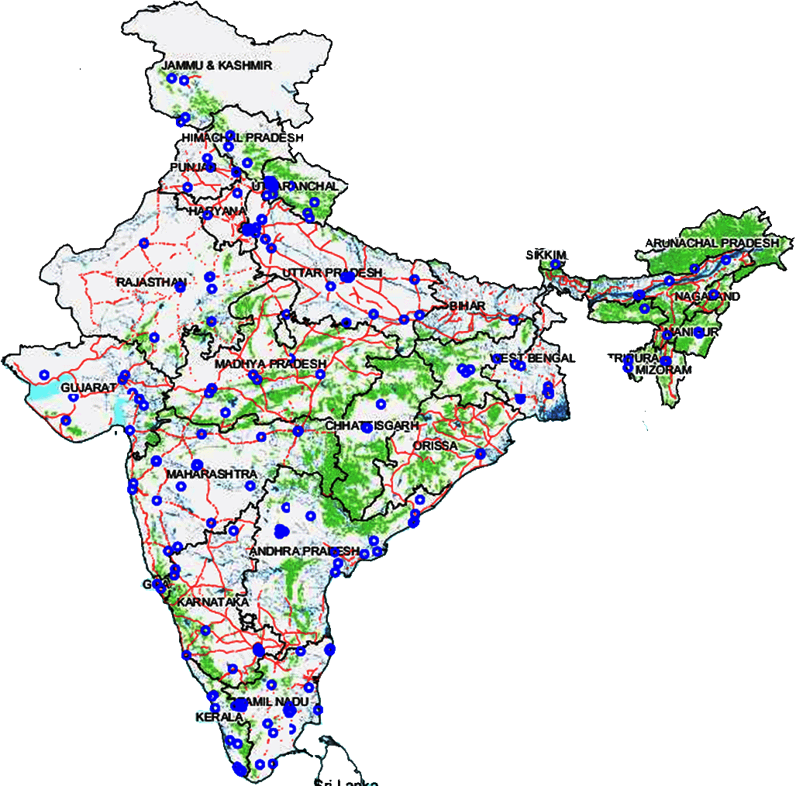
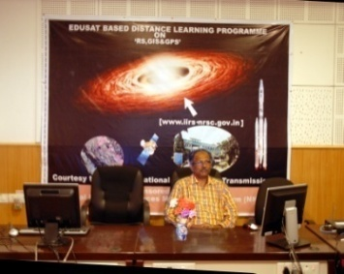
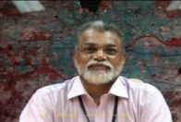
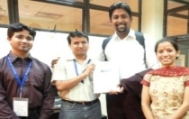
Whom are you targeting?
Outreach Programs @ IIRS
(Satellite based interactive & internet based e_learning Initiatives)
Initiated in 2007 to complement educational programs of Indian universities
About 30000 students from 370 Indian Universities/Institutions benefited so far
Who Can Participate?
UG & PG students/ Researchers/ Faculty
Individuals having good internet facility
Users under CEC-UGC / CIET networks
Institutions on high-speed National Knowledge Network (NKN)
University Network with IIRS/ISRO
Courses Offered
Basic Course on RS, GIS & GPS (12 Weeks)
Advanced Courses (4 Weeks)
IIRS e_learning Initiative
certificate course of 4 months
Rich e-learning content is being developed with high quality animations / flash interactions and easy understanding modules
Focus on e-learning theme is Principles of Remote Sensing, GIS and GPS

Slide 9
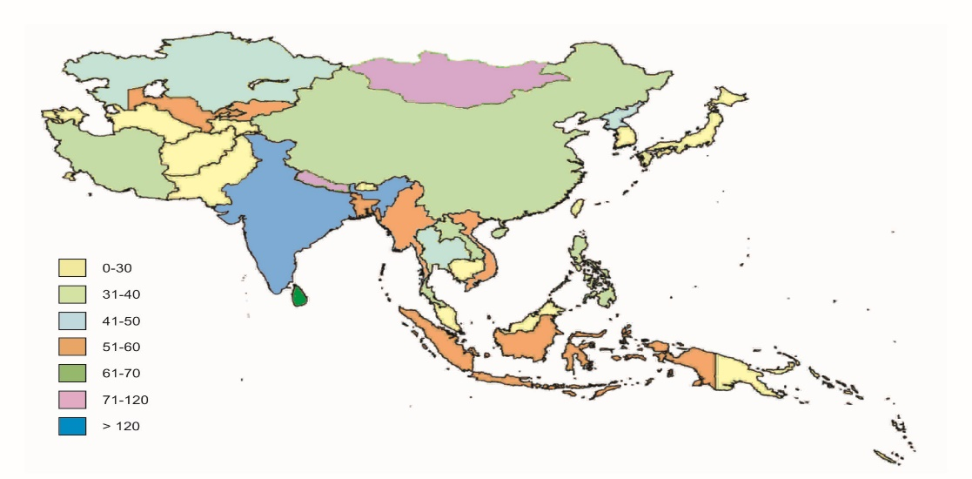
What best practices do you follow? …
CB for International Participants
CSSTE-AP (UN affiliated) HQ: IIRS
Host HQ of CSSTE-AP & Support to Director, CSSTE-AP
PG-Diploma in RS/GIS (9 months) – 20 courses since 1996
Short Course RS GIS in a thematic area
ITEC – Ministry of External Affairs
Short Course in RS & Digital Image Processing (8 week)
Short Course in Geoinformatics
Foreign Students In Regular Trainings
Variable
Around 1500 participants
from 35 countries

Slide 10
What evidence do you measure to show that capacity is built?
CSSTEAP Courses in 2015
19th PG course in ‘RS & GIS’ at IIRS Dehradun (July 1, 2014 – March 31, 2015).
9th PG course in ‘Satellite Meteorology and Global Climate’ at SAC Ahmedabad (August 1, 2014 - April 30, 2015).
9th PG course in ‘Space and Atmospheric Sciences’ at PRL Ahmedabad (August 1, 2014 - April 30, 2015).
Short Course on ‘Earth Observation for Disaster Response and Recovery Preparedness’ for Bhutan officials at IIRS, Dehradun (April 13–17, 2015) in Collaboration with UNDP, Bhutan & UN-SPIDER, Beijing
Short Course on ‘Geospatial Technologies for Coastal & Marine Disaster Management & Climate Change’ at IIRS, Dehradun (May 4–31, 2015)
International Training Course on ‘Small Satellite Missions’ at IIRS, Dehradun (November 16-27, 2015)
Completed
20th PG course on ‘RS & GIS’ at IIRS, Dehradun (July 1, 2015 - Mar.31, 2016)
10th PG course on ‘Satellite Communications’ at SAC, Ahmedabad (August 1, 2015 – April 30, 2016)
1st PG course on ‘Global Navigation Satellite Systems’ at SAC, Ahmedabad during August 1, 2015 – April 30, 2016
In progress

Slide 11
What best practices do you follow?
Capacity Building @ NRSC
NRSC & Regional Centers (West, East, Central and South) have contributed to Capacity Building for Officials from various User Departments and In-House Capacity Building for ISRO Scientists in effective use of Space Inputs by organizing Training Programs / Courses, Outreach and Promotional Activities. Officials from Government, Private / NGO, Academia including Research Scholars trained in various courses.
NRSC Capacity Building
Training / Courses
Outreach Activities
Types of Training Programmes organized at T&ED
Regular Courses
Special Courses
Customized courses based on user’s request
In-House Programmes for ISRO/DOS and NRSC Scientists
RS Applications Area and Regional Centers conducted
Outreach & Promotional Activities on Space Inputs for Governance & Development
Regional Centers conducted training programmes for users
Training Division
Regional Centres
Application Groups/ RSAA
Officials Trained from Various Courses at Training Division in 2015-16 ( no. of courses)
Year | Regular Course Participants | Special course Participants | Custom Course participants | In-house Participants | Officials Trained | No. of courses
2015-16 | 52 (2) | 303 (13) | 112 (5) | 38 (2) | 505 | 22

Slide 12
What best practices do you follow?
Capacity Building @ NRSC
In 2015-16, NRSC organized 22 training programmes, imparting training to 505 officials from User Departments through various courses including 150 persons through 6 Bhuvan overview trainings.
Brief details on training courses organized in 2015-16 as follows.
Regular courses: In the area of “Geospatial Technologies and Applications” and “Microwave Remote Sensing Applications” were organized to facilitate effective utilization of Remote Sensing data in various Geo-spatial Applications besides promoting RISAT utilization.
Special Courses: To provide exposure in State-of-the-art technology in emerging fields, 1 to 2 weeks Special courses on Emerging Trends in Remote Sensing, Hyperspectral Remote Sensing, Remote Sensing Ground Segment Systems, Advances in GIS, Open source GIS and Bhuvan Overview Training organized for the benefit of user community.
User Customized courses: Based on request from user departments, courses were organized in the area of specialization towards adoption and use of Remote Sensing technology in their organizations. Courses under ISRO-DMSP and two course for CWC officials, NDEM and Training for NCERT PG Teachers under ISRO/NCERT Initiative were organized.

Slide 13
What evidence do you measure to show that capacity is built?
Capacity Building @ NRSC
2,577 officials were trained in Bhuvan-NUIS on GIS Based Master Plan Preparation for Central and State level Urban administrators/Town Planners at Urban Local bodies (ULB). National/Regional/State level workshops were conducted by Urban Studies Group (NRSC), RRSC-South and Partner Institutions
500 people were trained under IWMP for DOLR MoRD on IWMP Bhuvan (Srishti) and Smart Phone App (Drishti) Training cum orientation Programme as well as 900 people were trained on Identification and mapping of small water bodies in Tribal Inhabited Area by Land Resources Group (NRSC)
700 people were trained through Bhuvan Outreach activities through Workshops, popularizing and Training programs by Bhuvan Team, NRSC
123 Officials were trained under Coordinated programme on Horticulture Assessment and Management using Geoinformatics (CHAMAN) by Agricultural Sciences Group (NRSC), RRSC-East/Central and South
44 Officials were trained on Feasibility Evaluation of Water Supply Pipeline Grid using Geospatial Techniques by Geosciences Group, NRSC
125 PG Geography Teachers from NCERT were trained under ISRO and NCERT initiative by RC-West, East, Central, South and Training Division (NRSC)
188 Officials from Archeological Survey of India were trained on “Inventory and Site Management plans of Monuments and Heritage” by RRSC-South, West and East

Slide 14
What best practices do you follow?
Capacity Building @ NRSC
Promotional Activities by NRSC including Regional Centers:
Organized User Interaction workshops
Organized National and International Workshops with Collaborating Organizations / Societies
Delivered Invited & Contributed Talks in various National workshops
Showcasing the potential of Geospatial Applications by means of Posters
Kept Exclusive Exhibition Stalls in various workshops providing awareness and outreach of Technology, visited by about 1 Lakh people.
Support to Institutions in Educational Activities by NRSC including Regional Centers:
As a part of Educational support, about 100 M.Tech / B.Tech students at NRSC, Hyderabad and 80 B.Tech Students at Regional Centres have carried out their course project work in the areas of
Geospatial Applications
Hardware development and
Software Development

Slide 15
What best practices do you follow?
Capacity Building @ NRSC
Courses Planned in 2016-17
Sl. No | Course Type | Course Name | Duration
1 | Regular | Microwave Remote Sensing and Applications | 2 weeks
2 | Special | Remote Sensing Ground Segment Systems | 6 days
3 | Special | Advances in GIS | 2 weeks
4 | Special | Hyperspectral Remote Sensing | 1 week
5 | Special | Digital Photogrammetry | 1 week
6 | Regular | Geospatial Technologies & Applications | 12 weeks
7 | Special | Bhuvan Overview Training with Hands-on Practical | 2 days
 | Customized Courses | Organized in Specific Areas Based on Request from User Organizations
Sl. No | In House Training | Planned in
1 | ISRO-STP on “Space Inputs for Disaster Management” for ISRO Scientists | June, 2016
2 | ISRO-STP on “Space Inputs for Governance” for ISRO Scientists | October, 2016
3 | “Technical Activities of NRSC” for NRSC Scientists – in Alternate Year | July:Aug, 2016

Slide 16
What best practices do you follow?
Capacity Building @ IIST
Undergraduate level programmes
1. B.Tech in Aerospace Engineering
2. B.Tech in Avionics
3. B.Tech in Engineering Physics (started from the year 2014).
4. Five Year Dual Degree Programme (B.Tech-M.S/M.Tech).

Slide 17
What best practices do you follow?
Capacity Building @ IIST
Academics and internship programmes abroad (for B.Tech Students)
California Institute of Technology (CALTECH), U.S.A.
Universities Space Research Association (USRA), U.S.A.
Jet Propulsion Laboratory (JPL), U.S.A.
Lockheed Martin Undergraduate Student Visitation Program
Mitacs Globalink Foundation, Canada

Slide 18
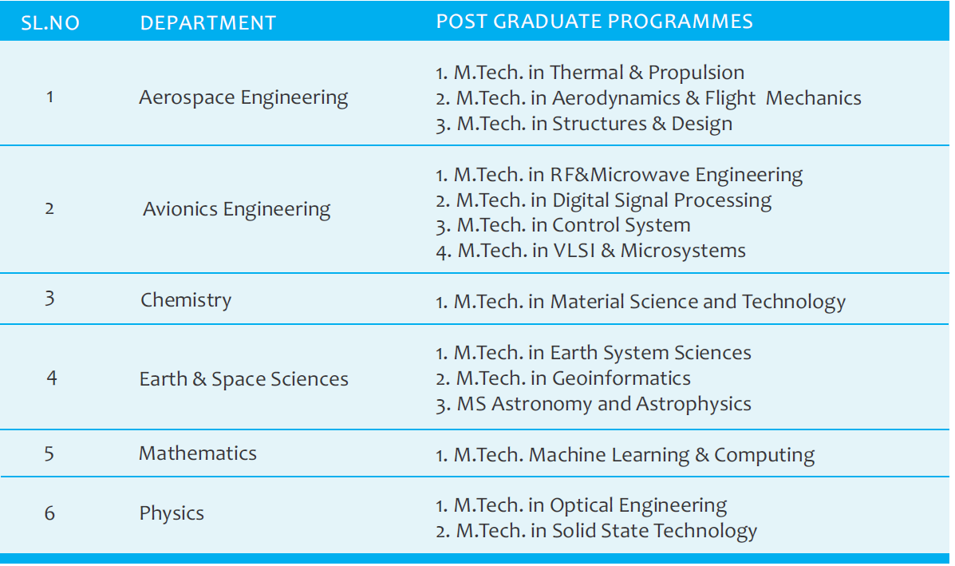
What best practices do you follow?
Capacity Building @ IIST
PG/Doctoral programmes

Slide 19
What evidence do you measure to show that capacity is built?
Capacity Building @ IIST
B.Tech student strength across the disciplines

Slide 20
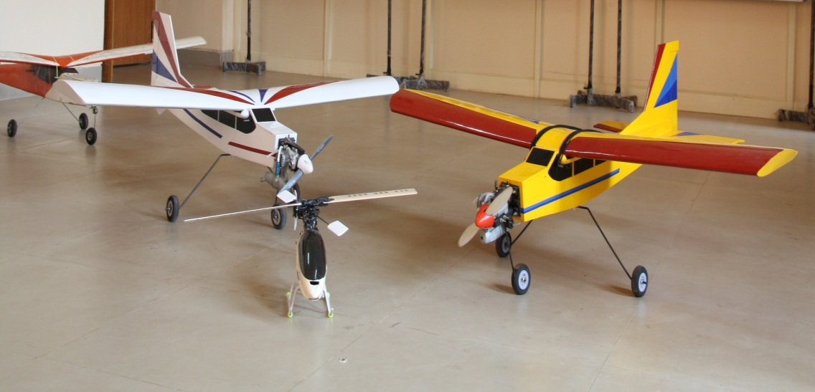
Centers of Excellence in IIST
What best practices do you follow?
Capacity Building @ IIST
Name | Objective | Department
Advanced Propulsion and Laser Diagnostics Lab | Performing propulsion research studies through laser diagnostic techniques. | Aerospace Engineering
Virtual Reality Lab | Carrying out various experiments in virtual reality, computer vision and image processing | Avionics
Center for Advanced Research in Nanoscience and Technology | Conducting advanced research in Nanoscience and technology and allied fields | Chemistry

Slide 21
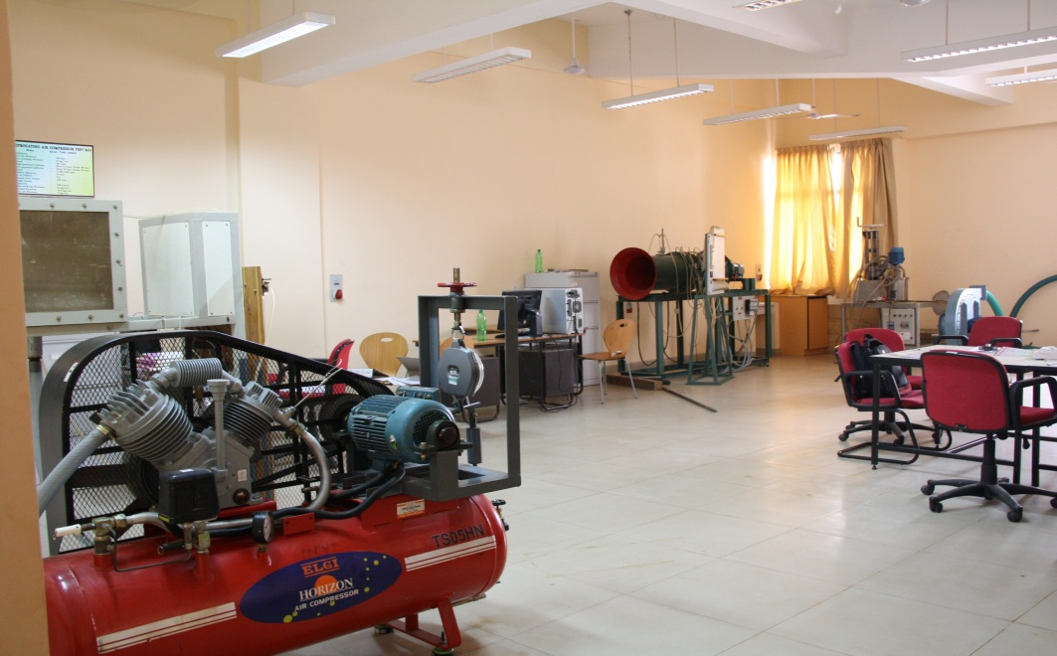
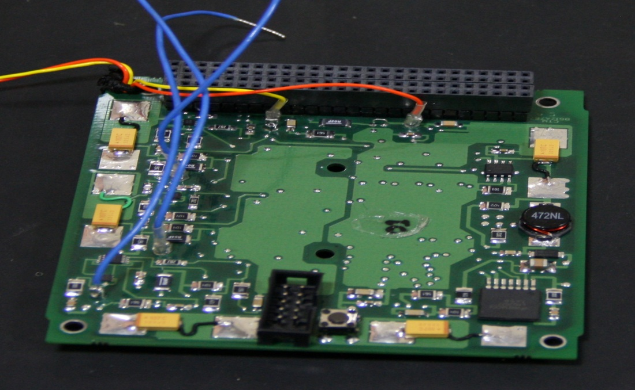
What best practices do you follow?
Capacity Building @ IIST
Advanced Space Technology Development Cell (ASTDC)
Identification of new technologies for space missions related to launch vehicles.
Development of payloads and advanced satellite systems with ISRO centres.
Incubation of business ideas of IIST students that target aerospace technology applications.

Slide 22
Summary: ISRO Capacity Building
Targeted CB Programs:
Individual CB: Education, training, employment and Mentoring …for future decision makers
Structured Training Programs (in-house)
Training of Trainers (School, UG teachers)
Tailor-made Training Programs
Active Learning & Offline Outreach Programs
Interactive Workshops

Slide 23
Summary: ISRO Capacity Building
ISRO’s Capitals to achieve programs:
Physical
Infrastructure
Institutional
Enabling policies & structures
Human
Relational abilities
Economic
Resources
Natural environment
Intersystem linkages
Opportunities
Knowledge
Skills
Motivation

Slide 24
Thank you for attention Q & A
Committee on Earth Observation Satellites

