Slide 1
Capacity Building Activities at SANSA
Committee on Earth Observation Satellites
Mahlatse Kganyago
South African National Space Agency
WGCapD-5 Agenda Item 15
Working Group on
Capacity Building & Data Democracy
Hampton, Virginia, USA
March 29th – April 1st, 2016

Slide 2
WGCapD-5
Hampton, Virginia, USA March 29th – April 1st, 2016
Presentation Outline
Training courses
Capacity Building Resources
Science Advancement Activities

Slide 3
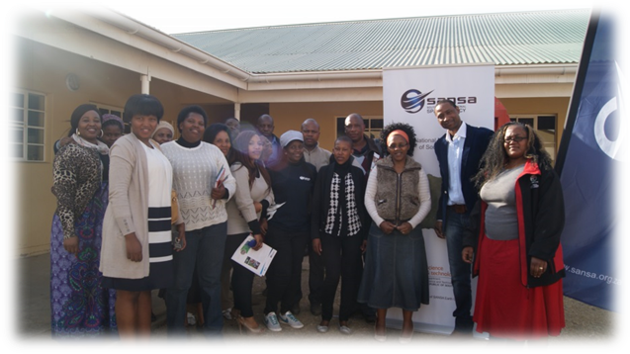
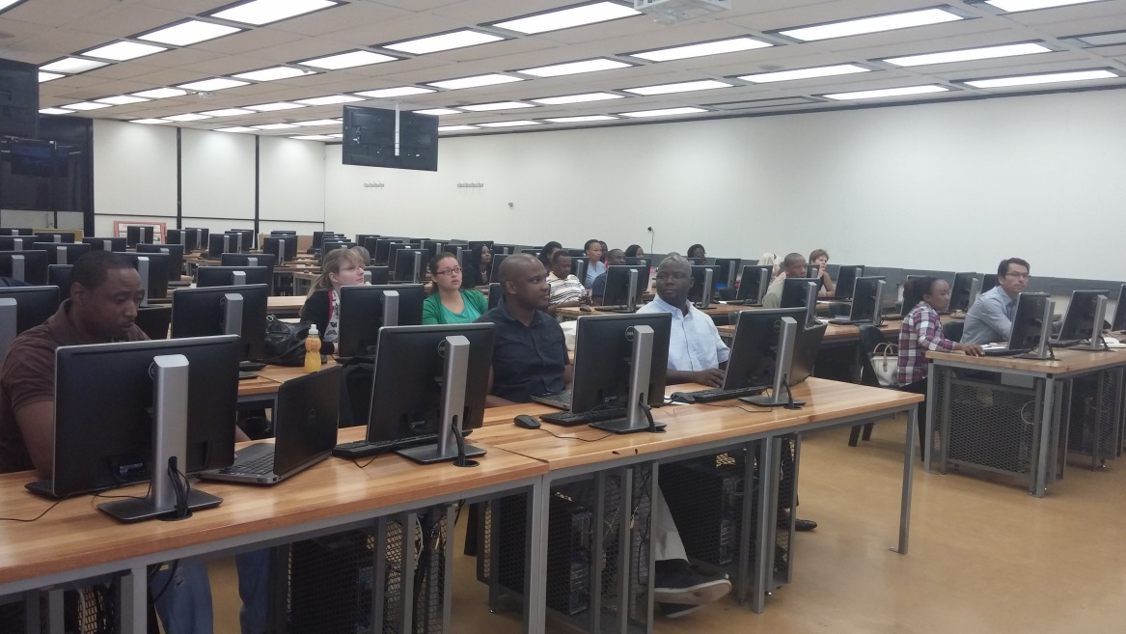
Training Courses
Introduction to Remote Sensing for Educators
Target Audience: School Teachers (Grade 10-12)
Outcomes: To provide practical GIS & RS lessons, to contribute to the way in which Geography is taught in schools.
Partners: Private companies, Depart. of Education Universities & Local Conferences.
Notes:
The new curriculum (Curriculum and Assessment Policy Statements (CAPS) now offers basic remote sensing and GIS sections under Geography subject from grade 10-12. Most schools in rural areas and townships have not received formal or practical training in remote sensing and GIS. The objective of SANSA’s “Introduction to remote sensing and GIS training workshop for educators” is to provide the geography teachers with practical lessons of remote sensing focusing more on the basic concepts that are offered at high school. Basic concepts of Geographic Information System (GIS) are also covered during the training course. The course combines lectures, demonstrations and hands-on activities to introduce the different topics.

Slide 4
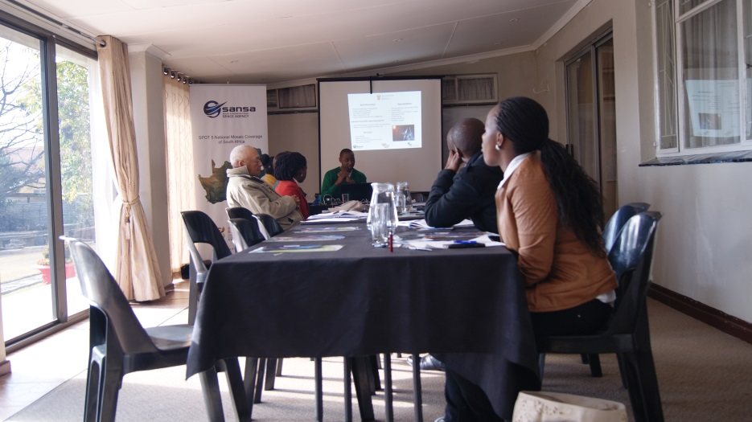
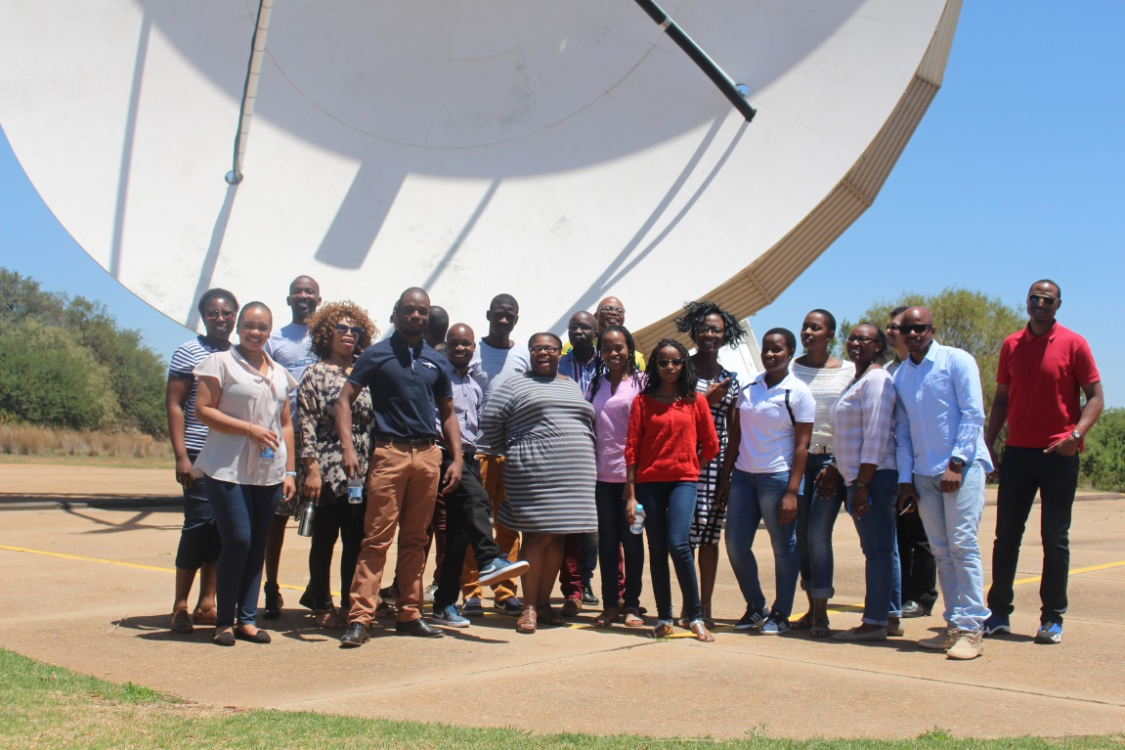
Training Courses…
Introduction to Remote Sensing for Local Authorities
Target Audience: Local municipalities & Government departments
Outcomes: To provide practical RS to local authorities, to improve service delivery through adoption of EO.
Notes:
This course is aimed at individuals who are involved in conducting spatial analysis/GIS and working for a local authority/municipality.
The objective of this course is to:
Provide local authorities with the practical background in Remote Sensing enabling them to confidently consider how earth observation can be used within their work environment.
It provides the fundamental steps to empower participants to acquire process and prepare optical remote sensing data to enable analysis in their workplace.

Slide 5
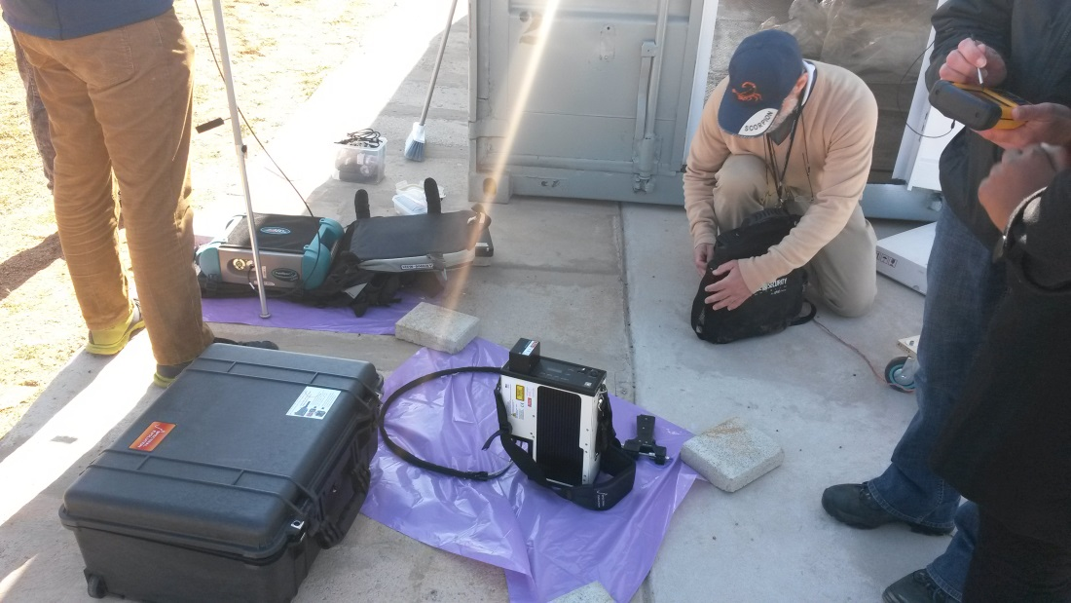
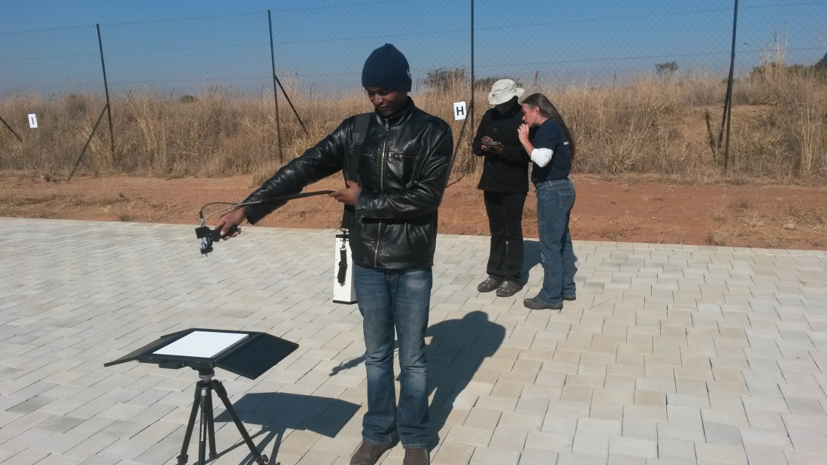
Training Courses…
Calibration and Validation of satellite imagery
Target Audience: Scientists (RS), Interns,
Outcomes: To provide participants with knowledge on the process of calibration and validation of optical satellites.
Partners: Research councils such as CSIR.
Notes:
The objective of this training was:
To provide participants with knowledge on the process of vicarious calibration and validation of optical satellites.
This course was aimed for remote sensing scientists who are interested in the production of quality image products. As part of the course, attendants had a chance to learn how SANSA’s Full-Range Spectral Evolution Spectroradiometer and CSIR’s spectroradiometer compare and work.

Slide 6
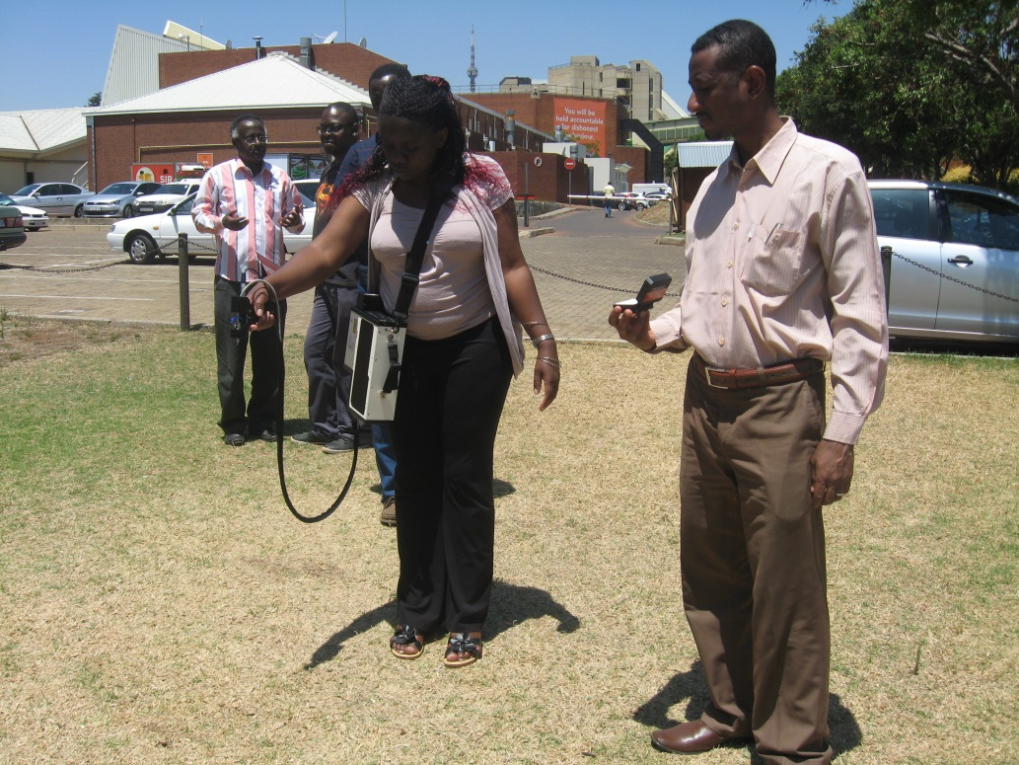
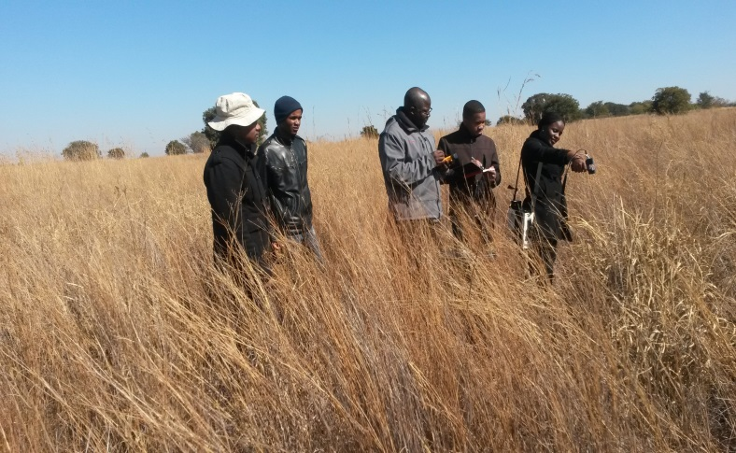
Training Courses…
Spectrometry and Spectral Analysis
Target Audience: Students (Honours, MSc, PHD), Lecturers, Interns.
Outcomes: To enable quality RS research and increase knowledge-base for analysing spectral data.
Partners: Universities; Research Institutions
Notes:
Spectrometry course was targeted at students (Honours, MSc and PhD level) that would like to make use of hyperspectral data in their research and would like to ensure they have grasped the best practices for conducting their research, in addition EO practitioners that wish to expand their knowledge to include the collection and analysis of field spectral data to validate their products.
The objective of this course through primarily hands-on practical sessions, is to:
Provide participants with the knowledge on best practices for collecting field spectra, how to go about downloading data and preparing it for analysis, and then some basic steps into how to go about analysing spectra.
The analysis of spectra will include pre-processing techniques, and performing some basic statistical analysis including plotting spectral data, multiple linear regression, partial least squares regression analysis and statistical analysis using open software R.

Slide 7
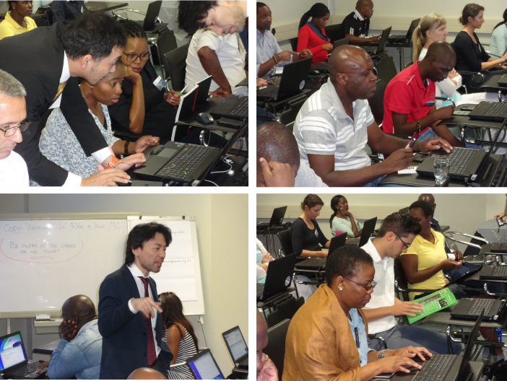
Training Courses…
JICA Hands on Training on Japanese EO Satellites
Advanced SAR Training Course
SAR Interferometry Training Course
Target Audience: Government institutions, Research councils, Private companies, municipalities.
Outcomes: To build capacity on SAR processing for various applications.
Partners: Space Agencies
Notes:
SANSA in collaboration with Japan International Cooperation Agency (JICA) conducted a series of training courses on the use of Japanese Earth Observation satellites in different applications.

Slide 8
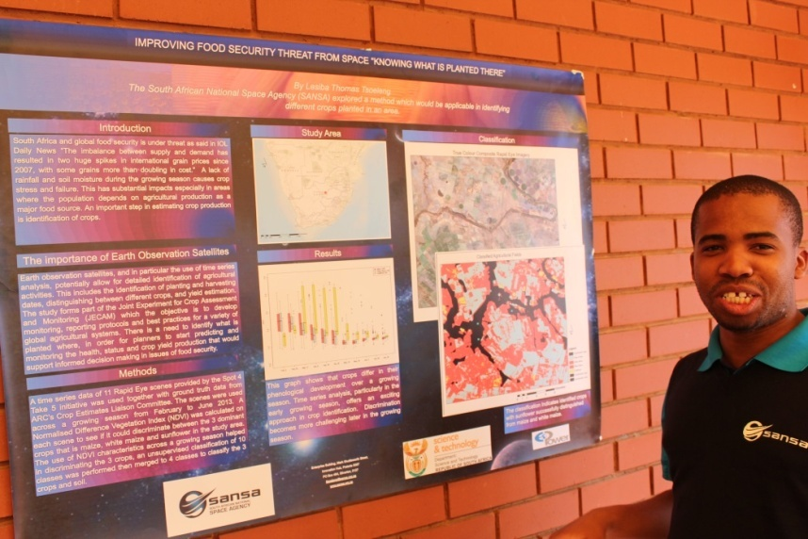
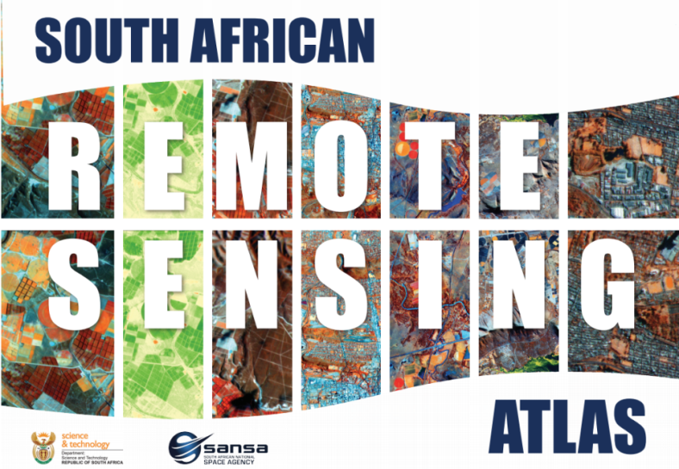
Capacity Building Resources
Fundisa Disk & Portal – Contains SPOT, VAPs, Hands-on tutorials, RS lecture Series, Open Source Software, Links to online CB recourses.
Fundisa School’s Edition – Open source software, RS data, and Hands-on tutorials (DVD disk).
Posters – On Various RS Applications presented at workshops and conferences.
South African RS Atlas – Hard copy, PDF, CD, website: http://atlas.sansa.org.za/ .
Notes:
The 40-pages atlas covers broad areas such as history of space technology, satellites, application of satellite images, geology, mining, agriculture, woody-cover mapping, water quality, urban planning, urban development and post-floods analysis. The atlas has been developed to cater for a wide range of audience from high school learners, tertiary students, government officials.

Slide 9
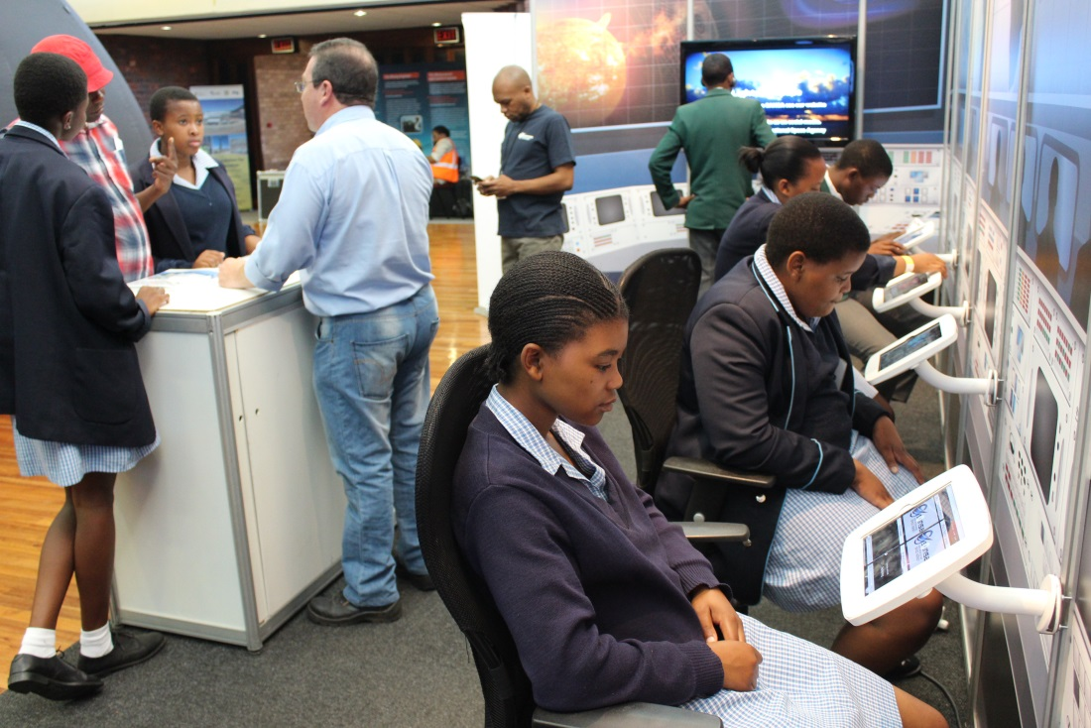
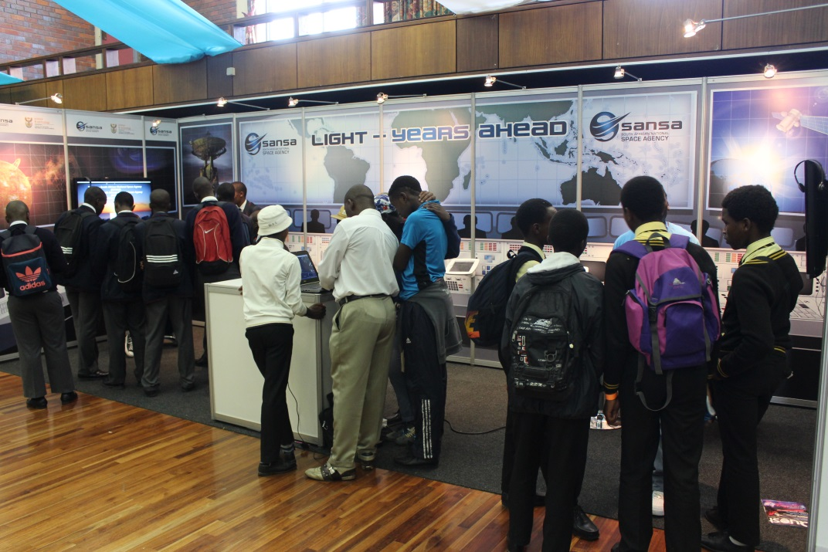
Science Advancement Activities
Sci-Fest National Festival
SASOL Science Festival
National Science Week
Site Tour for School Learners
School visits

Slide 10
What evidence do you measure to show that capacity is built?
COURSE INSTRUCTOR & MATERIAL SATISFACTION

Slide 11
Thank you

