Slide 1
GEO-XII Plenary & Ministerial Summit Andiswa Mlisa GEO Secretariat CEOS WGCapD 5th Annual Meeting Hampton VA, USA 30 March - 1 April 2016

Slide 2
GEO Vision

Slide 3
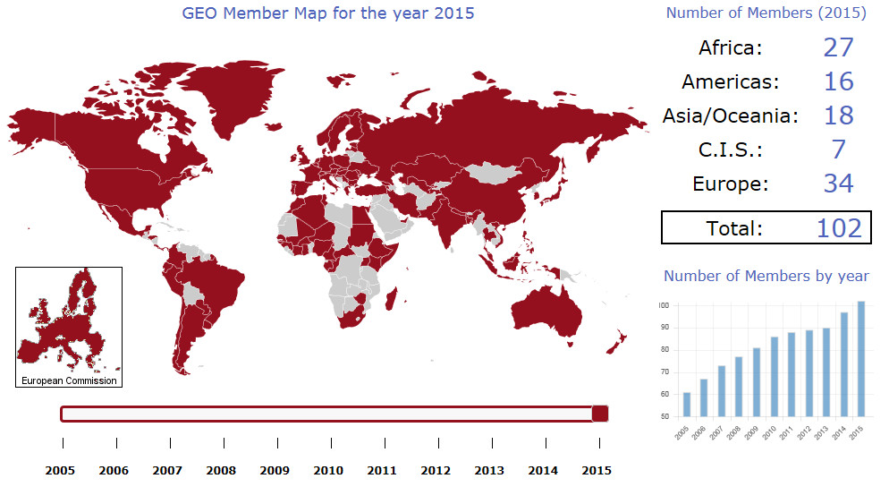
102 GEO Members

Slide 4
95 Participating Organizations

Slide 5
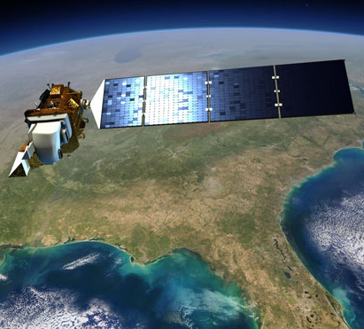
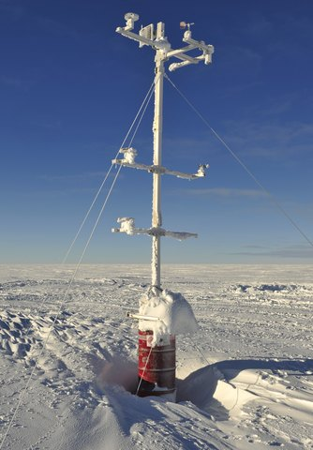
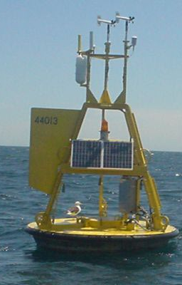
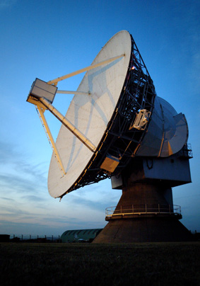
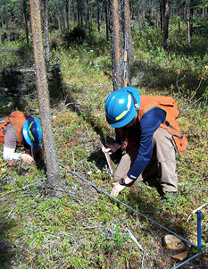
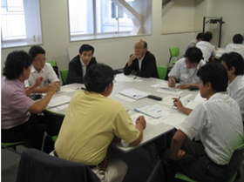
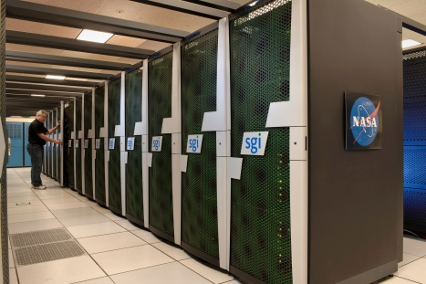
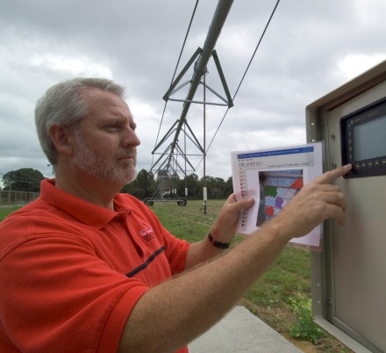
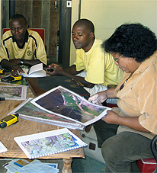
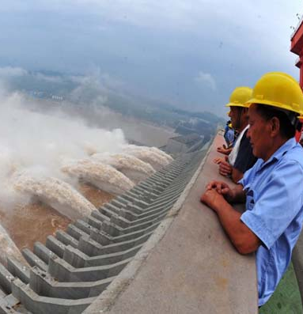
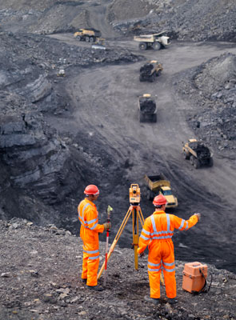
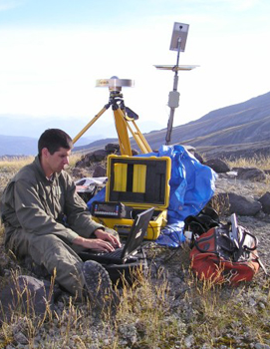
Commercial Sector Spans Information Value Chain
Data
providers
Value-Added providers
Downstream
users

Slide 6
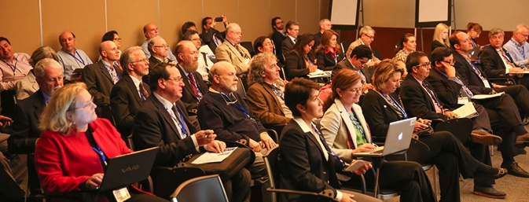
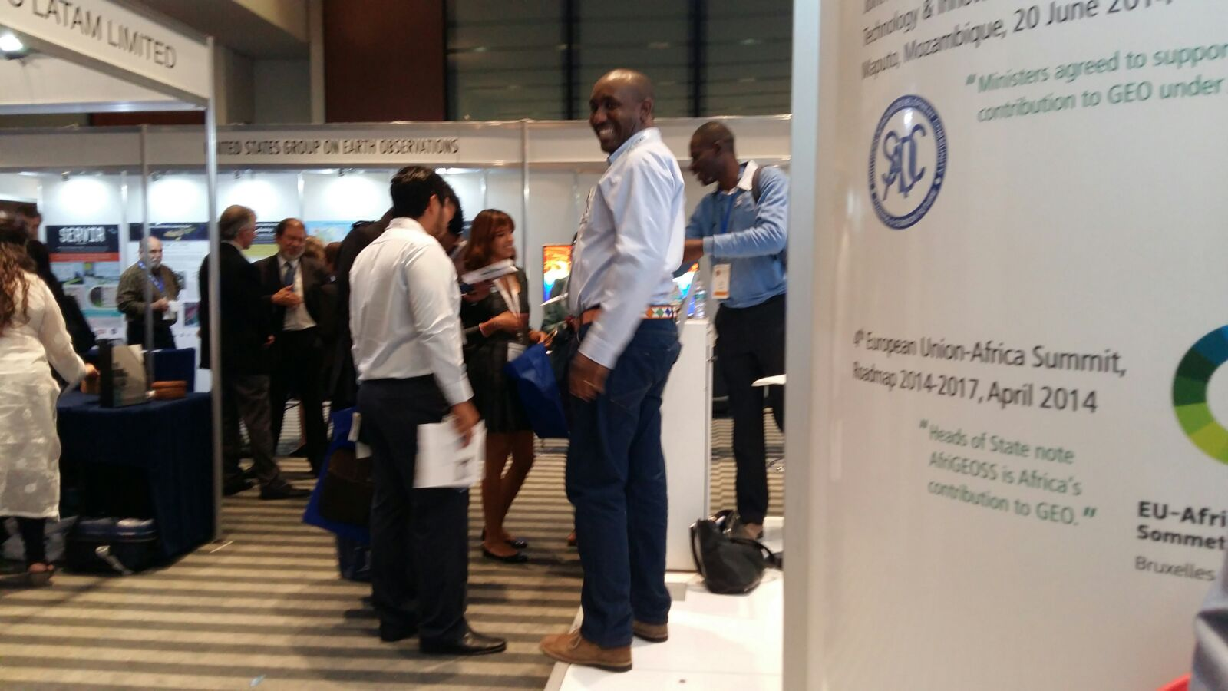
GEO-XII Plenary and Ministerial Summit
GEO Week 9 – 13 November 2015
Notes:
Ministers will reconvene in 2019 to review and reaffirm GEOs progress

Slide 7
Ministers Adopted the GEO Strategic Plan 2016 – 2025: Implementing GEOSS and further:
Confirm that full and open access to Earth observation data, information and knowledge is crucial for humanity;
Urge governments to promote GEO nationally, and through their representation in international organizations, to realize a more effective collaboration with GEO;
Resolve to sustain and develop the observing systems required to provide high-quality reference data and time-series Earth observations;
Call on GEO to launch a GEO initiative to leverage Earth observations to support the implementation, monitoring and evaluation of the 2030 Global Goals for Sustainable Development;
Notes:
Ministers will reconvene in 2019 to review and reaffirm GEOs progress

Slide 8
Redesign of the Work Programme GEO Implementation Mechanisms
Notes:
These actual implementation will be done through the GEO Work Programme
How many
GEO Flagships:
GEO Initiatives
GEO Community Activities:
GEO Foundational Tasks:
What is the level of Africa’s participation in each?

Slide 9
New Societal Benefit Areas

Slide 10
Update Rules of Procedure
Extended Executive Committee
From 13 to 16 Member (Africa, CIS and Europe increase by 1)
POs observers
Programme Board
CEOS Represented
Greater involvement of POs
Composition of Programme Board
Observers to Executive Committee

Slide 11
Capacity Building from the GEO Strategic Plan 2016 – 2025
GEO Core Function - Cultivating awareness, building capacity and promoting innovation
Building capacity, as well as sustaining and enhancing existing capacity, is essential for developing competencies in the effective use of Earth observations for responding to societal challenges and addressing sustainable development issues.
promote the engagement of institutional users worldwide;
Assist countries and regions in increasing their capacity to acquire, share, store, maintain, and utilize Earth observation data and information;
Engage with the international development and donor organizations to identify country-specific opportunities for demonstrating the value of Earth observations;
Pursuing opportunities to work with the appropriate national and sub-national entities to develop activities towards improving decision-making; and
Promote cooperation through national and regional GEO mechanisms.

Slide 12
GEO Work Programme 2016
Community Activities | 33 | 14
GEO Initiatives | 20 | 15
Foundational Tasks | 18 | 6
TOTAL | 71 | 35

Slide 13
CB in GEO Work Programme 2016
Level | Community Activities and Foundational Tasks |  | GEO Initiatives
Full Activity / Task | CA-15 | Water Cycle Capacity Building
 | CA-25 | Africa Global-scale Geochemical Baselines for mineral resource and environmental management: Capacity-building phase
 | CA-32 | Research Data Science Summer Schools (new-CODATA/RDA)
 | CA-33 | Building capacity for Forest Biodiversity in Asia and the Pacific Region
 | CD-01 | Capacity Building Coordination
Component | GD-04 | GEONETCast Development and Operations | GI-01 | GEOGLAM - Global Agricultural Monitoring and Early Warning
 | GD-09 | GEO Knowledge Base development | GI-02 | GEOBON-Global Biodiversity Observation
 |  |  | GI-03 | GFOI Global Forest Observations Initiative
 |  |  | GI-07 | Ocean and society - Blue Planet
 |  |  | GI-09 | Global Wildfire Information System
 |  |  | GI-11 | Information Services for Cold Regions
 |  |  | GI-15 | GEO-GNOME Initiative: GEO Global Network for Observation and Information in Mountain Environments
 |  |  | GI-18 | Earth Observations in Service of the 2030 Agenda for Sustainable Development
 |  |  | GI-19 | AmeriGEOSS
 |  |  | GI-20 | GEO Global Water Sustainability (GEOGLOWS) new-US

Slide 14
CB in GEO Work Programme 2016
Level | Community Activities and Foundational Tasks |  | GEO Initiatives
2016 Activities | CA-01 | Global Land Cover | GI-04 | Global Observing System for Mercury and Persistent Organic Pollutants (PoPs)
 | CA-09 | Precipitation
 | CA-10 | Evapotranspiration (and Evaporation) | GI-14 | GECO: the GEO Global Ecosystem Initiative
 | CA-12 | River discharge
 | CA-15 | Water Cycle Capacity Building
 | CA-16 | Global Drought Information System (GDIS)
 | CA-23 | Space and Security
 | CA-26 | Earth Observation in Cultural Heritage documentation
 | GD-07 | GCI Development (includes development of Data Management guidelines)
Objectives and / or Future Plans | CA-02 | WGLCA | GI-08 | GEO Geohazard Supersites and Natural Laboratories (GSNL)
 | CA-07 | Integrated Water-cycle Products and Services | GI-12 | Integrated Information Systems for Health (Cholera, Heat waves)
 | CA-29 | Using Geospatial Data to Identify and Monitor Ecosystem Service and Track in a Natural Capital – Ecosystems Accounts Framework | GI-16 | GEO-DARMA (Data Access for Risk Management)
 | CD-03 | Assess the benefits from EOs and of their socio-economic value

Slide 15
SBAs, Community Activities and Initiatives-1
SBA | GEO Initiatives |  | Community Activities
 | GI-02 | GEOBON-Global Biodiversity Observation (GEO BON) | CA-29 | Using Geospatial Data to Identify and Monitor Ecosystem Service and Track in a Natural Capital – Ecosystems Accounts Framework
 | GI-03 | GFOI Global Forest Observation Initiative | CA-30 | Harmful Algal Bloom (HAB) Early Warning System
 | GI-14 | GECO: the GEO Global Ecosystem Initiative | CA-31 | For Global Mangrove Monitoring
 | GI-15 | GEO-GNOME Initiative: GEO Global Network for Observation and information in Mountain Environments
 | GI-08 | GEO Geohazard Supersites and Natural Laboratories (GSNL) | CA-23 | Space and Security
 | GI-09 | Global Wildfire Information System | CA-26 | Towards Chinese tsunami mitigation system under GEO framework
 | GI-16 | GEO-DARMA = Data Access for Risk Management (to support the implementation of Sendai framework). | CA-27 | Foster Utilization of Earth Observation Remote Sensing and In Situ Data for All Phases of Disaster Risk Management (new-CEOS)
 |  |  | CA-28 | Global Flood Risk Monitoring
 | GI-10 | EO data and renewable energies | CA-06 | EO data and mineral resources (Includes Impact Monitoring System for Geo-Resource Exploration and Exploitation)
 |  |  | CA-25 | Africa Global-scale Geochemical Baselines for mineral resource and environmental management: Capacity-building phase

Slide 16
SBAs, Community Activities and Initiatives-2
SBA | GEO Initiatives |  | Community Activities
 | GI-01 | GEOGLAM-Global Agricultural Monitoring and Early Warning
 | GI-04 | Global Observing System for Mercury and Persistent Pollutants | CA-07 | Integrated Water-cycle Products and Services - Overall coordination
 | GI-12 | Integrated Information Systems for Health (Cholera, Heat waves) | CA-14 | GEO Water Quality
 | GI-13 | Integration of Methods for Air Quality and Health Data, Remote Sensed and In-Situ with Disease Estimate Techniques | CA-18 | Water Cycle Integrator (WCI)
 |  |  | CA-19 | E2E Water Indicators
 |  |  | CA-22 | Linking water tasks with wider societal benefit areas and the post-2015 global development framework
 | GI-17 | Global Urban Observation and Information | CA-24 | Earth Observation in Cultural Heritage documentation
 | GI-21 | Human Planet Initiative

Slide 17
SBAs, Community Activities and Initiatives-3
SBA | GEO Initiatives |  | Community Activities
 | GI-11 | Information Services for Cold Regions | CA-07 | Integrated Water-cycle Products and Services - Overall coordination
 | GI-20 | GEO Global Water Security (GEOGLOWS) | CA-08 | Water Vapor and Clouds (Aerosol & Precipitation)
 |  |  | CA-09 | Precipitation
 |  |  | CA-10 | Evapotranspiration (and Evaporation)
 |  |  | CA-11 | Soil Moisture
 |  |  | CA-12 | River Discharge
 |  |  | CA-13 | Groundwater
 |  |  | CA-14 | GEO Water Quality
 |  |  | CA-15 | Water Cycle Capacity Building
 |  |  | CA-16 | Global Drought Information System (GDIS)
 |  |  | CA-17 | GEO Great Lakes Activity
 |  |  | CA-18 | Water Cycle Integrator (WCI)
 |  |  | CA-19 | E2E Water Indicators
 |  |  | CA-20 | EartH2Observe
 |  |  | CA-21 | Total Water Prediction: Observations Infrastructure
 |  |  | CA-22 | Linking water tasks with wider societal benefit areas and the post-2015 global development framework

Slide 18
Foundational Task CD-01 Capacity Building Coordination
Coordination of the capacity building activities associated with the acquisition, processing and use of EO data and information for policy and decision-making. They include definition and use of clear mechanisms for identification of the “global CB offer”, its gaps in and promotion of coordinated actions to address them.
Task Team in place:
GEO Secretariat – coordination
Mark Noort, HCP International, Netherlands
Gregory Giuliani, UNIGE & UNEPGRID, Switzerland
Nancy Searby, NASA, CEOS WGCapD, United States
Eric Wood, USGS, CEOS WGCapD, United States
Angelica Gutierrez, NOAA, United States
Doug Muchoney, USGS, United States
Simon Hodson, CODATA
Capacity Building Forum

Slide 19
Foundational Task CD-01 Capacity Building Coordination
Activities and outputs:
Periodic review and update of the resource facility (relevance, maintenance and marketing)
Periodic review of capacity building needs
Develop and maintain a database with resource providers, ongoing programmes and activities
Undertake brokering activities - match needs with capabilities
Strengthen links with the Permanent Framework Network (PNF) for improved stakeholder interaction
Develop and maintain a database with resource providers, ongoing programmes and activities
Impact assessment - M&E – guidelines

Slide 20
Foundational Task CD-01 Capacity Building Coordination
Establish Capacity Building Forum to strengthen coordination of capacity building in GEO, sharing of information on activities, building synergies, collating capabilities and resources and identifying challenges and gaps and how these may be addressed.
Engagement with the 35 Community Activities, and Initiatives
Capacity Building Forum Meeting, 2 May 2016 (during the GEO Work Plan Symposium)

Slide 21
CB in GEO Work Programme 2016
Exact type / content of CB activity
Community targeted, recipients
Methods used
Coverage and gaps
Funding mechanisms
Sustainability
Outputs, outcomes and impact

Slide 22
AfriGEOSS Symposium
27 – 29 April 2016
Victoria Falls, Zimbabwe
GEO Work Programme Symposium
2-4 May 2016
Geneva, Switzerland
GEO-XIII Plenary
9-10 November
St. Petersburg, Russia
Andiswa Mlisa – amlisa@geosec.org
www.earthobservations.org

