Slide 1

The CEOS Systems Engineering Office
Tools & Applications
Presented by: Kim Keith

Slide 2
The Systems Engineering Office (SEO)
Management services:
CEOS website and mailing list management
CEOS Work Plan development
Outreach and training activities
Technical services:
Development of decision-making tools
Gap analyses of current and future satellite data acquisition and availability
Innovative technical solutions for CEOS

Slide 3
3 SEO Tools You Need to Know About
In this presentation:
The CEOS Visualization Environment (COVE)
The CEOS Data Policy Portal
The Space Data Management System (SDMS)

Slide 4
CEOS Visualization Environment (COVE)
www.ceos-cove.org
Uses Google Earth in your browser
Contains over 647 instruments on 240 satellites
Calculates the time and location of satellite coverage areas
Shows coverage areas on the globe or in a table
Notes:
Did you know ....
There are 1167 Earth orbiting missions
There are 121 active CEOS missions
Uses satellite position data
Browser-based tool using Google-Earth to display satellite coverage swaths and calculate coincident scene locations.
Automated daily satellite position data from CelesTrak.
Features include: saved bookmarks and state files, KML and KMZ input/output, custom regions, collaborative sessions.
Large mission database:
240 missions, 647 Mission-Instrument combinations

Slide 5
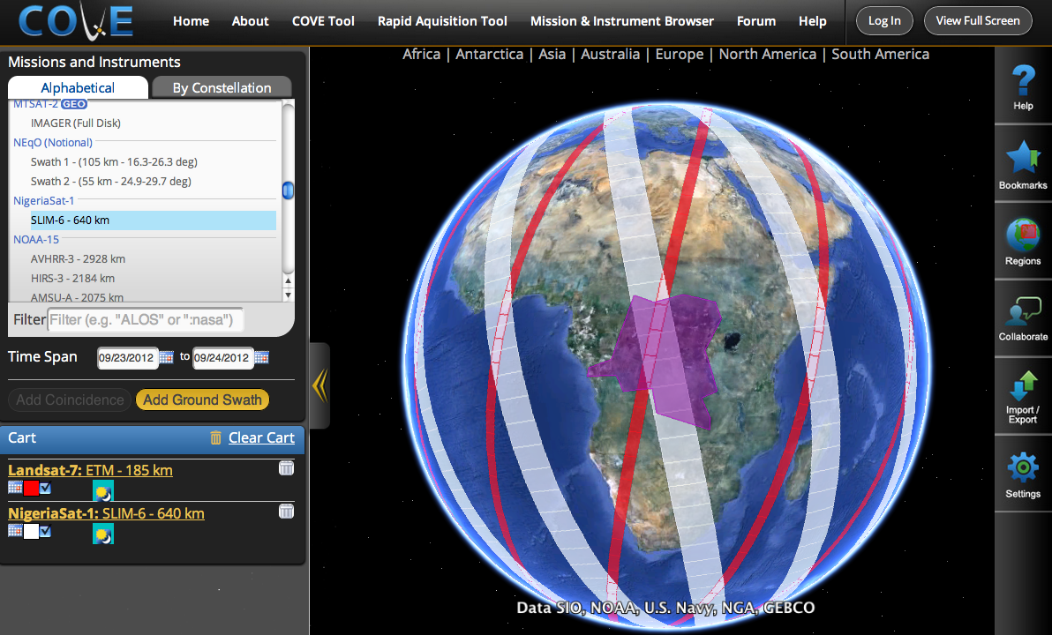
CEOS Visualization Environment (COVE)
www.ceos-cove.org
Notes:
Did you know ....
There are 1167 Earth orbiting missions
There are 121 active CEOS missions

Slide 6
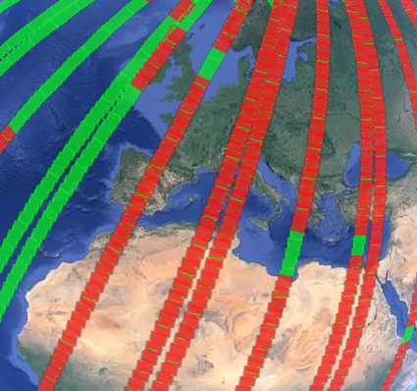
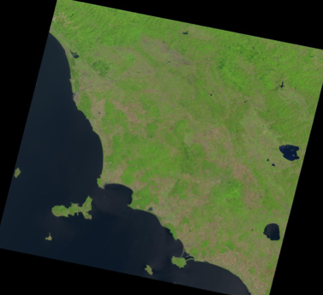
Even better…
Left: Landsat 8, Aug 1-3, over Europe: Green = potential coverage, Red = actual acquisitions
Right: The browse image over northern Italy on Aug 3, 2013.
Notes:
Save your coverage map image (JPEG format or KML).
Overlays for Landsat and Sentinal-2 data grids, and
ASTER DEM.
Also in Spanish

Slide 7
Even better…
Current browse image previews:
Landsat 7/8
SPOT 1-6
Pleiades-1A/1B
Coming soon:
TerraSAR-X
TanDEM-X
RapidEye
Radarsat-2

Slide 8
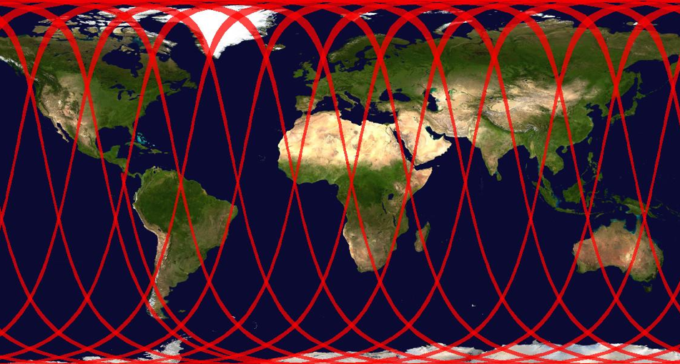
Other Capabilities
COVE in Spanish
Map image export
Virtual collaboration
Bookmarking
Data grids, ASTER Digital Elevation Model, MODIS Land Cover Classification, and other overlays
Map image export of Radarsat-2 (W3 mode) coverage on Aug 1, 2013
Notes:
Use overlays for Landsat and Sentinal-2 data grids

Slide 9
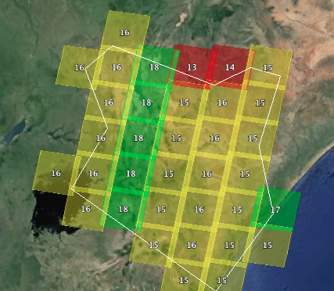
More COVE: The Coverage Analyzer
Archive analysis tool
Users select a date range, region, grid size (or Landsat WRS), and cloud cover threshold.
Output = number of acquisitions meeting the criteria for each grid cell in the region.
Landsat-8 total acquisitions in 2013 over Kenya, <20% cloudy, Level-1T processed
Still in early BETA testing ....

Slide 10
The Data Policy Portal
www.ceos-datapolicy.org
Data access policies for:
318 current instruments
297 past instruments
OPEN: Anonymous access, no restrictions
OPEN-SR: Simple Registration within 2 days
OPEN-AP: Advanced Protocol more steps or pre-approval
Restricted: Controlled access or commercial
No Access: No outside access
615 total from 25 countries

Slide 11
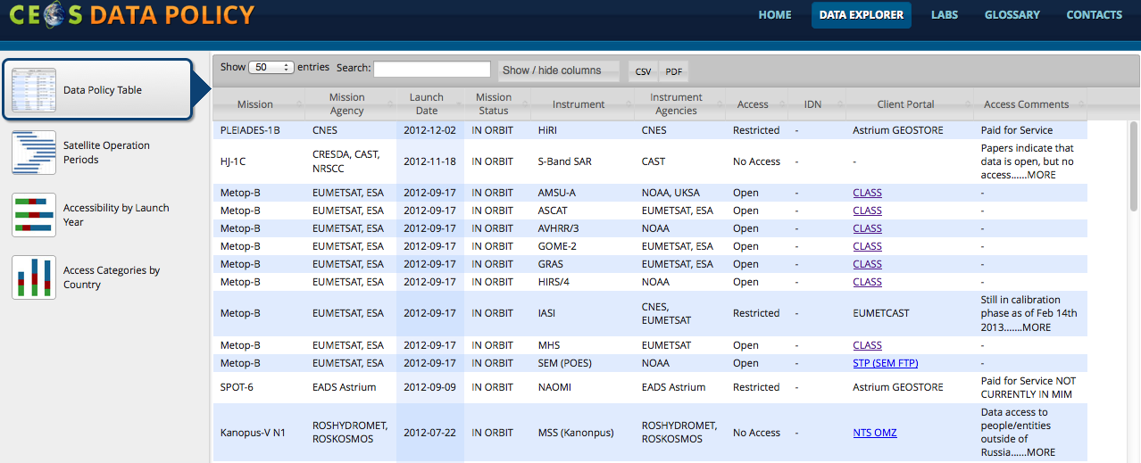
The Data Policy Portal
www.ceos-datapolicy.org
Data Columns:
Mission, Agency, Launch, Mission Status, Instrument, Instrument Agency, Data Access Policy, IDN, Client Portal, Comments. Other columns (hidden by default) are Orbit Type, Instrument Full Name, DataCORE, and CWIC/FedEO.
Features:
Free Text Search, Show/Hide Columns, Output in EXCEL and PDF, Satellite Timelines (with Agency and Country filters), Launches by Year and Country

Slide 12

Data Summary
  Access Summary
  Open = 36%
  Open-SR = 21%
  Open-AP = 5%
  Restricted = 33%
  Unknown = 5%
  All CEOS instruments: 62% Open
  Current CEOS instruments: 72% Open

Slide 13
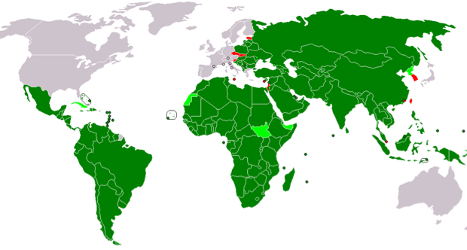



Space Data Management System (SDMS)
  The Problem:
  Many developing countries struggle to access, process, and use satellite data for local decision-making and national policies.
  Countries have difficulty using the diversity of space data systems and lack sufficient storage or bandwidth to manage relevant datasets.

Slide 14
Space Data Management System (SDMS)
  One Solution:
  UN-REDD, REDD+, GFOI, and GEOGLAM countries would benefit from a dedicated data system to support national Measurement, Reporting, and Verification (MRV).
  The United Nations Collaborative Program on Reducing Emissions from Deforestation and Forest Degradation
  The Global Forest Observations Initiative
  The Group on Earth Observations (GEO) Global Agricultural Monitoring Initiative

Slide 15
SDMS Concept
  CEOS, through the SDMS, will facilitate access to space datasets and analysis tools to support country-based reporting and decision-making. This system would be developed by the SEO, with support from WGISS.
Datasets
Tools
  SDMS features on the CEOS interface:
  Dedicated storage and cloud-computing
  Data archive search/discovery/access tools
  Analysis Tools: Data Processing, COVE, Coverage Analyzer, Google Earth Engine API
  Training and Capacity Building (with WGCapD)
Optical
SAR
Mosaics
CEOS
SDMS
Interface
Country
  SDMS features on the Country interface:
  Secure access to datasets and tools
  Ability to download and/or upload datasets
  Ability to conduct analyses and develop reports for in-country use
Reports
Datasets
KMLs
MRV reports
Space
In-Situ
Ground

Slide 16
Recap:
  The SDMS will provide:
  Data – Includes processed images (free or commercially purchased) and cloud-free mosaics (Google, WELD). Users can also upload other datasets and products.
  Tools – Data processing and analysis tools, COVE coverage analyzer, scene visualization, Cloud filtering tools (Earth Engine).
  Infrastructure – Centralized storage and cloud processing
  NOT thematic products – SDMS will deliver data and tools and not be responsible for creating products. Products are the responsibility of the end-user.
  The operational plan:
  The SEO will lead the development of SDMS prototypes and related tools and infrastructure, but will not be responsible for long-term operations.
  The long-term operations plan is TBD. These operations may be carried by other groups within the projects (e.g., GFOI, GEOGLAM, FAO, SilvaCarbon).
  Provisions for tool updates and training and capacity-building must be considered.

Slide 17
Data Services Prototypes

Slide 18
Summary of CEOS & SEO Resources
What measurements, instruments, and missions exist? What can I use them for?
The Earth Observation Handbookhttp://database.eohandbook.com
Which instruments can see my region of interest?
The COVE Tool Suite
http://www.ceos-cove.org

Slide 19
Summary of CEOS & SEO Resources
What’s the instrument’s data policy?
Where do I get the data?
The Data Policy Portal
http://www.ceos-datapolicy.org
Can you help me access and analyze the data, despite limited storage space and bandwidth?
The Space Data Management System
http://www.ceos-cove.org

Slide 20
The WGCapD Role
The WGCapD can and should play a role in capacity building for current CEOS initiatives and priorities (i.e. GFOI, GEOGLAM, WGDisasters).
There is an immediate need to start developing documentation and training on the SDMS.
Identifying additional ongoing funding to support these and other WGCapD activities is critical.

Slide 21

Discuss

Slide 22
Too much detail ahead…
Turn back!

Slide 23
SDMS Prototype for FAO
GFOI Project #1
The SEO is working directly with UN-FAO and KSAT (funded by Norway) to develop a pilot Space Data Management System (SDMS) for Ecuador, Uganda and Tanzania to support REDD+.
The planned features of this prototype are ...
  Password protected (secure) access for each country with separated country data
  Ability for countries to download and upload datasets
  Dedicated storage for Landsat datasets. Initially populated with only 2013 Landsat-7 data over each country for testing and evaluation.
  Web-based image visualization
  Cloud computing processing with OpenForis toolset and additional FAO analysis tools.
  Data archive search and discovery of Landsat using the COVE tool. Also provide a link to the USGS data ordering tool for data access.
Follow-on 3-year proposal under evaluation at FAO to expand the SDMS to 13 more REDD+ countries. The role of the CEOS SEO is uncertain.

Slide 24
Data Services Prototype for Kenya
GFOI Project #2
The SEO is working directly with Stephen Ward (SDCG), Nikki Fitzgerald (CSIRO) and Mwangi Kinyanjui (Kenya) to develop a data services prototype for Kenya. This project is also supported by the Clinton Foundation and the Government of Australia. The features of this prototype will include ...
  Password protected (secure) access for Kenya users.
  Landsat processed datasets (L1T) from 2013.
  These datasets will reside temporarily on an SEO-provided system, but will eventually be stored and maintained on local Kenya servers. In addition, more data will be added to develop baseline maps since 1990.
  Landsat data archive search and discovery tools (COVE and Coverage Analyzer).
  Will investigate providing a link to the USGS EarthExplorer tool for bulk data ordering of multiple scenes.
  Training tools to support data search/discovery/access.
  Investigate options for cloud removal and the production of cloud-free mosaic scenes.
  Will investigate using Google Earth Engine and will review methods used by USGS and the Landsat science community.

Slide 25
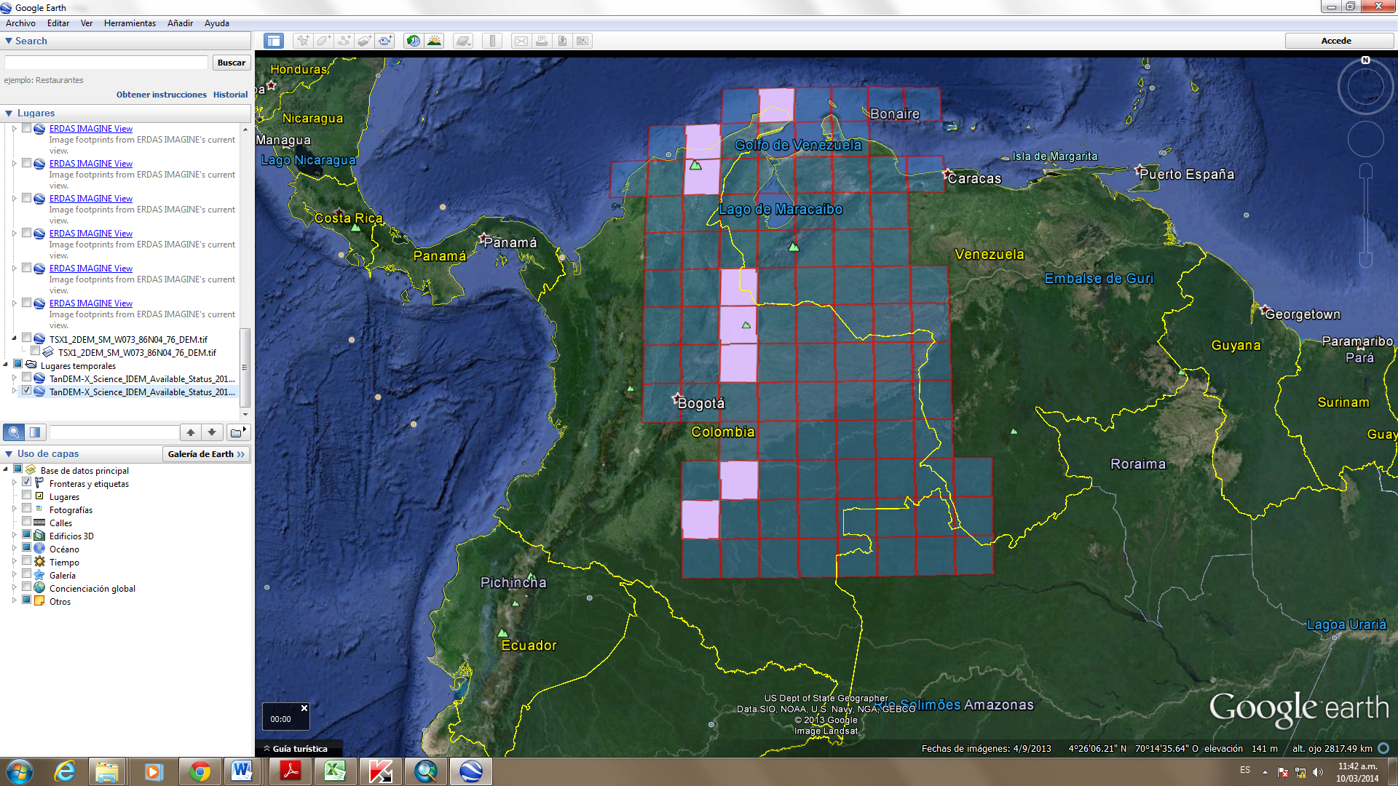
Data Services Prototype for Colombia
GFOI Project #3
The SEO is working directly with Sylvia Wilson (USGS, SilvaCarbon), Edersson Cabrera Montenegro (Colombia) and Gustavo Galindo Garcia (Colombia) to develop a data services prototype for Colombia. The features of this prototype will include ...
Password protected (secure) access for Colombia users.
Download and upload capability of datasets.
Dedicated storage for TanDEM-X DEM datasets acquired through the Intermediate DEM (IDEM) Announcement of Opportunity (closes March 18). The SEO led the proposal development and submitted on March 17.
IDEM datasets will cover 8 tiles over Colombia (see figure). Each tile location will provide 3 DEM resolutions ...
12-meter, 30-meter, and 90-meter.
Total data storage ... 24 tiles, 1.3 GB each = 31 GB
Cloud computing processing capability to allow local users to test SAR data processing tools (e.g., Gamma Modular SAR Processor) on locally stored datasets.

Slide 26
Data Services Prototype for GEOGLAM
Project #1
The SEO is working directly with the JECAM team (Ian Jarvis and Peirre Defourny) to develop a data services prototype for up to 5 JECAM test sites. The features of this prototype will include ...
  Password protected (secure) access for each JECAM science user with the ability to share data and tools across test sites. Data for each test site will be separated in folders.
  Download and upload capability for datasets.
  Dedicated storage for currently utilized datasets, including those purchased commercially. Datasets to be stored on the prototype server are TBD ... pending information from Ian and Pierre.
  Cloud computing processing capability to allow users to run analysis tools on local datasets.
  Data archive search and discovery using COVE. Links to archives from Landsat, Radarsat (coming soon), RapidEye (coming soon), TerraSAR-X, TanDEM-X, SPOT, Pleaides.

Slide 27
Data Services Prototype for GEOGLAM
Project #2
The SEO is working directly with the Asia-RiCE team (Shinichi Sobou) and Yves Crevier (CSA) to develop a data services prototype for Indonesia. The features of this prototype will include ...
  Password protected (secure) access for Indonesia Asia-RiCE science users.
  NOTE: The SEO will have access to the science data only for the purpose of hosting on the data services system. Science users must have approved access to Radarsat-2 data and abide by all requirements of the End-User License Agreement (EULA).
  Download and upload capability for datasets and analysis products.
  Dedicated storage for 35 Radarsat-2 images, provided by CSA.
  Cloud computing processing capability to allow JAXA to run SAR processing tools on remote servers for enhanced performance.

