Slide 1
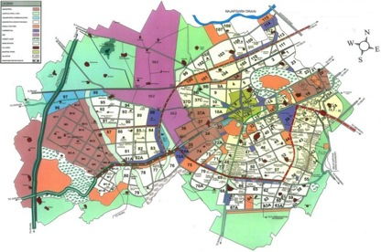
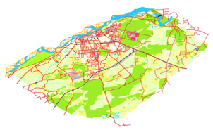
Bhuvan-NUIS- Master plan Preparation
Regional Workshop
IIRS, Dehra Dun
15 April, 2014
National Remote Sensing Centre, ISRO

Slide 2

Basic Idea & Broad Architecture
Inputs
Guidelines
URDPFI
Geospatial Data
Auxiliary Data
Bhuvan
Master Plan Preparation
GIS Software
(QGIS)
Bhuvan NUIS Environment

Slide 3
National Urban Information System (NUIS)
Scope: Large scale Urban Geospatial database for various levels of Urban Planning, Infrastructure development and e-governance.
Primary Layers
Urban land use
Physiography
Geomorphology
Geological Structures
Lithology
Soils
Drainage
Surface Water bodies
Road
Rail
Canal
Transportation Nodes
Incorporated Layers
Administrative Boundaries
Forest Boundary
Settlement & Village Locations
City / Town Boundaries
Metro - 13 towns
Class I – 70 towns
Class II – 15 towns
Class III – 19 towns
Class IV – 17 towns
Class V – 6 towns
Class VI – 12 towns

Slide 4
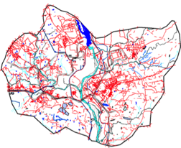
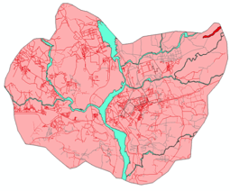
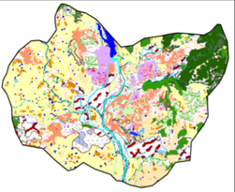
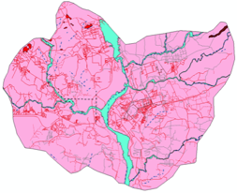
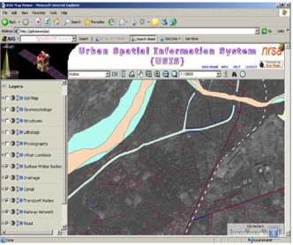
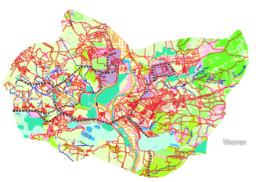
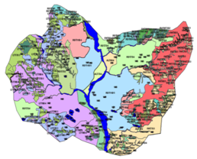
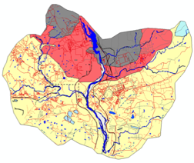
National Urban Information System (NUIS)
BASE
Physiography
PHYSIOGRAPHY
Urban Geospatial database for Urban Local Bodies (ULB’s) for Urban Planning, Infrastructure development and e-governance.
No. of Towns – 152 (~56 Sq. km)
URBAN LANDUSE
Lithology
LITHOLOGY
SOIL
Geomorphology
Soil
GEOMORPHOLOGY
Korba Town : 286 Sq.km
Bhuvan-NUIS based online Geospatial solution for Master Plan Preparation

Slide 5

What is Bhuvan NUIS ?
Bhuvan Geoportal has 152 Towns GIS Database offers National level Services
Open Source GIS Software for editing and data creation
Internet
(suggested. 512 Kbps)
Bhuvan NUIS
Online GIS
services & uploading
of output GIS products
Client side GIS Solution
Data Creation &
Uploading
Data & User Management
Towards Master Plan Preparation

Slide 6
Bhuvan NUIS – Access Mechanism
Bhuvan NUIS
Common Username & Password
Bhuvan NUIS QGIS Plug-in
(Operates through QGIS)
Web Portal login
(Operates on Bhuvan)
QGIS
Data Creation / Uploading
Data & User Management

Slide 7

Bhuvan NUIS – Basic Work flow
Public View
Web Portal
8
QGIS+Plugin
Feedback
S/W Installation
7
Bhuvan -
NUIS
Approve the Uploaded data
6
1
Authentication
(username & password)
Upload data to Bhuvan
2
5
Download s/w
QGIS and Plug-in
Create data
3
4
Install
Access and View data

Slide 8

Bhuvan NUIS – Access Privilege & User Management
NUIS Users
Town
State
National
Administrator
Town Administrator(TA)/ Commissioner
Approver
Town Planner(TPO)
Data Creator
JE/ Surveyor/ Draftsman/ Asst. Town Planner

Slide 9
Bhuvan NUIS - Layer Management
Layer Management
Not Uploaded Layers
Not Approved Layers
Pending Layers for Approval
Approved Layers

Slide 10
Basic Steps for Data Creator
Initial Setup of Bhuvan NUIS Environment
Step 1: Open Browser and enter URL
http://bhuvan-staging.nrsc.gov.in/projects/bhuvannuis
Step 2: Web Portal Login: Enter Username and Password
Step 3: Click on Login as JE
Step 4: Now user in Bhuvan NUIS Environment
Step 5: Explore data-tree on Bhuvan NUIS
Step 6: Download & Install GIS tool (QGIS)
Step 7: Download & Install Software Plugin for Bhuvan Assets under QGIS
Step 8: Enable Plugin under QGIS environment
Step 9: Explore Basic functionalities of Bhuvan NUIS

Slide 11
Basic Steps for Data Creator…..Contd
Regular Usage sequence for data editing and creation
Step 10: Start QGIS on local desktop
Step 11: Invoke “Get Bhuvan WMS service”
Step 12: Bhuvan NUIS Login: Enter username and password
Step 13: Enables NUIS data tree in GIS Environment + Use NUIS data
Step 14: Use QGIS for data creation, Edit, process, Analysis etc.
Step 15: Possibilities for Geo-referencing of Cadastral data
Step 16: Use Bhuvan NUIS layers, local layers & Attribute data on QGIS platform for Master plan preparation
Step 17: Upload Cadastral and Master Plan for Approval

Slide 12
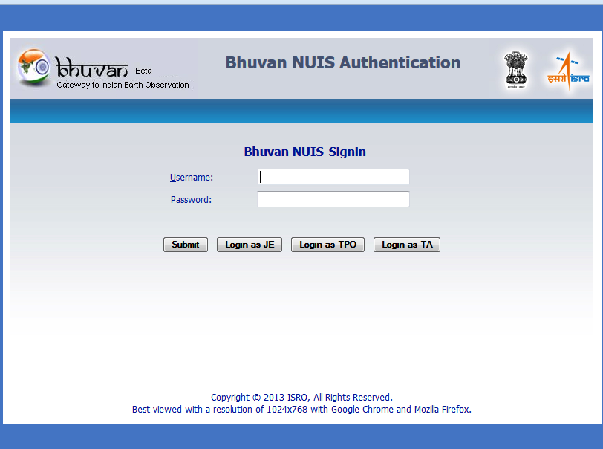
WEB Portal: Login
Login as JE: Data Creator

Slide 13
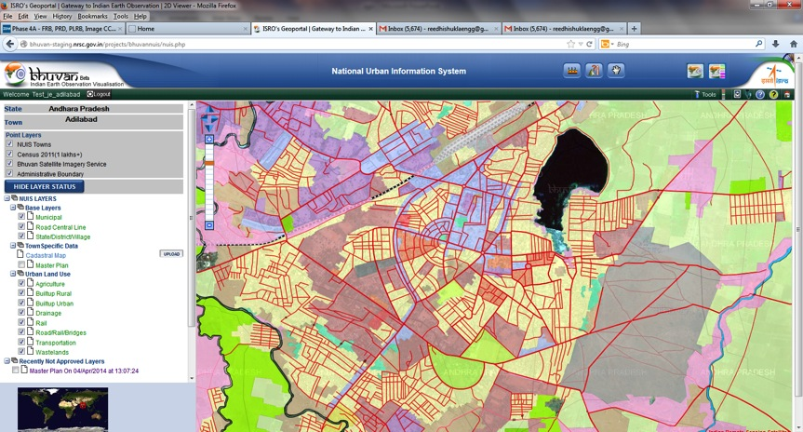
Data-Tree on Bhuvan NUIS
LAYER TREE
View NUIS data

Slide 14
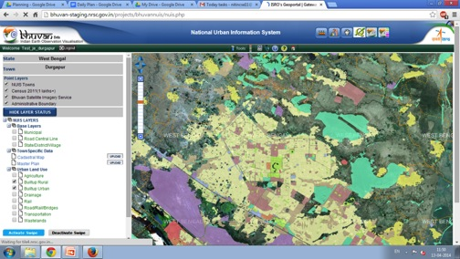


Download and Installation of Software Plugin Under QGIS
Click on the button to download the QGIS & plug-in.
Quantum GIS (QGIS)
Bhuvan NUIS QGIS Plug-in
Bhuvan WMS Legend Plug-in

Slide 15
Enable Plugin On QGIS
After Download, perform Plug-in 4 easy steps
Extract
Right Click on .zip file & extract
Copy
Right Click on folder & click copy
Paste
Go to plug-in directory of QGIS
Right click & Paste
Enable Plugin
in QGIS
Open QGIS
Plugin → Manage Plugin→ Check Bhuvan NUIS

Slide 16
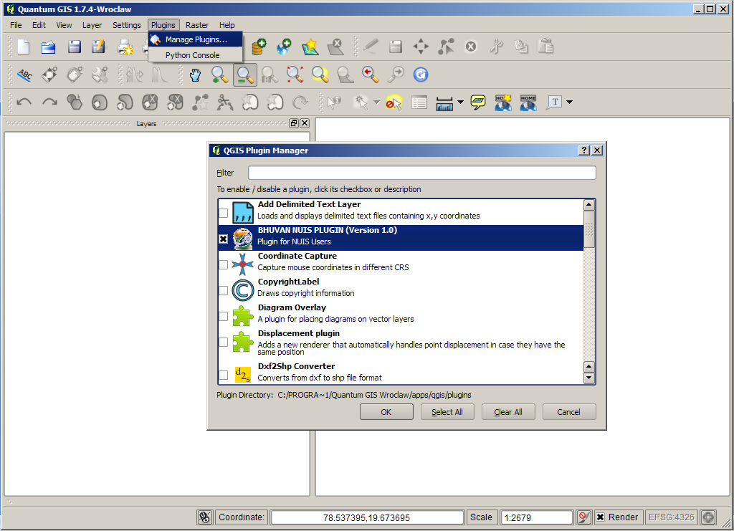
Enable Plugin in QGIS ……Contd

Slide 17
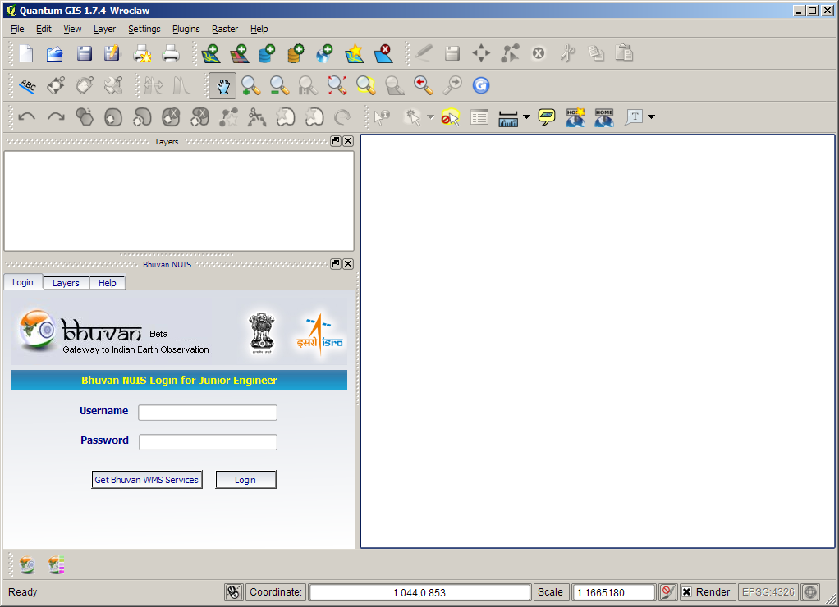
Plug-in under QGIS Environment
Bhuvan NUIS QGIS Plugin
Bhuvan NUIS QGIS Plugin Icon

Slide 18
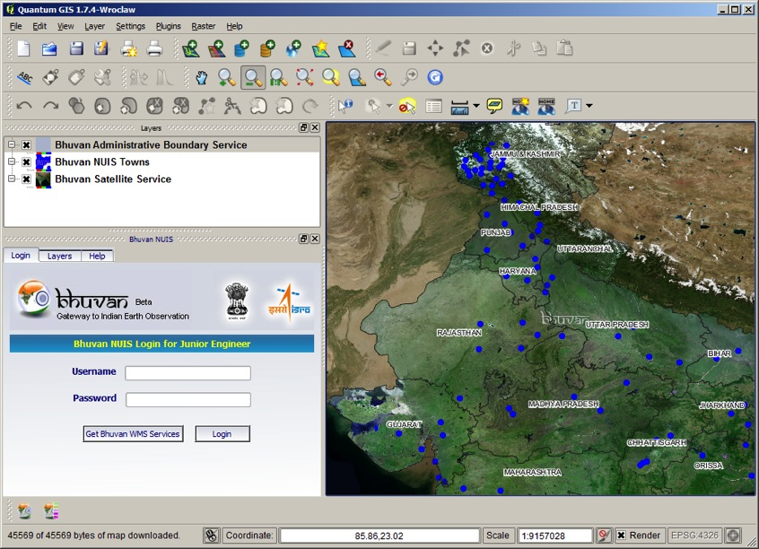
Satellite Data In QGIS Environment
To Access the NUIS Spatial Data
Upload data
Satellite Imagery Services.
Administrative Boundary (State, District, & Taluk).

Slide 19
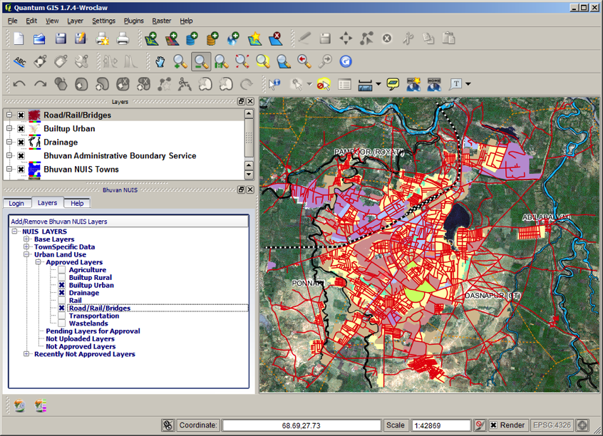
NUIS Data Tree in QGIS Environment

Slide 20
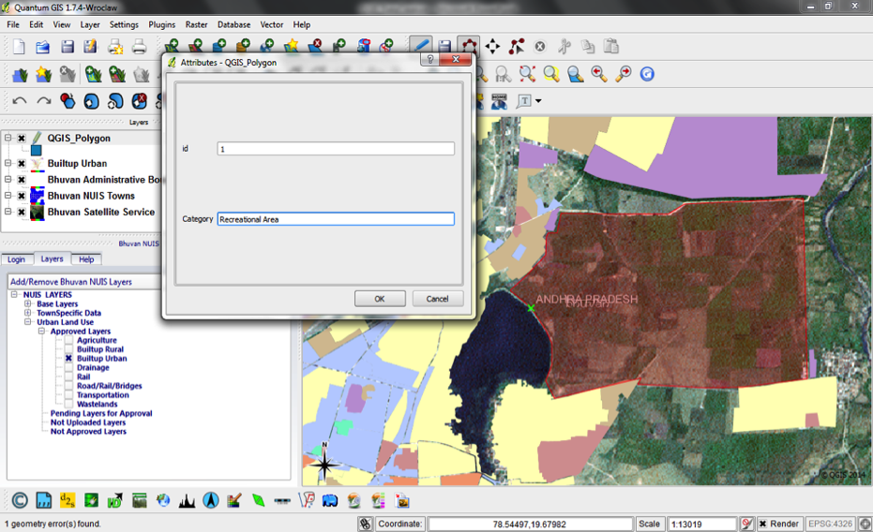
Edit & Data Creation Under QGIS

Slide 21
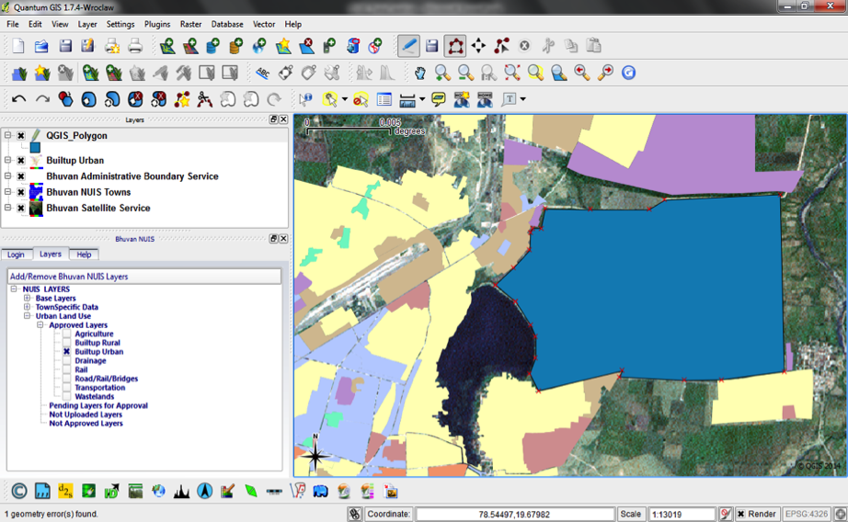
Edit & Data Creation under QGIS …… Contd

Slide 22
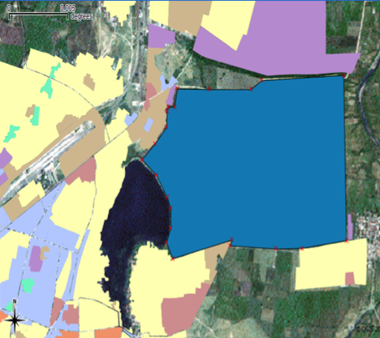
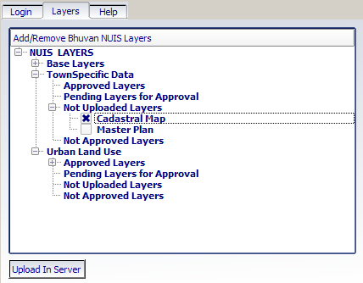
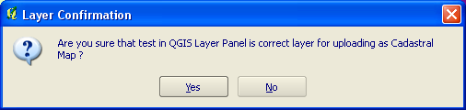
Upload/ Send Data For Approval

Slide 23
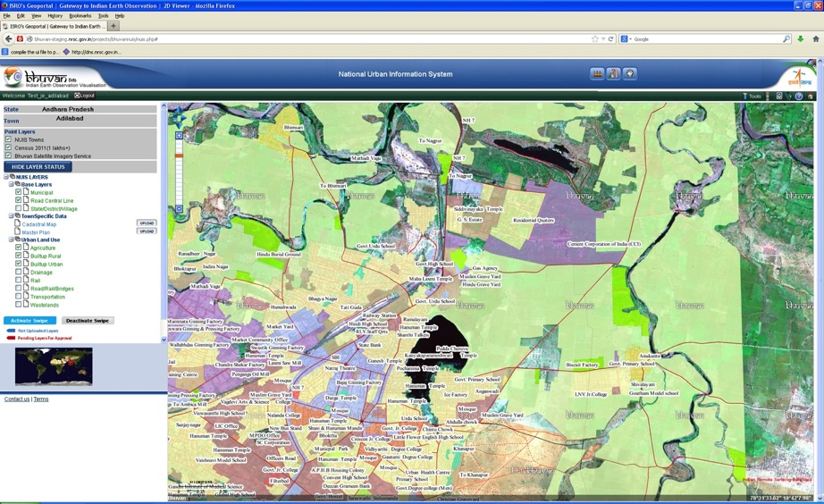
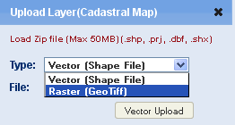
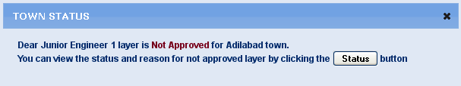
Upload/ send Data from Web Portal
Data Uploading
Status Intimation Alerts
Data Upload & Alerts

Slide 24
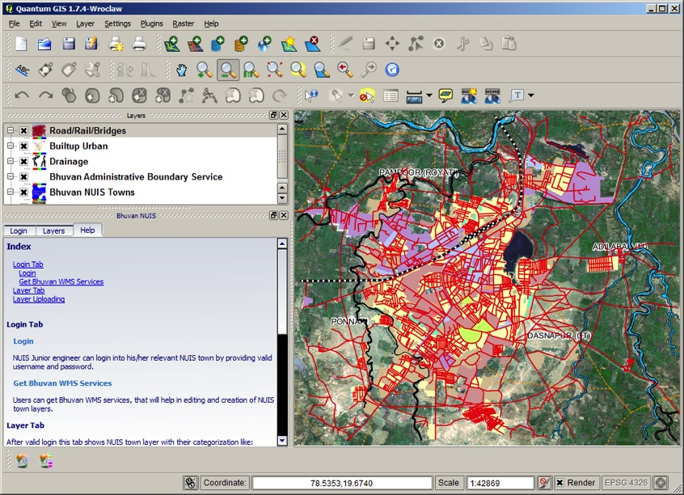
Help Module For Usage

Slide 25
Basic Steps to be followed by Approver
Step 1: “Web portal Login” through Login as TPO
Step 2: Get Alert Messages for “New Layer Upload by Creator”
Step 3: Explore data-tree on Bhuvan NUIS, Display layer & Legend
Step 4: Explore/ Analyse Layer(s) that are pending for Approval
Step 5: Based on Analysis “Approve / Reject” the layer in question
Step 6: If “Rejected”, Give Reasons – Descriptive information
Step 7: This Iteration is maintained as version until Final Approval
Step 8: If “Approved”, Go for Administrator’s Feedback
Step 9: Use Feedback facility to provide information
Further Process for Master Plan Approval could be adopted through Public domain Display using Bhuvan Geoportal.

Slide 26
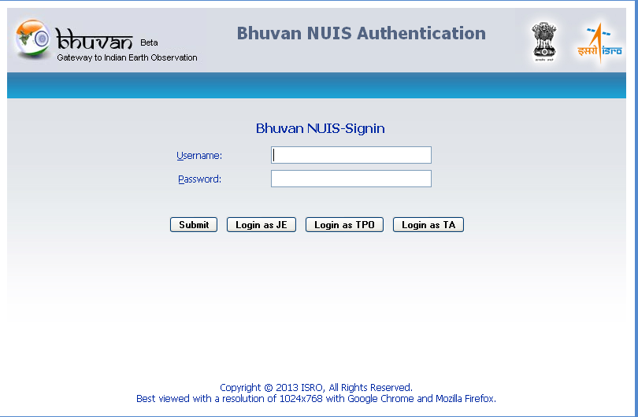
Web Portal For Approval
Login as TPO: Data Approver

Slide 27
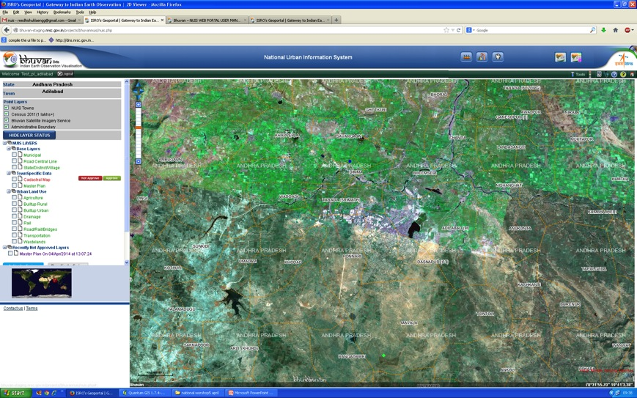
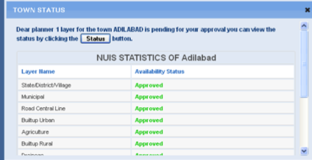
Alerts For New Updates
Alert: Data Pending Approval

Slide 28
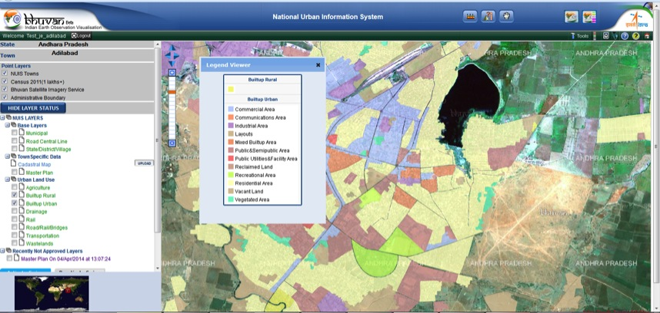
Layer Tree And Legend Display

Slide 29
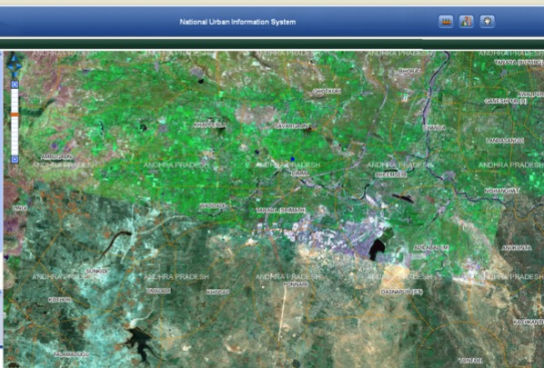
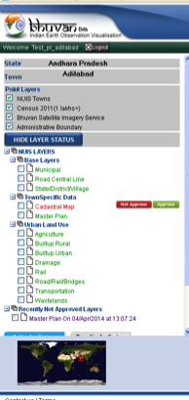



Explore for Data, “Pending Approval”
UPLODED DATA
Approved
Rejected
Uploaded data has to be approved.
Approval authority can approve it using this facility.
Clicking on button will make data in public domain.
Clicking on will reject the data and rejection reasons has to be mentioned.
On Rejection version of data will be maintained.

Slide 30
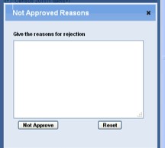

Data Rejection
UPLODED DATA
Approval
Rejected
Versions Of data for further reference
Versions of spatial data
Click on button to reject the data.
Give rejection reasons.
Version of rejected data will be maintained for further reference.

Slide 31
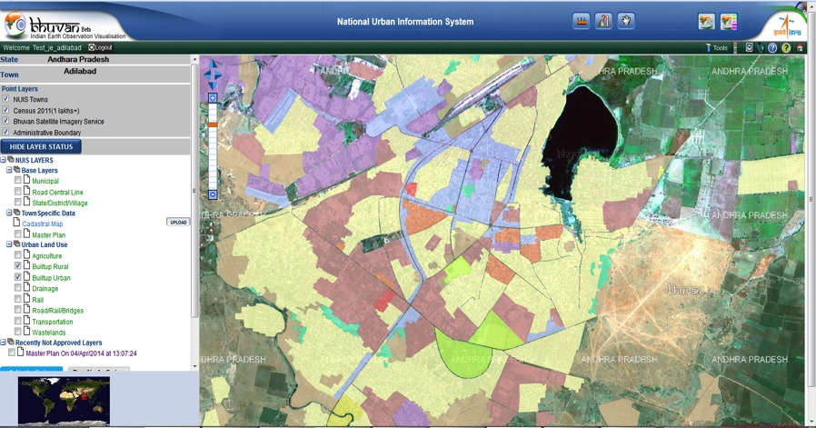
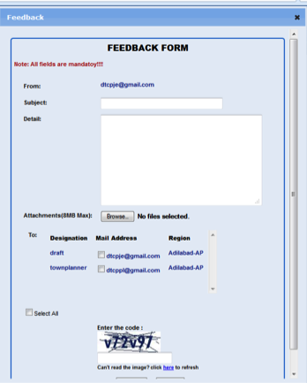
Feedback Mechanism

Slide 32
Access to Town Admin
Step 1: “Web portal Login” through Login as TA
Step 2: Explore data-tree on Bhuvan NUIS, Display layer & Legend
Step 3: Explore/ Analyse Layer(s).
Step 4: Based on Analysis “Send Feedback “
Acces to State Admin
Step 1: “Web portal Login” through submit button
Step 2: Select town under the relevant state.
Step 3: Explore data-tree on Bhuvan NUIS, Display layer & Legend
Step 4: Explore/ Analyse Layer(s).
Step 5: Based on Analysis “Send Feedback”

Slide 33
Acces to National Admin
Step 1: “Web portal Login” through submit button
Step 2: Select state.
Step 3: Select town under the relevant state.
Step 4: Explore data-tree on Bhuvan NUIS, Display layer & Legend
Step 5: Explore/ Analyses Layer(s).
Step 6: Based on Analysis “Send Feedback”

Slide 34
Web Portal Login - Town Admin
Login as TA: Town Administrator

Slide 35
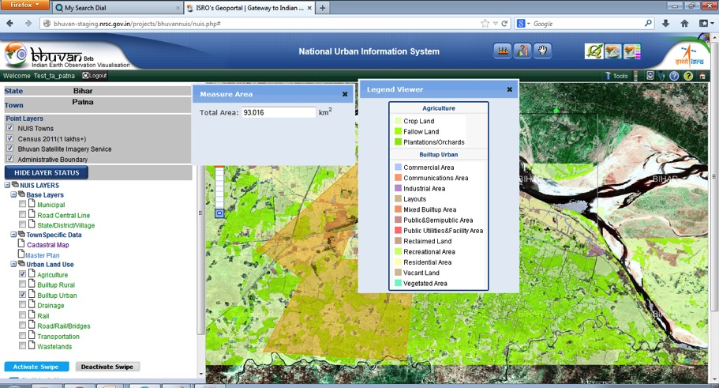
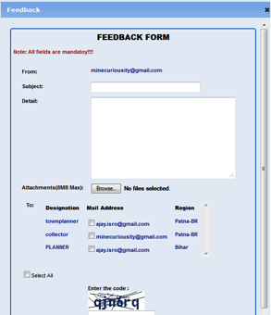
Web Portal For Town Admin……..contd

Slide 36
Web Portal Login - State & National Admin
Submit Option: For State & National Admin

Slide 37
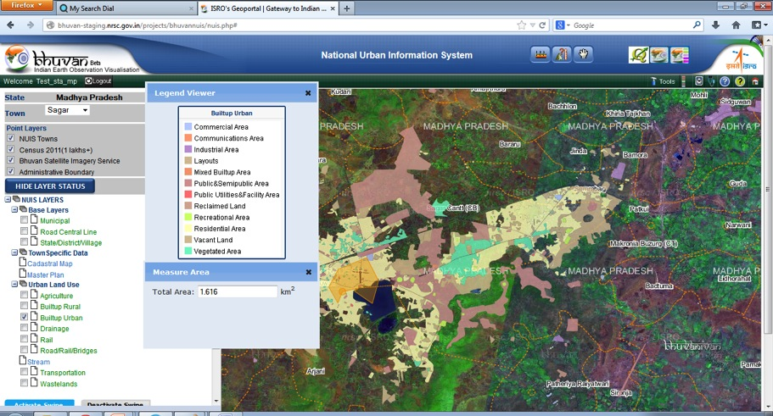
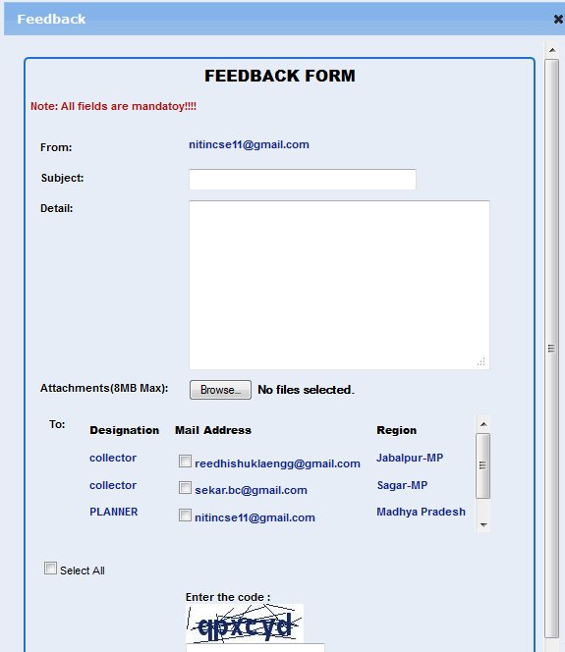

Web Portal For State Admin

Slide 38
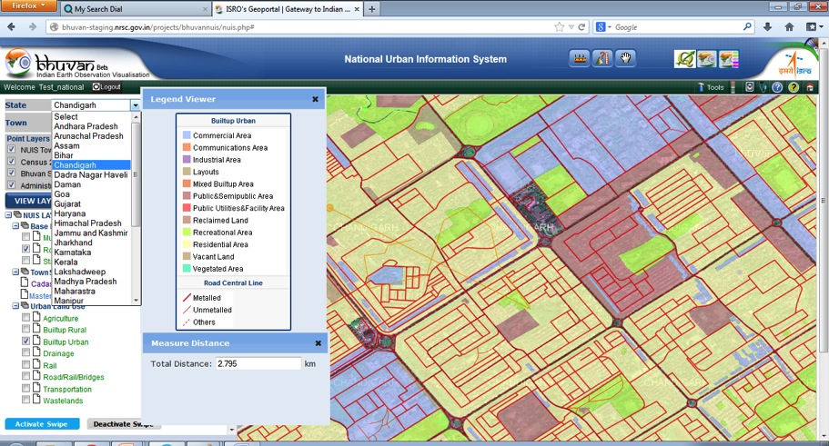
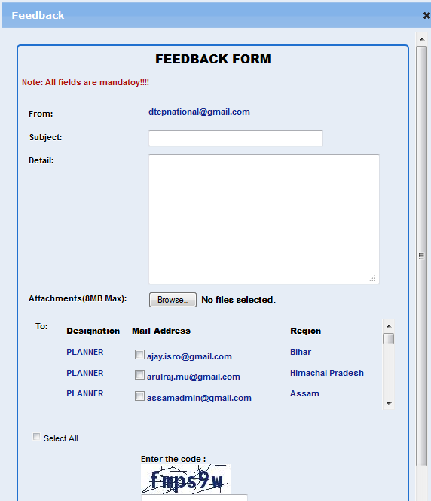
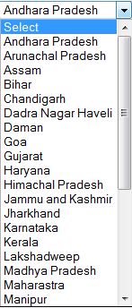
Web Portal For National Admin

Slide 39
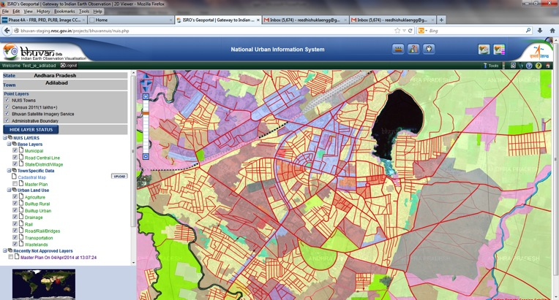
Help Documents(For further reading)
A
B
Help document for Web Portal
Help document for Bhuvan NUIS QGIS Plug-in

Slide 40






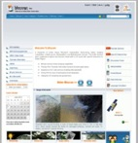
Summery – Bhuvan NUIS
Main Features
Database Server
Software Tools
Existing Data
Town Specific databases
Admin Boundaries
Ancillary Data
Creation and Updating
Bhuvan - NUIS
(Local GIS Tools)
Single point data management
Client Bhuvan server
Bhuvan data services
Update of Existing GIS data
Create New GIS data
Linking attributes to GIS
Mobile Apk for Field data
Final Data uplink to Bhuvan
Serve uploaded data as WMS
Single point data management.
Help module for Plug-in
Video lectures for download
GIS for
mapping
Geo web App
Internet
NUIS-Bhuvan Web App.
  Status Updation
  Data versioning
  Proper logging
  Feedback
Citizen View
  Overlay of Master Plan.
  Overlay of vector layers.
  Time series visualization.
  Feed back
  Town specific View :Authentication
  Junior Level Officer
    Create & Upload data
  Second Level officer
    Approve or Reject the data
    Status Update alert
    Secure Password on mobile
  Higher Level Officer
    Visualization/ Validation
  State : Access to all towns
  National : Access, state wise
Upload layers
Bhuvan services
Authentication
ISRO Bhuvan Geo-portal
Internet users
Adapability for future programs…….NUIS Phase II

Slide 41
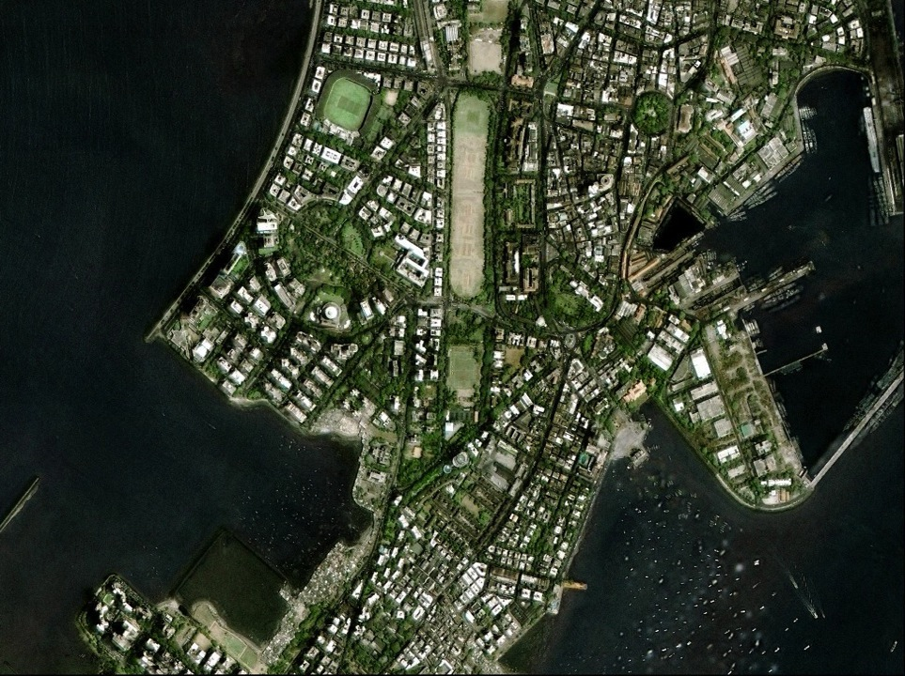
Video Lectures
(English + Hindi)
Thank you
Thank You

