Slide 1
TanDEM-X Edu Project
Phila Sibandze
3rd CEOS WGCapD Meeting
Dehradun India
23 - 25 April 2014

Slide 2
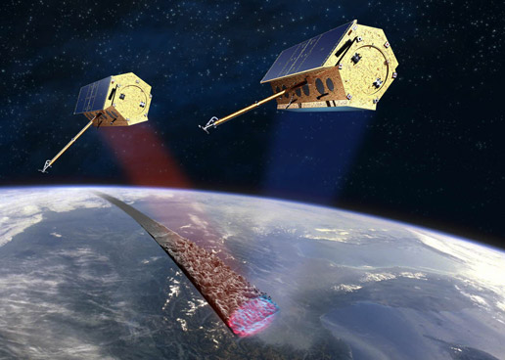
Content
Background
Objectives
Project Justification
Study Area
Action Plan
Work Plan
Project Team

Slide 3
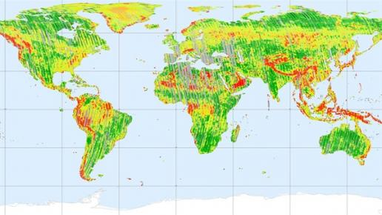
Background
Responded to a call for the TanDEM-X use.
Collaborative project between SANSA & DLR.
Discussions between SANSA & DLR.
Agreed that SANSA should take the lead.
Proposal under development.

Slide 4
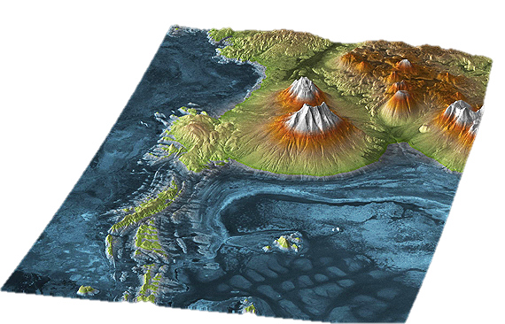
Objectives
The project should build capacity.
Increase awareness of the TanDEM-X.
Show advantages of high resolution DEM.
Chile

Slide 5
Project Justification
1. Importance
The project will contribute to the objectives of the CEOS WGCapD.
It will be the basis for information and skills development between institutions.
2. Capacity
Create the opportunity for developing capacity in SAR and DEM technology.
Establish an understanding of working with high resolution DEM for various applications.
3. Time and Cost
The project will take 6 months from the day of receiving the data. The l project cost will be covered by participating institutions (man hours, travelling, etc).

Slide 6
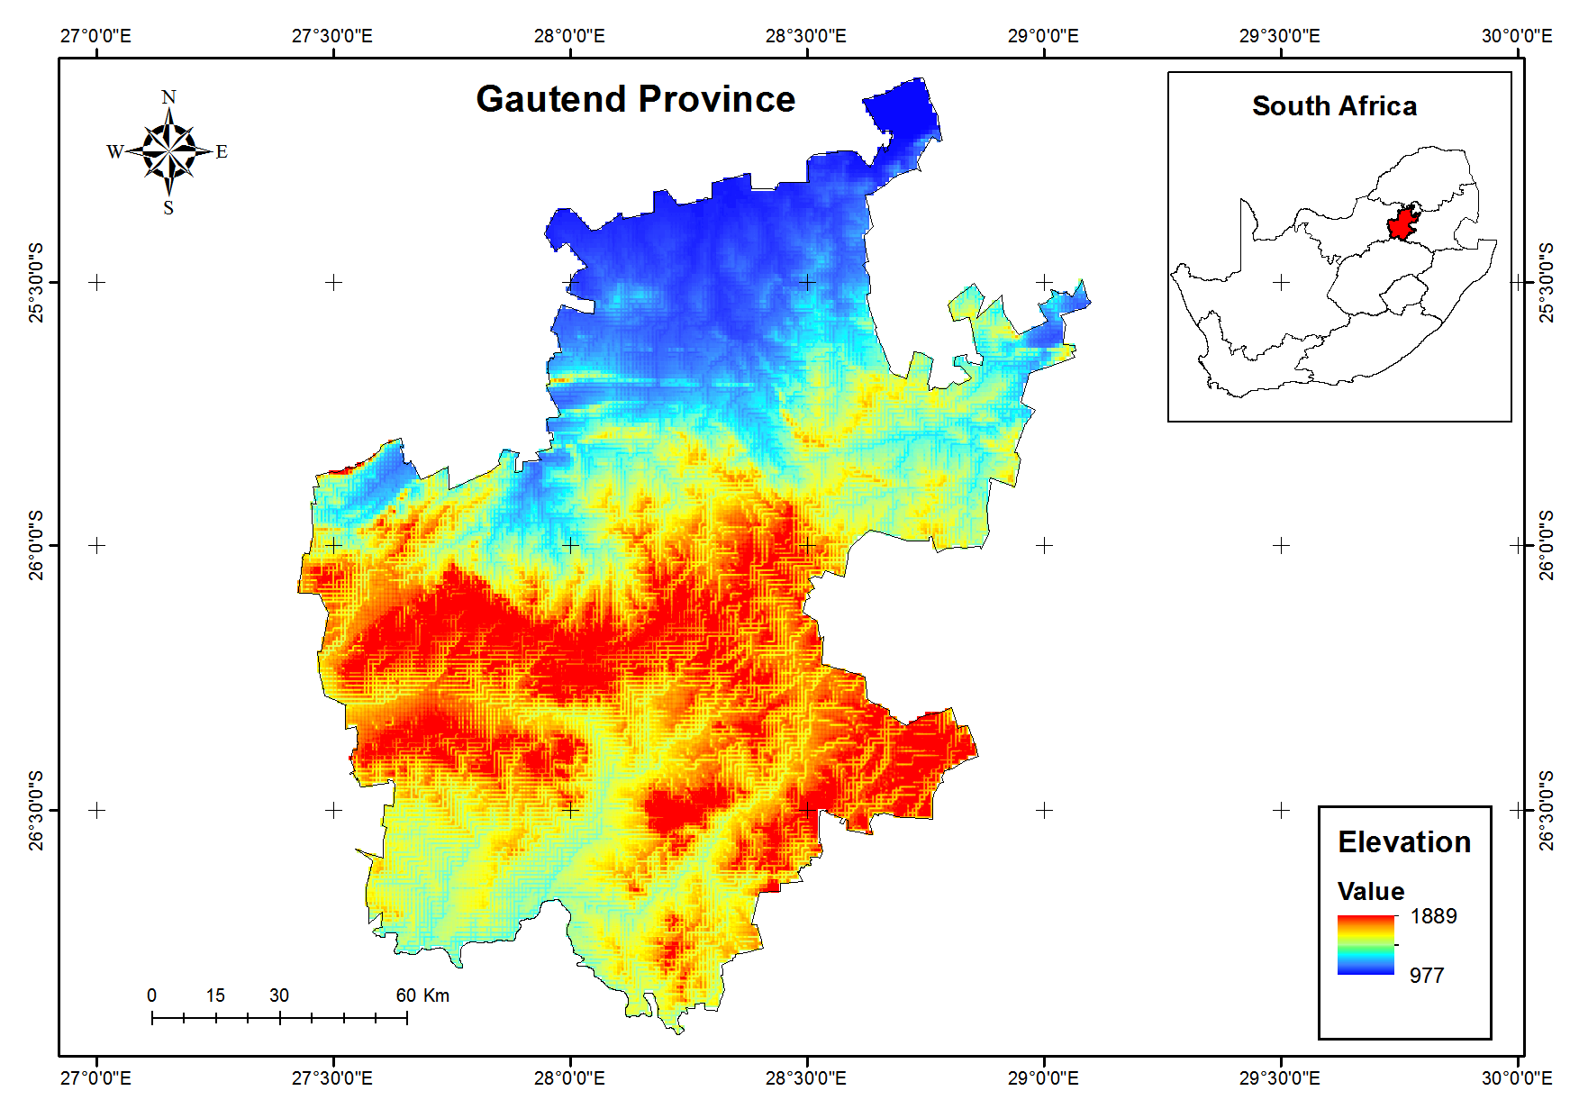
Study Area
Gauteng province of South Africa.
Covers an area of about 18 178 km².
Gauteng is the smallest but the most populated province with 12 272 263 inhabitants.

Slide 7
Action Plan
Proposal submission to acquire TanDEM-X.
Current status: Draft version sent to DLR.
Product development:
To be done by participating institutes (voluntary basis.)
WGCapD TanDEM-X Workshop:
Demonstrate the products developed for awareness.
Products and information Dissemination.
Reporting.

Slide 8
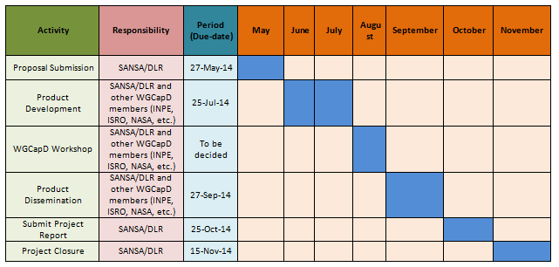
Work Plan

Slide 9
Project Team
Name | Activity | Institution
Phila Sibandze | Project Manager | SANSA
Dieter Hausamann | Co Project Manager | DLR
Nale Mudau Willard Mapurisa Clement Adjololo Radar community/expects | Technical expert | SANSA / University
? | Technical expert | DLR
WGCapD / institutions members | Technical expert | WGCapD / institutions volunteering

Slide 10
Thank you!

