Slide 1
WGCapD Collaboration with EOPOWER on Resource Facility
Nancy D. Searby/NASA,
Mark Noort/HCP International,
Jean-Christophe Desconnets/ESPACE-DEV, IRD

Slide 2
Presentation Outline
Introduction
– overview of EOPower
Objectives
– of CEOS Resource Facility collaboration
Scope
Current status
Opportunities
Way forward

Slide 3



The EOPOWER project
Earth Observation for economic emPOWERment
Mark Noort
Novi Sad GEO workshop
Novi Sad, Serbia
September 19, 2013

Slide 4









Project partners

Slide 5
What the project is about:
Create conditions for sustainable economic development
Through the increased use of Earth observation products and services
For environmental applications
Effective use of Earth observation for decision-making
Management of economic and sustainable development processes
Builds on GEONetCab, BalkanGEONET, OBSERVE, enviroGRIDS, SEOCA & EGIDA projects

Slide 6
What we will do:
Roadshow activities to promote the increased use of EO products and services for environmental applications
Create a portfolio of potential EO applications for economic development and environmental management
Enhancement of the resource facility on capacity building in the GEO web portal
Establishment of local focal points (nodes) that actively promote and provide capacity building on the use of EO for environmental applications effectively and at low-cost
Explore the establishment of a high-level forum of stakeholders
Establishment of a central feedback node

Slide 7
How will we do it?
Five general work packages:
Central feedback node, monitoring and evaluation
Capacity building
Resource facility
Science valorisation
Management

Slide 8
How will we do it (2)?
Eight regional work packages & one special package:
Southern Africa French-speaking Africa
Czech Republic & Slovakia Poland & Ukraine
Turkey and Turkish-speaking countries
Balkan Region Black Sea Region
Latin America International organizations

Slide 9
Create shared value:
Public sector
Private sector
Social sector
Opportunity for earth observation (integrated) solutions:
Integrate EO in general business / organizational process
Integrate different EO functionalities

Slide 10

Further information:
Project website: www.eopower.eu

Slide 11
GEONETCAB Capacity Building web
Desconnets J.C. (ESPACE-DEV, IRD)
Notes:
capacity buidling web is to provide information that helps decision makers, earth observations professional and scientist to be more familiar with observations applications

Slide 12
GEONetCab Capacity Building web
Current achievements (FP7 GEONetCab)
Hierarchy of Capacity Building resources

Slide 13
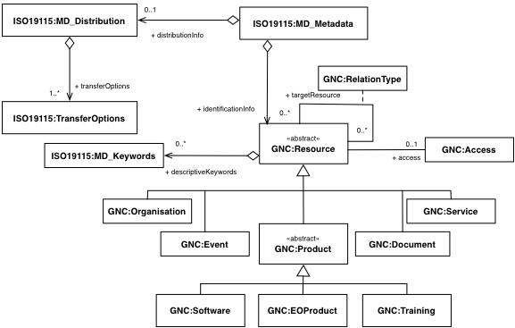
GEONetCab Capacity Building web
Current achievements (FP7 GEONetCab)
ISO 19115 metadata model to structure the description

Slide 14
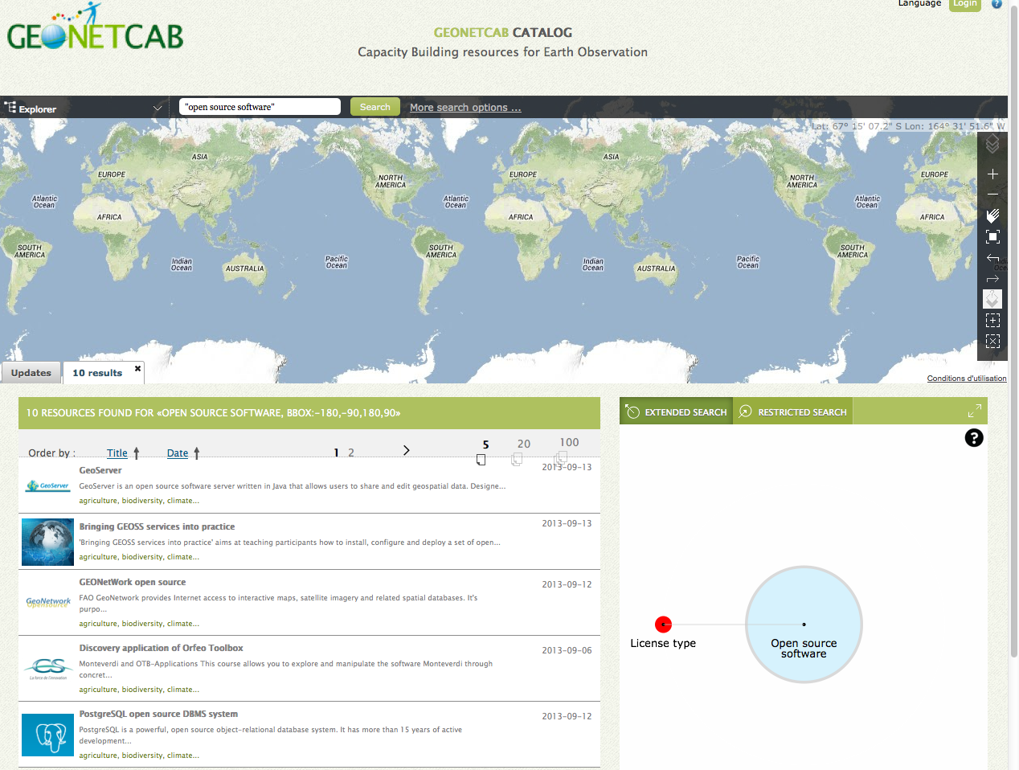
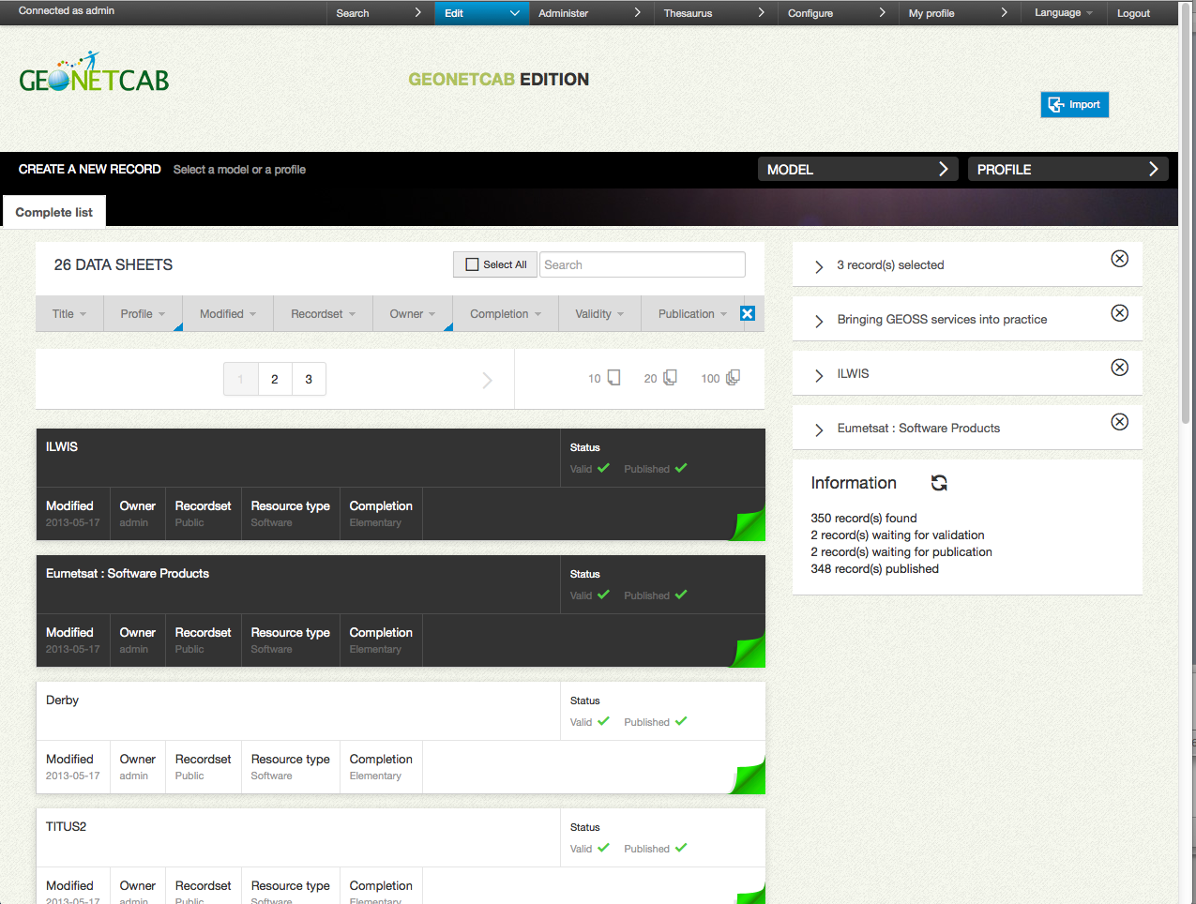
GEONetCab Capacity Building web
Current achievements (FP7 GEONetCab)
A catalog with few hundred references
Hierarchy of Capacity Building resources
ISO 19115 metadata model to structure the description
Web applications to discover, edit metadata, CSW interface to publish (OGC CSW)

Slide 15
GEONetCab Capacity Building web
Current achievements (FP7 GEONetCab)
Web applications to discover, edit metadata, CSW interface to publish (OGC CSW)

Slide 16
GEONetCab Capacity Building web
Current achievements (FP7 GEONetCab)
A catalog with few hundred references

Slide 17
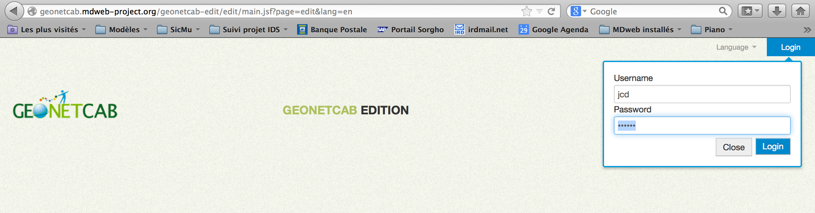
Populate the resource facility...
Simple workflow to publish or update information about a new CB resource
Notes:
1.
3. more to describe the content, access point, the geographical location if it is relevant
3. some components are available to help the filling such as autocomplétion, liste de valeurs,
4. the edit panel gives an overview of all your records with it status in term of

Slide 18
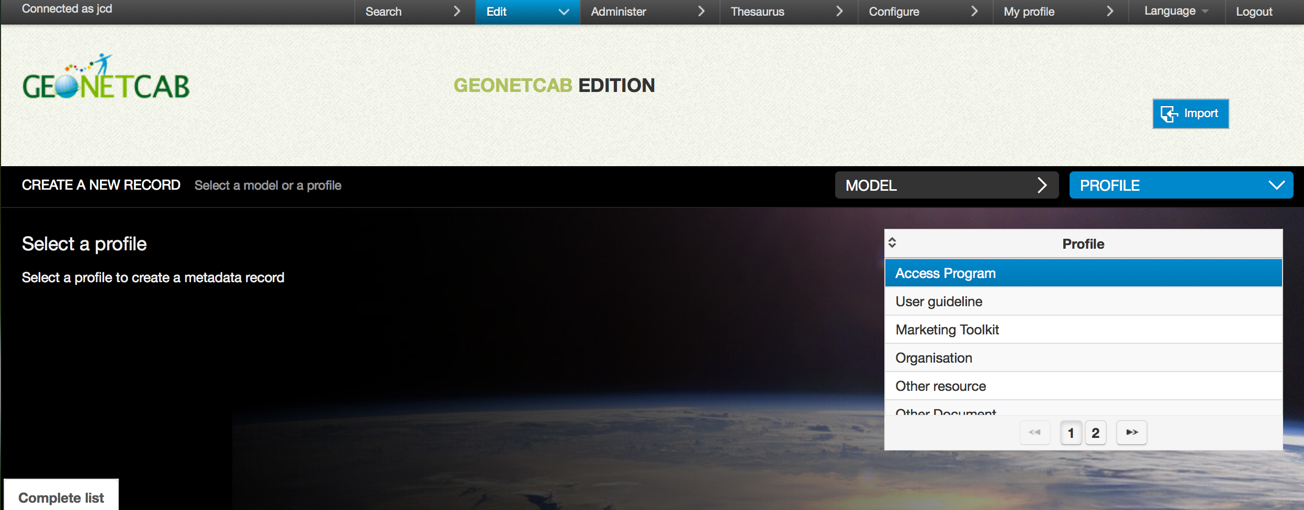
Populate the resource facility...
Notes:
1.
3. more to describe the content, access point, the geographical location if it is relevant
3. some components are available to help the filling such as autocomplétion, liste de valeurs,
4. the edit panel gives an overview of all your records with it status in term of

Slide 19
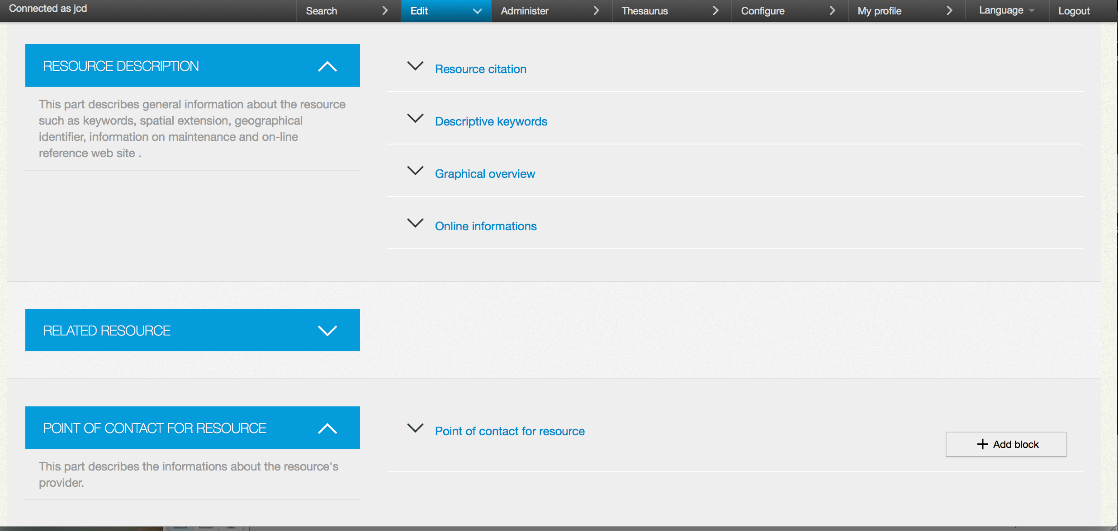
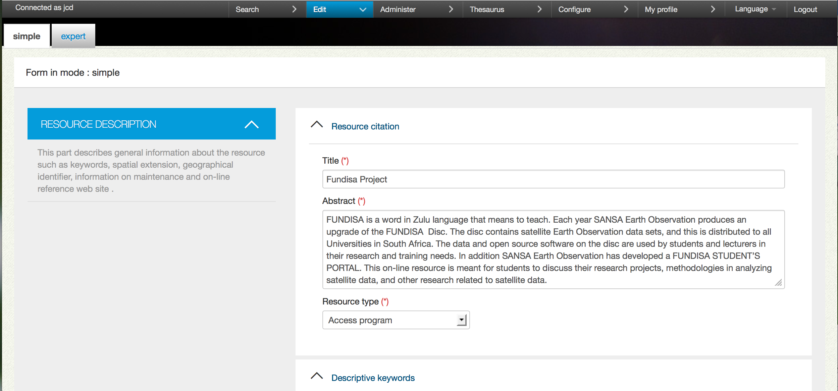
Populate the resource facility...
Notes:
1.
3. more to describe the content, access point, the geographical location if it is relevant
3. some components are available to help the filling such as autocomplétion, liste de valeurs,
4. the edit panel gives an overview of all your records with it status in term of

Slide 20
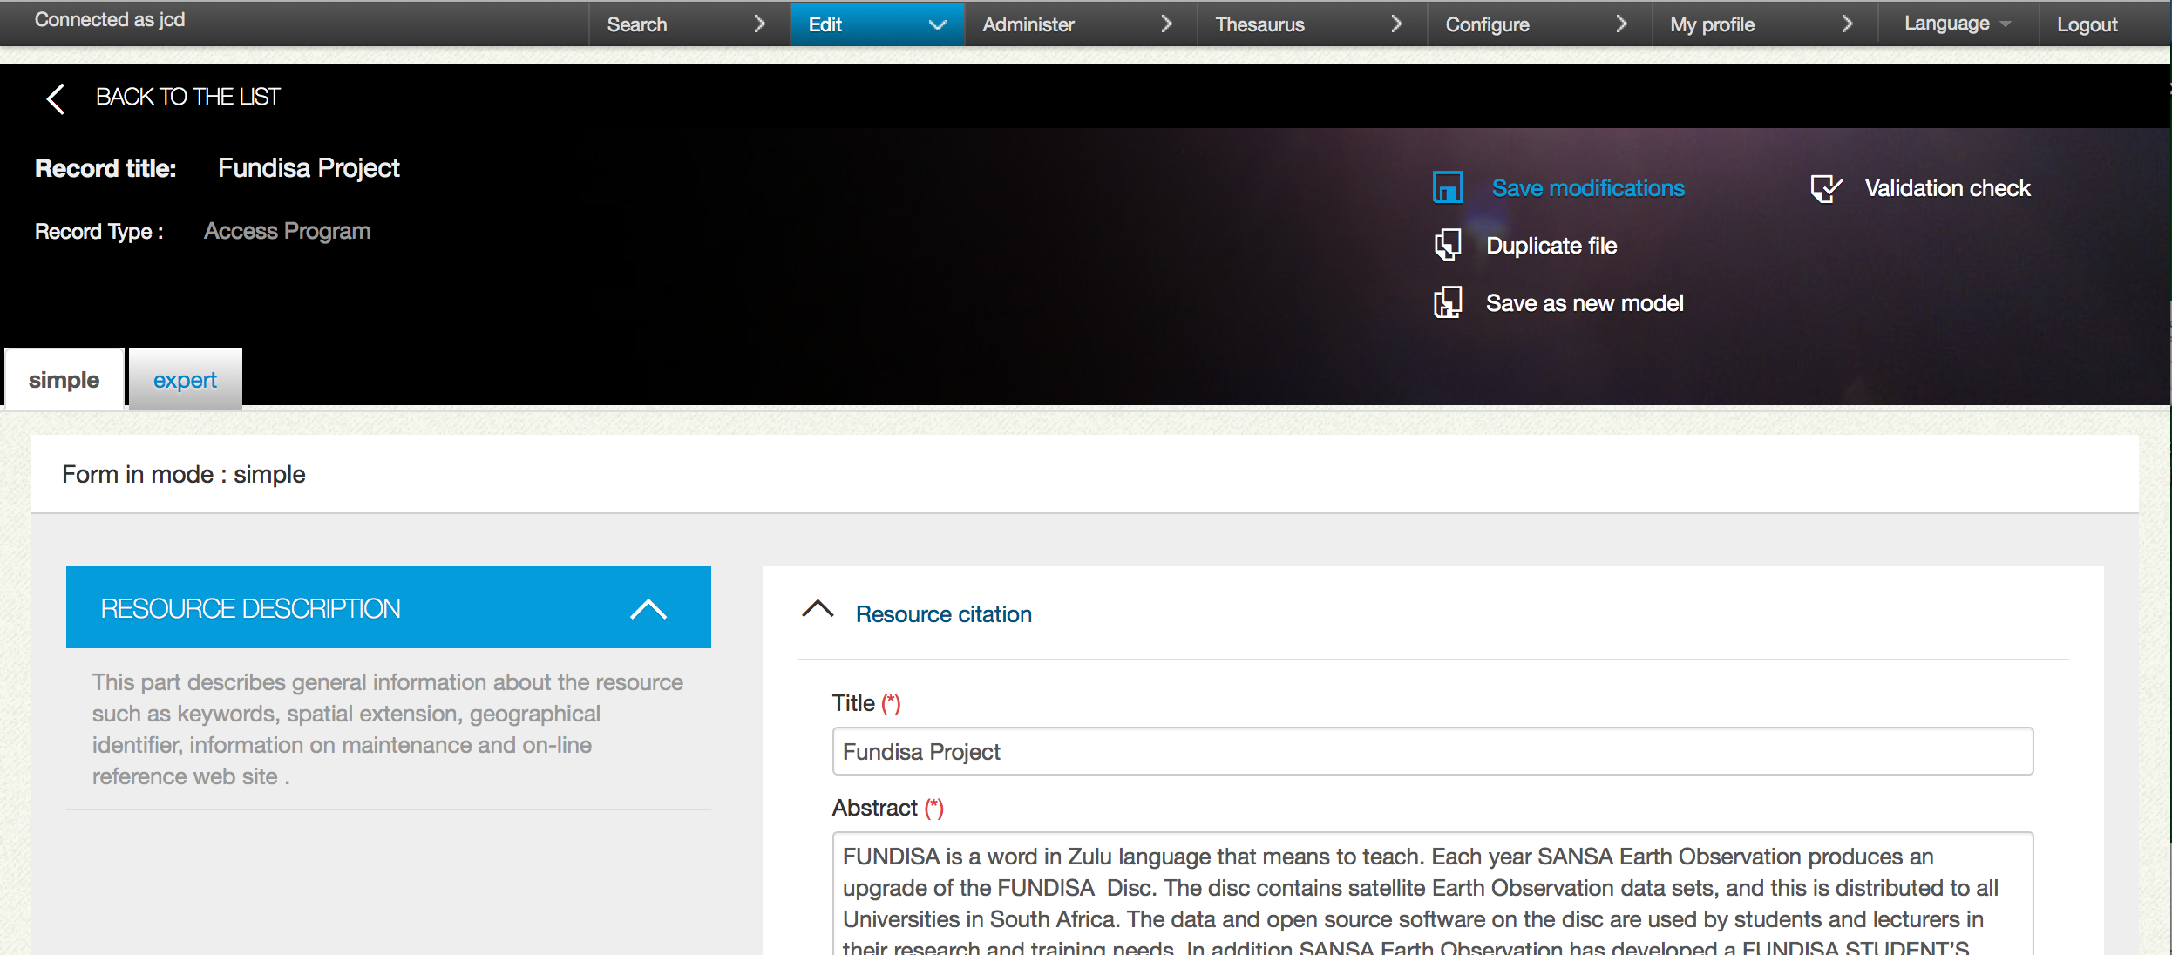
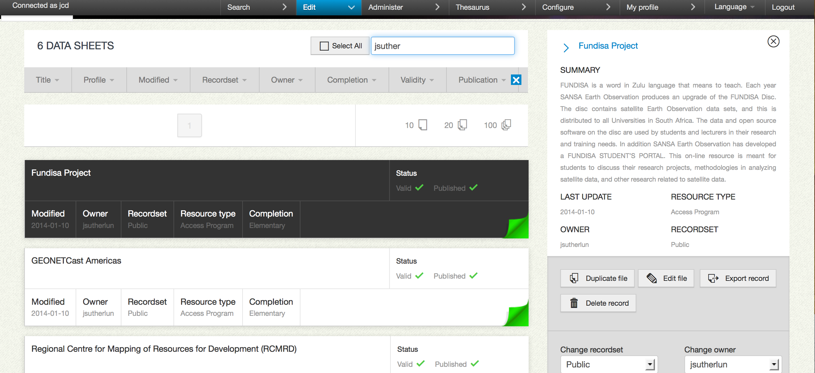
Populate the resource facility...
Notes:
1.
3. more to describe the content, access point, the geographical location if it is relevant
3. some components are available to help the filling such as autocomplétion, liste de valeurs,
4. the edit panel gives an overview of all your records with it status in term of

Slide 21
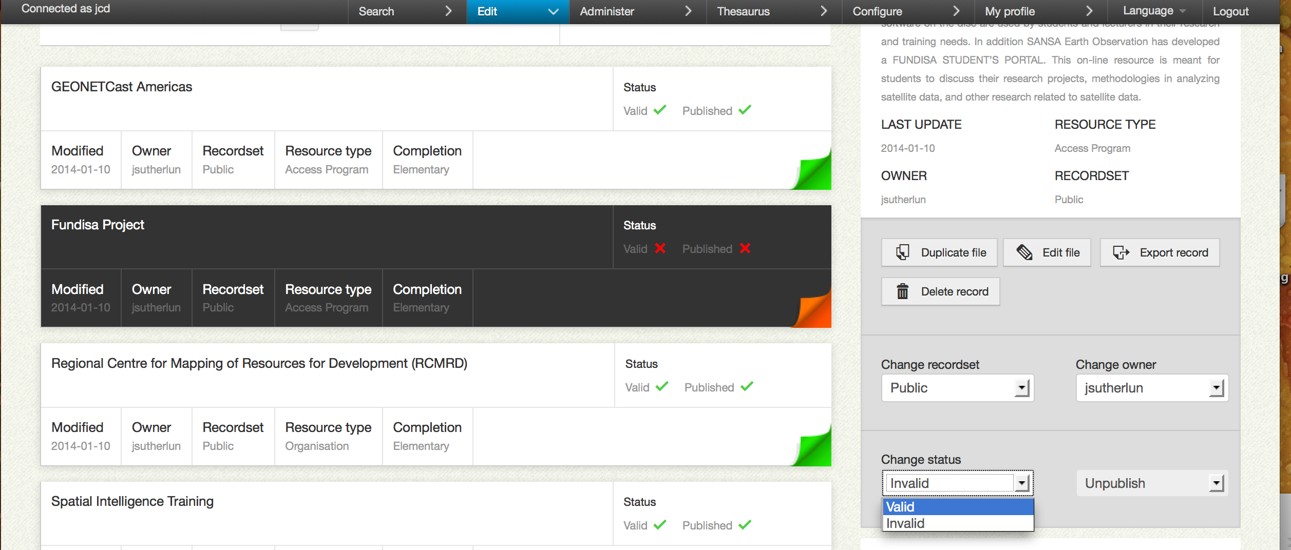
Populate the resource facility...
Notes:
1.
3. more to describe the content, access point, the geographical location if it is relevant
3. some components are available to help the filling such as autocomplétion, liste de valeurs,
4. the edit panel gives an overview of all your records with it status in term of

Slide 22
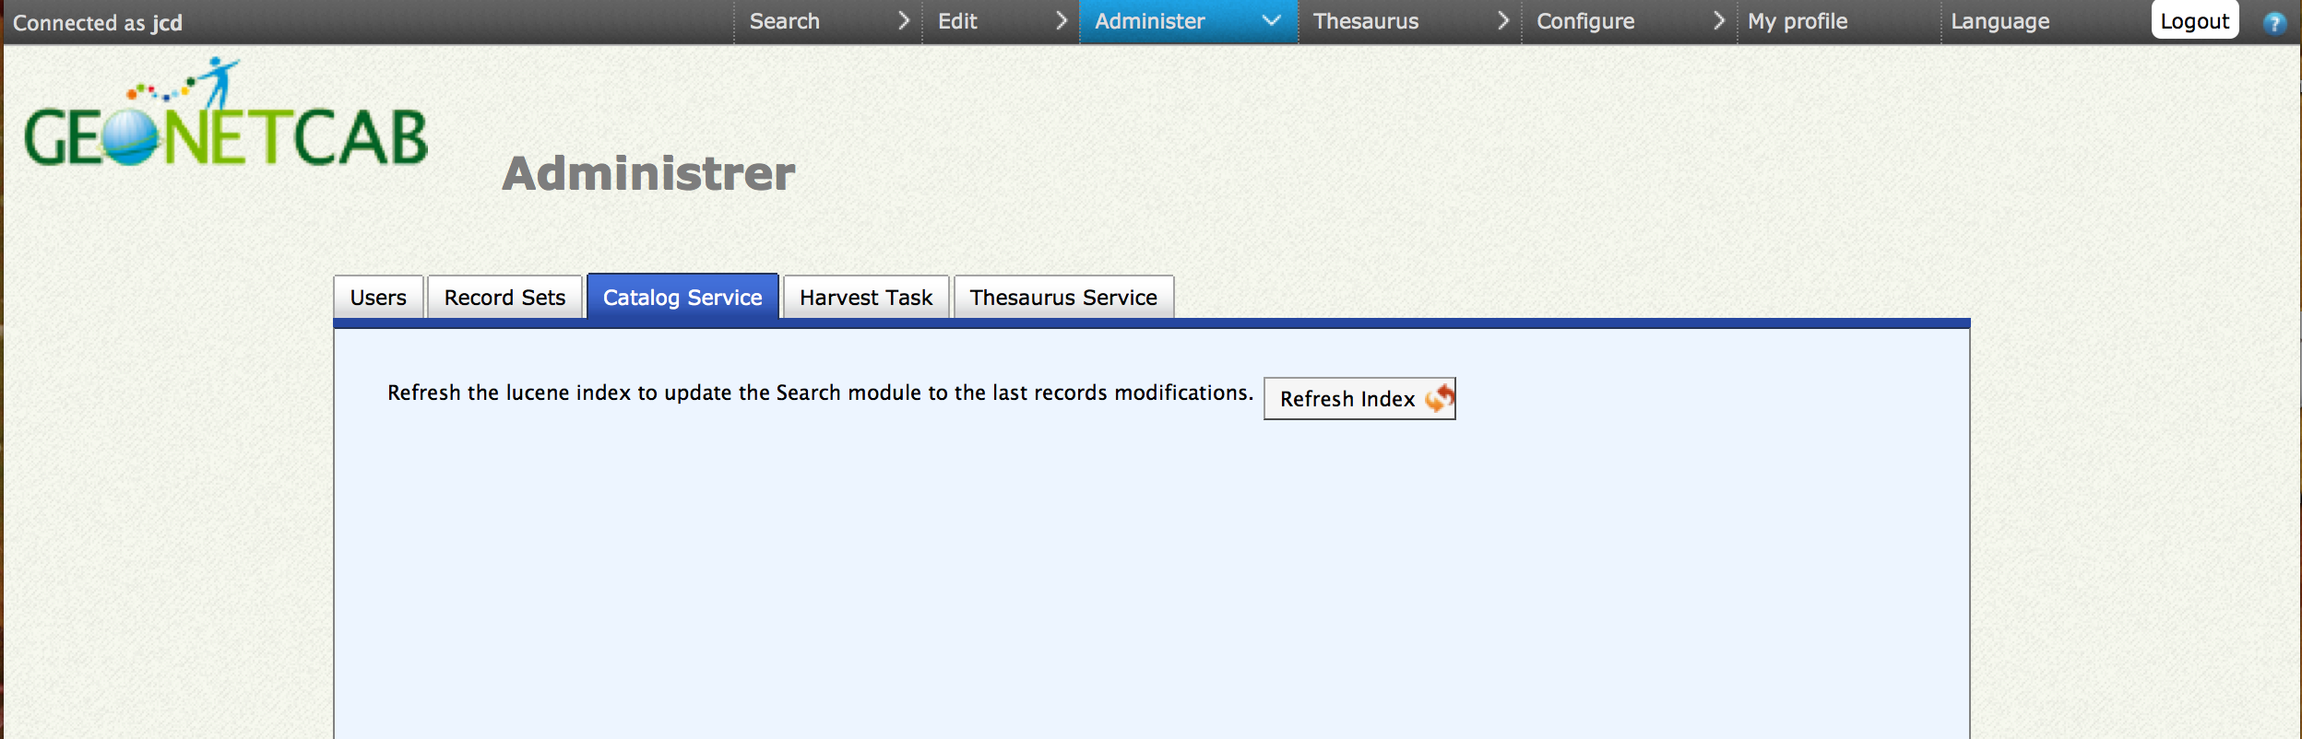
Populate the resource facility...
Notes:
faire la transition ici vers les limites
as you can see, it is not complicated

Slide 23


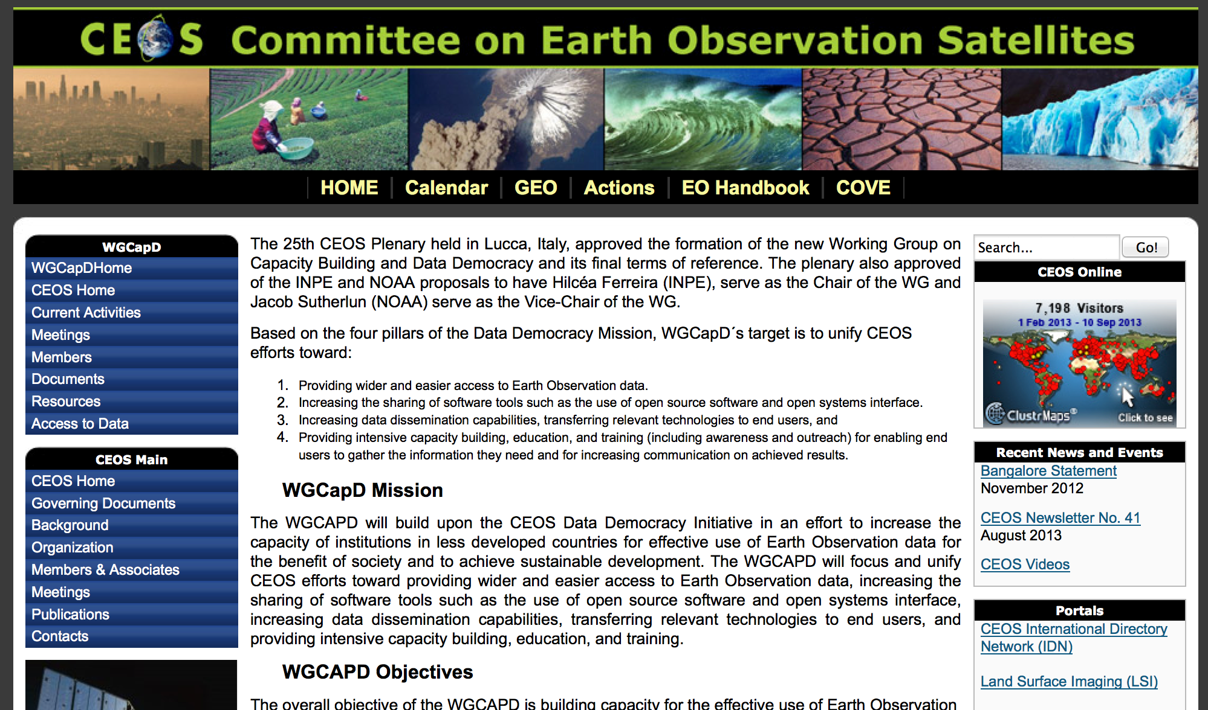
Identified barriers of current achievements
An inventory not enough comprehensive, limited visibility from others access services, including those of GEO-GEOSS
  Important work to input the description of resources and maintain the metadata up to date
  Many description are already avalaibles in others discovery service or web portal without an efficient way to interconnect
?
Notes:
transition vers le prochain transparent : aware of the differents limits

Slide 24
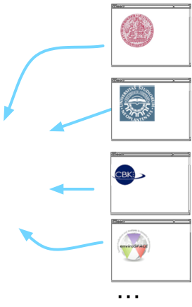
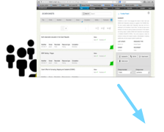

Technical framework for Resource facility
Interconnect EOPOWER discovering and cataloging platform with partner’s CB databases

Slide 25
Objectives & Scope of CEOS Resource Facility Collaboration
Identify EO capacity development opportunities and materials available from CEOS members
Make freely accessible through the resource facility
  See http://geonetcab.mdweb-project.org/search/main.jsf
Provide information that helps decision makers, policy makers, EO professionals and scientists become more familiar with EO applications and opportunities.

Slide 26
CEOS Status of CEOS Resource Facility Collaboration
EOPOWER timeline: May 2013 – May 2015
CEOS in past year:
  CEOS developed questionnaire, solicited Agency POC’s, and sent questionnaire to them
  Questionnaires were filled out and returned
  Some entries but not all have been completed.

Slide 27
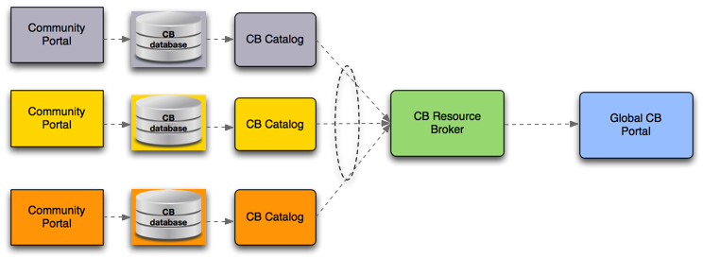

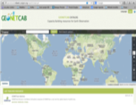

EOPOWER Status of CEOS Resource Facility Collaboration
  Architecture framework for a Capacity Building System of Systems (with IASON project)
  Brokered architecture allowing interoperability of diffferent autonomous CB systems

Slide 28
EOPOWER Status of CEOS Resource Facility Collaboration
  Main components of web distributed architecture of Capacity Building System of Systems
    The community portals and CB databases
    The component data access interface or metadata publishing
    Mediation and transformation of metadata components
    Editing component
    Discovery component

Slide 29
EOPOWER Status of CEOS Resource Facility Collaboration
  Implementation approach
    CB Systems
      Up to individual projects
      To participate, publish catalog, registry, or inventory of resources
    The Broker
      Discovery broker used in the GEOSS Common Infrastructure, based on extended ISO 19115 model, will be extended
    The Portal
      Adaptation of GeonetCAB portal

Slide 30
Opportunities and Way Forward
  Remaining EOPOWER tasks to May 2016
    Prototype system
    Methodological and technical guidelines to disseminate best practices of CB resource description with the geonetcab portal
    Integrate with GEOSS portal
    Continue to integrate content
  Remaining CEOS tasks
    Complete entries of existing questionnaire data
    Identify gaps in identified CEOS resources, and pursue contacts to obtain additional resources
    Figure out methods to build own capacity to continue to provide resources as available
    Other?

Slide 31
Thank you...
EOPOWER Resource Facility contacts
Jean.Christophe.Desconnets@ird.fr
m.noort@hcpinternational.com
Architecture Framework Capacity Building System of systems contacts
Jean.Christophe.Desconnets@ird.fr
Paolo.Mazzetti@cnr.it
CEOS EOPOWER liaison
Nancy.D.Searby@nasa.gov

