Slide 1


Updates on CEOS
Kerry Ann Sawyer
CEOS Executive Officer
and Brent Smith
WGCapD-3
Dehradun, India
23-25 April 2014

Slide 2
Overview
Mission, Objectives, and Organization
2013 CEOS Plenary Outcomes and 2014 Priorities
Overview of New CEOS Strategic Documents
Draft CEOS 2014-2016 Work Plan
SIT-29 Outcomes
CEOS WGCV-37 Meeting, Feb 17-20, 2014

Slide 3

Mission, Objectives, and Organization
CEOS WGCV-37 Meeting, Feb 17-20, 2014

Slide 4


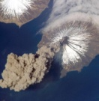



CEOS Mission and Objectives
Mission
CEOS ensures international coordination of civil space-based Earth observation programs and promotes exchange of data to optimize societal benefit and inform decision making for securing a prosperous and sustainable future for humankind.
Three Primary Objectives
To optimize the benefits of space-based Earth observation through cooperation of CEOS Agencies in mission planning and in the development of compatible data products, formats, services, applications and policies.
To aid both CEOS Agencies and the international community by, among other things, serving as the focal point for international coordination of space-based Earth observation activities, including the Group on Earth Observations and entities related to global change.
To exchange policy and technical information to encourage complementarity and compatibility among space-based Earth observation systems currently in service or development, and the data received from them, as well as address issues of common interest across the spectrum of Earth observation satellite missions.

Slide 5
Past Chair
CSA/Canada
CEOS Chair
EUMETSAT/Europe
Future Chair
JAXA/Japan
Troika (all 3 Chairs) 1-year terms
SIT Chair
CNES
Vice Chair
Vacant
2-year term
Secretariat
Chair Agency, ESA, EUMETSAT, JAXA/MEXT, NASA, NOAA
Permanent
CEO
NOAA
2-year term
SEO
NASA
Working Groups
Virtual Constellations
Ad Hoc Teams
WGCV
- Chair: CSA
- Vice Chair: DLR
WGCapD
- Chair: NOAA
- Vice Chair: SANSA
WGClimate
- Chair: NOAA
- Vice Chair: ESA
WGDisasters
- Chair: ESA
- Vice Chair: CSA
WGISS
- Chair: CNES
- Vice Chair: NASA
AC-VC
- NASA
- ESA
LSI-VC
- INPE
- ISRO
OCR-VC
- ESA
- NASA
- NOAA
OST-VC
- CNES
- EUMETSAT
OSVW-VC
- NOAA
- EUMETSAT
- ISRO
P-VC
- NASA
- JAXA
SST-VC
- ESA
- NOAA
SDCG for GFOI
- NSC
- ESA
- USGS
GEOGLAM
- CSIRO
- NASA
CTF
- JAXA
- NASA
LSSG
- INPE
21 November 2014
Notes:
The five main implementation mechanisms available to CEOS to undertake the work required on individual actions in support of GEOSS space segment targets are: CEOS Strategic Implementation Team, CEOS Secretariat, Five Standing Working Groups, CEOS Virtual Constellations, and Ad Hoc Teams.
5 CEOS Working Groups
Working Group on Capacity Building and Data Democracy (WGCapD): to develop a strategy for future CEOS activities in education and training, particularly in developing countries.
Working Group on Calibration & Validation (WGCV): to ensure long-term confidence in the accuracy and quality of Earth observation data and products.
Working Group on Information Systems & Services (WGISS): to stimulate, coordinate, and monitor the development of the systems and services which manage and supply the data and information from participating agencies’ missions.
Working Group on Climate (WGClimate): to provide guidance to CEOS regarding climate-related activities in support of various international organizations
Working Group on Disasters (WGDisasters): to coordinate CEOS activities to support the disaster management community
The CEOS Secretariat is chaired by the current CEOS host agency in support of the Plenary. In addition, to ensure the expeditious conduct of business, the past and the forthcoming CEOS chair are included in the CEOS Secretariat. The Secretariat prepares and distributes the minutes for the Plenary meetings, serves as a point-of-contact for external organizations interacting with CEOS, maintains and updates the CEOS database on space and ground segment activities, produces other periodic publications such as the CEOS Newsletter and Annual Report, ensures communications among members between meetings, reports at each Plenary session on its activities and the status of action items from previous Plenary meetings and perform other tasks as assigned by the CEOS Plenary.

Slide 6
CEOS Working Groups
Working Group on Calibration and Validation (WGCV)
  To ensure long-term confidence in the accuracy and quality of Earth observation data and products
  Working Group on Information Systems and Services (WGISS)
  To coordinate the development of Earth observation satellite systems and services which manage and supply the data and information from CEOS Agencies’ missions
Working Group on Capacity Building and Data Democracy (WGCapD)
  To increase the capacity of institutions in less developed countries for effective use of Earth Observation data for the benefit of society and to achieve sustainable development
Working Group on Climate (WGClimate) Jointly led with CGMS
  To facilitate the use of Essential Climate Variable (ECV) time-series through coordination Member Agencies’ initiatives and activities
Working Group on Disasters (WGDisasters) NEW
  Increase and strengthen the contribution of Earth Observation satellite to the various disaster risk management phases and raise the awareness on the benefits of using satellite Earth Observation in all phases of disasters.
Working Groups enhance technical cooperation among CEOS Agencies in specific topical areas with broad international benefit.
Notes:
Working Groups typically address topics such as calibration/validation, data portals, capacity building, and common data processing standards that area shared across a wide range of Earth observation domains. As a consequence, their activities are intimately connected with, and complementary to, the work of the Virtual Constellations and are often viewed as “cross-cutting” mechanisms within CEOS.

Slide 7
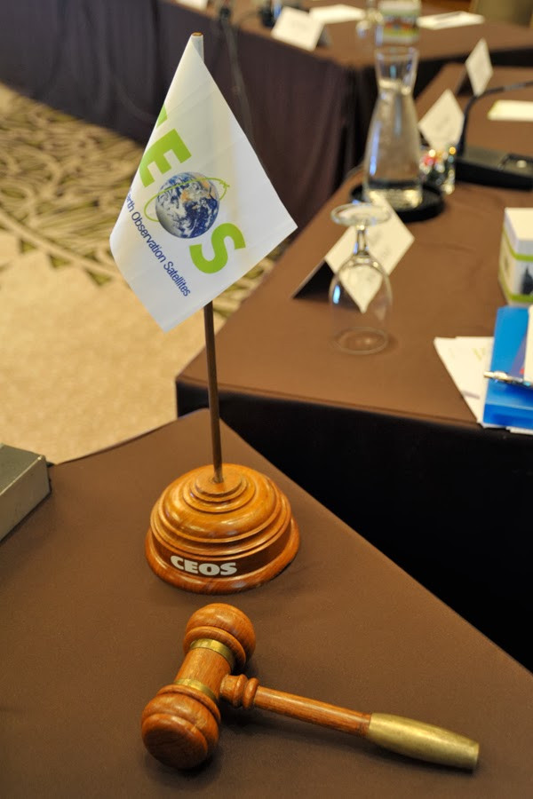
2013 CEOS Plenary Outcomes and 2014 Priorities
CEOS WGCV-37 Meeting, Feb 17-20, 2014

Slide 8

Outcomes from 27th CEOS Plenary
Endorsed the membership of the Vietnam Academy of Science and Technology (VAST, Member) and Geoscience Australia (GA, Associate)
Endorsed the proposed CEOS Self Study documents, including the CEOS Terms of Reference, Strategic Guidance, Governance and Processes, and the Terms of Reference of several core CEOS functions
Endorsed the updated Virtual Constellation Process Paper
Agreed that CEOS would by 15th November provide its inputs on the draft GEO Ministerial Declaration and draft Vision for GEO 2015, and that it would formulate a response to the outcomes of the GEO Ministerial at SIT-29
Received updates on the GEO Water Cycle Report, the Blue Planet task, the GEO Biodiversity SBA, and the Carbon Task Force, anticipating possible future engagement
Approved Iceland as a new Permanent Geohazard Supersite, and requested a recommendation to SIT-29 on the process for endorsing future Supersites
  The following CEOS Ad hoc Working Groups were approved by Plenary to continue activities:
    Ad hoc Space Data Coordination Group for GFOI (SDCG)
    Ad hoc Working Group on GEOGLAM
    CEOS Carbon Task Force (continued through milestone of adoption of report at SIT-29)
CEOS WGCV-37 Meeting, Feb 17-20, 2014

Slide 9
Outcomes from 27th CEOS Plenary – con’t
Endorsed the CEOS Disaster Risk Management Earth observation requirements, and agreed to consolidate CEOS Agencies’ response for its three pilots (floods, seismic risks and volcanoes)
Endorsed the creation of a new standing Working Group on Disasters, with ESA and CSA as its initial Chair and Vice Chair respectively
Received an update from the Space Data Coordination Group for GFOI on the status of the Global Baseline Strategy, and the formulation of new Space Data Services
Endorsed the CEOS Acquisition Strategy for GEOGLAM Phase 1
Endorsed the creation of a joint CEOS-CGMS Working Group on Climate, adopting un-amended the Terms of Reference endorsed by the CGMS Plenary (CGMS-41)
Adopted the Montreal Statement (next slide)
CEOS WGCV-37 Meeting, Feb 17-20, 2014

Slide 10

Montreal Statement – 2013
27th CEOS Plenary
CEOS Agencies have agreed to continue and enhance their cooperation to respond effectively to Earth Observation users’ needs…by achieving integration across the full range of Earth observations, by closing important observational gaps, and by promoting the sharing, and improving access to and use of, CEOS Agency data. This cooperation will be expressed through global-level initiatives and projects, including:
In a joint effort with the Coordination Group for Meteorological Satellites (CGMS), development and provision of climate data records, in support of climate monitoring, research, and services;
Coordinated space-based observations to support the effective monitoring and management of the worlds’ forested regions to support any future international climate agreement, including Reducing Emissions from Deforestation and forest Degradation, sustainable forest management, conservation and carbon enhancement (REDD+);

Slide 11
Montreal Statement – 2013
27th CEOS Plenary
Implementation of the 1st phase of the acquisition strategy for supporting the monitoring of agricultural production at national, regional and global levels which is complementary to the Agricultural Market Information System (AMIS) initiative;
Implementation of a strategy for observing and assessing the global carbon cycle;
Application of space-based Earth observations to support research in biodiversity, the world’s oceans, and an improved understanding of the global water cycle; and
Strengthened support to the disaster management community through both the creation of a new CEOS Working Group on Disasters and the development of a global observation strategy.
CEOS will accomplish these activities through contributions from its Virtual Constellations and Working Groups, among other mechanisms. CEOS will continue to address user needs, for data quality, data discovery and access, and capacity building.

Slide 12
Overview of new CEOS strategic documents
CEOS WGCV-37 Meeting, Feb 17-20, 2014

Slide 13
CSS Outputs
The final output of the CEOS Self Study effort is a set of strategic documents that will guide CEOS in the future.
  CEOS Terms of Reference (ToR)
  CEOS Strategic Guidance (SG) (~10 year life)
  CEOS Governance & Processes (GP) (~5 year life)
  Element ToRs for: CEOS Chair, SEC, SIT Chair, CEO, SEO
All documents can be found on the CEOS website under the “Governing Documents” link.
CEOS WGCV-37 Meeting, Feb 17-20, 2014

Slide 14
Input and Feedback Process
Broadly engage the CEOS community and leadership during the CSS development and review process to produce a set of strategic documents for endorsement at the 2013 CEOS Plenary.
  Multiple SIT and Plenary Meetings
  19 Past and Present Leadership Interviews
  80 individuals contributed to the Study Reports
  11 Agencies contributed to the Topical Teams
  8 Agencies represented on the Steering Team
  12 Agencies provided feedback during 4 Town Hall telecons
CEOS WGCV-37 Meeting, Feb 17-20, 2014

Slide 15
CEOS Terms of Reference - Highlights
Heavily based on the current ToR that has been in existence since 1984, with minor amendments
Definition: “CEOS Agencies” = Members and Associates
Members = Government organizations that have currently operating space-based programs or at least in Phase-B (detailed design)
Associates = Coordination groups and scientific or governmental bodies with significant activities that support CEOS objectives.
Provides a definition of temporary “Ad Hoc Teams” to investigate specific areas of interest, cooperation and coordination. Continuation requires confirmation at each annual Plenary meeting.
CEOS WGCV-37 Meeting, Feb 17-20, 2014

Slide 16
Strategic Guidance – Highlights #1
Short, 9-page document (7 pages of content)
Sections are consistent with the final set of CEOS Essential Questions
What are CEOS’s scope and Purpose?
What is the value of CEOS to others?
What are CEOS’s essential outcomes and relationships?
How does CEOS define and measure success?
What are the greatest risks and opportunities for CEOS?
The Strategic Guidance (SG) document contains the following sections:
Introduction and Background
CEOS Mission and Objectives
Goals
Value to Stakeholders
Approach
Definition and Measures of Success
Challenges, Opportunities, and Strategic Direction
CEOS WGCV-37 Meeting, Feb 17-20, 2014

Slide 17
Strategic Guidance – Highlights #2
Introduction and Background
  CEOS established in 1984
  Significant increase in Earth observation satellites ...
  109 currently operated by CEOS Agencies.
  Expanding user community that is becoming more organized ... GEO, GCOS, UNFCCC, UNISDR, etc.
CEOS Mission and Objectives
  Mission Statement: CEOS ensures international coordination of civil space-based Earth observation programs and promotes exchange of data to optimize societal benefit and inform decision making for securing a prosperous and sustainable future for humankind.
  Objectives: Optimize benefit of Earth observations, serve as focal point for international coordination, exchange information.
CEOS WGCV-37 Meeting, Feb 17-20, 2014

Slide 18
Strategic Guidance – Highlights #3
Goals
  Reduce observational gaps
  Improve coordination of Earth observations
  Promote Data Democracy by improving access and use of data
  Respond to user needs
Value to Stakeholders
  Coordinated Earth observation missions and data for societal benefit
  Provide data processing systems, products and science
  Forum for partnerships
Approach
  Internal coordination ... Agencies, Working Groups, Virtual Constellations, Ad Hoc Teams, SEC, SIT and Plenary.
  External Coordination ... via CEOS Chair with stakeholders
CEOS WGCV-37 Meeting, Feb 17-20, 2014

Slide 19
Strategic Guidance – Highlights #4
Definition and Measures of Success
  Achievement of its goals by measureable results for stakeholders. Sometimes hard to quantify, such as Agencies becoming motivated to contribute or lead
  Sustainability and engagement are critical to CEOS success
  Regular review of activities is needed to address viability and commitment
  Projects should have defined requirements, milestones, schedule and management plans
Challenges, Opportunities and Strategic Direction
  Challenges: Engaging stakeholders, maintaining leadership continuity and participation, managing cyclic and scarce resources
  Opportunities: Building capacity for Earth observation products, identifying gaps and promoting complementarity
  Strategic Direction: Optimize societal benefit, remain the focal point for international coordination of space-based Earth observations
CEOS WGCV-37 Meeting, Feb 17-20, 2014

Slide 20
Governance and Processes
Highlights #1
21 pages including 2 annexes. 15 pages of core content.
Consistent with the output of the Topical Teams, which were arranged around 5 themes.
Governance and Processes (GP) document includes ...
(1) Introduction and Background
(2) Organizational Roles and Responsibilities
(3) Decision-Making Process
(4) Major Meetings
(5) Membership and Participation
Annex 1 – Current list of Working Groups, Virtual Constellations,
Ad Hoc Teams
Annex 2 – Current list of CEOS Agencies and year of acceptance
CEOS WGCV-37 Meeting, Feb 17-20, 2014

Slide 21
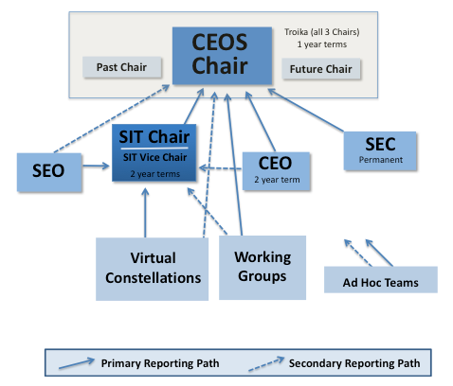
Governance and Processes – Highlights #2 Organizational Roles and Responsibilities
Note Primary and Secondary reporting paths
Primary leadership positions have dedicated ToRs
VCs have their own Process Paper and ToRs
Working Groups also have their own ToRs.
GEO SBA Coordinators removed from CEOS structure. This decision was coordinated with GEO.
Temporary “Ad Hoc Teams” have reporting paths to CEOS Chair or SIT Chair.

Slide 22
CEOS Chair and SIT Chair
The CEOS Chair provides overall leadership and guidance of the organization and its activities with regard to governance, stakeholder relationships, and mission objectives and priorities as implemented by the CEOS Working Groups, Virtual Constellations, and Ad Hoc Teams.
Works with the SIT Chair and the Secretariat to build capacity and complementarity among CEOS Agencies, stakeholders, and partner organizations by broadening the participation in and contributions to CEOS Earth observation activities
The SIT Chair provides strategic guidance on the direction, progress, and status of implementation activities in relation to the established priorities, commitments, and partnerships of the CEOS organization and the governance, stakeholders, and the accomplishment of deliverables and societal benefit contributions of the VCs and WGs. Oversee the activities of the CEOS VCs and, as delegated by the CEOS Chair, assist in overseeing the WGs. Oversight of these entities may include, but is not limited to, regular telecons with VC Co-Leads and WG Chairs to provide strategic guidance, understand progress and issues, and support the resolution of issues that require agency coordination.

Slide 23
Beyond the CSS … Part 1
Here are some future initiatives related to the CSS ...
Work Plan … As part of the initial CSS objectives, it was decided that a rolling 3-year CEOS Work Plan would be developed in early 2014 (to be updated annually). Development of the new Work Plan will be discussed in more detail shortly.
Website … The CEOS website will need revisions to the main content (background, org chart, etc.) to accurately reflect the new strategic document content. This will be led by Brian Killough (SEO) with support from Kerry Sawyer (CEO) and approval from the SEC.
CEOS WGCV-37 Meeting, Feb 17-20, 2014

Slide 24
Beyond the CSS … Part 2
New Working Group and New Initiatives Process Papers … CEOS has not had a formal “tactical” process document for new CEOS Working Groups or new CEOS Initiatives. A Process Paper does exist for New Virtual Constellations, so a similar output is likely needed for Working Groups and New Initiatives. Many CEOS members have expressed a desire for additional details regarding the processes by which new groups or new work are proposed and endorsed by CEOS.
New Document Management System ... CEOS has used several tools for managing documents in the past ... Website and Google-Docs. These options are not a good long-term solution and do not utilize a consistent organizational scheme. CEOS should consider options for the future to maintain a record of our key documents.
CEOS WGCV-37 Meeting, Feb 17-20, 2014

Slide 25
Draft CEOS 2014-2016 work plan review/discussion
CEOS WGCV-37 Meeting, Feb 17-20, 2014

Slide 26

CEOS 2014-2016 Work Plan
Purpose: To set forth near-term objectives and deliverables designed to achieve the goals outlined in the CEOS Strategic Guidance document.
It includes a description of CEOS activities to be executed in the current calendar year (2014), and summarizes anticipated activities for the subsequent two years (2015-2016).
Detailed information, including planned milestones and deliverables, accomplishments, and issues, will be available and routinely updated in the CEOS Action Tracking System
CEOS WGCV-37 Meeting, Feb 17-20, 2014

Slide 27
Three-Year CEOS Work Plan
The last of the CSS Strategic Documents
Under direction of the CEOS Chair and in consultation with CEOS leadership, the CEO develops the CEOS Work Plan (three-year longevity, updated annually).
Use the Montreal Statement as a basis for CEOS priority objectives for 2014 and 2015-2016
Retains original intention to provide overall guidance for CEOS on expected outcomes for CEOS and its stakeholders
Content will include a concise characterization of the main deliverables, their delivery schedule and associated high-level activities
In addition to providing an overview for Plenary, this plan will also inform the progress monitoring activities carried out during the course of the year by the SIT and CEOS Chairs.
Will cover the full three-year period, with more detailed information available for the first year. It is anticipated that the Work Plan will maintain the current thematic structure, with each theme addressed in no more than 1 and 1/2 pages. This theme information will be presented in tabular form with a generic structure that is common across all themes (e.g. Deliverable/Objective Identifier and Description, Proposed Completion Date, Background Information, Responsible CEOS Entity
CEOS WGCV-37 Meeting, Feb 17-20, 2014

Slide 28
Nine Thematic Areas in the 2014-2016 CEOS Work Plan - DRAFT
Climate Monitoring, Research, and Services
Carbon Observations, Including Forested Regions
Observations for Agriculture
Observations for Disasters
Capacity Building, Data Access, Availability and Quality
Support to Other Key Stakeholder Initiatives
Advancement of the CEOS Virtual Constellations
Outreach to Key Stakeholders
Organizational Issues
CEOS WGCV-37 Meeting, Feb 17-20, 2014

Slide 29
Status of CEOS Work Plan
CEO presented CEOS Work Plan status at SIT-29, characterizing it as still draft but about 85% complete, with inputs still being received from CEOS entities.
CEO estimated that it would take about six weeks to finalize the Work Plan which would involve editorial review and concurrence on content and level of detail.
A final version will be prepared to be endorsed virtually per existing CEOS procedures.
In e-mail correspondence in the days following SIT-29, CEO thanked Eric Wood/Jane Olwoch for updated CapD inputs to the CEOS Work Plan.

Slide 30
CEOS Working Group Process Paper
WGs are one of two permanent working-level mechanisms for coordinating CEOS multilateral activities.
Each WG will prepare Terms of Reference which may be supported by short WG Work Plan consistent with Strategic Guidance Document and relevant activities outlined in CEOS 3-Year WP.
Each WG is led by Chair and Vice-Chair, with two-year terms with Vice-Chair succeeding Chair.
Vice-Chair nominees require support from their agency and must be approved/endorsed by CEOS Plenary.
Procedures for resolving breaks in leadership.
Observers and/or experts are encouraged, if endorsed by CEOS Agency.
WGs have flexibility to structure themselves internally and typically meet formally at least once per year.
WG’s primary reporting path is to CEOS Chair; WG’s report at CEOS Plenary and at monthly Secretariat telecons.
WGs do not require annual Plenary approval, but proposed modifications to focus and activities do require Plenary review/approval.

Slide 31
CEOS New Initiatives Process Paper
The New Initiatives Process Paper describes the process for consideration and approval of new CEOS initiatives which will be judged by the following criteria:
  a) Alignment with CEOS strategic goals
  (b) Benefit to internal and/or external stakeholders
  (c) Feasibility and affordability
Each proposed new initiative must be sponsored by a CEOS entity and will be thoroughly addressed in connection with CEOS high-level decision meetings.
A “sufficient number” of CEOS Agencies would need to be involved in the new initiative.
A final draft of the New Initiatives Process Paper is being coordinated following SIT-29.

Slide 32
SIT-29 Outcomes Relating to WGCapD
Jane Olwoch presented a summary of CapD 2013 accomplishments as well as an outline of 2014 planned activities. She also related the circumstances of Jacob Sutherlun’s departure as Chair and Eric Wood’s appointment as interim 2014 Chair, with 2015 leadership continuity (to the end of Jacob’s original term) to be determined later among USGS, NOAA and SANSA.
All WGs and VCs were charged to (a) ensure that their respective websites are kept updated; and to (b) review their membership and leadership with a view to encourage broader participation by CEOS Agencies.
Connectivities involving CapD were referenced in connection with:
  Disaster WG (CapD-linked Mesoamerica and East Africa workshops)
  WGISS (potential connection noted by WGISS/Richard Moreno)
  Ocean Surface Vector Winds VC (training activities of value to CapD)
  GFOI SilvaCarbon (CapD and SilvaCarbon to liaise to ensure optimal deployment of WG capabilities and GFOI Space Data Services)

