Slide 1
CEOS Disasters Working Group and Disaster Risk Management Pilots
Presented at the WGCapD meeting in Dehradun, India
by Stu Frye (stuart.frye@nasa.gov)
23 April 2014
Acknowledgment is to be given to Ivan Petiteville, Stephane Chalifoux, Andrew Eddy, Dan Mandl, Pat Cappelaere, Karen Moe, John Evans, and Fritz Policelli for contributions to this presentation

Slide 2
Contents
CEOS Disasters Working Group Status
Description of CEOS/GEO disaster risk management (DRM) pilots
Including background information
Perspective of a typical disaster scenario/use case
Challenges to the end user
The need for consistent DRM terms/taxonomy for discovery and use
Examples

Slide 3
Status - Update since 2013 Plenary
All activities presented at 2013 Plenary progressing according to schedule (see next presentations for details):
Pilots: Agencies’ responses to EO requirements from 3 Pilots (floods, seismic hazards, volcanoes) received and assessed; Strategic EO Acquisition Plan developed.
Supporting activities e.g. flood monitoring and supersites on-going
Supersites: evaluation of new candidates completed. Selection process being improved.
Recovery Observatory: proposal consolidated
2015 WCDRR+HFA2: several key contacts established, key strategic messages prepared, CEOS Voluntary Commitment drafted, participation (and contribution) in key preparatory meetings in 2014 carefully prepared.
action 27.11
action 27.18
action 27.9
action 27.10

Slide 4
Status - Update since 2013 Plenary
“Structure of WGDisasters” prepared by ad hoc team (CNES, CSA, DLR, ESA, JAXA, NASA, NOAA and USGS incl. CEO and SEO)
team members selected for their key role in disaster-related activities in 2013.
3 CEOS Agencies just joined WGDisasters following call from CEOS Chair: Australia, South Africa and China
action 27.12

Slide 5
Several Teams before 2014 …
CEOS teams involved in disaster-related activities …. no particular order …:
DRM team incl. 3 Thematic Teams (floods, seismic risks, volcanoes) + Recovery Observatory Oversight Team + 2015 WCDRR Task Team
Supersites Coordination Team
Disaster SBA Team (support to GEO Disaster activities. Includes coordination of GEO-related activities of other teams)
WGISS GA4D team (WGISS Architecture for Disaster)
Disaster Study Group (temporary mandate to reorganize CEOS Disaster activities)
CEOS WGs, VCs, SEO with disaster-related activity: e.g. WGCapD for Capacity Building activities, ACC for Volcanic Ash Monitoring, ..

Slide 6
Many Actors Involved …
Issue: overlap and confusion between teams conflicting requests for EO data → inefficient use of resources and potential conflicts
Many CEOS Members Staff and many Experts from non-CEOS Partner Organizations involved :
Dozens of people from multiple organisations involved e.g. 60 in CEOS DRM alone.
Mixed profiles:
Experts in specific types of hazards (e.g. floods, volcanoes, …)
Specialists supporting multi-hazard disaster activities

Slide 7
Hazard-Specific & Cross-Hazards Teams
Some teams are very focused on specific types of hazards (“vertical activities”):
Pilots Teams on Floods, Seismic Risks and Volcanoes, and
Activities outside pilots such as Volcanic Ash Monitoring (ACC)
Other teams work on cross-hazards disaster-related activities (“horizontal activities”):
Recovery Observatory Oversight Team; 2015 WCDRR Task Team; Supersites Coordination Team; Disaster SBA Team; WGISS GA4D Team; SEO Team; WGCapD

Slide 8
“Vertical” & “Horizontal” Teams in 2013…
FLOODS
Thematic Team
SEISMIC
RISKS
Thematic Team
VOLCANOES
Thematic Team
Recovery Observatory Oversight Team
2015 WCDRR – HFA2 Team
Supersites Coordination Team
Disaster SBA Team
WGISS GA4D Team
SEO
WGCapD

Slide 9
Constraints of Organisation (1/2)
Structure of WGDisasters shall:
Set jointly agreed objectives (incl. calendar & milestones) for the WG, objectives in line with CEOS Strategy & CEOS Work Plan.
Accommodate the “vertical” and “horizontal” nature of various activities, and facilitate coordination across these elements.
Allow future growth of activities (e.g. new type of hazard).
Take into account the differences in expertise associated with various types of hazards.
Reflect the level of effort that agencies can realistically invest
Maximize the quality of work produced.
Ensure adequate communication between WG members.

Slide 10
Constraints of Organisation (2/2)
Structure of WGDisasters shall (cont’):
Properly promote CEOS outcomes & successes
Properly interface with the User Community incl. major stakeholders
Properly interface with the GEO Disaster Community and tie in to other related GEO activities
Not all ongoing CEOS disaster activities should be transferred to WGDisasters
No transfer of activity whenever it better fits with expertise of other CEOS Teams (e.g. Capacity Building / Training (WGCapD) , Gap Analysis (SEO), Volcanic Ash Monitoring (ACC Virtual Const. ), G4D (WGISS))
Close cooperation and sharing of information with CEOS teams

Slide 11
Goals & Objectives of WG Disasters
Ensure close cooperation with User Community and Foster the use of EO data in support of DRM by:
Increasing awareness of the benefits of EO data use by the DRM community, in particular through pilot demonstrators
Encouraging and enabling relevant EO scientific research and application development.
Promoting CEOS disaster activities as well as major disaster-related activities from space agencies, executed outside CEOS framework, such as Sentinel Asia, International Disaster Charter, SERVIR, …

Slide 12
Goals & Objectives of WGDisasters (cont’)
Establishing a close dialogue with UN agencies and other DRM stakeholders to ensure:
A successful participation in 2015 WCDRR and later HFA2 implementation. Includes close cooperation with the Japanese government (host) and with influent national representations.
A proper positioning of EO data from space in 2015-2025 post-Hyogo Framework for Action (HFA2) and
Liaising with the major stakeholders and other representatives of the user community involved in disaster risk management to better understand and assess their needs and priorities, taking into account the resources available in the CEOS agencies.
Assessing prioritized needs of User Community involved in all DRM phases from data providers to final end-users, in close cooperation with major stakeholders such as UN ISDR, Donor Institutions (e.g. World Bank, regional development banks), ..

Slide 13
Goals & Objectives of WGDisasters (cont’)
Ensuring the coherency and improving the coordination of disaster-related activities undertaken by the CEOS Agencies
Facilitating EO data access for DRM-related activities.
Assessing the long-term sustainability of the timely provision of both:
Good quality EO data by space agencies and
Adequate Value added information (derived from EO data) by value-added companies.
Includes identification of potential donors.

Slide 14
WGDisasters Structure
Proposed structure (slide 18) ensures a smooth transition from previous situation (slides 4 to 7), addresses the constraints identified (slides 8 to 9) and shall serve the WG’s goals & objectives (slides 11 to 13)
All CEOS Agencies involved in disaster activities, have worked together since 2013 CEOS Plenary to agree on proposed structure.
Overview of structure presented to several CEOS SEC telecons and discussed in detail with CEOS SIT Chair
Proposal amended to take into account suggestions from CEOS SIT Chair (27 Jan. 2014)

Slide 15
Roles & Functions - Overview
Title | Role held by
WG Chair | I.Petiteville (ESA) with Secretarial support (A.Eddy)
WG Vice-Chair | S.Chalifoux (CSA)
Liaison to GEO Disaster SBA | F.Lindsay (NASA). Outgoing GEO Disaster Task Coordinator
Liaison to User Communities | One or two persons. Still to be identified
“Vertical” Thematic Teams | See next slide # 14
“Horizontal” Cross-Hazard Teams | See next slide # 15
WG Experts | Several experts that do not belong to any specific team.

Slide 16
Roles & Functions (cont’)
Title | Team Members
Floods Team | S.Frye (NASA) and B. Kuligowski (NOAA) as co-Leads + Experts (CEOS and non-CEOS)
Seismic Hazards Team | P.Bally (ESA) and J.Hoffmann (DLR) as co-Leads + Experts (CEOS and non-CEOS)
Volcanoes Team | M.Poland (USGS) and S.Zoffoli (ASI) as co-Leads + Experts (CEOS and non-CEOS)
“Vertical” Thematic Teams

Slide 17
Roles & Functions (cont’)
Title | Function | Team Members
Recovery Observatory Oversight Team | Define and implement the concept of Recovery Observatory (RO). Note: no automatic engagement from Agencies involved, to provide data when 1st RO will be triggered. | S.Hosford (CNES) as Lead + Experts (CEOS and non-CEOS)
WTT Team – (2015 WCDRR – HFA2 Team ) | Define and implement the strategy to optimize the participation of CEOS in 2015 WCDRR (Japan, March 2015) and to position satellite EO in HFA2 | C.Ishida (JAXA) as Chair + Experts (CEOS and non-CEOS)
Data Coordination Team | Coordinate the response of space agencies to requirements from Thematic Teams and RO Team. Includes the responsibilities of former Supersite Coordination Team ) | Chair (not identified yet) + 1 Representative per Space Agency (see slide 17)
“Horizontal” Cross-Hazard Teams

Slide 18
Proposed WG Internal Organisation: Teams & Functions
ESA
WGDisasters
Experts
NASA outgoing
WG Chair
(single person with secretarial support)
Liaison to GEO Disaster SBA
(single person)
WG Vice-Chair (single person)
Liaison to User Communities
(one or two persons)
CSA
tbd
NASA & NOAA
ESA & DLR
USGS & ASI
FLOODS
Thematic Team
(2 co-leads + experts)
SEISMIC
RISKS
Thematic Team
(2 co-leads + experts)
VOLCANOES
Thematic Team
(2 co-leads + experts)
…
…
…
CNES
Recovery Observatory Team (1 Lead + experts)
…
2015 WCDRR – HFA2 Team (1 Chair + experts)
JAXA
…
Data Coordination Team (1 Chair + 1 Representative per Space Agency .
Includes the former Supersite Coordination Team )
tbd
…

Slide 19
Data Coordination Team Members
As per 26 March 2014
AGENCY | REPRESENTATIVE
ASI | Simona Zoffoli
CNES | Steven Hosford
CSA | Christine Giguère
DLR | Jens Danzeglocke , Jörn Hoffmann
ESA | Ivan Petiteville
JAXA | Chu Ishida
NASA | Stu Frye , Frank Lindsay
NOAA | Bob Kuligowski
USGS | Brenda Jones

Slide 20
Open Items
Data Coordination Team and Supersites Coordination Team are merged. New Chair sought.
J.Hoffmann (DLR) cannot lead the team
Liaison to GEO Disaster SBA. New Liaison sought.
F.Lindsay (NASA) is stepping down.
Liaison to User Communities: WGDisasters plans outreach to disaster stakeholders (one or two non-CEOS persons to be identified)
Current WG Terms of Reference to be extended to teams

Slide 21
DRM Pilots Context
Purpose – to improve delivery of satellite data and products for societal benefit in local/regional setting, but on a global scale
Method - develop and infuse Earth Observation (EO) monitoring and modeling technology for data acquisition, processing, and product distribution for disaster applications
Sensor Webs and applied science research for full-cycle DRM
Experience - based on Committee on Earth Observation Satellites (CEOS) and Group on Earth Observations (GEO) activities
CEOS DRM Pilots address ground validation, crowd sourcing, and hand-held clients to validate disaster products and services
Capacity building to infuse standardized web servers and clients that provide open access to critical disaster management information, data, and maps via the internet using common, open desktop tools

Slide 22
Pilots Overview

Slide 23
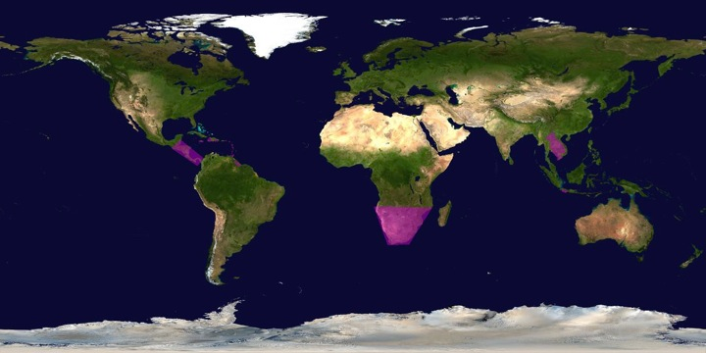
Target areas for Flood Pilot EO data
Develop flood monitoring products for flood mitigation, warning, response and recovery in the Caribbean/Central America, Southern Africa and Southeast Asia. Use these regional pilots to validate/calibrate lower resolution global flood products and to develop capacity in region.

Slide 24
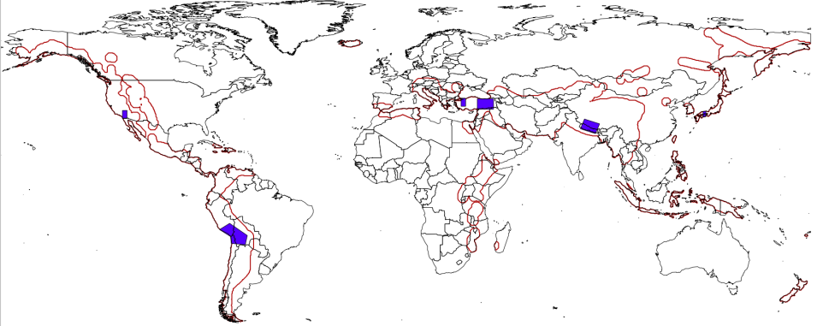
Target areas for Seismic Pilot EO data
Portions (in purple) of the global seismic belt including the Alpine-Himalayan Belt (incl. Turkey, Iran, Tibet, etc.), subduction zones in South America, with validation sites in Southern California, Western Turkey and Southern Japan. Gradually extend to red zones beyond current pilot.

Slide 25
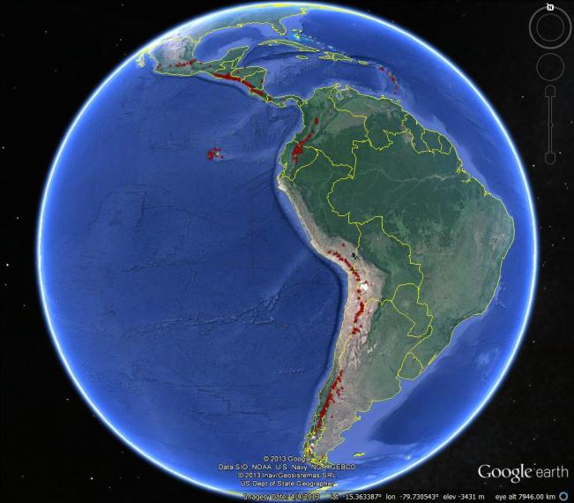
Target Areas for Volcano Pilot EO data
Notes:
Latin America was chosen for the regional component because:
1) the volcanoes are situated in a diversity of environments (from rain forest to high-altitude desert), providing a good test of the capabilities of different types of satellite data in different settings,
2) volcanic activity is abundant, including deformation with no eruption (e.g., Lazufre) as well as persistent eruptive activity (e.g., Tungarahua, Arenal, Reventador, Villarica),
3) explosive eruptions that disrupt air travel are likely over the course of the three-year pilot and have occurred frequently in the past (e.g., Cordon Caulle, Chaiten, Guagua Pinchincha), and
4) volcano observatories and monitoring agencies in Latin American countries would directly benefit from the additional resources that this pilot will make available. It is hoped that the regional study will demonstrate that EO data can help to identify volcanoes that may become active in the future (i.e., provide a forecasting ability) as well as track eruptive activity that may impact populations and infrastructure on the ground and in the air, ultimately leading to improved targeting for permanent EO-based observations and in-situ volcanic monitoring efforts.

Slide 26
Response to Pilots:
Strategic EO Data Acquisition Plan
Detailed EO Requirements for each pilot approved at last Plenary
Pilot definition included types of data required, frequency of observations and polygons of interest, etc
Pilot EO Requirements submitted to Data Coordination Team made up of representatives from CEOS agencies
Assessment of EO Requirements between last Plenary and SIT-29 by each individual agency
Agencies’ responses analysed and consolidated by Data Coordination Team and pilot Leads. (WGDisasters meeting # 1, Montreal 17-19 March)
Analysis included trade-offs between pilots (e.g. Pleiades data to be used in priority for volcanoes and seismic hazards), synergies across pilots (volcanoes and seismic hazards) and possible overlaps with other major initiatives (GEOGLAM, GFOI in S-E Asia, Supersites)

Slide 27
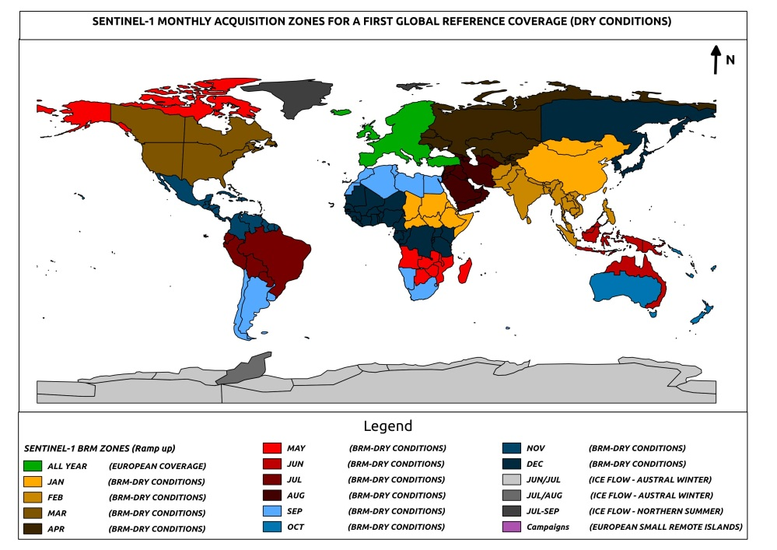
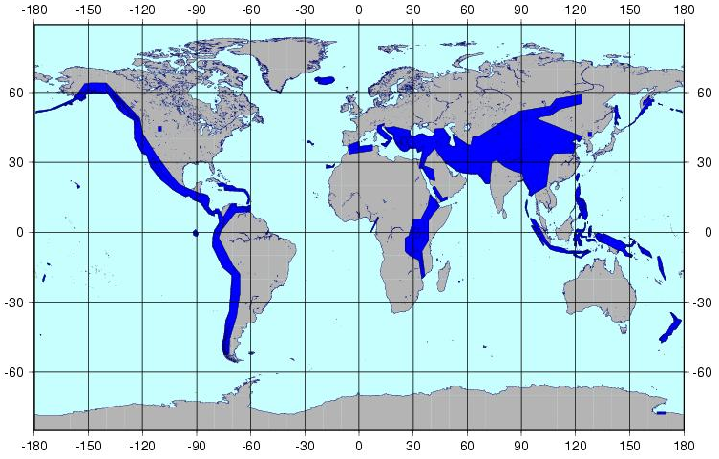
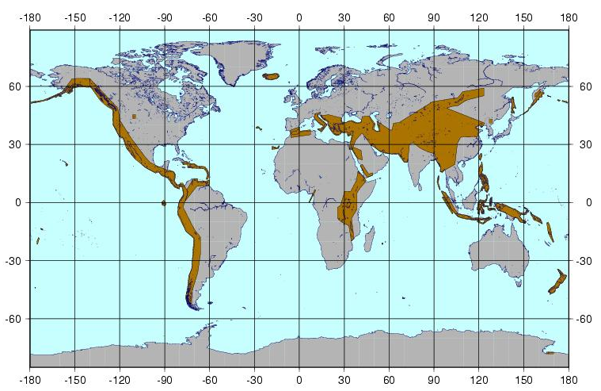
Analysis from Space Agencies

Slide 28
Data Contributions* from CEOS Agencies (1/3)
CEOS Agency | Flood Pilot | Seismic Pilot | Volcano Pilot
ASI Proposed contribution under review. | Approximately 300 CSK images/year/pilot over three years, in addition to existing GSNL commitments. Priority given to archived imagery. NRT images for rapid science products under Flood Objective B, Seismic Objective C (1-2 events/year) and Volcanic Objective C (1 major eruption) to be evaluated on case by case basis.
CNES NRT imagery request being discussed with commercial partner | SPOT World Heritage Archive made available to pilots (1000s of SPOT-5 archived images) with five-year rolling buffer. Up to 50 Pleiades images/year/pilot over three years. Commitment to be finalized after discussions with industrial partner. Night-time SPOT-5 imagery during 2014. ANR KalHaiti data base over Haiti.
CSA Review against commercial conflict required. | About 500 RSAT-2 products to support the Flood Pilot until November 2016 (end of the Pilot). More than 400 RSAT-2 products to support GSNL i.e. Hawaii (ongoing) and Iceland (in negotiation with MDA). Potential access to Volcano Watch Background Mission over Latin America (archived RADARSAT-2 products). Data for rapid science products for Seismic and Volcano Pilots evaluated on case-by-case basis: contribution of 40 RSAT-2 products for Event Supersite: Sinabung Volcano, Indonesia.
*contributions are in addition to existing GSNL contributions and International Charter data made available during or after activation

Slide 29
Data Contributions* from CEOS Agencies (2/3)
CEOS Agency | Flood Pilot | Seismic Pilot | Volcano Pilot
ESA Sentinel-1 launch April 2014. Six months commissioning. Sentinel-2, SMOS. | Sentinel-1 gradually made available starting with pilot targets in 2014 when these converge with baseline observing strategy. +20000 scenes over Italy, Japan, California, Turkey & Greece the first year overall for 3 pilots | Sentinel-1 gradually made available starting with pilot targets in 2014 and with the goal to cover priority areas of Objective A for 2016 – 10s of 1000s of images | Sentinel-1 gradually made available starting with pilot targets in 2014 and with the goal to cover priority areas of Objective A for 2016, especially when these converge with seismic areas
DLR Proposed contribution under review. Review against commercial conflict required. | 200 TSX scenes over three years; access to TanDEM Elevation Model without data transfer (through viewer) being considered | Assessment of validation areas and data volumes (Objective A) under way. Possible access to TanDEM Elevation Model without data transfer being considered. | 400 TSX scenes over three years (under Obj. A); contribution to Obj. C to be evaluated after eruption; access to TanDEM Elevation Model for erupting volcano being considered.
JAXA Proposed contribution under review. ALOS-2 launch May 2014. | 100 ALOS-2 products/year/pilot made available for promotion/demonstration; additional data available at marginal cost of $100/scene; barter arrangements for further data requests under review. Acquisitions requested are covered by ALOS-2 Basic Observation Scenario
*contributions are in addition to existing GSNL contributions and International Charter data made available during or after activation

Slide 30
Data Contributions from CEOS Agencies (3/3)
CEOS Agency | Flood Pilot | Seismic Pilot | Volcano Pilot
NASA EO-1 estimated end of life 2016 | 300 EO-1 images/year 2014-2015 | JPL/ARIA to provide rapid processing for 2-4 events/year under Objective C | Hyperion data for lava temperature and structure information (approx. 100 images/year 2014-2015)
NOAA | Precipitation products; flash flood warning system in regional pilot areas | N/A | Atmospheric data products over Latin America
USGS Further tasking of Landsat-8 possible if required | Landsat-8 imagery | Landsat-8 imagery | Night-time tasking of Landsat-8 over 19 active volcanoes in Latin America
*contributions are in addition to existing GSNL contributions and International Charter data made available during or after activation

Slide 31
How data will be exploited – flood pilot
Geographic Area | Product | Value Added Partner
Haiti | Flood extent maps, flood risk maps, landslide maps, flash flood guidance / threat maps, integrated risk assessment platform | SERTIT, CIMA, INGV, Altamira, CIMH, RASOR FP7, NOAA/HRC
Other Caribbean islands, Central America | Flood damage maps, change detection products, co-registered map overlays | CATHALAC, CIMH, NASA/GSFC
Namibia | Flood extent maps, flood warning products, co-registered map overlays | Namibia Hydrology Dept, Namibian Water Authority, NASA
Zambezi basin | Flood extent maps, flood forecast models, flood hazard maps, flood depth forecasts | Lippmann Institute (PAPARAZZI, HAZARD, WATCHFUL), DELTARES, NASA/JPL
Mekong | Flood extent maps, flood risk maps, flash flood guidance / threat maps | Mekong River Commission, NASA, NOAA/HRC, USGS, University of South Carolina, Texas A&M
Java (Bandung, Jakarta, Cilacap) | Flood risk maps, subsidence maps tied to flood risk, tsunami risk maps (Cilacap only), flood extent maps | SERTIT, Deltares, CIMA, Altamira, INGV, RASOR FP7
Products used by: national end users, civil protection agencies, World Bank, Red Cross, River Commissions (Kavango, Zambezi, Mekong)

Slide 32
How data will be exploited – seismic pilot
Activity | Product | Value Added Partner
Wide extent monitoring for strain map generation | Interfermetric processing (conventional InSAR and PSinSAR) to derive strain rate estimates based on deformation measurements; Generation of fault mapping products; EO based urban footprint to support exposure mapping as supporting information for seismic risk analysis. | COMET+, ISTerre
Geohazard Supersites and Natural Laboratories | Interfermetric processing (conventional InSAR and PSinSAR) to derive interseismic, co-seismic and post-seismic deformation mapping products; Generation of surface fracture mapping products to support modelling of seismic sources and possibly map some large aftershock in the surroundings. | Various over each supersite and event supersite, on best efforts basis
Rapid generation of science products | Interfermetric processing (conventional InSAR and PSinSAR) to derive co-seismic and post-seismic deformation mapping products; Generation of surface fracture mapping products to support modelling of seismic sources and possibly map some large aftershock in the surroundings. | INGV, JPL/ARIA
Products used by: academia and researchers, civil protection agencies…

Slide 33
How data will be exploited – volcano pilot
Activity | Product | Value Added Partner
Regional volcanic monitoring in Latin America | Terrain deformation products over 300 volcanoes to identify unsuspected activity; weekly monitoring of 19 active volcanoes; thermal anomaly detection; atmospheric products during eruptions; ash dispersal and ash cover maps. | Bristol University, Cornell University, Open University, NOAA, Buenos Aires and Washington VAACS
Development of new methodologies and products for intensive monitoring over supersites | Using GSNL data collects over the volcano supersites, the CEOS pilot will develop and validate new monitoring protocols for active volcanoes and generate products that could be used for global monitoring of holocene volcanoes after the pilot period. | USGS, INGV, University of Iceland
Major volcano eruption 2014-2016 | Pre-event deformation products if data available over volcano selected, to examine retroactively the benefit of deformation mapping in precursor phase Co- and Post-event deformation Co- and Post-event products for ground (ash cover, thermal monitoring etc.) Co- and Post-event atmospheric products (ash dispersal, SO2 monitoring etc.) | USGS/VDAP, Bristol, Cornell and others depending on eruption location
Products used by: national end users, civil protection agencies, volcanic observatories in Latin America, VAACS

Slide 34
Response to Pilots:
CONCLUSIONS
Majority of contributions (open & free data) confirmed by Agencies. Some options still being worked (e.g. alternatives addressing some data policies constraints.
Main issue: data contributions are for R&D activity; should some activities become operational after 2016, funding is required to ensure sustainability
Consolidated response from space agencies very positive; volume of EO data & products confirmed is similar or greater to what was initially provided for Forest Carbon Tracking and for JECAM.
Main objectives of each pilot can be reached with the firm contributions announced.
On-going refinement for data; some specific imaging requirements being reconsidered given trade-offs between agencies: how to best exploit synergies?

Slide 35
User Challenges
Users are split into three categories:
Satellite operators and their value added providers,
National agencies/ regional centers/ international organizations, and
The general public (think weather app on your smart phone)
Users b) and c):
Want products specific to their disaster event, not data they have to manipulate
Don’t want to program, they want to execute requests with point and click apps
Don’t want to purchase software tools, they want open source tools that are freely available and ubiquitous

Slide 36
User Challenges #2
All users want products to be accessible using tools they usually have installed on their desktop or hand held devices
Digital products are preferred over paper (important to disaster users we have in our regional pilots)
PNG and JPEG are nice for pictures in reports and presentations, BUT…
All users want map based products such as
KML raster overlays and vectorized polygons
These can be combined with other data on a common map background for mashups/analysis/reporting

Slide 37
User Challenges #3
There are hidden services that the users will expect without necessarily knowing they need to ask for it.
Situational awareness requires a stream of new data in addition to static overlays and archive data
New acquisitions need to be visible to all users so they can know what to request for tomorrow and the next day, available from the variety of feasibilities that are provided
Automated mapping servers and map service organizations need to have new data availability published and the capability to subscribe for notification of URL/URI of those data sets
Product processing should be automated for every available user option – either for every data set or on-demand for specific detection and classification algorithms

Slide 38
User Challenges #4
More hidden services that the users will expect without necessarily knowing they need to ask for it.
Tiling and compression should be available for raster and vector-based products that can be ingested and visualized by desktop and hand-held devices without any programming knowledge
Product publication and distribution can be via RSS or Atom-type feeds, but should evolve to become “product feeds”
Product providers need to ensure that
Native resolution is maintained
Products are terrain corrected and co-registered to map control points
Products are delivered only within the user area of interest (i.e., down scaling global-regional-local)
Delivered products can be easily validated/corrected by non-experts

Slide 39
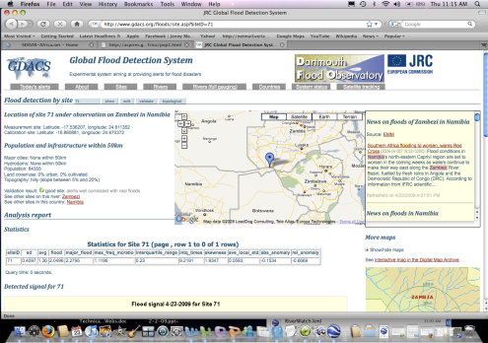
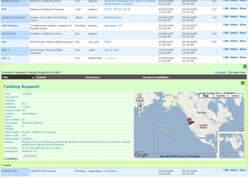
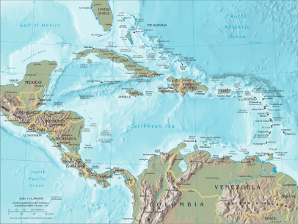
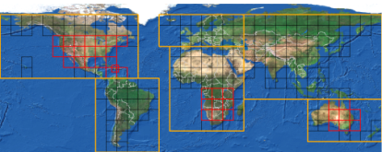
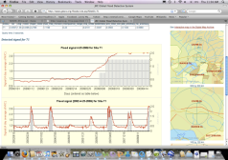
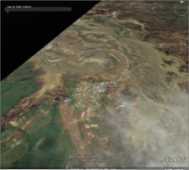
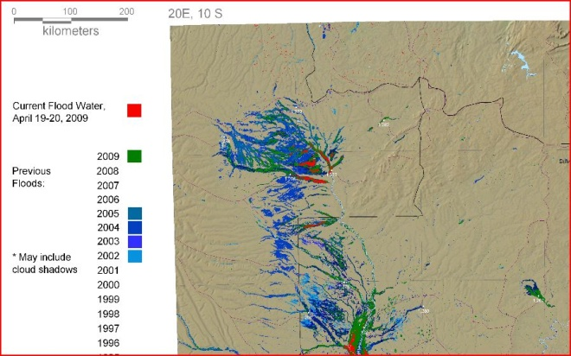
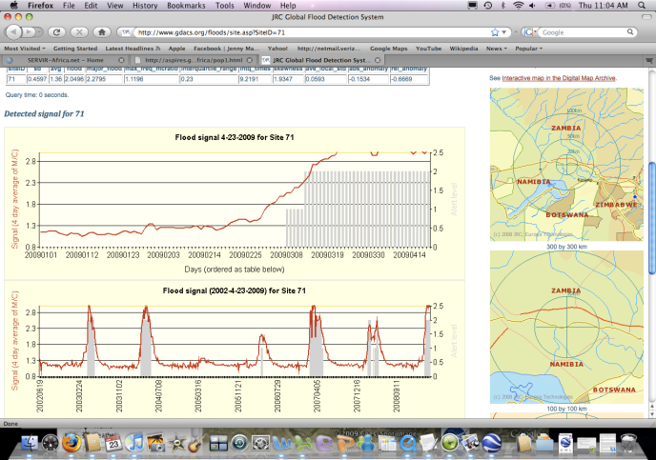
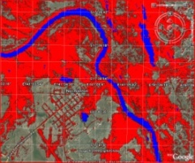
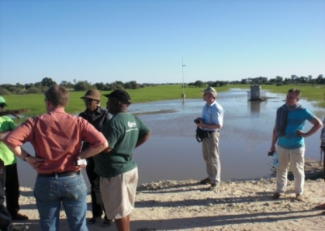
Detect Floods
Task Sensor
Initiate Request
Acquire Data (Image)
NASA Disaster Sensor Web Concept
Analyze Risks
Acquire Data
Analyze Image
Validate Model
(River Gauge)
Notes:
Note: recommendation from Report on Integration of Satellite data into Operational Flood Warning and Response establishes a “second track’ for the Sensor-Web, with satellite triggers provided by CIMH based on NWP (WRF) and ground radar, and integrating river gauges.

Slide 40
NASA Web Service URLs
OpenID Provider-Server https://op.geobliki.com/ controls the security (this is where you setup your account)
Campaign Manager http://geobpms.geobliki.com/home allows tasking requests to be submitted (i.e., target requests)
EO-1 Server http://eo1.geobliki.com/ this is where EO-1 data can be found along with the status of future and past task requests
Radarsat Server http://radarsat.geobliki.com/radarsat where we provide access to Radarsat-2 browse images, metadata, and processed flood products in several formats
MODIS Flood Server http://oas.gsfc.nasa.gov/floodmap/ is where you can point your browser to manually check on daily MODIS flood maps (browser GUI-based only)
MODIS Flood Server API http://modis.geobliki.com/modis is the server that provides an Application Programmer Interface (API) for accessing the daily MODIS maps

Slide 41
NASA URLs Concluded
Flood Dashboard Client http://matsu.opencloudconsortium.org/namibiaflood this is an example of a client implementation that runs on a cloud computing platform provided through a collaboration with the University of Illinois/Chicago and Open Cloud Consortium
Web Coverage Processing Service (WCPS) http://matsu.opencloudconsortium.org/wcps/session/login is for generating and executing algorithms against satellite data
Pub/Sub Server http://opsb.geobliki.com/session/new is for setting up subscriptions to be notified when new products of interest to you are published….The notifications come via Email, SMS, or twitter and contain RSS or Atom feeds for you to follow to find the product. Clients can be automated to monitor the feeds and pull the data they are programmed for
NASA URLs, server descriptions, and instructions available at
http://eo1.gsfc.nasa.gov/new/sensorWebExp/SensorWebReadMore.html

Slide 42
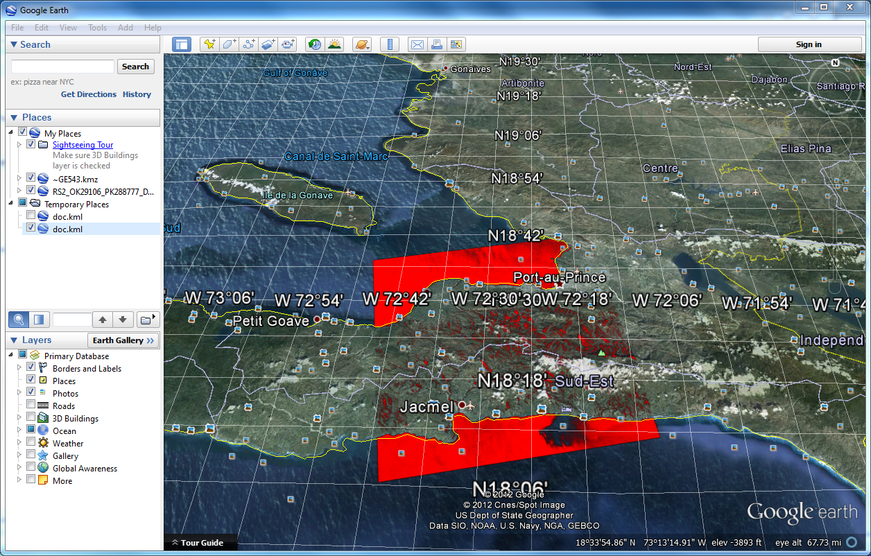
Radarsat-2 Water Detection Example (red)

Slide 43
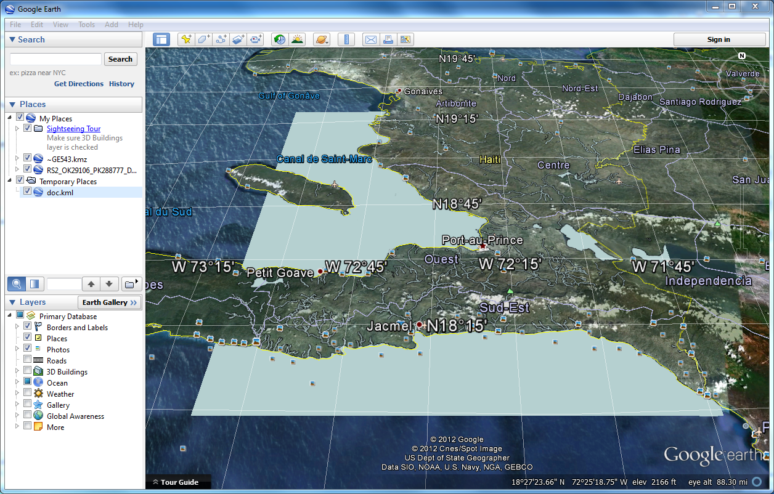
Open Street Map Reference Water (blue)

Slide 44
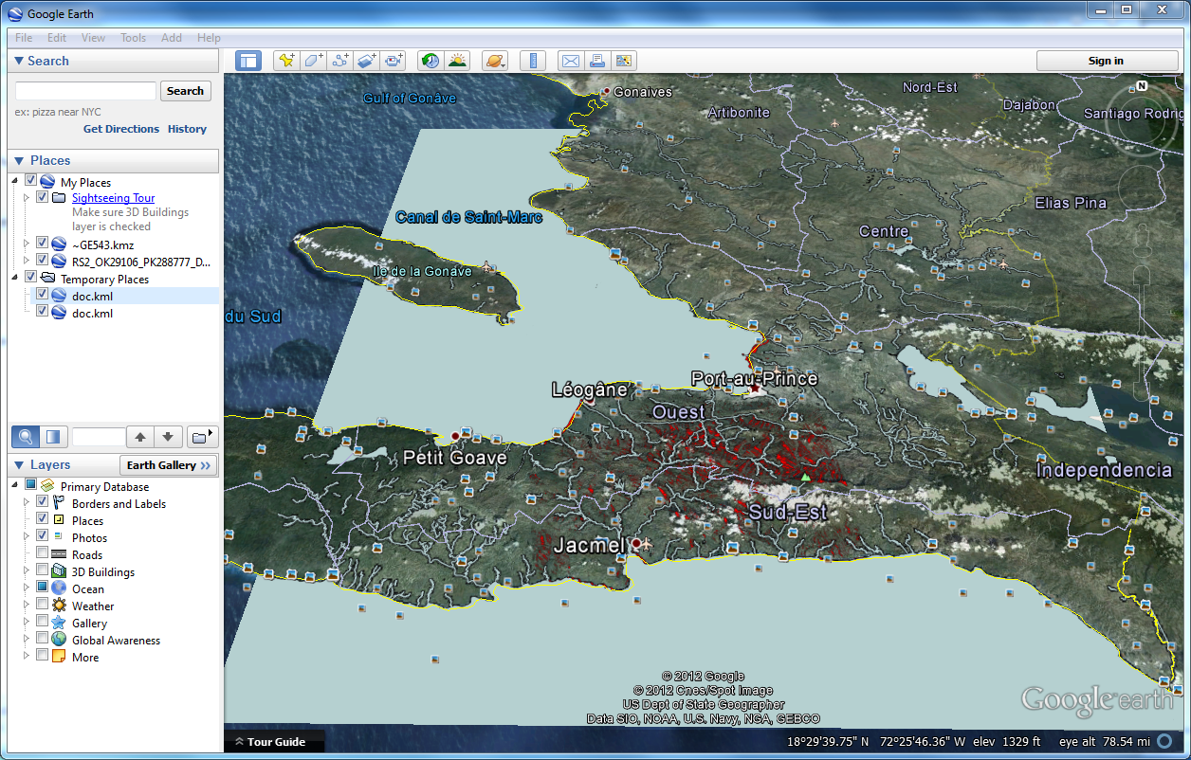
Combined Overlays (blue on red) Indicates Flooded Areas

Slide 45
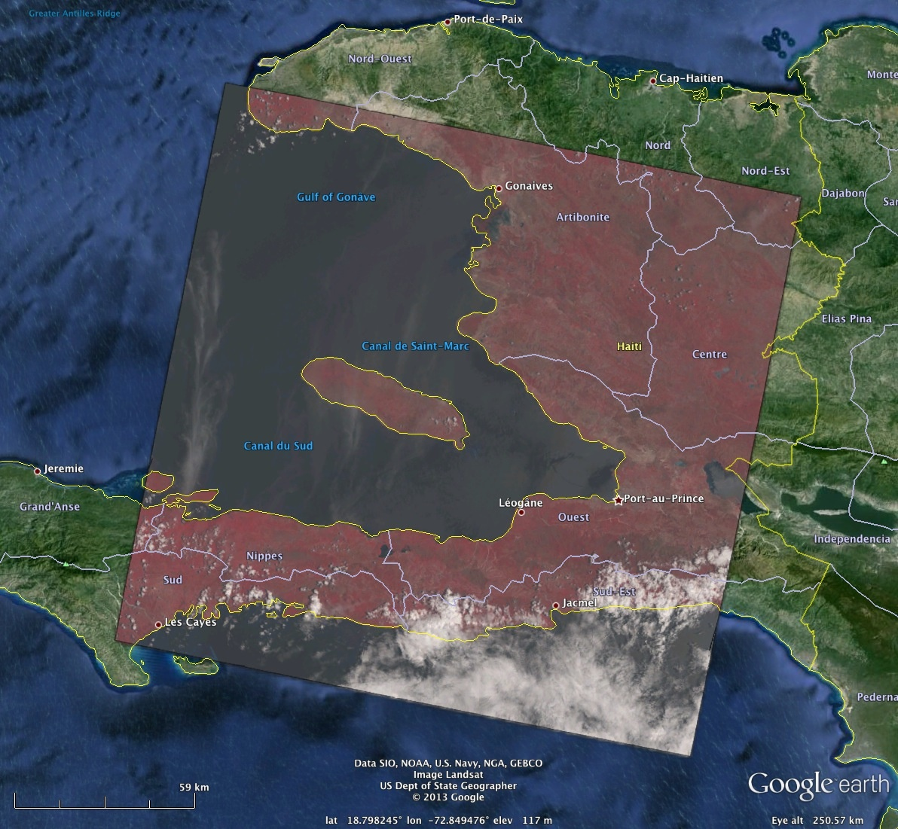
Landsat-8 example in Haiti for construct of reference water mask
LC80090472013117LGN01 vis_composite (5-4-3) (EPSG 4326) TIF Compressed 76.4MB
Original Data Set 8 OLI Bands TIF 108.7MB each (7461x7281 pixels 30m resolution)
45

Slide 46
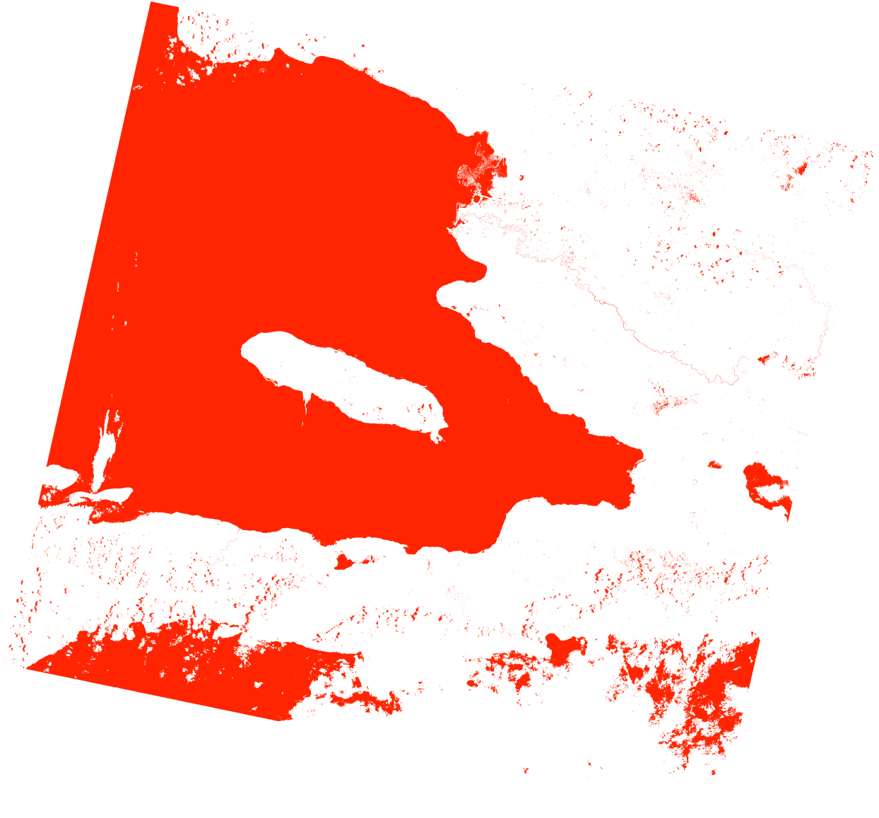
Surface Water Detection Product
Using WCPS
Note: Particular Algorithm is Not Relevant In this Example
5.9MB TIF LZW Compressed
28

Slide 47
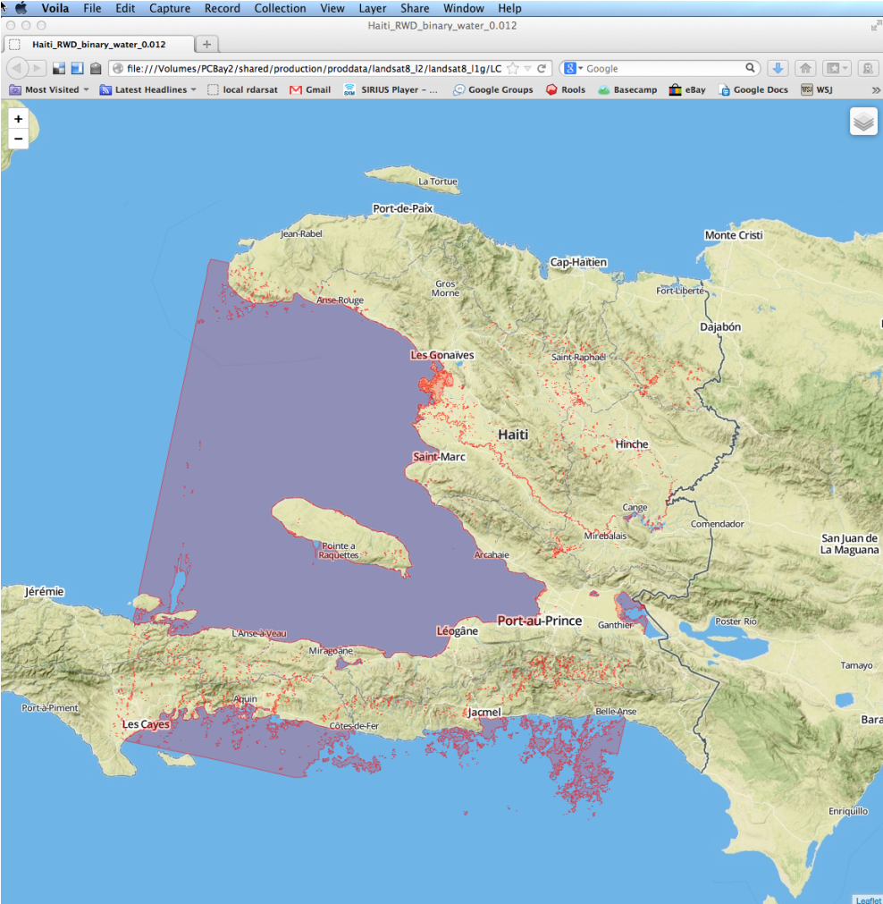
Resulting Product On Mobile Browser
Mapbox.js, MapBox Terrain Layer…
Other Layers Can be Added From OpenStreetMap such as Reference Water…
Or Population Density…
Final Achievement:
Product Compressed Size From:
2.2MB to 350KB

Slide 48
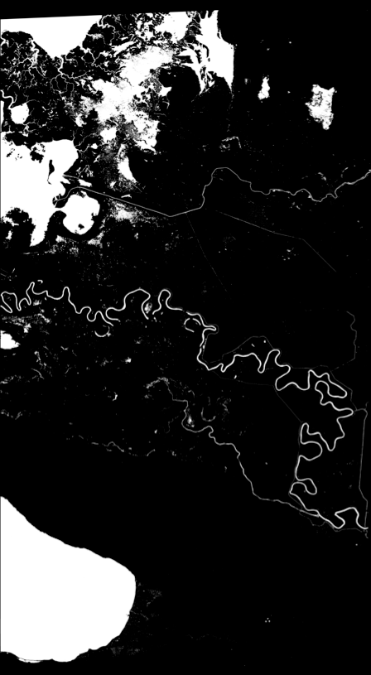
Worldview-2 Processed Data (Binary TIF File)
Surface Water in White
Files: Haiti_RWD_binary_water_0.012.tif
Size is 9419, 17304
Coordinate System is:
GEOGCS["WGS 84",
DATUM["WGS_1984",
SPHEROID["WGS 84",6378137,298.257223563,
AUTHORITY["EPSG","7030"]],
AUTHORITY["EPSG","6326"]],
PRIMEM["Greenwich",0],
UNIT["degree",0.0174532925199433],
AUTHORITY["EPSG","4326"]]
Origin = (-72.761256,19.38983)
Pixel Size = (0.000018,-0.000018)
~2m/pixel resolution
Image Structure Metadata:
INTERLEAVE=BAND
Corner Coordinates:
Upper Left ( -72.7612560, 19.3898340)
Lower Left ( -72.7612560, 19.0783620)
Upper Right ( -72.5917140, 19.3898340)
Lower Right ( -72.5917140, 19.0783620)
Center ( -72.6764850, 19.2340980)
Band 1 Block=9419x1 Type=Byte, ColorInterp=Gray
30

Slide 49
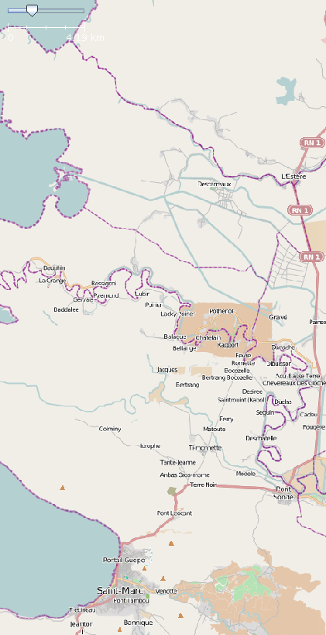
OpenStreetMap
Surface Water Detected in White
31

Slide 50
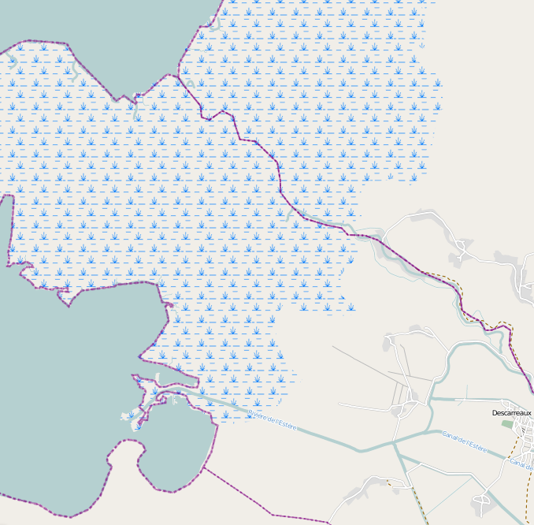
natural=wetland
wetland=swamp
OSM has an area marked as wetland/swamp
That could be mis-identified as flooded area
in satellite imagery
32

Slide 51
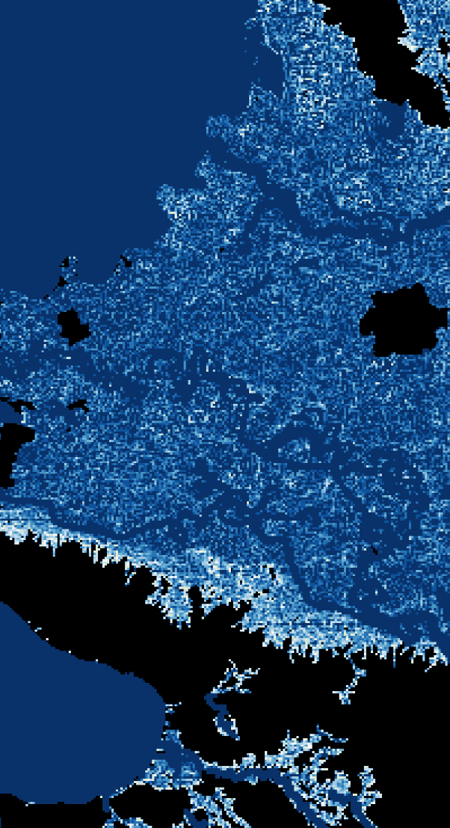
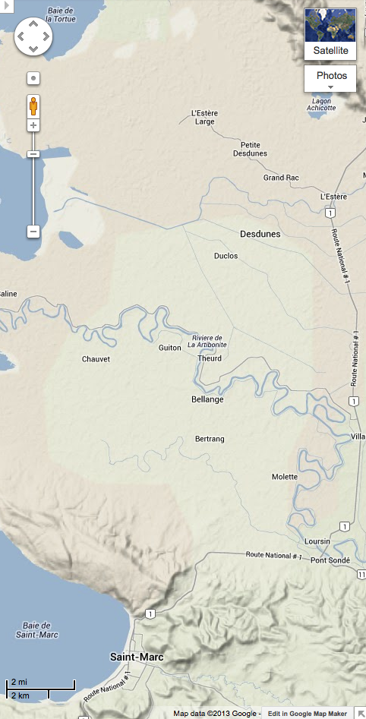
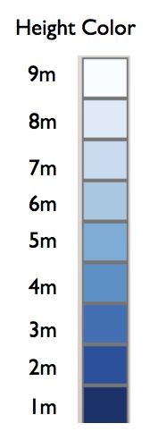
Height Above Nearest Drainage: In Black, Areas to be masked based on Digital Elevation Model
Removed:
46,297 out of 23,659,581
https://maps.google.com
Terrain Map

Slide 52
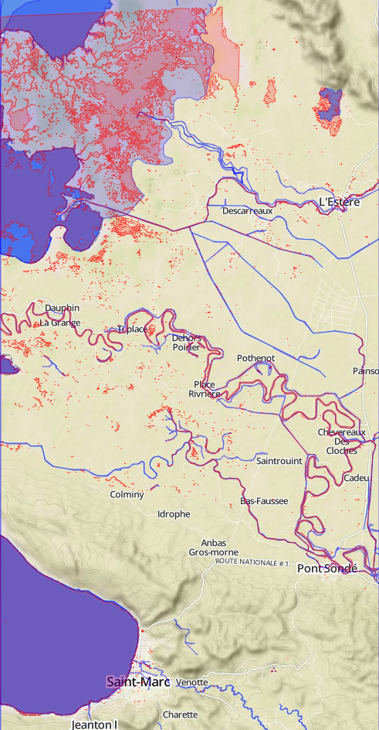
Resulting Zoomable Flood Map In Browser
Red: Surface Water (after HAND masking)
Blue: OSM Reference Water
Background: Terrain Map From Mapbox
52

Slide 53
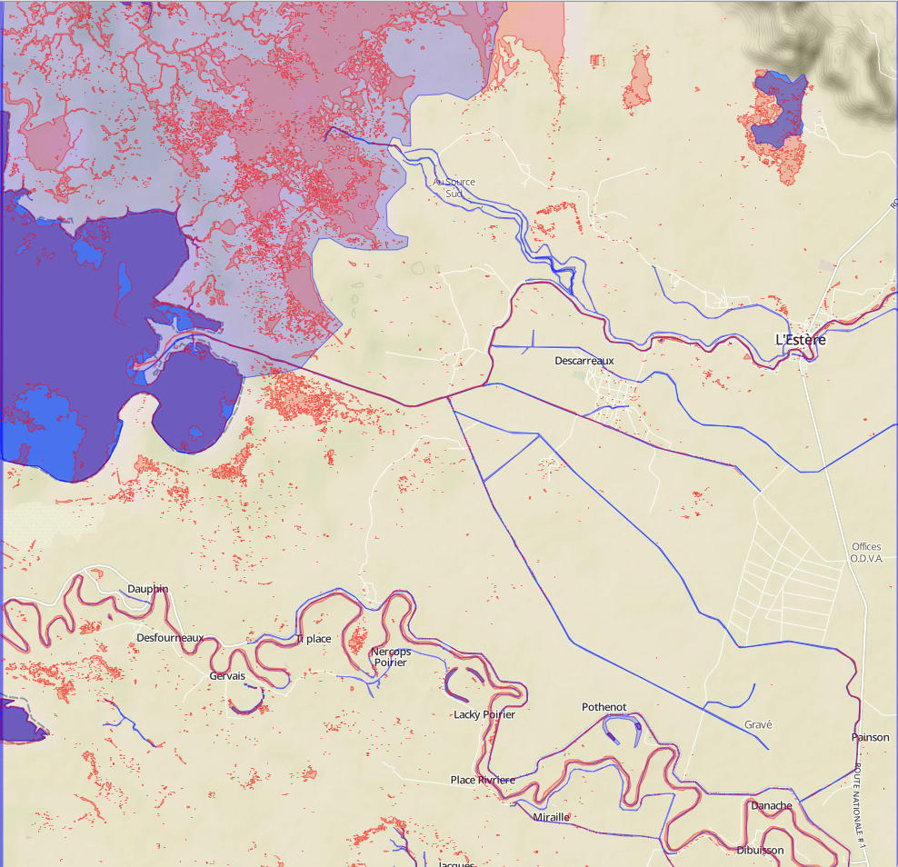
OSM Marshes / Swamp / Watersheds
OSM Marshes/Watershed Tags Are Important
53

Slide 54
OSM Field Validation Approach
Planet OSM
Baseline Water
Database
NRT Satellite
Data
Postgres
Database
(Joyent)
Enhanced Water Reference
and Flood Maps
Baseline Water Layer
Flood Map Processor
Radarsat.Geobliki.
Com (Joyent)
Water extent and Flood Maps (KML tiles, MB tiles, OSM tiles)
publish NRT map
Regional Hydrology
SME Server W/
JOSM
National Hydrology
Agency Server W/
JOSM
Annotated
High water reference
Low water reference
Flood Map
National Postgres Database
Edit polygons:
Drought OR
Low Normal OR
High Normal OR
Not flooded: misclassified as flooded
Flooded: misclassification due to deep slope reflection OR
Flooded: misclassification due to dry flat surface OR
Flooded: misclassification due to vegetation cover OR
Flooded: misclassification due to other
Enter Notes
Input data source (field measurement/ other: describe)
Land Cover Type
text
publish corrected map
Automated Time Stamp
Mobile Platform
Track Collector
For Field Data
GPS Stamp for shoreline
(Lat, Long, Altitude)
User Name/ User Type
36

Slide 55
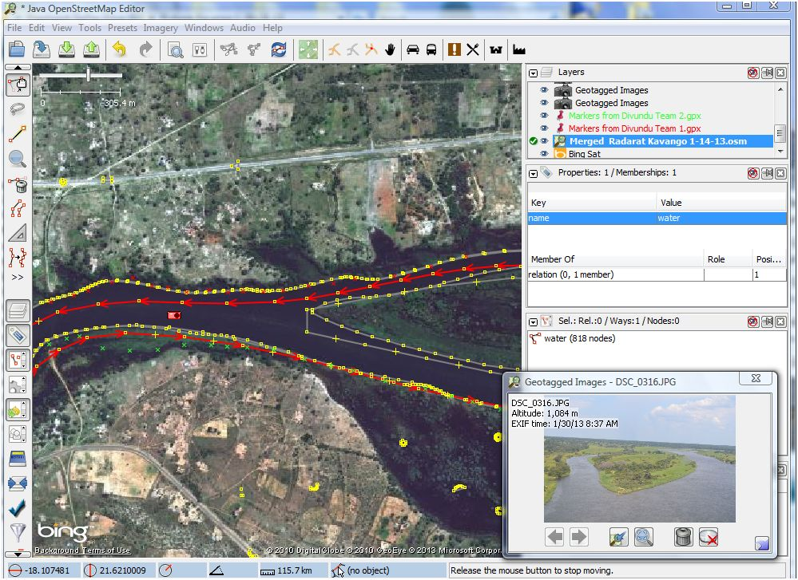
Ground Cal/Val Exercise with Radarsat, EO-1, Ground Team, Helicopter team, OpenStreetMap, Crowd Sourcing on Kavango river in Namibia 1-30-13
Radarsat Water Edge Detection (yellow polygon)
EO-1 Water Edge Detection (red)
Team 1 walking bank to collect GPS point s (red X’s)
One of 500 GPS photos from helicopter
Team 2 walking bank to collect GPS point s (green X’s)
55

Slide 56
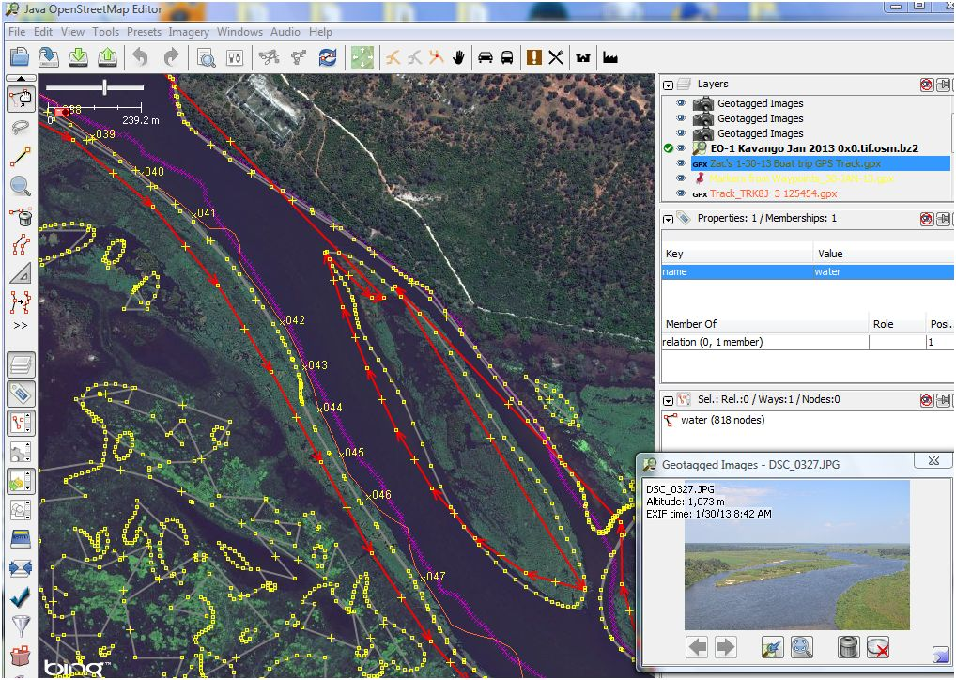
Integrated Water Edge Detection Display with Boat GPS Measurements,
GPS located photos, Radarsat/EO-1 water edge detections
Radarsat Water Edge Detection (yellow polygon)
Boat Team 1 track walking bank to collect GPS point s (purple track)
EO-1 Water Edge Detection
Boat Team 2 track walking bank to collect GPS points (orange track with numbered waypoints)
38

