Slide 1
GeoNestCast/ EumetCast stations mapping

Slide 2
Introduction
eLearning requires students to have access to internet
Access to internet services remains a challenge for developing countries
Use of existing GeoNetcast/ EumetCast network to distribute the eLearning materials (documents, presentations,videos)
Solution proposed during WGCAPD 2nd annual meeting in Frascati

Slide 3
Objective and scope
Objective:
Map the geographic locations of GeoNetCast/EumetCast stations
Distribute material during training
Scope
Source and map the geographic locations of the stations
Establish “arrangement” with the GeoNetCast/EumetCast users/data providers

Slide 4
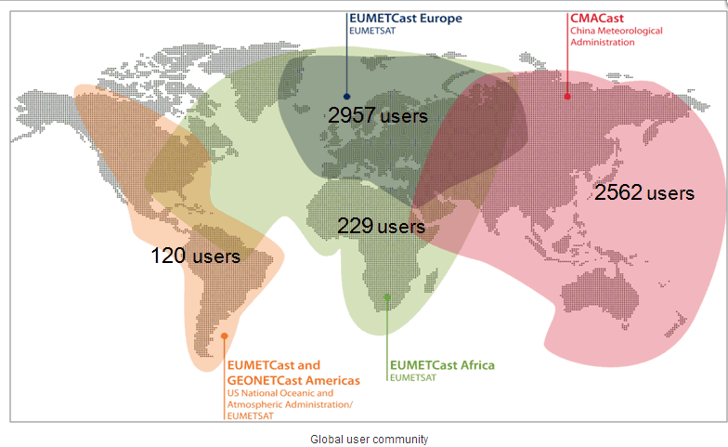
GeoNetCast/ EumetCast stations

Slide 5
Current status
49 stations found
EumetCast cant provide the required the information
However, they can contact their users and discuss our initiative

Slide 6
Current status
Stations on Google-Earth
Thanks to Cecere Thomas and Sharon Hamann from USGS

Slide 7
Opportunities and Way Forward
To be discussed

