Slide 1
WGCapD e-learning Course Hilcéa Ferreira/INPE

Slide 2
Presentation Outline
Background
e-learning Course Rationale
Support from CEOS Agencies
Results
Lessons Learned
Challenges
Plans for the Future
Way Forward…

Slide 3
Background
WGEdu → WGCapD (2011)
WGCapD Mission:
The WGCapD will build upon the CEOS Data Democracy Initiative in an effort to increase the capacity of institutions in less developed countries for effective use of Earth Observation data for the benefit of society and to achieve sustainable development.
The WGCapD will focus and unify CEOS efforts toward providing wider and easier access to Earth Observation data, increasing the sharing of software tools such as the use of open source software and open systems interface, increasing data dissemination capabilities, transferring relevant technologies to end users, and providing intensive capacity building, education, and training.

Slide 4
e-learning Course Rationale
Education is a tool for wider outreach to the world community capacity building and the effective management of natural resources for sustainable development.
The International e-learning course on Introduction to Remote Sensing Technology is an effort by CEOS Agencies toward: Providing wider and easier access to Earth Observation data;
Increasing the sharing of software tools such as the use of open source software and open systems interface;
Increasing data dissemination capabilities, transferring relevant technologies to end users.
The main goal of this course was to disseminate the remote sensing technology among University Lecturers , encouraging them to use remote sensing in Earth sciences applications.
www.dpi.inpe.br/ceos/e_learning/

Slide 5
Support from CEOS Agencies
Organized by:
Supported by:

Slide 6
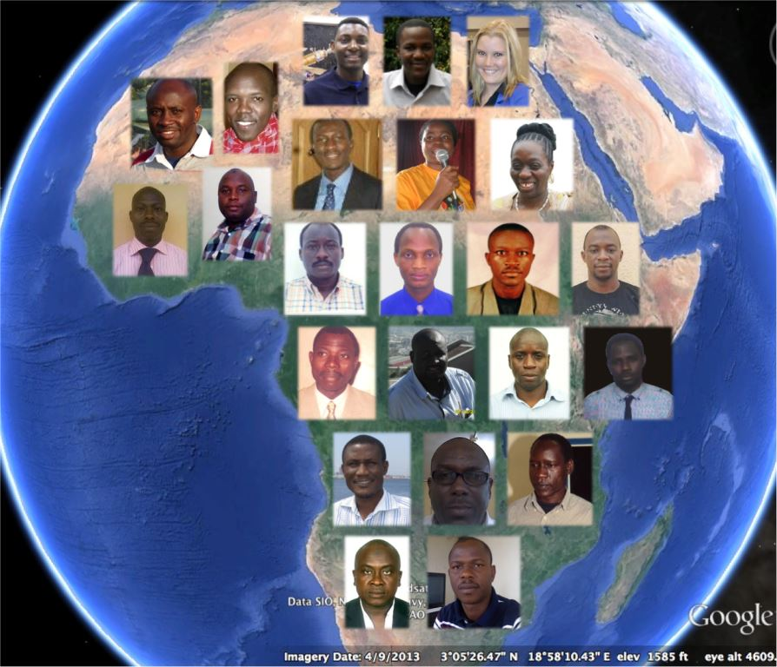
Results
Pilot Course: February 18 to June 10, 2013.
July, 2013: e-learning course was finished and the final grades were compiled: from 30 students enrolled, 16 have successfully completed the course (55%).
From the 13 that have failed, 5 of them have not really participated but 8 of them, although not really handing in assignments, have checked TelEduc almost every week, mainly the Readings Tool, and participated in the web-sessions.
Certificates issued by INPE and sent to students by FEDEX.
Course Materials organized into a WIKI: http://wiki.obt.inpe.br/doku.php?id=e-learning
Evaluation report available!

Slide 7
E-learning course: Students feedback

Slide 8
Follow-up Survey
Follow-up Survey: sent to all students (3 times: December 8, 2013; February 08, 2014 and March 2, 2014). Two different set of questions for students who successful completed the course and the ones that somehow FAILED (dropped) or FAILED but kept online in TelEduc.
1- The training experience has been useful in your work. How? 2- Multiplier effect: were you able to use the knowledge acquired in a new course or project? 3- Data Democracy Principles: the course has helped you a- With easier access to Earth Observation data? b- Use of open source software and open systems interface? 4- The course has helped you to make connections with other colleagues for exchanging ideas and materials.
Out of 30 students, there were 15 responses.
Report still to be compiled…

Slide 9
Challenges
A lot of work to organize and coordinate all instructors and students
It was essential to have a person dedicated to organize and interact with instructors and students at all times during the course.
Long-term commitment for Coordinator and Instructors

Slide 10
Plans for the Future
I invite the group to brainstorm about the following questions:
Are we going to offer another e-learning course?
For what region? Objectives? Contents? For how long?
We should keep in mind the main outcomes listed in the Draft Workplan which describe the following thematic areas for the period 2014-2016:
Climate Monitoring, Research, and Services
Carbon Observations, Including Forested Regions
Observations for Agriculture
Observations for Disasters
Capacity Building, Data Access, Availability and Quality
Advancement of the CEOS Virtual Constellations
Outreach to Key Stakeholders
Support to Other Key Stakeholder Initiatives
Organizational Issues

Slide 11
Plans for the Future
→ Engaging with other CEOS Working Groups and Virtual Constellations
WGCapD should be supporting CEOS multilateral activities.
There are many Capacity Building activities being carried on within the the WGs, VCs and CEOS main projects

Slide 12
Plans for the Future
ANY THOUGHTS?
QUESTIONS?
WAY FORWARD...
Thanks!
hilcea@dpi.inpe.br

