Slide 1
SRTM 2 Data Release
Jacob Sutherlun
2/25/2012
Ilhabela, Brazil

Slide 2
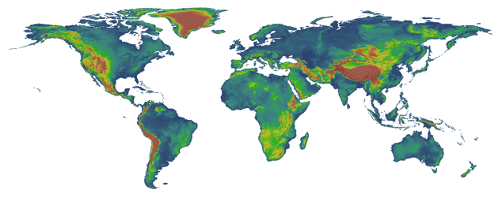
NASA Shuttle Radar Topography Mission
11 Day Mission to Map the Most of the World in February 2000 on Space Shuttle Endeavor
Produced High Quality Elevation Data
90m Data Available Free Worldwide via USGS
30m Data Available over the United States Only

Slide 3
Uses of SRTM Data
Digital Elevation Models (DEM)
More accurate DEM’s lead to better:
Agriculture Planning
Urban Planning
Integrated Water Resource Management
Flash Flood Forecasting

Slide 4
Proposal to Release SRTM 2 Data
Many attempts to have SRTM 2 data released to the public for the entire Earth
US consortium of agencies have worked together to secure the release of the data with NOAA serving as the POC
South Sudan and Somalia as pilot projects
Consideration of further release of data to be coordinated through CEOS WGCBDD
Strategic plan for new data requests needed to maximize efficiency of release of data

Slide 5
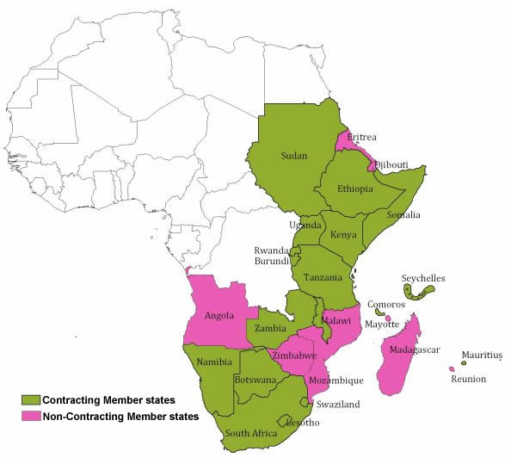
Possible Activities
Coordinating the requests for data release
Partnering with the Regional Center for Mapping of Resources for Development (RCMRD)
Ministerial Level Agency for 18 Countries in East and Southern Africa
CEOS WGCapD/RCMRD joint training courses
Refugee planning
IWRM
Flood Forecasting
Agriculture Products
Possible Webinar/ E-learning module intersection
RCMRD has contacts with South Sudan mapping institutions
Ministry of Water, Ministry of Statistics
GEO Work Plan DEM

