Slide 1
CEOS WGCBDD Potential Activity:
Regionally Focused Webinar Series
Eric C. Wood
USGS Representative
WGCBDD Annual Meeting,
February 29, 2012

Slide 2
Overview
Background
Why Webinars
Webinars
What are they ?
Who presents them?
Audience ?
Mechanics ?
Scheduling ?
Discussion

Slide 3
1. Background (WG Edu to CBDD)
WGEdu conducted traditional workshops
Curriculum development
WG Website – staging curriculum
Plenaries began driving change with one issue being our method of capacity building
Eventually, this new working group - WGCBDD
“CEOS Agencies continue to support the GEO Data Democracy Initiative through a newly-reconstituted CEOS Working Group on Capacity Building and Data Democracy (WGCBDD). “
CEOS WGCCBD Study Team
November 7, 2011

Slide 4
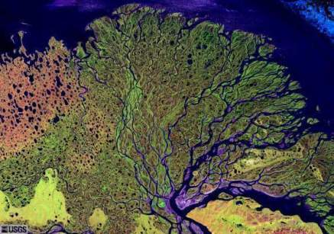
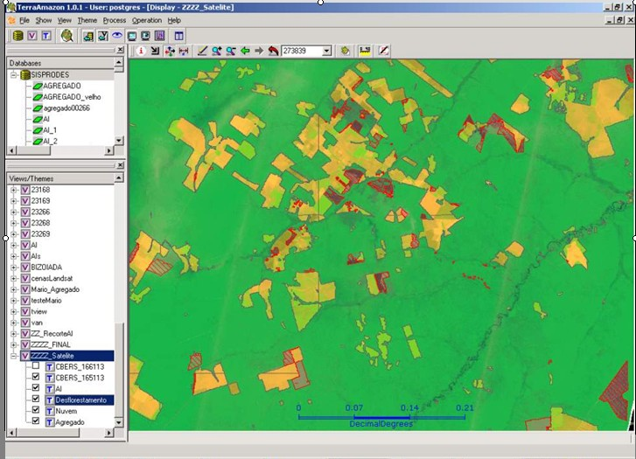
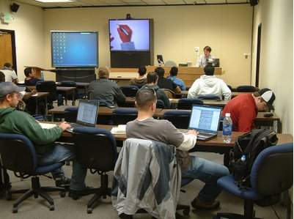
Data democracy = open access to data + software/tools + capacity

Slide 5
2. Why Webinars
Webinar = internet web-based seminar
Cost (travel, facilities, etc.)
Number of people “reached”
Can continue regionalization without 3-5 year repeat cycles
Another way people expect to receive information
Acceptable to “change agents”

Slide 6
3. Webinars
What are they (in the CEOS context) ?
Threads (forests, food security, disaster, climate change impacts, etc.)
Datasets and tools from CEOS members
Utilize libraries/archives of member’s webinars series (e.g. EUMETSAT)
Libraries/archives of regional collaborators
Build capacity of both presenters and users
Who presents them
Audience
Mechanics
Scheduling

Slide 9
Working in Sync with GEO
GEO Capacity Building
Developing Institutional and Individual Capacity (ID02/C1,C2)
CEOS Lead on 19 of 60 GEO components (see list)
11 chosen for CEOS level “contribution” (see list)

Slide 10
DD “supported” by USGS/EROS
Domestic (US)
NLCD
Topo
NIDIS
Phenology
Native American Activities
NativeView
NASA TCUP
NASA ROSES GCCE
Global
GMTED
GeoSur
W. Africa Landcover
Landcover (GLC)
Afghanistan Portal
Iraq Portal
GOFC
FEWS-Net
LPDAAC

Slide 11
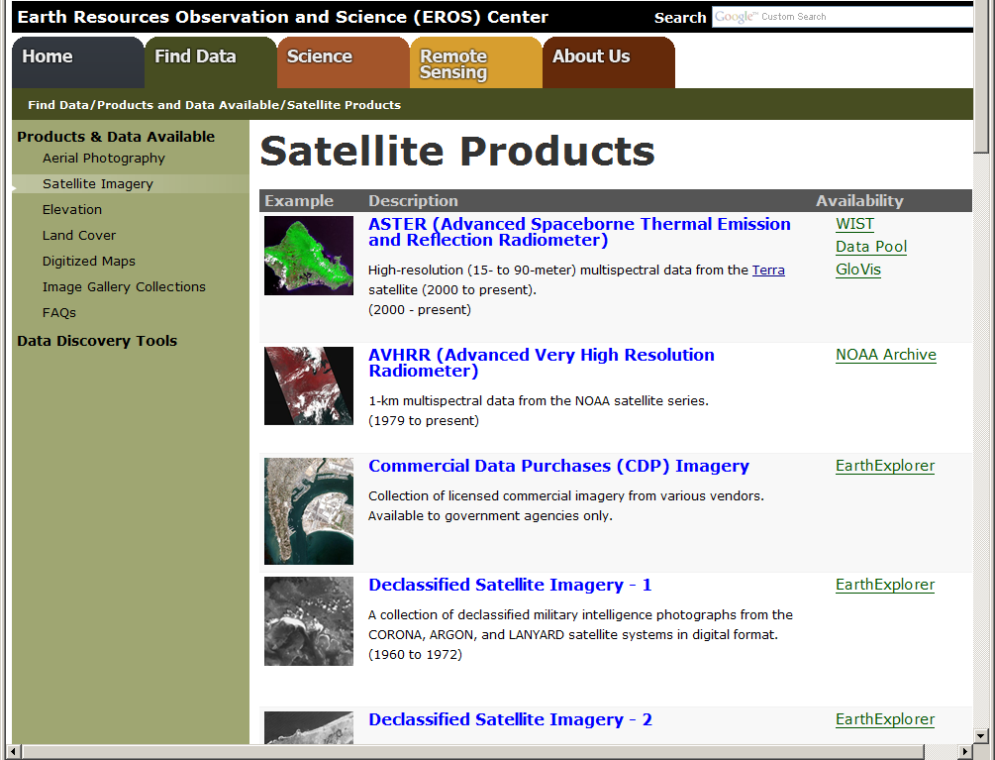

Slide 12
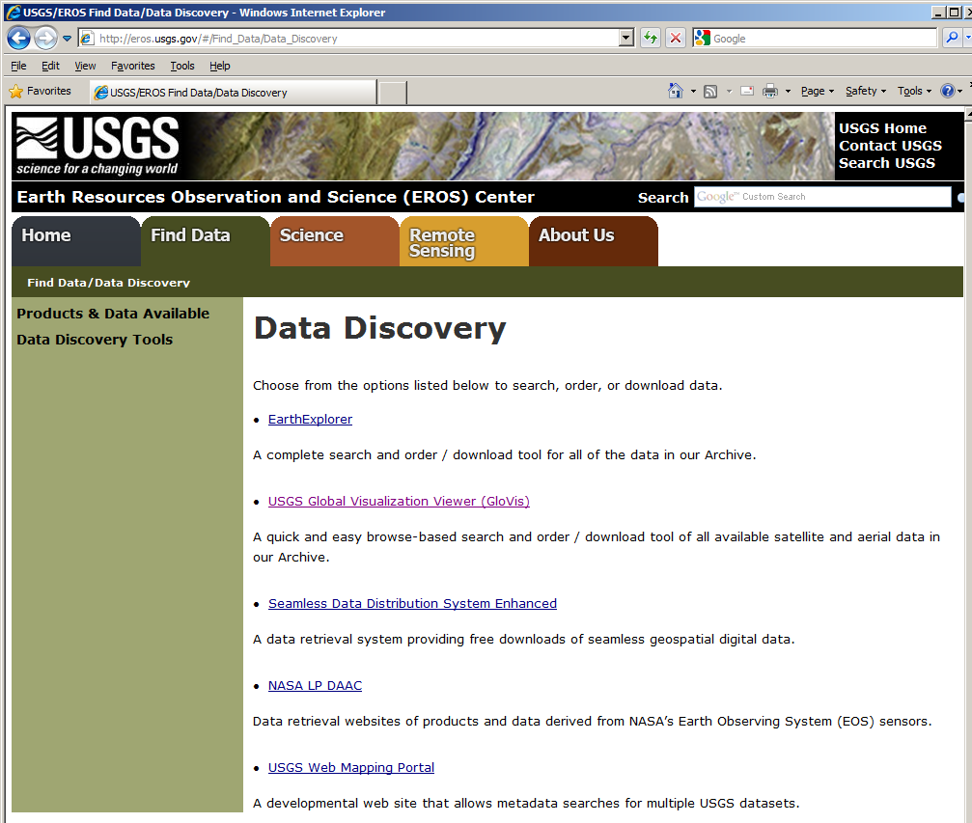

Slide 13
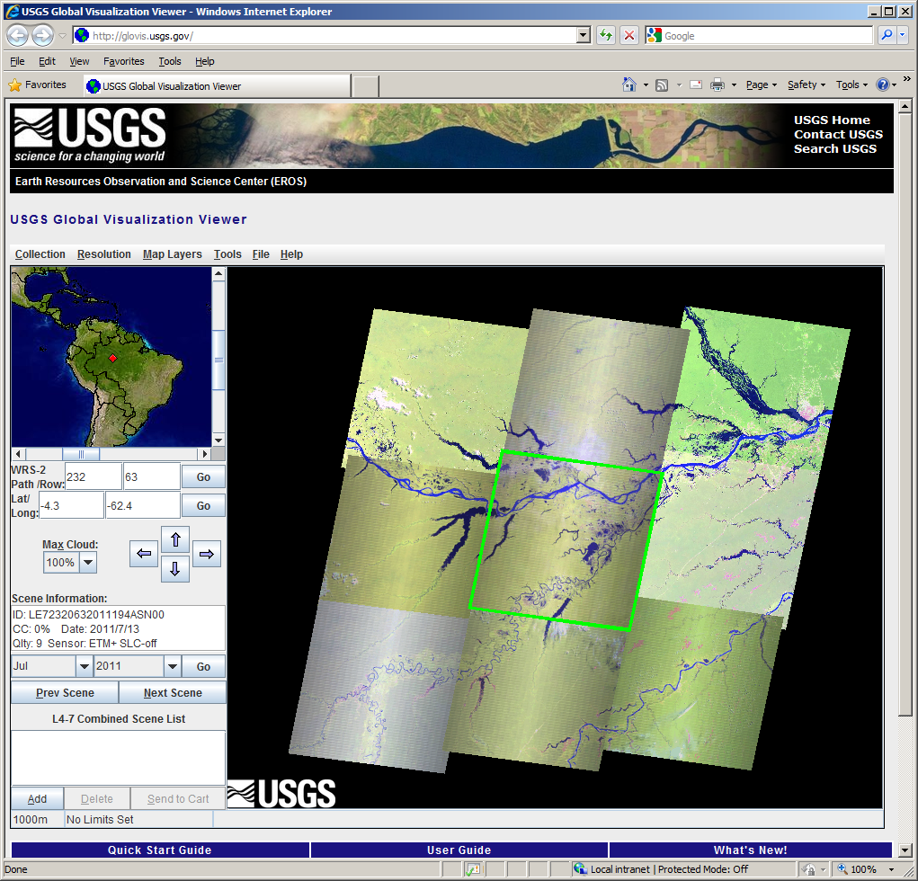

Slide 14
Summary of the International Workshop on

Slide 15
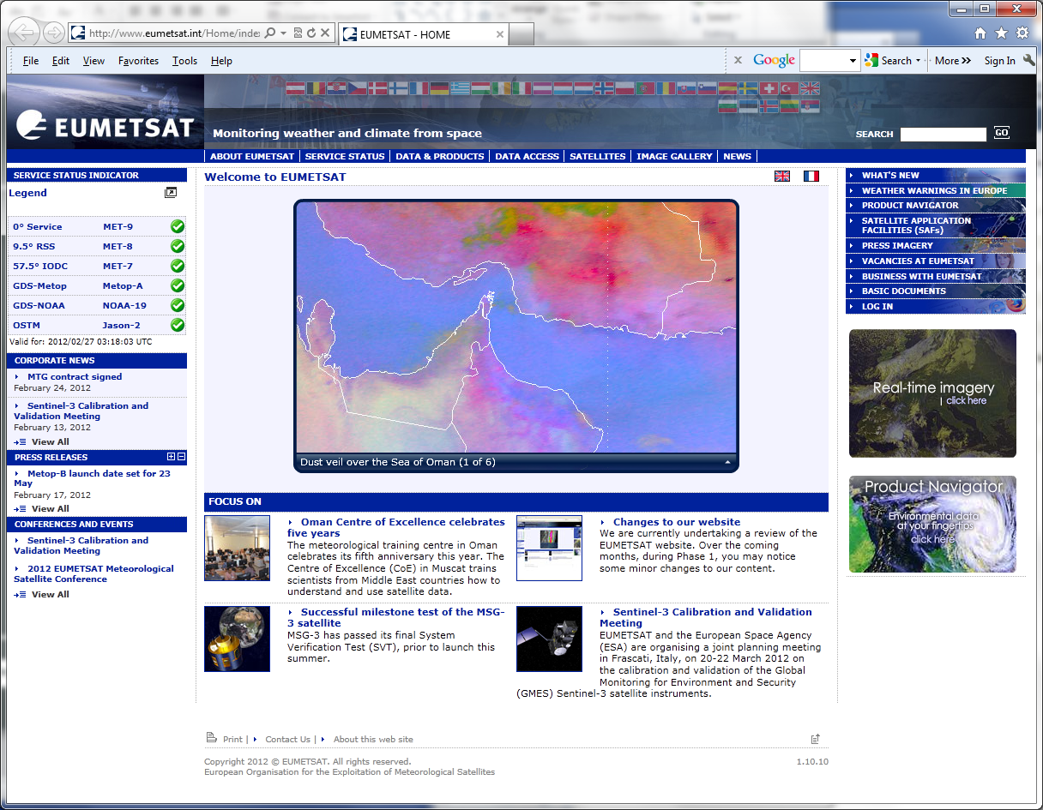

Slide 16
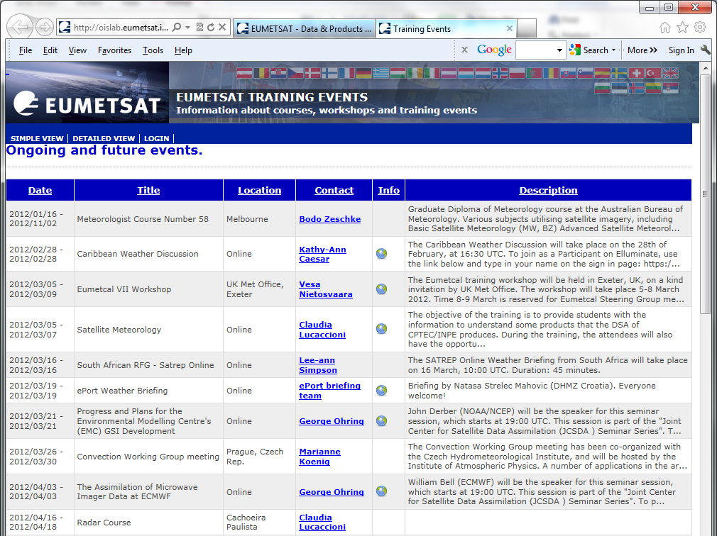

Slide 17
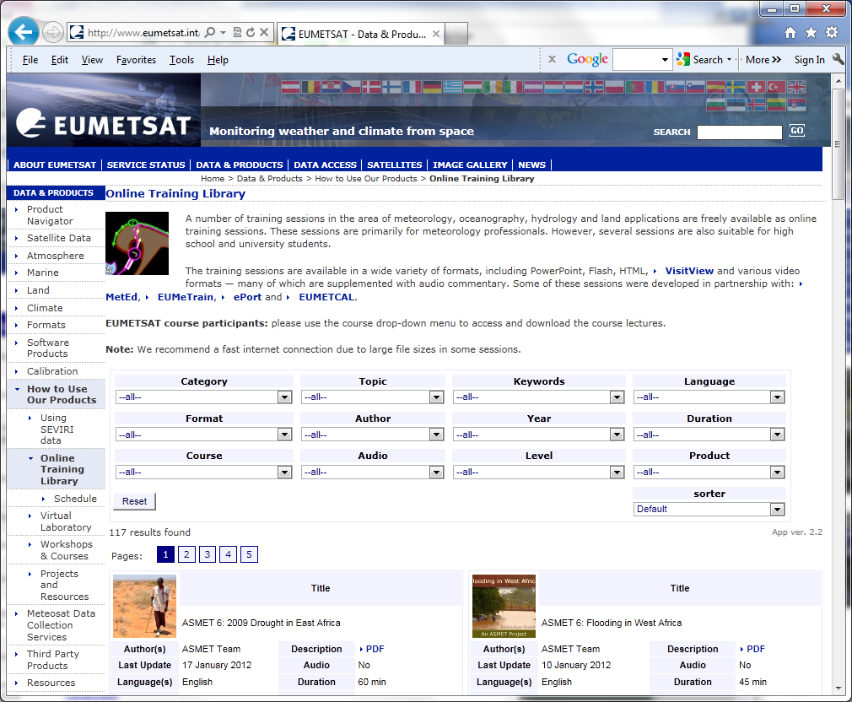

Slide 18
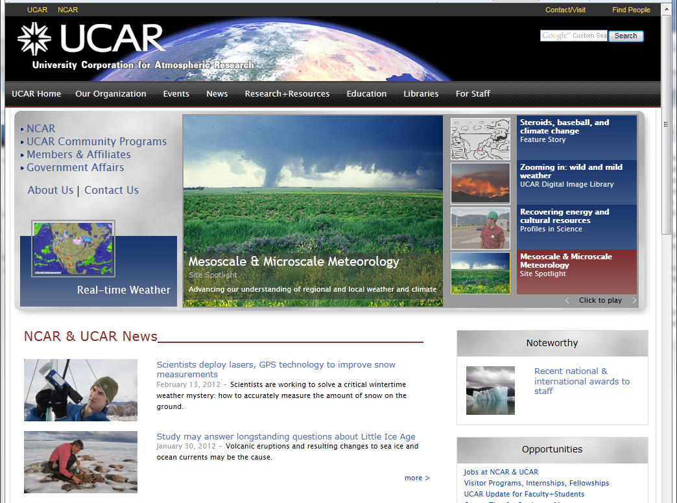

Slide 19
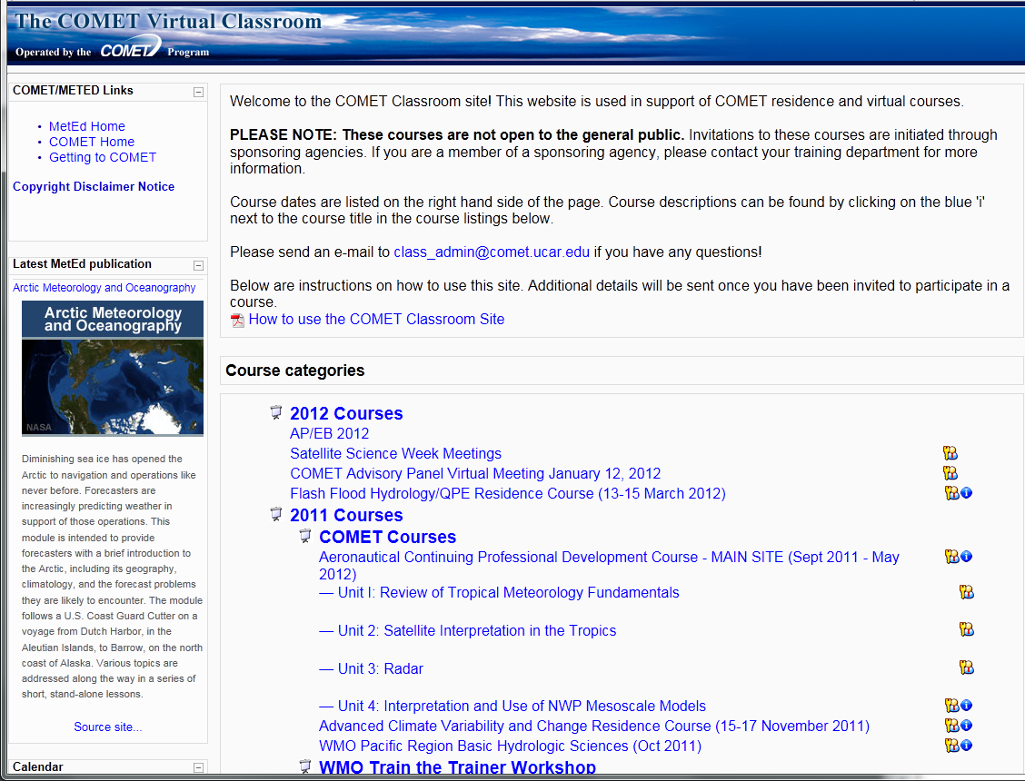

Slide 20
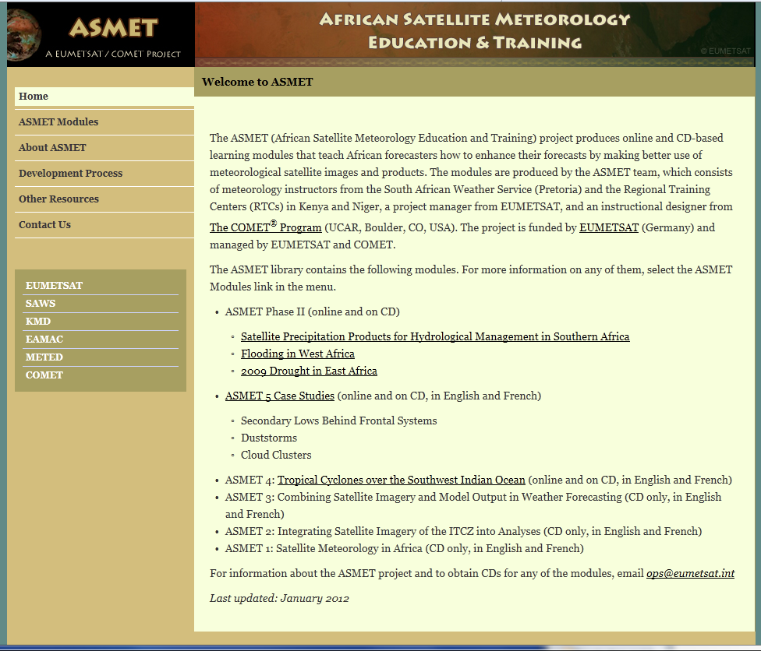

Slide 21
3. Webinars
What are they
Who presents them
Remember, this is a CEOS activity , not an inventory of member activities
Nonetheless, mostly scientists and “presenters” from CEOS member agencies
Regional collaborator s (LA, Africa, Asia)
Pull from training (e.g. INPE sessions)
Other agencies with desired content/program
Audience
Mechanics
Scheduling

Slide 22
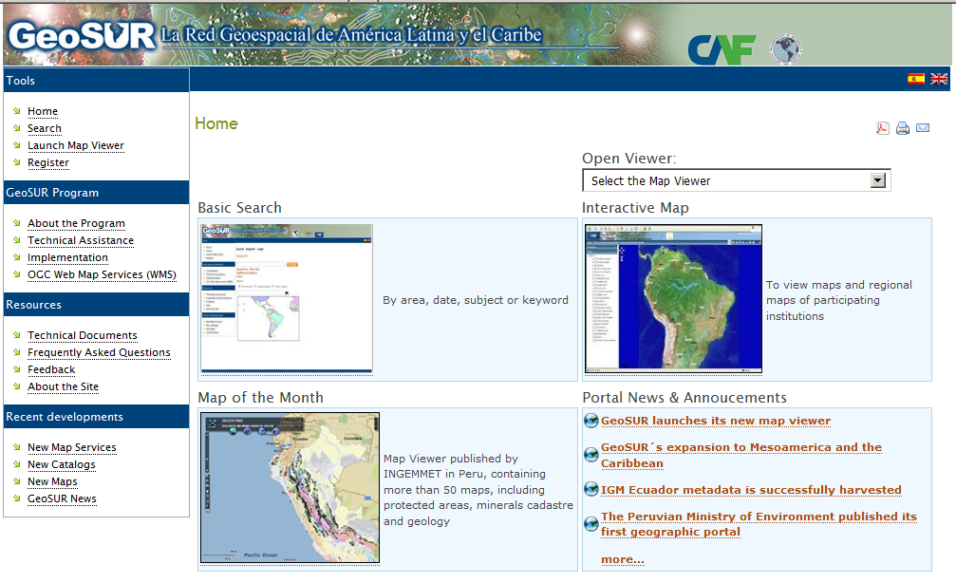
Cooperacion Andino Fomento

Slide 23
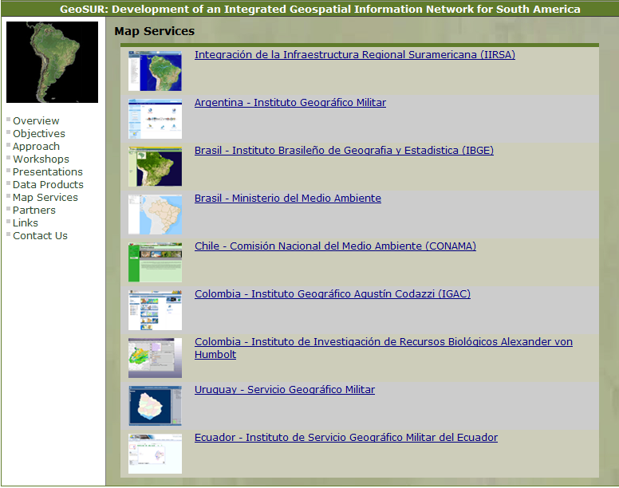

Slide 24
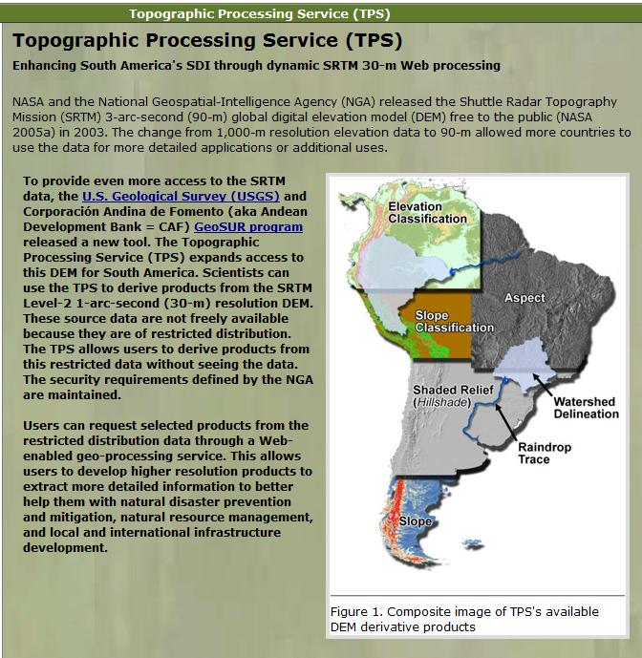
Cooperacion Andino Fomento

Slide 25
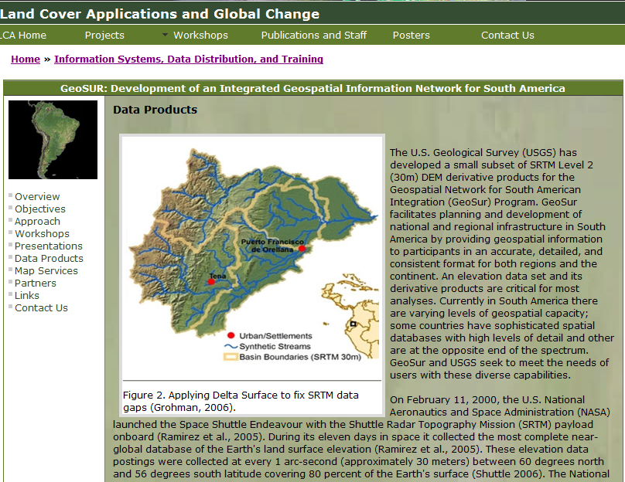

Slide 26
3. Webinars
What are they
Who presents them
Audience
Under-served communities
Regional science communities
Mechanics
Scheduling

Slide 27
Under-served Communities
Developing countries (govt. and research agencies, and NGOs)
Wide range of International NGOs
Specific groups in developed countries (e.g., Native Americans, Indigenous communities, student researchers, etc. )

Slide 28
3. Webinars
What are they
Who presents them
Audience
Mechanics
Web conferencing software ( one for all vs. presenter’s agency software)
Scheduling

Slide 29
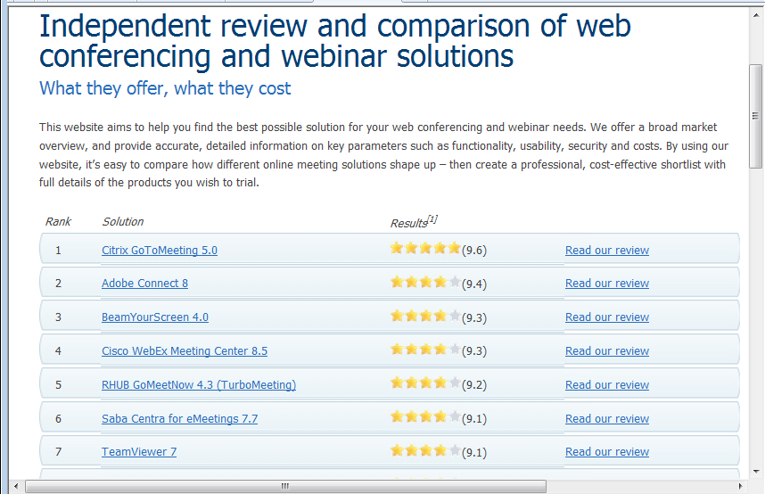

Slide 30
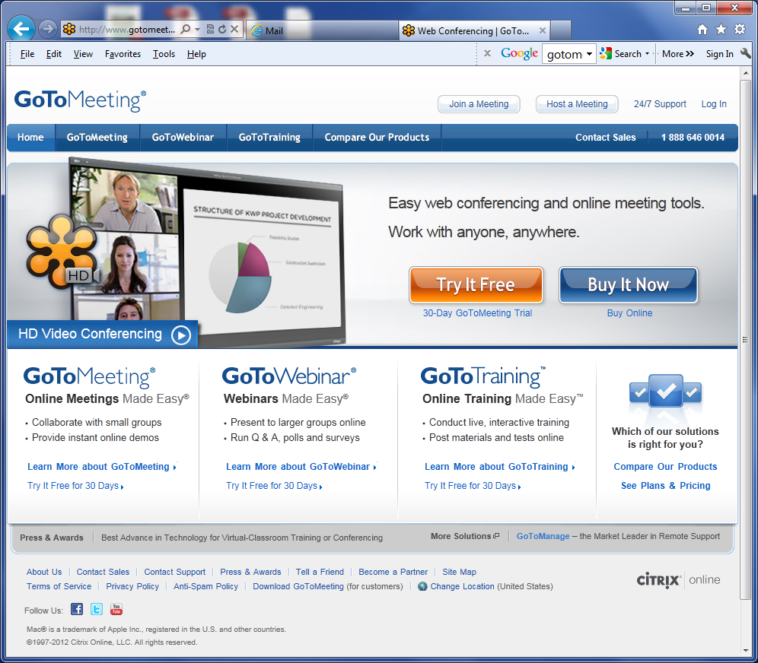

Slide 31
Uses ReadyTalk

Slide 32
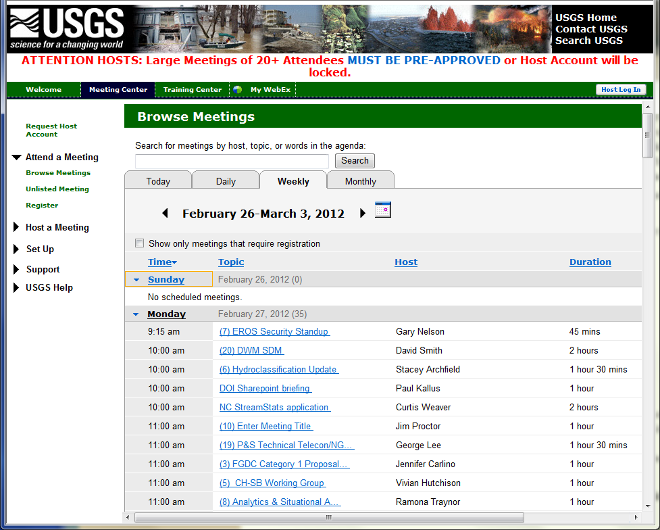

Slide 33
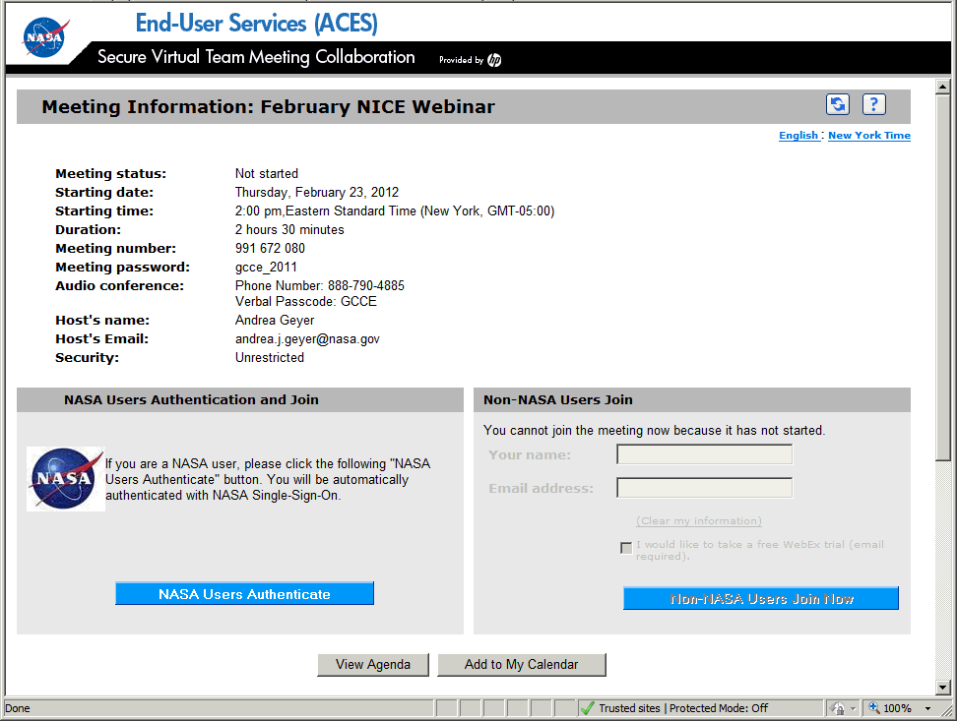

Slide 34
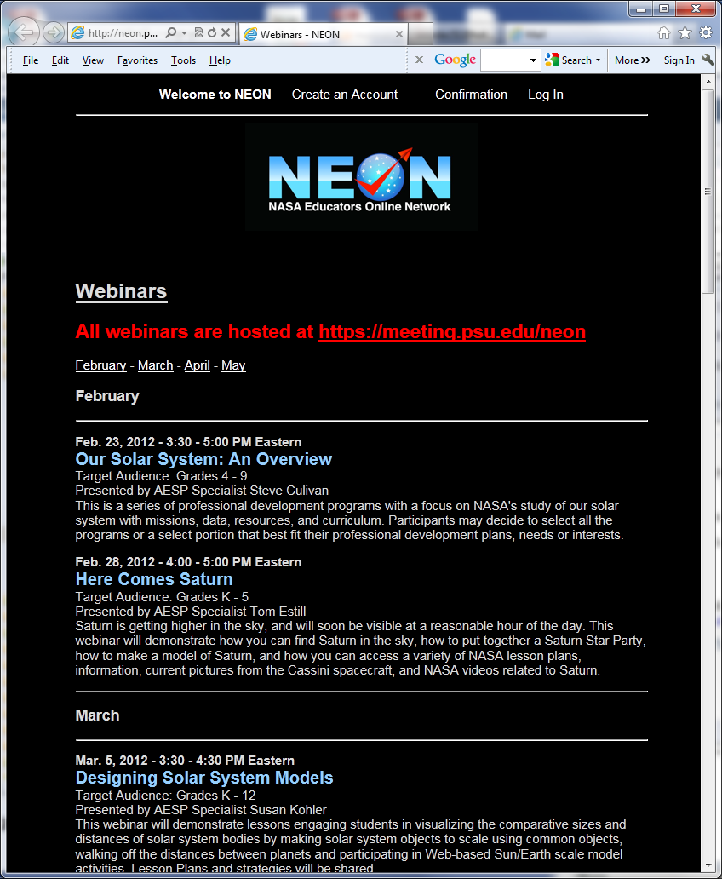
NASA, but through cooperators
Penn State

Slide 35
3. Webinars
What are they
Who presents them
Audience
Mechanics
Scheduling
Not until we confirm there is demand and reach a critical threshold of content and presenters
At or after beginning of INPE eLearning course

Slide 36
4. Discussion
Is this a good activity for WGCBDD?
Is it viable?
Funding ?
Content ?
Presenters ?
Demand ?

Slide 37
Thank you
Eric C. Wood
woodec@usgs.gov

