Slide 1

CEOS Work Plan for 2012
CEOS Working Group on Capacity Building
And Data Democracy
29 February – 2 March 2012
Timothy Stryker
CEOS Executive Officer

Slide 2
Expected CEOS 2012 Outcomes
Improved Coordination of Space Agency Activities Related to Climate
CEOS Response to 2010 GCOS IP and improvement in coordinated outputs for monitoring of ECVs
CEOS Input to Systematic Observation Requirements for GCOS Satellite Supplement
Development of FCDRs and related data sets (WG Climate)
Cooperation with GEO, WMO, and CGMS on space-based system to support climate information and adaptation
Further alignment of VCs to contribute to GCOS IP

Slide 3
Expected 2012 Outcomes (cont’d)
Progress Towards Established CEOS-GEO Priorities
CEOS leadership within and support to the GEO Global Forest Observation Task (incl GFOI IP and SDCG)
Continued development of the CEOS Strategy for Carbon Observations from Space
Advancement of CEOS Data Democracy activities within the reorganized WGCBDD
Further alignment of the CEOS VC objectives/activities to GEO 2012-2015 Work Plan Tasks

Slide 4
Expected CEOS 2012 Outcomes (cont’d)
Progress Toward Established GEO-CEOS Priorities (cont’d)
Continued support to development and operationalization of the GEOSS Common Infrastructure (GCI) and its elements
The development of a more integrated approach in the areas of disaster mitigation and disaster management
Continued support to the Joint Experiments on Crop Assessment and Monitoring (JECAM) initiative
Continued CEOS leadership of/support to the QA4EO initiative

Slide 5
Expected CEOS 2012 Outcomes (cont’d)
Considering CEOS Support to Further Key GEO Priority Initiatives
Exploratory dialogue on data requirements and CEOS Agency capacities to support the G20/GEO Global Agricultural Monitoring (GLAM) initiative
Continued dialogue on potential CEOS contributions to integrated water cycle products and services
Continued dialogue on potential CEOS contributions to the GEO Biodiversity Observation Network (GEO BON)

Slide 6
Expected 2012 Outcomes (cont’d)
Continued and Enhanced CEOS Outreach to Key Stakeholders: GEO, COP, UNFCCC, SBSTA, G8/G20
Maintenance to CEOS online services such as the CEOS website and Missions, Instruments and Measurements (MIM) database
Publication of the CEOS Newsletter
CEOS inputs for Rio+20 Summit, including a print update of the CEOS Earth Observation Handbook
Further review/adoption of CSS recommendations
Preparatory materials for, and discussion at, SIT-27

Slide 7
WGCBDD Contributions to CEOS Objectives
Advancement of CEOS Data Democracy activities within the reorganized WGCBDD
  Carry out CEOS “Data Democracy” Mission
    Wider access to EO data
    Increase the use and sharing of software tools
    Transfer relevant technologies to end users
    Provide intensive capacity building, education, and training
  Development of specific CEOS actions in support of GEO Task ID-02: Developing Institutional and Individual Capacity
  CEOS-unique capacity building activities
  Support to “threads” (e.g., disaster response, climate change, water resources)
  Close interaction/coordination with other CEOS entities
    Plenary/SIT: Executive decision-making on resources and strategic priorities
    Feedback into CEOS Self-Study
    Coordination with other CEOS WGs, Virtual Constellations, and SBA Teams
  Liaise as needed with GEO on data sharing initiatives

Slide 8
Backup Slides/
Background Information

Slide 9
CEOS in General
Established in 1984 under auspices of G-7 Economic Summit of Industrialized Nations
  Focal point for international coordination of space-related Earth Observation (EO) activities
  Optimize benefits through cooperation of members in mission planning and in development of compatible data products, formats, services, applications, and policies
Operates through best efforts of Members and Associates via voluntary contributions
30 Members (Space Agencies), 22 Associates (UN Agencies, Phase A programs or supporting ground facility programs)
As the space component of the Global Earth Observation System of Systems (GEOSS), CEOS is implementing high priority actions in support of Group on Earth Observation (GEO) Tasks
Notes:
9

Slide 10
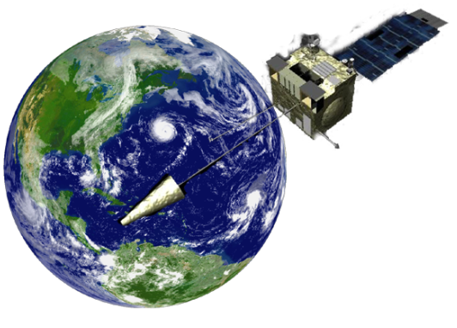
CEOS Objectives
To optimize benefits of space-borne Earth observations through:
  Cooperation of its Members in mission planning
  Development of compatible data products, formats, services, applications, and policies;
To serve as a focal point for international coordination of space-related Earth observation activities;
To exchange policy and technical information to encourage complementarity and compatibility of observation and data exchange systems.

Slide 11



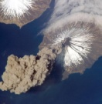



CEOS Structure 2012
Troika
Past Chair
Chair
Future Chair
(1-year terms)
ASI/Italy
ISRO/India
CSA/Canada
Troika
Strategic Implementation
Team (SIT)
Permanent Secretariat
CEOS Executive Officer (CEO)
Systems Engineering Office (SEO)
Chair: NASA Vice Chair: [TBD]
Chair Agency
ESA, EUMETSAT,
JAXA, NASA, NOAA, Past and Future Chairs
USGS (CEO) &
NOAA (DCEO)
NASA
(2-year terms)
(2-year terms)
WGCV
WGISS
WGCBDD
WGClimate
CEOS SBA Coordinators
Virtual Constellations for GEO
Chair
USGS
Vice Chair
CSA
Chair
JAXA
Vice Chair
[TBD]
Chair
INPE
Vice Chair
NOAA
Chair
EC-JRC
Vice Chair
NOAA
Atmospheric Composition
- NASA
- ESA
Precipitation
- JAXA
- NASA
Land Imaging
- USGS
- ISRO
- INPE
Ocean Surface Topography
- NASA
- EUMETSAT
Ocean Color Radiometry
- ESA
- ISRO
- NASA
Ocean Surface Vector
Wind
- NOAA
- ISRO
- EUMETSAT
Sea Surface Temperature
- ESA
- NOAA
- Agriculture
- Biodiversity
- Climate
- Disasters
- Ecosystems
- Energy
- Health
- Water
(2-year terms)
WGCV=Working Group on Calibration and Validation
WGISS=Working Group on Information Systems and Services
WGCBDD=Working Group on Capacity Building and Data Democracy
WGClimate = Working Group on Climate
SBA = Societal Benefit Area (GEO)

Slide 12
CEOS Strategic Implementation Team (SIT)
Created in 1996 to advance the involvement of CEOS in the development of the Integrated Global Observing System (IGOS)
Plays a central role in coordination of existing and future missions of CEOS agencies in support of GEO, GCOS, WMO, UNFCCC, etc.
Comprised of the Principals of CEOS Member Agencies and some Associates with the authority to commit Agency support to initiatives
SIT Chair Key Responsibilities
  Lead CEOS interaction with GEO/GEOSS and strengthen linkages to GEO and GEOSS
  Lead CEOS Virtual Constellation for GEO development and implementation activities
  Assist CEOS interaction with GEO Committees
SIT Objective: To define, characterize, and develop the vision for CEOS participation in GEO and strengthen CEOS linkages to GEOSS
Notes:
12

Slide 13
CEOS Virtual Constellations for GEO
Demonstrate the value of collaborative partnerships in addressing key observational gaps and bridging multiple GEO SBAs while maintaining the independence of individual contributions
Focus dialogue from “all topics/all agencies” to smaller, more specialized groups
Guidance for design and development of future systems to meet the broad spectrum of EO requirements
  Avoid duplication and overlap in EO efforts
  Close information gaps for GEO SBAs
  Establish and sustain global EO coverage and data availability
Seven Virtual Constellations approved and under development
  Atmospheric Composition (NASA and ESA)
  Land Surface Imaging (USGS, ISRO, and INPE)
  Ocean Surface Topography (NOAA and EUMETSAT)
  Precipitation (NASA and JAXA)
  Ocean Color Radiometry (EC-JRC, JAXA, and NASA)
  Ocean Surface Vector Wind (NOAA, ISRO, and EUMETSAT)
  Sea Surface Temperature (ESA and NOAA)

Slide 14
CEOS Working Groups
Working groups enhance technical cooperation among CEOS Agencies in specific topical areas with broad international benefit.
Working Group on Calibration and Validation (WGCV):
  To ensure long-term confidence in the accuracy and quality of Earth observation data and products
  Working Group on Information Systems and Services (WGISS)
  To coordinate the development of Earth observation satellite systems and services which manage and supply the data and information from CEOS Agencies’ missions
Working Group on Education, Training, and Capacity Building (WGEdu)
  To develop a strategy for future CEOS activities in education, training, and capacity building for societal benefit, particularly in Developing Countries
Working Group on Climate (WGClimate)
  To facilitate the use of Essential Climate Variable (ECV) time-series through coordination Member Agencies’ initiatives and activities

Slide 15
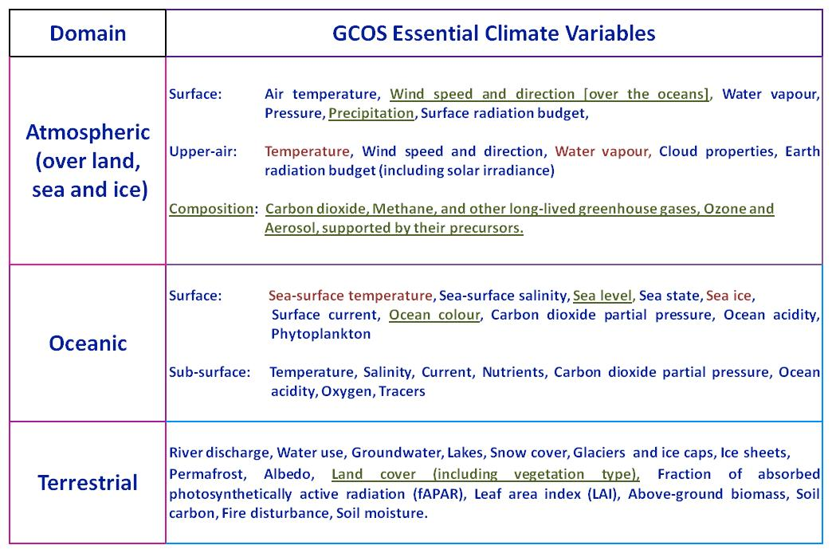
CEOS and the Global Climate Observing System (GCOS)
Observations being collected by current Virtual Constellations are underlined
Observations that could be collected by new Virtual Constellations are in red font
Notes:
ECVs are required to support the work of the UNFCCC and the IPCC and thereby GEO.
ECVs are technically and economically feasible for systematic observation.
These variables require international exchange to access both current and historical observations.
Currently, there are 48 ECVs as shown in the table (as detailed in the 2010 Update to the GCOS Implementation Plan).
Additional variables required for research purposes have not been included.

Slide 16
CEOS Members and Associates
MEMBERS
Agenzia Spaziale Italiana (ASI)
Canadian Space Agency (CSA)
Centre National d’Etudes Spatiales (CNES), France
Centro para Desarrollo Tecnólogico Industrial (CDTI), Spain
China Center for Resources Satellite Data and Applications (CRESDA)
Chinese Academy of Space Technology (CAST)
Comisión Nacional de Actividades Espaciales (CONAE), Argentina
Commonwealth Scientific & Industrial Research Organisation (CSIRO), Australia
Deutsches Zentrum fürLuft-und Raumfahrt (DLR), Germany
European Commission (EC)
European Organisation for the Exploitation of Meteorological Satellites (EUMETSAT)
European Space Agency (ESA)
Geo-Informatics and Space Technology Development Agency (GISTDA), Thailand
Indian Space Research Organisation (ISRO)
Instituto Nacional de Pesquisas Espaciais (INPE), Brazil
Japan Aerospace Exploration Agency/Ministry of Education, Culture, Sports, Science, and Technology (JAXA/MEXT)
Korea Aerospace Research Institute (KARI)
National Aeronautics and Space Administration (NASA), USA
National Oceanic and Atmospheric Administration (NOAA), USA
National Remote Sensing Center of China (NRSCC)
National Satellite Meteorological Center/Chinese Meteorological Administration (NSMC/CMA)
National Space Agency of Ukraine (NSAU)
National Space Research Agency of Nigeria (NASRDA)
Netherlands Space Office (NSO)
Russian Federal Space Agency (ROSKOSMOS)
Russian Federal Service for Hydrometeorology and Environmental Monitoring (ROSHYDROMET)
South African National Space Agency (SANSA)
Scientific and Technological Research Council of Turkey (TÜBITAK)
United Kingdom Space Agency (UKSA)
United States Geological Survey (USGS)
ASSOCIATES
Belgian Federal Science Policy Office (BELSPO)
Canada Centre for Remote Sensing (CCRS)
Council for Scientific and Industrial Research (CSIR)
Crown Research Institute (CRI), New Zealand
Global Climate Observing System (GCOS)
Global Geodetic Observing System (GGOS)
Global Ocean Observing System (GOOS)
Global Terrestrial Observing System (GTOS)
Intergovernmental Oceanographic Commission (IOC)
International Council for Science (ICSU)
International Geosphere-Biosphere Programme (IGBP)
International Ocean Colour Coordinating Group (IOCCG)
International Society of Photogrammetry and Remote Sensing (ISPRS)
Norwegian Space Center (NSC)
Swedish National Space Board (SNSB)
United Nations Economic and Social Commission for Asia and the Pacific (ESCAP)
United Nations Educational, Scientific and Cultural Organization (UNESCO)
United Nations Environment Programme (UNEP)
United Nations Food and Agriculture Organization (FAO)
United Nations Office for Outer Space Affairs (UNOOSA)
World Climate Research Programme (WCRP)
World Meteorological Organization (WMO)

