Slide 1
IGARS-2012 (Munich, GE, July 23 – 27, 2012)
Session: „Education, Training, and Capacity Building in Remote Sensing“
Dieter Hausamann & Maurizio Fea
March 2, 2012

Slide 2
Outline
Session: „Education, Training, and Capacity Building in Remote Sensing“
Location
DLR_School_Lab @ IGARSS
Combined DLR/ESA EO Training Facility

Slide 3
IGARSS-2012 EDU: Present (preliminary) status
„Education, Training, and Capacity Building in Remote Sensing“
3 Slots/14 Submissions :
Space Agencies (5 Presentations)
Global and Regional Programmes (5 Presentations)
Tools and Software (4 Presentations)
These Slots aren‘t parallel!?!
Additional Feature: Practical EO Training Facility, consisting of
DLR_School_Lab Oberpfaffenhofen+ ESA Eduspace
Experiments:
Radar Tech/Infrared & Laser Tech/SatNav (Lead: DLR)
EO Data Analysis (Lead: ESA)
Operation Monday – Thursday
Invited School Classes (Secondary)
Teacher Groups + Session Particiants
Operation in English
All Participants can Watch the Trainings

Slide 4
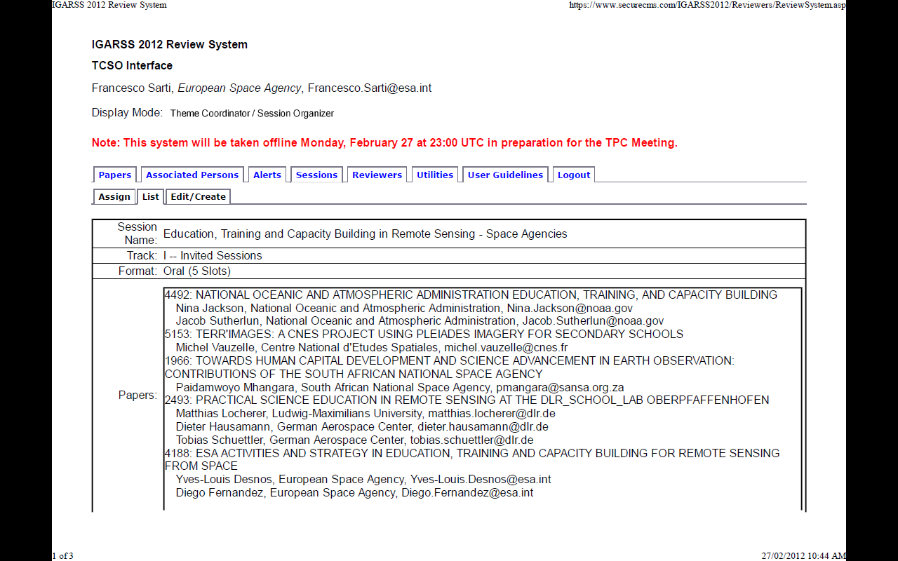

Slide 5
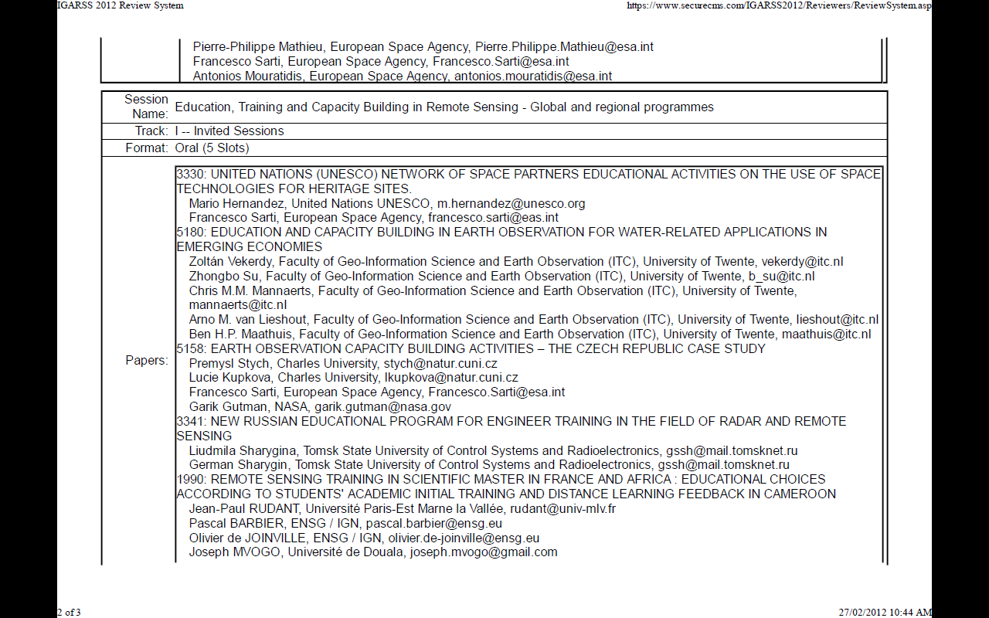

Slide 6
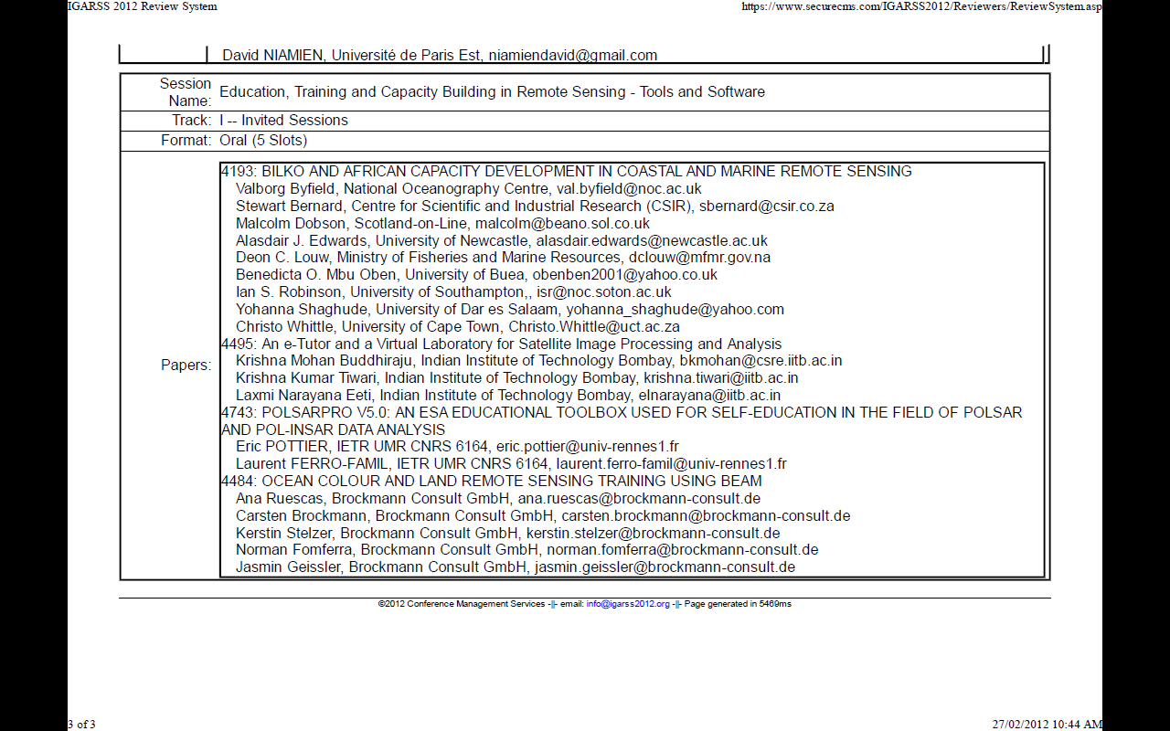

Slide 7
IGARSS-2012 EDU: Present (preliminary) status
„Education, Training, and Capacity Building in Remote Sensing“
3 Slots/14 Submissions :
Space Agencies (5 Pres.)
Global and Regional Programmes (5 Pres.)
Tools and Software (4 Pres.)
These Slots are not parallel!?!
Additional Feature: Practical EO Training Facility, consisting of
DLR_School_Lab Oberpfaffenhofen+ ESA Eduspace
Experiments:
Radar Tech/Infrared & Laser Tech/SatNav (Lead: DLR)
EO Data Analysis (Lead: ESA)
Operation Monday – Thursday
Invited School Classes (Secondary)
Teacher Groups + Session Particiants
Operation in English
All Participants can Watch the Trainings

Slide 9
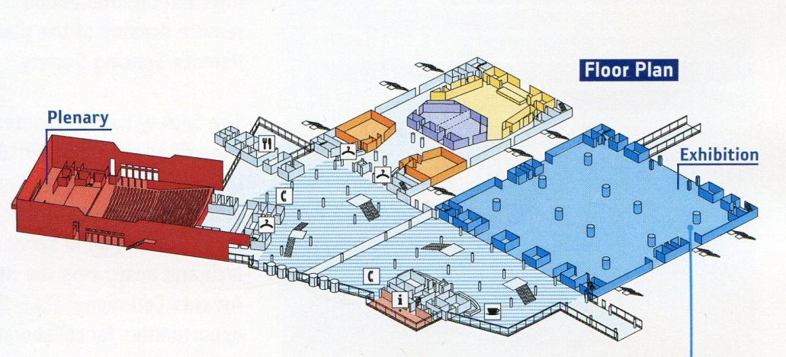
ICM Floor Plan: 2.000 participants/15 parallel sessions

Slide 10
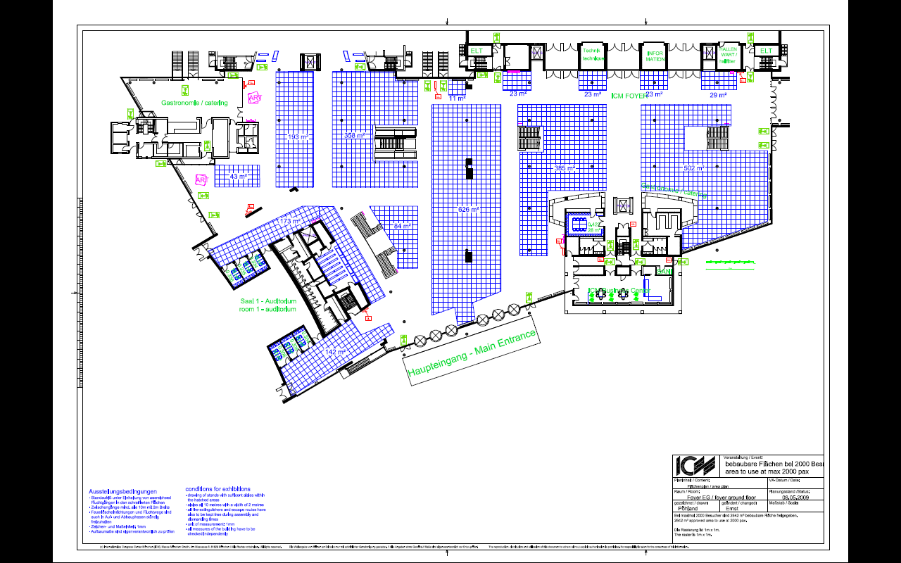

Slide 11
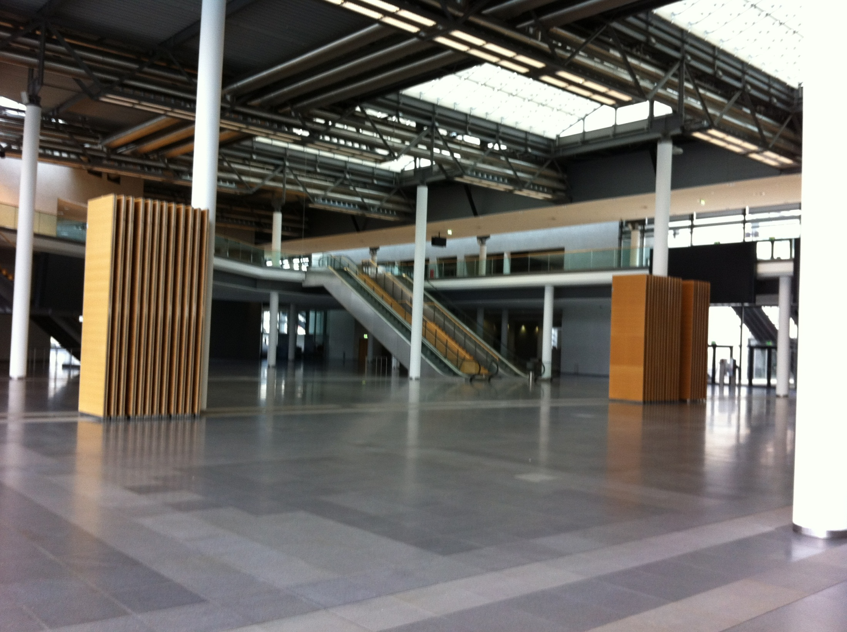

Slide 12
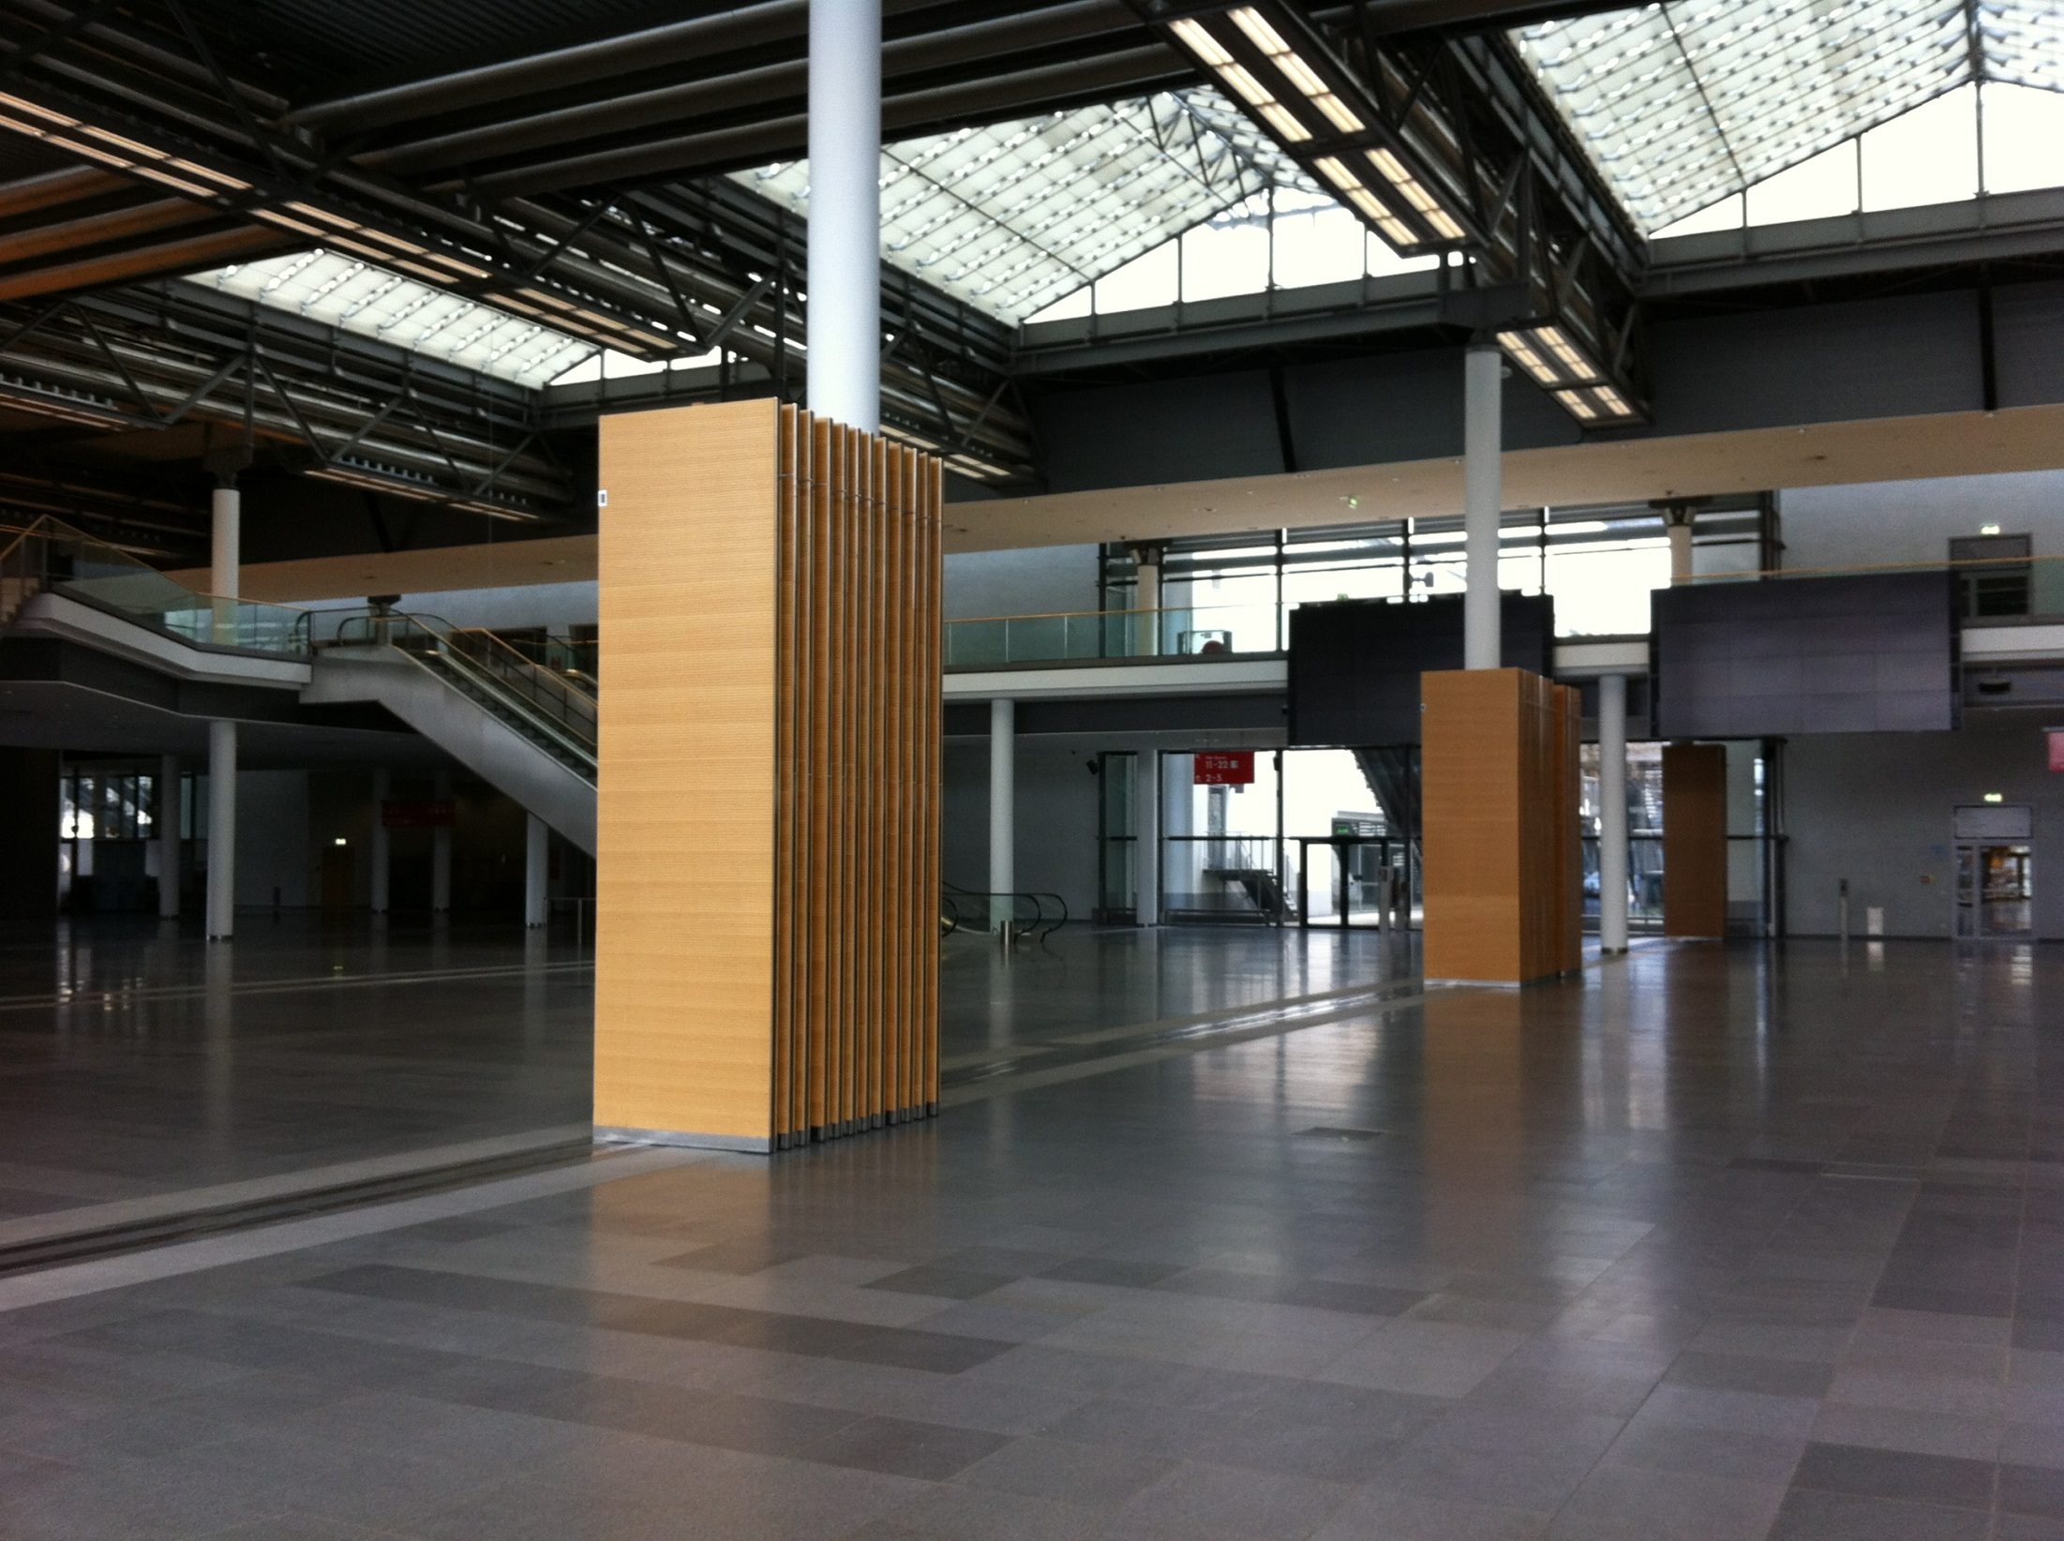

Slide 13
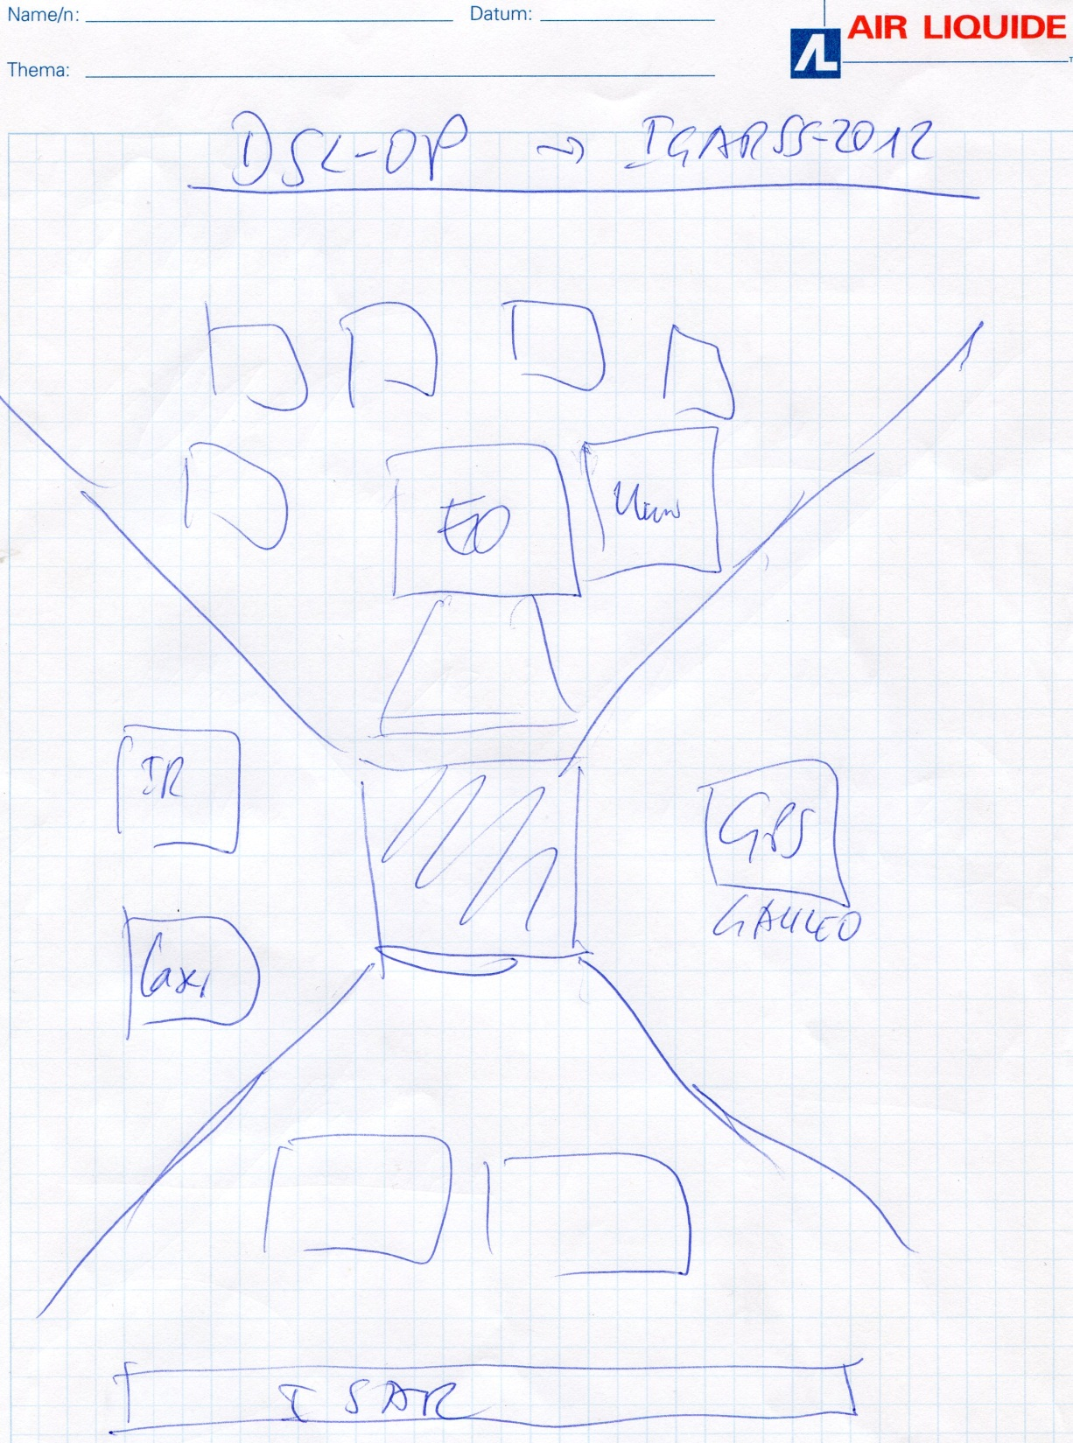

Slide 14
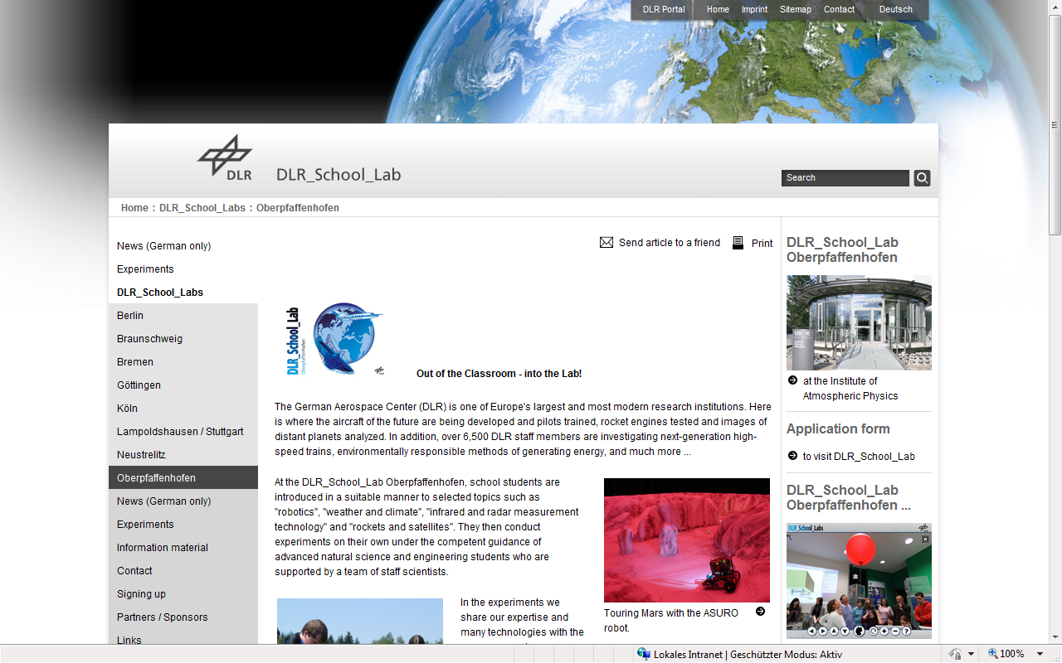
http://www.dlr.de/schoollab/en/desktopdefault.aspx/tabid-1738/10609_read-23762/

Slide 16
IGARSS-2012 EDU: Present (preliminary) status
„Education, Training, and Capacity Building in Remote Sensing“
3 Slots/14 Submissions :
Space Agencies (5 Pres.)
Global and Regional Programmes (5 Pres.)
Tools and Software (4 Pres.)
These Slots are not parallel!?!
Additional Feature: Practical EO Training Facility, consisting of
DLR_School_Lab Oberpfaffenhofen+ ESA Eduspace
Experiments:
Radar Tech/Infrared & Laser Tech/SatNav (Lead: DLR)
EO Data Analysis (Lead: ESA)
Operation Monday – Thursday
Invited School Classes (Secondary)
Teacher Groups + Session Participants
Operation in English
All Participants can Watch the Trainings OR participate themselves

