Slide 1

CEOS Calendar for 2012
CEOS Working Group on Capacity Building
And Data Democracy
29 February – 2 March 2012
Timothy Stryker
CEOS Executive Officer

Slide 2
Overview
CEOS Calendar (www.ceos.org)
  CEOS Events
  GEO Events
  Related Events
  Will require notification by CEOS Agencies of attendance at meetings so that, if required, attendee may act or listen on behalf of CEOS
Ensure CEOS is represented at key meetings
Notes:
I will focus mainly on CEOS and GEO Events in this brief presentation (well, as brief as a 12-month review can be)

Slide 3
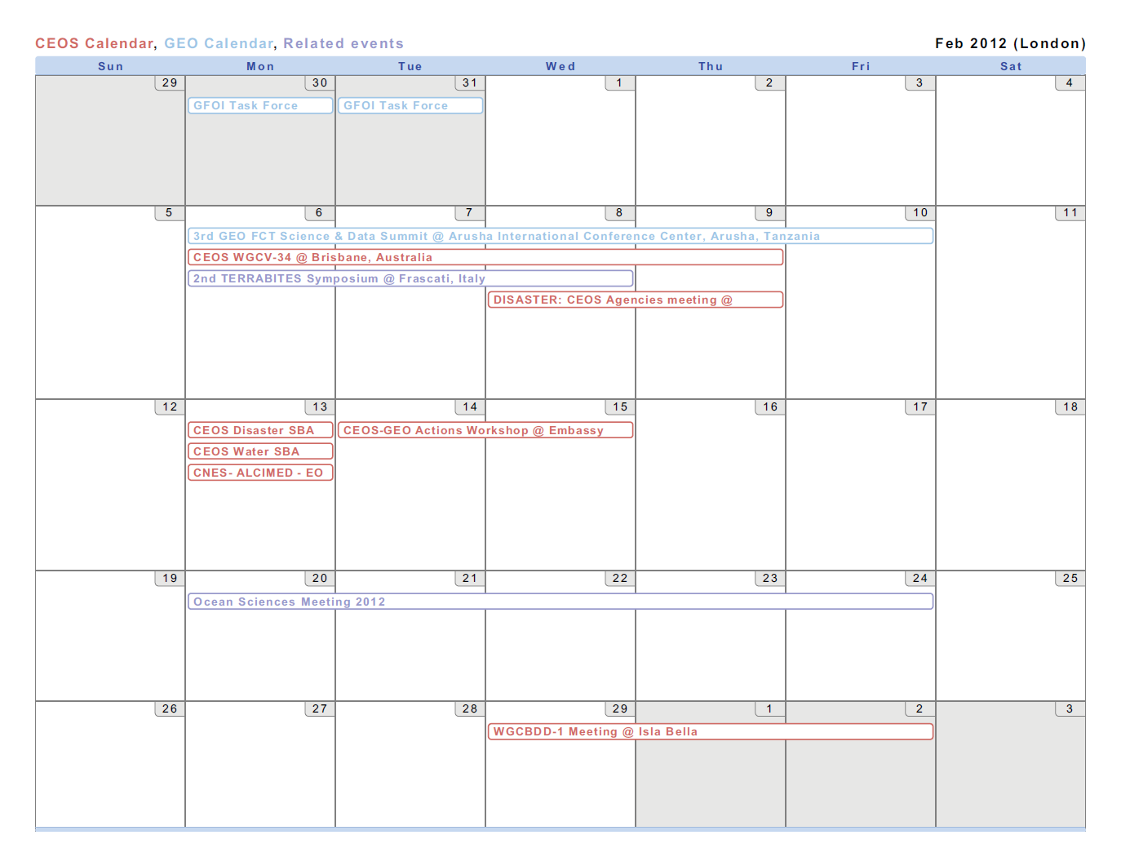

February 2012
Notes:
CEOS WGCV-34: 6-10 Feb in Brisbane, Australia
CEOS-GEO Actions Workshop: 14-15 Feb in Washington DC

Slide 4
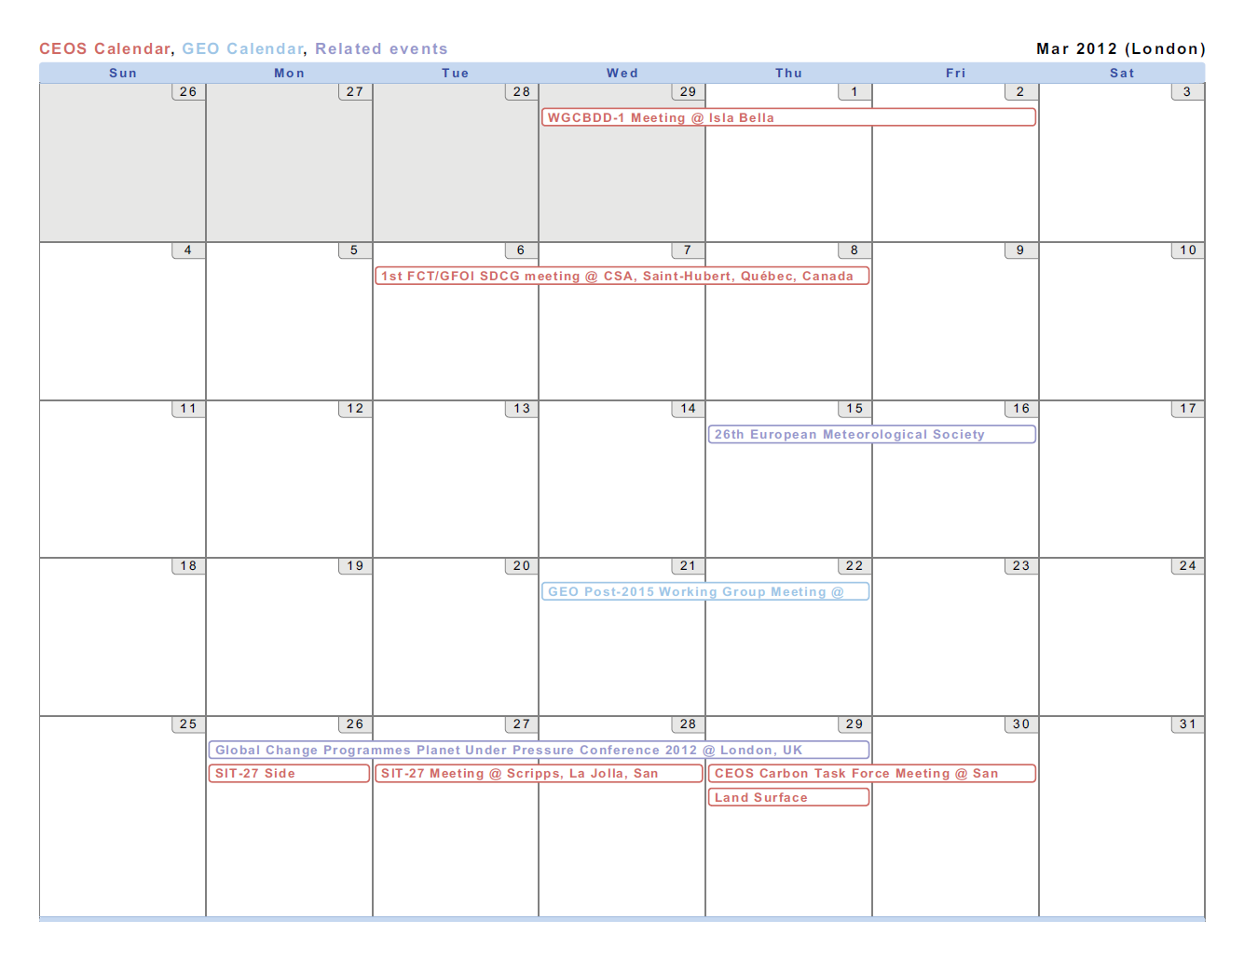
March 2012
Notes:
CEOS WGCBDD-1: 1-2 Mar in Isla Bella, Brasil
CEOS SIT-27 and associated side meetings: 26-28 Mar in La Jolla, California, USA
CEOS LSI Constellation Meeting: 29 Mar in La Jolla, California, USA
CEOS Carbon Task Force Meeting: 29-30 Mar in La Jolla, California, USA

Slide 5
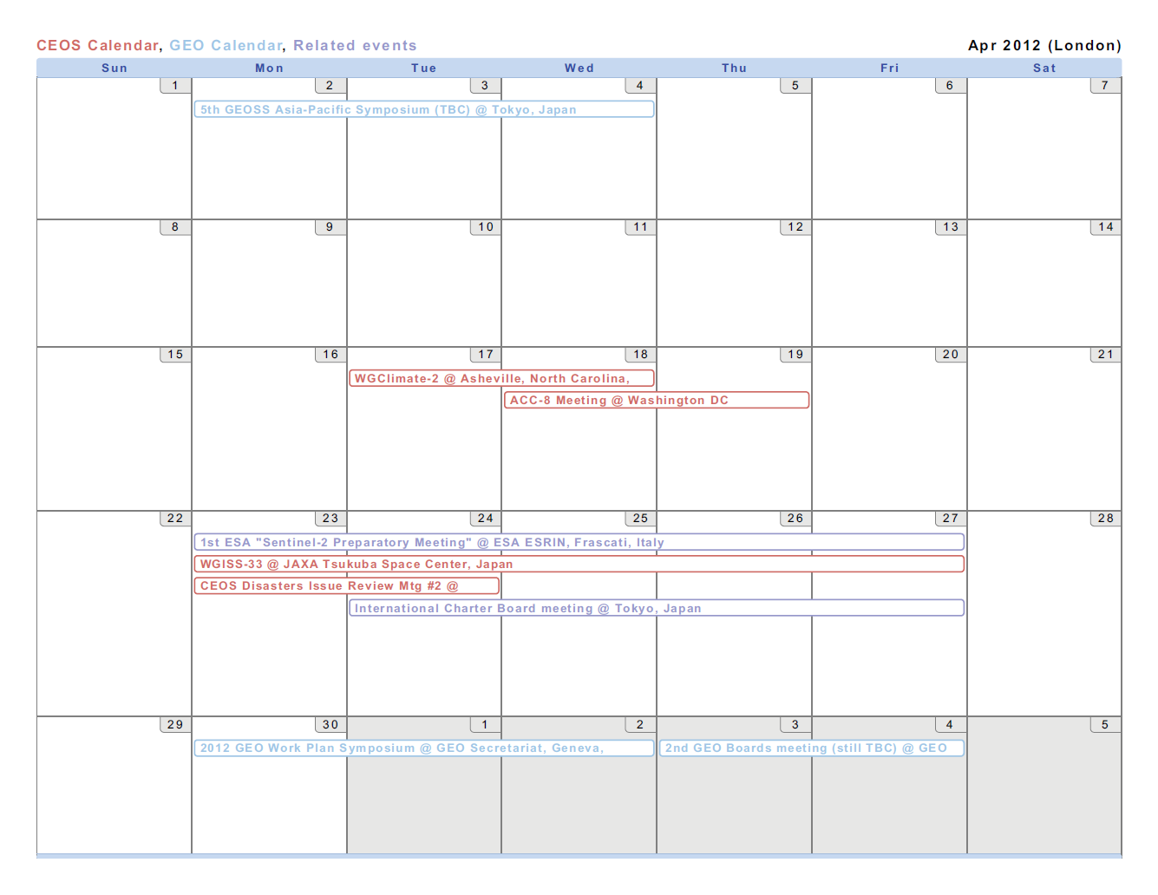
April 2012
Notes:
CEOS WGISS-33: 23-27 Apr in Tokyo, Japan

Slide 6
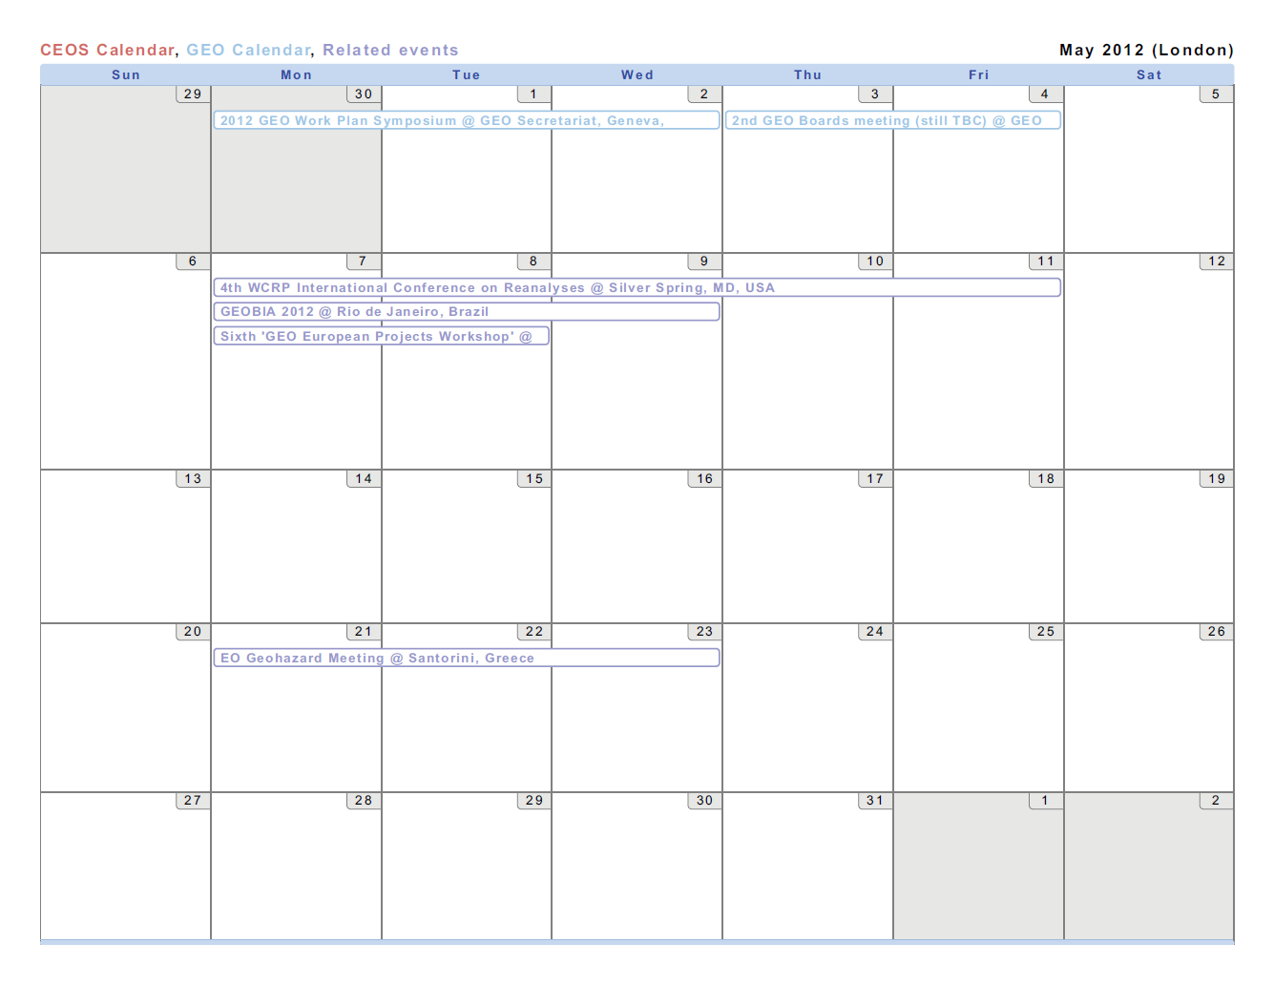
May 2012

Slide 7
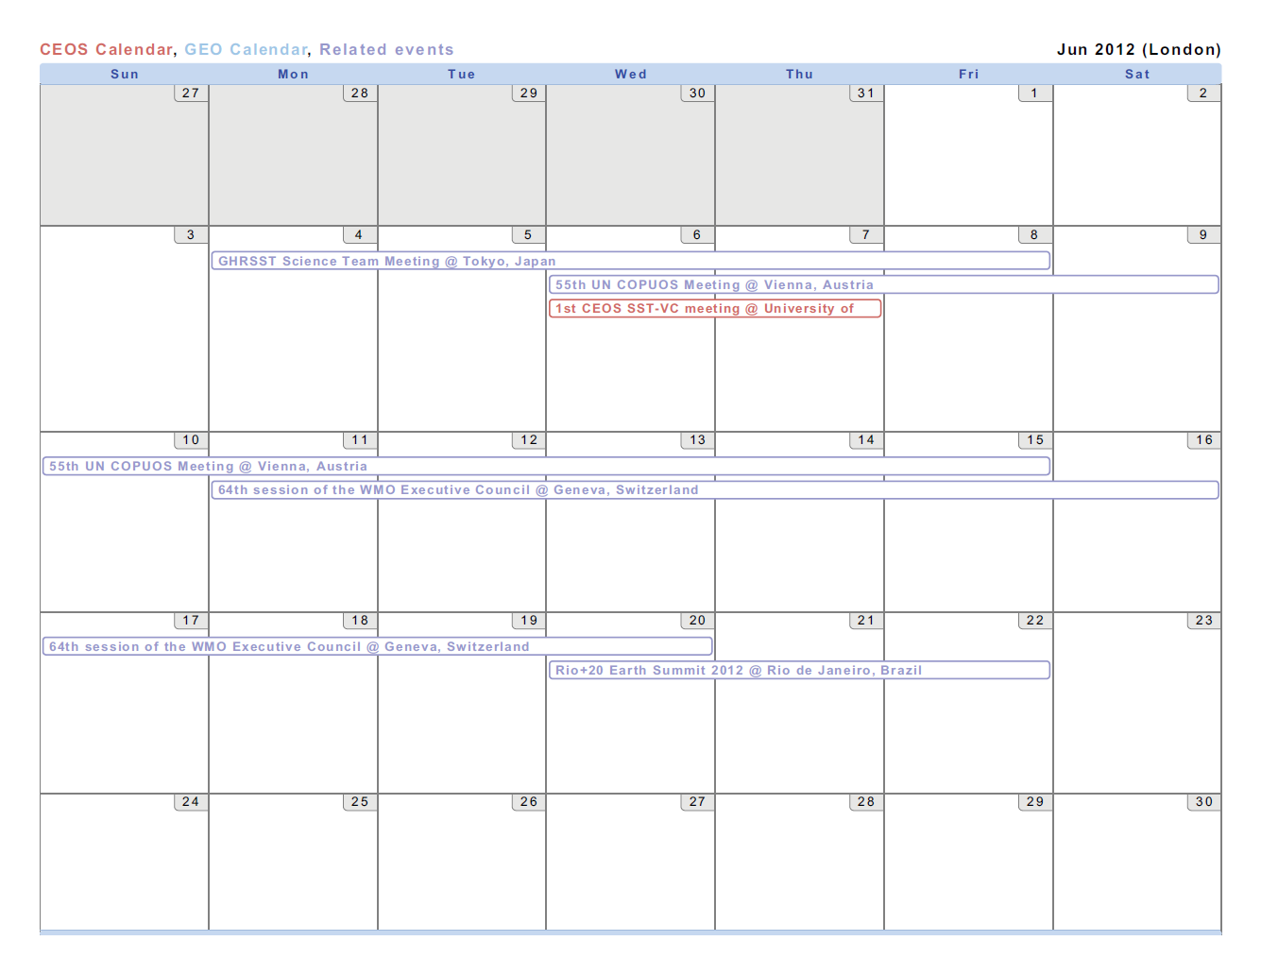
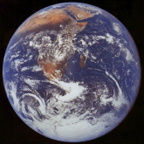
June 2012
Notes:
Rio+20: 20-22 Jun in Rio de Janeiro, Brasil

Slide 8
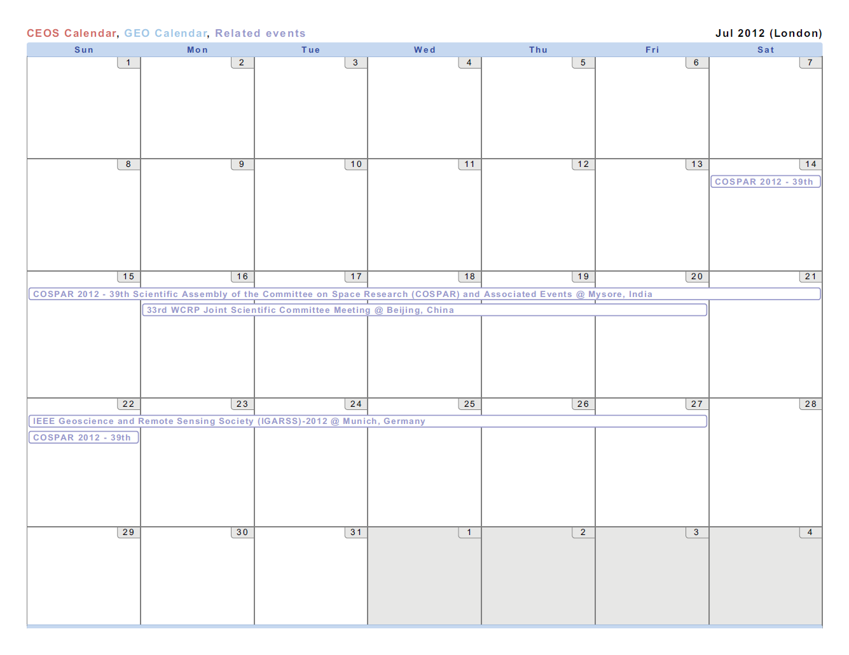
July 2012
Notes:
32nd WCRP Joint Scientific Committee Meeting: 16-20 July in Beijing, China
IGARSS-2012: 22-27 Jul in Munich, Germany

Slide 9
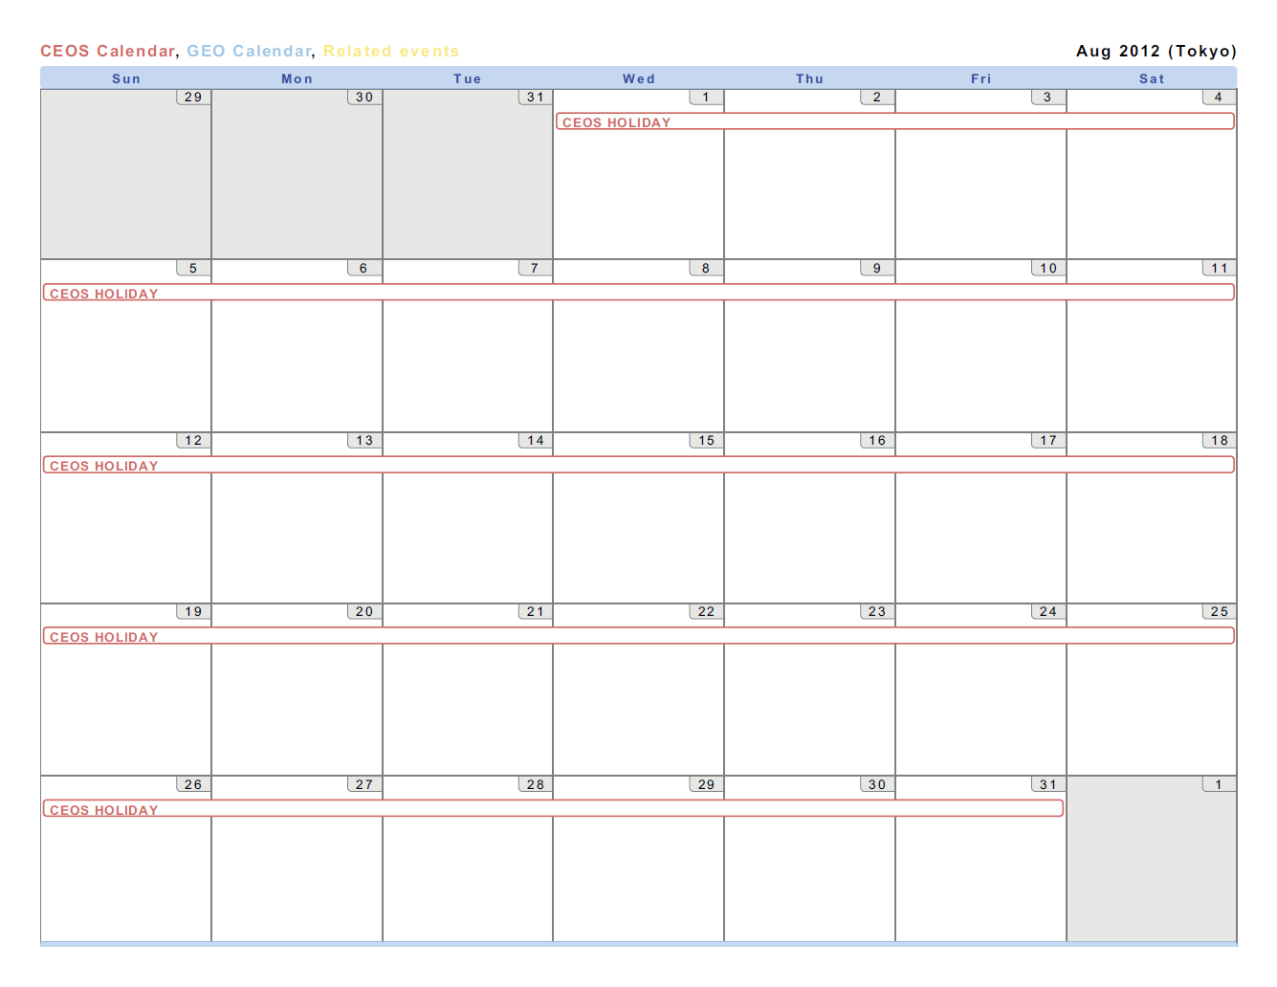

August 2012
On Holiday!
Closed for Business

Slide 10
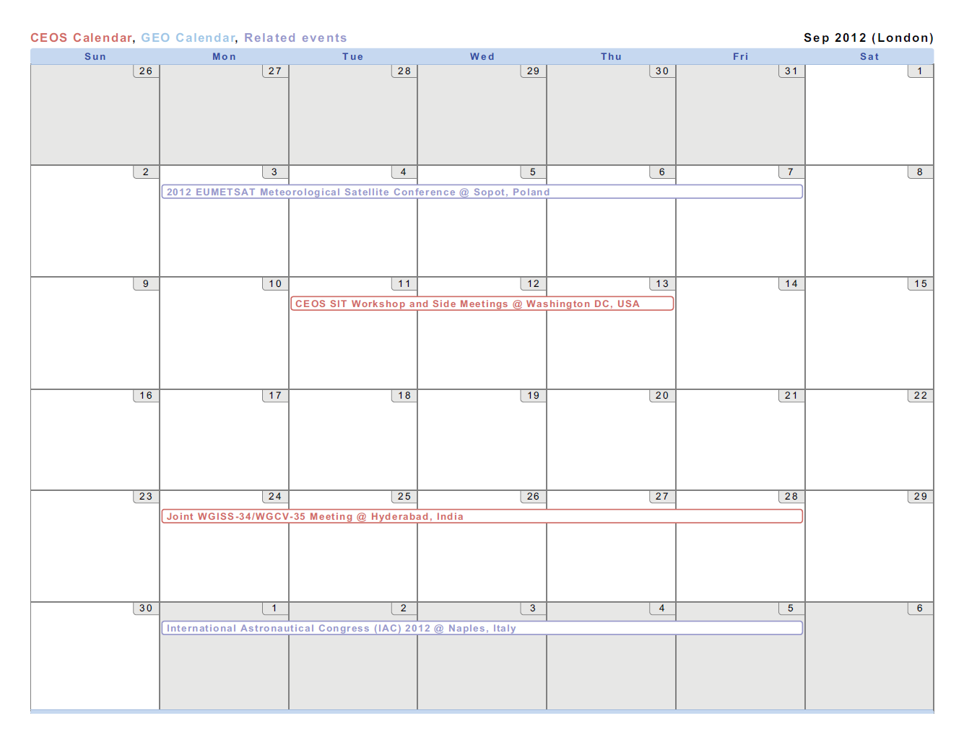
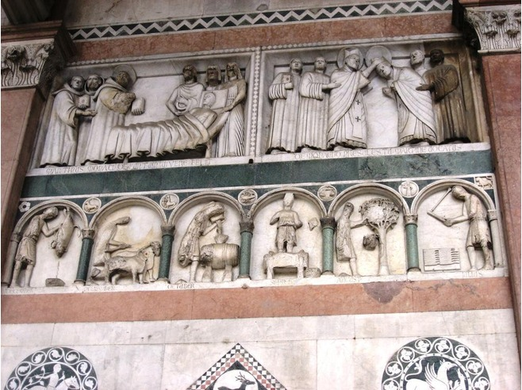
September 2012
Notes:
CEOSs WGCV-35/WGISS-34 Joint Meeting: 10-14 Sep in India (exact location TBD)
CEO Birthday: 30 Sep
September is also the month that we crush our grapes (for those of us that were on the city tour of Lucca last evening, recall the sculptures of the months from the Duomo di San Martino)

Slide 11
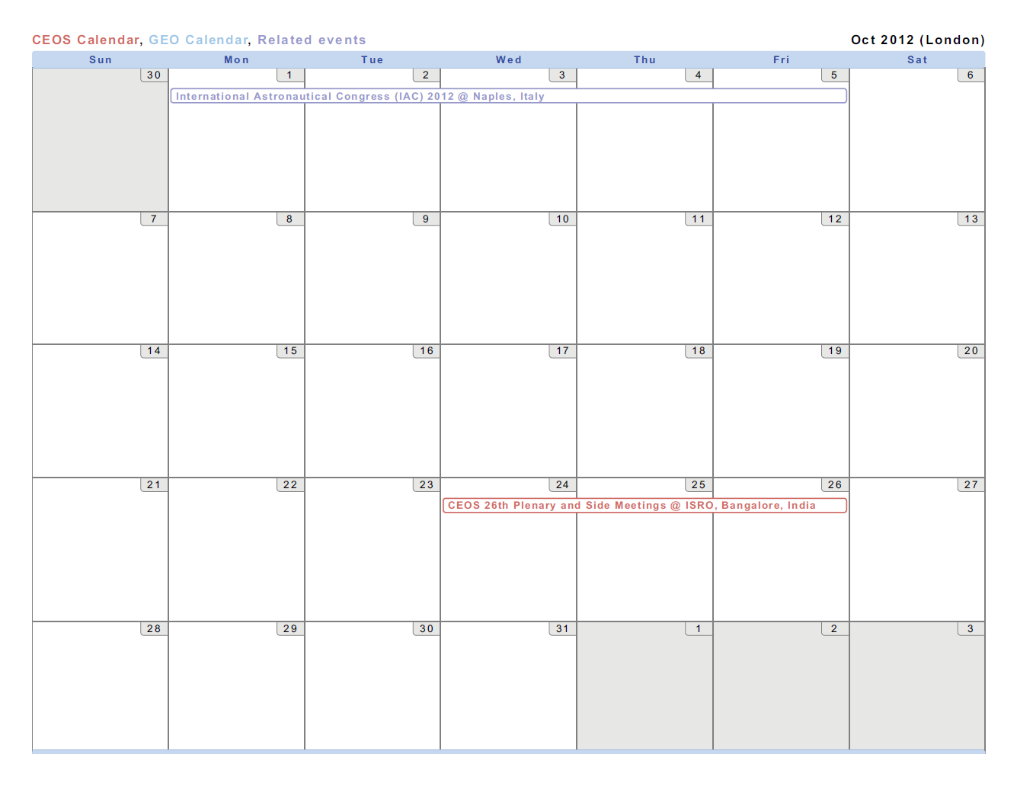
October 2012
Notes:
CEOS 26th Plenary and associated side meetings: 29-31 Oct in Bangalore, India
And October is when CEOS makes the wine

Slide 12
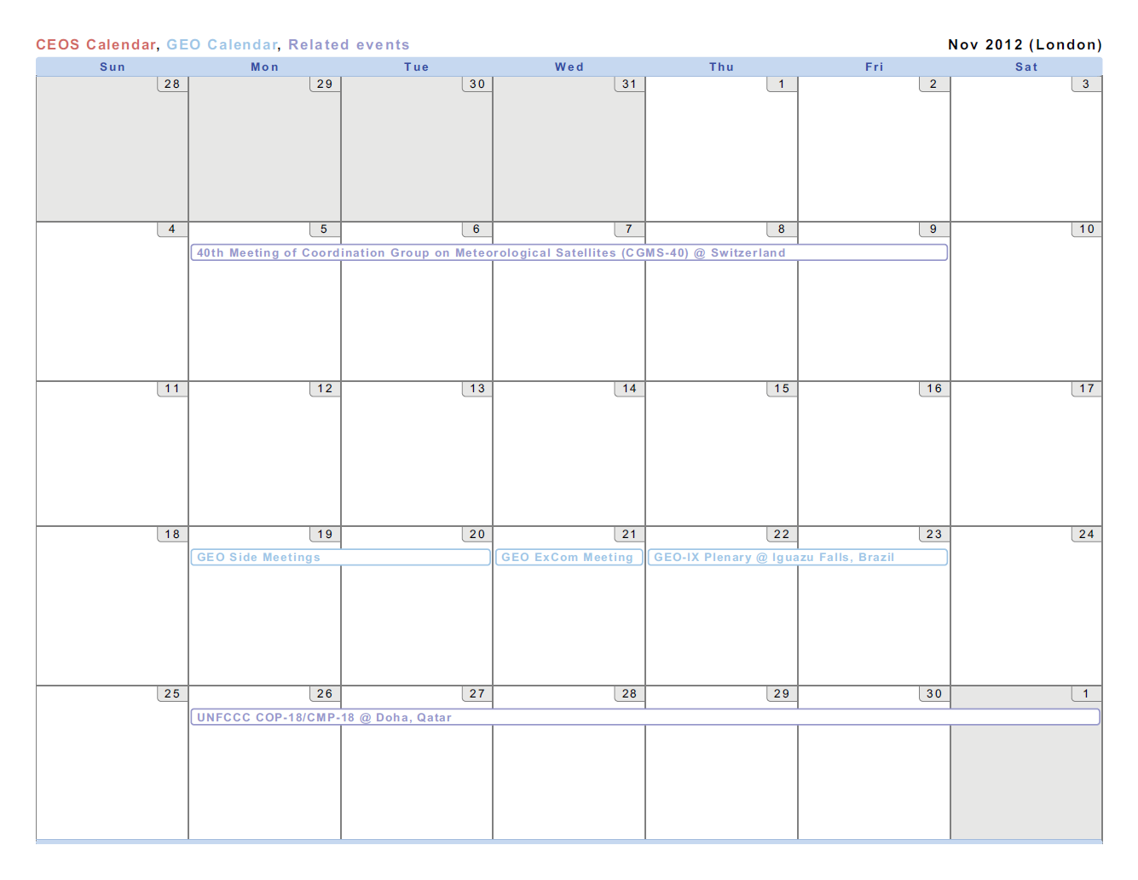
November 2012
Notes:
CGMS-40: 5-9 Nov in Basel, Switzerland
GEO-IX Plenary: location and dates will be confirmed next week but generally, second week in November
UNFCCC COP-18 has not yet been scheduled; Locations are between Korea and Qatar
CEOS needs to start planning now for our COP-18 activities (Mark?)

Slide 13
TBC CEOS Events
OCR VC
OSVW VC
OST VC
PC

Slide 14
Issues
Maintain current status of events on the CEOS website
  Many of the “meetings” are not up to date (e.g., announcing an upcoming meeting for 2010)
Calendar is reviewed during monthly SEC telecons
  Please provide any information or updates to DCEO (kerry.sawyer@noaa.gov)
Dec Nov Oct Sep Aug July
Notes:
Courtesy of the Duomo di San Martino in Lucca

