Slide 1
GEONETCast Delivering Environmental Data to Users Worldwide
Jacob Sutherlun
Ilhabela, Brazil
29 February 2012

Slide 2
GEONETCast: Description
A satellite-based data and product distribution network:
Low cost, stand alone, off-the-shelf reception stations.
3 regional broadcasts make up the global GEONETCast system.
Started in 2006 GEO Work Plan: Task CB-06-04, a high priority capacity building area task under monitoring of the GEO Architecture and Data Committee.
Demo of GEONETCast, as built upon EUMETCast, in 2006
Development of GEONETCast initiative for GEO community participation, including data products for and user involvement from all nine societal benefit areas.
Provide near-global coverage with established data exchange between regional broadcasts.
CMA (CMACast, over Asia and western Pacific),
EUMETSAT (EUMETCast, over Europe, Africa, and Americas)
NOAA (GEONETCast Americas, over the Americas and Caribbean)

Slide 3
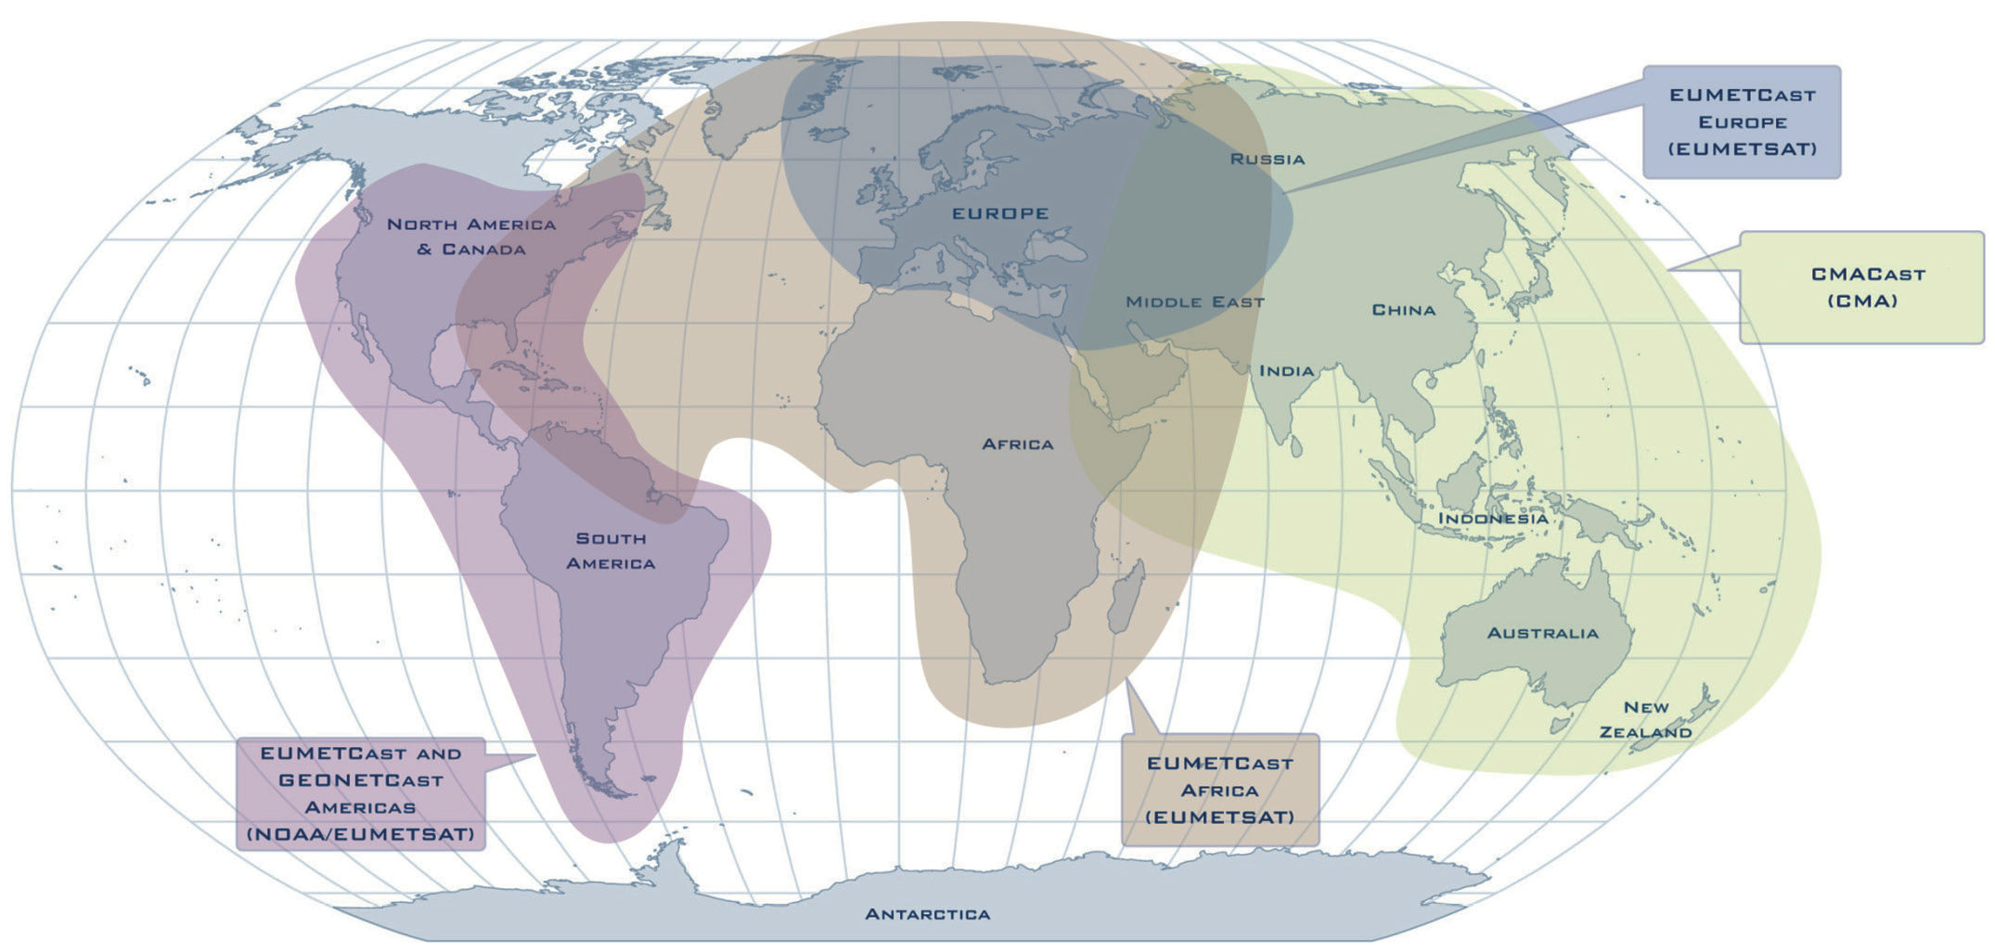
GEONETCast: Global Coverage

Slide 4
GEONETCast: Details
High availability, low latency data and product delivery to Users;
Particularly applicable in areas of poor telecommunications infrastructure or where there is risk of damage due to disasters;
Well-established mechanism for Users to request the inclusion of additional data or products;
Ability to receive products generated by content providers in other regions.
Regional Systems Are Connected

Slide 5
GEONETCast: Details
Receiving stations use low-cost, off the shelf DVB-S broadcast technology
Receive station cost ~ $2,000 - $3,000;
Small or no recurring licence costs or subscription fees
No internet connection required at User stations.
Kencast, Inc. Fazzt Client Application
Received File Transmission Screen on GEONETCast Americas Receive Station

Slide 6
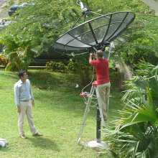
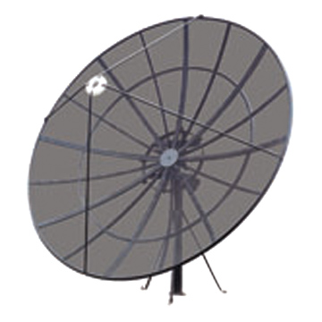
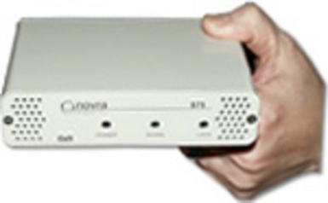
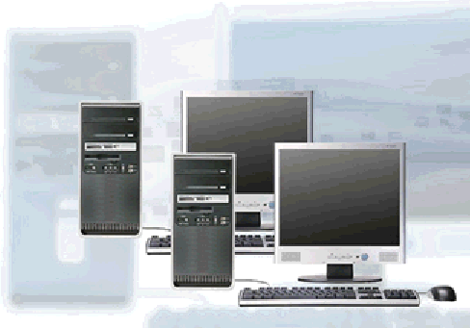
GEONETCast Americas - Receive Station
- Personal computer with client software
- Satellite antenna ~2.4 m
- DVB-S receiver card or box
CATHALAC/SERVIR
Antenna Installation

Slide 7
GEONETCast: Water Resource Management
Water Resource Mgmt.
Agriculture Products
Drought Monitoring
Vegetation
Soil Moisture
Precipitation
Example (At right):
Vegetation Index (NDV) from INPE/CPTEC in Brazil from AVHRR and MODIS

Slide 8
GEONETCast: Disaster Management
Disaster Application Examples:
Auxiliary dissemination mechanism for the International Charter “Space and Major Disasters”
Precipitation Forecast for Disaster Preparedness for Floods and Landslides
Portable GEONETCast Americas Receiving Stations for disaster response and recovery
Costa Rica Instituto Meteorológico Nacional / National Meteorological Institute of Costa Rica (IMN) Precipitation Product

Slide 9
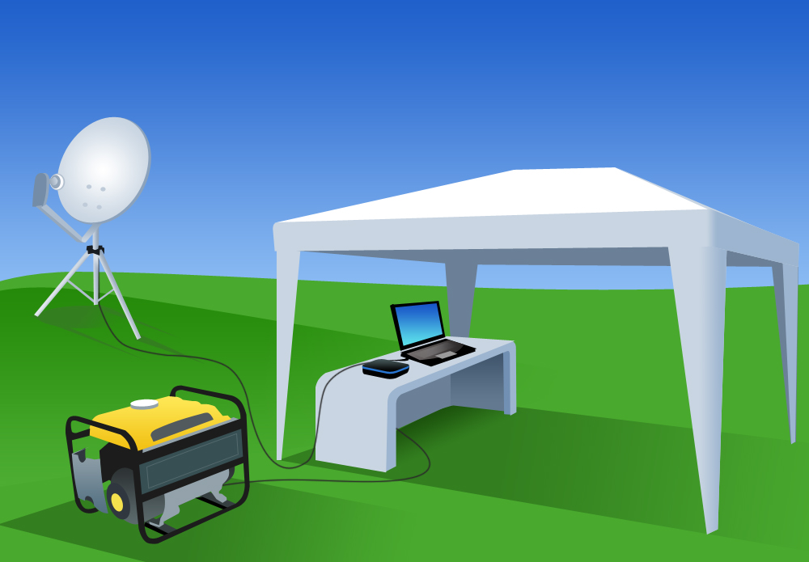
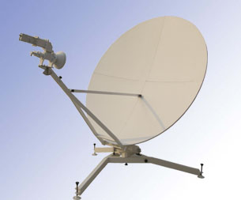
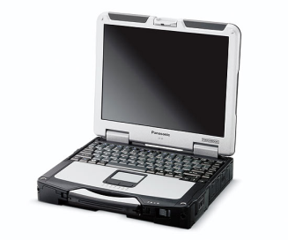
Portable GEONETCast-Americas
Receiving Station
Laptop with Fazzt Client Software
USB DVB-S Receiver
1.8M Flyaway Antenna (C band)
Brazil National Center for the Monitoring and Alerting of natural Disasters (CEMADEN)
Notes:
Aqui está ilustrado a simplicidade e praticidade de uma estação móvel de recepção de dados GNC-A. Com uso de gerador de energia a gasolina para garantir a autonomia elétrica, antena portátil de 1,8metros(responde muito bem ao footprint do Intelsat-9 em nosso território), módulo de recepção DVB-S externo(USB) conectado a um robusto laptop rodando o software para recepção de dados de satélites Fazzt Client.

Slide 10
Future of GEONETCast
2012-2015 GEO Work Plan
IN-04 GEOSS Communication Networks
C2 GEONETCast
Leads
China (CMA), Russia (Roshydromet), USA (NOAA), EUMETSAT
Priority Actions (Relating to this Working Group)
• Further develop GEONETCast – a distribution system for GEOSS information using
communication satellites and low cost, off-the-shelf reception stations. Evolve GEONETCast into
a fully operational global system disseminating data and products across all Societal Benefit Areas
• Foster relationships with data providers and users to enhance data content in line with the evolving needs of users and decision-makers
• Expand interaction with networks of users in developing countries to improve access to data in
areas with limited data accessibility. In particular, facilitate improved access to disaster
information in developing countries through collaboration with key disaster management
mechanisms, including the International Charter on Space and Major Disasters (see also DI-01)
Notes:
(a) better understand the needs for Earth observation products/data/information from the various user communities through whatever WGCBDD's user engagement mechanisms would be, and (b) as providers of resources (EO, systems, services, education resources, etc), the WG members could then help respond to these needs by offering and contributing the required resources through the GNC.

Slide 11
Actions/Descions
Determine if/how the working group can support GEONETCast
Develop specific actions on how the WG will contribute to the GEONETCast component
Determine POC for the GEONETCast project should we decide to pursue it

