Slide 1
Celebrating 10 years of…
WGCapD
CEOS Webinar Toolkit
Lauren Childs-Gleason, NASA
Dr. Chris Barnes, USGS

Slide 2
Background & Purpose
WGCapD Recommendation @ 2020 CEOS Plenary:
CEOS should create a “Webinar Toolkit” that includes guidelines and good practice for creating and branding CEOS webinars. The toolkit would include how-to guidance, templates, and branding design assets. WGCapD also proposed a framework for CEOS working teams to gain WGCapD support during the webinar creation process and amplification of promotional efforts.
Objectives:
Increase awareness of CEOS, its activities, and resources available
Harness the work done by SIT Chair on branding the CEOS thematic observation strategies (TOS)
Increase recognition of CEOS-sponsored activities and resources through standardization/branding
Bring WGCapD lessons learned on webinar good practices to CEOS working teams
Benefits:
Easy to follow webinar creation process
Curated archive of useful documentation & resources
Strengthened & more effective CEOS webinars
Increased recognition of CEOS contributions
Enhanced community awareness, access, and ability to use satellite data and supporting technologies
Increased number of people benefiting from the CEOS working team efforts

Slide 3




Toolkit Structure
Primary Resource:
Webinar Creation Guide
Templates:
Storyboard Template
Trainee Spreadsheet
Post-Training Questionnaire Template
Report Template
Supporting Guidance:
Design Elements:
Promotional Flyer Template (PPT)
Draft Thematic Observation Icons
Presentation Templates (to be completed after icons)
Logo & Icon Bank
Needs Assessment Guide
Learning Objectives Guide
Promotion Guide

Slide 4
Toolkit Guides
Webinar Creation Guide
Serves as a starting point for those creating a webinar
Provides guidance on:
  Full process and phases of webinar development
  General good practices for each step
  Insights into branding and webinar evaluation
  Tips for effective webinars
  Resource list
Many of the good practices and tips come from the WGCapD Training Best Practices document
Needs Assessment Guide
Discusses general steps for conducting a needs assessment, the different approaches available, general considerations, and resources
Learning Objectives Guide
Provides an overview of the importance of good learning objectives, how to write them effectively, and considerations and resources available
Webinar Promotion Guide
Identifies suggested promotional activities and steps, characteristics of good promotional emails, general tips and considerations, and resources

Slide 5
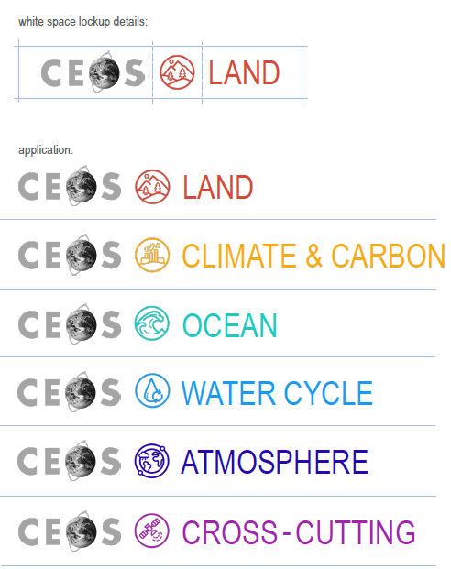


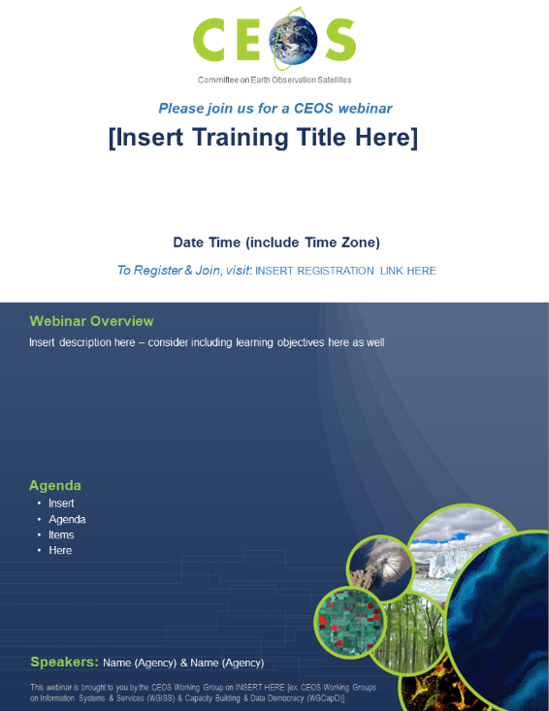
Templates & Design Assets
Currently Available
Storyboard Template
Trainee Spreadsheet
Post-Training Questionnaire Template
Report Template
Draft Thematic Observation Icons
Draft Promotional Flyer Template
Coming Soon
Presentation Templates
Logo & Icon Bank

Slide 6
WGCapD Review Support
Conduct Needs Assessment
Identify Target Audience & Trainers
Define Webinar Learning Objectives
Develop Webinar Materials
Promote Webinar to Potential Attendees
Pre-Webinar: 60-90 days before
Share Rubric
Trouble-shoot Technical Difficulties
Publicize Ongoing Event
Offer Interactive Participation for Attendees
Use Exercises to Convey Material Presented
Webinar Good Practice
During Webinar:
WGCapD can review
Conduct Post-Training Survey
Prepare Lessons Learned Document
Complete a Training Report
Post Report on CEOS Website
Include Participants in CEOS Training Distribution List
WGCapD actions
Post-Webinar: 5-45 days after

Slide 7
Toolkit Implementation
Implementation Actions:
Create
Review
Test
Use
Promote
Looking Ahead: Timeline
Collect feedback on current guides and templates Now – March 17th
Formalize implementation process & promotion plan This Week
Icon approval by broader CEOS endorsement March
Finalize templates using icons & build logo/icon bank March
Build & post a WGCapD webpage for the toolkit End of March
Beta test: Jupyter Notebooks Webinar (CB-20-04) March – June

Slide 8
Discussion
WGCapD Review (Members)
WGCapD Actions (Secretariat)
Conduct Needs Assessment
Identify Target Audience & Trainers
Define Webinar Learning Objectives
Develop Webinar Materials
Promote Webinar to Potential Attendees
How can we collectively support the review process and fairly distribute the workload?
Needs assessment
Learning objectives definition
Development of webinar materials
What is the proper pipeline to receive requests? Through WGCapD Secretariat? To pre-determined POCs?
How can we promote the toolkit and spark its use among CEOS working teams and ourselves?
What do we consider “successful” use of the toolkit? How will we track and report on its use?
Share Rubric
Trouble-shoot Technical Difficulties
Publicize Ongoing Event
Offer Interactive Participation for Attendees
Use Exercises to Convey Material Presented
Conduct Post-Training Survey
Prepare Lessons Learned Document
Complete a Training Report
Post Report on CEOS Website
Include Participants in CEOS Training Distribution List

