Slide 1
Celebrating 10 years of…
WGCapD
Scene-setter and Discussion
Nancy D. Searby, WGCapD Chair
Pham Thi Mai Thy, WGCapD Vice-chair

Slide 2
Plans for WGCapD-10
Overall: Building a vision for the next decade
Internal discussions
Global perspective
Big picture from keynote
Diverse perspectives from those not involved in CEOS
CEOS member panel on floods as a use case to understand the landscape
Regional perspective
Reflection and next steps

Slide 3
Celebrating 10 years of…
WGCapD
CEOS Governance and Priorities
Marie-Claire Greening
CEOS Executive Officer
e: marie-claire@greeningconsulting.co.uk

Slide 4
CEOS Organisational Structure
Past Chair
CEOS Chair
Future Chair
Troika (all 3 chairs) 1-year terms
SEO
SIT Chair
CEO
Secretariat
SIT Vice-Chair
DCEO
Permanent
2-year term
2-year term
Virtual Constellations
Working Groups
Ad Hoc Teams
Primary Reporting Path
Secondary Reporting Path

Slide 5
CEOS Priorities
Ensure that climate observation requirements identified by the Global Climate Observing System (GCOS) – and implications of the Paris Climate Agreement – are addressed.
Ensure, in the context of the Sendai Framework for Disaster Risk Reduction 2015-2030, that CEOS Agency data are made available in support of disaster risk reduction and that CEOS continues engagement with UN agencies and authorities.
Ensure that space-based Earth observations support the success of the next decade of the Group on Earth Observations (GEO), and that CEOS engagement in GEO governance and leadership is enhanced.
Proactively engage in global discussions on the critical challenges that face society, including attaining the 2030 Agenda for Sustainable Development.
CEOS operates on a best-efforts basis. Responsible CEOS Entities are expected to accomplish the Objectives/Deliverables identified in the CEOS Work Plan to the best of their abilities.

Slide 6
CEOS Chair
NASA CEOS Chair theme 2021-22:
Space-based Earth Observation Data for Open Science and Decision Support
The 2021 CEOS Chair Implementation Plan has 17 measures of success including:
EOTEC DevNet
Establish the Earth Observation Training, Education, and Capacity Development Network (EOTEC) DevNet and collect training resources that incorporate the use of EO to support national vulnerability assessments, disaster risk reduction plans, and climate adaptation and mitigation plans.

Slide 7
Celebrating 10 years of…
WGCapD
Thank you!
CEOS website: https://ceos.org

Slide 8
WGCapD Work Plan Summary - Part 1

Slide 9
WGCapD Work Plan Summary - Part 2

Slide 10
WGCapD Work Plan Summary: Recently Closed Deliverables

Slide 11
Upcoming WGCapD Efforts to Highlight
EOTEC DevNet
Branded webinar toolkit
Continued assessment of capacity building needs and barriers
Incorporating lessons learned from operating at a time of global pandemic

Slide 12
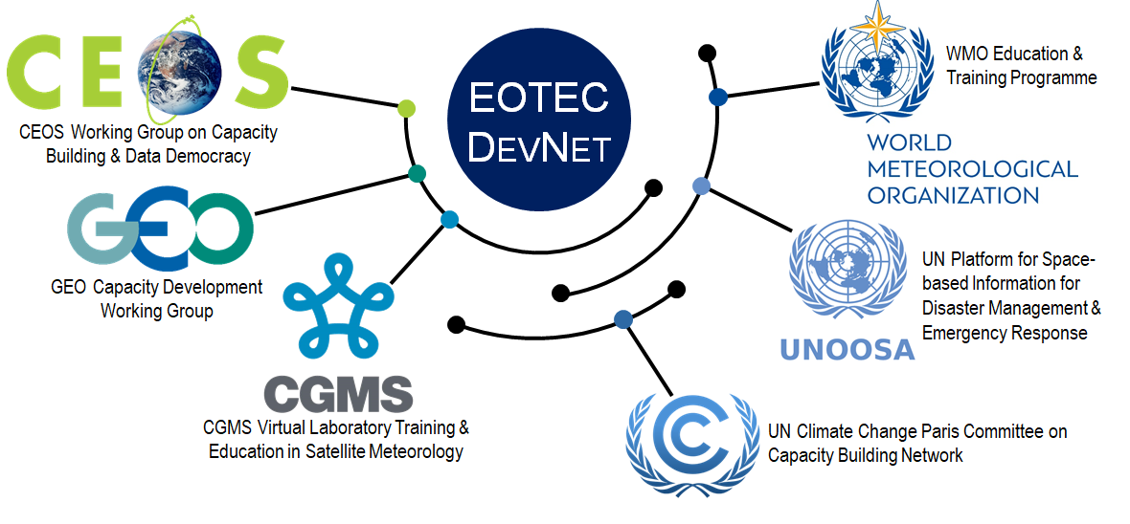
Earth Observation Training, Education, and Capacity Development Network

Slide 13
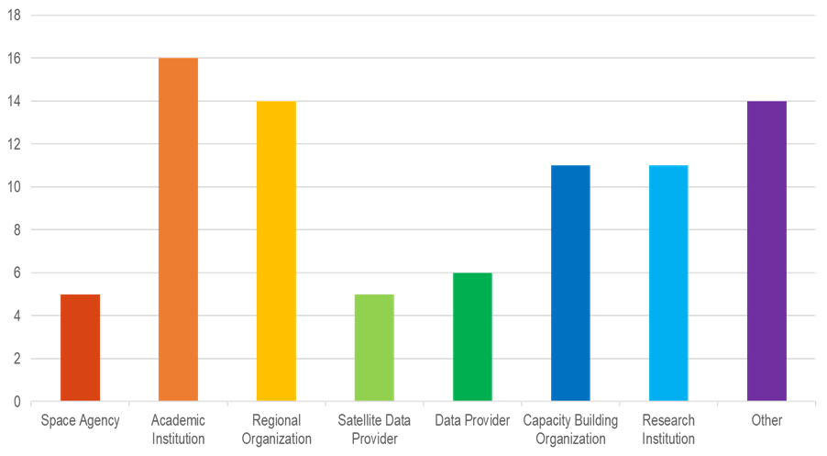
Capacity Building Assessment Survey Results
Respondents reflect the diversity of the EO capacity building community

Slide 14
Upcoming WGCapD Efforts to Highlight
Uneven impact of the pandemic:
44% saw reduced ability to facilitate trainings
55% saw minimal effect
36% saw expanded reach
Models for blended virtual/in-person programs remains a key priority
Learned a lot about unique and common barriers to active use of EO data

Slide 15
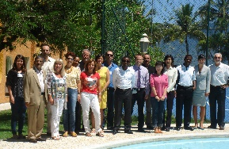
WGEdu & WGCapD History
Focus: GeoCab Portal support, KenyaCube, SAR trainings
COVID-19 drives first all-virtual annual meeting; virtualization of many deliverables
WGEdu Formed
WGEdu 🡪 WGCapD
Focus: Growing training, workshops, and data collections
Focus: Support of Data Cubes, AmeriGEOSS & AfriGEOSS
2003
2013
2015
2017
2019
2021
1999
2012
2014
2016
2018
2020
WGEdu formally adds capacity building to mandate
Focus: DEM Workshops
Focus: Increased number of trainings, workshops, and online courses
EOTEC DevNet established, Resource Portal & CEOS Webinar Toolkit launched
Focus: Awareness building
Focus: Deeper engagement of GEO

Slide 16
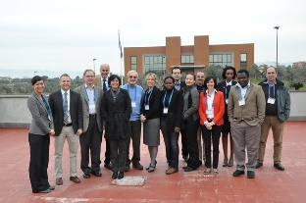
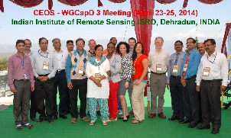
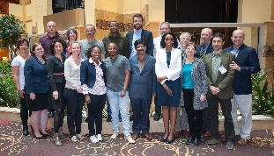
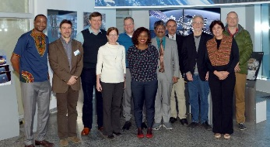
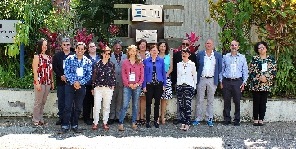
WGCapD Chair & Meeting History
Chair / Vice-Chair
Year
Annual Meeting
Hilcea Ferreira, INPE / Jacob Sutherlun, NOAA
Hilcea Ferreira, INPE / Jacob Sutherlun, NOAA
Jacob Sutherlun, NOAA > Eric Wood, USGS / Jane Olwoch, SANSA
Eric Wood, USGS / Jane Olwoch, SANSA
Jane Olwoch, SANSA / Senthil Kumar, ISRO
Jane Olwoch, SANSA > Phila Sibanze, SANSA / Senthil Kumar, ISRO
Senthil Kumar, ISRO / Nancy Searby, NASA
Prakash Chauhan, ISRO / Nancy Searby, NASA
Nancy Searby, NASA / Pham Thy, VNSC
Nancy Searby, NASA / Pham Thy, VNSC
2012
2013
2014
2015
2016
2017
2018
2019
2020
2021
WGCapD-1: Ilhabela, Brazil
WGCapD-2: Frascati, Italy
WGCapD-3: Dehradun, India
WGCapD-4: Pretoria, South Africa
WGCapD-5: Hampton, USA
WGCapD-6: Oberpfaffenhofen, Germany
WGCapD-7: Sao Jose dos Campos, Brazil
WGCapD-8: Dehradun, India
WGCapD-9: San Francisco, USA Virtual
WGCapD-10: Virtual

