Slide 1
Supporting Decision Makers: Challenges & Opportunities in Strengthening Skills in EO Data Management, Analysis, and Applications around the World
Barbara J. Ryan,
Executive Director
WGIC
CEOS WGCapD-10 Annual Meeting
02 March 2021

Slide 2
Overview
Brief Introduction
Enabling Conditions
Challenges/Opportunities
The Way Forward

Slide 3
69 Years in 69 Seconds
Boards
Eco.Seq.Trust
ICES
ISRSE
MELOA
SEDAC
START
Born in Dalton, NY
Near Letchworth State Park – “Grand Canyon of the East”
Education
B.S. Geology
M.S. Civil Engineering
M.S. Geography
Employment
Family

Slide 4
Enabling Conditions:
Better Integration & Coordination
Open Data
Building on What’s Been Done
Hyper Partnering
Linkages to Policy Mandates

Slide 5
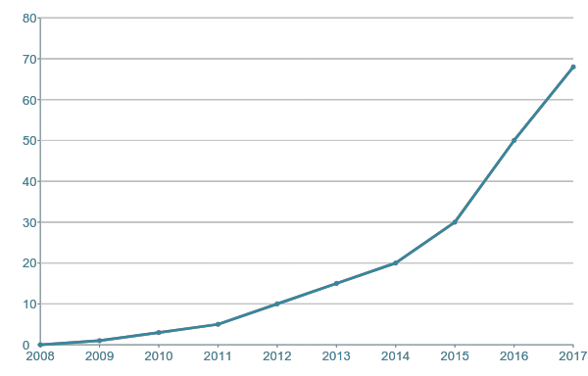
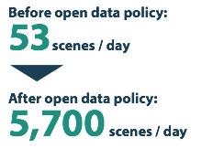
MILLIONS OF LANDSAT SCENE DOWNLOADS
Open
Data

Slide 6
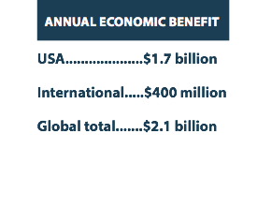
BILLIONS OF ECONOMIC BENEFIT (USD)
Open
Data

Slide 7
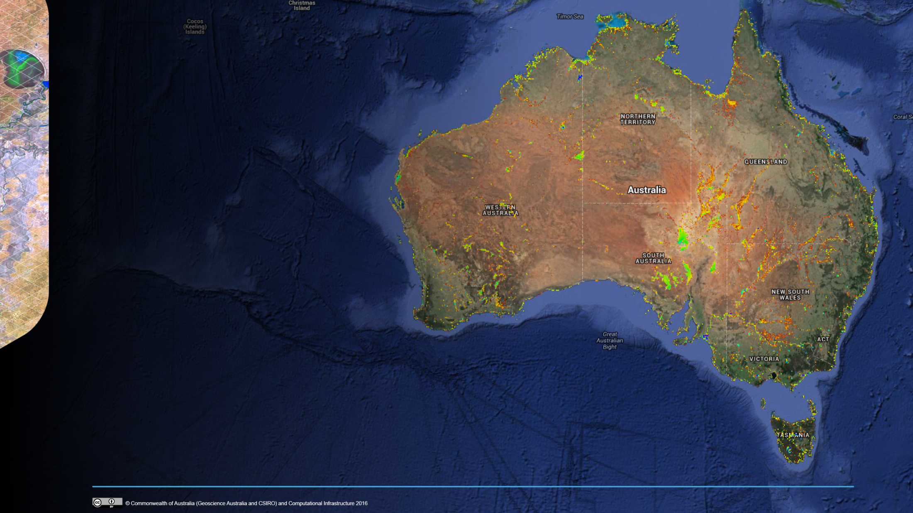
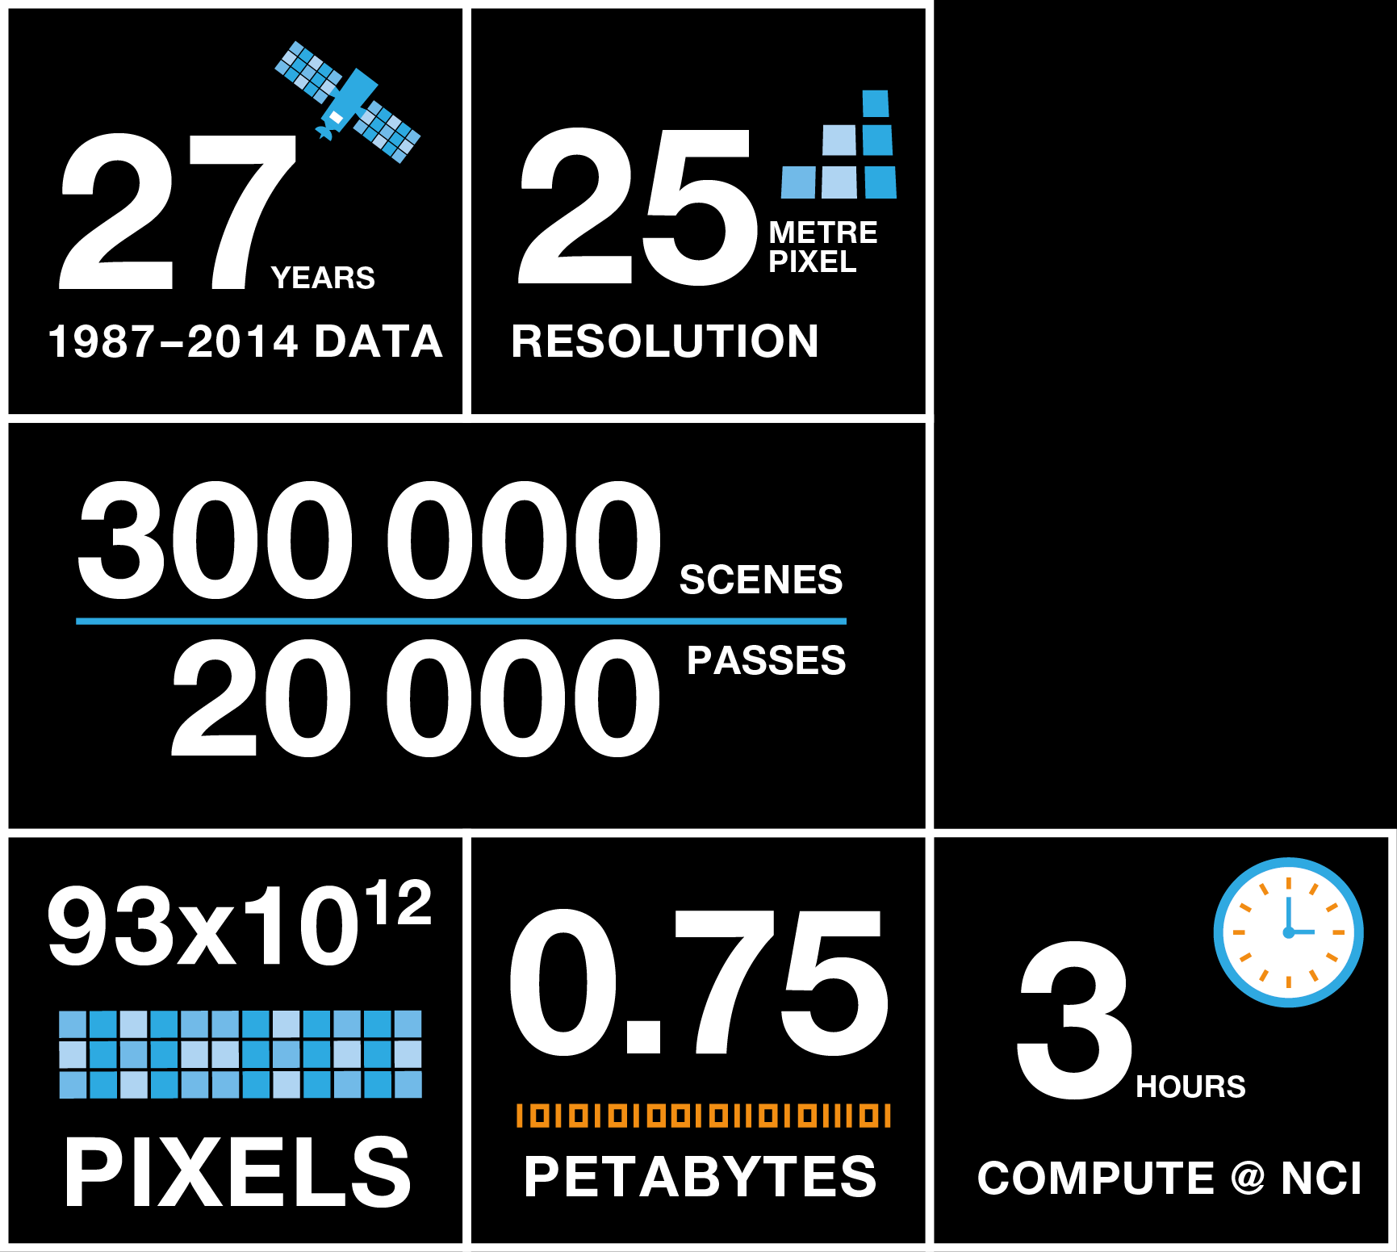
Continental Scale Water Observations from Space
27 Years of data
25m N ominal Pixel Resolution
Approx. 300 000 individual scenes in approx. 20 000 passes
Entire 27 years of 1 312 087 ARG25 tiles => 93x10¹² pixels visited
0.75 PB of data
3 hrs at NCI
Building
on what’s
been done
Notes:
But the Data Cube paradigm has enabled us to do not only undertake this analysis at a regional scale for the first time, it has in fact enabled us to scale this to produce a comprehensive national product
We can now analyse 15 years of data, across the country, representing every <n> square metres … in under 1 day.
Not only does this mean we can now for the first time produce this analysis once …
It means that we can produce it in an ongoing basis, enabling the production of updated information as new data becomes available, and enabling researchers to interact with the data iteratively to improve quality and try new ideas
And it means that, in future, industry and others can build value-adding products on top of this data by leveraging the services-based approach adopted

Slide 8
Better Integration & Coordination
Internally -- within our respective organizations;
Nationally -- between and among our respective national entities;
Regionally – e.g. continent-wide efforts, associations; and
Globally – GEO for delivering the policy linkages referenced earlier (and others).

Slide 9
Hyper-Partnering
Other organizations working in the same trade space – GEO, START, UNITAR, UNOOSA, The World Bank, WMO, etc.;
Academia;
Not-for-Profits; and the
Private Sector.

Slide 10
slide2.jpg
Barbara J. Ryan

Slide 11
Back-Up Slides

Slide 12
A Global not-for-profit Trade Association of Private Sector Companies working in the geospatial ecosystem.

Slide 13
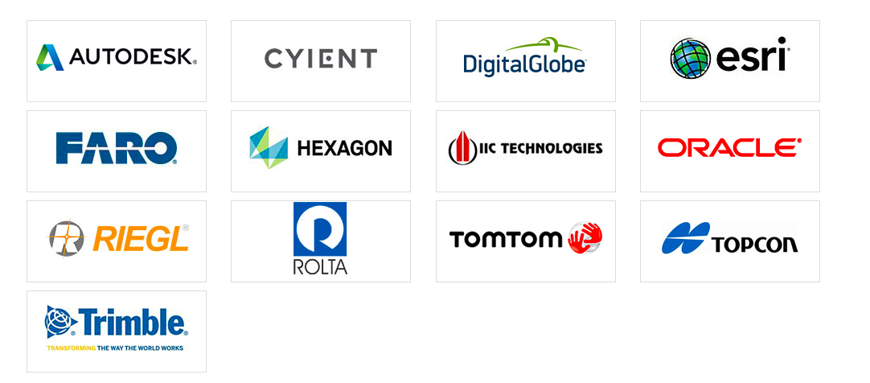
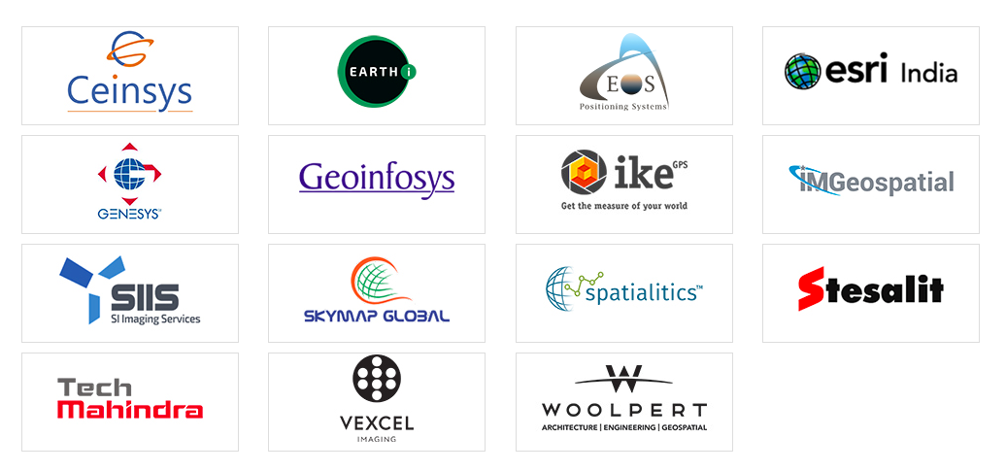
Patron Members
Corporate Members
Associate Members
Affiliate Members

